Slide 1
Superconducting Magnets
Gijs de Rijk
CERN
CAS
Budapest, Hungary, 7th October 2016

Slide 2
High Field Accelerator Magnets
Introduction: magnetic field and superconducting magnets
How to get high fields in accelerator dipole and quadrupole magnets ?
Superconductors for magnets
Practical accelerator magnet design
High field superconducting magnets for future accelerators
Literature on High Field Magnets
2

Slide 3
Maxwell equations
Integral form Differential form
$$\oint{\vec{H}d\vec{s}}=\int_{A}{\left(\vec{J}+\frac{∂\vec{D}}{∂t}\right)}d\vec{A}$$
$$rot\vec{H}=\vec{J}+\frac{∂\vec{D}}{∂t}$$
Ampere’s law
$$\oint{\vec{E}d\vec{s}}=−\frac{∂}{∂t}\int_{A}{\vec{B}}d\vec{A}$$
$$rot\vec{E}=−\frac{∂\vec{B}}{∂t}$$
Faraday’s equation
$$\int_{A}{\vec{B}}d\vec{A}=0$$
Gauss’s law for magnetism
$$div\vec{B}=0$$
$$\int_{A}{\vec{D}}d\vec{A}=\int_{V}{ρ}dV$$
Gauss’s law
$$div\vec{D}=ρ$$
With:
$$\vec{B}=μ\vec{H}=μ_{0}\left(\vec{H}+\vec{M}\right)$$
$$\vec{D}=ε\vec{E}=ε_{0}\left(\vec{E}+\vec{P}\right)$$
$$\vec{J}=κ\vec{E}+J_{imp.}$$

Slide 4
Magnetic field quality: multipole description
$$B_{y}\left(z\right)+{iB}_{x}\left(z\right)={10}^{−4}B_{1}\sum_{n=1}^{∞}{\left(b_{n}\right.}+ia_{n}){\left(\frac{x+iy}{R_{ref}}\right)}^{n−1}$$
$$with:$$
$$z=x+iy,$$
$$B_{x} and B_{y} the flux density components in the x and y direction,$$
$$R_{ref} the radius of the reference circle,$$
$$B_{1} the dipole field component at the reference circle,$$
$$b_{n} the normal nth multipole component,$$
$$a_{n }the skew nth multipole component.$$
In a ring shaped accelerator, where the beam does multiple passes, one typically demands :
$$a_{n}, b_{n} ≤1 unit {10}^{−4}$$

Slide 5
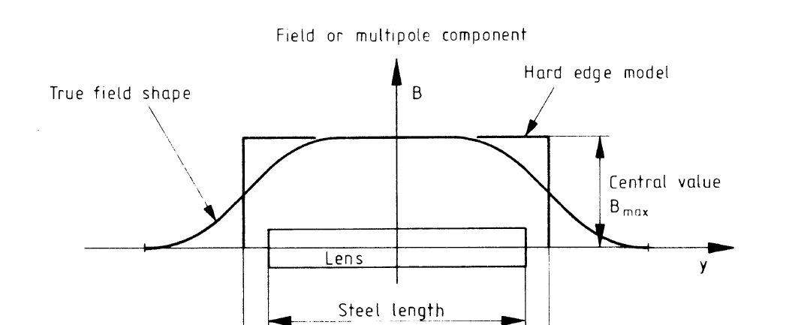
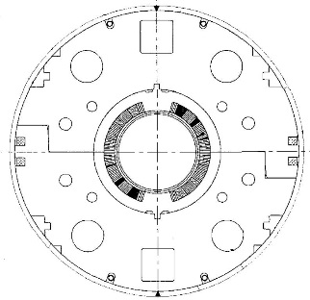
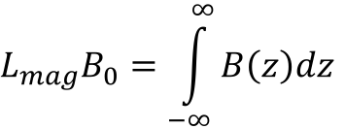
Magnetic Length
In 3D, the longitudinal dimension of the magnet is described by a magnetic length
$$L_{mag}B_{0}=\int_{−∞}^{∞}{B\left(z\right)dz}$$
Courtesy A. Milanese, CERN
A circular yoke around the coil can give a 10-15% field increase
The magnetic length L_{mag} for SC magnets is adjustable by varying the length of the yoke: often the coils stick outside the end of the yoke: no easy rule of thumb for L_{mag}
Notes:
Looking along the longitudinal (z) direction, the field B is maximum at the centre (z = 0) of the magnet, it is more or less constant till reaching the ends, where it rolls off to reach a 0 value outside. The magnetic length l_{m} is defined as that length which – multiplied by the central field value B₀ – returns the same integrated field.
The same holds substituting the field B with the gradient G, or with any multipoles B_{n}, A_{n}. In this case, the integrals have to be performed on the not-normalized (upper case) coefficients, and the normalized terms (lower case) are then obtained by dividing by the integral of the fundamental harmonic.
For long magnets – where the longitudinal dimension is much larger than the gap – the behavior is dominated by the (long) central part, so taking the values of 2D simulations and multiplying by a length yields good results. For short magnets, the behavior is intrinsically 3D.

Slide 6

Magnetic fields
From Ampere’s law with no time dependencies
We can derive the law of Biot and Savart
(Integral form)
If you wanted to make a B = 8 T magnet with just two infinitely thin wires placed at 50 mm distance one needs : I = 5•10⁵ A
LHC dipole coil 80 turns of 11850 A at 8.3 T = 9.48•10⁵ A )
To get high fields one needs very large currents in small volumes
For LHC dipole@8.3 T ~1 MA in 3300 mm² : ~300 A/mm²
(overall current density in the coil area)
Courtesy E. Todesco

Slide 7

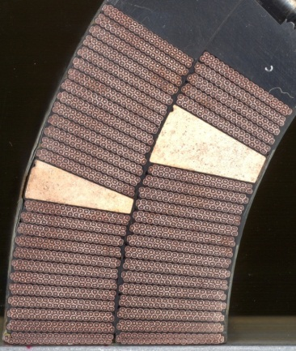
Coils for generating the Perfect Dipole Field
Conductors 2 solid Intercepting ellipses (or circles)
  A uniform, opposite polarity, current density in the area of two intersecting ellipses produces a pure dipolar field, but:
    The aperture is not circular
    Not easy to simulate with a flat cable
Thick conductor shell with a cosθ current distribution J = J₀ cosΘ
  Pure dipolar field
  Easier to reproduce with a flat rectangular cable
θ

Slide 8
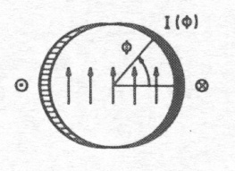
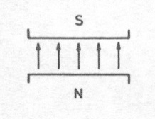
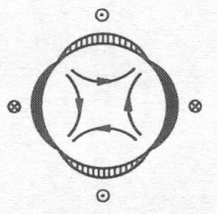
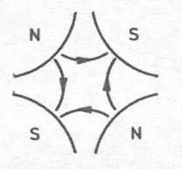

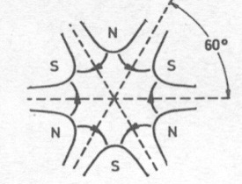
Magnet types and higher orders
a “pure” multipolar field can be generated by a specific coil geometry
normal
skew
dipole n=1
quadrupole n=2
sextupole n=3
Courtesy P. Ferracin, CERN

Slide 9
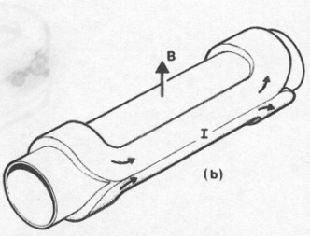
What is specific about accelerator magnets ?
Cylindrical volume with perpendicular field
Dipoles, quadrupoles, etc
Field quality:
Field quality formulated and measured in a multipole expansion,
Long magnets: dipoles from 6 m (Tevatron) to 15 m (LHC)
Often magnets are bend (9.14 mm sagitta for the LHC dipoles)
Artist view of a dipole, from M. N. Wilson « Superconducting Magnets »
CosΘ coil : J = J₀ cosΘ

Slide 10
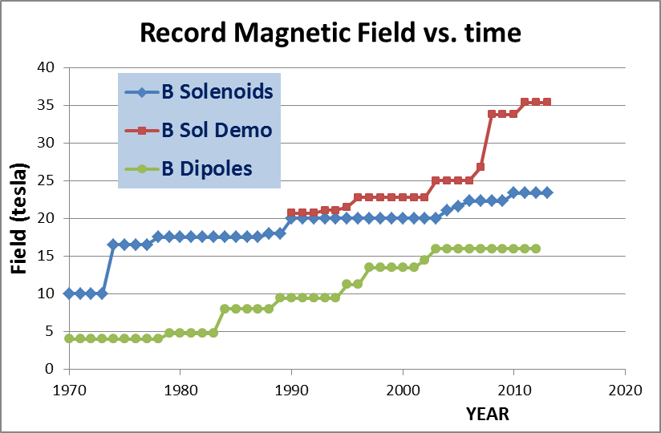
The state of the art:
Comparison between dipoles and solenoids
We can see roughly a factor 2 due to Coil «efficiency» and to force-stress management
Courtesy L. Rossi

Slide 11
Superconducting accelerators magnets; the state of the art
Maximum attainable field slowly approaches 16 T
  20% margin needed (80% on the load line):
  for a 16 T nominal field we need to design for 20 T

Slide 12
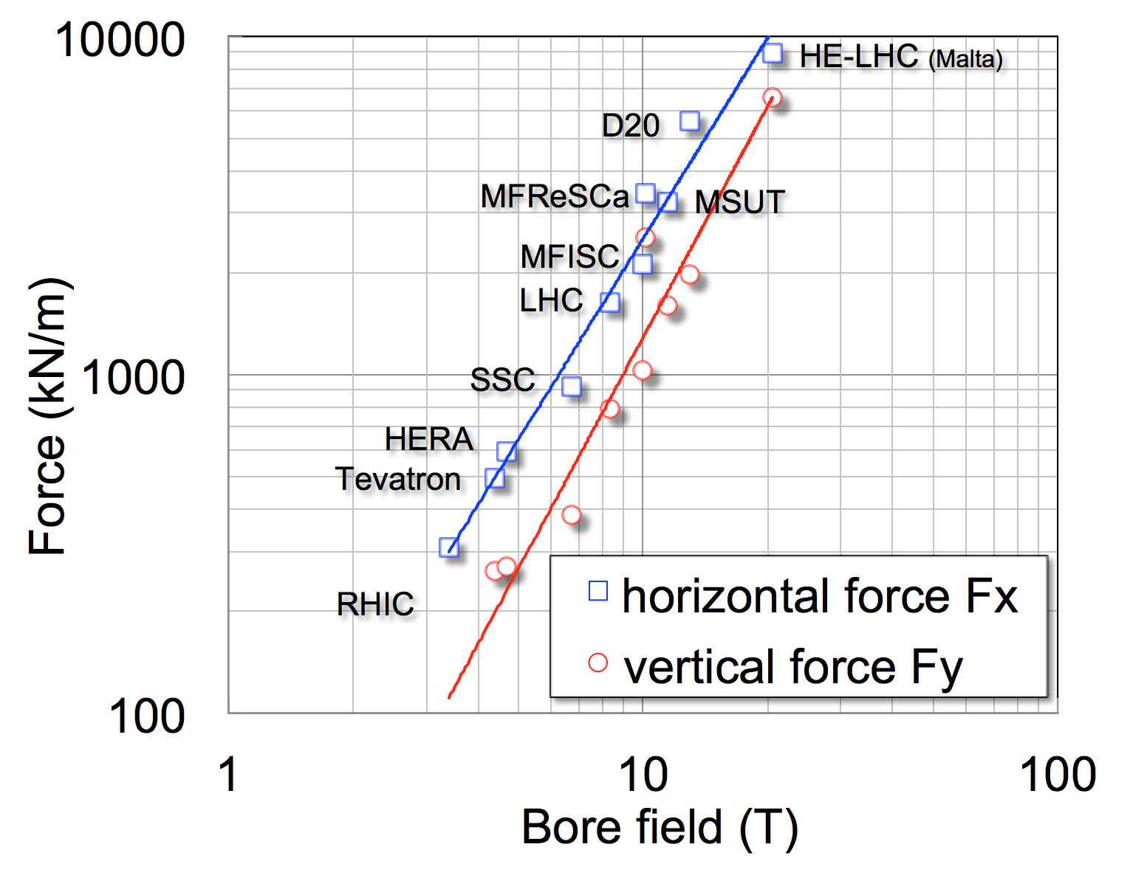
Forces
Scaling of force on coil quadrant vs. Field
Plot for recent production and R&D dipoles
The electromagnetic loads in a 20 T dipole would be a factor 5 to 8 larger than in the LHC dipoles

Slide 13
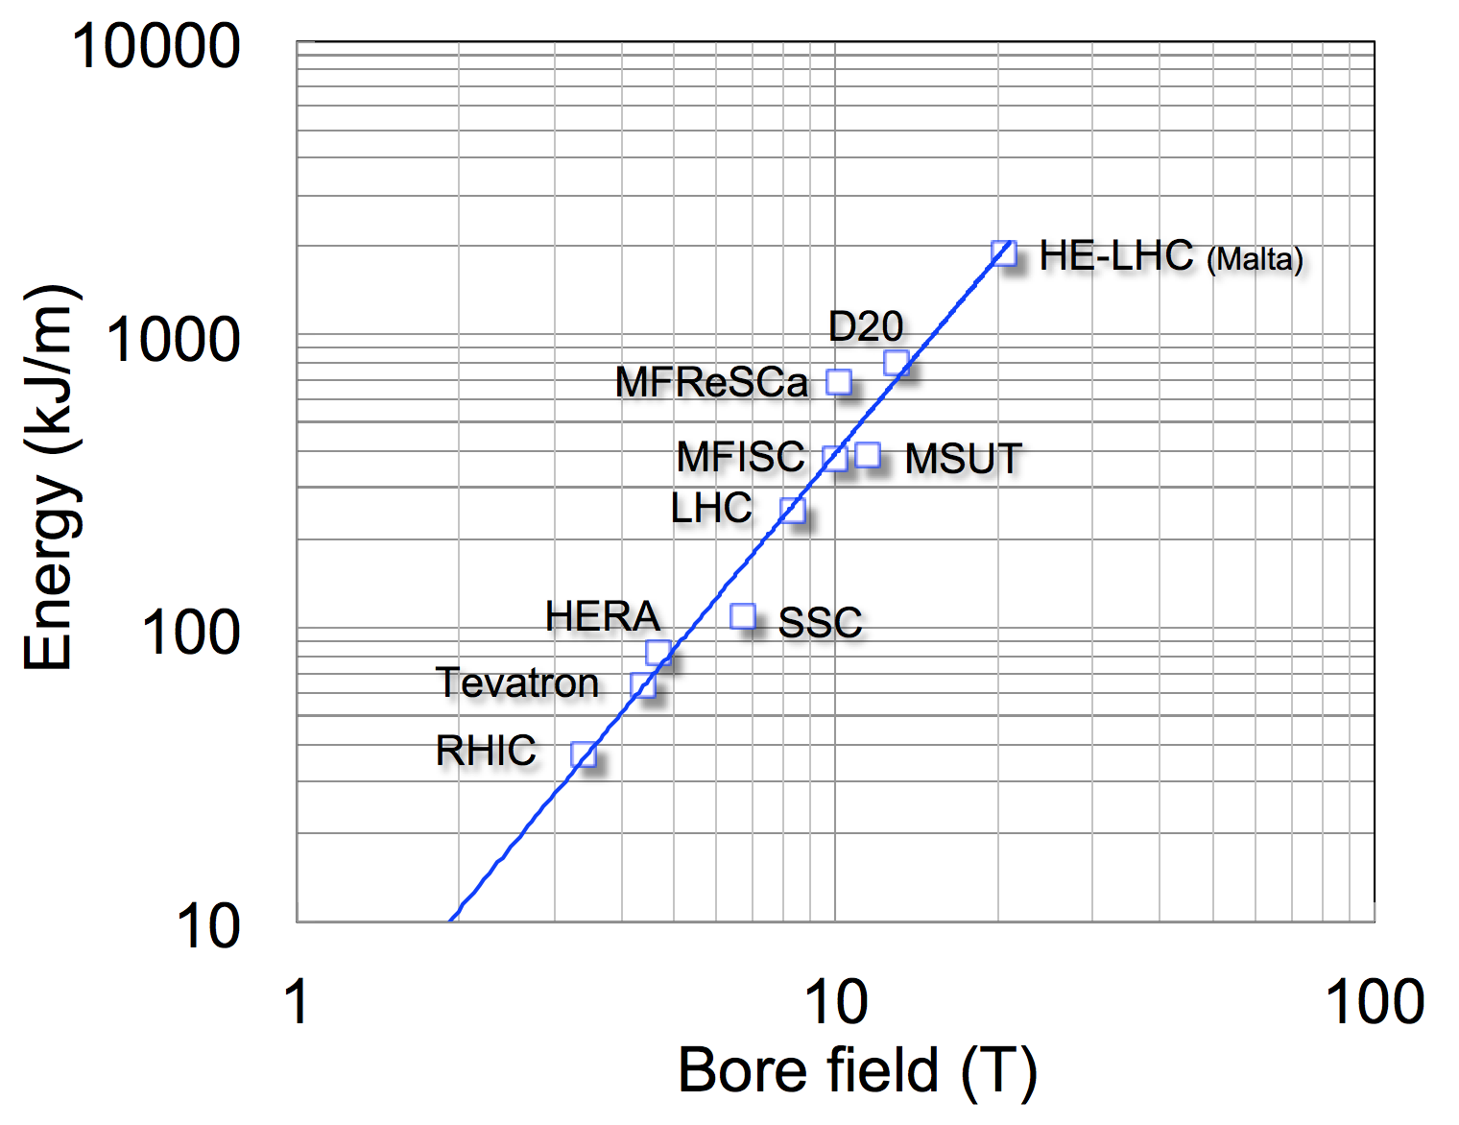
Stored Energy
Scaling of the energy per unit length of magnet vs. Field
Plot for recent production and R&D dipoles
Scaling of the energy per unit length of magnet in recent production vs. R&D dipoles
x10

Slide 14
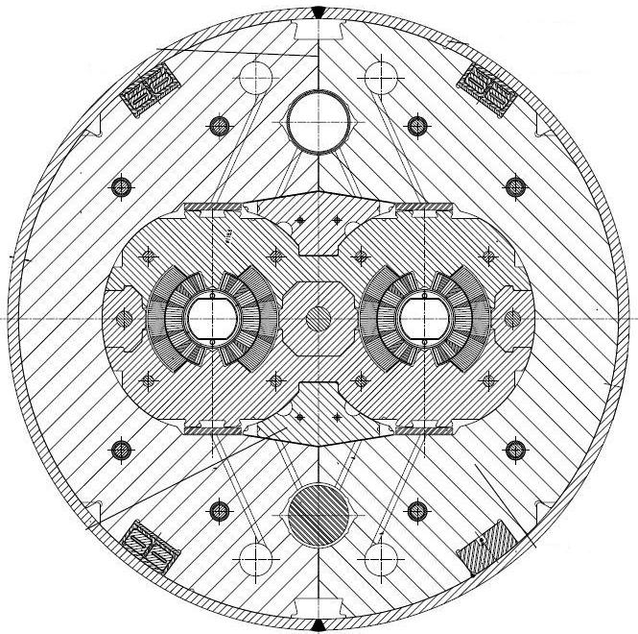
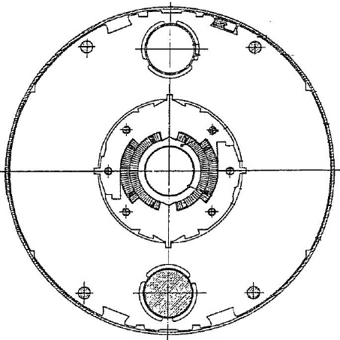
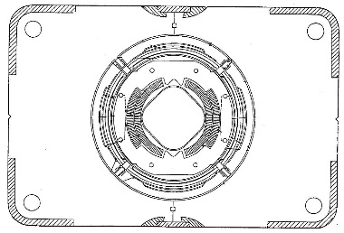
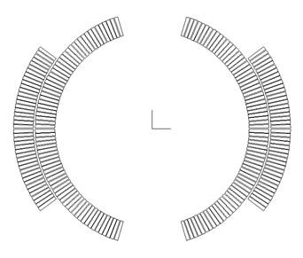
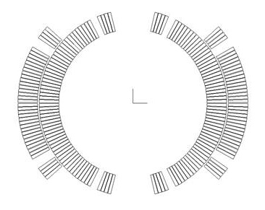
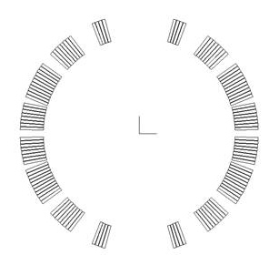
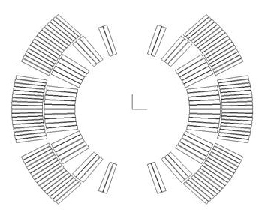
Existing Superconducting Accelerator dipole magnets (1)
.
Tevatron
76 mm bore
B = 4.4 T
T = 4.2 K
first beam 1983
HERA
75 mm bore
B = 5.0 T
T = 4.5 K
first beam 1991
RHIC
80 mm bore
B = 3.5 T
T = 4.3-4.6 K
first beam 2000
LHC
56 mm bore
B = 8.34 T
T = 1.9 K
first beam 2008
Courtesy P. Ferracin, CERN
Notes:
All these machines are cooled with He. LHC is the only one to work with superfluid helium. These extra 2 K mean a lot – the cryogenic system becomes at once more complex and less thermodynamically efficient – though the heat transfer between the bath and the coil is much improved. From a magnetic viewpoint, working at 1.9 K instead of 4.2 K shifts the critical current curve of Nb-Ti enough to make operation at 8.3 T (or almost, we are at 7.7 T now in the machine) possible with margin.
LHC is the only twin bore layout of these four.
The Tevatron is the only one with a warm iron yoke, that is, the iron is not in the cold (liquid He) mass.

Slide 15
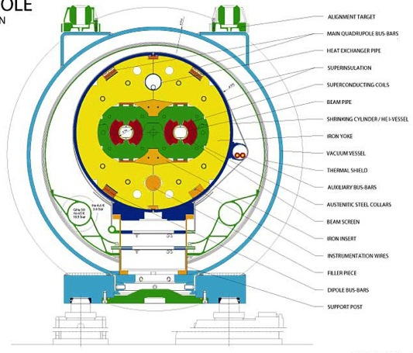
Existing Superconducting Accelerator dipole magnets (2)
Tevatron: 4.4 T
1983
RHIC: 3.5 T
2000
Courtesy R. Gupta
HERA: 5 T
1992
LHC: 8.34 T
2008

Slide 16
Existing Superconducting Accelerator dipole magnets (3)
Machine | place | Type | Energy (GeV) | Peak Dipole field (T) | ♯ dipoles | Dipole Length (m) | Ring circ. (km) | Year
Tevatron | FNAL (USA) | p-pbar FT/coll. | 1000 x 1000 | 4.4 | 774 | 6.12 | 6.28 | 1983/ 1987
HERA | DESY (D) | e^{-/+} - p collider | 40x920 | 5 | 416 | 8.82 | 6.34 | 1992
RHIC | BNL (USA) | p-p, Au-Au, Cu-Cu, d-Au | 100/n | 3.5 | 2x192+12 | 9.45 | 3.83 | 2000
LHC | CERN (Eu) | p-p, Pb-Pb | 7000 x 7000 | 8.34 | 1232 | 14.3 | 26.66 | 2008
20 years were needed to go from 4 T to 8 T !

Slide 17
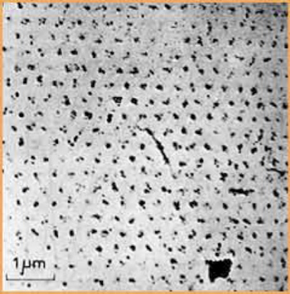
Type II Superconductors
Below a the critical surface the material is “superconducting”. Above the surface it is “normal conducting”
Θ_{c} Critical Temperature (at zero field and current density)
B_{c2} Critical Field (at zero temperature and current density)
J_{c} Critical Current Density ( at zero temperature and field)
The Critical surface depends on the material type Nb-Ti, Nb₃Sn, etc) and the processing
Superconducting
means: R = 0
J: few x 10³ A/mm² inside the superconductor
Critical surface
for Nb-Ti
Courtesy M. Wilson
Courtesy L. Bottura
Quantized fluxoids in a superconductor

Slide 18
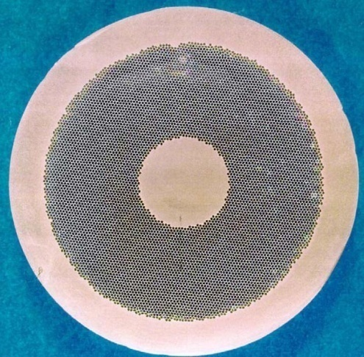
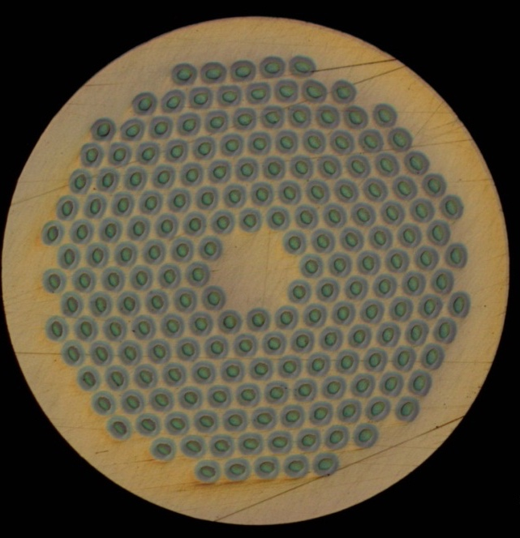
Superconductivity
Typical operational conditions (0.85 mm diameter strand)
Cu
Nb-Ti
Nb₃Sn
J ~ 5 A/mm²
I ~ 3 A
B = 2 T
J ~ 1500-2000 A/mm²
I ~ 400 A
B = 8-9 T
J ~ 1500-2000 A/mm²
I ~ 400 A
B = 12-13-16 T
Courtesy P. Ferracin, CERN

Slide 19
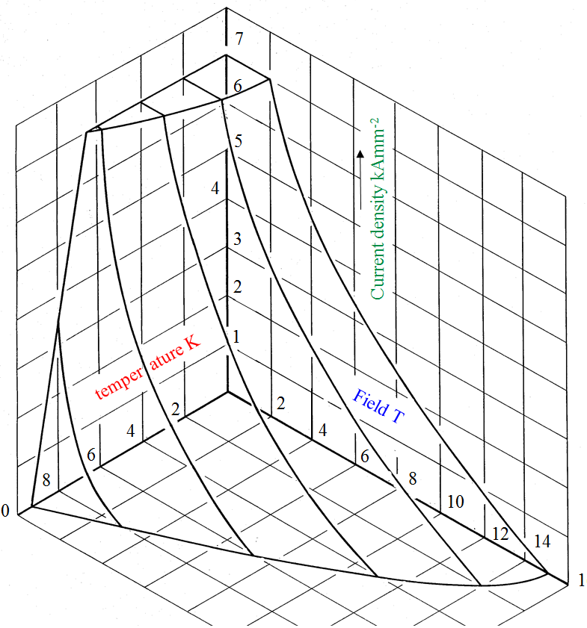
Superconducting materials: Nb-Ti
Niobium and titanium combine in a ductile alloy
  It is easy to process by extrusion and drawing techniques.
When cooled down to about 9 K it becomes a type II superconductor.
  T_{c} is ~9.2 K at 0 T.
  B_{C2} is ~14.5 T at 0 K.
The cost is approximately 100-150 US$ per kg of wire.
Courtesy: M.N. Wilson

Slide 20
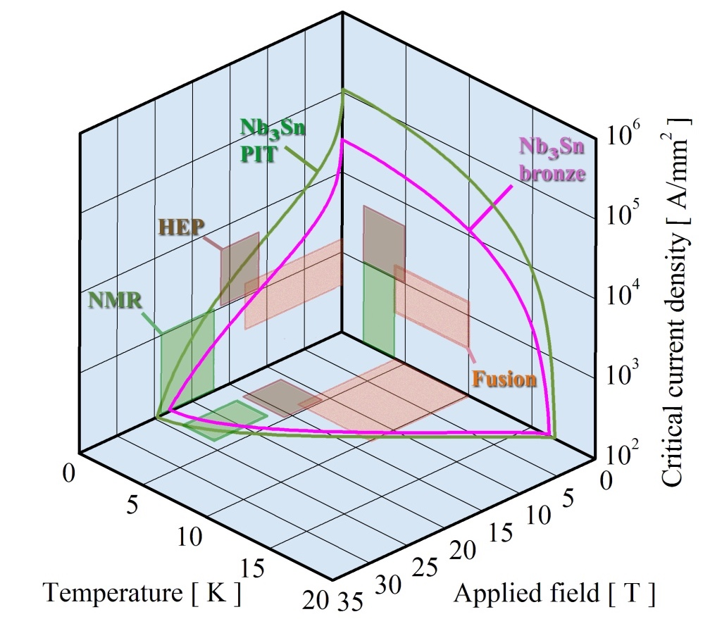
Superconducting materials: Nb₃Sn
Niobium and tin form Nb₃Sn
  Brittle and strain sensitive
When cooled down to about 18 K it becomes a type II superconductor.
  T_{C0m} is ~18 K at 0 T and 0 strain.
  B_{C20m} is ~28 T at 0 K and 0 strain.
The cost is approximately 700-1500 US$ per kg of wire.
Courtesy: A. Godeke

Slide 21
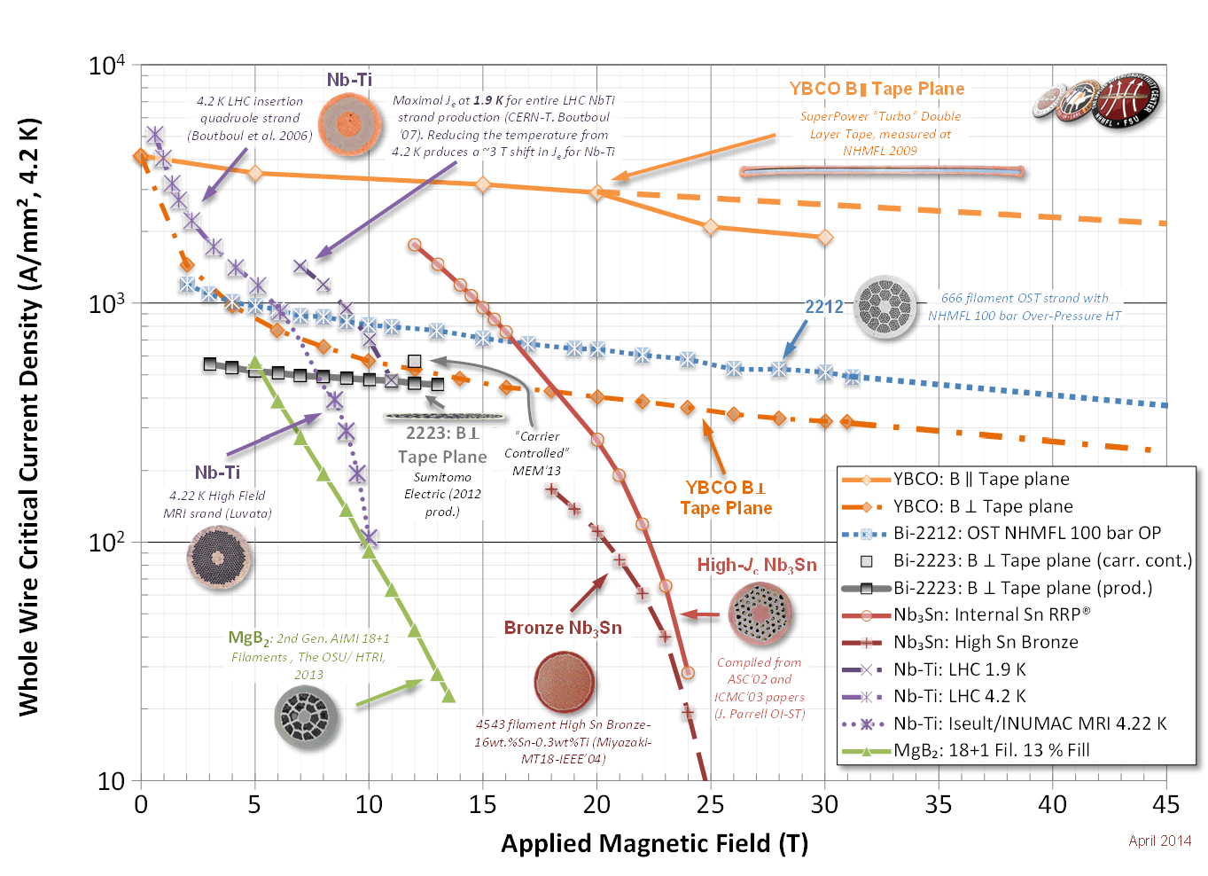
Available Superconductors
Nb-Ti: the workhorse for 4 to 10 T
  Up to ~2500 A/mm² at 6 T and 4.2K or at 9 T and 1.9 K
  Well known industrial process, good mechanical properties
  Thousands of accelerator magnets have been built
  10 T field in the coil is the practical limit at 1.9 K
Nb₃Sn: towards 20 T
  Up to ~3000 A/mm² at 12 T and 4.2 K
  Complex industrial process, higher cost, brittle and strain sensitive
  25+ short models for accelerator magnets have been built
  ~20 T field in the coil is the practical limit at 1.9 K, but above 16 T coils will get very large
HTS materials: dreaming 40 T (Bi-2212, YBCO)
Current density is low, but very little dependence on the magnetic field
Used in solenoids (20T range), used in power lines – no accelerator magnets have been
built (only 1 model) – small racetracks have been built

Slide 22
High temperature superconductor zoo

Slide 23
Superconducting strands: Nb-Ti
Nb-Ti is the workhorse for present accelerators, medical magnets, cyclotrons, etc
J(A/mm²)
B(T)
T(K)

Slide 24
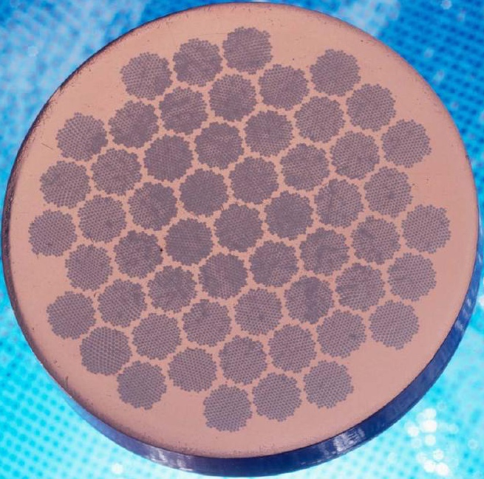
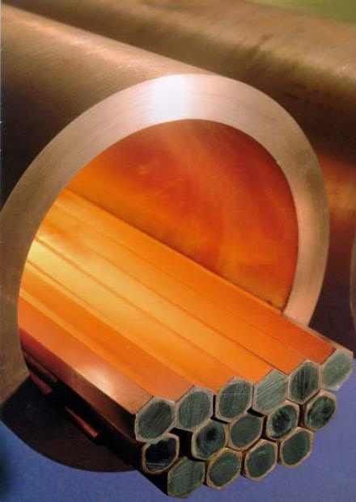
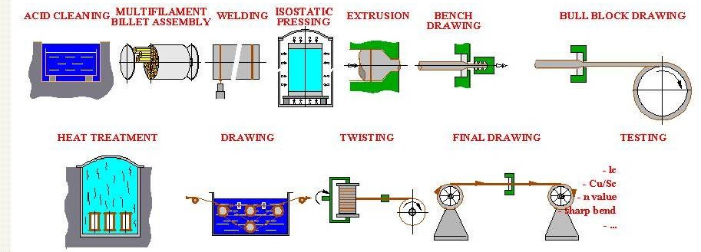
Multifilament wires
Fabrication of Nb-Ti multifilament wires
Monofilament rods are stacked to form a multifilament billet, which is then extruded and drawn down.
When the number of filaments is very large, multifilament rods can be re-stacked (double stacking process).
A. Devred
Courtesy A. Devred, ITER; P. Ferracin, CERN

Slide 25
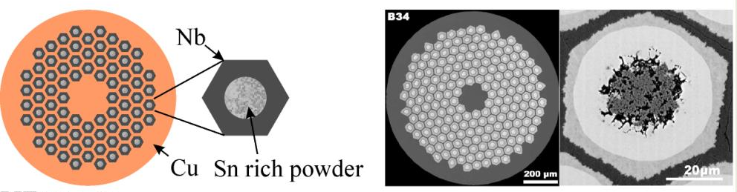
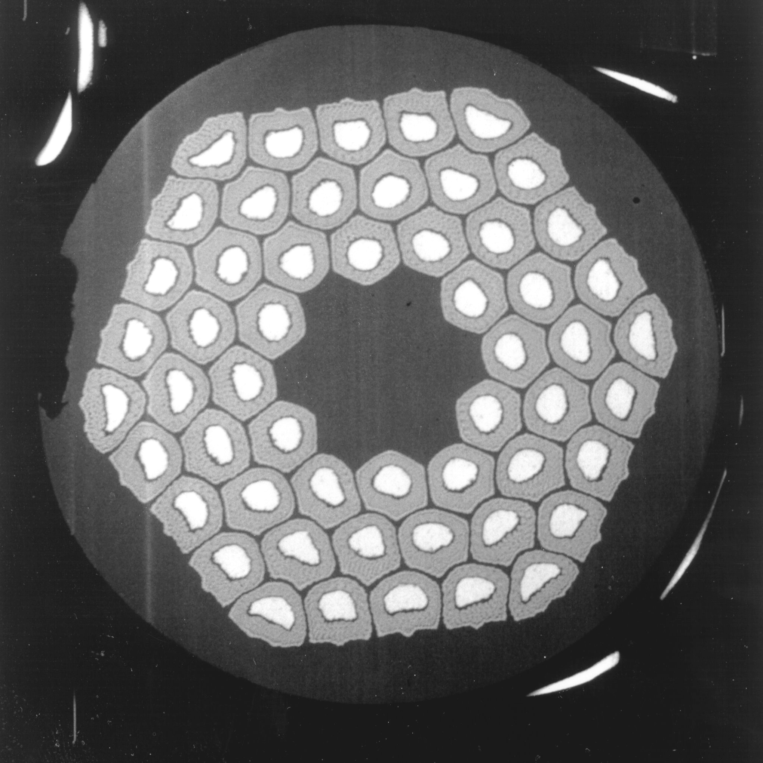
Multifilament wires
Fabrication of Nb₃Sn multifilament wires
Since Nb₃Sn is brittle, it cannot be extruded and drawn like Nb-Ti.
The process requires several steps:
  Assembly multifilament billets from Nb₃Sn precursor
  Fabrication of the wire through extrusion-drawing
  Fabrication of the cable
  Fabrication of the coil
  “reaction”: the Cu, Sn and Nb are heated to 600-700 C and the Sn diffuses in Nb and reacts to form Nb₃Sn
Powder in tube (PIT) process
Courtesy P. Ferracin, CERN

Slide 26
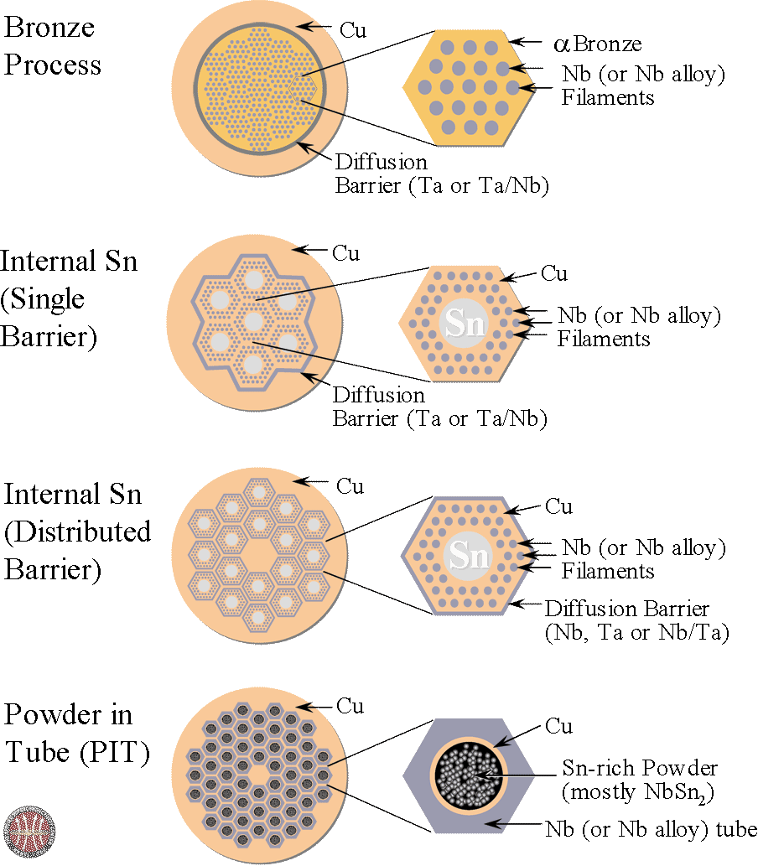
Nb₃Sn strand types

Slide 27
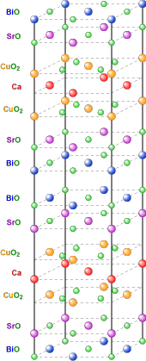
Superconducting strands and tapes: BSCO
BSCO: Bismuth strontium calcium copper oxide
Available in strands (OST)
Can reach 400 A/mm² (overall)
Is fragile under stress and strain
Powder in a silver tube
Has to be reacted at 850°C with a temperature precision of 1°C in an oxygen atmosphere
Can be cabled in high current Rutherford cables
Difficult technology but could be promising for high field magnets in >20 T region

Slide 28
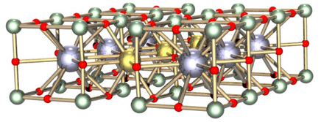
Superconducting tapes: YBCO
YBCO: Yttrium barium copper oxide
Available in tapes : YBCO deposited on a substrate to impose the texture (1-2 μm)
Can reach > 600 A/mm² (overall)
Is strong under axial stress and strain
Limited cabling possibilities:
Difficult technology but could be promising for high field magnets in >20 T region.
A

Slide 29
Superconducting cables for magnets
We need multi-strand cables
  Superconducting accelerators are ramped up in time spans 100 s to 1000 s
  Coils are designed for voltages to ground of around 1000 V
  With the number of turns and the current the inductance is to be limited to keep the voltage below 1000 V
  Dipoles and Current:
    Tevatron B = 4.4 T ; I ~ 4000 A
    Hera B = 5 T ; I ~ 6000 A
    LHC B = 8.3 T ; I ~ 12000 A
  For magnets 10 T < B < 15 T the current has to be 10kA < I < 15 kA
  For stability reasons strands are 0.6 mm < strand diameter < 1 mm
  With a Cu-nonCu ratio (stability) around 1 and a Jc ~ 1000 A/mm²
  ➔ a 1 mm diameter strand can carry ~400 A
  ➔ so we need a 30 strand cable to get up to 12 kA

Slide 30
Cable types
.
Courtesy A. Balarino

Slide 31
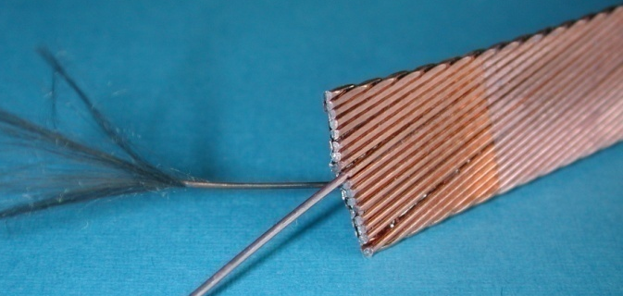
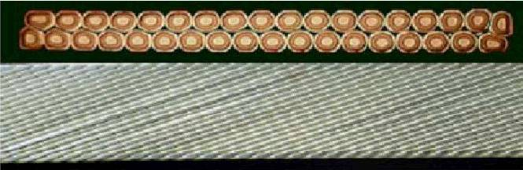
Rutherford cables
Compact cables giving high overall current density
Easy rectangular geometry for convenient winding

Slide 32
How to get high fields in accelerator dipole and quadrupole magnets ?
From Ampere’s law one can derive the field resulting from the current in a line conductor and integrate this over the surface of a coil
Dipole 60º sector coil [see ref 10, 14]
  The field is proportional to the current density j
  The field is proportional to coil width
  The field is independent of aperture
with: r : inner radius coil
w : coil width
ρ : radial coordinate
J : current density
Quadrupole 30º sector coil [see ref 11, 14]
  The gradient is proportional to the current density j
  The gradient depends on w/r
➔ by having very high current density close to the beam pipe
Cross-section of a
dipole
based on 60º sector coils
Cross-section of a quadrupole
based on 30º sector coils
See: E. Todesco et al. ref[10] and indirectly : N. Wilson ref[1], K-H Mess et al. ref[2]
For a in depth study of magnetic field calculations: S. Russenschuck ref[4]

Slide 33
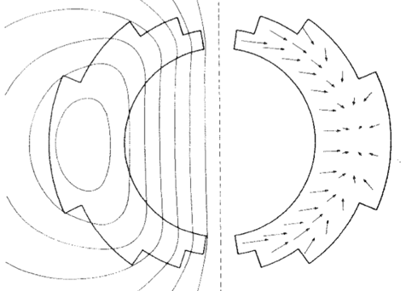
The forces with high field dipole and quadrupole magnets
One can derive the maximum stress in the mid-plane for a sector dipole coil
Dipole 60º sector coil [see ref 1, 12]
(Typically: for 8T : 40 MPa , for 13 T 130 MPa )
with: r : inner radius coil
ρ : radial coordinate
w : coil width
J : current density
Quadrupole 30º sector coil [see ref 1, 13 ]
Cross-section of a
dipole
based on 60º sector coils
Courtesy M. Wilson
Cross-section of a quadrupole
based on 30º sector coils

Slide 34
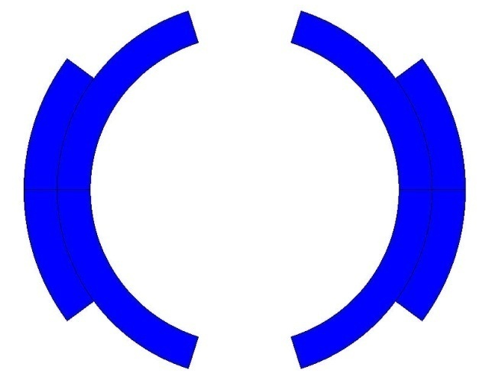
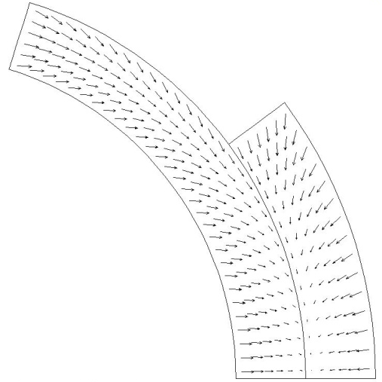
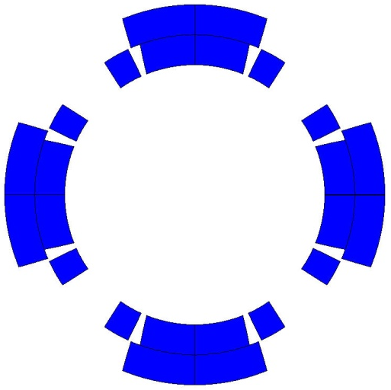
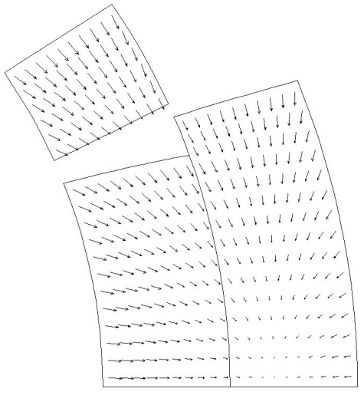
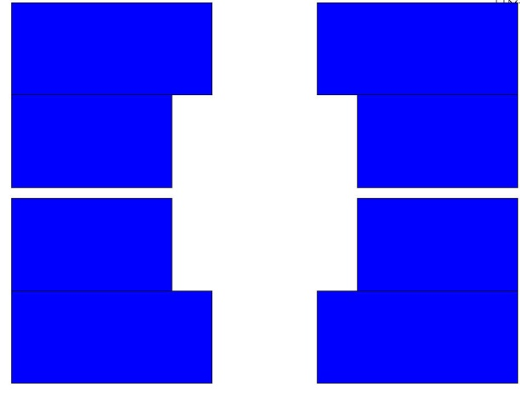
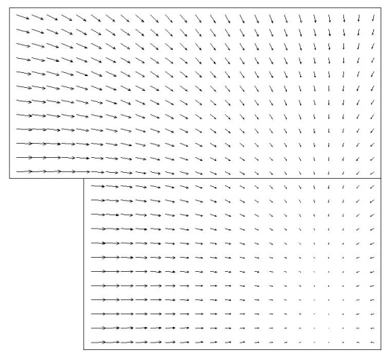
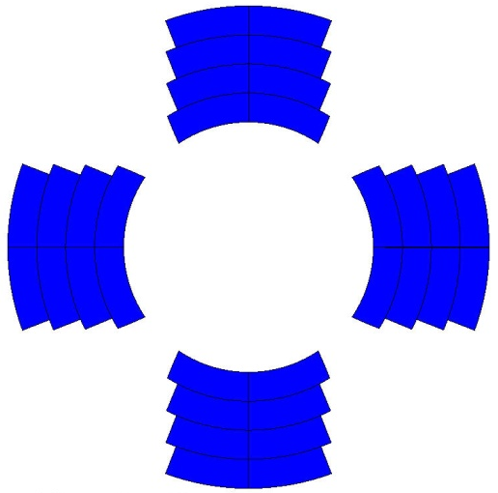
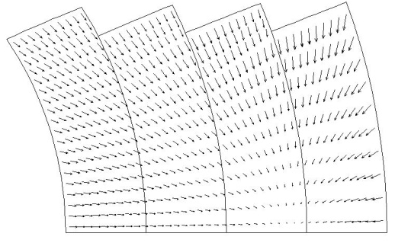
Electro-magnetic forces
The e.m. forces in a dipole magnet tend to push the coil
  Towards the mid plane in the vertical-azimuthal direction (F_{y}, F_{θ} < 0)
  Outwards in the radial-horizontal direction (F_{x}, F_{r} > 0)
The e.m. forces in a quadrupole magnet tend to push the coil
  Towards the mid plane in the vertical-azimuthal direction (F_{y}, F_{θ} < 0)
  Outwards in the radial-horizontal direction (F_{x}, F_{r} > 0)
Tevatron dipole
TQ
HD2
HQ
Courtesy P. Ferracin, CERN

Slide 35
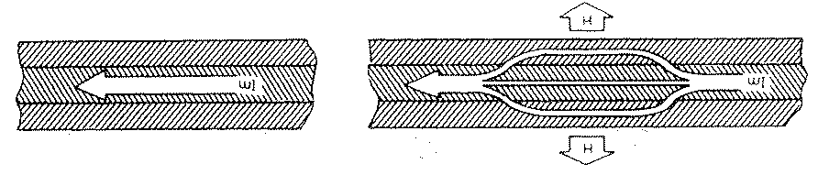
Conductor stability and AC behaviour
Pure massive superconductor is not stable as they (Nb-Ti, Nb₃Sn) are poor normal conductors
To ‘cryogenically stabilize’ the conductor one surrounds it in Cu:
  good electrical conductivity
  good heat transfer to the He
During current ramping the filaments will magnetize ➔ make them thinner
Filaments will have magnetic coupling ➔ twist the strand
Practical low temperature superconductors are made as thin (5 μm – 100 μm) superconducting filaments in a Cu matrix , which is twisted
Courtesy M. Wilson

Slide 36
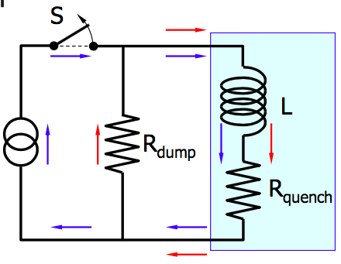
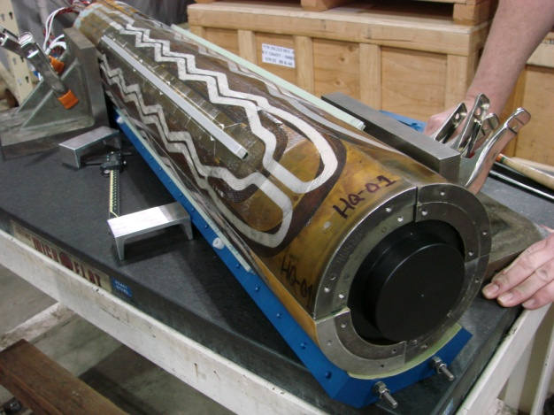
Quench: a thermal runaway effect
Due to perturbations locally the conductor can get T > T_{c} (J_{l},B_{l})
A thermal runaway can then occur, called a Quench
With stored energies > MJ the coils can overheat if nothing is done (T = 3000K is possible ! )
What to do ?
Detect the quench : SC: R=0 → V=0, quench V>0 (typically 100mV threshold)
Switch power convertor off
Heat up the whole coil with quench heaters
Dump energy of the circuit into a dump resistor

Slide 37
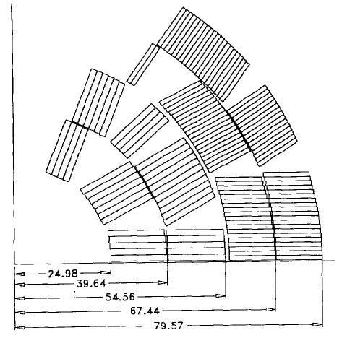
Practical accelerator magnet design: Dipoles
Two types of coils are in use for high field magnets:
Cos(Θ) coil and Block coil
Cos(Θ) coil (the traditional solution)
  Allows a very good field quality (b_{n} < 1.10⁻⁴) in thin coils
    all (but one) existing accelerators use this type of coil
  Is very efficient wrt the quantity of superconductor used
  The EM forces cause a stress buildup at the midplane where also high fields are located
  Wedges are needed in the straight part (‘Keystoned’ cable)
  The ends are short, special geometry for which there is a large experience but not it is easy
D20
Courtesy M. Wilson
Courtesy LBNL

Slide 38




Practical accelerator magnet design: Dipoles
Block coil (used on development magnets)
  Used with thick coils the field quality is good
    Not yet used in accelerators
  Is less efficient (~10%) wrt to cos(Θ) for quantity of superconductor used
  The EM forces cause a stress buildup at the outside edge of the coil where the fields are lower
  The straight part is very easy : rectangular cable and wedges (field quality)
  ‘flared ends’ look easy but there is little experience exists to make them
HD2
Courtesy LBNL

Slide 39


Quadrupole coil geometries
Cos(Θ) coil
  Allows a very good field quality (b_{n} < 1.10⁻⁴)
    all (but one) existing accelerators use this type of coil
  Is very efficient wrt the quantity of superconductor used
  The EM forces cause a stress buildup at the midplane where also high fields are located, (but are limited)
  Wedges are needed in the straight part (‘Keystoned’ cable)
  The ends are short, special geometry for which there is a large experience but not it is easy
Courtesy M. Wilson

Slide 40
Prestress
Why prestress ?
  Field quality is determined by the cable positioning (be precise to ~0.02 mm)
  Under the MN forces the coils will move
    Apply prestress to fix the positioning
  Very small amounts of heat can quench the coil: limit the movement (avoid stick-slip effects on ~10 μm movements)
    ➔Apply prestress to fix the positioning
How to put prestress ?
  Three methods:
  Compress at room temperature: collar system
  Use room temperature prestress plus differential shrinkage at cooldown: Al or stainless steel shrinking cylinder and/or a (shrinking) key
  Compress a bit at room temperature and use differential shrinkage at cooldown: Al shrinking cylinder + bladder and key system
Order of magnitudes: LHC @ 8.34 T: 70 MPa warm, 30 MPa cold
Fresca2 @ 13 T: 60 MPa warm, 130 MPa cold

Slide 41

Prestress: collars
“The classical solution”
Thin collars put around the coil
The coil is well contained in a fixed cavity
Pressed together and locked with pins or keys
At 300K apply a prestress 2‐3 times of what is needed as part of the stress is lost during cooldown: for very high field tends to be too high (LHC:70 MPa at 300 K and 40 MPa at cold)
Field quality is in good part determined by collar shape
If the coils size is not so well controlled, the stress can be too high or too low
Nb₃Sn is stress sensitive and this could be a problem
LHC dipole
CERN
Hera dipole
DESY
TQC quadrupole
LARP-FNAL

Slide 42
Prestress: shrinking cylinder and/or prestress key
The differential shrinking and room temperature prestress between a (thick) shell or key and the Fe (split) yoke provides prestress
Pre-stress completely depends on dimensioning of the components and the materials
HFDA
FNAL
Courtesy A. Zlobin

Slide 43


Prestress: Al shrinking cylinder + bladder and keys
Developed at LBNL, example: TQS a LARP model quadrupole
300 K: Bladders pressurized with water (<600 bar) , then insert keys ➔ load between 10 MPa and 80 MPa
Cooldown: differential shrinkage between AL shell and Fe yoke load another ~100 MPa
Needs careful mechanical FE modeling before and strain measurements during bladder operations and cooldown
Aluminum shell
4 pads
Yoke
Filler
Keys
Bladder
2 layers
Courtesy S. Caspi

Slide 44
Looking in the kitchen of future magnet development
What is happening after the 8T magnets for LHC ?
At CERN
Upgrade the LHC luminosity: HL-LHC (HILUMI)
  use large aperture Nb₃Sn triplet quadrupoles (12T class)
  improve collimation: use a few 11T dipoles to make space
Go to higher energies
  16 T Nb₃Sn dipoles in the LHC ring for E_{com}=26 TeV : HE-LHC
  16 T Nb₃Sn dipoles in a 100 km new ring for E_{com}=100 TeV : FCC (Future Circular Collider)
  But even !
  20 T HTS hybrid dipoles in the LHC ring: for E_{com}=33 TeV : HE-LHC
  20 T HTS hybrid dipoles in a 80 km new ring for E_{com}=100 TeV : FCC
In China
A similar completely new project is being studied in China: SPPC (C=54 km, B=20 T, E_{com}=71 TeV)
For these, basic High Field Magnet development programs are since many years running in the US and Europe and recently in China

Slide 45
Superconducting accelerators magnets; the state of the art
Maximum attainable field slowly approaches 16 T
  20% margin needed (80% on the load line):
  for a 16 T nominal field we need to design for 20 T

Slide 46






CERN-European development evolution
FReSCa2 13T
Nb₃Sn Dipole
Short Model Coil
Race-track
Model Coil
11 T dipole
(CERN)
RMC (Racetrack Model Coil)
SMC (Short Model Coil)
FReSCa2
Horizontal Pad
Nb₃Sn Coil
Vertical Pad
Electrical connexion box
Laminated Yoke
Aluminium Shell
Longitudinal Rods

Slide 47

Basic magnet technology development for HILUMI and beyond (2004-2013) ; US development evolution
By courtesy of D. Dietderich, LBNL

Slide 48



Basic HFM development :
Some achievements at LBNL (1995-2004)
Since 20 years LBNL is running a high field dipole development program
Some achievements:
D20, 50 mm aperture, cosQ 4 layer dipole, reached 13.5 T@1.9K
HD1, flat block coil, 8 mm aperture, reached 16 T
HD2, flared end block coil, 36 mm aperture, reached 13.8 T
These pose a clear breakthrough above 10 T with a new coil layout (block coil) and a mechanical structure aimed (shell-bladder and keys) at high fields
A.D. McInturff, et al., Proc. of PAC 1997, 3212

Slide 49





Basic HFM development : EuCARD high field dipole (Fresca2):
Fresca2 : CERN, CEA construction phase
First tests 2014
156 turns per pole
Iron post
B_{center} = 13.0 T
I_{13T} = 10.7 kA
B_{peak} = 13.2 T
E_{mag} = 3.6 MJ/m
L = 47mH/m
Diameter Aperture = 100 mm
L coils = 1.5 m
L straight section = 700 mm
L yoke = 1.6 m
Diameter magnet = 1.03 m
42
42
36
36
Courtesy Attilio Milanese, Pierre Manil

Slide 50




Fabrication of Fresca2 coils
Straightforward technology to wind block coils with flared ends:
This is a lesson for FCC magnets !

Slide 51


HILUMI IT magnet zoo
Courtesy E. Todesco

Slide 52





HL-LHC: MQXF low beta Nb₃Sn quadrupole
Spring 2016 the first model achieved the nominal and ultimate field at FNAL !
A CERN LARP collaboration.
Nominal Gradient 132.6 T/m
Aperture diameter 150 mm
Peak Field 12.1 T
Current 17.5 A
Loadline Margin 20% @ 1.9 K
Stored Energy 1.32 MJ/m
By courtesy of G. Ambrosio (FNAL), P. Ferracin (CERN et al)

Slide 53




HL-LHC: 11 T Dispersion suppressor magnet
First Nb3Sn magnet to go into an accelerator (2019) !
Present model program (CERN and FNAL)
  demonstrated the required performance (11.25 T at 11850 A) and Achieved accelerator field quality
Nominal Field 11 T
Aperture diameter 60 mm
Peak Field 11.35 T
Current 11.85 kA
Loadline Margin 19.7% @ 1.9 K
Stored Energy 0.96 MJ/m

Slide 54

FCC development (2014 - ... )
Geneva
PS
SPS
LHC
LHC
27 km, 8.33 T
14 TeV (c.o.m.)
HE-LHC
27 km, 20 T
33 TeV (c.o.m.)
FCC-hh
80 km, 20 T
100 TeV (c.o.m.)
FCC-hh
100 km, 16 T
100 TeV (c.o.m.)i

Slide 55

Magnets for FCC and HE-LHC
For a 17 + 17 TeV collider
  Need 20 T dipoles
2010 first ideas on HE-LHC magnets
Graded HTS ⎻ Nb₃Sn ⎻ Nb-Ti
Courtesy: E. Todesco

Slide 56






FCC: Magnet design for 16 T dipoles, LTS Nb₃Sn
P. McIntyre, 2005
E. Todesco 2013
D. Schoerling 2015
Blocks
J.M. Van Oort, R. Scanlan, 1994
Cos-θ
Common coils
Canted Cos-θ
R. Gupta, 1997
E. Todesco, 2013
GL. Sabbi, 2014
S. Caspi, 2014

Slide 57











US program lines
cos-θ
canted-cos-θ
common coils
2017
5T Nb-Ti
2014-2015
10T Nb₃Sn
2015-2016
2018
2016

Slide 58











FCC: 16T dipole options
Block coil
Canted Cos-theta
Cos-theta coil
C. Lorin, M. Durante (CEA)
Common coils
B. Auchmann (CERN/PSI)
S. Farinon, P. Fabbricatore (INFN)
F. Toral (CIEMAT)

Slide 59

FCC Nb₃Sn performance targets
D_{strand}: 0.5…1 mm
J_{C} (16 T, 4.2 K) > 1500 A/mm²
μ₀ΔM (1 T,4.2 K) <150 mT (D_{fil} < 20 μm)
RRR > 150
UL > 5 km
Cost(16 T, 4.2 K) < 5 USD/kAm
Large cables, cabling !
Field quality
Stability, protection
ITER material cost per kg
All single parameters are in reach, their combination is the challenge !
Ultimate Nb₃Sn ? Pursue the idea of improved high field pinning
(D. Dietrich and R. Scanlan, A. Godeke)

Slide 60





HTS: First attempt towards 20 T
6 T HTS (YBCO) insert for test in FReSCa2
To get to 19 T
But without bore
CEA + CRNS Grenoble
19 T
J.M. Rey, F. Borgnolutti, CEA-Saclay

Slide 61




  EuCARD2 5T accelerator quality ReBCO magnet
5 Tesla stand alone, (18 T in 13 T background), @ 4.5K, 40 mm aperture, 10 kA class cable, Accelerator Field quality
http://eucard2.web.cern.ch/

Slide 62



EuCARD2 5T : Feather0 - Feather-M2.0
Feather0: First coil in the test station
Feather2: winding of first coil with dummy cable in progress

Slide 63







CERN HTS program plan (planning phase)
Twisted stack
CORC
Roebel
“DOCO”
?
?

Slide 64
Final remark
Superconducting accelerator magnets in the 4 T – 8 T range are “state of the art” using Nb-Ti conductor
Magnets in the 12 T range using Nb₃Sn are in the prototyping phase for HILUMI
Development models have been shown to work up to 16 T
For future colliders 16 T magnets are being designed
Development for HTS magnets for the 20 T range has started
Lots of fun ahead !

Slide 65
Literature on High Field Magnets
Books
M. Wilson, Superconducting magnets / Oxford : Clarendon Press, 1983 (Repr. 2002). - 335 p
K-H. Mess, P. Schmüser, S. Wolff, Superconducting Accelerator Magnets, Singapore, World Scientific, 1996. - 218 p.
Y. Iwasa, Case studies in superconducting magnets : design and operational issues . - 2nd ed. Berlin : Springer, 2009. - 682 p.
S. Russenschuck, Field computation for accelerator magnets : analytical and numerical methods for electromagnetic design and optimization / Weinheim : Wiley, 2010. - 757 p.
CERN Accelerator school, Magnets, Bruges, Belgium 16 – 25 June 2009, Editor: D. Brandt, CERN–2010–004
Conference proceedings and reports
21st International Conference on Magnet Technology, Hefei, China, 18 - 23 Oct 2009, IEEE Trans. Appl. Supercond. 20 (2010)
The 2010 Applied Superconductivity Conference, Washington DC, US, 1-6 Aug 2010, , IEEE Trans. Appl. Supercond. 21 (2011)

Slide 66
Literature on High Field Magnets (2)
Papers and reports
S. Caspi, P. Ferracin, “Limits of Nb3Sn accelerator magnets“, Particle Accelerator Conference (2005) 107-11.
S. Caspi, P. Ferracin, S. Gourlay, “Graded high field Nb3Sn dipole magnets“, 19th Magnet Technology Conference, IEEE Trans. Appl. Supercond., (2006) in press.
E. Todesco, L. Rossi, “Electromagnetic Design of Superconducting Dipoles Based on Sector Coils”, Phys. Rev. Spec. Top. Accel. Beams 10 (2007) 112401
E. Todesco, L. Rossi, AN ESTIMATE OF THE MAXIMUM GRADIENTS IN SUPERCONDUCTING QUADRUPOLES, CERN/AT 2007-11(MCS),
P. Fessia, et al., Parametric analysis of forces and stresses in superconducting dipoles, IEEE, trans. Appl, Supercond. Vol 19, no3, June 2009.
P. Fessia, et al., Parametric analysis of forces and stresses in superconducting quadrupole sector windings, sLHC Project Report 0003
Websites
http://www.magnet.fsu.edu/magnettechnology/research/asc/plots.html

Slide 67
Acknowledgements
For this lecture I used material from lectures, seminars, reports, etc. from the many colleagues. Special thanks goes to:
Giorgio Ambrosio (FNAL), Luca Bottura (CERN), Shlomo Caspi (LBNL), Arnaud Devred (ITER), Paolo Ferracin (LBNL), Attilio Milanese (CERN), Jeroen van Nugteren, Juan-Carlos Perez (CERN), Lucio Rossi (CERN), Stephan Russenschuck (CERN), Ezio Todesco (CERN), Davide Tommasini (CERN), Martin Wilson

