Slide 1
GBT-FPGA Tutorial
Creation of a reference design in standard mode

Slide 2
Outline
Demo setup and configuration
How to implementation the GBT-FPGA IP using records
How to implementation the required additional modules
How to make my design versatile (multi-links, enable/disable features)
How to debug the design

Slide 3
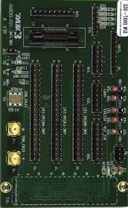
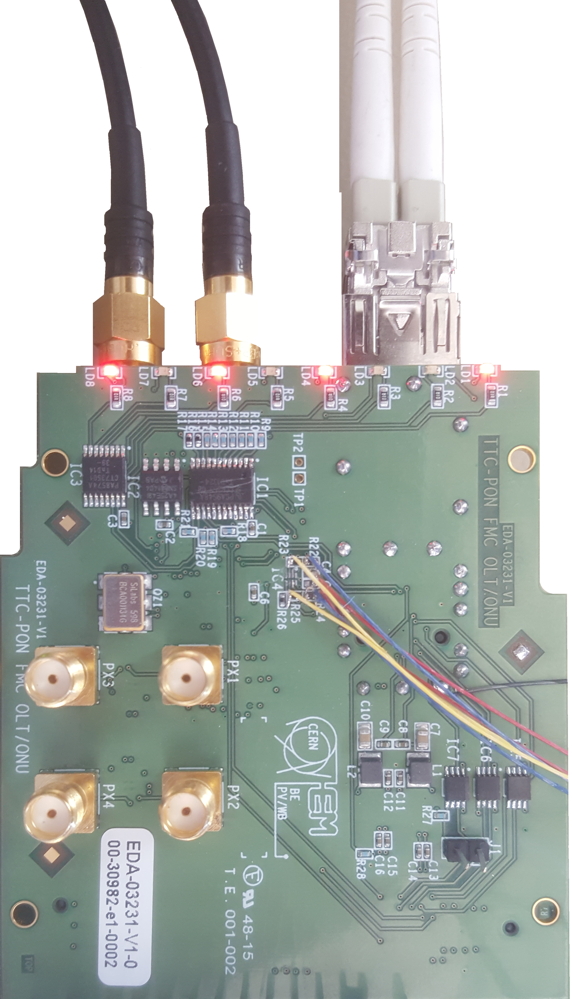

Demo setup and configuration
What is my demo setup ?
Clock in
(LHC Clock)
TTC PON FMC
Xilinx FMC (HW-FMC-105-DEBUG)
Optical fibber
(SFP)
SMA OUT
LHC Clock (to FPGA)
Transceiver Clock (to MGT REFCLK pins)
Altera Arria 10 GX Development kit

Slide 4


Demo setup and configuration
What are the clock and data schemes ?
SI5338
FrameClk (LHC Clock)
LHC Clock
MGT RefClk (240MHz)
SFP Connector
Data Tx
Data Rx

Slide 5

Demo setup and configuration
How to initialize the SI5338 PLL ?
  Using the ClockBuilder tool from SILabs
  I2C bus located on the card
  I2C OpenCore IP
On-board osc.
RESET
Arria 10
TCL
SDA
JTAG cable
JTAG Server
Avalon MM
OpenCore I2C
SCL

Slide 6
How to implementation the GBT-FPGA IP using records
What is the content of the GBT bank instance?
gbt_bank
gbt_tx
multi_gigabit_transceiver
gbt_rx
*
gbt_tx_scrambler
mgt_std
gbt_rx_framealigner
*
*
gbt_tx_encoder
mgt_latopt
gbt_rx_gearbox
*
gbt_tx_gearbox
gbt_rx_decoder
gbt_rx_descrambler
gbt_rx_status
*: Contains device specific instances

Slide 7
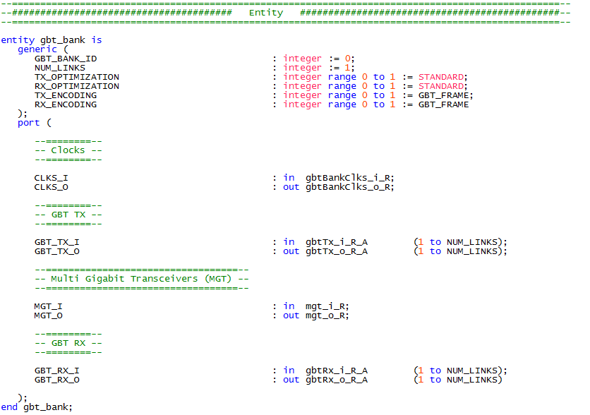
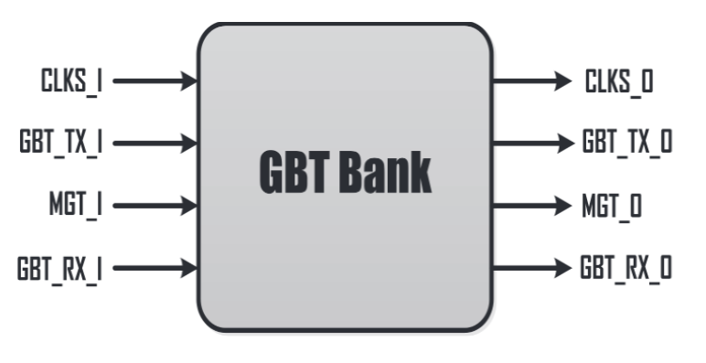
How to implementation the GBT-FPGA IP using records
What are the GBT Bank interfaces ?
Configuration
Records
Warning: configuration can be made using two different ways ! Do not mix these to avoid bugs.
First way: Specify only the GBT_BANK_ID parameters when you implement the module. In this case, the information are get from the gbt_banks_user_setup package (gbt_bank/your_device/xxx_xxx_gbt_bank_user_setup.vhd)
Second way: Specify all the parameters except the GBT_BANK_ID (its value shall be 0, default value).

Slide 8
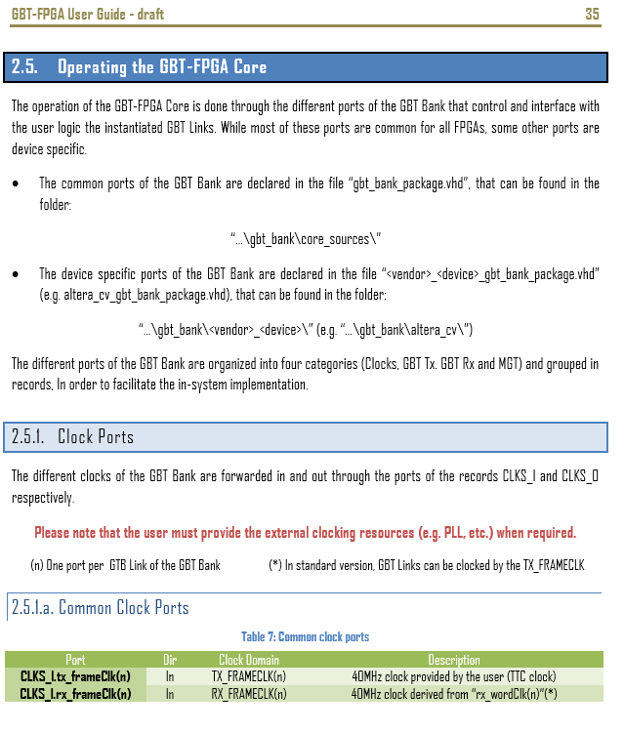
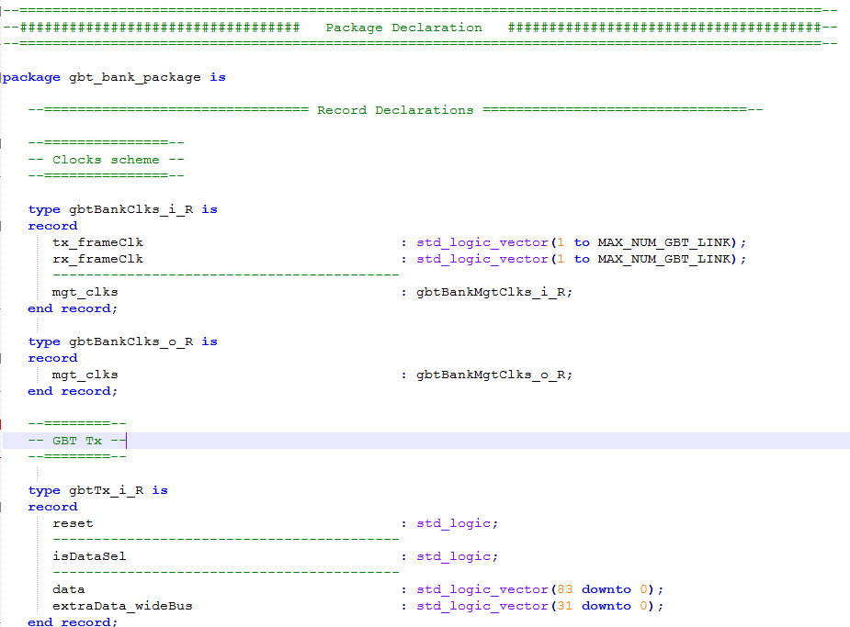
How to implementation the GBT-FPGA IP using records
How to find records definition?
  GBT-FPGA User guide
    2.5. Operating the GBT-FPGA Core
  VHDL files
    gbt_bank/core_sources/gbt_bank_package.vhd: records generic for all the devices
    gbt_bank/<device>/xxx_xxx_gbt_bank_package.vhd: device specific records

Slide 9
DEMO

Slide 10
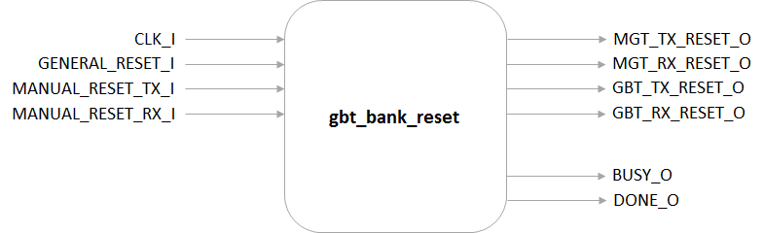
How to implementation the required additional modules
GBTBank reset
Generates the reset signal for the different part of the GBT Bank: TX, RX and MGT
GBT_TX_RESET_O
MGT_TX_RESET_O
MGT_RX_RESET_O
GAP_DELAY
GBT_RX_RESET_O
INITIAL_DELAY
TIME_N
GAP_DELAY
TIME_N

Slide 11
DEMO

Slide 12
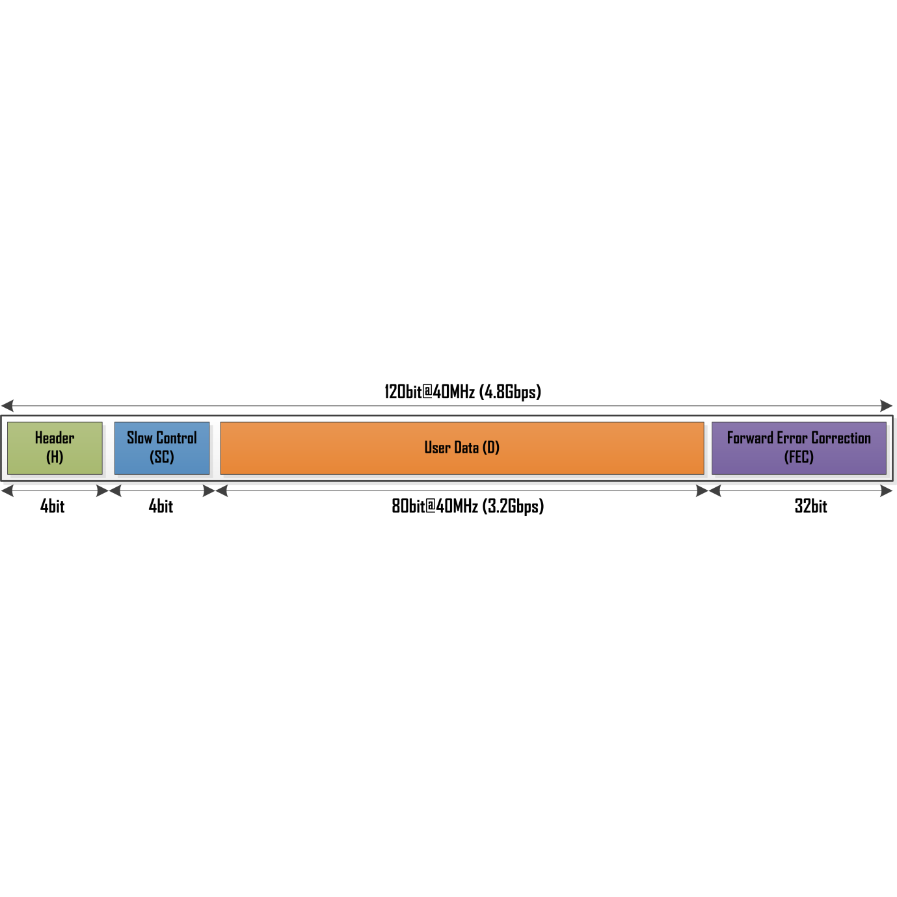
How to implementation the required additional modules
GBT Data pattern generator
gbt_pattern_generator
RESET_I
TX_DATA_O
TX_FRAMECLK_I
TX_EXTRA_DATA_WIDEBUS_O
TX_ENCODING_SEL_I
TEST_PATTERN_SEL_I
STATIC_PATTERN_SCEC_I
STATIC_PATTERN_DATA_I
STATIC_PATTERN_EXTRADATA_WIDEBUS_I

Slide 13
How to implementation the required additional modules
GBT Data pattern checker
gbt_pattern_checker
RESET_I
GBTRXREADY_LOST_FLAG_O
RX_FRAMECLK_I
RX_DATA_I
RXDATA_ERRORSEEN_FLAG_O
RX_EXTRA_DATA_WIDEBUS_I
RXEXTRADATA_WIDEBUS_ERRORSEEN_FLAG_O
GBT_RX_READY_I
RXDATA_ERROR_CNT
RXDATA_WORD_CNT
RX_ENCODING_SEL_I
STATIC_PATTERN_SCEC_I
STATIC_PATTERN_DATA_I
STATIC_PATTERN_EXTRADATA_WIDEBUS_I
RESET_GBTRXREADY_LOST_FLAG_I
RESET_DATA_ERRORSEEN_FLAG_I

Slide 14
DEMO

Slide 15


How to make my design versatile (multi-links, enable/disable features)
Generate statement for multi-links:
Generate statement to enable/disable features:

Slide 16
DEMO

Slide 17

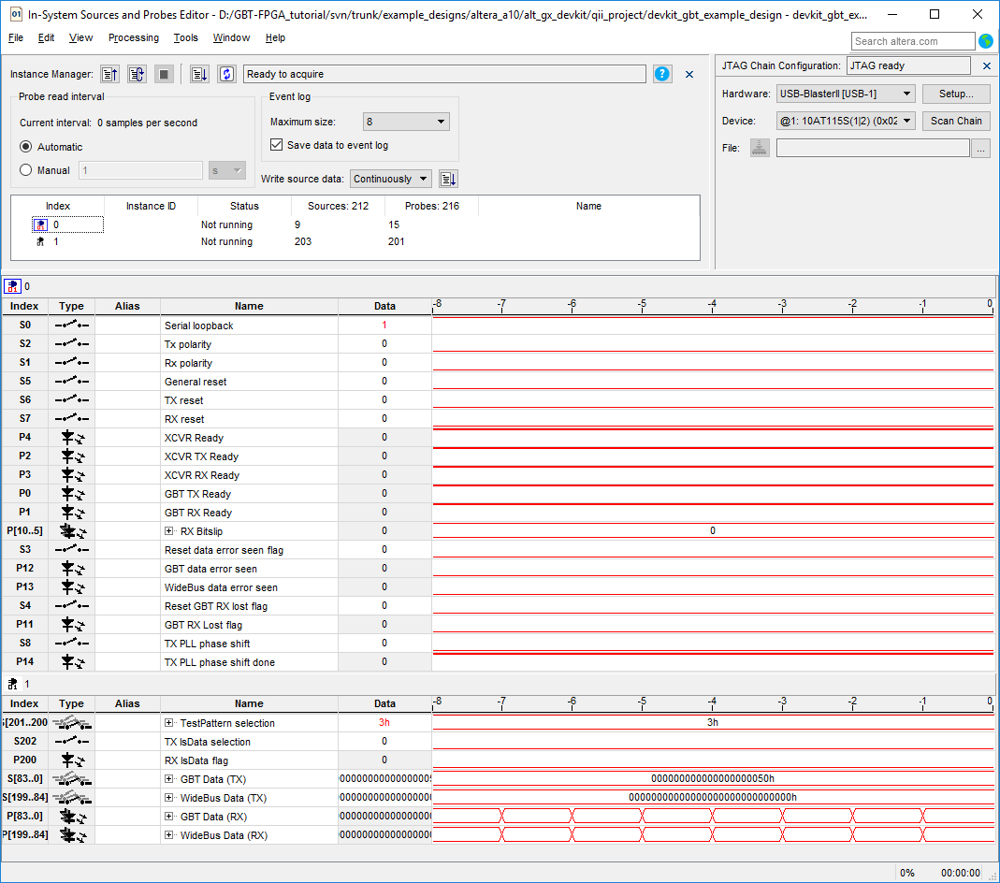
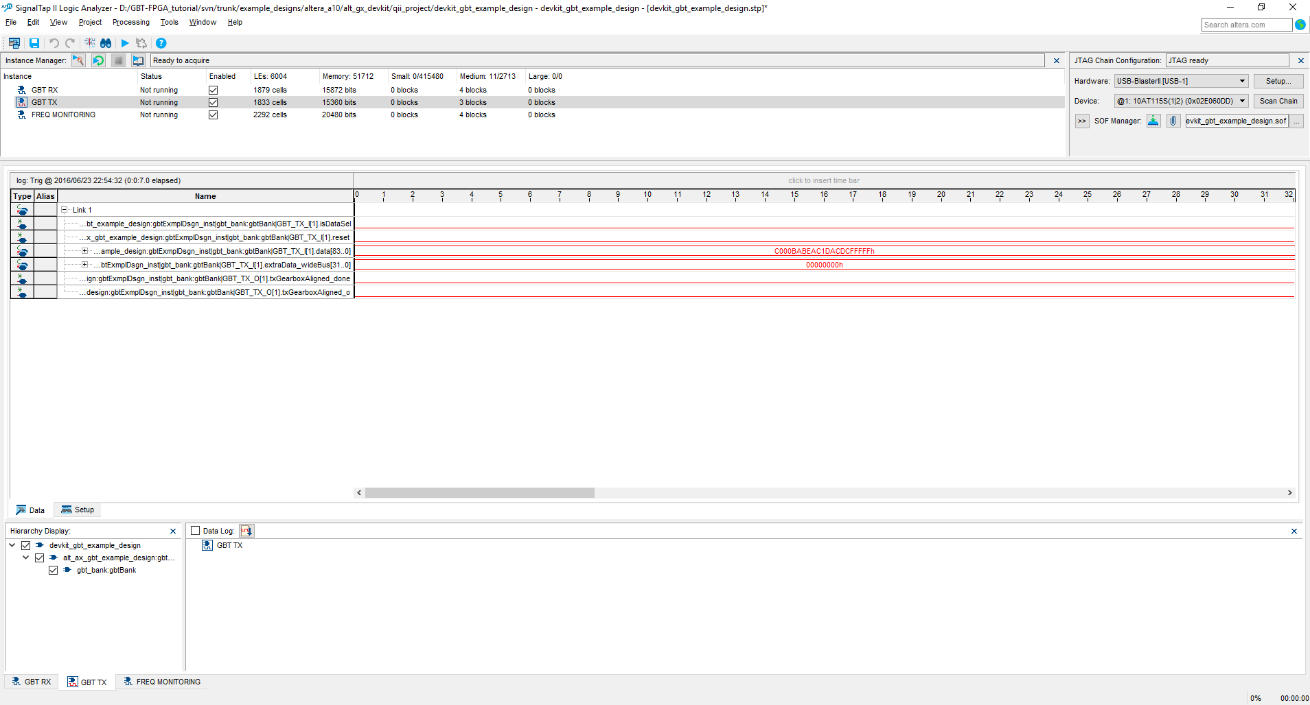
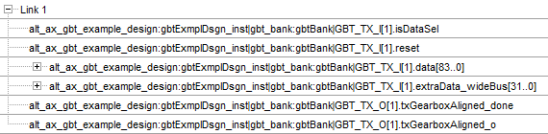
How to debug the design
ISSP and Signal tap

Slide 18
DEMO

