Slide 1
Position-Sensitive Gaseous Photomultipliers: Research and Applications

Slide 2
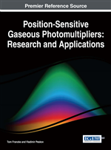
We would like to present our new work - a book
By Tom Francke (Myon, Sweden)
and
Vladimir Peskov (CERN)
Publisher-IGI Global, USA
Release Date: May, 2016,
15 Chapters, 562 pages
Its main focus is on new designs, technological aspects
and physics of operation of positon- sensitive photomultipliers,
so it fits well this working group

Slide 3

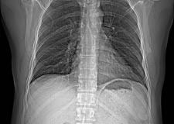
Let me first present my co-author Tom Francke
We met at CERN in 1986, where he worked on photosensitive substances and later on various RICH designs. Then we continue to collaborate in Sweden, where he lead the XCouter company, developing micropattern detectors for medical application

Slide 4
General notes:
The book summarizes the experience of many groups in developments of photocathodes and position sensitive multipliers
Why are these detectors unique, why they deserved to be described in a dedicated book?
The main advantage is-a large sensitive area, since there are no constrains on the window size.
(Vacuum detectors max. diameter is 20 inch for PM and for MCP 8x8 inch2)
They are also position -sensitive
(let me remind you that gaseous detectors were the first electronic position-sensitive detectors
(PMT were not position-sensitive and MCP and multianode PMTs appeared latter)

Slide 5
8x8 inch
Vacuum PMT
Vacuum MCP
ALICE RICH-
each module
40x60cm2

Slide 6
This is why micropattern structures are so important in gaseous PMTs: due to their geometry they are capable to supress photon and ion feedbacks
The problems, however are: feedback, cathode degradation by ion bombardment, etc.

Slide 7
Book structure

Slide 12
Let me highlight some achievements, designs, developments and associated problems

Slide 13
1.TMAE photocathode- was a breakthrough in 1980th
Highest QE, however chemical aggressive. It requires also careful cleaning. In books can be find the recipes and solutions

Slide 14
Feedback and its suppression

Slide 15
2. Liquid photocathode- a nice physical effect

Slide 16
3. Search for air-stable solid photocathodes

Slide 17
4. CsI photocathode
CsI
CsI has quantum efficiency
comparable to TMAE, but is not
chemically aggressive, tolerates
a shot contact with air and
thus it is much easier to handle.
This is why it fully replace TMAE
in most of detectors
It has also potential foe better time
resolution since there is practically
no jitter in creation photoelectrons
TMAE

Slide 18
Feedback problem also exists , hut the electronics was improved with time , so the operation at lower gains becomes possible
In CsI -RICH detector small
feedback was even useful
One of the remaining problems –is discharges induced at high rate environment (COMPASS)

Slide 19
5. The future: gaseous detectors sensitive to visible light?

Slide 20
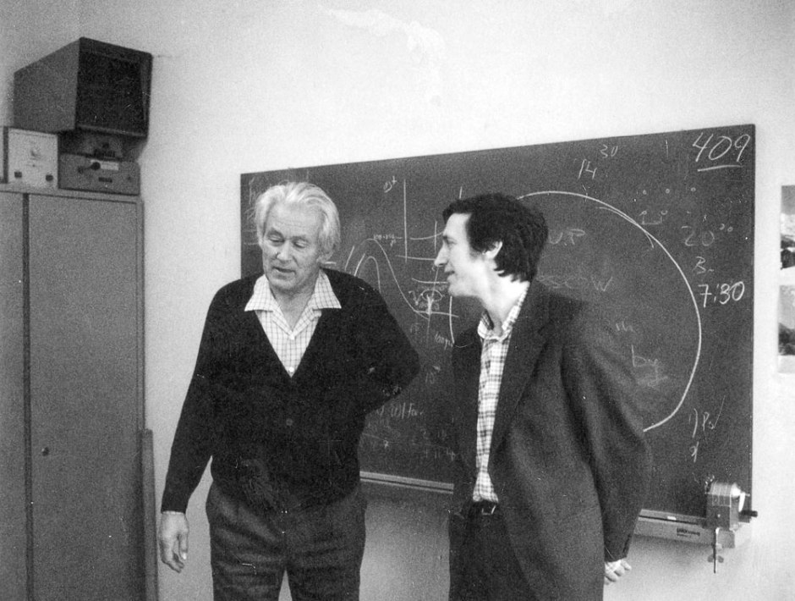
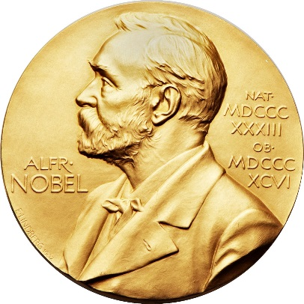
Famous Charpak joke:
“The next Noble prize in the field of gaseous detectors will be given the persons who develop position-sensitive gaseous detectors sensitive to visible light”

Slide 21
The progress
First Hamamatsu gaseous detectors sensitive to visible
light had gains ~ 10 now is ~10000

Slide 22
Applications

Slide 23
The main application is, of course, RICH

Slide 24
Other applications were mentioned as well, like plasma diagnostic, astrophysics ets

Slide 25
Conclusions
We tried to give in this book an exhaustive compilation of knowledge on photosensitive gaseous detectors: their technology , main design and physics of operation.
We think that one of its important feature is that it contains unpublished or difficult reachable information on handling some products, like cleaning of TMAE, preparation of some photocathodes etc.
The latest, probably has a special value because people participating in these exciting developments and possessing the unique “know- how” are gradually stepping down from the scientific activity and their experience can be lost
We hope the book will be useful for researches, technicians, engineers, university professors and especially for students

