Slide 1


Microscopic and fluid modeling of
Resistive Plate Chambers
Danko Bošnjaković and Saša Dujko
Institute of Physics, University of Belgrade, Serbia
RD51 collaboration meeting
CERN, June 2016

Slide 2
Outline
Introduction
Microscopic Monte Carlo model
Classical fluid model
“Corrected” fluid model
Conclusion and future work

Slide 3
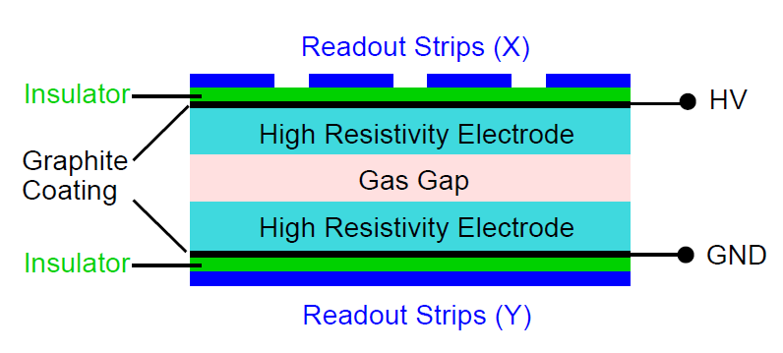
Resistive Plate Chamber (RPC): principles of operation
Developed by Santonico and Cardarelli (1981).
Consists of two parallel plate electrodes made of material of high volume resistivity for supression of destructive discharges.
incoming particle
(taken from C. Lippmann, PhD thesis)
Resistive material:
  glass (ρ = 10¹²-10¹³ Ωcm).
  bakelite (ρ = 10¹²-10¹² Ωcm).
Operating conditions:
  atmospheric pressure, room temp.
  reduced electric fields: 200 to 400 Td.
  timing resolution: 50 ps to ~1 ns.
  spatial resolution: ~1 mm.
  counting rate capability: up to ~1 kHz/cm²
Gas mixtures:
Ar, C₂H₂F₄, iso-C₄H₁₀, SF₆.

Slide 4
Simulation and modeling of RPCs
Model(s) | Advantages | Disadvantages
Analytical e.g. Riegler NIMA 602 (2009) 377; Fonte JINST 8 (2013) P11001 | Can provide general conclusions | Often approximate
Fluid equations e.g. Moshaii NIMA 661 (2012) S168; Fonte IEEE TNS 43 (1996) 2135 | Space charge effects, photoionization and recombination can be relatively easily included Computationally efficient | Provide average quantities (deterministic)
Macroscopic stochastic e.g. Riegler et al. NIMA 500 (2003) 144; Salim et al. JINST 7 (2012) P11019 | Provide stochastic quantities such as efficiency, timing resolution and charge spectra Computationally efficient | Based on different models of avalanche fluctuations (e.g. Legler, Polya) which can be approximate
Microscopic stochastic e.g. Bošnjaković et al. JINST 9 (2014) P09012 | Provide stochastic quantities Accurate | Computationally demanding

Slide 5
Our “microscopic” Monte Carlo model of RPC †
Based on tracking of each electron and its collisions with the background gas in a bounded space between the cathode and the ’absorbing’ anode
Includes primary ionization and signal induction
Electron path is determined using an analytical solution for the equation of the electron motion
Determination of a probability and nature of a collision;
Probability density that the collision occurs in the time interval (t,t+dt)
Relative probabilities of collisional processes
The nature k of collisional process occurs
Procedure for the collision dynamics
Isotropic scattering is assumed
v_{i}
θ
The azymuthal angle φ
electron
φ
The polar angle θ
molecule
The change in the electron energy after an elastic collision
† D. Bošnjaković, Z.Lj. Petrović and S. Dujko (2014), J. Instrum. 9, P09012.

Slide 6
C₂H₂F₄ cross sections
Cross sections for C₂H₂F₄ were developed by our group† using measured swarm data from Urquijo et al. (2009).
† O. Šašić et al. (2013), J. Phys. D 46, 325201.

Slide 7
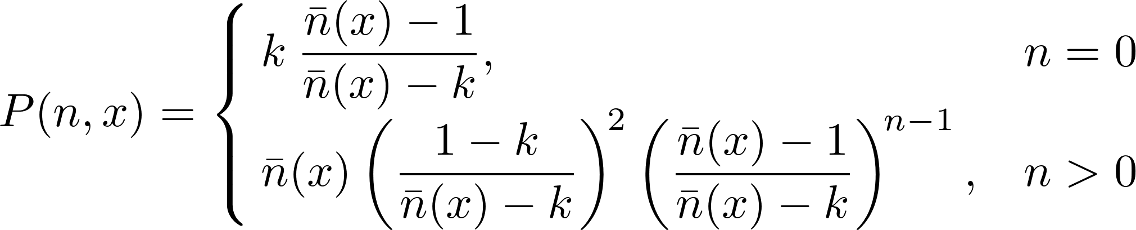
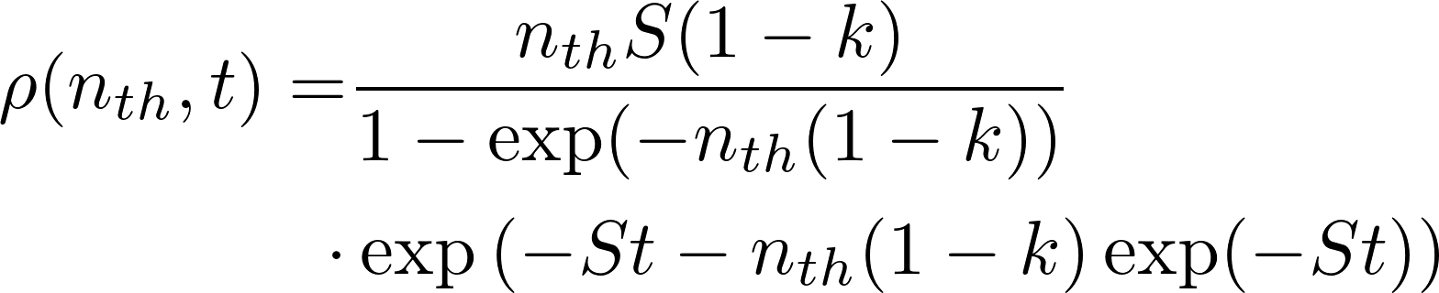
Results: Single-electron avalanches†
We simulated 2×10⁴ single-electron avalanches in a gas mixture of 85% C₂H₂F₄ + 5% iso-C₄H₁₀ + 10% SF₆ (a timing RPC mixture)
Threshold: 10000 electrons
E/N = 439 Td
Deviation from the exponential dependence
(t = 290 ps)
Legler’s model of avalanche statistics
Legler’s model
An analytical model for time response functions‡
† D. Bošnjaković, Z.Lj. Petrović and S. Dujko (2014), J. Instrum. 9, P09012.
‡ W. Riegler (2009), Nucl. Instrum. Meth. A 602, 377.

Slide 8
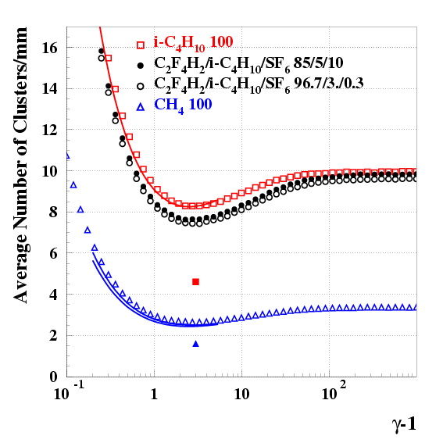
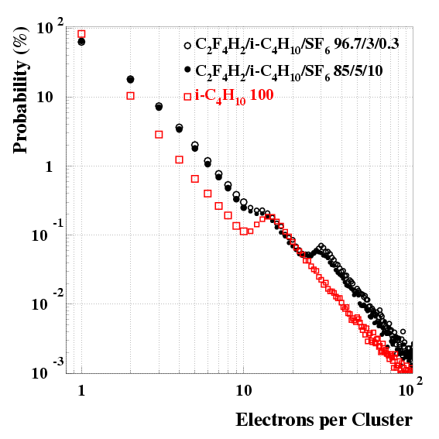
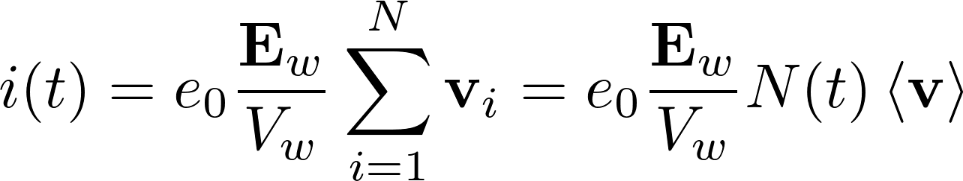
Primary ionization
Primary ionization consists of point-like clusters. The distance between neighboring clusters is exponentially distributed. Mean distance between clusters and cluster size distribution are calculated using HEED.
1/λ = 7.5 cl/mm
(MIPs)
taken from W. Riegler, C. Lippmann, R. Veenhof, NIMA 500 (2003) 144
Signal induction (Ramo’s theorem)
Induced current:
mean electron velocity
“flux drift velocity”
† I.B. Smirnov (2005), Modeling of ionization produced by fast charged particles in gases, Nucl. Instrum. Meth. A 554, 474.

Slide 9
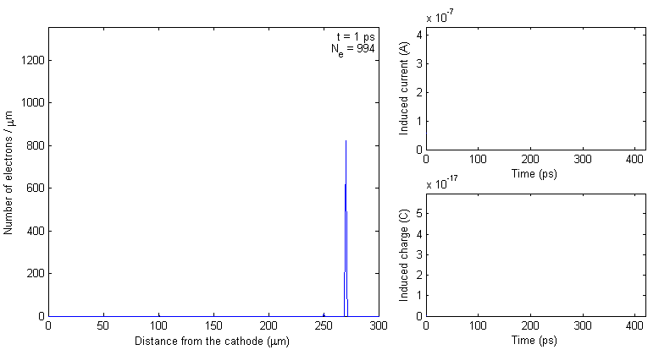
Our “microscopic” Monte Carlo model of RPC †
CATHODE
ANODE
Initial positions of primary clusters.
Temporal evolution of an RPC signal for 3 primary clusters consisting of 1, 10 and 100 electrons, respectively. The reduced electric field is set to 421 Td and the gas mixture of C₂H₂F₄:iso-C₄H₁₀:SF₆=85:5:10 was considered.
† D. Bošnjaković, Z.Lj. Petrović and S. Dujko (2014), J. Instrum. 9, P09012.
Notes:
Tezinsko polje je 1.48 po mm koje je izracunato u rieglerovom radu za rastojanje od 0.3 mm (Riegler 2003).

Slide 10
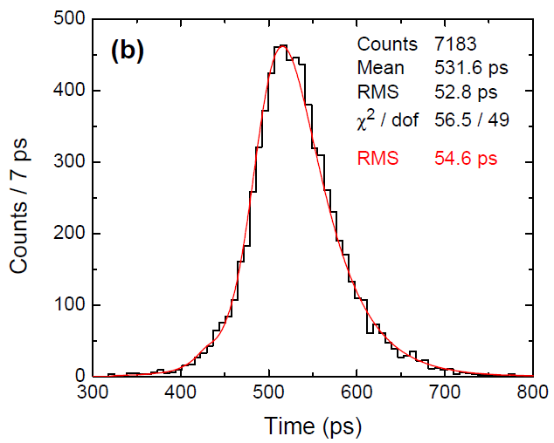
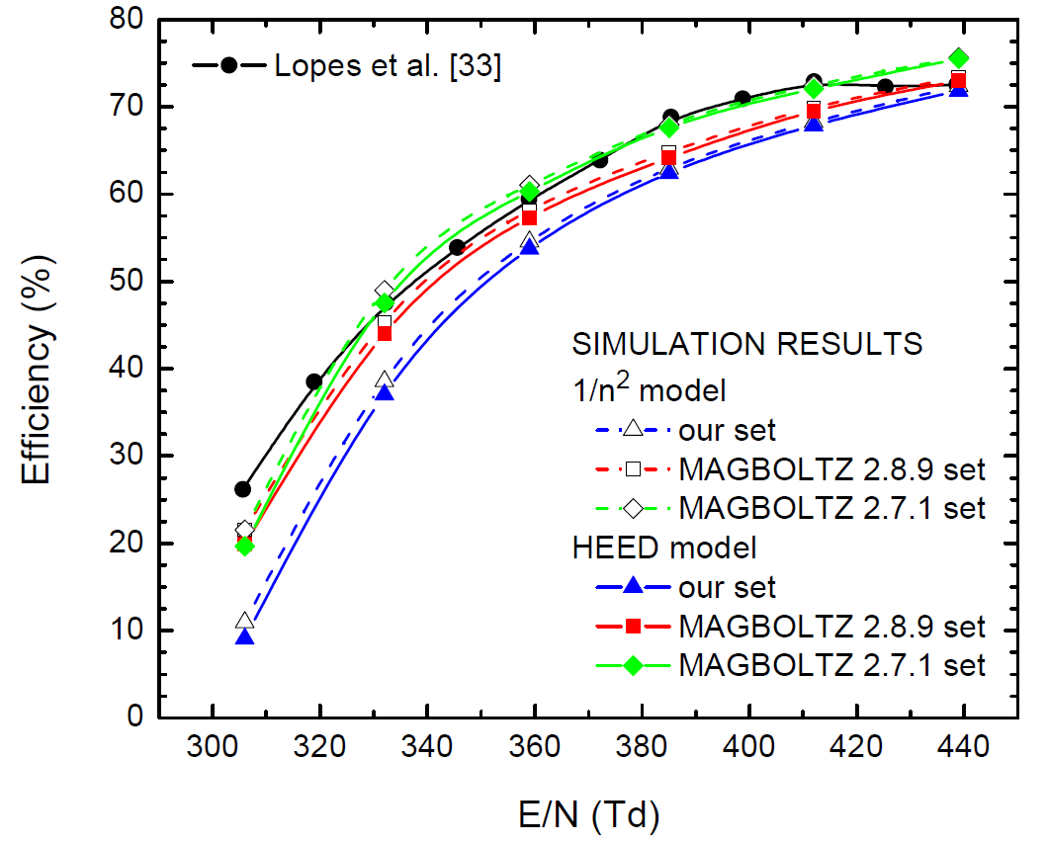
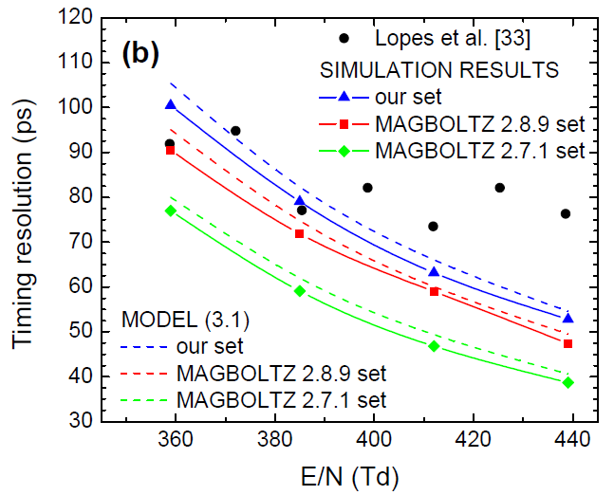
Results: Realistic RPC events. Timing and efficiency †
Gas mixture of C₂H₂F₄ (85%), iso-C₄H₁₀ (5%) and SF₆ (10%); 3 different cross section sets for C₂H₂F₄
Primary ionization: 7.5 cl/mm; 1/n² and HEED cluster size distributions
0.3 mm gas gap
Threshold was set to 2 fC (corresponds to about 10⁶ electrons in the gap, no space charge)
Comparison with measurements by
Lopes et al. (2012)
HEED
our
C₂H₂F₄
set
E/N = 439 Td
(2012)
HEED
(2012)
† D. Bošnjaković, Z.Lj. Petrović and S. Dujko (2014), J. Instrum. 9, P09012.

Slide 11
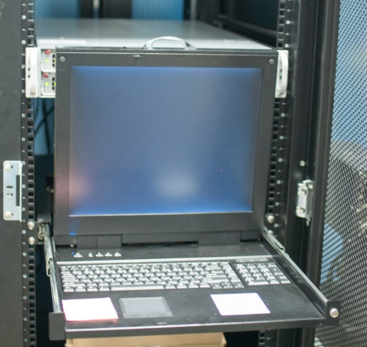
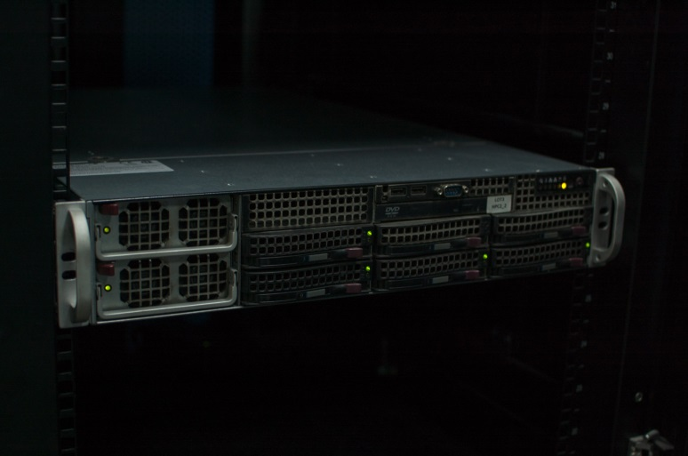
Computing requirements
The calculations were performed on our lab’s computing system:
5 nodes x 4 CPUs AMD Opteron 6272 @ 2.1GHz (16 cores)
Total # CPU cores: 320
Total RAM: 768 GB
Our MC RPC simulation with 10000 events takes about 2 days of computation time on 300 CPU cores (14400 CPU hours).

Slide 12
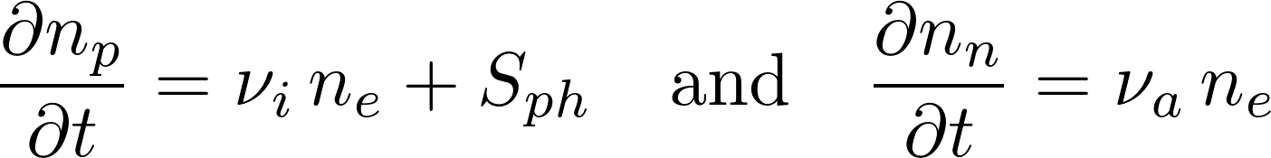

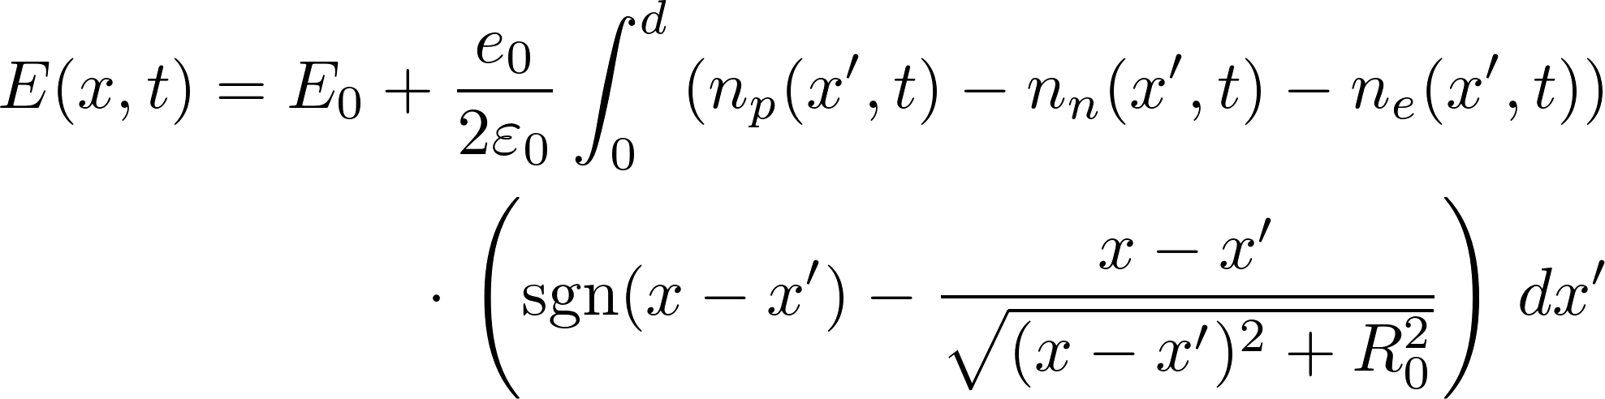
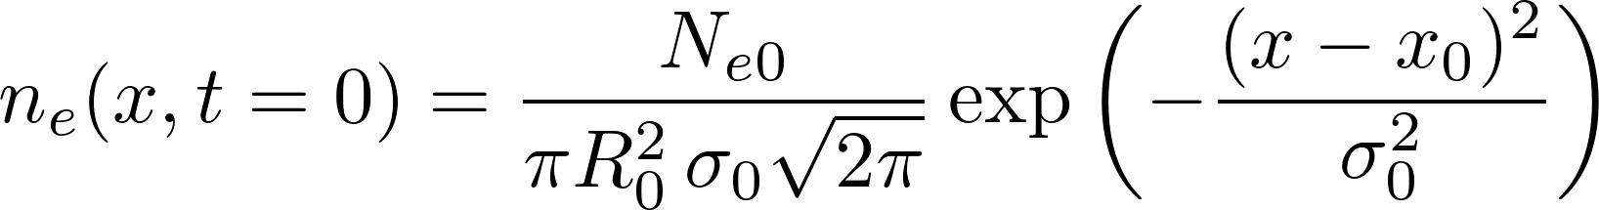
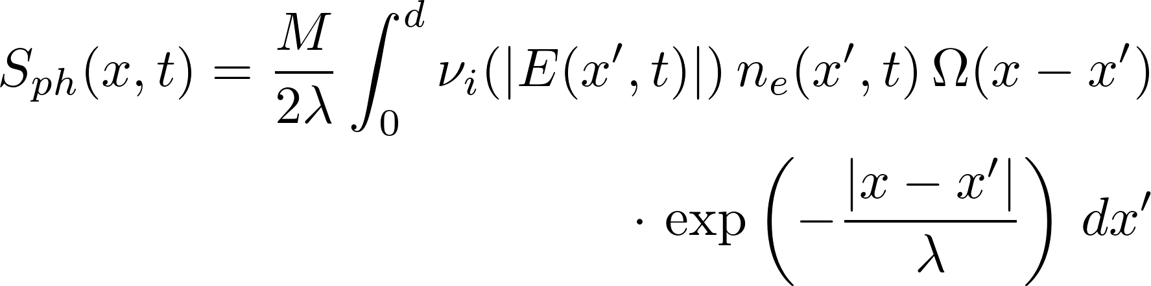
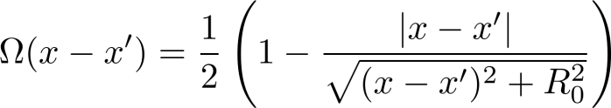
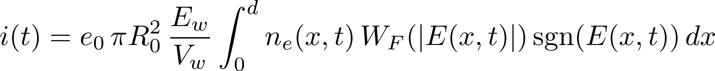
1.5D classical fluid model
Transport equations for electrons and ions
‘first-order’
model
flux
Transport data
bulk
model based on hydrodynamic approximation
Electric field (the charge is deposited inside the cylinder with radius R₀ and distributed uniformly in the radial direction)
Boundary conditions
Initial conditions
Photoionization source term
Numerical scheme
Spatial derivative: 2nd order central finite difference
Time integration: 4th order Runge-Kutta method
Induced current (Ramo’s theorem)

Slide 13
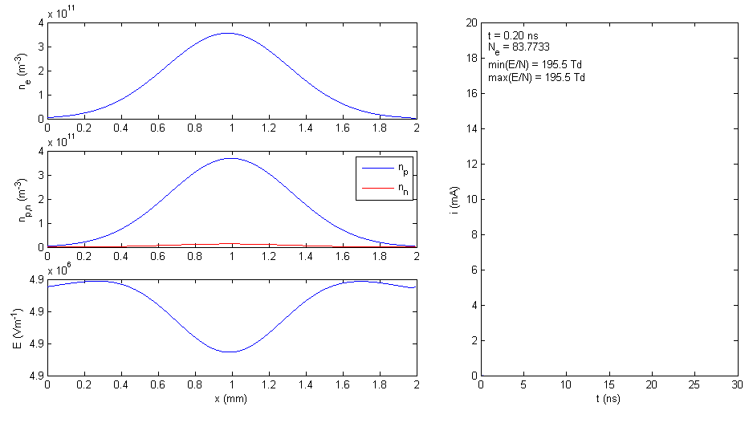
1.5D classical fluid model: an example
Avalanche and streamer development in ATLAS triggering RPC
gas mixture: 94.7% C₂H₂F₄ + 5% i-C₄H₁₀ + 0.3% SF₆
E₀/N = 196 Td (operating field)
bulk data are assumed

Slide 14
1.5D classical fluid model: induced current (flux vs bulk data)
ATLAS triggering RPC
94.7% C₂H₂F₄ +
5% i-C₄H₁₀ +
0.3% SF₆
gas gap: 2 mm
ALICE timing RPC
90% C₂H₂F₄ +
5% i-C₄H₁₀ +
5% SF₆
gas gap: 0.25 mm
Timing RPC 2
85% C₂H₂F₄ +
5% i-C₄H₁₀ +
10% SF₆
gas gap: 0.3 mm

Slide 15
1.5D classical fluid model:
induced charge (flux vs bulk data)
The maximum difference between induced charges calculated using flux and bulk data is about 80% for the ATLAS RPC and few hundred percent for timing RPCs
Due space charge effects at higher electric fields, this difference is about 6% for ATLAS RPC and about 30% for timing RPCs
ALICE TOF
ALICE TOF

Slide 16
1.5D classical fluid model:
different C₂H₂F₄ cross sections
t = 6.29 ns
ATLAS triggering RPC
gas mixture
94.7% C₂H₂F₄ + 5% i-C₄H₁₀ + 0.3% SF₆
2 mm gas gap
E0/N = 196 Td (operating point)
the observed differences stem from
different drift velocities and effective
ionization rates
t = 13.13 ns
t = 10.76 ns

Slide 17
1.5D classical fluid model:
different C₂H₂F₄ cross sections
8 kV
(160 Td)
Induced signals in ATLAS triggering RPC
gas mixture
94.7% C₂H₂F₄ + 5% i-C₄H₁₀ + 0.3% SF₆
2 mm gas gap
9.8 kV
(196 Td)
10.7 kV
(213 Td)

Slide 18
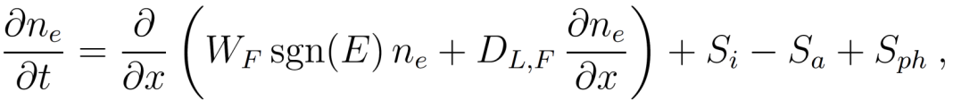
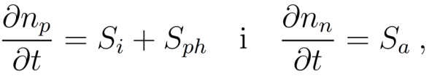
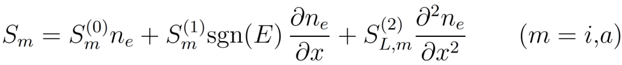
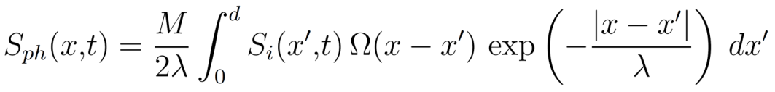
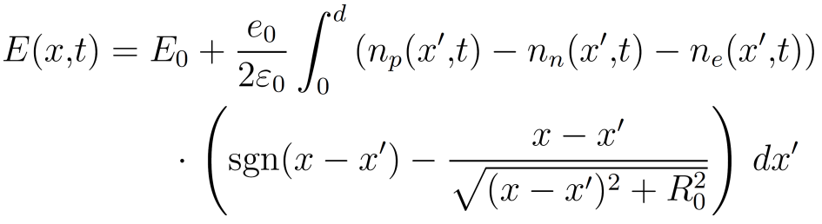
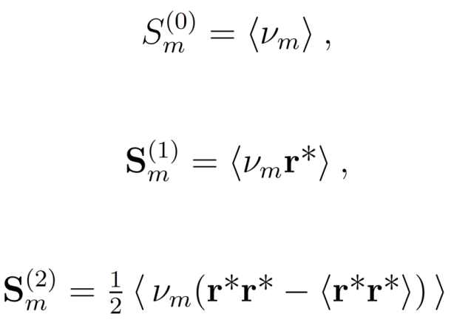

1.5D fluid model based on hydrodynamic
approximation (“corrected model”)
flux data
Transport equations
and
Source term due to ionization/attachment
Photoionization source term
Electric field
Calculation of source term coefficients
where

Slide 19
1.5D corrected fluid model:
avalanche and streamer evolution
t = 0.45 ns
ALICE timing RPC gas mixture:
90% C₂H₂F₄ + 5% i-C₄H₁₀ + 5% SF₆
0.25 mm gas gap
E0/N = 415 Td (operating point)
during the avalanche phase, profiles
match with those from bulk case
positive streamer velocity is also similar
to that from bulk case
t = 1.07 ns
t = 0.92 ns

Slide 20
1.5D corrected fluid model: induced signals
Induced current
Induced charge
ATLAS
ATLAS
ALICE TOF
ALICE TOF

Slide 21
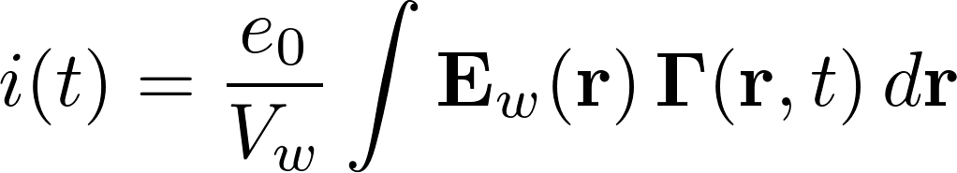

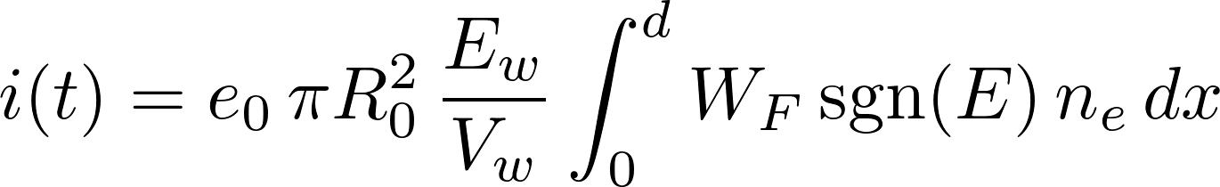
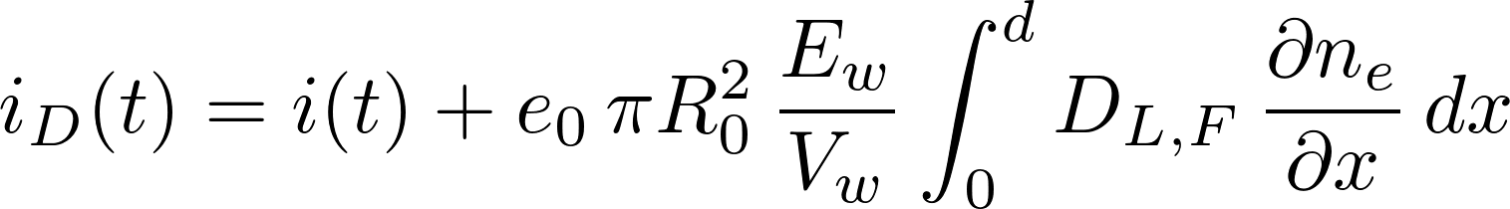
1.5D corrected fluid model: induced signals
Application of Ramo’s theorem
In general, should total flux be included i.e.
ATLAS RPC
max=0.33%
ALICE TOF RPC
max=0.95%
where flux density ?
Hydrodynamic approximation
Implementation in fluid model
vs

Slide 22
Conclusion and further work
We have developed a 3D Monte Carlo microscopic model for timing resolution and efficiency of RPCs with low signal discrimination threshold
A full microscopic model for RPCs would have to be able to simulate realistic thresholds. It should also follow the signal development until the end so that charge spectra can be obtained. This would require the inclusion of space charge effects.
Problem: limited computing resources
Possible solution: PIC/MC simulation with super particles
We have developed a 1.5D classical fluid model and also a model based on hydrodynamic approximation. Using these models we have shown how different transport data used as input affect the calculated RPC signals.
These models should be compared with local mean energy model and PIC/MC simulation.

