Slide 1
Undulator-based THz source
Jürgen Pfingstner
4. October 2016

Slide 2
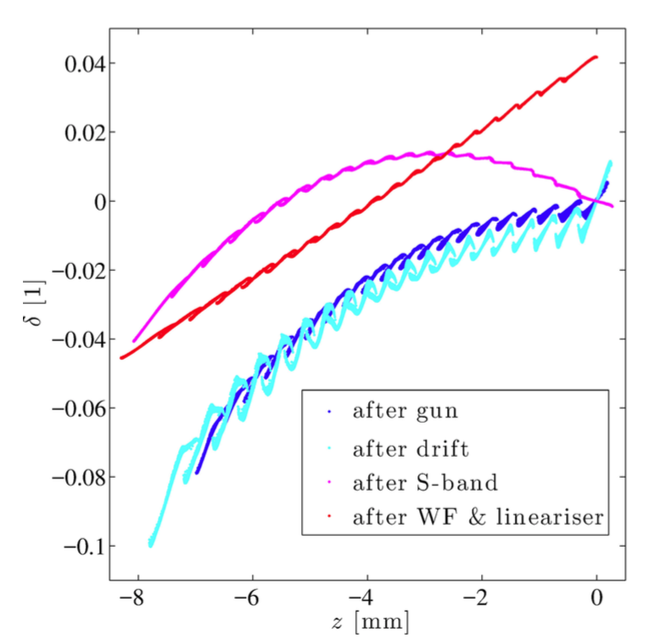
Overview
Introduction
Comb beam generation
Test scenario for CALIFES
Conclusions

Slide 3
1. Introduction

Slide 4
THz source for SwissFEL
Request from material scientists:
  f_{THz} = 1 – 20 THz (λ_{THz} = 300 – 15μm)
  E_{p} ≈ 100μJ
  Δω/ω₀ < 10% (pref. 5%)
  Phase locked
  f_{rep} = 100Hz
Motivation:
  Vibrations within the material lattice occur manly in the THz regime:
    Free electrons (plasmon)
    Lattice vibrations (phonon)
    Spin coupling (magnon)
    ...
  To study these effects, material excitation with THz source.

Slide 5
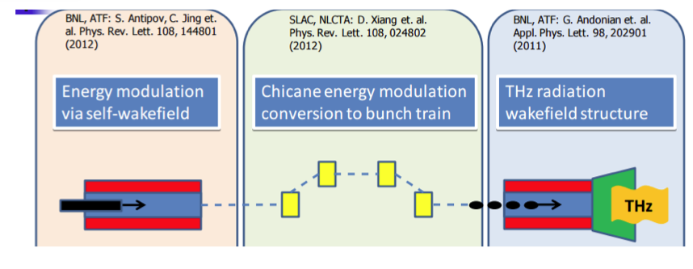

Option 1: THz source based on wakefield modulation
Principle:
Energy modulation via wakefield of dielectric structure.
Conversion into intensity modulation via bunch compressor.
Energy extraction via a second structure (PETS principle).
Tuning:
Advantages:
Bunch of SwissFEL would be used for source.
Construction and operation cost is nearly negligible.
Studied by Simona Bettoni

Slide 6
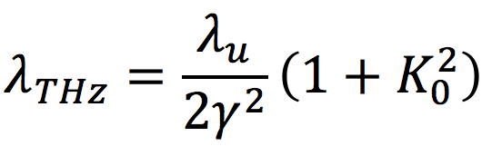
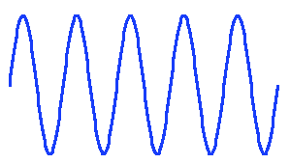
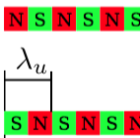
Option 2: Undulator-based THZ source
Undulator parameter:
Challenge to go to so large λ_{THz}.
Helical undulator (symmetric strong natural focusing).
γ = 50 (E_{b}=25MeV, space charge).
λ_{u} = 6cm (compactness).
K₀ = 0.75 - 4.9 (for tuning); equals to B₀ = 0.09T – 0.88T.
Q = 1nC charge necessary.
Phase locking:
SASE: easy, but no phase locking.
Seeding: THz lasers not quite strong enough.
Comb beam: create bunching before undulator.

Slide 7
2. Comb beam generation

Slide 8
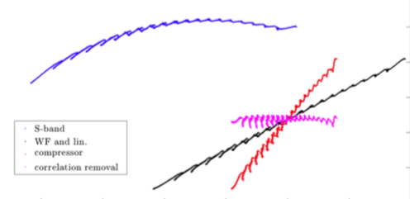
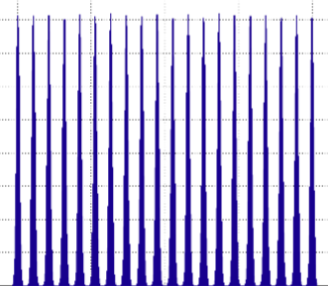


Comb beam facility
δ=ΔE/E₀
z
comb laser
S-band
gun
S-band
ACC
X-band
lineariser
Variable bunch
compressor
S/X-band
de-chirper
undulator
Current
smearing due to space charge effect
Current

Slide 9
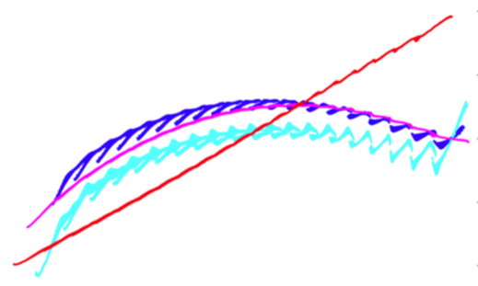
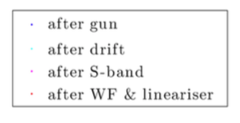
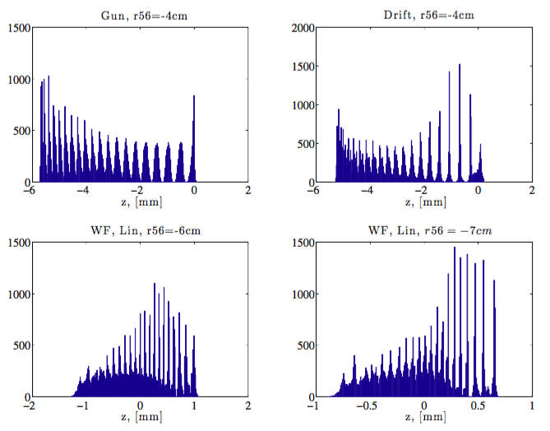
Longitudinal phase space
δ = E/E₀
Longitudinal phase space is complicated because of long comb pulse:
  Long. space charge smearing.
  RF curvature.
  Variable RF compression.
  Charge dependence.
At SPARC experiment with 2 or 4 bunches, here 16 bunches.
Challenge to find a setup with equally spaced bunches at undulator.
Current I [a.u.]

Slide 10
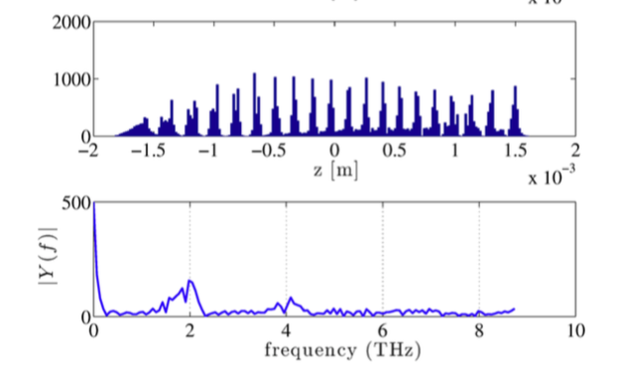
Operational considerations
A setup for a uniform charge profile has been found:
  1nC, 20 pulses, 10° gun phase, R₅₆ = -3.5 cm
It will be difficult enough to create a proper bunching at one frequency.
Proposition to keep tuning manageable:
  Keep beam setting before bunch compressor fixed.
  Separation of linearisation and compression: no dogleg with sextupoles.
But this will create only one specific bunching (see next slide).

Slide 11
Frequency tuning
Tuning with variable R₅₆ of BC (pulse length change).
Re-bunching only achieved for very limited frequency range.
Undulator simulations show that also a not re-bunched beam can be used, since the remaining energy modulation converts to bunching in undulator.
Challenges of a compression with factor 1 – 20:
  With current setup, frequency range still limited to 1 – 4 THz, since energy modulation will smear too much above.
  To increase range, an strong increase of the energy chirp would help, since smaller R₅₆ can be used. This would be in general beneficial for the challenging bunch compression of a factor 20.
  Also, higher-order non-linearities may become a problem at one point.

Slide 12
3. Test scenario for CALIFES

Slide 13
Facility layout
Limitation:
E_{min} = 130MeV.
No Thz with undulator, since too long.
comb laser system
Gun
ACC1
X-band
lineariser
BC1
ACC2
ACC3
BC2
CTR diagnostics
Tuning:
BC1: Variable R₅₆ to bring bunch to right length (frequency).
ACC2, ACC3: phase change can be used to de-chirper, but additional acceleration is at the moment unavoidable.
BC2: creates bunching by tilting up the energy spread from longitudinal space charge.
New hardware:
Comb laser system.
X-band lineariser.
BC1 between ACC1 and ACC2.
BC2.
CTR diagnostics.
If ACC2, ACC3 could be freely tuned, THz could be created in undulator.

Slide 14
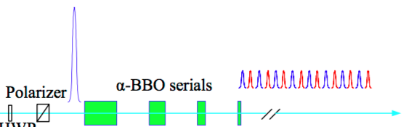
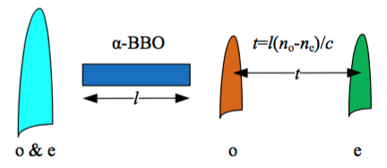
UV laser stacking
Laser stacking principle:
  Birefringent crystal (α-BBO).
  Different indices of refraction in different directions.
  Vertically and horizontally polarised light will be differently delayed.
  2mm crystal = 1ps delay.
  4 α-BBO with different lengths that are 45° rotated w.r.t. to each other.
Full laser facility
  Cathodes needs UV laser pulse.
  3x up-conversion from IR laser
  For 1Thz Pulse length must be ≈0.5ps FWHM.
  Problem: Current Nd:YAG system ≈8-10ps. We need Ti:Sa system!
  Baseline 1THz. Could it be increased to 5Thz (see next slide)?
Taken from L. Yan, IPAC10, WEPD051.

Slide 15
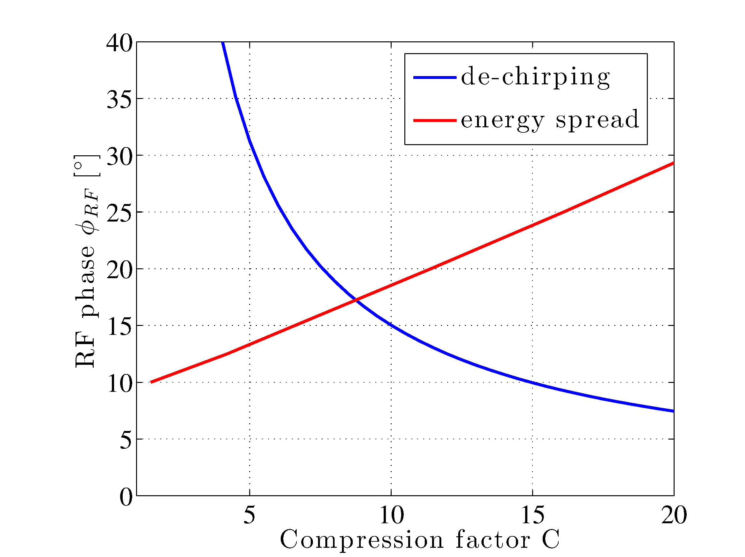
Bunch compressor specification
Limit for compression factor C:
  Removal of energy chirp after compression.
  Initial energy spread.
Maximal C≈5.
  This already assumes φ_{RF}=90° in ACC2 and ACC3.
  General limitation for tuning range.
Bunch compressor:
  L = 0.75m.
  Θ = 15°.
  Δε_{x,CSR} = 1.7%.
No estimate for second BC yet.
R₅₆ = -3.3cm
R₅₆ = -11cm
How could 1-20 THz be reached at all?
  Full range at once seems impossible.
  Two laser and gun setups: 1 and 5 THz.
  Tune with BC with C=1-5.
  Laser pulse length < 100 fs FWHM

Slide 16
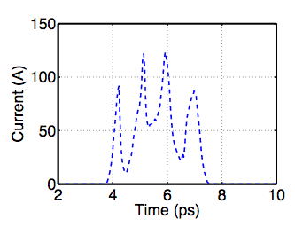
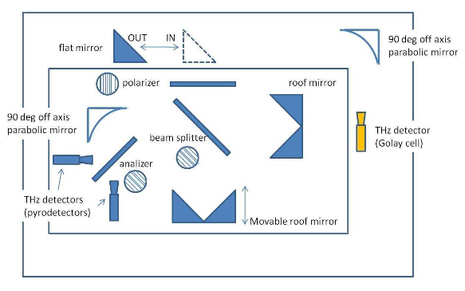
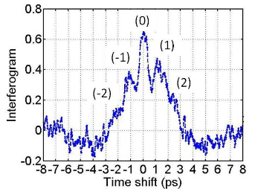
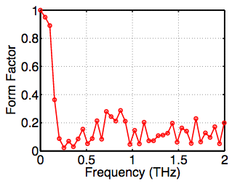
Diagnostics
At SPARC a the following system has been used.
CTR due to a metal coated foil.
Interferometer creates autocorrelation function
Scanning measurement.
foil
comb beam
Autocorrelation measurement
Taken from E. Chiadroni et al, IPAC11 THPS101

Slide 17
4. Conclusions
Two THz source concept for the SwissFEL under study.
Report on the comb-beam undulator-based THz source.
Challenges:
  To get a uniform enough longitudinal phase space.
  At SPAC with max. 4 bunches. Here with 16 bunches.
  Additionally, bunch length should be tuned without destroying energy modulation.
It would be necessary to test these concept, since it is a significant step w.r.t. performed experiments.
Additional equipment:
  Comb laser system (new Ti:Sa laser), X-band lineariser, 2xBC, CTR diagnostics,
  Preferable individual RF setting for ACC1, ACC2

Slide 18
Thank you for your attention!

