Slide 1



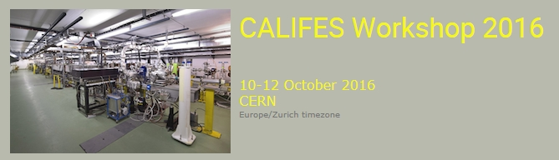

CALIFES past experience as a user facility
W. Farabolini on behalf of the Califes users

Slide 2



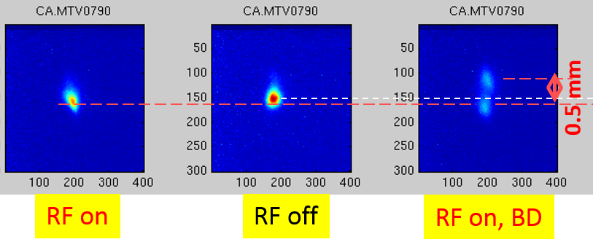
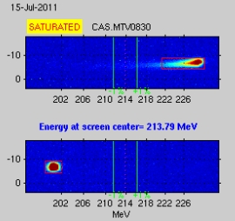
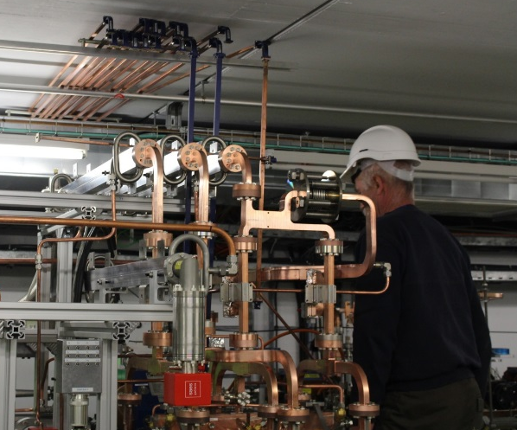
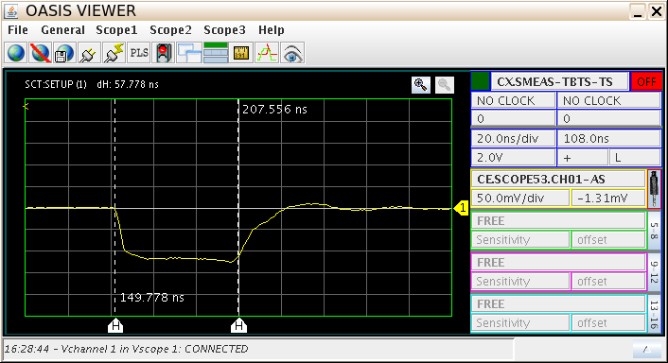
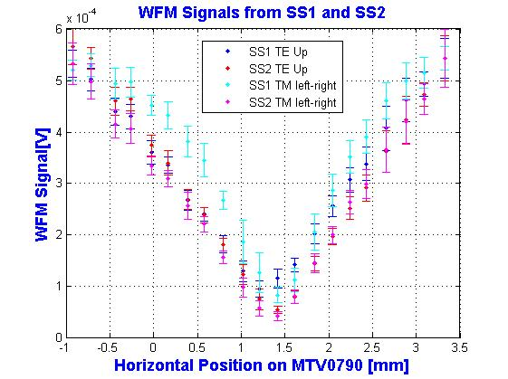
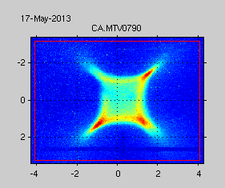
Initial scope of CALIFES
CALIFES was built in 2008 principally to test the high gradient accelerating structures:
  Validation of the accelerating gradient as function of the input power
  Frequency tuning of the structures
  Statistics about transverse kicks due to breakdowns (A. Palaia thesis, Uppsala Univ.)
  Structure transverse alignment checking
  Wakefield Monitors resolution (F. Peauger CEA, R. Lillestol Oslo Univ. )
  Octupolar component of the accelerating field (J Ogren, Uppsala Univ.)
  RF phase adjustment between structures in the CLIC module
  Beam kick due to transverse wakefields (my talk, Mon. 17:30)
LO = 11994.2 MHz
RF On
Frequency downmix of the beam generated power
RF Off
Octupolar beam shape
Measure of energy gain
Beam position scan in WFM
Waveguide phase problems

Slide 3
But rapidly many other users came
Most of them related to the CLIC study
  Various types of BPMs (cavity, strip-line [F. Cullinan, J. Towler RHUL, A. Benot Morell])
  Beam transverse profile diagnostics (OTR, ODR, Diffraction Cherenkov [S. Mazzoni talk Mon. 15:45, T. Lefevre talk, Tues. 11:00])
  Beam loss monitors (optic fibres, diamond detector, ionisation chambers [S. Mallow, M. Kastriotou, E. Del Busto])
  Longitudinal beam profile (Electro-Optical System [R. Pan PhD] )
  Magnetic survey of the environment [B. Heilig, Geological and Geophysical Institute of Hungary]
But now also from outside of the community
  Irradiation test bench for ESA Jupiter mission [R. Garcia and M. Tali talks, Mon. 18:00]
  Strip line BPM for AWAKE (S. Lui, TRIUMF)
  JUAS for students practical training (my talk, Wed 9:35)

Slide 4
In 2014
Rui Pan (PhD student), Electro-0ptical Bunch Profile Measurement at CTF3 IPAC’13 MOPME077.
F. Cullinan (PhD student), J. Towler A Prototype Cavity Beam Position Monitor for the CLIC Main Beam, IBIC'12 MOPA18
Sophie Mallows(PhD student), A fiber Based BLM System Research and Development at CERN, HB2012 THO3C05

Slide 5
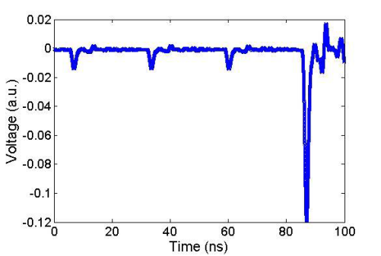
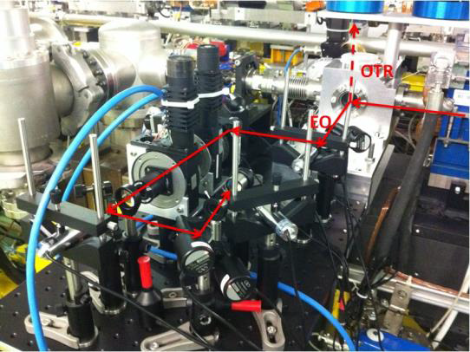
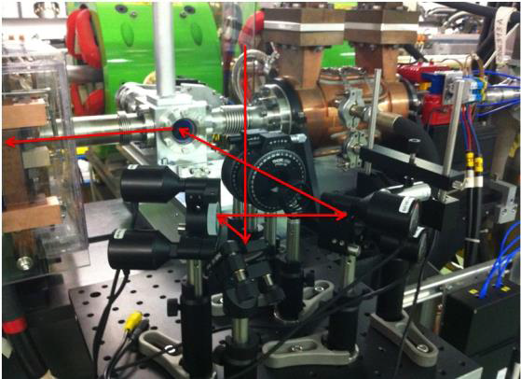
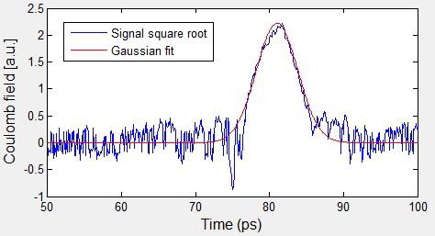
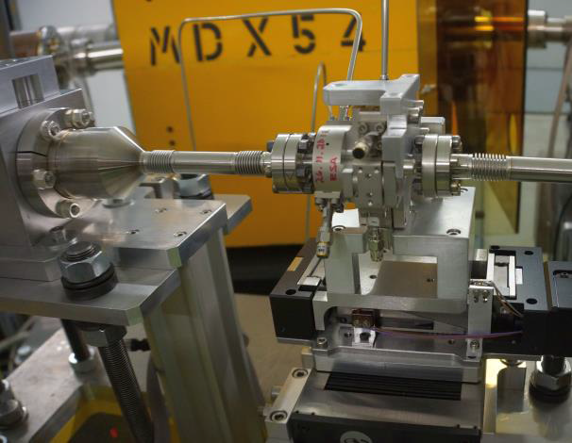
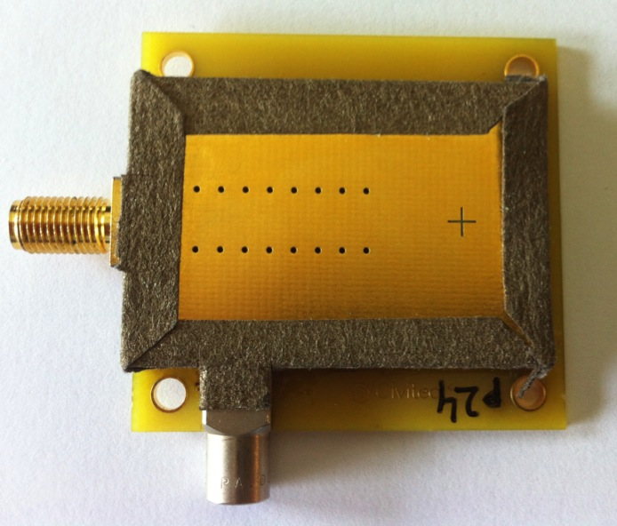
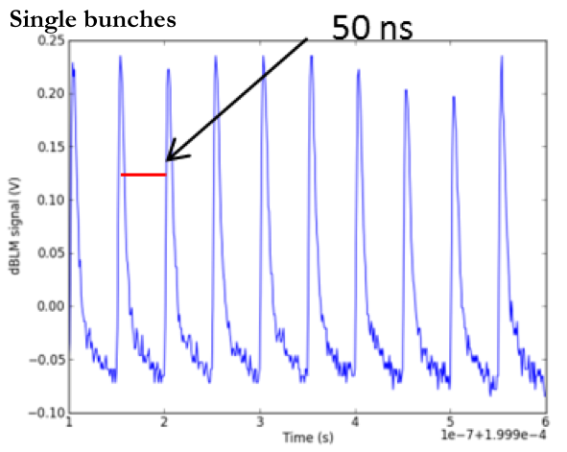
Some diagnostics test in 2014
Extraction
Injection
PhD Thesis of R. Pan
Electro Optical Sampling (EOS) for bunch length measurement
F. Cullingam J. Towler
Diamond beam loss detectors
High resolution cavity BPM
F. Burkart, O. Stein,
E. Nebot Del Busto

Slide 6
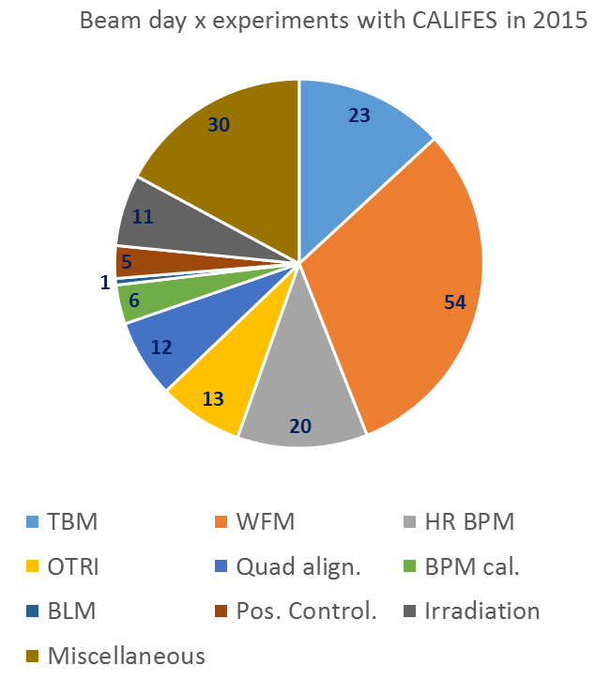
Experiments with CALIFES in 2015
Test Beam Module : 23 days W. Farabolini & Drive Beam Team
Wake Field Monitors : 54 days R. Lillestol et al.
High Resolution Cavity BPMs : 20 days J. Towler
Interferometric OTR : 13 days R. Kieffer
Beam alignment in Quadrupoles : 12 days N. Aftab, S. Javeed
Califes Cavity BPMs calibration : 6 days N. Aftab, S. Javeed
Beam Loss Monitor: 1 day M. Kastriotou
Girders positions control : 5 days V. Rude, M. Duquenne
Irradiation Test Bench : 11 days R. Alia et al.
Strip Line BPMs A. Benot Morell
Miscellaneous : 30 days (beam preparation, development, studies non referenced in the log-book…)
Total: 175 days (users x days)
Klystron MKS30 for PHIN : 5 weeks
Very high beam reliability (almost no non-programmed unavailable day)

Slide 7

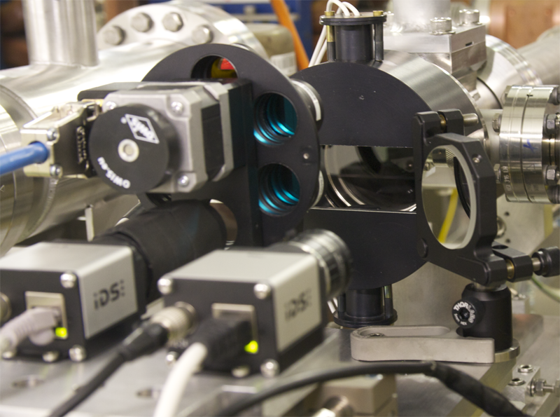
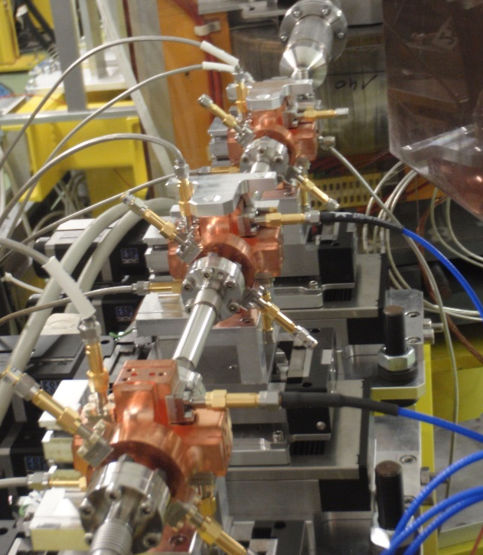
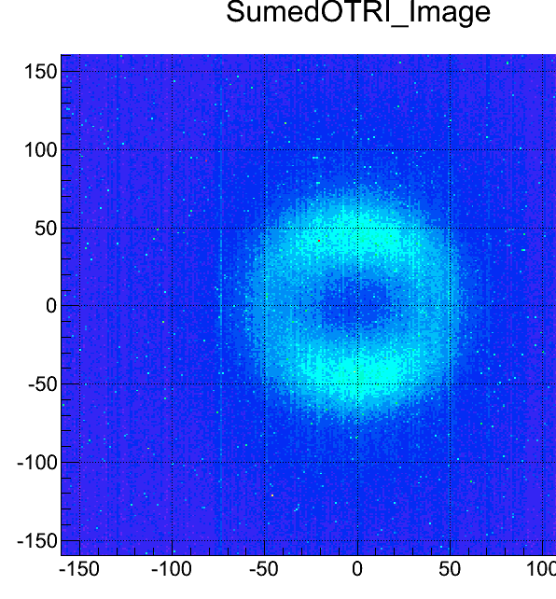
Some installed experiments in 2015
Optical Transition Radiation Interferences (R. Kieffer, T. Lefevre)
3 High Resolution Cavity BPMs on motorized stages
(J. Towler, M. Wendt, A. Lyapin, S. Boogert)
The ESA monitor aligned before test (M. Tali, R. Garcia Alia)

Slide 8
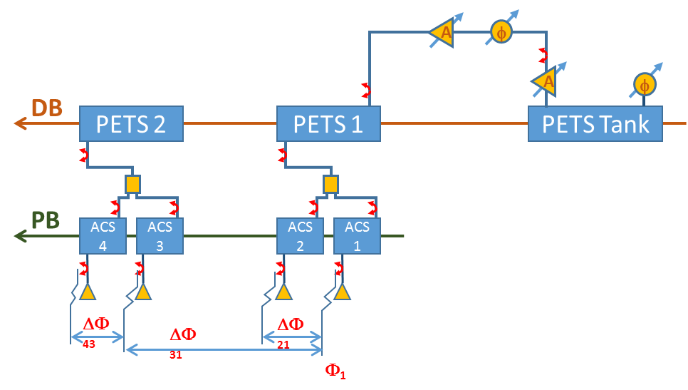
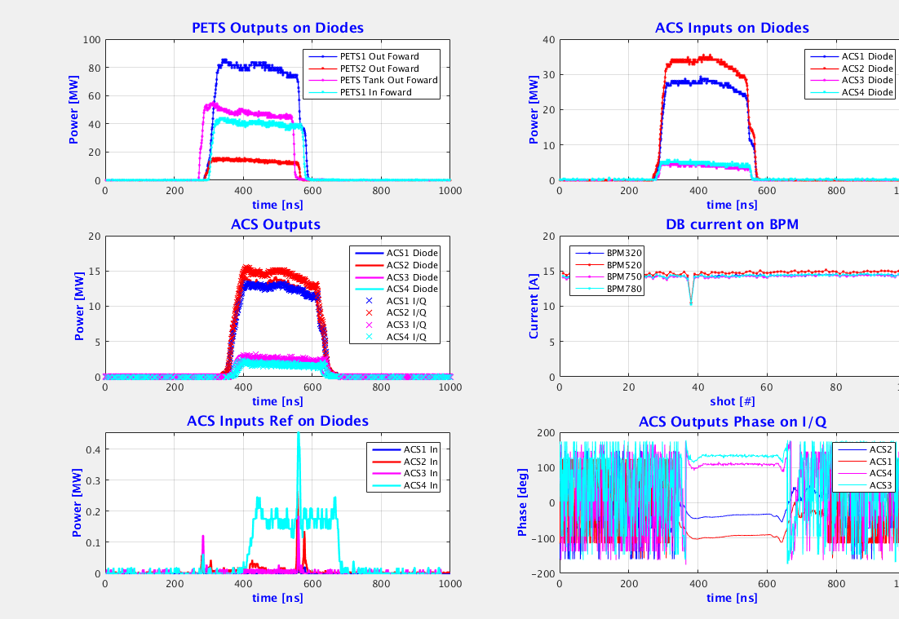
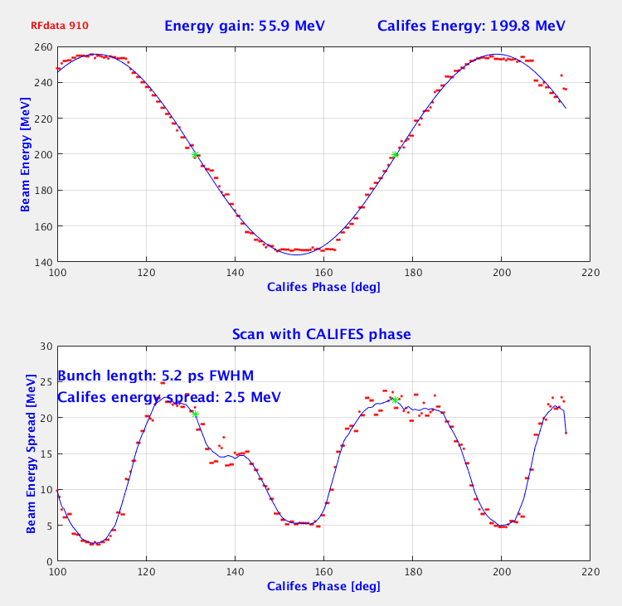
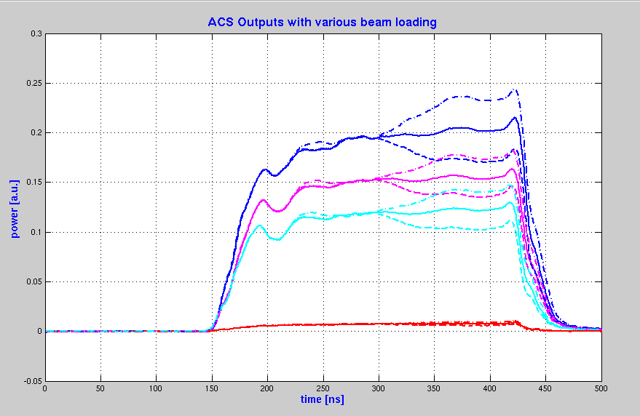
And for 2016
Intense activity on the CLIC Module before shutdown
  High gradient performances with DB factor 4, and now 8
  Use of the octupolar component for structures alignment
  Wake Field Monitor resolution
  Wakefield transverse kicks
  Use of the 12 GHz cavities to measure bunch length
RF scheme
Beam loading (and anti-loading) with CALIFES long train visible on ACSs output coupler
RF control panel
Energy and energy spread as function of CALIFES phase

Slide 9
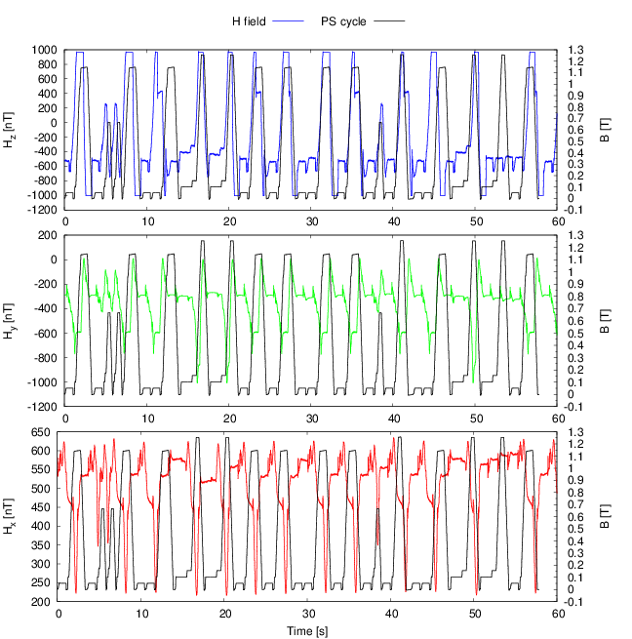
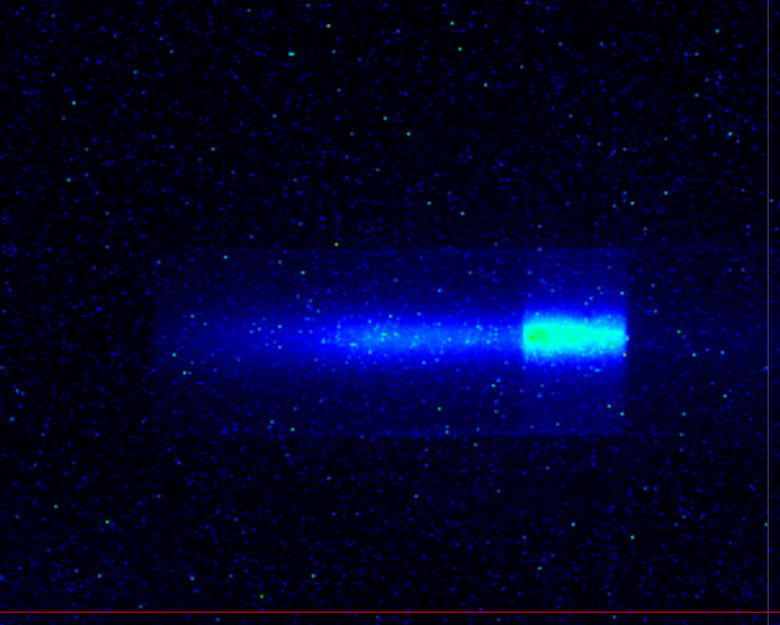
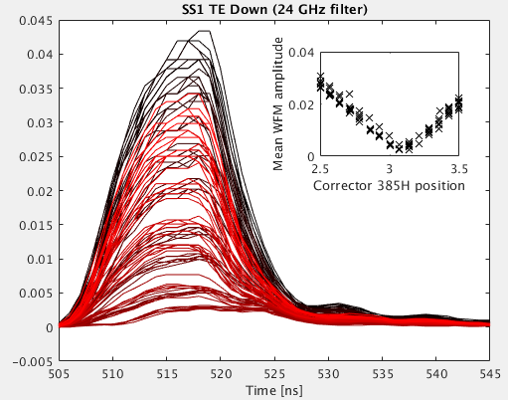
And still ‘external’ user experiments
Cherenkov radiation
(R. Kieffer, T. Lefevre)
Wakefield monitors scan (R. Lillestol)
Magnetic stray field measurements
(E. Marin Lacoma)

Slide 10
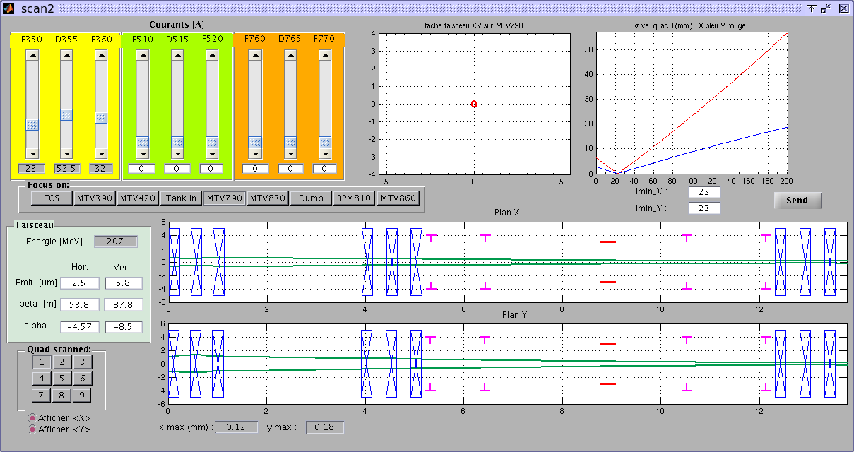
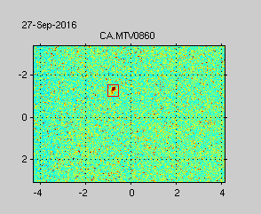
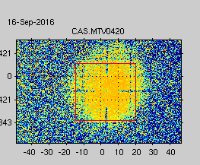
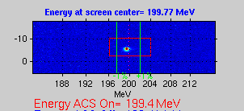
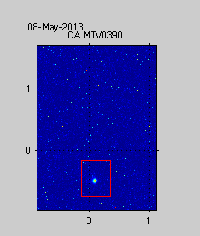
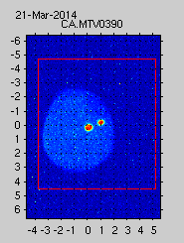
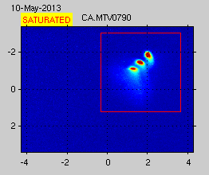
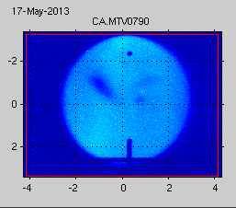
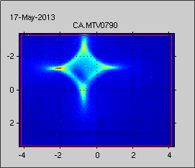
A flexible and pretty well controlled beam
Single bunch beam for high resolution cavity BPM study
Low energy spread: 0.7 MeV
Dark current beam for irradiation 34 mm FWHM
A versatile laser beam operated by skilled specialists helps a lot: F. Friebel, C. Hessler, M. Martinov
Current in quadrupoles -> beam envelope
Without RF power
At zero-crossing (rising RF power side)
At zero-crossing (falling RF power side)
Large flat beam for octupolar component study
30 μm 1σ beam
Separated bunches

Slide 11

Conclusions
CALIFES has proven to be capable to reliably provide an electron beam with a large range of parameters to various users.
We are already operating with a user facility spirit
  flexibility
  assistance to the teams
And above all: enthusiasm for novel experiments
Thank you for your attention
?

