Slide 1
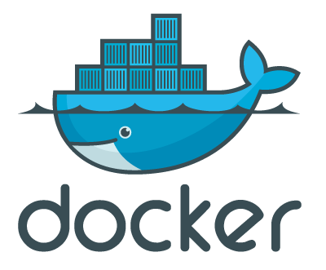
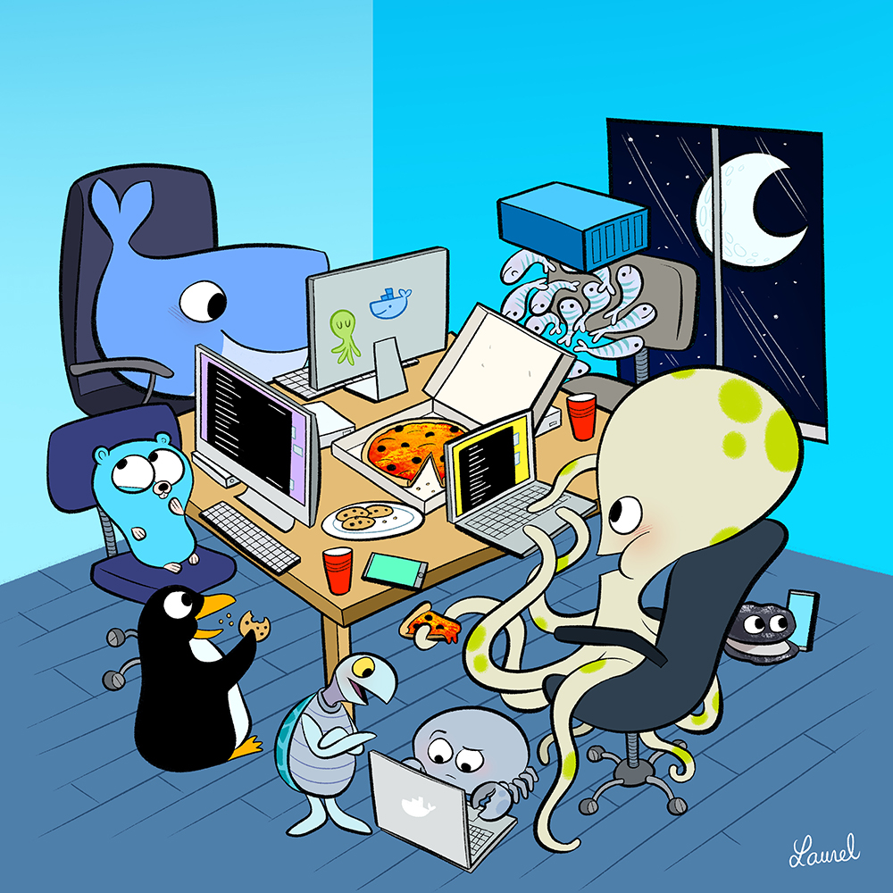
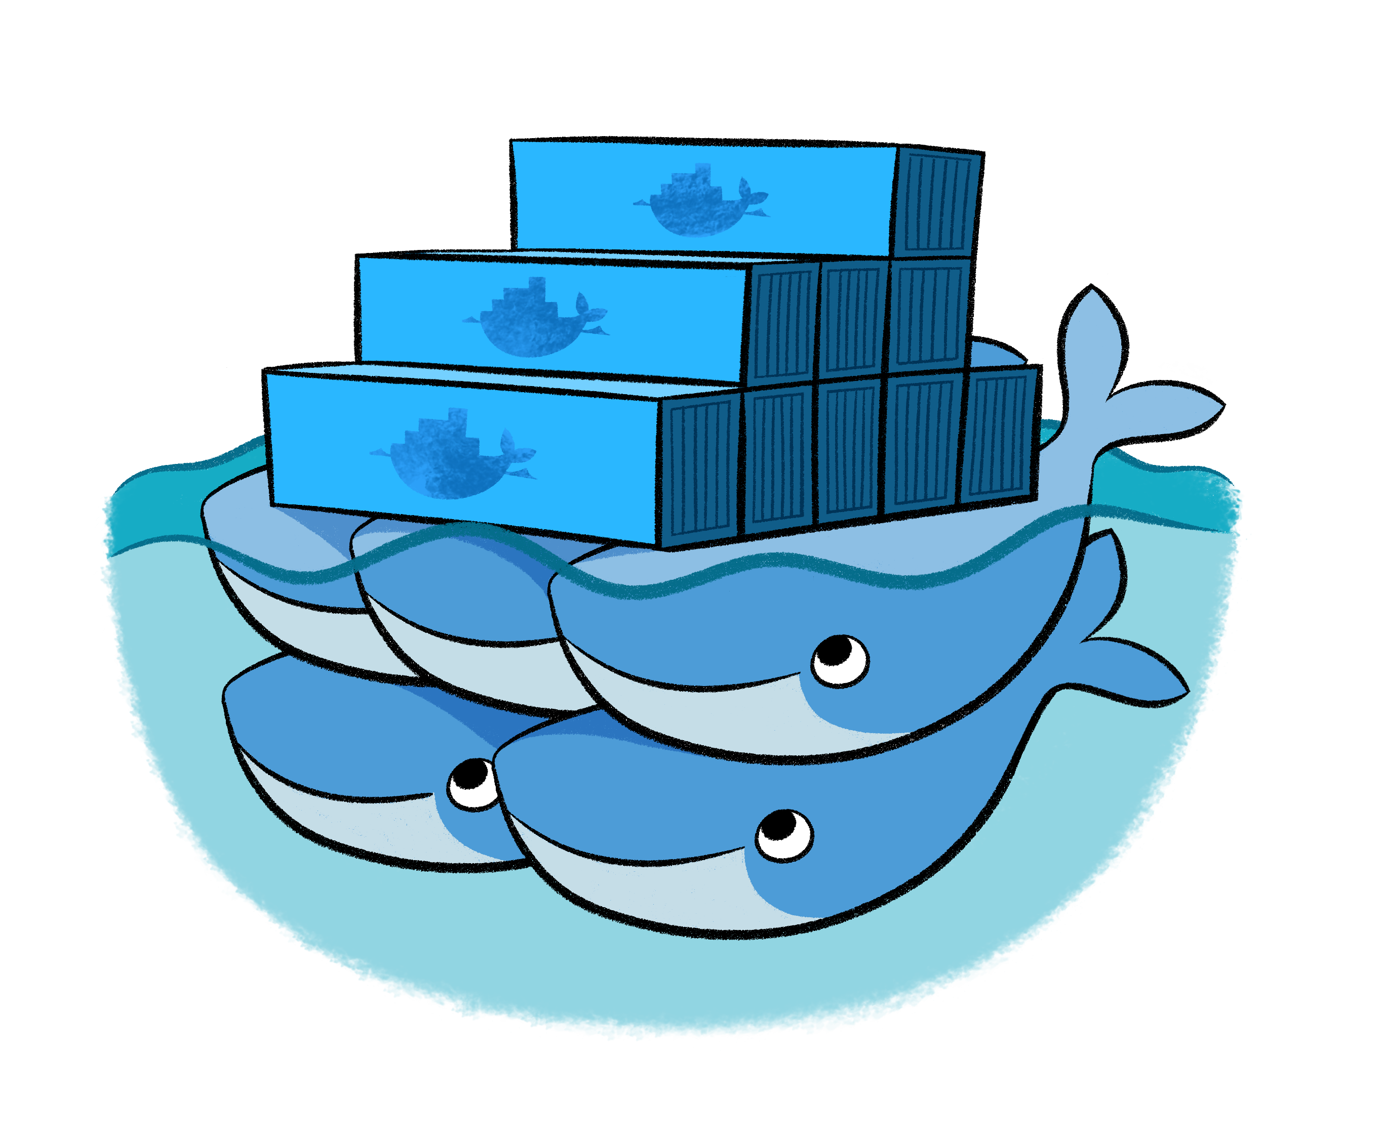
Introduction to Docker
Axel Voitier – CERN BE/ICS
Workshop – 30th of May 2015
Notes:
1

Slide 2
Containers

Slide 3
Container philosophy
Simply execute a program
Anywhere you want
Whatever it is
With its complete set of dependencies
28/05/2015
ICE Tea - Axel Voitier, CERN EN/ICE
3

Slide 4
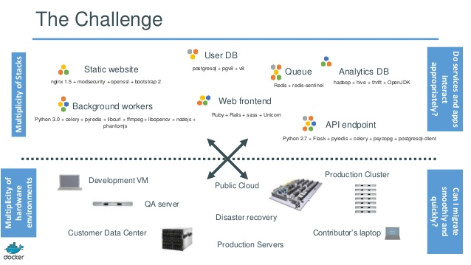
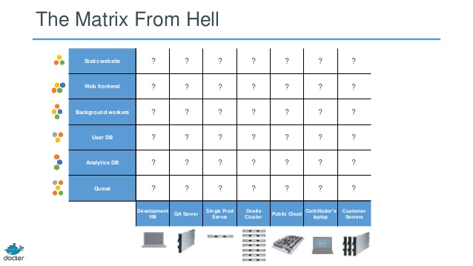
Why?
28/05/2015
ICE Tea - Axel Voitier, CERN EN/ICE
4

Slide 5
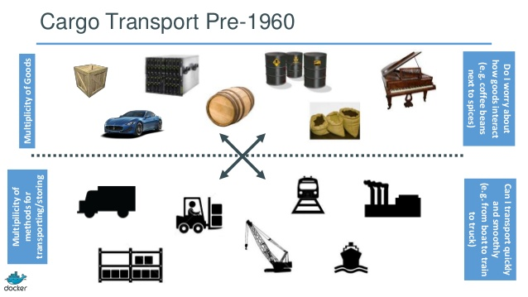
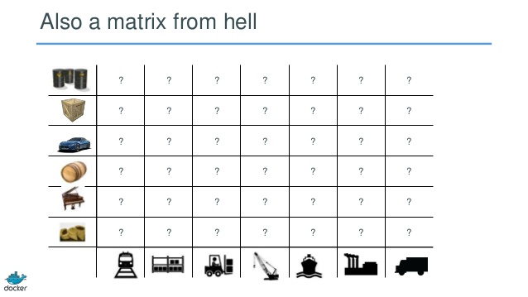
Didn’t it already happened in human history?
28/05/2015
ICE Tea - Axel Voitier, CERN EN/ICE
5

Slide 6
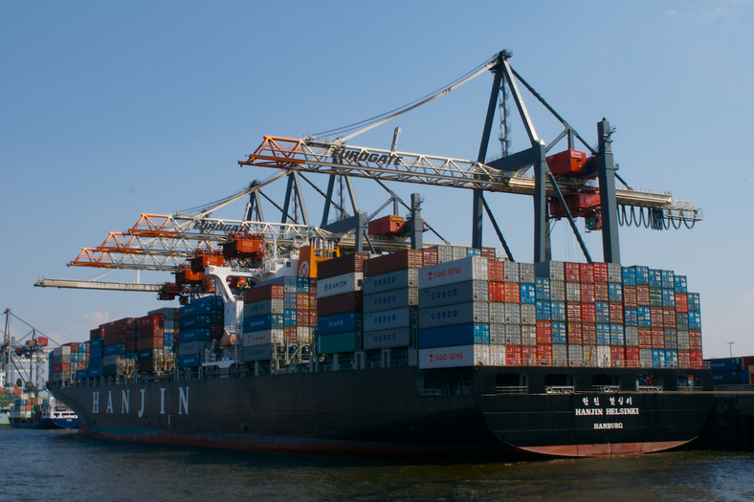
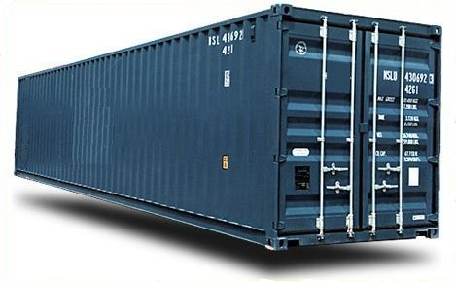
Didn’t someone already solved that?
28/05/2015
ICE Tea - Axel Voitier, CERN EN/ICE
6

Slide 7
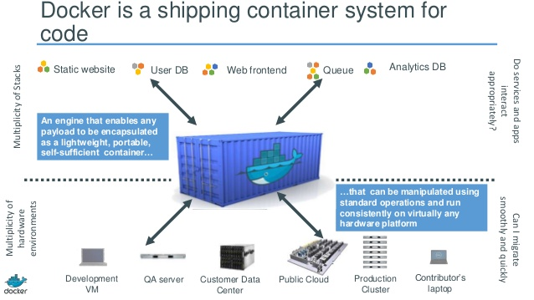
Can we reuse it?
28/05/2015
ICE Tea - Axel Voitier, CERN EN/ICE
7

Slide 8
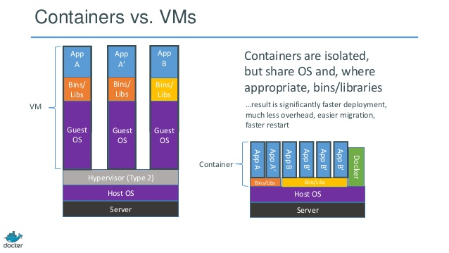
So… it’s a VM?
28/05/2015
ICE Tea - Axel Voitier, CERN EN/ICE
8

Slide 9
What is it then?
Process isolation
Same kernel than host
28/05/2015
ICE Tea - Axel Voitier, CERN EN/ICE
9

Slide 10
What is it then?
Process isolation
Separated execution environment
28/05/2015
ICE Tea - Axel Voitier, CERN EN/ICE
10

Slide 11
What is it then?
Process isolation
File system isolation
(layers + copy on write)
28/05/2015
ICE Tea - Axel Voitier, CERN EN/ICE
11

Slide 12
What is it then?
Process isolation
Security attributes
Kernel Namespaces
File systems Mount
Name/Domain Identifiers
Inter Process Communication
Network
Process ID
Users
Control groups
Resources:
CPU
Memory
28/05/2015
ICE Tea - Axel Voitier, CERN EN/ICE
12

Slide 13
Show me Show me Show me!
avoitier@pcen33943:~$ docker run -it ubuntu:14.04.2 /bin/bash
Unable to find image 'ubuntu:14.04.2' locally
Pulling repository ubuntu
07f8e8c5e660: Pulling image (14.04.2) from ubuntu, endpoint: https://registry-1.07f8e8c5e660: Download complete
e9e06b06e14c: Download complete
a82efea989f9: Download complete
37bea4ee0c81: Download complete
Status: Downloaded newer image for ubuntu:14.04.2
root@c15650832436:/#
28/05/2015
ICE Tea - Axel Voitier, CERN EN/ICE
13

Slide 14
Others!
avoitier@pcen33943:~$ docker run -p 8080:8080 jenkins
…
avoitier@pcen33943:~$ docker run -it --rm logstash logstash -e 'input { stdin { } } output { stdout { } }'
Logstash startup completed
Hello
2015-05-28T20:20:37.882Z ea4dddcd396e Hello
avoitier@pcen33943:~$ docker run --name some-drupal -p 8080:80 -d drupal
f8b866f46ab0eb3b81f5b2c9983f4a1368cfa6eaf8b1f59bc23b13f52aea6945
All three are images provided “officially”
28/05/2015
ICE Tea - Axel Voitier, CERN EN/ICE
14

Slide 15
Images

Slide 16
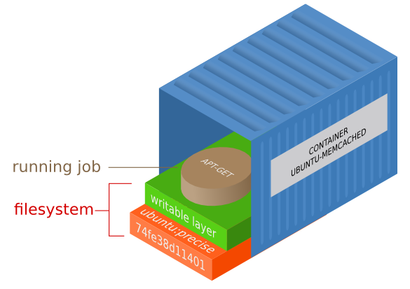
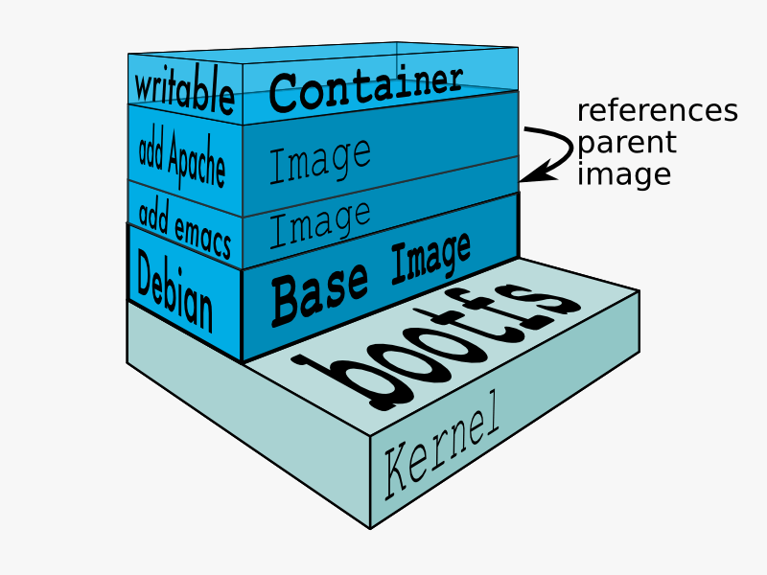
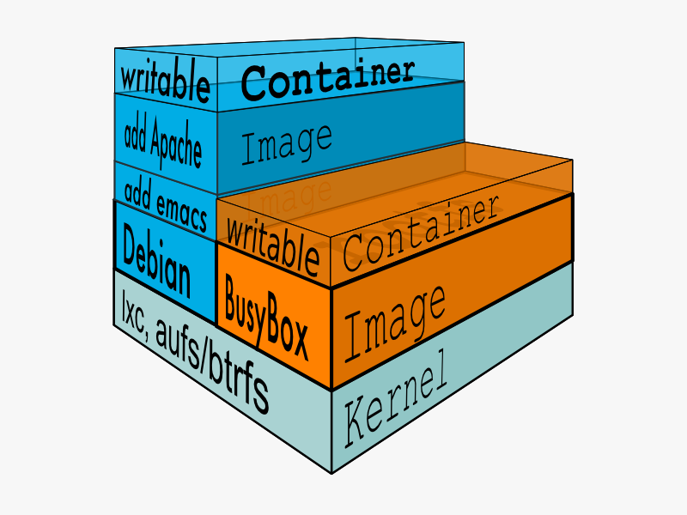
Images?
28/05/2015
ICE Tea - Axel Voitier, CERN EN/ICE
16

Slide 17
How do you make an image?
Dockerfiles!
FROM java:8u45-jdk
# Install maven
RUN apt-get update
RUN apt-get install -y maven
WORKDIR /code
# Prepare by downloading dependencies
COPY pom.xml /code/pom.xml
RUN mvn dependency:resolve
RUN mvn verify
# Adding source, compile and package into a fat jar
COPY src /code/src
RUN mvn package
EXPOSE 4567
CMD ["java", "-jar", "target/sparkexample-jar-with-dependencies.jar"]

Slide 18
How do you build an image?
avoitier@pcen33943:~$ docker build -t axelvoitier/java-spark-hello-world .
… Lots of output …
Successfully built 326e52248099
avoitier@pcen33943:~$ docker run -d -p 4567:4567 axelvoitier/java-spark-hello-world
…

Slide 19
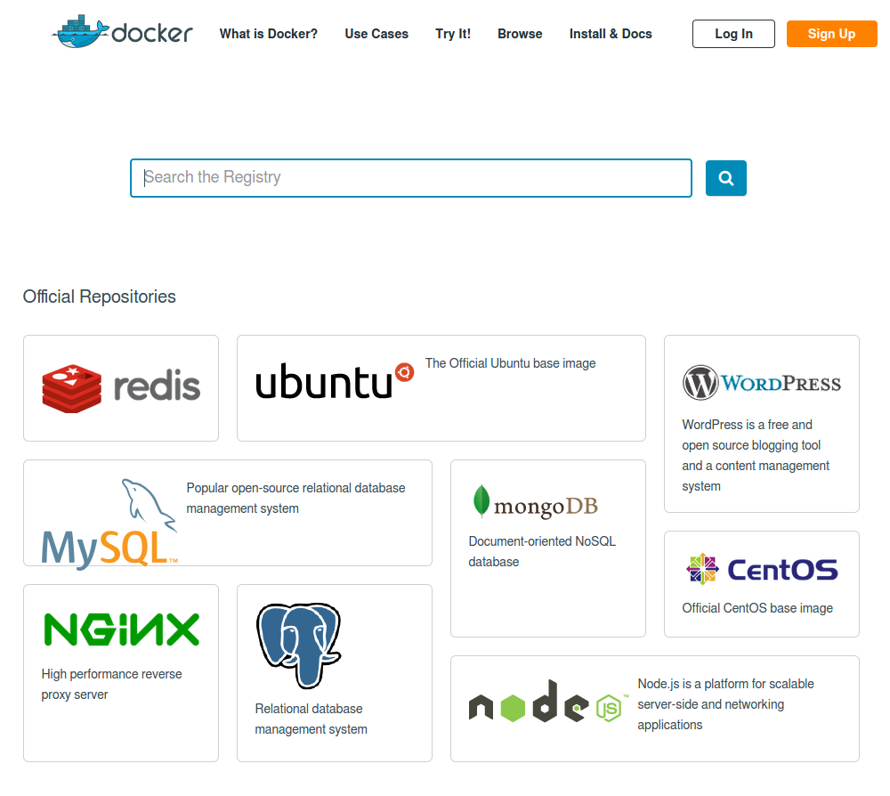
And where can I find other images?
The registry hub!
https://registry.hub.docker.com
(also instanceable by yourself as a container for your own private registry ☺)
28/05/2015
ICE Tea - Axel Voitier, CERN EN/ICE
19

Slide 20
Container philosophy, extended
Simply execute a program
Anywhere you want
Whatever it is
With its complete set of dependencies
Write once, run everywhere
28/05/2015
ICE Tea - Axel Voitier, CERN EN/ICE
20

Slide 21
Docker Machine & Swarm

Slide 22
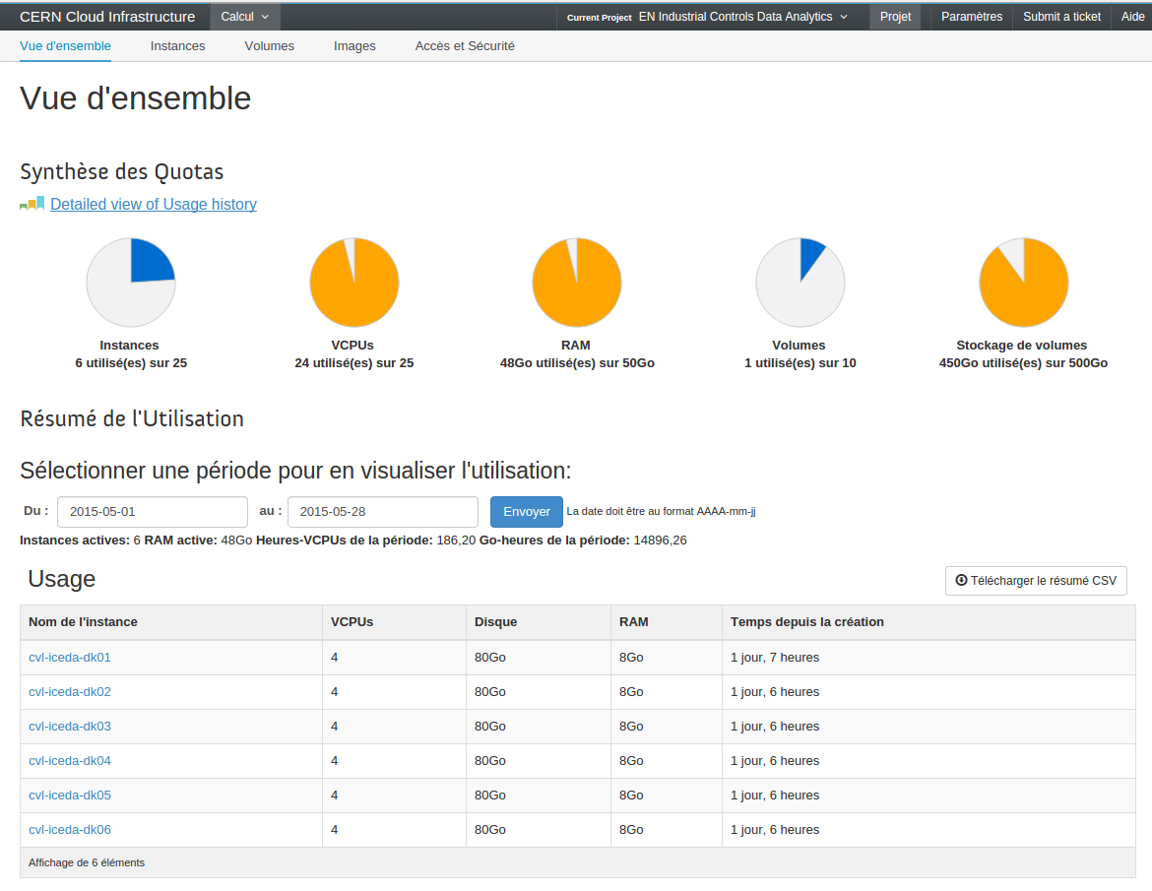
28/05/2015
ICE Tea - Axel Voitier, CERN EN/ICE
22

Slide 23
Your own docker swarm!
avoitier@hpen33120:~/machine swarm$ docker info
Containers: 7
Strategy: spread
Filters: affinity, health, constraint, port, dependency
Nodes: 6
cvl-iceda-dk01: 188.184.162.81:2376
└ Containers: 2
└ Reserved CPUs: 0 / 4
└ Reserved Memory: 0 B / 8.188 GiB
cvl-iceda-dk02: 128.142.134.48:2376
└ Containers: 1
└ Reserved CPUs: 0 / 4
└ Reserved Memory: 0 B / 8.188 GiB
cvl-iceda-dk03: 128.142.136.45:2376
└ Containers: 1
└ Reserved CPUs: 0 / 4
└ Reserved Memory: 0 B / 8.188 GiB
cvl-iceda-dk04: 128.142.136.37:2376
└ Containers: 1
└ Reserved CPUs: 0 / 4
└ Reserved Memory: 0 B / 8.188 GiB
cvl-iceda-dk05: 128.142.163.114:2376
└ Containers: 1
└ Reserved CPUs: 0 / 4
└ Reserved Memory: 0 B / 8.188 GiB
cvl-iceda-dk06: 128.142.192.102:2376
└ Containers: 1
└ Reserved CPUs: 0 / 4
└ Reserved Memory: 0 B / 8.188 GiB

Slide 24
Spreading the load over 6 nodes
avoitier@hpen33120:~/machine swarm$ docker info
Containers: 30
Strategy: spread
Filters: affinity, health, constraint, port, dependency
Nodes: 6
cvl-iceda-dk01: 188.184.162.81:2376
└ Containers: 5
└ Reserved CPUs: 0 / 4
└ Reserved Memory: 0 B / 8.188 GiB
cvl-iceda-dk02: 128.142.134.48:2376
└ Containers: 5
└ Reserved CPUs: 0 / 4
└ Reserved Memory: 0 B / 8.188 GiB
cvl-iceda-dk03: 128.142.136.45:2376
└ Containers: 5
└ Reserved CPUs: 0 / 4
└ Reserved Memory: 0 B / 8.188 GiB
cvl-iceda-dk04: 128.142.136.37:2376
└ Containers: 5
└ Reserved CPUs: 0 / 4
└ Reserved Memory: 0 B / 8.188 GiB
cvl-iceda-dk05: 128.142.163.114:2376
└ Containers: 5
└ Reserved CPUs: 0 / 4
└ Reserved Memory: 0 B / 8.188 GiB
cvl-iceda-dk06: 128.142.192.102:2376
└ Containers: 5
└ Reserved CPUs: 0 / 4
└ Reserved Memory: 0 B / 8.188 GiB

Slide 25
Networking

Slide 26
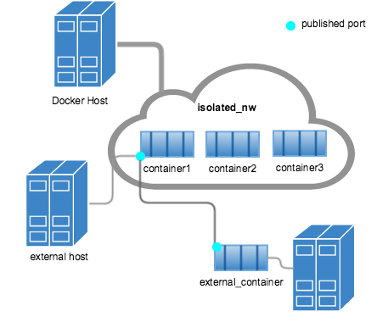
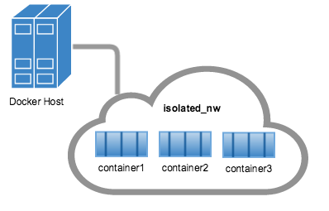
Simple networking

Slide 27
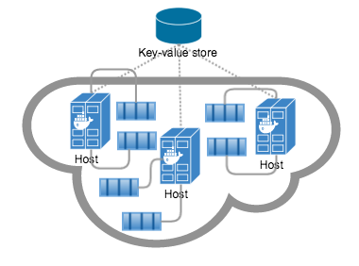
Multi-host networking

Slide 28
Security

Slide 29
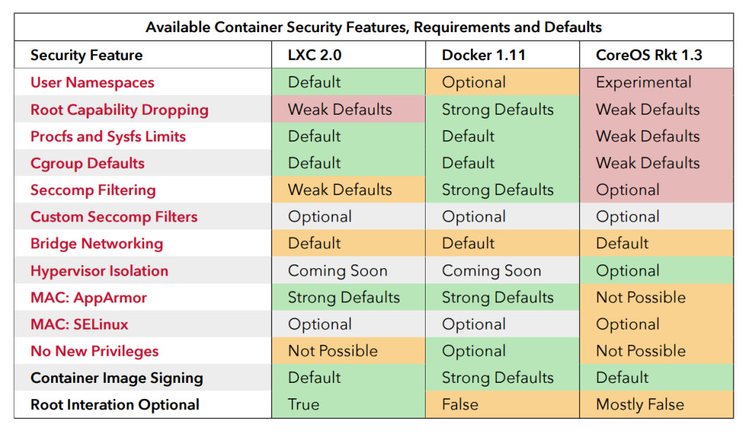
Security features

Slide 30
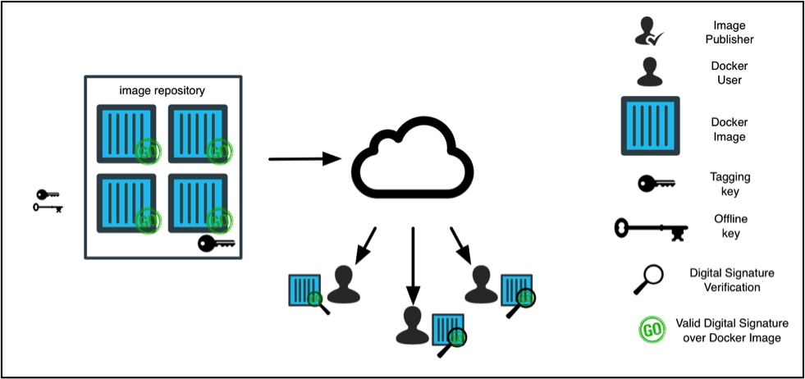
Security: Docker Content Trust

Slide 31
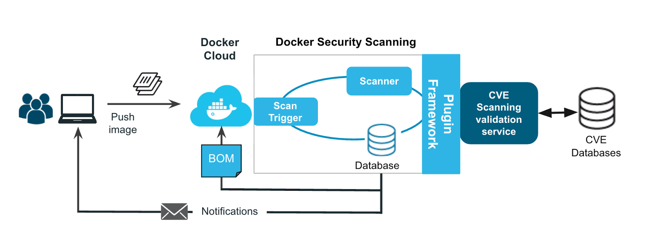
Security Scanning

