Slide 1


18th May 2016
TSG41 Chiller decision v0r1

Slide 2
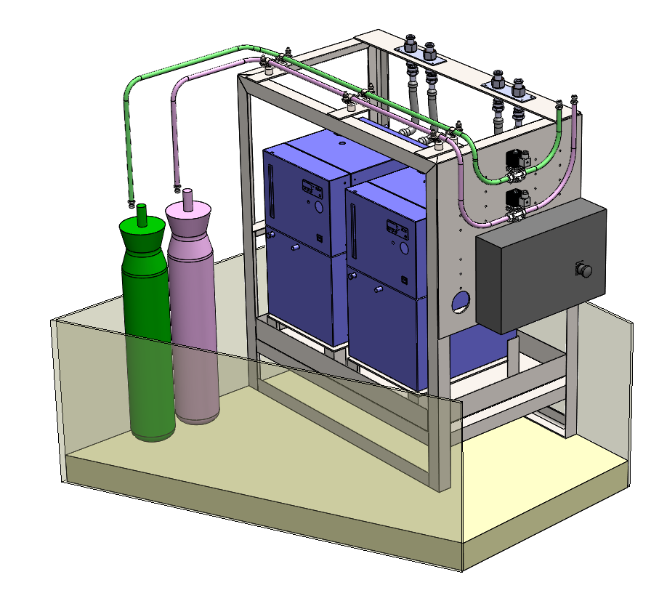
TSG41 Module Concept
Decision on type of chiller to be used in TSG41 module (air cooled or water cooled)

Slide 3
TSG41 Module - Chillers
Huber model | Unichiller-007 | Unichiller-012w
Type | Air cooled | Water cooled
Cooling power (W @ 15°C) | 700 | 1200
Fill (l) | 3.8 | 3.8
Temperature stability (°C) | ±0.5 | ±0.5
Size (mm) | 350 x 430 x 622 | 350 x 430 x 622
Weight (kg) | 57 | TBC
Heat output per chiller (kW) | 1.26 | 2.16
TSG area heating (kW) | 2.5kW into air | 4.3kW into water
Approx cost | 4840 EUR | TBC EUR

Slide 4
TSG41 Module Concept
Air heating into TSG41 module ‘room’ is 2.5kW – need to understand if this can be managed
We still currently have a preference for air cooled chillers since:
No additional water system required (simpler)
Air chillers can run unattended (water to water cooled chillers needs to be turned off when chiller not in use)
Chillers are special to accommodate Galden (different internal seals required) so lead time needs to be accommodated

