Slide 1

MTF Q1/Q3
EDMS: 1689048
Dressed Coil produced at Berkeley
Project Office – Configuration, Quality & Resources Office
Configuration, Quality and Resources Office – Berkeley Lab.

Slide 2
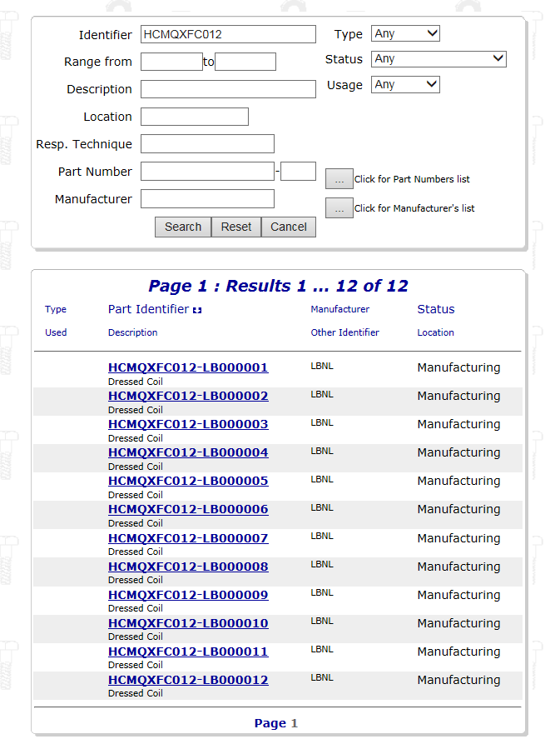
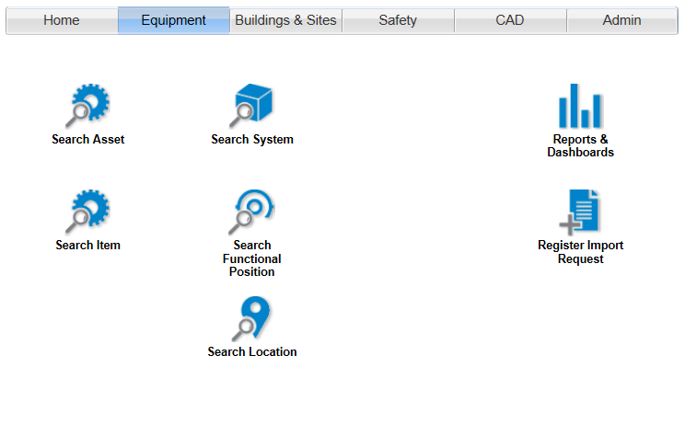
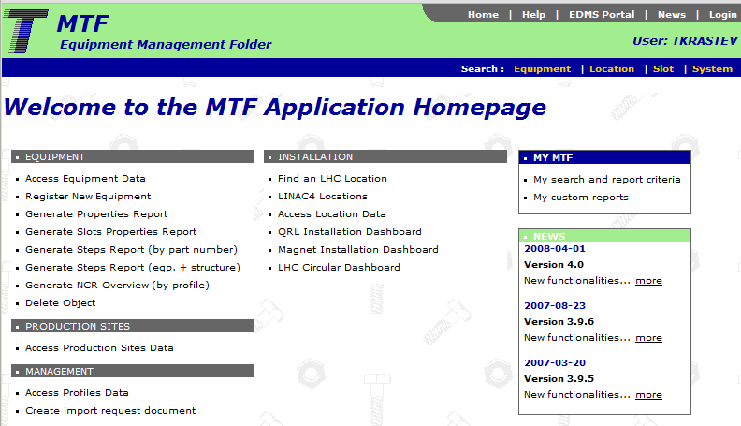
Access to MTF
We may access to the MTF of each asset through EDMS, Equipment Search (1), or directly from MTF Application Homepage (2) either
1
2

Slide 3
Access to MTF
Items/Assets?
We can see the number of assets (physical entity/ies produced from one design) that belong to an item (conceptual entity)
How we may see the assets?
We introduce the name of the item and therefore we will see the number of assets that will be manufactured from this item

Slide 4
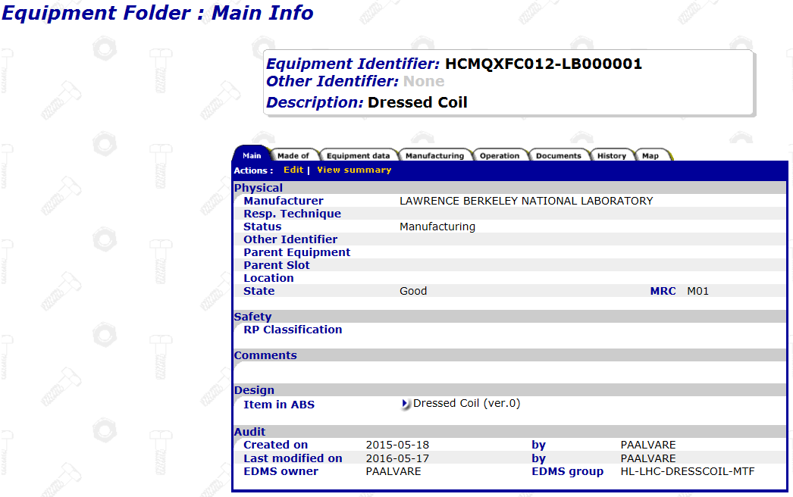
MTF Assets
Each asset will have its Manufacturing and Testing Folder (MTF), where all documentation/data generated during the FAV & Installation will be stored.
If you have the access rights, you can use the ‘Edit’ button to change the status, manufacturer, state and other information about equipment

Slide 5
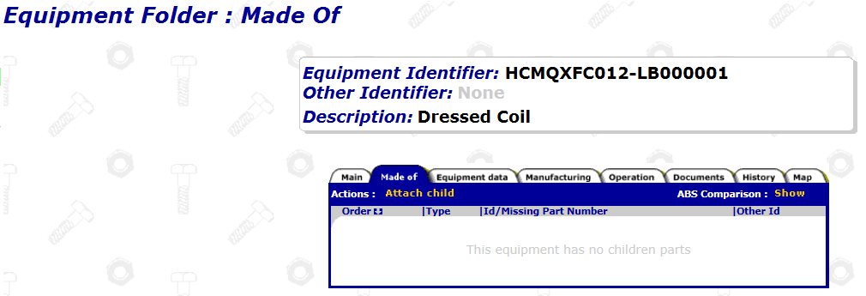
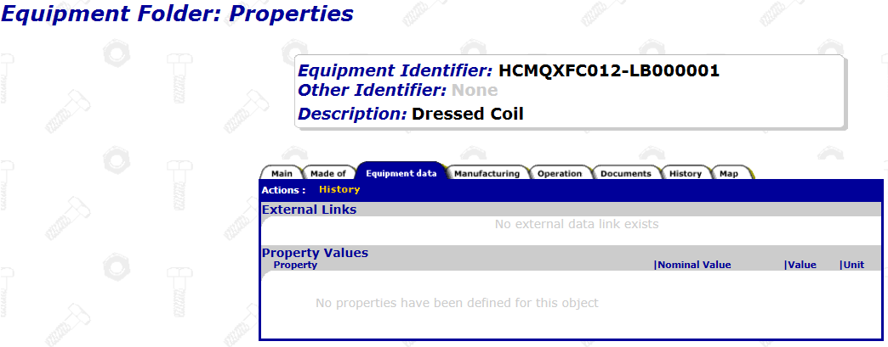
Equipment data & Properties
Subcomponents of the asset can be defined within the MTF of the asset
Nominal values can be displayed in this tab.
Results obtained can be introduced to see the actual data of the asset.

Slide 6
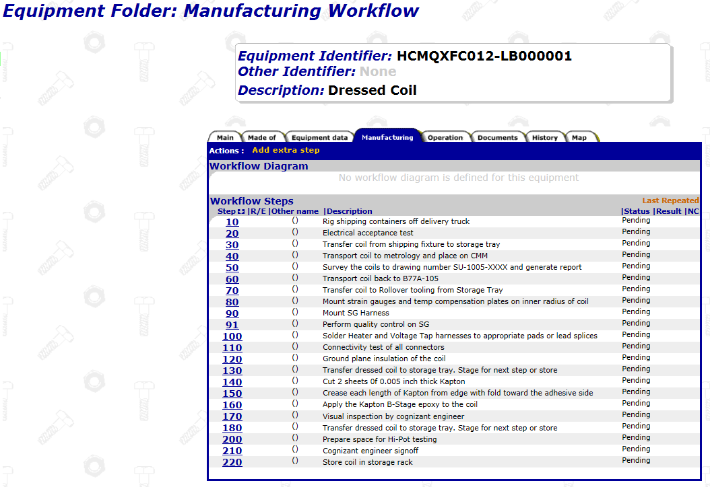
Manufacturing Workflow
Input provided by Supplier
Before starting the production, productions steps (manufacturing and QC) to be settled (MIP provided by supplier):
Implementation on MTF
Feed MTF folder of each asset during the production

Slide 7
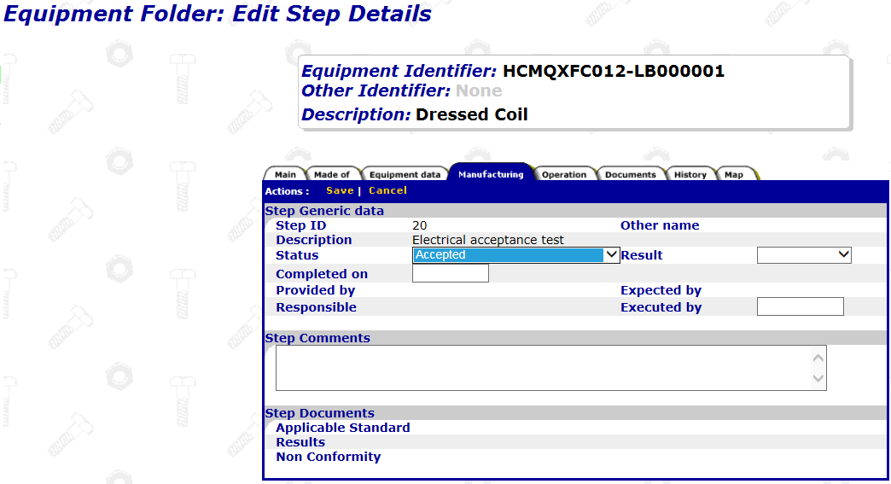
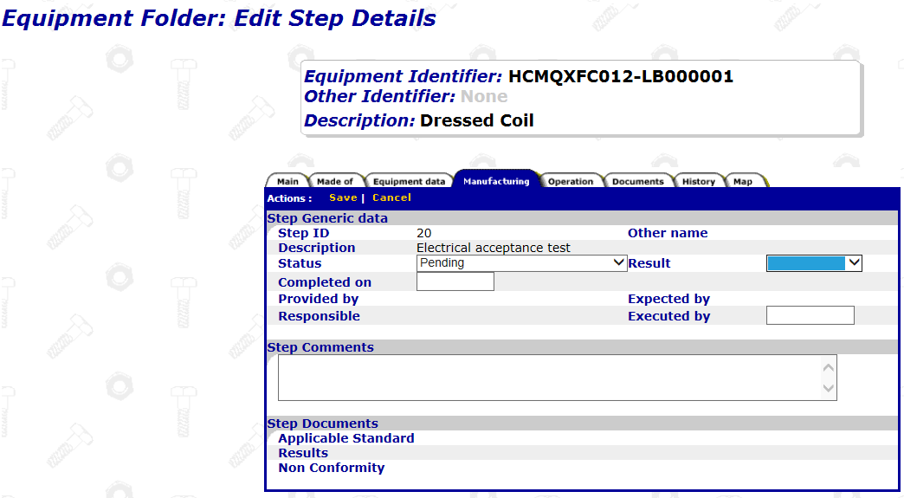
Approval of steps
Each step to be approved upon completion. We click in the Workflow Step number and then we EDIT to give the acceptance of the step and results OK (if the step would not have been accepted, then in results we select Not OK)

Slide 8
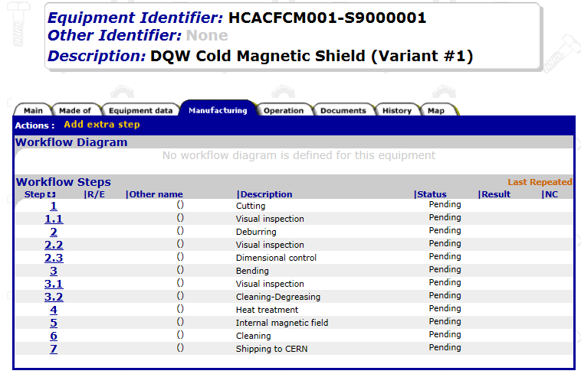
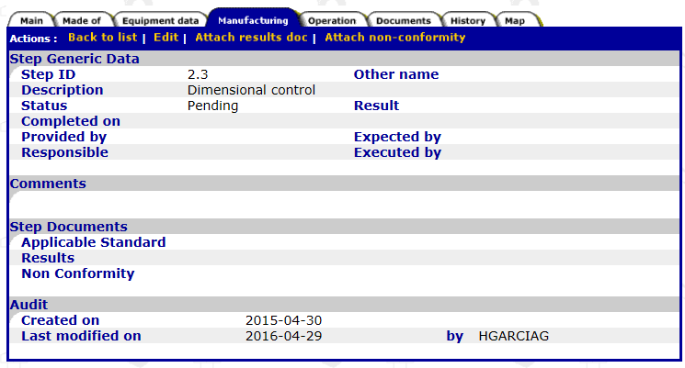
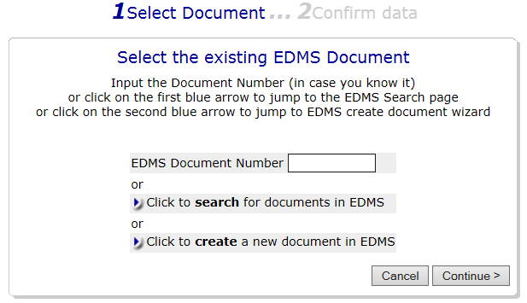
Manufacturing Documentation
Reports and documents related to each step to be attached in the MTF folder of each asset. Documents can be previously uploaded on EDMS or can be attached directly in MTF (if so, EDMS document is created automatically)
The step is approved and the report with results is attached.
If the step is not approved and a Non Conformity is opened, we can also attach it
Document to attached from EDMS or directly on the step (it will be then automatically created on EDMS)
The document associated to this step of the asset is attached in MTF.
This process to be repeated for each asset

Slide 9
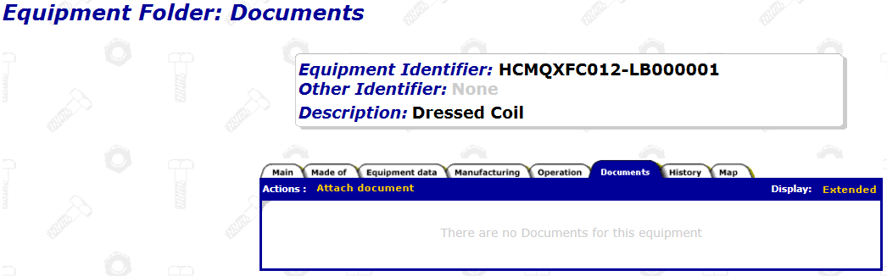
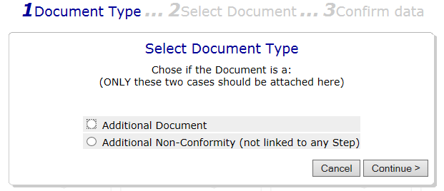
Other documents to be attached
Any other document can be attached to the MTF of the asset:
Material certificates
Procedures applicable
Manufacturing drawings
MIP
Welding maps
Etc.

Slide 10
Thanks for your attention

