Slide 1
AWAKE Software
Low-level FESA server
Expert application(s)
OP applications
  Timber logging (off-line)
  YASP (on-line)
Next steps

Slide 2
FESA server #1
RT actions:
  Prepare (1 second before SPS fast extraction)
    Handle on-line calibration (-6dB, 0dB, +6dB)
    Prepare acquisition (arm)
  Acquire (n msec after fast SPS extraction)
    Read-out acquisitions
    Normalise to positions (mm)
    Publish results

Slide 3
Beam position normalisation
For all BPMs – setting: nbBeforeMax, nbAfterMax
For each of 16 BPMs 2 2 VFCs (Hor/Ver)
  If FPGA status says data available
    Read raw delta and sum and store (200 samples each)
    Find maximum in sum and store sample index (sumMaxIndex)
    Find average of all delta samples in the range:
      aveDelta => (sumMaxIndex – nbBeforeMax) -> (sumMaxIndex + nbAfterMax)
    Find scaling-factor:
      calLevel_dB = 6 or? Nf = (-1 + 10^(6./20)) / (+1 + 10^(6./20)) = 0.332
    Scale = bpmKf * Nf * 0.5 * (CAL_ADC_+6dB – CAL_ADC_-6dB)
    Position = (Scale * (aveDelta – deltaOffset)) - geoOffset;
    Correct?

Slide 4
On-line calibration
Common for all BPMs
ExpertSetting:
  calibrationRequest (on/off)
  calibratorLeftDown (on/off)
  calibratorRightUp (on/off)
Data for each BPM
CalibrationData:
  calibrationHorDeltaRaw
  calibrationVerDeltaRaw
  calibrationHorSigmaRaw
  calibrationVerSigmaRaw

Slide 5
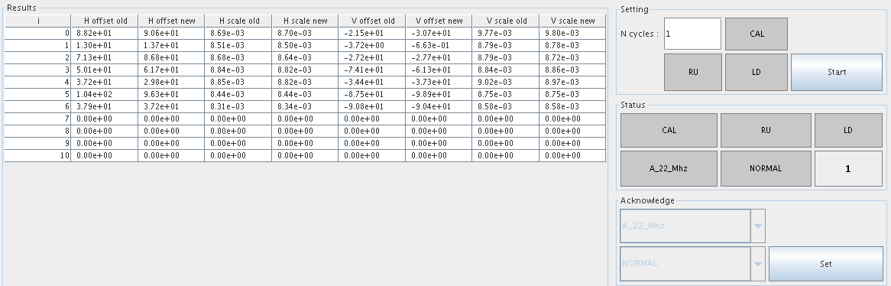
BI Expert application ‘Electrical Calibration’
Result: Calibration factors (offset and scale)

Slide 6
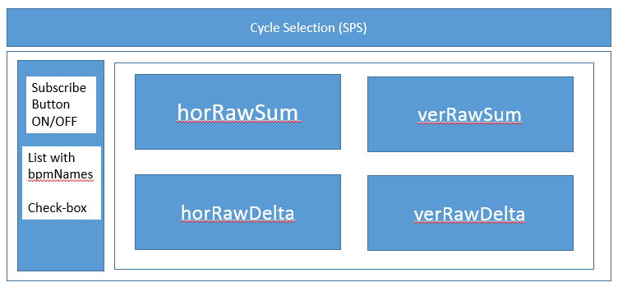
BI Expert application #2
Visualisation of raw signals for selected BPMs

Slide 7
Next steps
Introduction of hardware access library
Development and test of algorithms
Worries:
  Lack of test bench with realistic setup (calibration / beam)

