Slide 1


21st May 2016
Beamline components close out v0r1

Slide 2
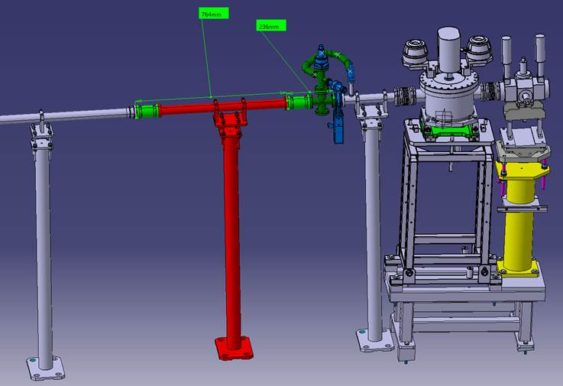
Sections (upstream & downstream) to be updated when vapour sources are ready (August)
Current beamline infill piece

Slide 3
Beamline components to be REUSED
DN16 CF to KF adaptor
Vacuum sensor
DN16 angle valve
Vacuum sensor
VACOM unequal cross (UX040016RS)
VACOM equal cross (X40RS)
CERN sector valve
DN40 flange cap

Slide 4
Beamline components NEEDED
Edge welded bellows DN16
DN16 elbow
Double sided DN40 flange
Edge welded bellows DN40
MPP valve

Slide 5
Beamline components
Please could the assumptions about component reuse be reviewed and approved in the next week
WDL will take responsibility for purchasing the following parts from VACOM
Description | VACOM part number | Qty (per end)
VACOM BELLOW DN16CF | EWB16R-10-316LNS | 1
VACOM DN40CF EDGE WELDED BELLOW | EWB40R-40-316LNS | 1
VACOM DN40CF DOUBLE SIDED FLANGE | F40D38-316LNS | 1
VACOM DN16CF ELBOW | EL16R-316 | 1
Also need both MPP protection valves (01032-CE44-BDF1) but these have already been purchased (currently in Munich)

Slide 6
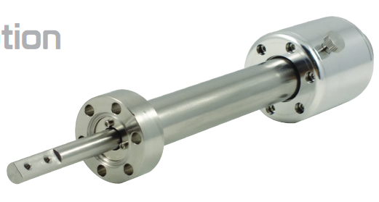
Other beamline components – linear positioner
We are using a linear positioner (MPPL16-100-H) to protect the chamber viewport
The linear positioner is magnetically coupled
Can it be confirmed that this is OK?
WDL will take responsibility for purchasing the following part

Slide 7
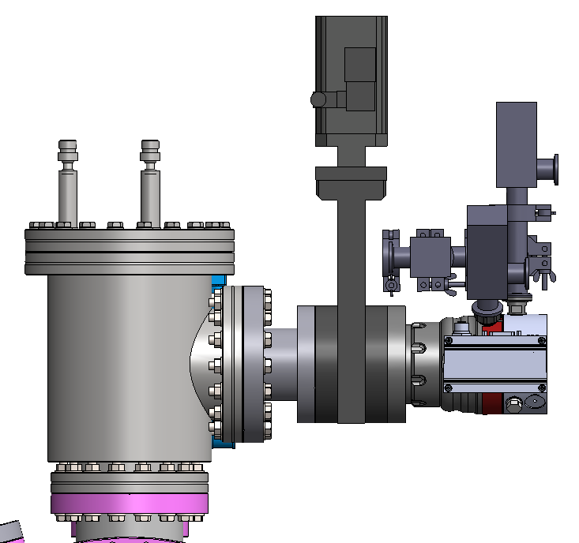
Other beamline components – vacuum system
Pumping group (TMP, valve & accessories)
CERN/MPP to supply
HSR cold trap
(on order)
Adaptor piece
VACOM TA100063R-316
WDL will purchase

Slide 8
Other beamline components – vacuum trolley
Vacuum trolleys required
CERN/MPP to supply
All interconnect flexihoses required for pumping system
CERN/MPP to supply

