Slide 1
CERN – WDL coordination
2nd weekly meeting
26.05.2016 – Sebastien Bustamante EN/EA/EC

Slide 2
Treated actions
(ref: Joint Meeting Action List 190516.xlsx )
Chiller unit (Action 13 and 19)
-> water fire pipe min. height for chiller integration OK
-> water cooled solution with pressure reducing valve at input (TBC, but should be ok)
  Lead times?
Argon bottle integration (Action 12)
  Can be integrated in the volume ?
  Should be ok (TBC)-> not necessary to adapt chiller unit structure

Slide 3
Treated actions
(ref: Joint Meeting Action List 190516.xlsx )
Confirm 3D forges sourcing route to Lesker (Action 20)
-> Measures have been taken to have the forged flanges sent to Lesker by the 28th (Still need to be confirmed on the 26th May)
Confirm free issue ship date of blanks to Lesker (Action 23)
-> A first batch has been shipped
-> A second one with the two remaining flanges will be shipped by the 28th May

Slide 4
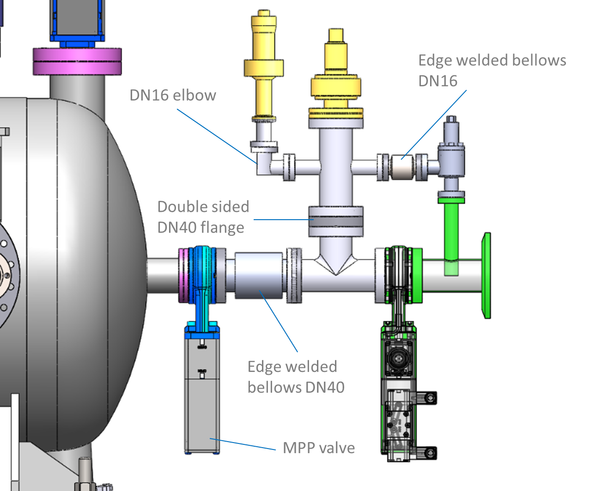
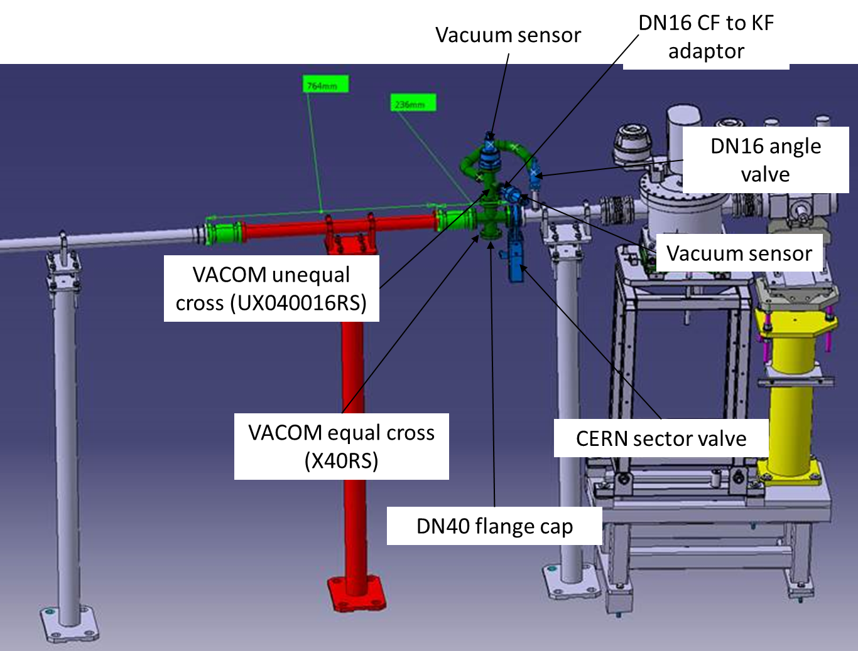
Open points
Beam line component reuse (Ref: Beam line components close out v0r1.ppt)
TBC
TBC
Length to be checked

Slide 5
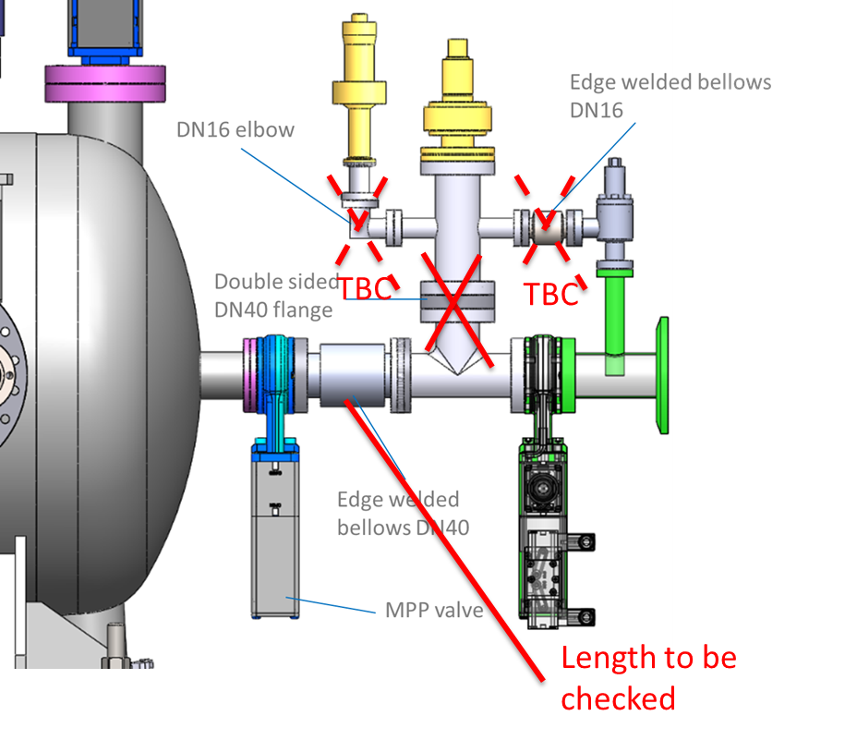
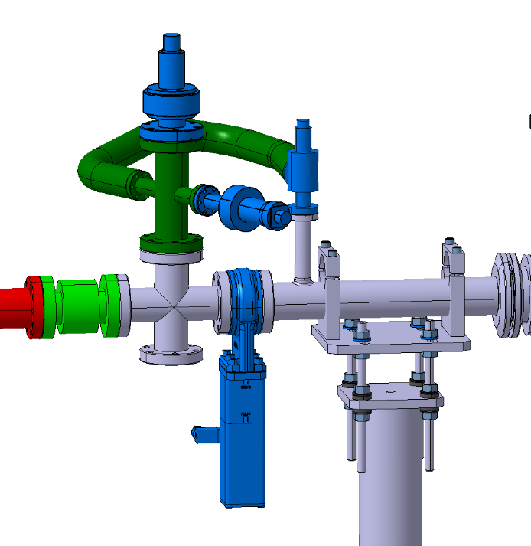
Open points
Beam line component reuse (Ref: Beam line components close out v0r1.ppt)
CERN layout for pumping group

Slide 6
Open points
Beam line component reuse (Ref: Beam line components close out v0r1.ppt)
  Linear positioner selected is not ok. A solution with compressed air shall be investigated
  Pumping group will be provided by CERN
  Vacuum trolleys + interconnect flexihoses will be provided by CERN

Slide 7
Open points
Use of the CERN compressed air network (action 21)
  After discussion with Jan, it seems that he sent to Patrick and WDL some technical description of the solution used here at CERN…
  -> I need these information to complete action 21
CAD files to be updated and shared
  Need to define a test protocol for above ground tests to start tests coordination plan (What? How? Who? When?)

