Slide 1

Proposal to drop Capacity view in REBUS
Information System Task Force
16th June 2016

Slide 2
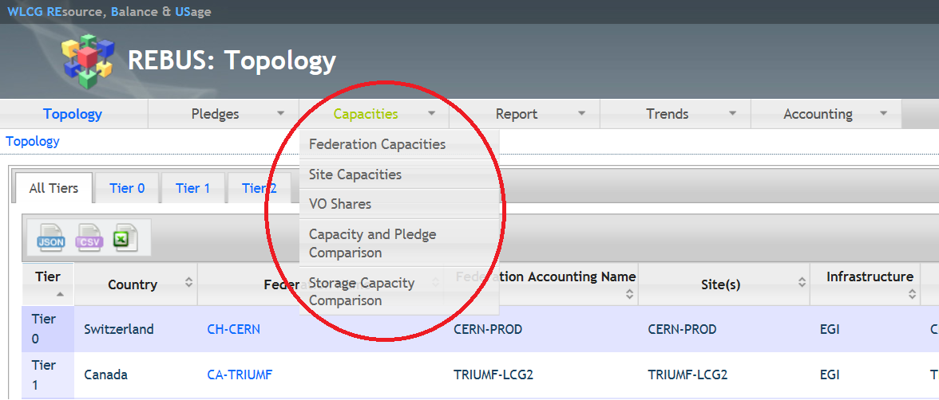
What is the capacity view?

Slide 3
Where are the values taken from?
The values are taken from the BDII (lcg-bdii) that is queried once per hour
  Queries are in GLUE 1
  This is the case for both EGI and OSG
Moreover, MyOSG is queried also once per hour and some values are added
  Using the MyOSG Vofeed:
    http://myosg.grid.iu.edu/rgsummary/xml?datasource=summary&summary_attrs_showwlcg=on&all_resources=on&gridtype=on&gridtype_1=on&active=on&active_value=1&disable_value=1
  And it overwrites what has been collected from the BDII if the site appears in both BDII and MyOSG (see known issues!)
No validation or consistency check is performed

Slide 4
Capacity views in REBUS
Federations Capacities
  https://rebus.cern.ch/apps/capacities/federations/
Sites Capacities
  https://rebus.cern.ch/apps/capacities/sites/
VO shares
  https://rebus.cern.ch/apps/capacities/vo_shares/
Pledge and Capacity comparison
  https://rebus.cern.ch/apps/capacities/pledge_comparison/
Storage Capacity Summary
  https://rebus.cern.ch/apps/capacities/site_storage/

Slide 5
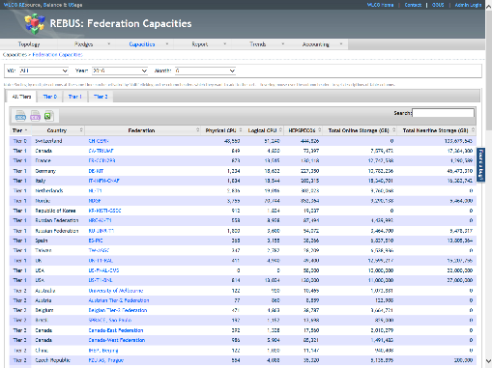
Federations Capacities
Aggregation of capacities published by the sites within the federation

Slide 6
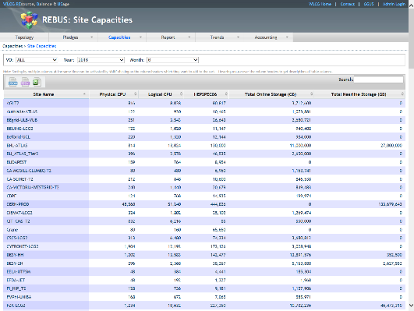
Sites Capacities
BDII variables:
  Sum of all the SubClusters in the site:
    GlueSubClusterLogicalCPUs
    GlueSubClusterPhysicalCPUs
    GlueProcessorOtherDescription
  Sum of all the SEs in the site:
    GlueSETotalOnlineSize
    GlueSETotalNearlineSize
MyOSG variables:
  HEPSPEC
  StorageCapacityMin
  StorageCapacityMax

Slide 7
Historic Information
Both site and federation capacities can show an historic value as well:
  Selecting year and month
  In that case, an average of the values published during the selected month is shown

Slide 8
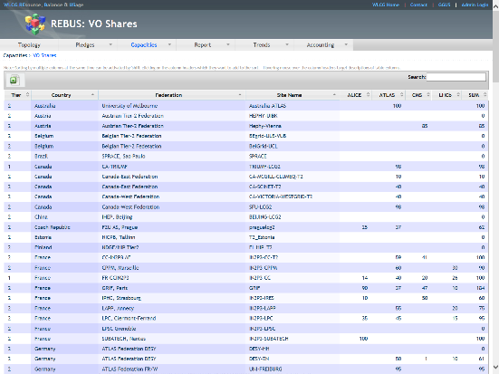
VO shares
BDII variables:
  For EGI sites:
    GlueCECapability
  For OSG sites:
    GlueSiteSponsor

Slide 9
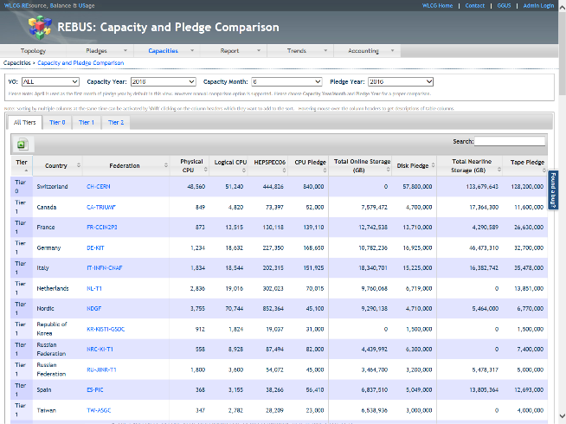
Capacity and Pledge Comparison

Slide 10
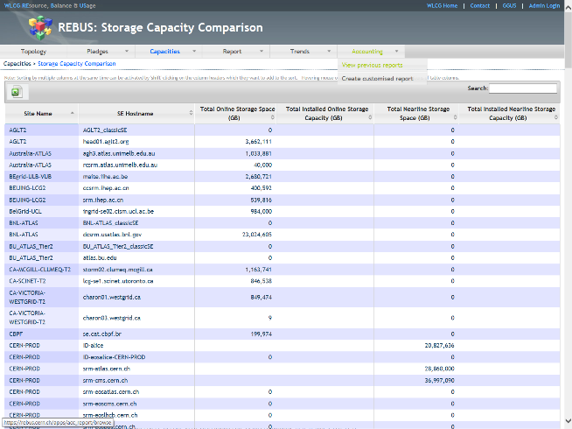
Storage Capacity Comparison

Slide 11
Known Issues
REBUS assumes that in case two or more GlueSublcusters in a site publish the same number in GlueSubClusterLogicalCPUs, this is doublecounting and it takes into account the value only once
If the foreign key attribute (site) in GlueSE doesn’t match the actual GOCDB site name, the SE is not taken into account
Sites that appear in both BDII and MyOSG, get their BDII values overwritten by MyOSG values
MyOSG doesn’t publish LogicalCPUs and PhysicalCPUs, therefore, these values are only published for OSG sites if they are published in the BDII

Slide 12
Motivations to drop capacity view
REBUS is just republishing information that is available in BDII/MyOSG
  Offering a set of in principle interesting attributes through the webUI
However, it adds a complex internal logic that prevents from showing exactly what BDII publishes
  This is very confusing for sites
Moreove LHC experiments do not rely on REBUS

Slide 13
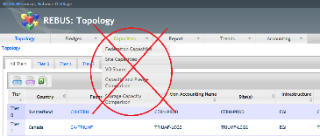
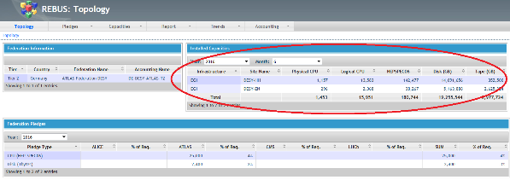
Proposal
Remove the capacity tab from the main menu
Adjust federation information showing today a summary of sites capacities by just including a list of sites belonging to the federation

Slide 14
Additional material
https://twiki.cern.ch/twiki/bin/view/EGEE/AllAboutREBUS

