Slide 1
LINAC5
A New Linear Accelerator for OPENMED at CERN
Jimmy Garland
Linear Accelerators Group, CERN

Slide 2


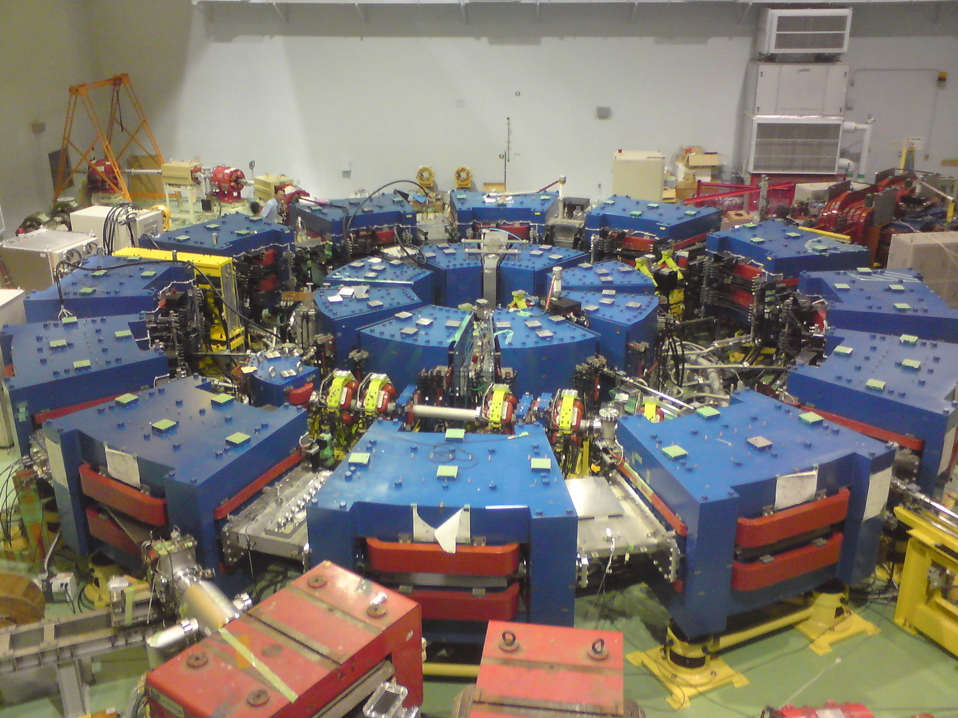
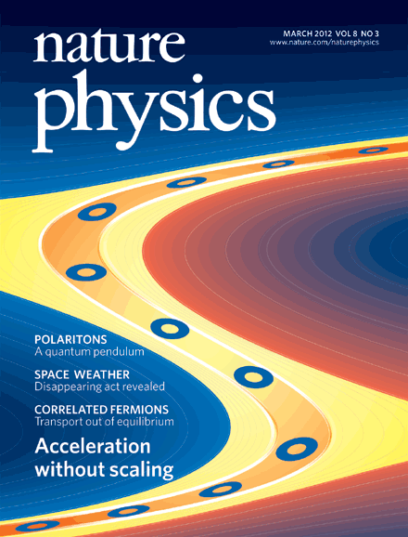
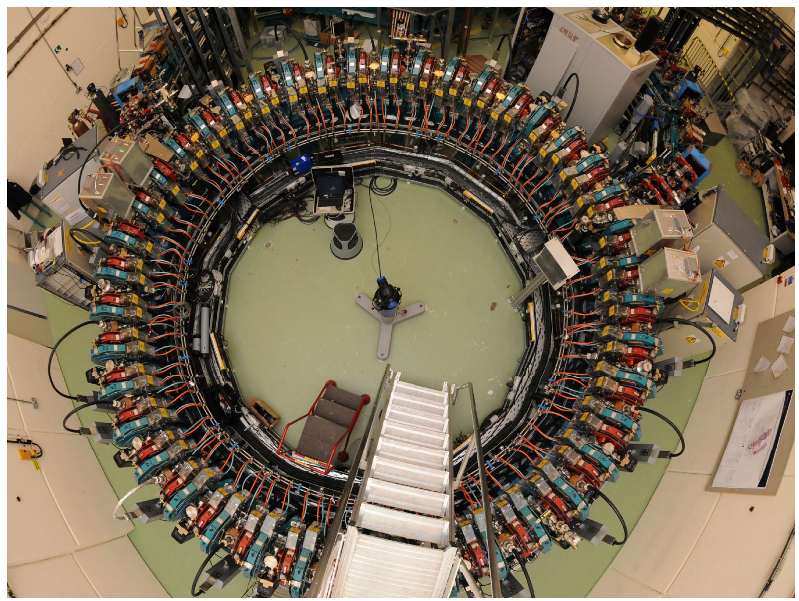
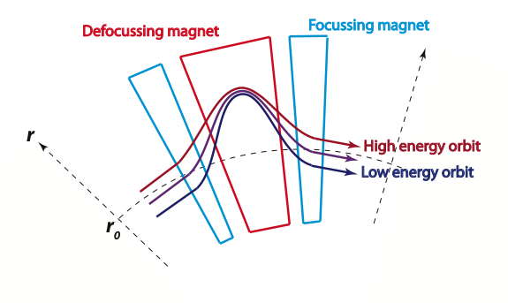
My background:
Studied at University of Manchester, UK.
PhD in accelerators for medical and energy applications.
Postdoc. designing a circular accelerator for proton therapy and other FFAGs.
EMMA - Electron Model for Many Applications
2.5 m radius
Fixed-Field Alternating-Gradient
KURRI, Japan. 150 MeV proton FFAG
Came to CERN in 2015 to work on a linear accelerator for medical applications...
Nature Physics 8, 243-247 (2012)
0.5 μs acceleration from 10 – 20 MeV

Slide 3
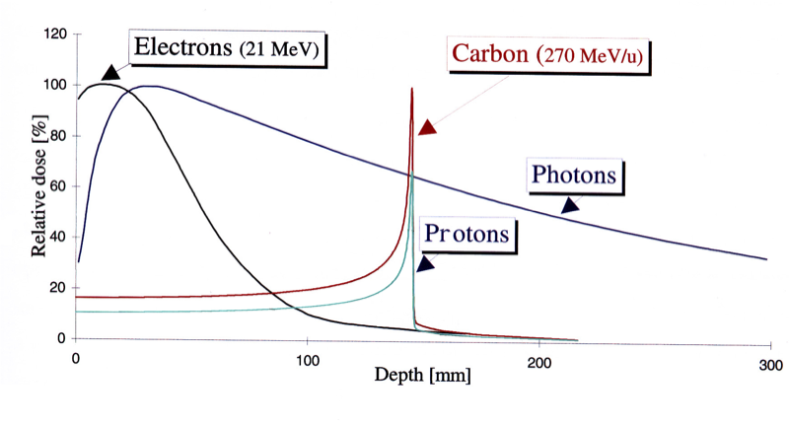
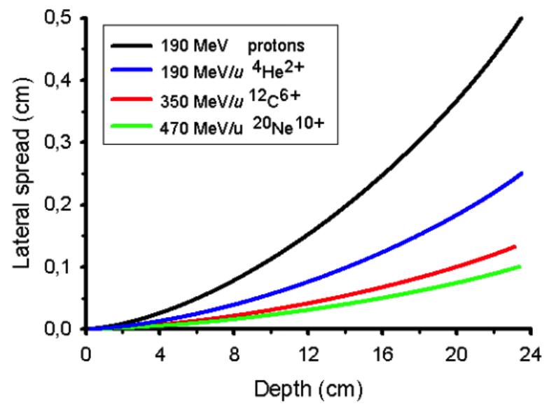
OPENMED
What is OPENMED?
Why study ions?
CERN’s study group on accelerators for medical applications.
Aim to build a facility for studying multiple ion species in a medical-use context.
Biomedical studies: tissue/cell exposure, detector studies, precision statistical experiments.
Protons and other ions utilise ‘Bragg peak’ to treat cancer tumors.
Ions potentially more precise and more effective.
Less fundamental research has been carried out with ions to date.
H, He, Li, Be, B, C, N, O
Plot author: Cepheiden

Slide 4
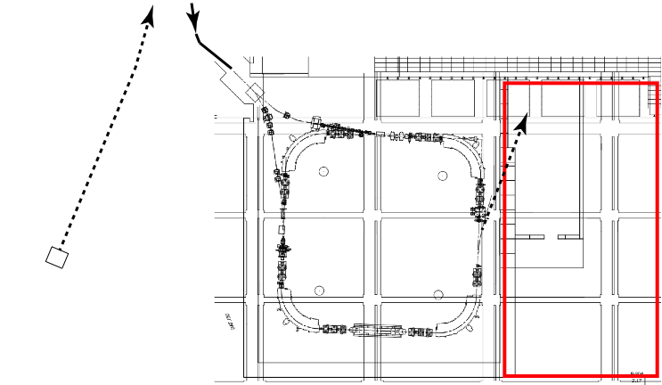
OPENMED Facility Plan
To switching
beam lines
PS complex
Injection
into LEIR
Existing infrastructure
Early-stage design.
Facility will use existing LEIR accelerator to reach up to 430 MeV/u for ions.
New extraction system and experimental area in building 150.
New front-end and linear accelerator: LINAC5.
New extraction line
LEIR
(Low Energy
Ion Ring)
LEIR
Experimental
area
LINAC5

Slide 5
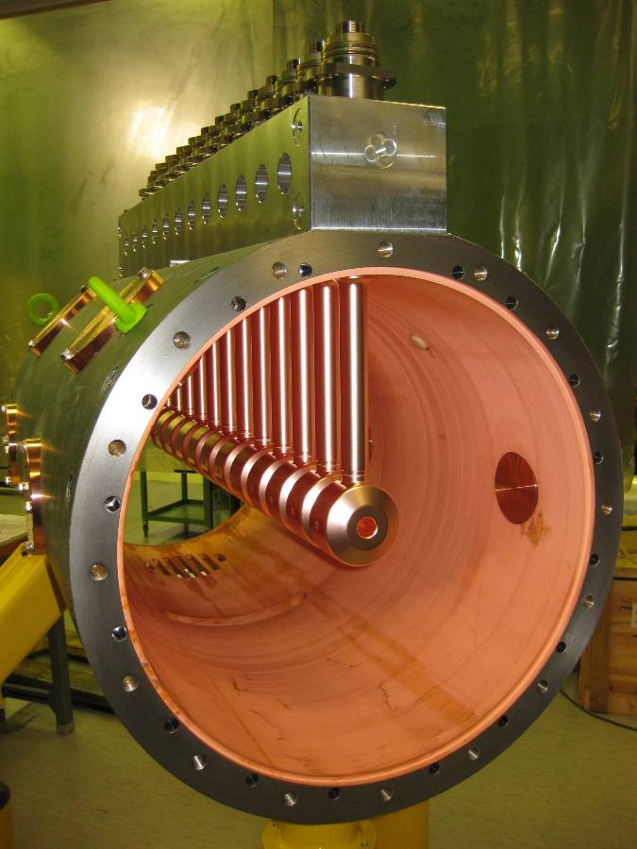
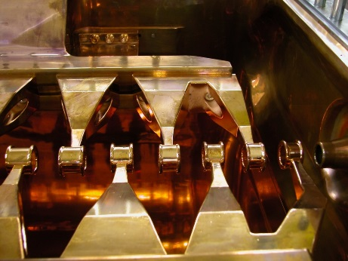

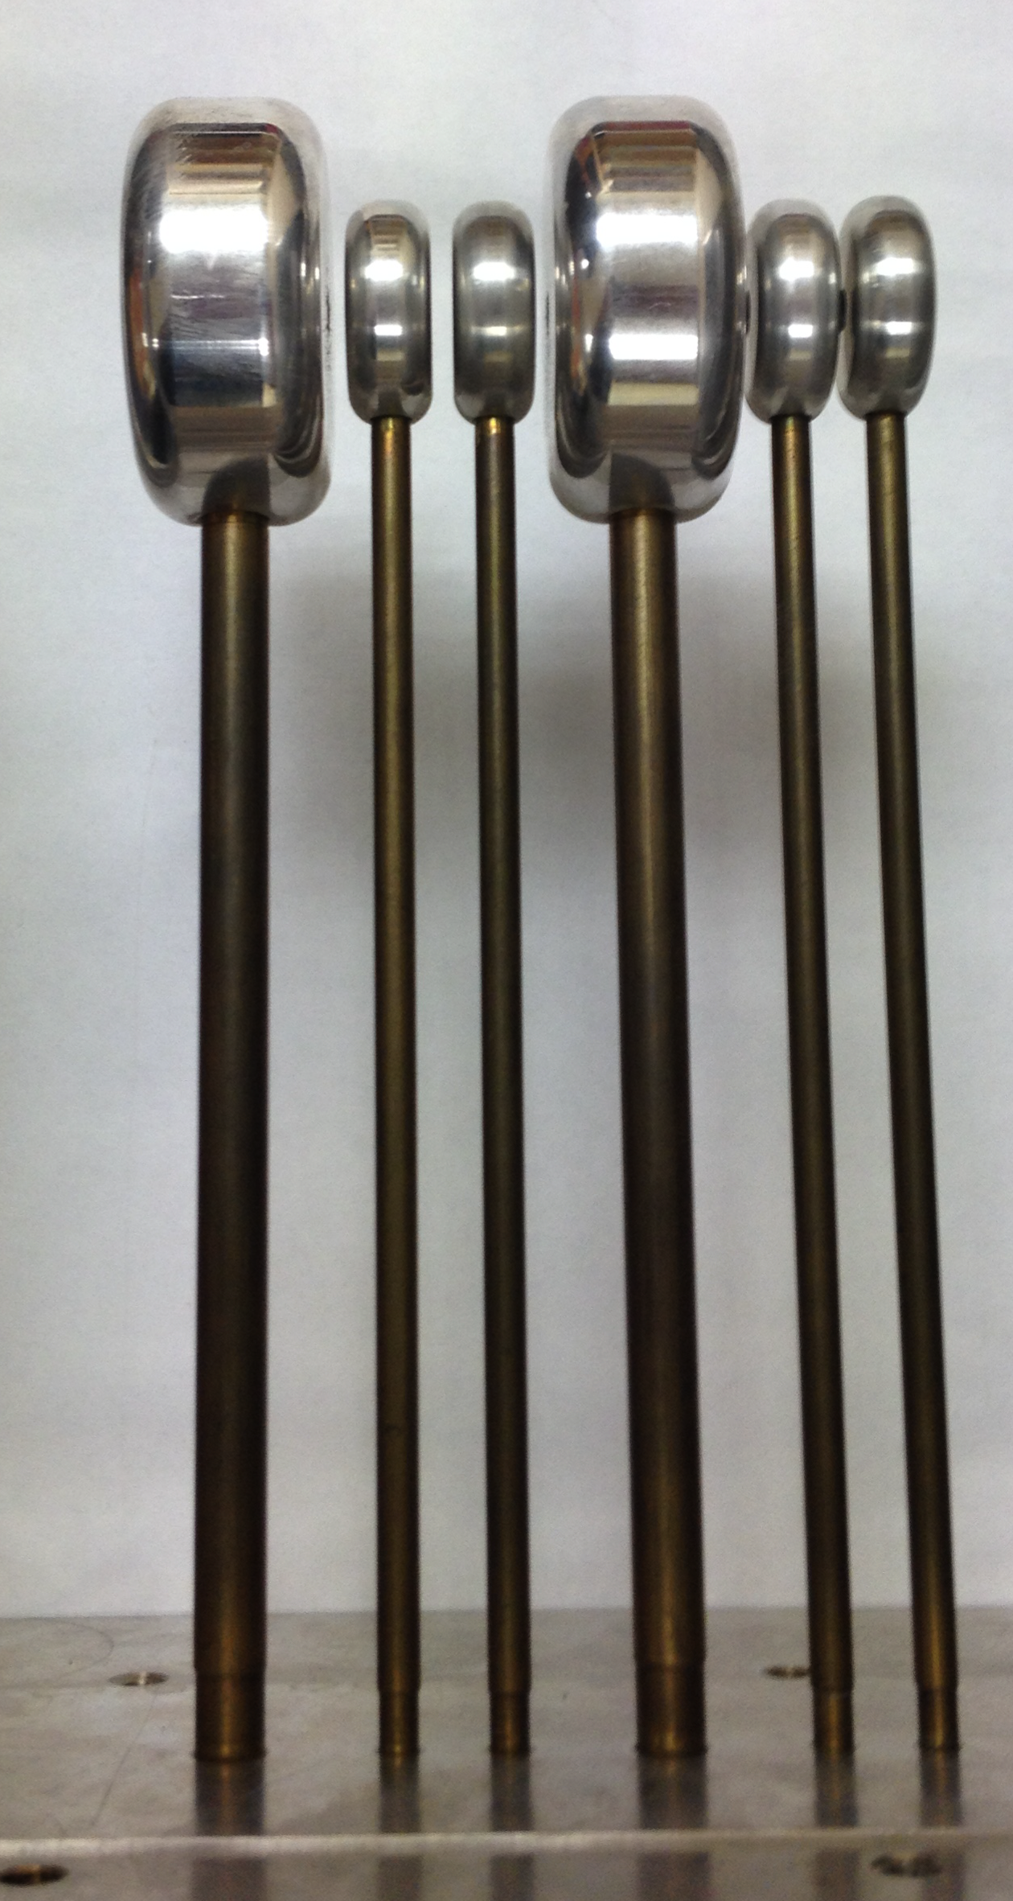
LINAC5 Design Considerations
What structure should the LINAC have?
to LEIR
Focusing is important: particles are often transversely defocused by an RF field.
Alvarez Drift Tube Linac (DTL)
Inter-digital H (IH)
Quasi-Alvarez
Long
Good focusing control
Quadrupoles in each drift tube
Short
Limited focusing control
No quadrupole in drift tubes
In between!
Variable focusing control
Quadrupoles in n^{th} drift tube

Slide 6
LINAC5 Design Progress
Three design studies were made.
Ions with charge to mass ratio (q/m) of ¼ are the ‘heaviest’ -> baseline design.
Quasi-Alvarez provides more focusing capability than IH with shorter length than DTL.
Parameter | DTL | Quasi-Alvarez | IH
Linac length [m] | 8.2 | 5.4 | 3.5
Frequency [MHz] | 202.56 | 405.12 | 202.56
x/y emittance [π.mm.mrad] (rms norm.) | 0.158 / 0.179 | 0.135 / 0.135 | 0.136 / 0.136
Longitudinal emittance [π.mm.mrad] (rms norm.) | 0.095 | 0.19 | 0.19
Aperture radius [mm] | 8.0 | 6.0 | 10.0
Max. 5rms envelope [mm] | 2.9 | 2.9 | 6.5
Max. 5rms phase envelope [deg] | 10 | 20 | 23
Transmission [%] | 99 | 99 | 97
Tank Power [MW] | 1.0 | 0.5 | ?

Slide 7
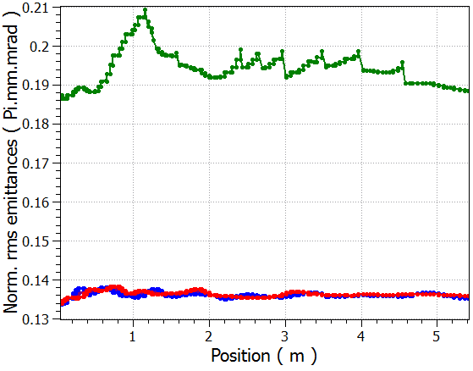
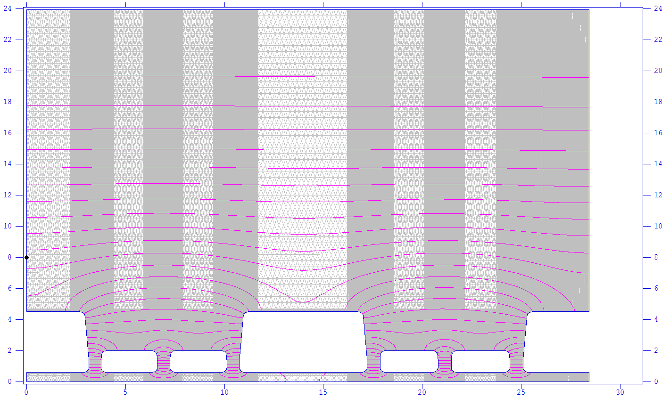
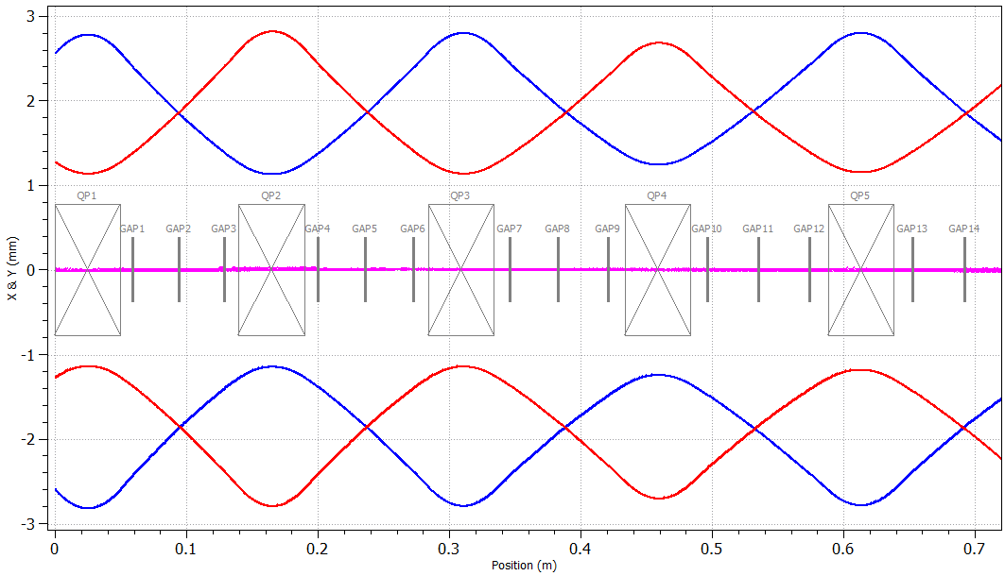
LINAC5 Design Progress
Quasi-Alvarez
Emittance
Beam envelope
Green = longitudinal
Blue = horizontal
Red = vertical
X & Y [mm]
Blue = x
Red = y
Position [m]
One half period
RF electric field map

Slide 8
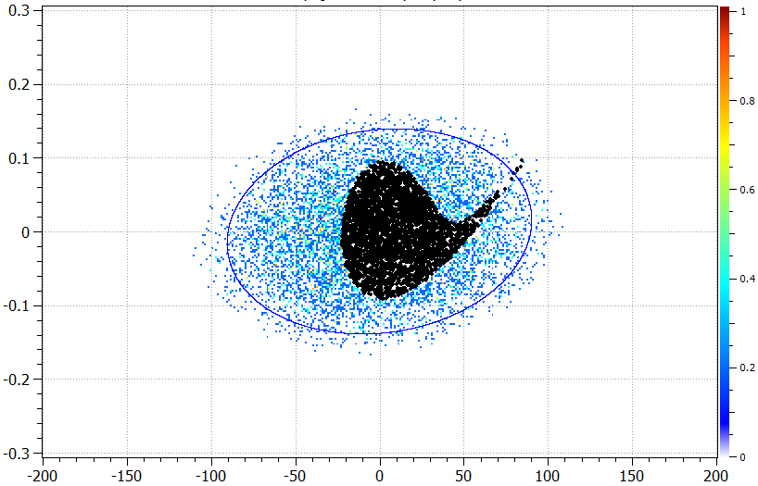
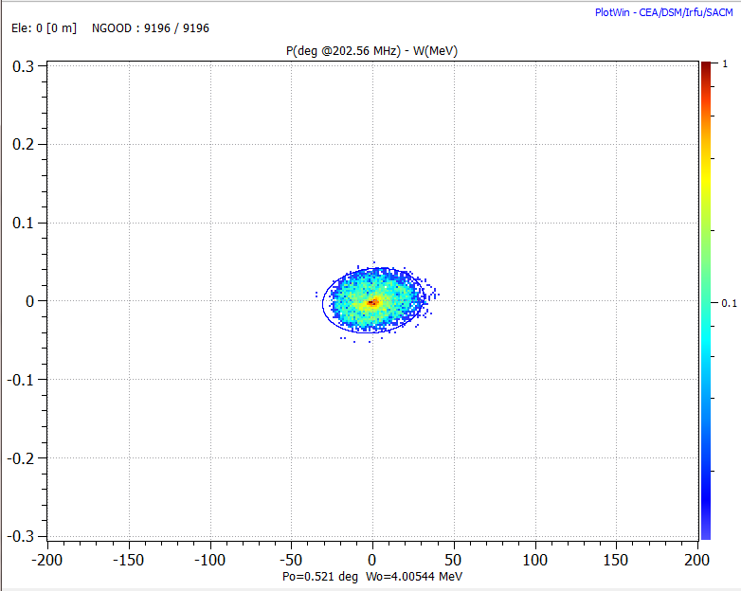

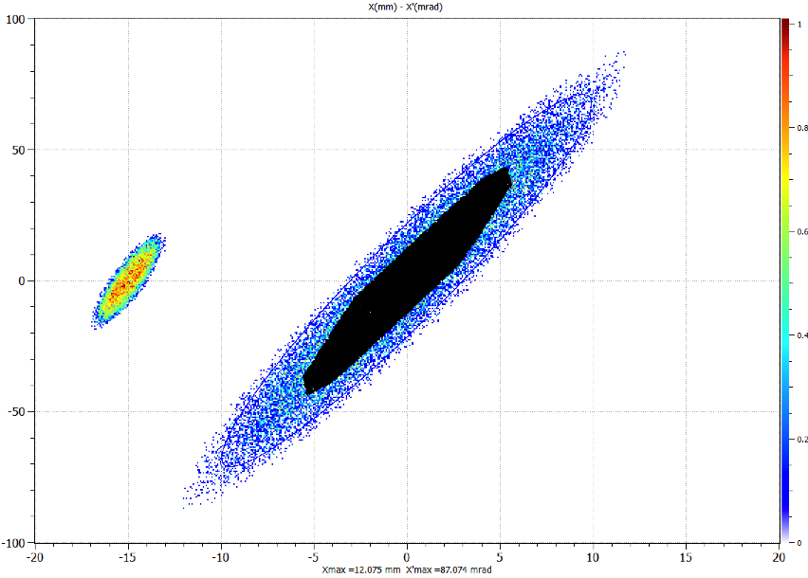
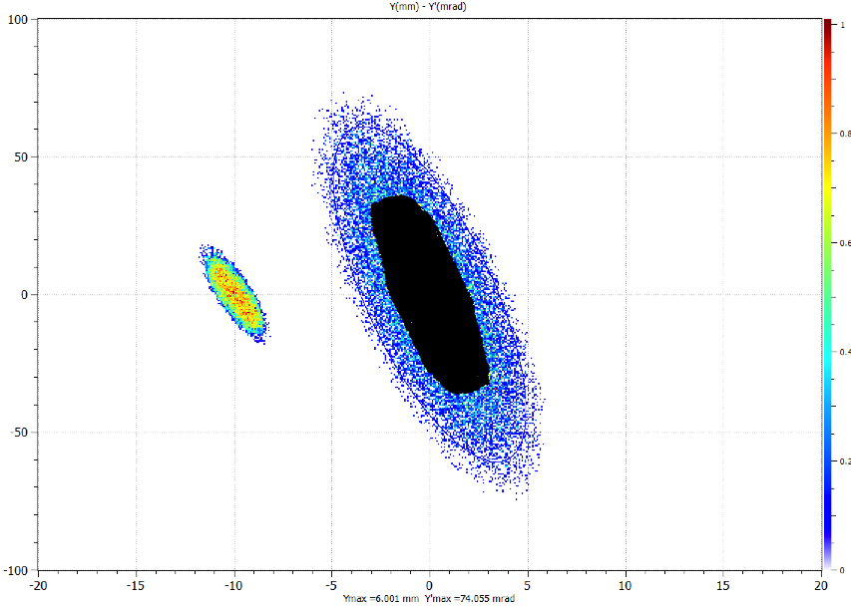
Acceptance
Longitudinal
Area in phase space which traverses the whole structure in a given plane.
White: RFQ beam
W [MeV]
Horizontal
100
50
Vertical
100
Phase [deg.]
0
X’ [mm]
Black: acceptance
50
-50
Blue: initial input
0
X’ [mm]
-100
-15
-5
0
5
10
-10
15
x [mm]
-50
-100
-15
-5
0
5
10
-10
15
x [mm]

Slide 9
LINAC5: Next Steps?
Design compact magnets for drift tubes.
Error studies in the structure.
Many ion species to be studied, look at different optimised scenarios for OPENMED.
Design a matching section from RFQ to Linac.
Full electromagnetic 3D modeling.

Slide 10
Thank you for your attention!

Slide 11
Backup 1.
Ions species (q/m) | Final total kinetic energy [MeV] | Kinetic energy needed for constant rigidity [MeV]
1/4 | 16.8 (4 MeV/u) | 16.8 (4.2 MeV/u)
1/3 | 12.6 (4 MeV/u) | 22.4 (7.5 MeV/u)
1/2 | 8.4 (4 MeV/u) | 33.4 (16.7 MeV/u)

