Slide 1
Raman LIDAR for Ultra High Energy Cosmic Rays experiments.
Marco Iarlori – marco.iarlori@aquila.infn.it
CETEMPS/DSFC University of L’Aquila – Italy
with
Vincenzo Rizi and Aurelio Grillo
AtmoHEAD 2016 – Olomouc (Czech Republic), 12-14 September 2016

Slide 2
Outline:
Raman LIDAR in the framework of EARLINET/ACTRIS:
  Quality Assurance (QA)
    Effective Resolution.
  SCC (Single Calculus Chain)
Raman LIDAR in AUGER.
AtmoHEAD 2016 – Olomouc (Czech Republic), 12-14 September 2016

Slide 3
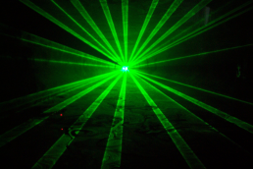
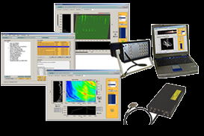
Interaction between
radiation and object
signal
propagation
radiation
propagation
radiation
source
detector
Data acquisition and analysis
AtmoHEAD 2016 – Olomouc (Czech Republic), 12-14 September 2016

Slide 4
Interaction between
radiation and object
signal
propagation
radiation
propagation
radiation
source
detector
Data acquisition and analysis
AtmoHEAD 2016 – Olomouc (Czech Republic), 12-14 September 2016

Slide 5
Emitted laser photon number
Laser photon transmission through medium
Probability of a transmitted photon to be scattered
Scattered photon transmission through medium
Probability of a scattered photon to be collected
Lidar system efficiency and geometry factor
AtmoHEAD 2016 – Olomouc (Czech Republic), 12-14 September 2016

Slide 6
In general, the interaction between the light photons and the particles is a scattering process.
The expected photon counts are proportional to the product of the
(1) transmitted laser photon number,
(2) probability that a transmitted photon is scattered,
(3) probability that a scattered photon is collected,
(4) light transmission through medium, and
(5) overall system efficiency.
Background photon counts and detector noise also contribute to the expected photon counts.
You will find the LIDAR equation written in several way (even in this presentation!)
This is just one…
AtmoHEAD 2016 – Olomouc (Czech Republic), 12-14 September 2016

Slide 7
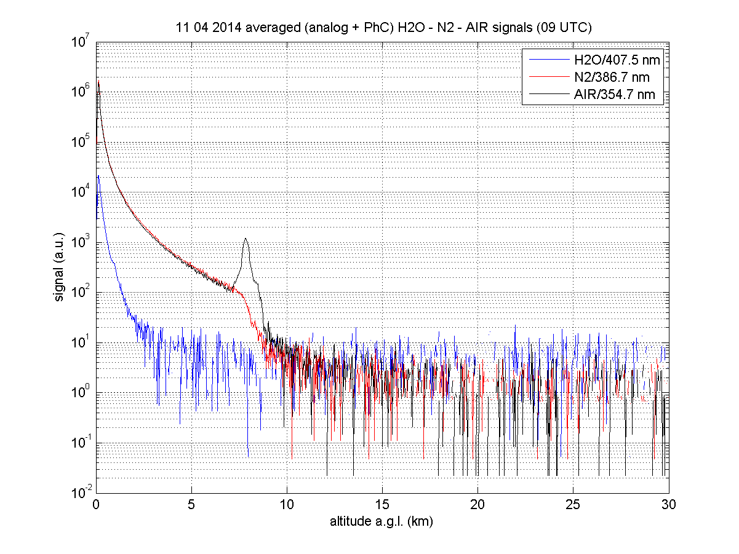
Raman LIDAR signals
AtmoHEAD 2016 – Olomouc (Czech Republic), 12-14 September 2016

Slide 8
EARLINET, the European Aerosol Research Lidar Network, was founded in 2000 as a research project for establishing a quantitative, comprehensive and statistically significant database for the horizontal, vertical, and temporal distribution of aerosols on a continental scale.
Since 2000, EARLINET is continuing to provide the most extensive collection of ground-based data for the aerosol vertical distribution over Europe.
Since 2000, EARLINET has strongly developed in terms of number of stations and spatial distribution, from 17 stations in 10 countries in 2000, to 27 stations in 16 countries in 2013.
EARLINET has strongly developed also in terms of technological advances with the spread of advanced multi-wavelength Raman lidar stations in Europe.
AtmoHEAD 2016 – Olomouc (Czech Republic), 12-14 September 2016

Slide 9
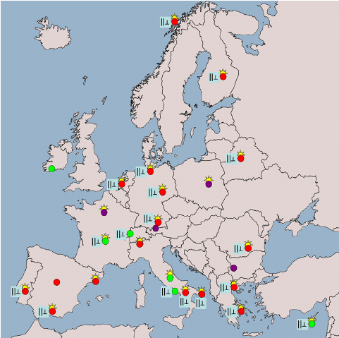
Map of the EARLINET stations currently active. Red dots indicate multiwavelength Raman lidar stations (EARLINET core stations). Green dots correspond to stations with at least one Raman channel. Violet dots denote lidars with only elastic backscatter channels. The ||⊥ symbol indicates that the station has depolarization-measurement capabilities. The “sun” symbol means collocation with an AERONET sun photometer.
AtmoHEAD 2016 – Olomouc (Czech Republic), 12-14 September 2016

Slide 10
EARLINET Quality Assurance: Instruments
Mandatory for all EARLINET station
Internal Quality check-up
Instrument Intercomparison
Matthias V., J. Bösenberg, V. Freudenthaler, A. Amodeo, D. Balis, A. Chaikovsky, G. Chourdakis, A. Comeron, A. Delaval, F. de Tomasi, R. Eixmann, A. Hågård, L. Komguem, S. Kreipl, R. Matthey, I. Mattis, V. Rizi, J.A. Rodriguez, V. Simeonov, X. Wang, “Aerosol lidar intercomparison in the framework of the EARLINET project. 1. Instruments”, Appl. Opt. 43, N. 4, 961-976, 2004.
Ulla Wandinger et al., “EARLINET instrument intercomparison campaigns: overview on strategy and results.” Atmos. Meas. Tech., 9, 1001-1023, 2016 http://www.atmos-meas-tech.net/9/1001/2016/ doi:10.5194/amt-9-1001-2016
AtmoHEAD 2016 – Olomouc (Czech Republic), 12-14 September 2016

Slide 11
EARLINET Quality Assurance: Instruments
Internal Quality check-up
Tools (developed by V. Freudenthaler, Univ. Munich) :
Rayleigh fit test: The Rayleigh fit test shows the accuracy of agreement between a lidar signal and a calculated molecular (Rayleigh) signal in a lidar range presumably without aerosols.(long range quality check)
Telecover test: The boundary layer is the most interesting region for climatology of the aerosol. Here all lidar systems suffer from signal saturation and are limited by the optical overlap function. This test can be used to estimate the optical overlap function and other near range distortions. (near range quality check)
Trigger delay test: An error in the trigger delay between the real laser output and the detection system start (system trigger, Zero-bin) can cause large errors in the near range signal up to about 1 km range. Especially important in Raman retrieval, because it directly heavily effect the aerosol extinction measurements in the near range.
And few others…
AtmoHEAD 2016 – Olomouc (Czech Republic), 12-14 September 2016

Slide 12
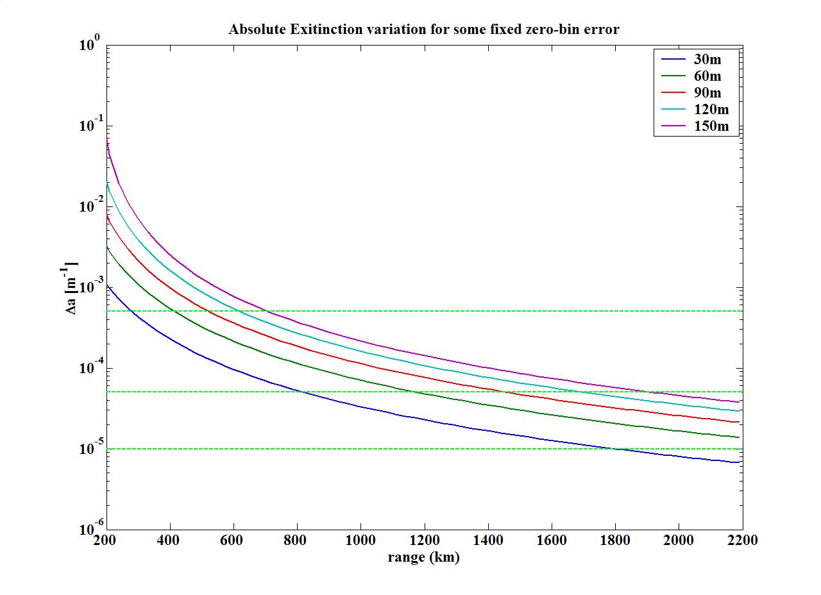
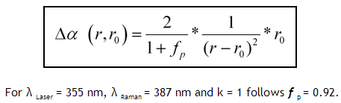
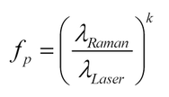

EARLINET Quality Assurance: Instruments
Internal Quality check-up
L’AQUILA Raman ZeroBin Test
Max average tropos. Ext.
Min average tropos. Ext.
Average tropos. Ext. Error
AtmoHEAD 2016 – Olomouc (Czech Republic), 12-14 September 2016

Slide 13
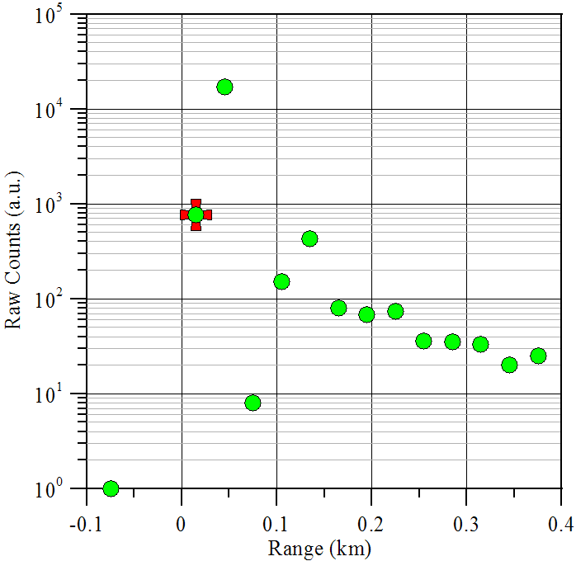
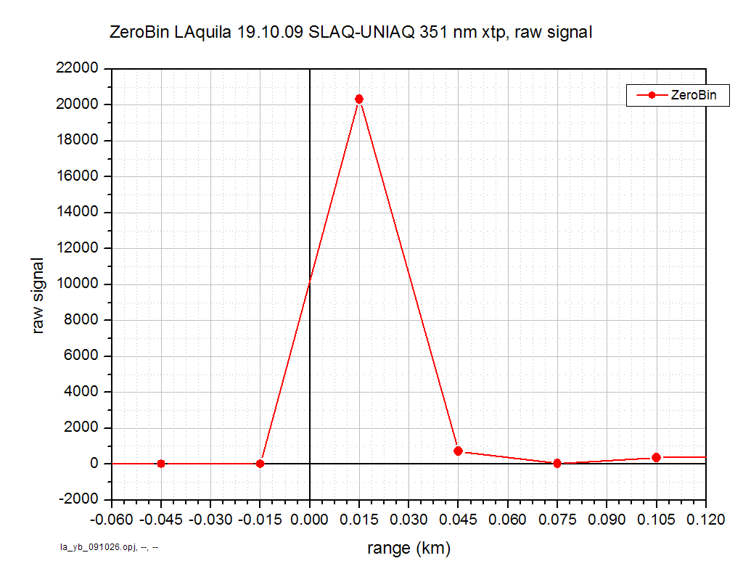
EARLINET Quality Assurance: Instruments
Internal Quality check-up
L’AQUILA Raman Lidar ZeroBin Test
AtmoHEAD 2016 – Olomouc (Czech Republic), 12-14 September 2016

Slide 14
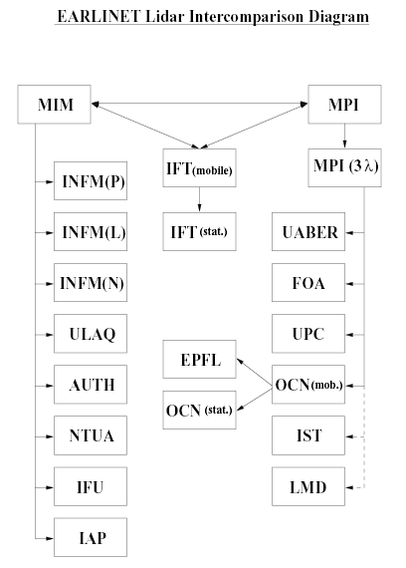
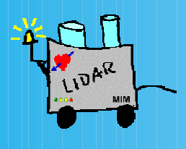
SLICE (Southern Lidar Intercomparison Experiment) CAMPAIGN
L’Aquila Station Results year 2000
EARLINET Quality Assurance: Instruments
Instrument Intercomparison
Meteorologisches Institut der
Ludwig-Maximilians-Universität
München (MIM)
AtmoHEAD 2016 – Olomouc (Czech Republic), 12-14 September 2016

Slide 15
EARLINET Quality Assurance: Instruments
Instrument Intercomparison
OLD SYSTEM: RECEIVER: 100cm ∅ f/10 Cassegrain telescope
RAW RESOLUTION OF THE SYSTEM 30m
SLICE (Southern Lidar Intercomparison Experiment) CAMPAIGN
L’Aquila Station Results
year 2000
AtmoHEAD 2016 – Olomouc (Czech Republic), 12-14 September 2016

Slide 16
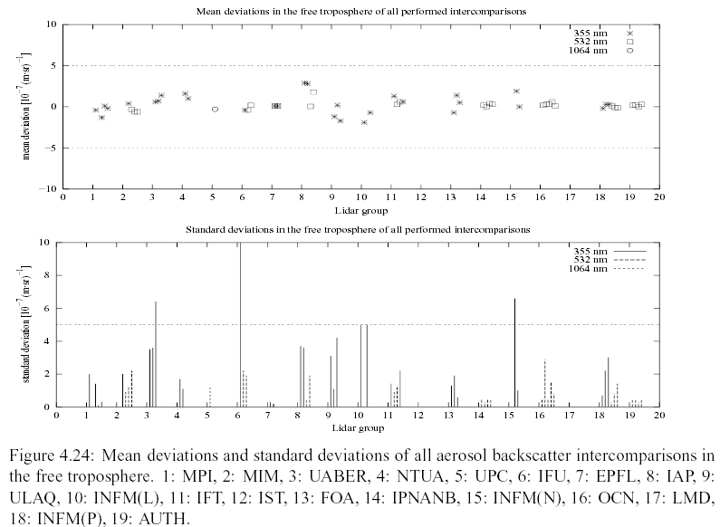
EARLINET Quality Assurance: Instruments
Instrument Intercomparison
SLICE (Southern Lidar Intercomparison Experiment) CAMPAIGN
L’Aquila Station Results
year 2000
AtmoHEAD 2016 – Olomouc (Czech Republic), 12-14 September 2016

Slide 17


EARLINET Quality Assurance: Instruments
Instrument Intercomparison
LIDAR systems’intercomparison
SLAQ
CETEMPS/Univ. L’Aquila
vs
POLIS
Meteorologisches Institut der Universität München, Munich
September 2012
LALI 2012
Aerosols, Clouds, and Trace gases Research InfraStructure Network
AtmoHEAD 2016 – Olomouc (Czech Republic), 12-14 September 2016

Slide 18
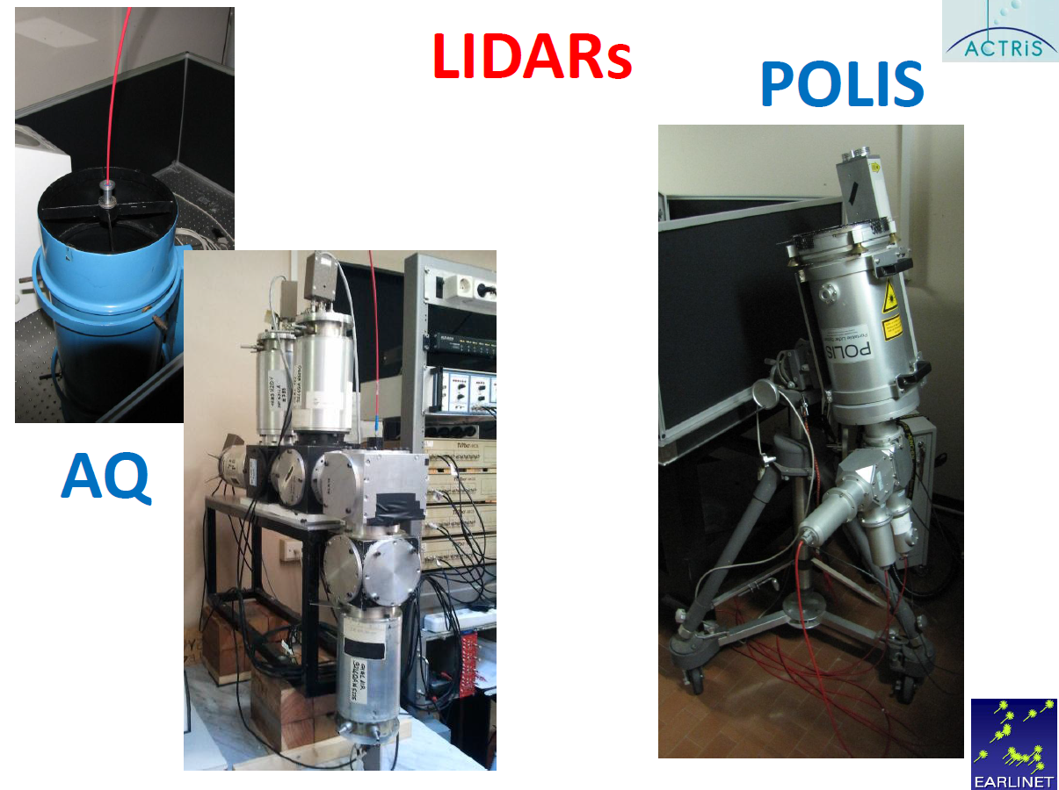
EARLINET Quality Assurance: Instruments
Instrument Intercomparison
LALI 2012
AtmoHEAD 2016 – Olomouc (Czech Republic), 12-14 September 2016

Slide 19
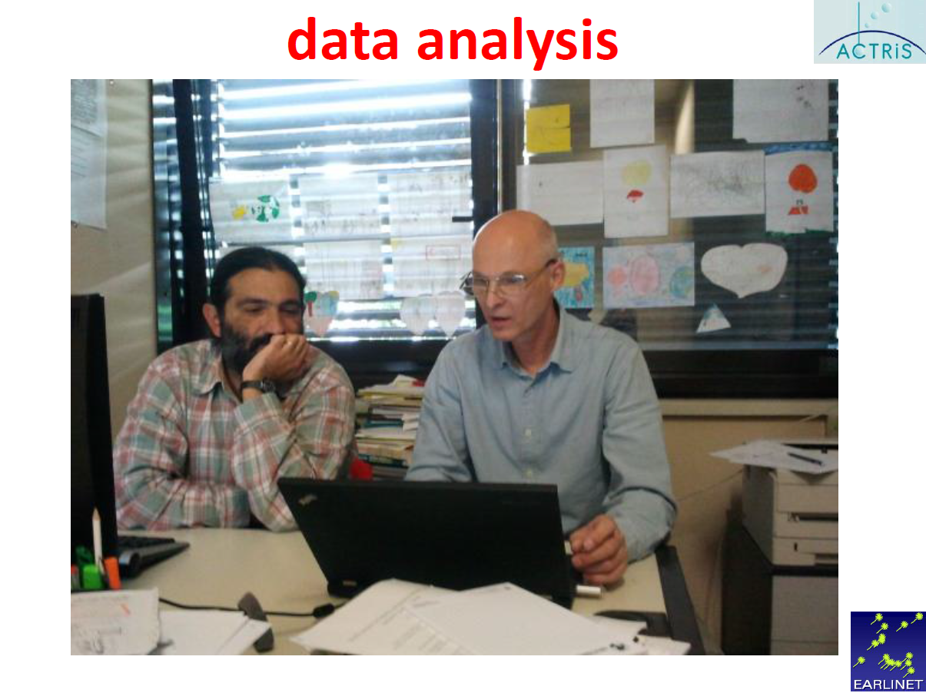
EARLINET Quality Assurance: Instruments
Instrument Intercomparison
LALI 2012
AtmoHEAD 2016 – Olomouc (Czech Republic), 12-14 September 2016

Slide 20
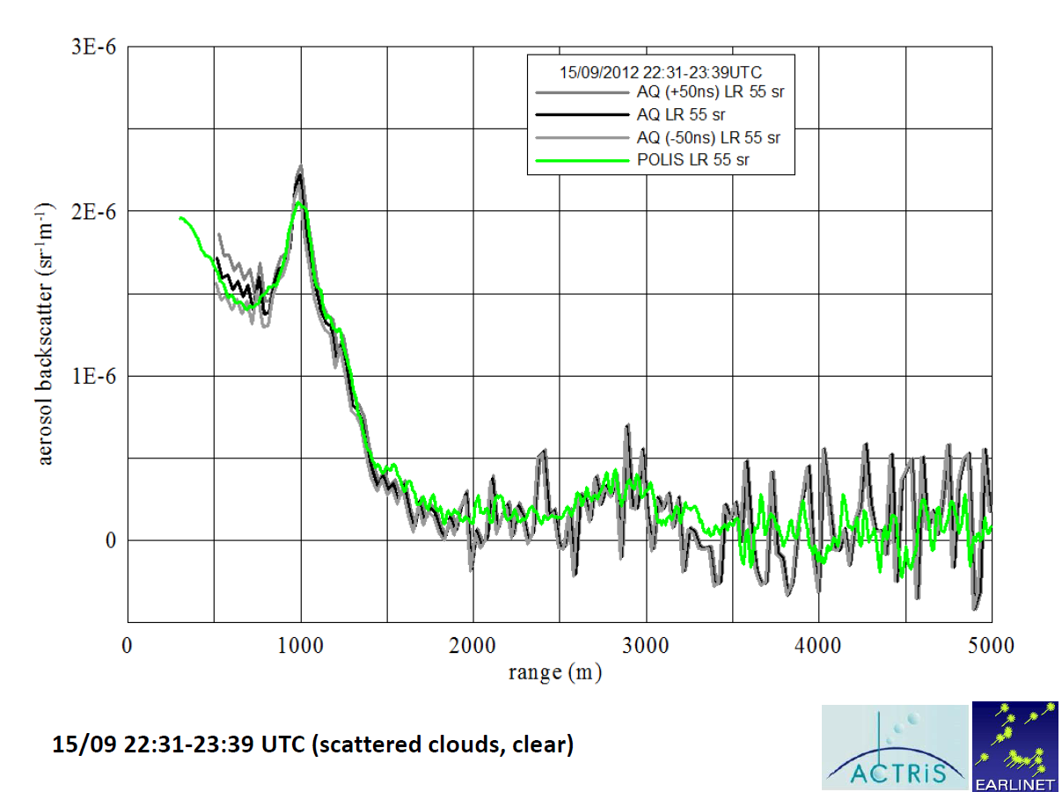
EARLINET Quality Assurance: Instruments
Instrument Intercomparison
LALI 2012
“…Excellent performance of the L’Aquila UV lidar (la01) was obtained.
Mean systematic deviations from the signals of the reference system (mu01) were <2 % throughout the entire observa-
tional range. ..”
From:
Ulla Wandinger et al., “EARLINET instrument intercomparison campaigns: overview on strategy and results.” Atmos. Meas. Tech., 9, 1001-1023, 2016 http://www.atmos-meas-tech.net/9/1001/2016/ doi:10.5194/amt-9-1001-2016
AtmoHEAD 2016 – Olomouc (Czech Republic), 12-14 September 2016

Slide 21
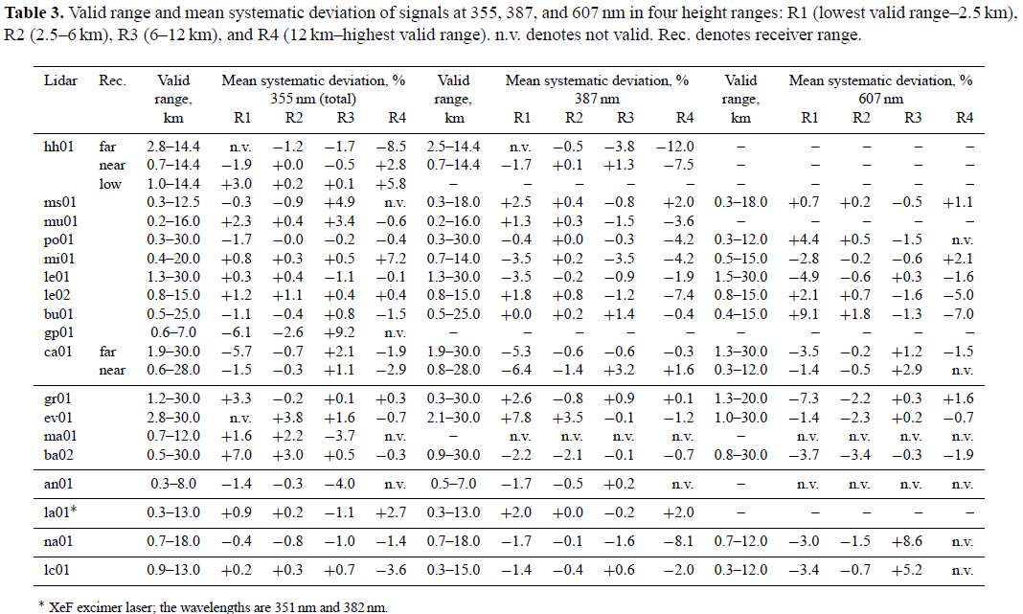
EARLINET Quality Assurance: Instruments
Instrument Intercomparison
Good performance for all EARLINET system
AtmoHEAD 2016 – Olomouc (Czech Republic), 12-14 September 2016

Slide 22
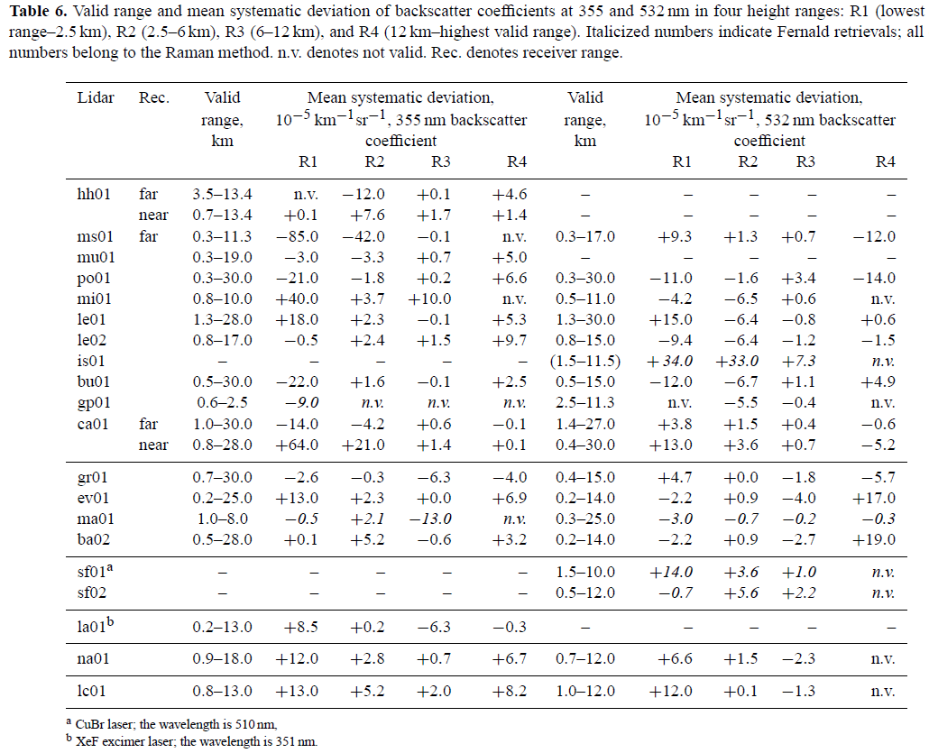
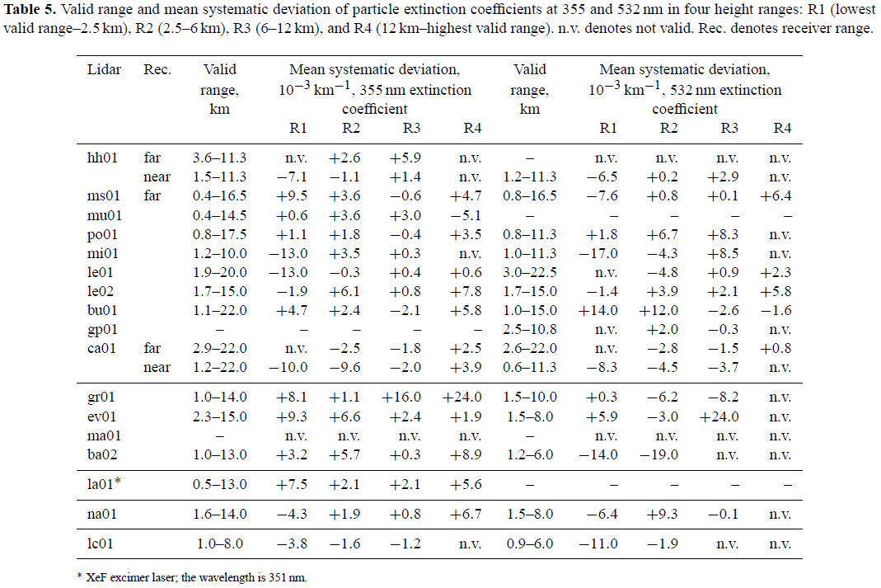
EARLINET Quality Assurance: Instruments
Instrument Intercomparison
Good performance for all EARLINET system
AtmoHEAD 2016 – Olomouc (Czech Republic), 12-14 September 2016

Slide 23
EARLINET Quality Assurance: Algorithms
Mandatory for all EARLINET station.
The QA of the Algorithms for the retrieval of optical properties of the aerosols was (and is) done for both the elastic retrieval (the so called Fernald/Klett inversion, for the aerosol backscatter only) and for the Raman retrieval (for both the aerosol extinction and backscatter)
Böckmann C., U. Wandinger, A. Ansmann, J. Bösenberg, V. Amiridis, A. Boselli, A. Delaval, F. De Tomasi, M. Frioud, A. Hågård, M. Horvat, M. Iarlori, L. Komguem, S. Kreipl, G. Larchevêque, V. Matthias, A. Papayannis, G. Pappalardo, F. Rocadembosch, J.A. Rodriguez, J. Schneider, V. Shcherbakov, M. Wiegner, “Aerosol lidar intercomparison in the framework of the EARLINET project. 2. Aerosol backscatter algorithms”, Appl. Opt. 43, N. 4, 977-989, 2004.
Pappalardo G., A. Amodeo, M. Pandolfi, U. Wandinger, A. Ansmann, J. Bosenberg, V. Matthias, V. Amiridis, F. De Tomasi, M. Frioud, M. Iarlori, L. Komguem, A. Papayannis, F. Rocadenbosch, X. Wang, “Aerosol lidar intercomparison in the framework of the EARLINET project. 3. Raman lidar algorithm for aerosol extinction, backscatter and lidar ratio”, Appl. Opt., 43. N. 28, 53705385, 2004.
AtmoHEAD 2016 – Olomouc (Czech Republic), 12-14 September 2016

Slide 24
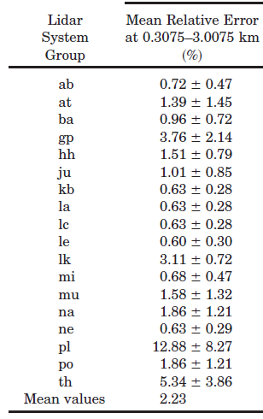
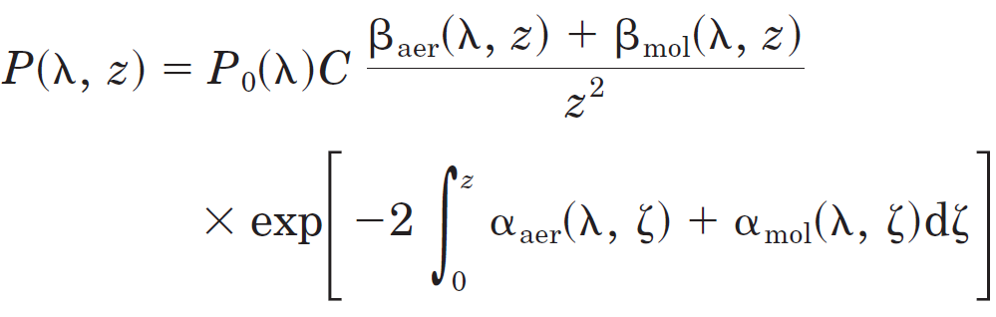
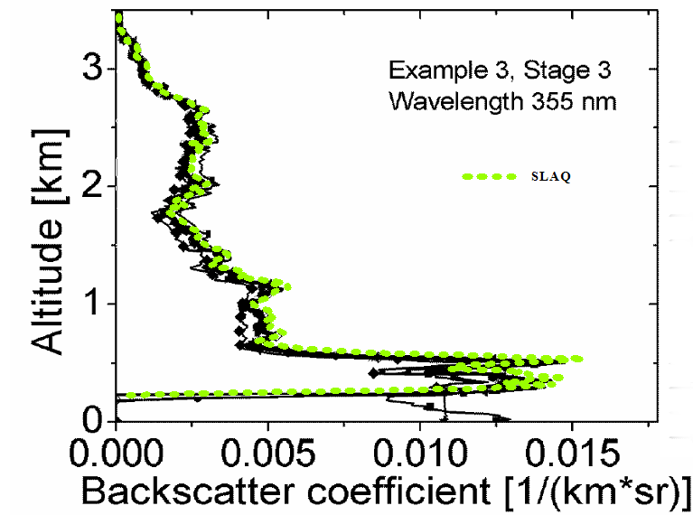

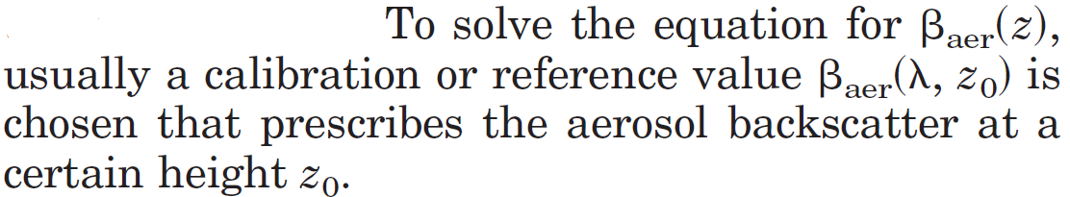
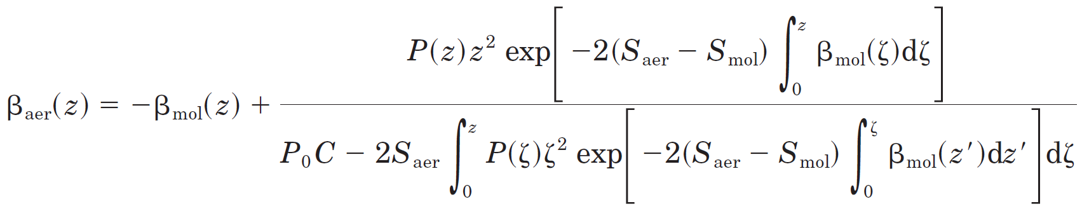
EARLINET Quality Assurance: Algorithms
Fernald/Klett inversion. We use a variation of this inversion method (so called “iterative”)
AtmoHEAD 2016 – Olomouc (Czech Republic), 12-14 September 2016

Slide 25
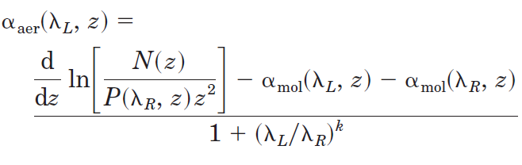
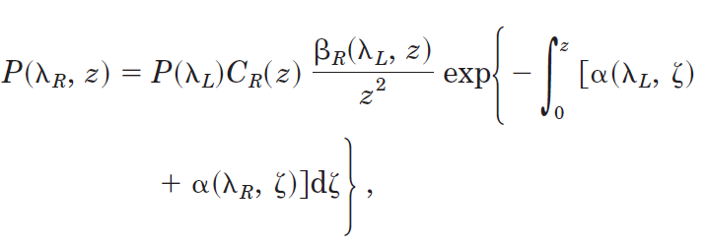
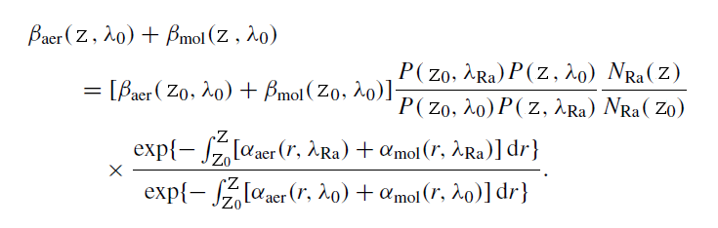
EARLINET Quality Assurance: Algorithms
Raman inversion.
Derivative algo (low pass digital filter): we are loosing vertical resolution because
the removal (at some degree) of high frequency (high resolution).
AtmoHEAD 2016 – Olomouc (Czech Republic), 12-14 September 2016

Slide 26
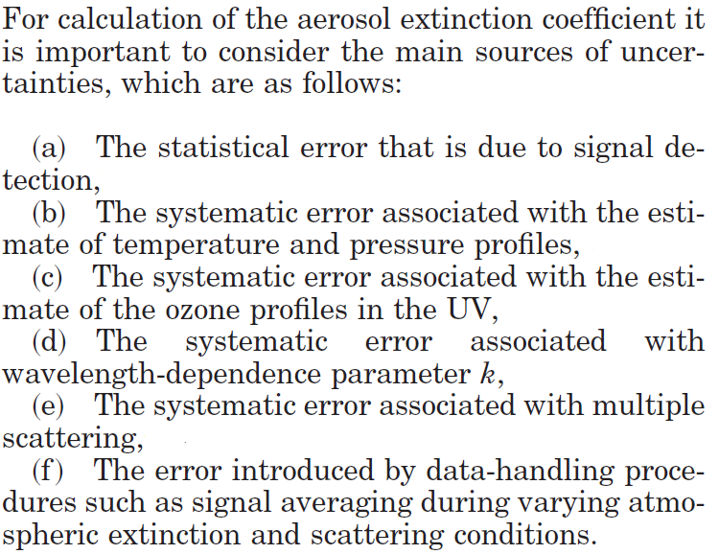
EARLINET Quality Assurance: Algorithms
AtmoHEAD 2016 – Olomouc (Czech Republic), 12-14 September 2016

Slide 27
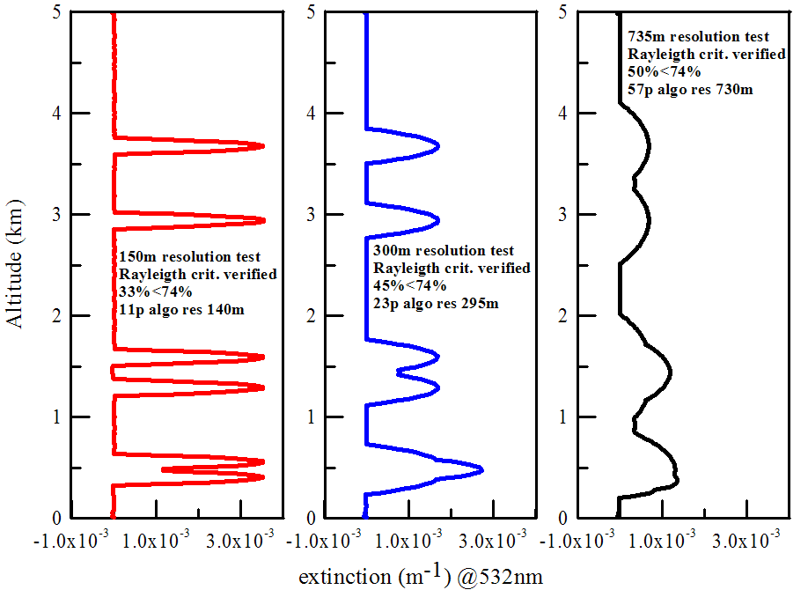
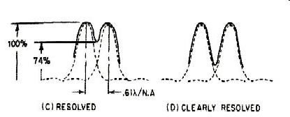
EARLINET Quality Assurance: Algorithms
The Effective Resolution
AtmoHEAD 2016 – Olomouc (Czech Republic), 12-14 September 2016

Slide 28
EARLINET Quality Assurance: Algorithms
The Effective Resolution
Why the Resolution changes?
The algorithms used in the lidar data analysis often alter the spectral content of the data, mainly acting as low-pass filters to reduce the high-frequency noise :
Beside noise removal action, they always distort the underlying “true” signal in magnitude and spatial extension.
The loss of spatial details in a signal (those that correspond to the high frequencies cut) implies a reduction the resolution.
The likely presence of several separated layers in a lidar profile pose the question if they are resolved or not because the distortion caused by the smoothing.
The tradeoff between signal distortion and noise removal pose an optimization question we start to answer with consequences on the Effective Resolution (ERes).
The operative ERes estimation is in the SCC.
Effective resolution concepts for lidar observations. M. Iarlori, F. Madonna, V. Rizi, T. Trickl, and A. Amodeo. Atmos. Meas. Tech., 8, 5157-5176, doi:10.5194/amt-8-5157-2015, 2015
AtmoHEAD 2016 – Olomouc (Czech Republic), 12-14 September 2016

Slide 29
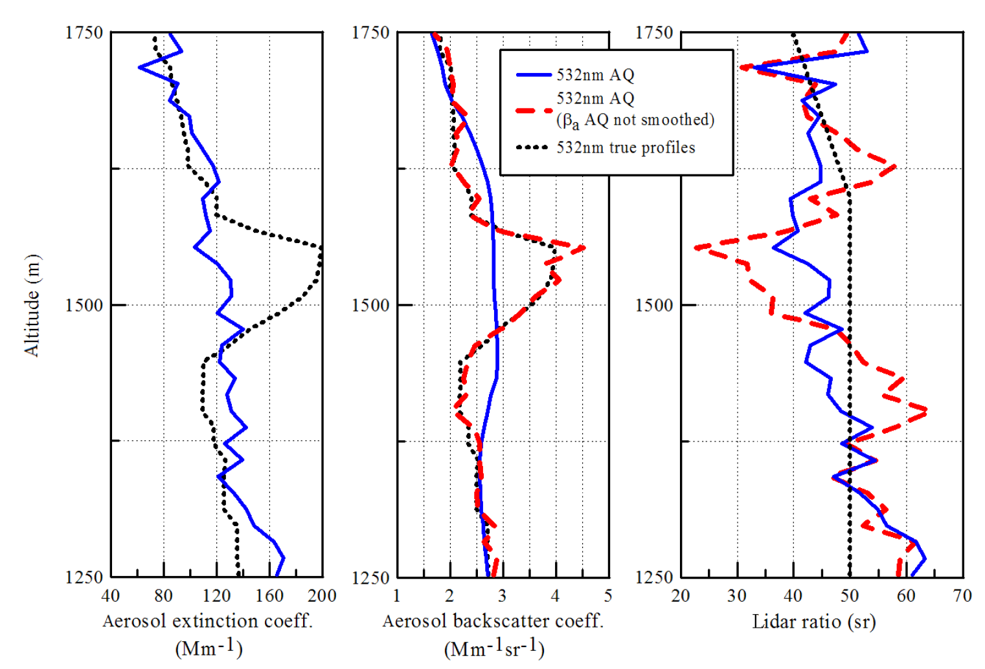
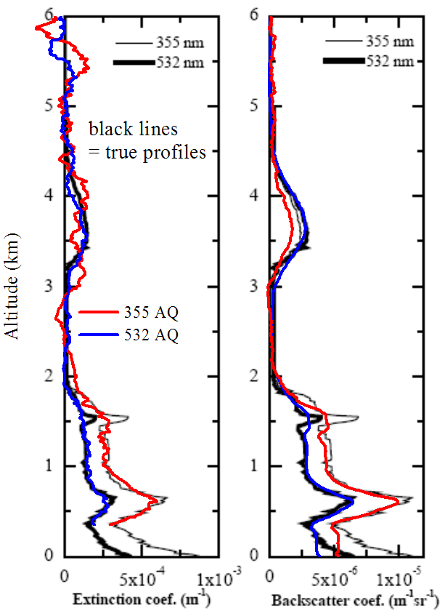
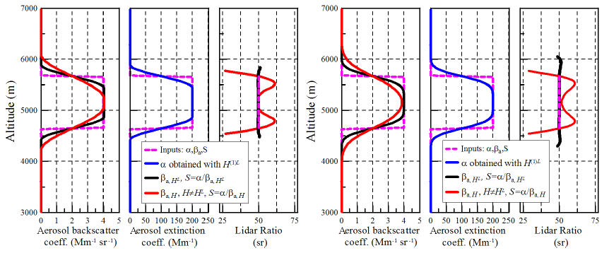
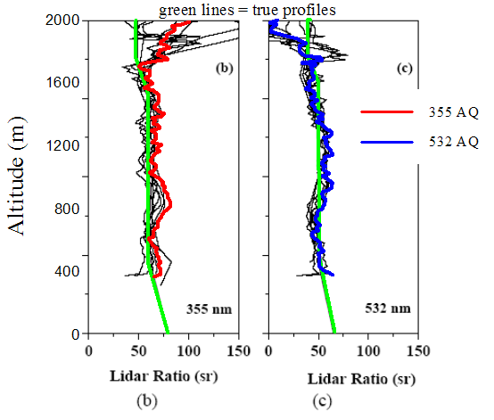
EARLINET Quality Assurance: Algorithms
The Effective Resolution
From EARLINET III paper…
The true extinction layer @1.5km is heavily “distorted” by the low pass derivative filter used for the inversion ( actually is “flat” now)…
…then to obtain a reasonable S, the backscatter must be smoothed accordingly.
Ex. if β is not smoothed at all (or not enough), S will be systematically underestimated.
Signal Combination: Lidar Ratio
AtmoHEAD 2016 – Olomouc (Czech Republic), 12-14 September 2016

Slide 30
EARLINET Quality Assurance: Algorithms
The Effective Resolution
Which are those algorithms? Examples:
Direct Smoothing: it's often directly employed on several Lidar products in order to reduce random error. It’s equivalent to apply a low-pass filter.
The numerical derivative: i.e. the Lidar data inversion algorithms to obtain aerosol extinction (and the VAOD), PBL/ML height or DIAL ozone concentration etc. The ideal numerical derivative enhances high frequencies: This means that in order to perform effectively a numerical derivative of a signal, a smoothing filter has to be coupled in cascade with the ideal derivative.
Other situation where Vertical Resolution matters. Example:
Signals Combination & Comparison: Lidar Ratio: a high-resolution aerosol backscatter coefficient profile, having well-resolved layers, could be combined with a heavily smoothed, low-resolution simultaneous extinction profile, where the same layers can be not well resolved. This would result in a biased estimation of the actual values of the lidar ratio. We have to be sure that all the involved profiles are full temporally and spatially consistent. i.e. not only taken at same place and time, but also with the same resolution.
Not only vertical. Example:
Horizontal resolution: In plots of vertical profile timeseries, it's often applied same sort of low pass filter (a running average for example).
AtmoHEAD 2016 – Olomouc (Czech Republic), 12-14 September 2016

Slide 31
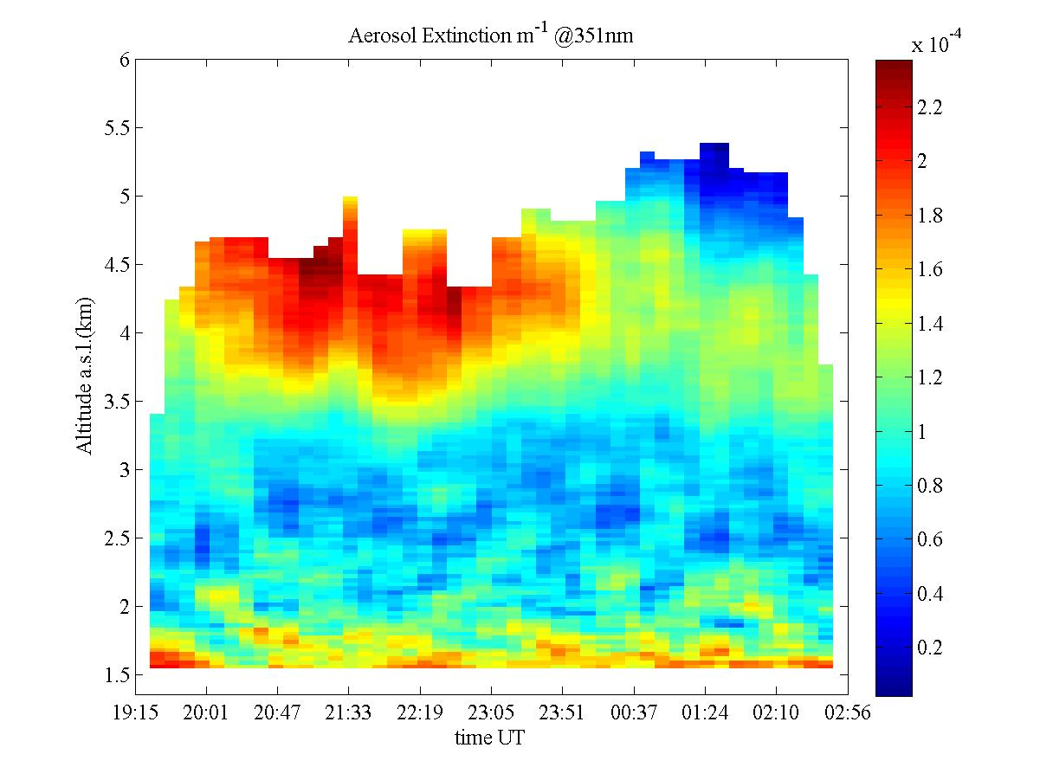
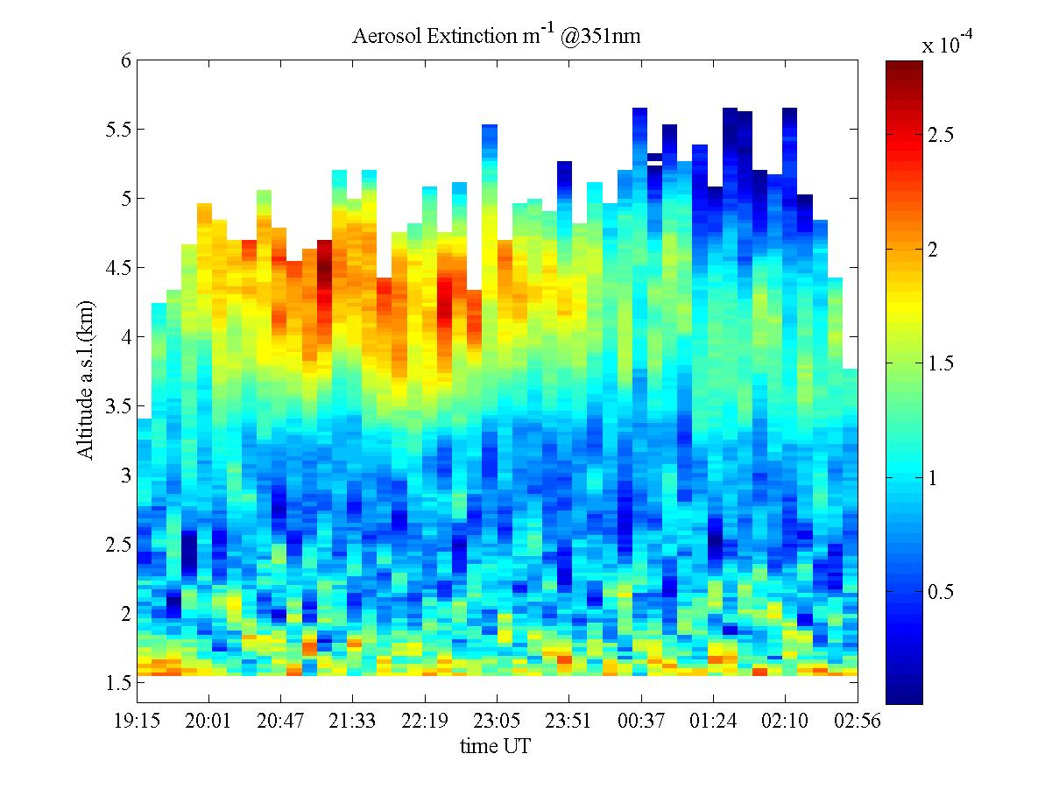
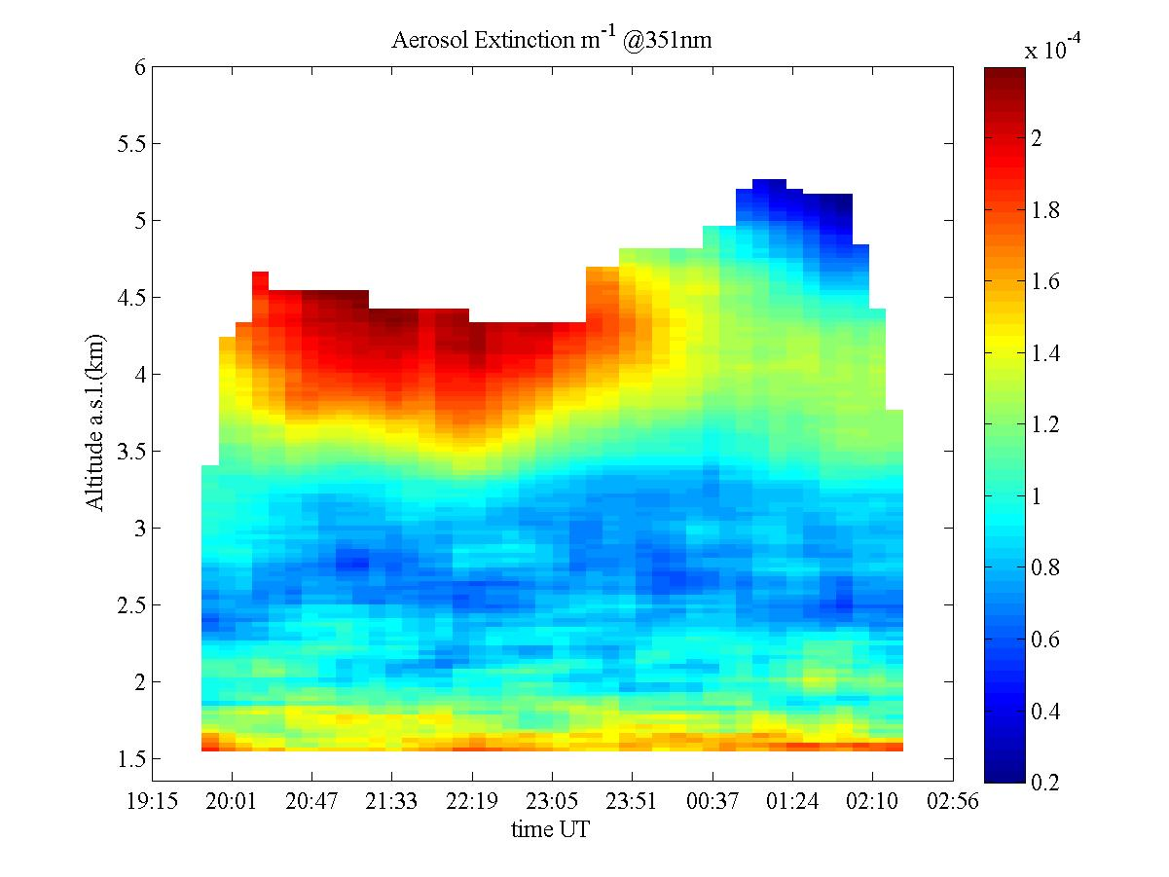
The Effective Resolution
The Horizontal Smoothing
…even more smoothed
Look at the differences in the scale for the aerosol extinction values…
Max goes from ~300 to ~220 Mm⁻¹ while min from ~0 to ~20 Mm⁻¹
AtmoHEAD 2016 – Olomouc (Czech Republic), 12-14 September 2016
Notes:
Not included in the paper

Slide 32
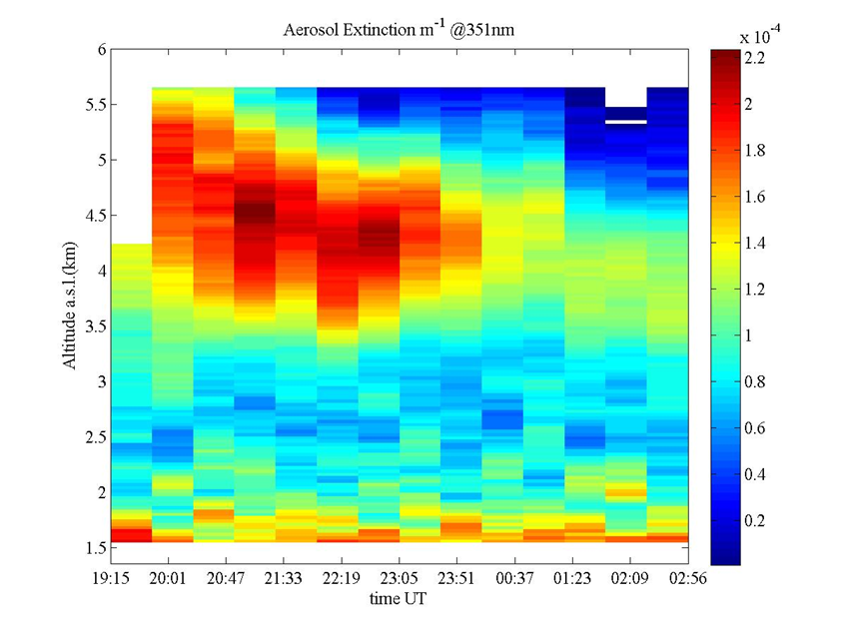
The Effective Resolution
10min profiles (smoothed)
The Horizontal Smoothing
30min profiles
10min profiles smoothed by a running mean that involve 3 profiles shows details (and a scale for the extinction values) that are comparable with a 30min profile timeseries.
AtmoHEAD 2016 – Olomouc (Czech Republic), 12-14 September 2016
Notes:
Not included in the paper

Slide 33
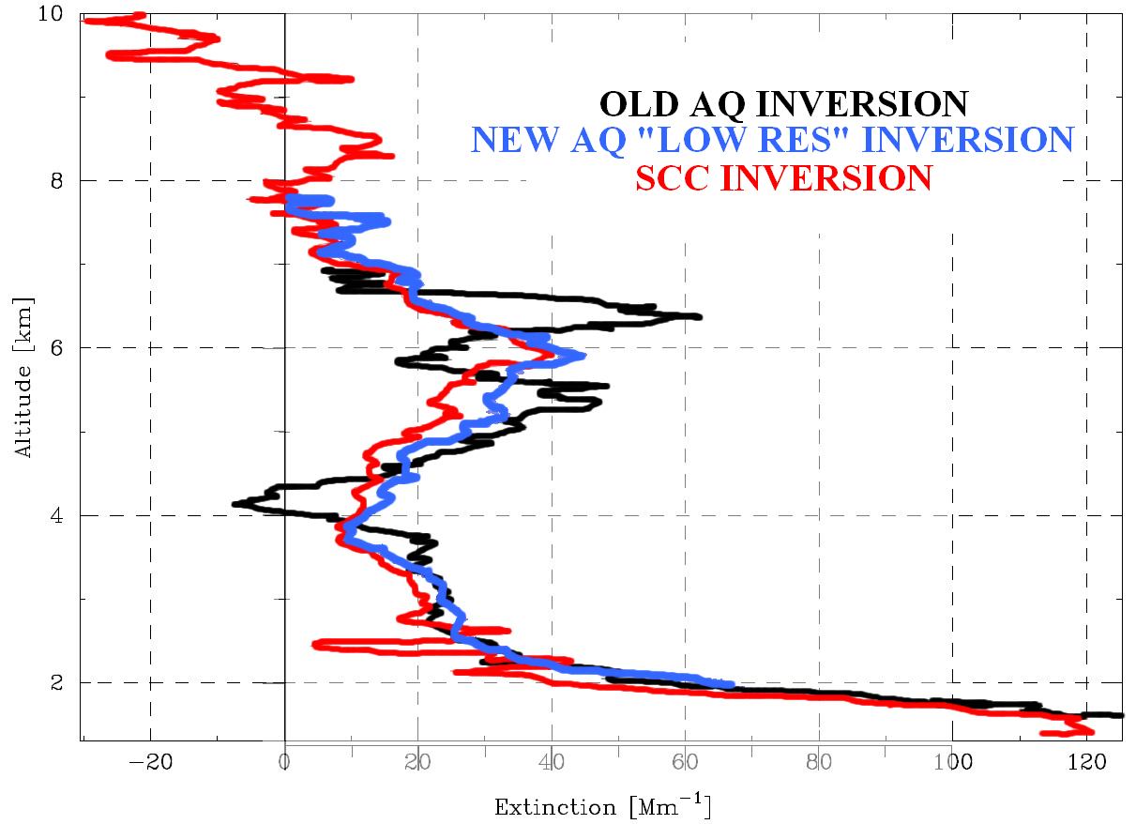
EARLINET Quality Assurance: Algorithms
The Effective Resolution
The Effective Resolution
The black profile is not “wrong”, but it has a different resolution: the information about the actual resolution it’s important.
two layers resolved
one layer resolved
AtmoHEAD 2016 – Olomouc (Czech Republic), 12-14 September 2016

Slide 34
In our community the use of the polynomial fit approach to the smoothing/derivate algorithms is quite common, but the shift to the digital filter approach gives:
Faster algorithms than the standard least square approach: an interesting feature for the SCC algorithms.
Easy to be adapted to deal properly with the large dynamic range of a lidar profile.
A relatively straightforward statistical error analysis.
An analysis of the impulse/frequency response permits ready to use, operative effective resolution definitions.
Several type of low pass filter are possible (SG filter, Gaussian, windowed… etc).
The Digital filters that we have examined are defined by the convolution:
The above Eq. is a representation of the Linear Time Invariant (LTI) Finite Impulse Response (FIR) digital filter.
The impulse response of a LTI FIR filter are the h_{k} coefficients.
The statistical error calculation is rather straightforward, if compared with the covariant matrix calculation involved when (for example) standard LS is employed:
ACTRIS Workshop – Lille 28-31 Oct 2014

Slide 35
EARLINET Quality Assurance: Algorithms
The Effective Resolution
Two approaches will be considered for the quantitative assessment of the ERes:
– The first one is related to the distortion induced by the smoothing process on any non-trivial input signal. In fact, the area preservation property (common to all the considered
smoothing filters) implies that if the peak of a layer is reduced, its spatial width will increase and potentially could overlap with another feature present in a profile. The final result will be that it is no longer possible to distinguish one peak from another (i.e., they are no longer
resolved): this means that a low-pass filter reduces the vertical resolution. This latter statement naturally leads to the use of the Rayleigh criterion for the determination the effective resolution.
– The second approach is based on the removal of high frequencies due to the smoothing operation : Noise Reduction Ratio (NRR) Criterion. Since high frequencies in space domain correspond to relatively small-scale details in the lidar profiles, if they are lost in a certain amount this will imply a reduction of the resolution in the output profile with respect to the input one. Incidentally, it should be noted that since a smoothing filter damps effectively only high frequencies and since it is common to deal with white noise, the low-frequency portion of the noise is still present in the smoothed signal, for example in the form of long-wave ripples. Moreover, a link is established between the ERes estimated with each of those two approaches and the corresponding cut-off frequency definition.
AtmoHEAD 2016 – Olomouc (Czech Republic), 12-14 September 2016

Slide 36
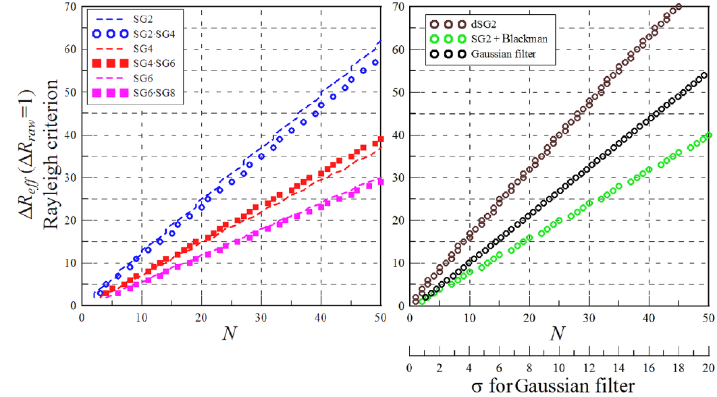
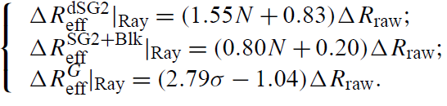
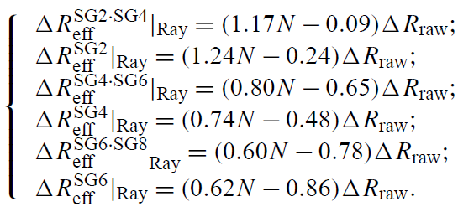
EARLINET Quality Assurance: Algorithms
The Effective Resolution
AtmoHEAD 2016 – Olomouc (Czech Republic), 12-14 September 2016

Slide 37
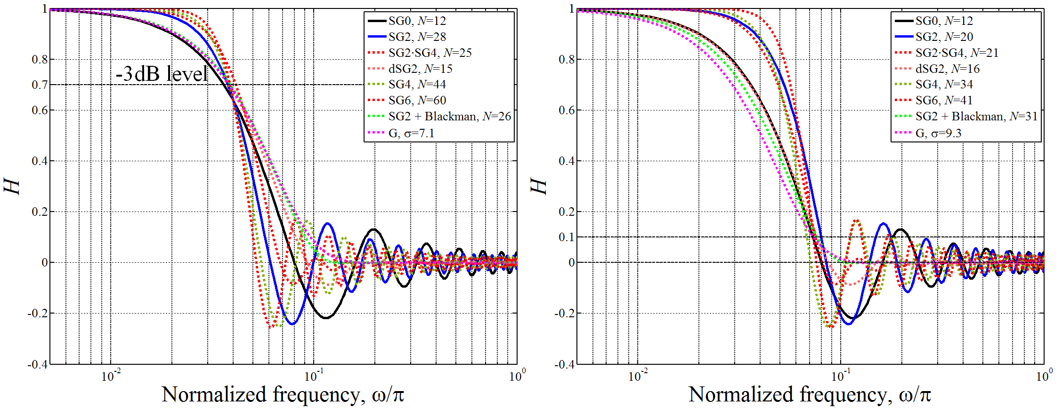
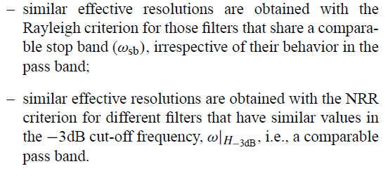
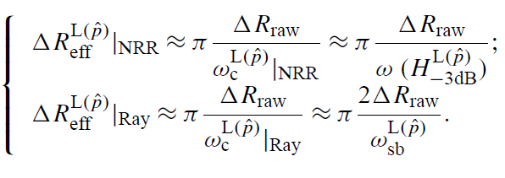
EARLINET Quality Assurance: Algorithms
The Effective Resolution
NRR Criterion
Rayleigh Criterion
Smoothing filters always convey a distortion
action on signals and a quantification/optimization/control of this effect is highly desirable: our next goal.
AtmoHEAD 2016 – Olomouc (Czech Republic), 12-14 September 2016

Slide 38
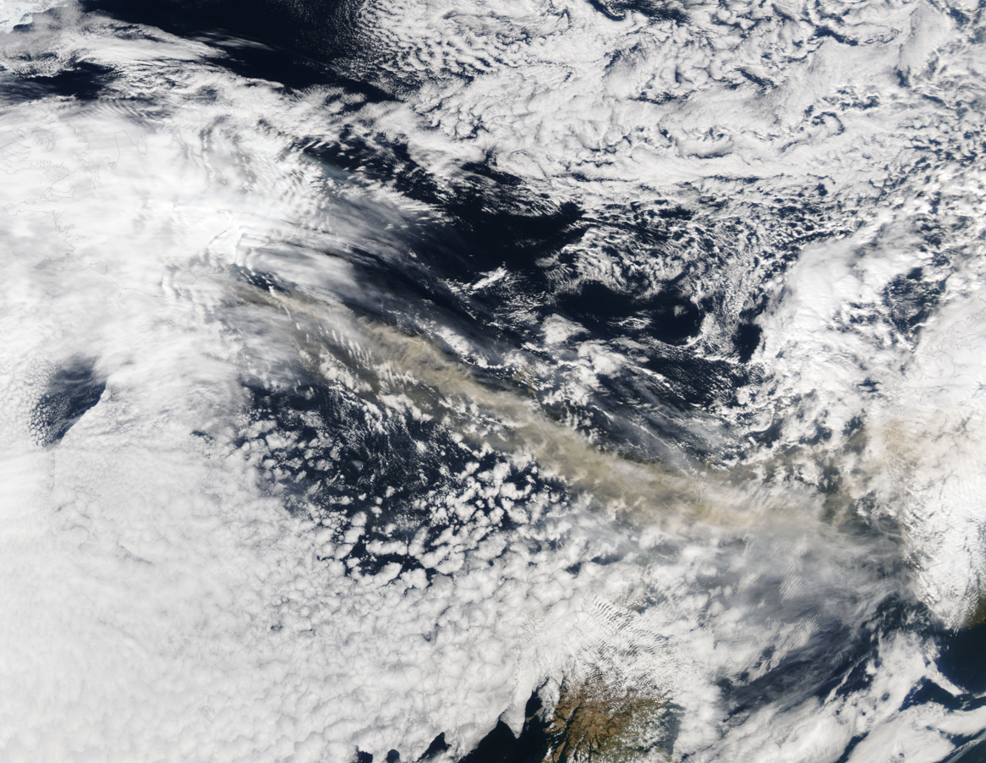
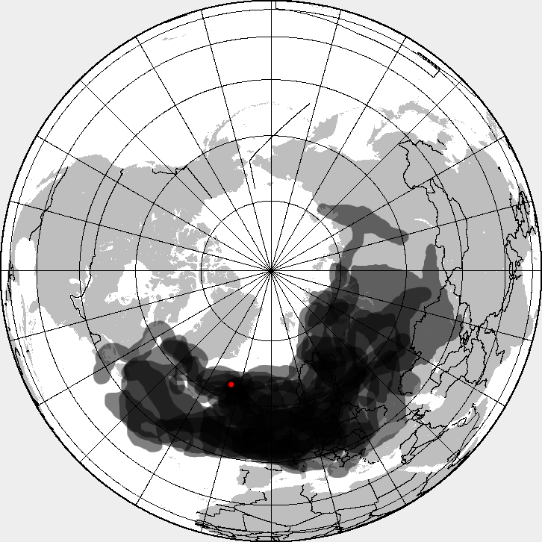
EARLINET Quality Assurance: the SCC
Among others, the case of the eruption of Eyjafjallajökull volcano in Iceland 2010 demonstrated the need for an automated tool for fast and coordinated data delivery.
AtmoHEAD 2016 – Olomouc (Czech Republic), 12-14 September 2016

Slide 39
EARLINET Data Near Real Time data analysis: the SCC
The main idea was to develop a data processing chain that allows all stations to retrieve, in a fully automatic way, the aerosol backscatter and extinction profiles starting from the raw lidar data of the lidar systems they operate.
The main advantage of this approach is that it increases the rate of population of the aerosol database of the lidar network and to promote the usage of vertically resolved aerosol parameters within the scientific community.
At the base of the SCC is also fully traceability of quality-assured aerosol optical products. The SCC ensures high-quality products by implementing quality checks on both raw lidar data and final optical products. Quality checks are part of a rigorous quality assurance program developed within EARLINET.
It is also quite important that the retrieved products are available in real time or in near-real time for large geographical areas: this means that a research network (or station) could also be operational.
EARLINET Single Calculus Chain – overview on methodology and strategy. G. D'Amico, A. Amodeo, H. Baars, I. Binietoglou, V. Freudenthaler, I. Mattis, U. Wandinger, and G. Pappalardo. Atmos. Meas. Tech., 8, 4891-4916, doi:10.5194/amt-8-4891-2015, 2015.
EARLINET Single Calculus Chain – technical – Part 1: Pre-processing of raw lidar data. Giuseppe D'Amico, Aldo Amodeo, Ina Mattis, Volker Freudenthaler, and Gelsomina Pappalardo. Atmos. Meas. Tech., 9, 491-507, doi:10.5194/amt-9-491-2016, 2016.
EARLINET Single Calculus Chain – technical – Part 2: Calculation of optical products. Ina Mattis, Giuseppe D'Amico, Holger Baars, Aldo Amodeo, Fabio Madonna, and Marco Iarlori. Atmos. Meas. Tech., 9, 3009-3029, doi:10.5194/amt-9-3009-2016, 2016.
EARLINET: potential operationality of a research network. M. Sicard et al.. Atmos. Meas. Tech., 8, 4587-4613, doi:10.5194/amt-8-4587-2015, 2015
AtmoHEAD 2016 – Olomouc (Czech Republic), 12-14 September 2016

Slide 40
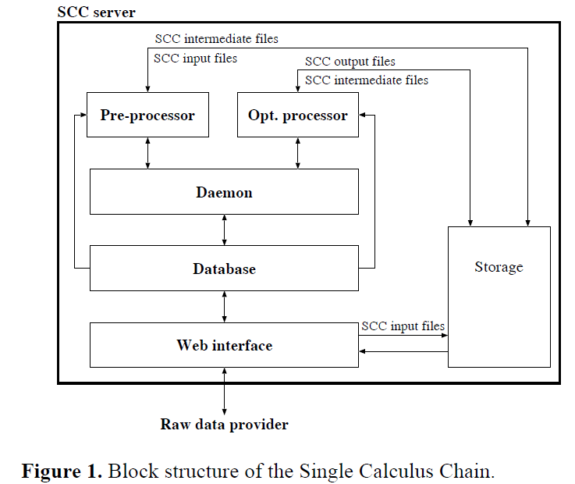
EARLINET Data Near Real Time data analysis: the SCC
AtmoHEAD 2016 – Olomouc (Czech Republic), 12-14 September 2016

Slide 41
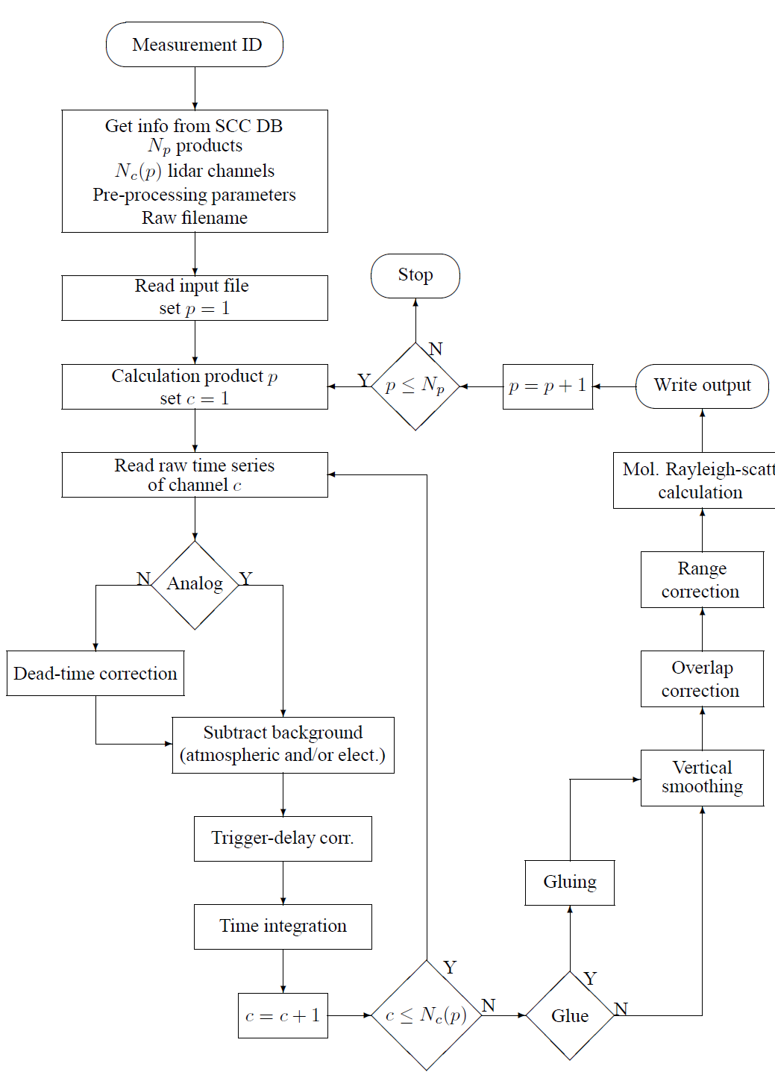
EARLINET Data Near Real Time data analysis: the SCC
ELPP (EARLINET Lidar Pre-Processor)
ELPP gets the full set of information and parameters needed for the pre-processing:
  how many products should be calculated (Np);
  how many lidar channels are needed for the calculation of each product(p);
  all input parameters required for the analysis (dead-time value, trigger delay, etc.)
Once this information is obtained, ELPP starts to calculate pre-processed signals for all configured products.
The output (i.e. the range-corrected lidar signals, the statistical
Ucertainties) and the molecular atmospheric
Profiles) is sent to the optical processor module ELDA.
AtmoHEAD 2016 – Olomouc (Czech Republic), 12-14 September 2016

Slide 42
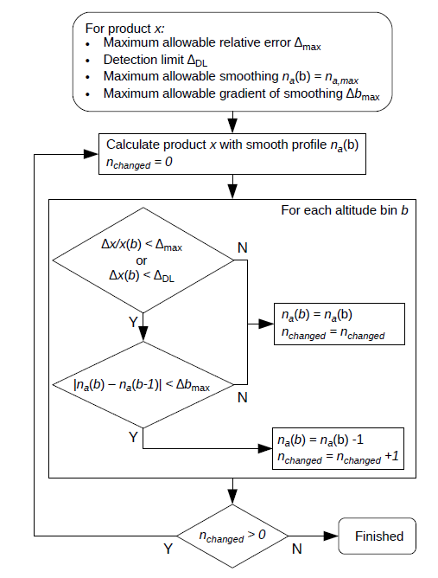
EARLINET Data Near Real Time data analysis: the SCC
ELDA (EARLINET Lidar Data Analyzer)
ELDA is the optical processor module of the SCC. It is a software package that retrieves profiles of particle backscatter coefficients that are derived from an elastic signal only or from a combination of an elastic signal and a Raman signal as well as profiles of particle extinction coefficients with the Raman method in an automatic way and without the need for operator interaction.
An expert group performed a survey among the EARLINET groups in order to compile a list of all algorithms used in the community and to collect individual solutions for critical calculus subsystems. All reported algorithms and methods have been reviewed with respect to their general applicability for the automated algorithms of the SCC software.
AtmoHEAD 2016 – Olomouc (Czech Republic), 12-14 September 2016

Slide 43
EARLINET Data Near Real Time data analysis: the SCC
For all products and retrieval algorithms, the statistical uncertainties shall be calculated with the Monte Carlo method or by means of error propagation.
Some methods and algorithms have been especially developed or adopted for ELDA like the automated vertical smoothing and temporal averaging, the handling of effective vertical resolution and the merging of product profiles in case of measurements with near-range and far-range telescopes.
The user has the option to adjust the degree of smoothing and averaging of each individual product by setting a detection limit and threshold values for the maximum allowable relative statistical error.
The development of ELDA is continuing.
Because its modular structure new products, usecases, and methods can easily be implemented, e.g., if new, more complex lidar systems are developed or if new products are required from the user community.
The Monte Carlo (MC) method is based on the random generation of new lidar signals. Each range bin of these signals is considered as a sample element of a Gauss probability distribution with mean value and standard deviation that corresponds to the value and uncertainty of the pre-processed signal profiles. The extracted lidar signals are then processed with the same algorithm to produce a set of solutions. The standard deviation of these solutions is finally used as profile of the statistical error.
AtmoHEAD 2016 – Olomouc (Czech Republic), 12-14 September 2016

Slide 44
EARLINET Quality Assurance: Conclusions
In the EARLINET collaboration since the beginning, a great importance is put in QA.
As a result a growing community, each with often very different lidar system (most of which are in-house developed) can produce good quality data.
The common ground given by the achievements of the QA in both the hardware and software side, together with the expertise gained during the last 15 year, permitted a further effort: the development of a common, automatic tool to analyze the data the Single Calculus Chain (SCC).
…and, last but not least, we have the opportunity to collaborate with other community like the UHECR one.
AtmoHEAD 2016 – Olomouc (Czech Republic), 12-14 September 2016

Slide 45
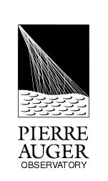
Raman LIDAR & UHECR experiments: AUGER
atmosphere as a calorimeter
fluorescence detector concept
UHECR (Ultra High Energy Cosmic Rays)
energy deposit in the atmosphere
fluorescence (UV range)
fluorescence detector
Fluorescence yield
Detector calibration
E: shower energy
T: atmospheric optical transmission
AtmoHEAD 2016 – Olomouc (Czech Republic), 12-14 September 2016

Slide 46
Raman LIDAR & UHECR experiments: AUGER
Total atmospheric (optical) transmission
It can be easily estimated with sufficient precision ...
High variability …
direct measurements
s range along the line of sight
The absorption can be neglected …
AtmoHEAD 2016 – Olomouc (Czech Republic), 12-14 September 2016

Slide 47

Raman LIDAR & UHECR experiments: AUGER
http://apcauger.in2p3.fr/Public/Presentation/
AtmoHEAD 2016 – Olomouc (Czech Republic), 12-14 September 2016

Slide 48
Raman LIDAR & UHECR experiments: AUGER
Raman Lidar is one of standard and more reliable instruments in the atmospheric physic to measure the profiles of the optical properties of the aerosols.
For this reason it was natural to propose it to the AUGER community for the required vertical aerosol optical depth (VAOD) measurements.
With the expertise gained in the EARLINET we developed high quality Raman Lidars for the AUGER experiment.
They have been tested against our Quality Assured “EARLINET certified” Raman Lidar.
The measurements are of good quality, but they have been proved to be more challenging (and so stimulating!) because we had to push the capability of the instrument near to its limit mainly because the very low aerosol content.
AtmoHEAD 2016 – Olomouc (Czech Republic), 12-14 September 2016

Slide 49

Raman LIDAR & UHECR experiments: AUGER
# 1
Aug. 2006 to Jun. 2007
RAMAN LIDAR (located at Los Leones: 35.32S, 69.30W, 1416m a.s.l.),
remotely operated, with the primary goal of measuring (at the best) the
vertical profile of the aerosol optical depth.
In spite of some problems, one year of observations allows to characterize the aerosols climatology over the site.
AtmoHEAD 2016 – Olomouc (Czech Republic), 12-14 September 2016
V.R.

Slide 50





Raman LIDAR & UHECR experiments: AUGER
The RAMAN CORNER
RAMAN
receiver
Elastic
Optical fiber
from telescope
O₂
Laser
N₂
V.R.
V.R.
DAQ
telescope
V.R.
V.R.
V.R.
AtmoHEAD 2016 – Olomouc (Czech Republic), 12-14 September 2016

Slide 51

Raman LIDAR & UHECR experiments: AUGER
An example of RAMAN LIDAR data
The aerosol extinction, backscatter and lidar ratio profiles measured on May 18, 2007 (about 48000 laser shots) in the period 19:26-20:06LT. The error bars indicate the propagated statistical indetermination
Entrainment zone
Planetary Boundary Layer
AtmoHEAD 2016 – Olomouc (Czech Republic), 12-14 September 2016

Slide 52
Raman LIDAR & UHECR experiments: AUGER
AtmoHEAD 2016 – Olomouc (Czech Republic), 12-14 September 2016

Slide 53
Raman LIDAR & UHECR experiments: AUGER
VAOD and INTβ monthly mean values (at about 5km)
summer
autumn
winter
spring
AtmoHEAD 2016 – Olomouc (Czech Republic), 12-14 September 2016

Slide 54
The Raman (monthly mean) VAODs and INTβ:
Low values during late fall and early winter
High values in summer
Relative high content of aerosols in late winter and early spring (diffuse regional meteorological pattern? Increased occurence of dust storms? …)
AtmoHEAD 2016 – Olomouc (Czech Republic), 12-14 September 2016

Slide 55
Raman LIDAR & UHECR experiments: AUGER
# 2
Sept. 2010 to July 2011
RAMAN LIDAR (located at 37.9228N, 102.6109W and 1198m a.s.l. in Prowers County, Colorado, about 15 km south of Lamar, Colorado, USA).
remotely operated, with the primary goal of measuring (at the best) the
vertical profile of the aerosol optical depth to be compared with simultaneous side scattering technique.
AtmoHEAD 2016 – Olomouc (Czech Republic), 12-14 September 2016

Slide 56

The Raman LIDAR system: the side pictures show the 3 channel LIDAR receiver, the telescope, and the laser transmitter (UV mirrors, and beam expander).
AtmoHEAD 2016 – Olomouc (Czech Republic), 12-14 September 2016

Slide 57



Raman LIDAR & UHECR experiments: AUGER
The LT is an optical bench housing the laser, two 1” dichroic beam splitters (DBS), a flipper mirror (FM), an iris diaphragm (IR), a depolarizer (DP), a 2” and
a 1” steering mirrors (SMR and SMS), 2 beam-expanders (5X and 10X, BEX5 and BEX10), and an energy probe (EP), all these components generate and characterize the laser pulse that is vertically sent in the atmosphere. The dichroic beam splitters remove the residuals of the primary and second harmonics still present in the pulse of the diode pumped Nd:YAG laser; the flipper mirror sitting along the path of the laser pulse can be set in two different positions: when is up the LT generate the laser pulse for the Raman LIDAR; when is down, it sends the laser pulse to the LT part that generates the laser pulse for Side Scattering Detector.
AtmoHEAD 2016 – Olomouc (Czech Republic), 12-14 September 2016

Slide 58
Raman LIDAR & UHECR experiments: AUGER
Left: The VAODs data versus time as measured with the AMT (black dots) and the Raman LIDAR (blue squares) at 6 km a.g.l. Right: VAODs measured with the AMT versus Raman LIDAR for hours observed with both instruments. The diagonal is shown in black, a fit to the black dots in red.
AtmoHEAD 2016 – Olomouc (Czech Republic), 12-14 September 2016

Slide 59
Raman LIDAR & UHECR experiments: AUGER
# 3
May 2013 to …
RAMAN LIDAR (located at 35°16'50.65"S, 69°20'12.26"O and 1379m a.s.l. in Central Raman LIDAR Facility (previous Central Laser Facility) at AUGER observatory
remotely operated, with the primary goal of measuring (at the best) the
vertical profile of the aerosol optical depth to be the benchmark of the measurements carried with FD telescopes and the central laser.
AtmoHEAD 2016 – Olomouc (Czech Republic), 12-14 September 2016

Slide 60




The Raman LIDAR at C(R)LF
AtmoHEAD 2016 – Olomouc (Czech Republic), 12-14 September 2016

Slide 61

Raman LIDAR
Weather
Station
Microwave
Link
Insulation
Laser,
Beam Switching,
Robotic Calibration
Storage and
future expansion
Thermal
Reservoir
(2000 L Water)
Batteries
AtmoHEAD 2016 – Olomouc (Czech Republic), 12-14 September 2016

Slide 62
This LIDAR and analysis methods benchmarked against EARLINET
STATUS and PERFORMANCES of the Raman LIDAR:
opto-mechanics highly stable;
low power consumption;
sampling from boundary layer to free troposphere;
one vertical profile of AOD and aerosol backscatter in 12’ or 24’.
UPGRADE of the Raman LIDAR:
capability to measure the H2O mixing ratio profile;
better detection of the (weak) Raman backscatterings;
AtmoHEAD 2016 – Olomouc (Czech Republic), 12-14 September 2016

Slide 63
CLF benchmarking
PRODUCTS of the Raman LIDAR:
- Aerosol Optical Depth at different altitudes
- aerosol backscatter coefficient vertical profile
- water vapour mixing ratio profile
30min before and after the FD run (2 profiles/day)
vertical resolution of about 0.1 km
realtime AOD estimation and cloud detection
new
AtmoHEAD 2016 – Olomouc (Czech Republic), 12-14 September 2016

Slide 64


Quality of the Raman LIDAR
VAOD measurements at C(R)LF
AtmoHEAD 2016 – Olomouc (Czech Republic), 12-14 September 2016

Slide 65


Raman LIDAR
Vertical Aerosol Optical Depth $τ_{aer}\left(s\right)$
sources of errors
constant
range scale
N₂ Raman backscatter
$$τ_{aer}\left(s\right)=−\frac{log\left(\frac{C∙s^{2}L_{R}\left(s\right)}{T_{mol}\left(s\right)∙T_{mol}^{R}\left(s\right)∙n_{mol}\left(s\right)}\right)}{1+{\left(\frac{λ_{o}}{λ_{R}}\right)}^{k}}$$
optical properties of
molecular atmosphere
Angstrom exponent
RANDOM/STATISTICAL
SYSTEMATIC
AtmoHEAD 2016 – Olomouc (Czech Republic), 12-14 September 2016

Slide 66
Raman LIDAR
Vertical Aerosol Optical Depth $τ_{aer}\left(s\right)$
sources of errors
- statistics of N₂ Raman backscatter and background
- constant (calibration)
- N₂ Raman deadtime correction (PhotonCounting)
- setting of the range scale (0th bin and binning)
- Angström exponent (aerosol properties, to be assumed)
- variability of the optical properties of molecular atmosphere (to be assumed)
RANDOM/STATISTICAL
SYSTEMATIC
AtmoHEAD 2016 – Olomouc (Czech Republic), 12-14 September 2016

Slide 67

AtmoHEAD 2016 – Olomouc (Czech Republic), 12-14 September 2016

Slide 68


Max Count Rate for PhC < 1/tau=90Mhz
AtmoHEAD 2016 – Olomouc (Czech Republic), 12-14 September 2016

Slide 69








Raman LIDAR
Vertical Aerosol Optical Depth $τ_{aer}\left(s\right)$
estimations of the errors
12 min standard acquisition: $N_{laser} shots \sim 24000; {∆t}_{bin} =200 ns$
SYSTEMATIC (MAX)
${\left.{∆τ}_{aer}\left(s\right)\right|}_{t_{d}}≅− 0.01$ $\left(if not accounted for\right);$
$t_{d}=11.2 ns and{ ∆t}_{d}=±0.4 ns (negligible effects on indetermination$);
${\left.{∆τ}_{aer}\left(s\right)\right|}_{t_{o}}≅± 0.00\text{5} \left(if not accounted for\right)$;
$∆t_{o}=± 50 ns$ (laser output jitter)
$${\left.{∆τ}_{aer}\left(s\right)\right|}_{t_{o}}=±0.001$$
$${\left.{∆τ}_{aer}\left(s\right)\right|}_{k}≅− 0.04∙τ_{aer}\left(s\right) \left(if not accounted for\right)$$
$$k=1 ±0.5 \left(aerosol type\right)$$
$${\left.{∆τ}_{aer}\left(s\right)\right|}_{k}≅± 0.02∙τ_{aer}\left(s\right)$$
$${\left.{∆τ}_{aer}\left(s\right)\right|}_{mol}≅− 0.001 \left(Rayleigh scattering cross sections\right)$$
$${\left.{∆τ}_{aer}\left(s\right)\right|}_{mol}≅+ 0.005 \left(temperature and pressure\right)$$
$${\left.{∆τ}_{aer}\left(s\right)\right|}_{mol}≅±0.005$$
AtmoHEAD 2016 – Olomouc (Czech Republic), 12-14 September 2016

Slide 70









Raman LIDAR
Vertical Aerosol Optical Depth $τ_{aer}\left(s\right)$
estimations of the errors
12 min standard acquisition: $N_{laser} shots \sim 24000; {∆t}_{bin} =200 ns (=30 m)$
$${\left.{∆τ}_{aer}\left(s\right)\right|}_{L_{R}(s)}≅± 0.01 (s ≤3 km)$$
$$s ≤3 km$$
$$τ_{aer}\left(s\right) \sim 0.05$$
$${\left.{∆τ}_{aer}\left(s\right)\right|}_{B}≅± 0.003 (s ≤3 km)$$
$${\left.{∆τ}_{aer}\left(s\right)\right|}_{stat} ≅± 0.011$$
$${\left.{∆τ}_{aer}\left(s\right)\right|}_{calib}≅± 0.004$$
$${\left.{∆τ}_{aer}\left(s\right)\right|}_{t_{o}}=±0.001$$
$${\left.{∆τ}_{aer}\left(s\right)\right|}_{syst} ≅± 0.011$$
$${\left.{∆τ}_{aer}\left(s\right)\right|}_{k}≅± 0.02∙τ_{aer}\left(s\right)$$
$${\left.{∆τ}_{aer}\left(s\right)\right|}_{mol}≅±0.005$$
AtmoHEAD 2016 – Olomouc (Czech Republic), 12-14 September 2016

Slide 71


Raman LIDAR
Vertical Aerosol Optical Depth $τ_{aer}\left(s\right)$
estimations of the errors
12 min standard acquisition: $N_{laser} shots \sim 24000; {∆t}_{bin} =1400 ns (=210 m)$
$${\left.{∆τ}_{aer}\left(s\right)\right|}_{L_{R}(s)}≅± 0.004 (s ≤3 km)$$
$$s ≤3 km$$
$$τ_{aer}\left(s\right) \sim 0.05$$
$${\left.{∆τ}_{aer}\left(s\right)\right|}_{B}≅± 0.003 (s ≤3 km)$$
$${\left.{∆τ}_{aer}\left(s\right)\right|}_{stat} ≅± 0.006$$
$${\left.{∆τ}_{aer}\left(s\right)\right|}_{calib}≅± 0.004$$
$${\left.{∆τ}_{aer}\left(s\right)\right|}_{t_{o}}=±0.001$$
$${\left.{∆τ}_{aer}\left(s\right)\right|}_{syst} ≅± 0.011$$
$${\left.{∆τ}_{aer}\left(s\right)\right|}_{k}≅± 0.02∙τ_{aer}\left(s\right)$$
$${\left.{∆τ}_{aer}\left(s\right)\right|}_{mol}≅±0.005$$
LOWER VERTICAL RESOLUTION
AtmoHEAD 2016 – Olomouc (Czech Republic), 12-14 September 2016

Slide 72

Raman LIDAR
Vertical Aerosol Optical Depth $τ_{aer}\left(s\right)$
estimations of the errors
12 min standard acquisition: $N_{laser} shots \sim 24000; {∆t}_{bin} =1400 ns (=210 m)$
$${\left.{∆τ}_{aer}\left(s\right)\right|}_{L_{R}(s)}≅± 0.004 (s ≤3 km)$$
$$s ≤3 km$$
$$τ_{aer}\left(s\right) \sim 0.05$$
$${\left.{∆τ}_{aer}\left(s\right)\right|}_{B}≅± 0.003 (s ≤3 km)$$
$${\left.{∆τ}_{aer}\left(s\right)\right|}_{stat} ≅± 0.006$$
$${\left.{∆τ}_{aer}\left(s\right)\right|}_{calib}≅± 0.004$$
$${\left.{∆τ}_{aer}\left(s\right)\right|}_{t_{o}}=±0.0005$$
$${\left.{∆τ}_{aer}\left(s\right)\right|}_{syst} ≅± 0.011$$
$${\left.{∆τ}_{aer}\left(s\right)\right|}_{k}≅± 0.02∙τ_{aer}\left(s\right)$$
$${\left.{∆τ}_{aer}\left(s\right)\right|}_{mol}≅±0.005$$
BETTER KNOWLEDGE OF TIMING
AtmoHEAD 2016 – Olomouc (Czech Republic), 12-14 September 2016

Slide 73

Raman LIDAR
Vertical Aerosol Optical Depth $τ_{aer}\left(s\right)$
estimations of the errors
The indetermination on VAOD with 210 m vertical resolution is:
$± 0.006$ due to statistics
$± 0.011$due to systematics
The (RL) VAOD at 3km a.g.l. is:
0.08 mean 0.04 std.dev.
AtmoHEAD 2016 – Olomouc (Czech Republic), 12-14 September 2016

Slide 74
Raman LIDAR Status and Future in UHECR experiments
RL for AUGER is in good shape.
Exploiting our AUGER experience, for CTA we will build a Raman LIDAR with Turin e Naples university, starting from the ARCADE design (see the LAURA Valore talk) handling both the hardware side and data analysis.
We would start with the site characterization then in the future the Raman Lidar could be one of the operative tools for the atmospheric monitoring of CTA.
AtmoHEAD 2016 – Olomouc (Czech Republic), 12-14 September 2016

Slide 75
Thank you!
AtmoHEAD 2016 – Olomouc (Czech Republic), 12-14 September 2016

Slide 76
EXTRA SLIDES
AtmoHEAD 2016 – Olomouc (Czech Republic), 12-14 September 2016

Slide 77



EXTRA SLIDES
From Ina Mattis
(Deutscher Wetterdienst, Meteorologisches Observatorium
Hohenpeißenberg, Germany)
AtmoHEAD 2016 – Olomouc (Czech Republic), 12-14 September 2016

Slide 78

AtmoHEAD 2016 – Olomouc (Czech Republic), 12-14 September 2016

Slide 79
PERFORMANCES of the Raman LIDAR
aerosol nightime variability
Before and after a FD shift night.

Slide 80

Before

Slide 81

After
evolution of boundary layer

Slide 82
PERFORMANCES of the Raman LIDAR
aerosol day to day variability
Clean and dirty nights along a FD shift.

Slide 83

Clean

Slide 84

Dirty

Slide 85



UPGRADES of the Raman LIDAR at CLRF
Liquid Light Guide (LLG) replacement
AIR channel neutral density filters
N2/H2O Raman signals beam splitter
Single Board Computer (SBC) power supply 12V/5V converter

Slide 86


Slide 87

large particles
LR ∼10÷30sr
desert aerosols
LR ∼35÷45sr
continental
aerosols
LR ∼50÷70sr
dust or
polluted aerosol
LR ∼80÷100sr
τ(4.5 km)

Slide 88



The Liquid Light Guide will be replaced by:
∼720 ∅ 250μm fibers
… and better transmission.

Slide 89


One of the neutral density filters (NDS50, t≅0.38, or NDS40, t≅0.30) in front of the AIR PMT will be removed to increase the signal of a factor 3.

Slide 90


The dichroic mirror splitting H2O and N2 Raman returns will be replaced by a more efficient beam splitter.
>90%
<0.1%

Slide 91


The SBC 12V/5V converter is based on the switching regulator RECOM 0642:
R-78B5.0-1.5
Vin = 6.5-18 V
Vout = 5.0 V (max 1.5 A)
With a blocking diode for protection and capacitor filtering.

Slide 92
Aerosol extinction algorithm
Polynomial fit approach

Slide 93
Aerosol extinction algorithm
Digital filter approach
If c_{k} are determined by least square approach the digital filter is often called Savitzky-Golay (SG) Filter

Slide 94
Aerosol extinction algorithm

Slide 95
Aerosol extinction algorithm

Slide 96
Aerosol backscatter algorithm
Polinomial filter smoothing effect
Derivative filter smoothing effect

Slide 97




EARLINET Quality Assurance: Instruments
Internal Quality check-up
L’AQUILA Raman Lidar Telecover Test
Goal:
- test and verify the alignment of laser and optics and
- determine the distance of full overlap.
Principle:
- compare lidar signals from different parts of the telescope aperture.
Some Findings:
Complete overlap estimation ~0.7km
easy E-W alignment, more tricky N-S
No “exit” of the beam from telescope FOV
AtmoHEAD 2016 – Olomouc (Czech Republic), 12-14 September 2016

Slide 98

EARLINET Quality Assurance: Instruments
Internal Quality check-up
AQ RayFitTest
This checkup tells us the quality of the signals in the far range. Especially analog signals show distortions there. Additionally we gather information about the use of Radiosonde data at different sites.
AtmoHEAD 2016 – Olomouc (Czech Republic), 12-14 September 2016

