Slide 1
Introduction for summer students
2016

Slide 2
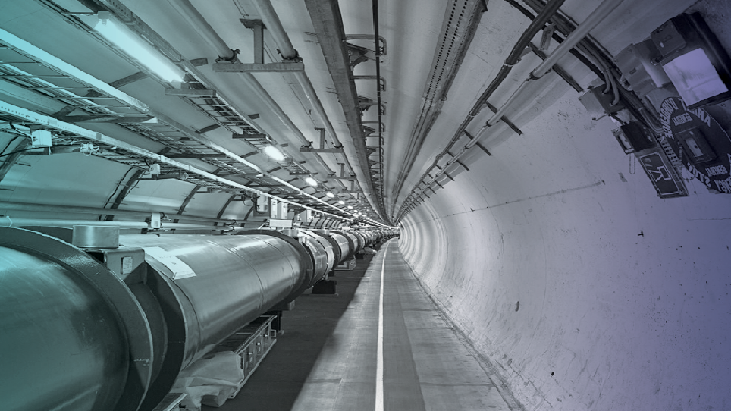
CERN: A UNIQUE
ENVIRONMENT IN WHICH
TO PUSH TECHNOLOGIES
TO THEIR LIMITS

Slide 3
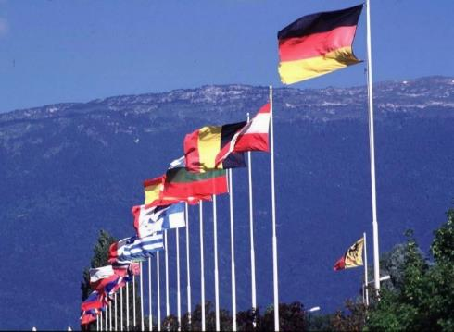
What is CERN?
European Organization for Nuclear Research
~ 2300 staff
~ 1050 other paid personnel
~ 11000 users
Budget ~1100 MCHF
Founded in 1954
Member States: Austria, Belgium, Bulgaria, Czech Republic, Denmark, Finland, France, Germany, Greece, Hungary, Israel, Italy, Netherlands, Norway, Poland, Portugal, Slovakia, Spain, Sweden, Switzerland and United Kingdom
Candidate for accession: Romania
Associate Members in the Pre-Stage to Membership:, Cyprus, Serbia,
Associate Members: Pakistan, Turkey
Observers to Council: India, Japan, Russia, United States of America, the European Commission, Joint Institute for Nuclear Research and UNESCO
Summer Students 2016
CERN openlab Introduction
3

Slide 4
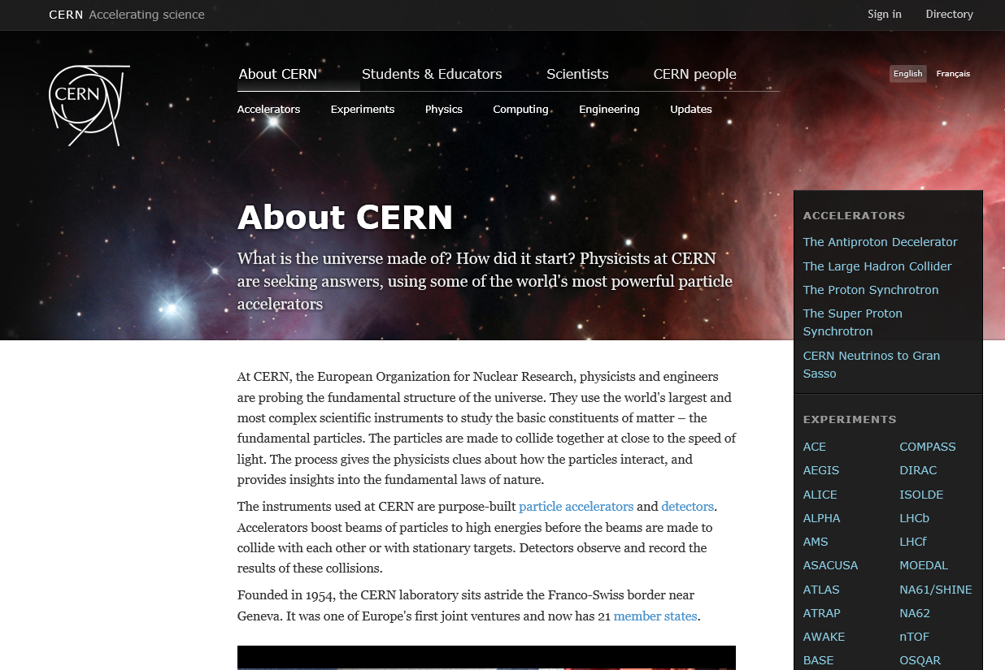

CERN Structure
Beams
Information Technology
Site Management and Buildings
Human Resources
Engineering
Theoretical physics
Technology
Site Management and Buildings
Experimental physics
http://home.cern
http://home.cern/about
Industry, Procurement and Knowledge Transfer

Slide 5
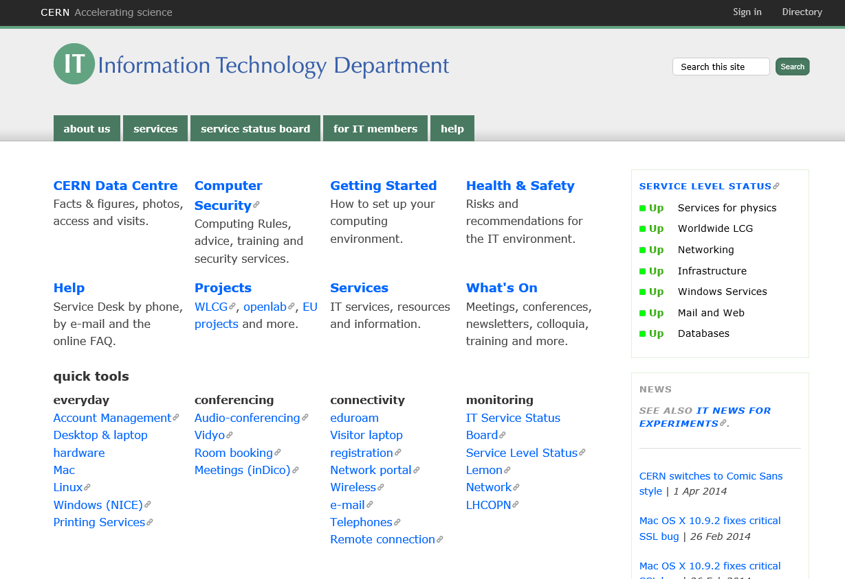
IT Department
http://information-technology.web.cern.ch/

Slide 6
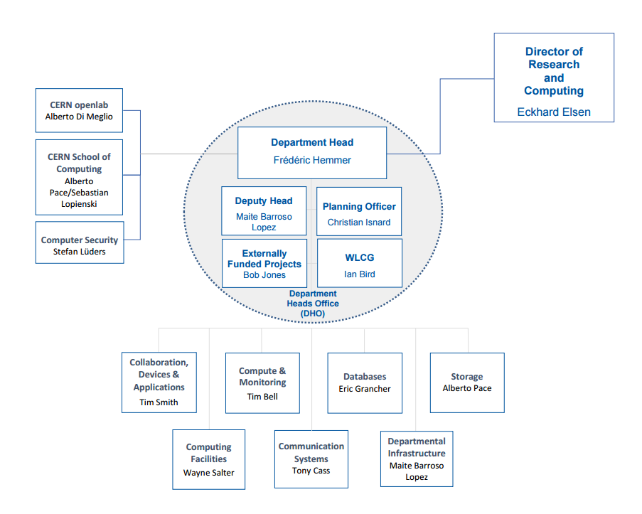
IT Department Structure

Slide 7
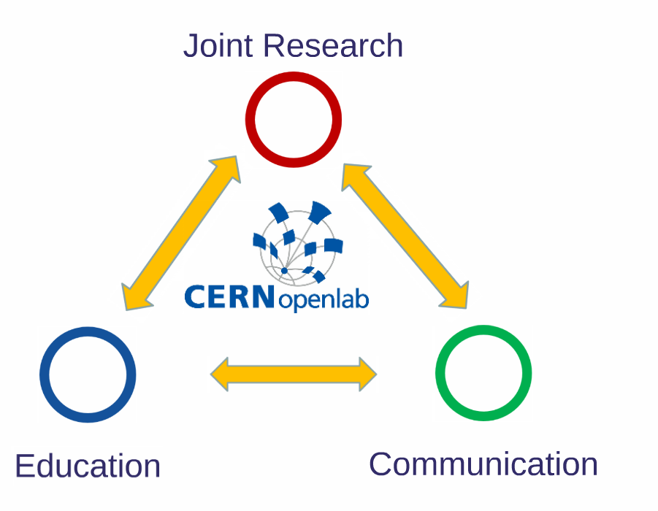
CERN openlab in a nutshell
A science – industry partnership to drive R&D and innovation
with over a decade of success
Evaluate state-of-the-art technologies in a challenging environment and improve them
Test in a research environment today what will be used in many business sectors tomorrow
Train next generation of engineers/employees
Disseminate results and outreach to new audiences
Summer Students 2016
CERN openlab Introduction
7

Slide 8
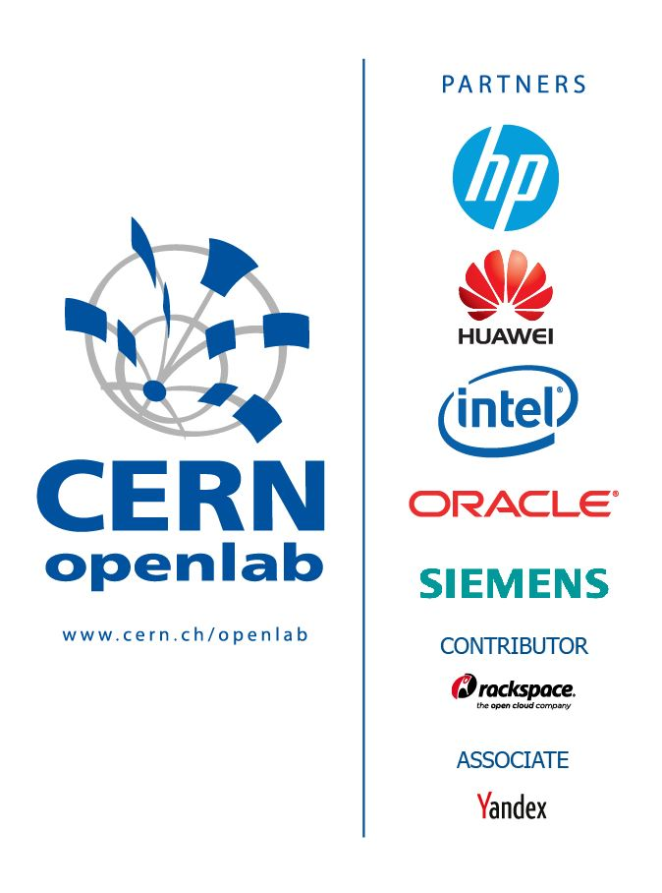












Partners
Contributors
Associates
Research
Summer Students 2016
CERN openlab Introduction
8

Slide 9

CERN openlab Phase V

Slide 10
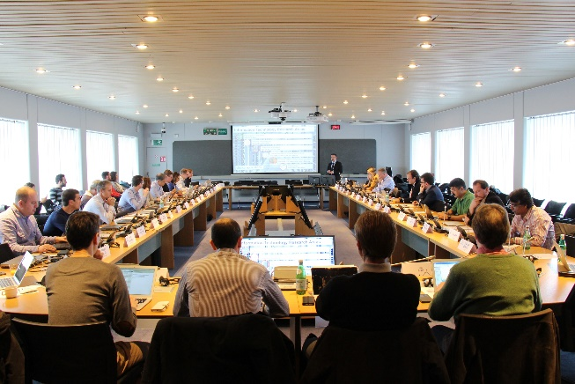
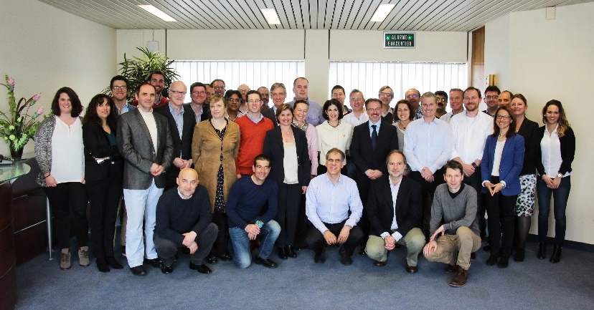
15 Years of Successful Collaboration
I
2003
II
2006
III
2009
IV
2012
V
2015
15 Years
Anniversary
2016
Set-up
2001
CERN openlab Collaboration Board 2016
Summer Students 2016
CERN openlab Introduction
10

Slide 11



























The community
Summer Students 2016
CERN openlab Introduction
11

Slide 12
How do we manage it?
Mgmt team
(Head, CTO, Comms, Admin)
Project 1
(Project leader)
Project 2
(Project leader)
Project N
(Project leader)
Collaboration Board
(all members represented)
CERN Partner Contacts
CERN/IT Mgmt.
(DHO, IT-EC Project
Office, etc.), Legal, KT
Summer Students 2016
CERN openlab Introduction
12

Slide 13
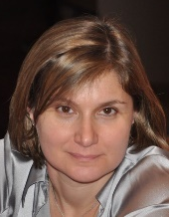
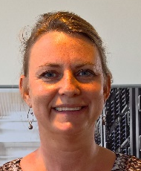

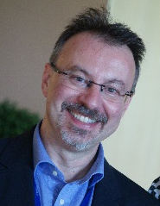

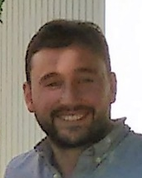
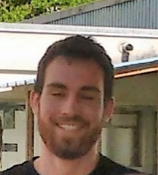
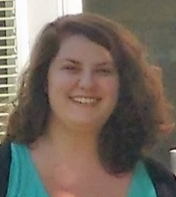
The Team
Kristina Gunne
CERN openlab
Admin/Finance Officer
Maria Girone
CERN openlab
CTO
Fons Rademakers
CERN openlab
CRO
Sotirios Pavlou
Junior Admin Officer
Maria-Athanasia Pachou
Junior Communication Officer
Alberto Di Meglio
CERN openlab
Head
Melissa Gaillard
IT Department Communication Officer
Andrew Purcell
CERN openlab
Communication Officer
Summer Students 2016
CERN openlab Introduction
13

Slide 14

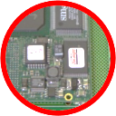


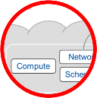


The Technical Programme
Data acquisition and filtering
Collecting data
Networks and connectivity
Connecting resources
Data storage architectures
Storing and serving data
Compute management and provisioning (cloud)
Managing resources for processing
Computing platforms, data analysis, simulation
Improving processing and code efficiency
Medical applications
Data analytics/Machine Learning
Extracting information

Slide 15

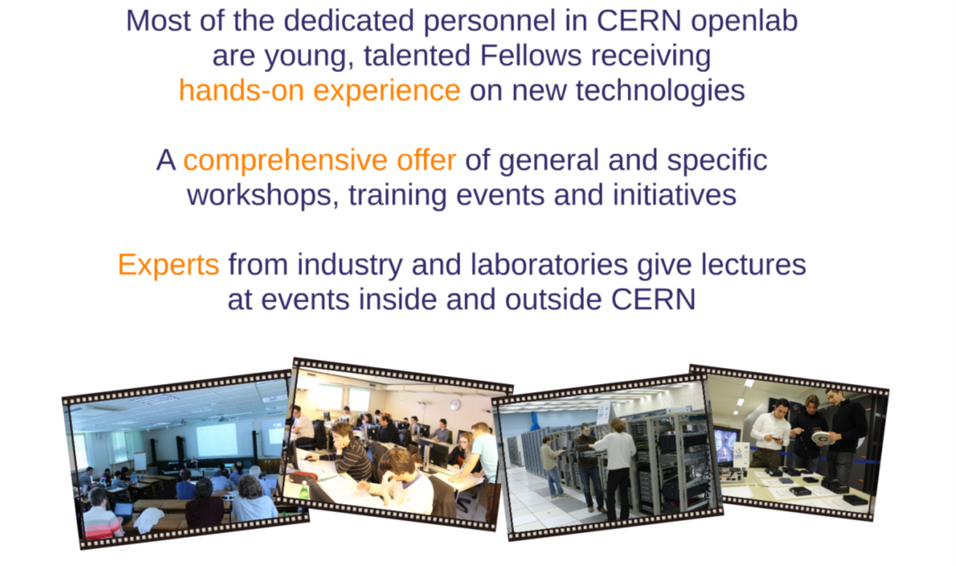
The Educational Programme
Summer Students 2016
CERN openlab Introduction
15

Slide 16
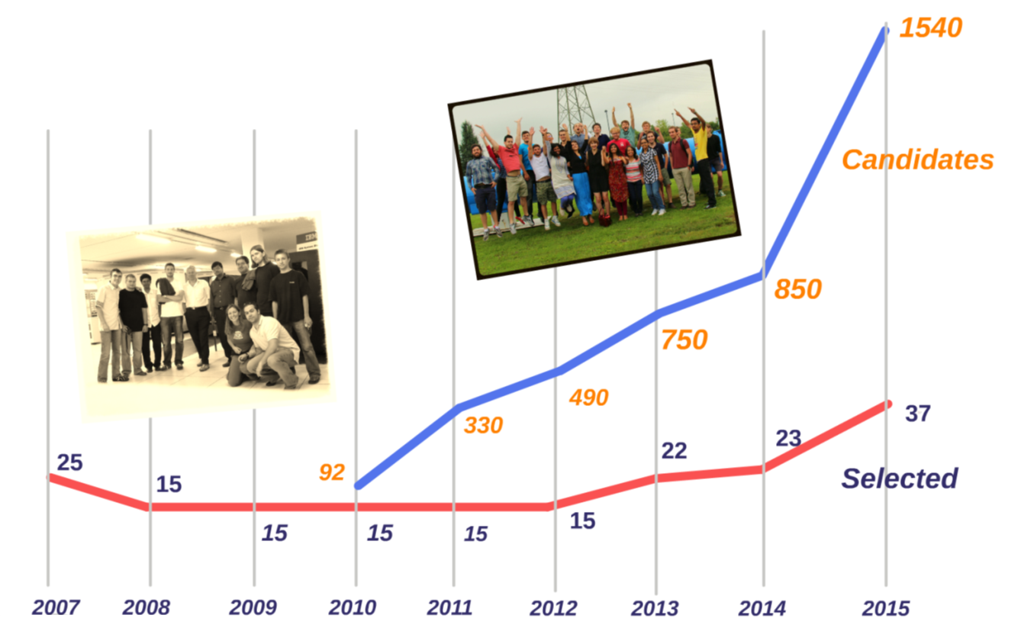
Summer Student Programme
  In 2016
  ~1500 applicants
  39 selected students
  Lecture series
  Visits to external labs/companies
  Lightning talks session
40
Summer Students 2016
CERN openlab Introduction
16

Slide 17
Your CERN Experience
9 weeks
A project to complete
A report to be submitted
  Template provided (http://openlab.web.cern.ch/templates)
  Initial draft after 4 weeks (table of content, main sections)
  Final draft to your supervisor a week before leaving
A 5-minute ‘lightning talk’ to describe your project and its outcome
Visits to external companies and research institutes
A series of lectures about IT, computing and data management applied to HEP and other scientific domains
  http://indico.cern.ch/category/8040/
Summer Students 2016
CERN openlab Introduction
17

Slide 18
Confidentiality agreement
Some of you will be carrying out work that is confidential.
You may be working with technologies from industrial partners that is still under a non-disclosure agreement (NDA).
Summer Students 2016
CERN openlab Introduction
18

Slide 19
Summer student guide
http://indico.cern.ch/
event/537114/
overview
Summer Students 2016
CERN openlab Introduction
19

Slide 20
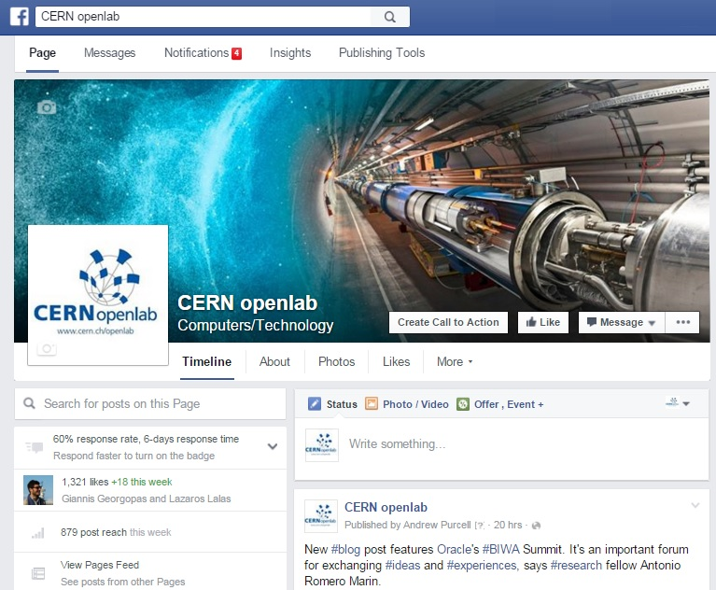

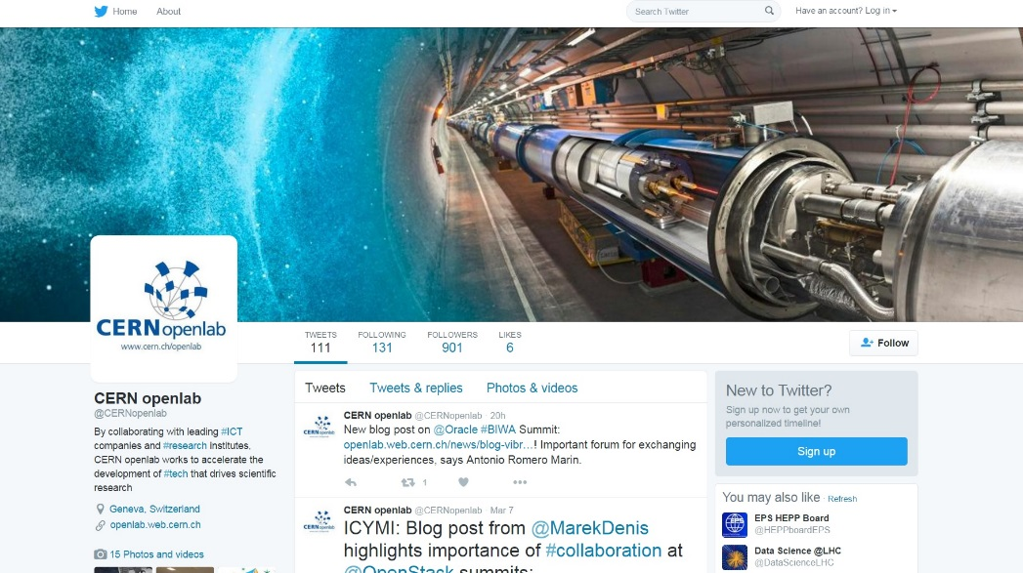
Connect with us – and each other!
http://cern.ch/go/lw7v
http://cern.ch/go/9s9L
Summer Students 2016
CERN openlab Introduction
20
@CERNopenlab

Slide 21
Executive contact
Alberto Di Meglio, CERN openlab Head
alberto.di.meglio@cern.ch
Technical contacts
Maria Girone, CERN openlab CTO
maria.girone@cern.ch
Fons Rademakers, CERN openlab CRO
fons.rademakers@cern.ch
Communication contacts
Mélissa Gaillard, IT Dep. Communication Officer
melissa.gaillard@cern.ch
Andrew Purcell, CERN openlab Communication Officer
andrew.purcell@cern.ch
Maria Pachou, CERN openlab Junior Communications Officer
maria-athanasia.pachou@cern.ch
Admin/Finance contactS
Kristina Gunne, CERN openlab Administration Officer
kristina.gunne@cern.ch
Sotirios Pavlou, CERN openlab Junior Administration Officer
sotirios.pavlou@cern.ch
Summer Students 2016
CERN openlab Introduction
20

