Slide 1
Welcome to the CERN openlab summer student programme!
Kristina Gunne
CERN openlab
Admin/Finance Officer
Sotiris Pavlou
CERN openlab
Junior Admin Officer

Slide 2
Lecture programme
openlab summer student lectures and events
(in general 15.00-16.30, Tue and Thu)
http://indico.cern.ch/category/8040/
“Obligatory”
CERN summer student programme
https://indico.cern.ch/category/345/

Slide 3

Events, Programme
Welcome event July 6th
Field trip Zurich 14-15 July
Field trip Lausanne 22 July
Web fest 29-31 July
CERN visits

Slide 4

Reminders
Medical questionnaire
Fill out the medical questionnaire and send it to → medical.service@cern.ch
Subject: Summer students – openlab 2016
Summer student contract to:
hr.contracts@cern.ch
Subject: OPL SUMM contract

Slide 5

Insurance
You will be insured by UNIQA, cards will be sent to your office.
For reimbursement details, please visit:
http://hr-dep.web.cern.ch/chis/chis-benefits-and-conditions

Slide 6

Payments
Cash payments only
First pay this Friday (hopefully)
Notification will be sent to you via email
Second pay in about a month
Third payment the last day of your contract
Change CHF-> EUR without charge at UBS

Slide 7

Cafeteria reduction
10 % reduction for meals (not sandwiches etc) at lunch time in Novae restaurants
Students under 25 years
Special cards available at the secretariats

Slide 8



Bike and security
Take the e-learning course on bike security
  http://cern.ch/go/qhC6
Rent your bike
  Fill out the bike rental form
  Get it stamped by your secretariat
  Go to building 6167
  -Deposit 100 CHF
Use your helmets!!

Slide 9
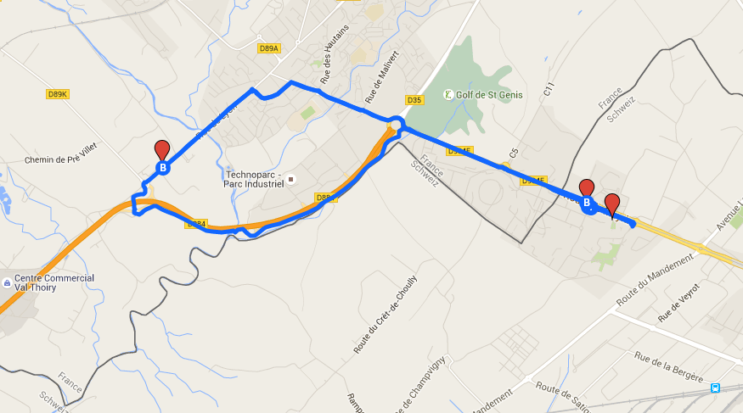
Suggested map for biking and walking
Follow this map
http://cern.ch/go/7MGt
Entrance E (Saint Genis)
Open (one way only):
07:00-09:30
and
16:30-19:00
Do not forget your CERN access card!

Slide 10

Hotel
18.85€/person/night in a four bed studio (75.40€ per room/night)
22.76€/person/night in a three bed studio (68.30 € per room/night)
28.60€/person/night in a double room (57.20 €per room/night)
56.10€/person in a single room
Prices include VAT but not breakfast

Slide 11



A few things to remember…
Hotel Shuttle
  book 24h in advance except for the tours in the morning and in the evening
  7 persons maximum per shuttle
Some good advice
  Please use the provided drying racks to dry your laundry
  Please make sure your rooms are tidy and things are put away before the cleaning service passes. Ask the reception which day this is.
  Be careful with the hotel equipment in general.
  Please respect the general rule of silence after 22h.
  The hotel reception is ready to help you with your invoice at any time (ie after your payments)
  Network connectivity- cabled access possible if needed.

Slide 13



Respect instructions

Slide 14
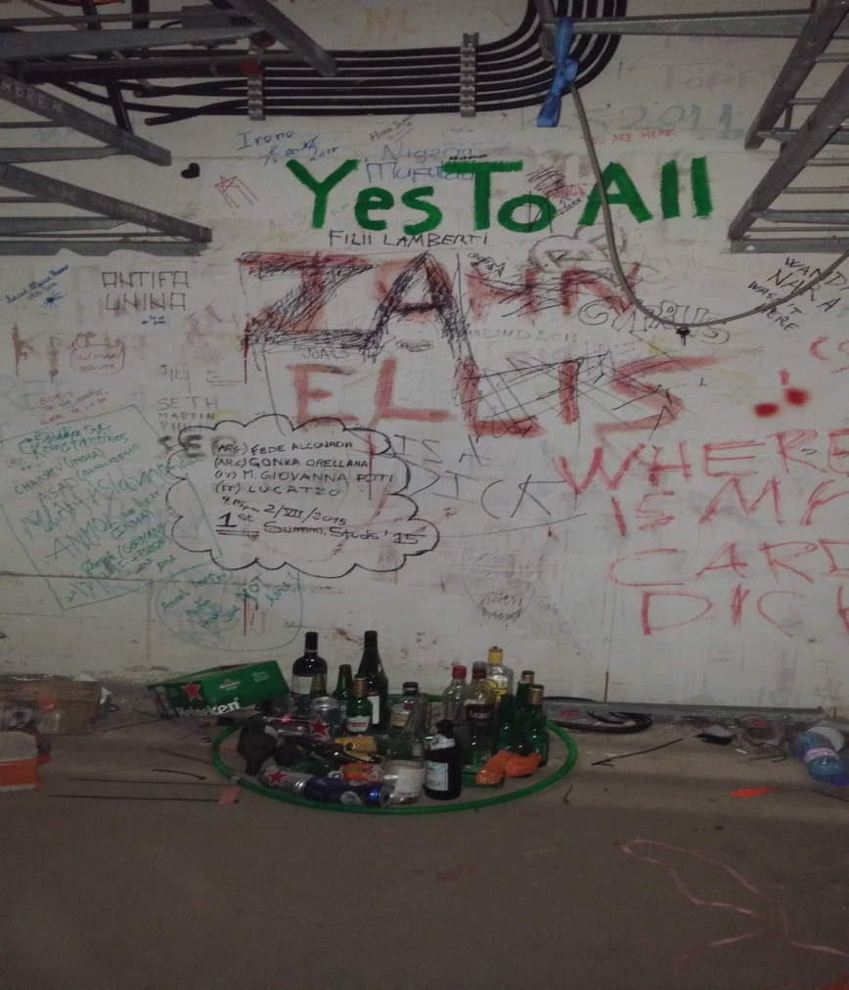
The “Temple”
Now you have seen it…
DO NOT GO HERE!
Health Hazard
Risk of being expelled from CERN

Slide 15



Coffee and Ice-cream meetings
Fridays at 16h in R2
Informal get together when we can talk about any of your questions, weekend plans etc…

Slide 16
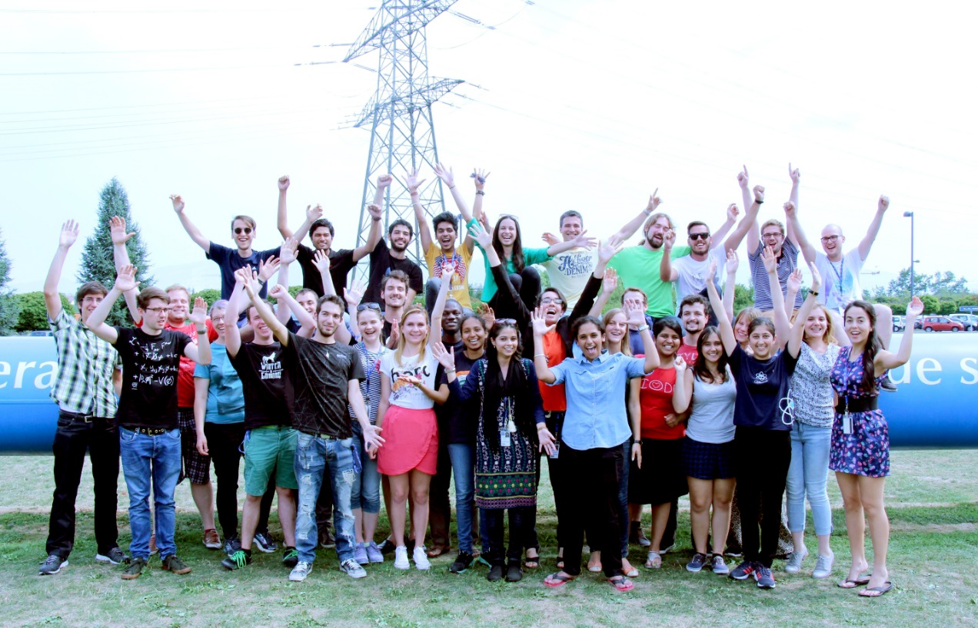
Questions?

