Slide 1
THE PERFECT PITCH
Marthe N. Dehli
Entrepreneurship Development Officer
@marthedehli

Slide 2

ILENE ROSENZWEIG & MICHAEL CARUSO
30 SEC – 2 MIN
SPARK INTEREST

Slide 3
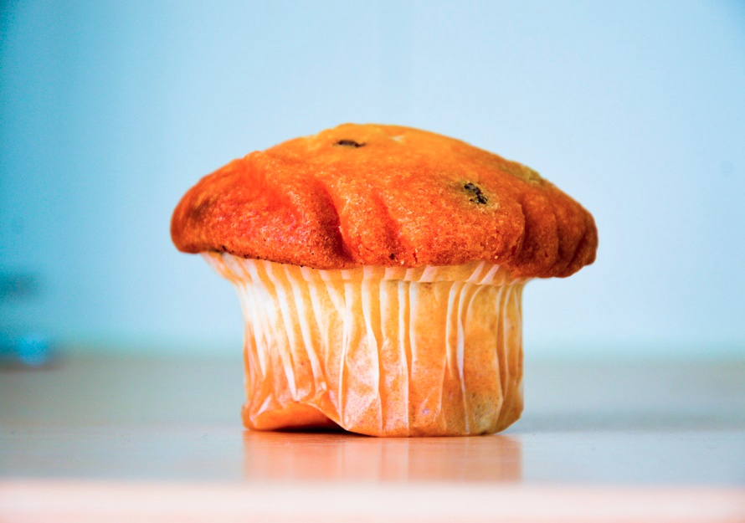
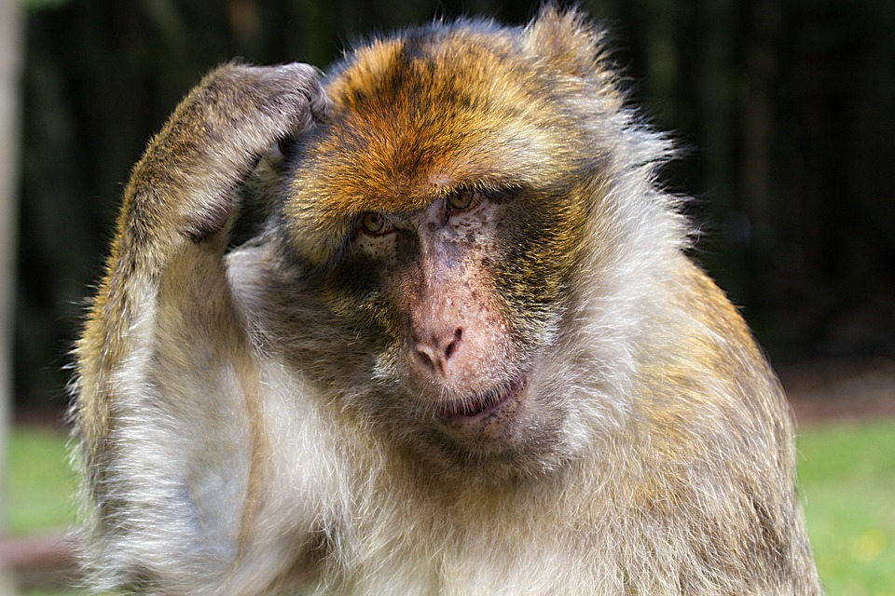

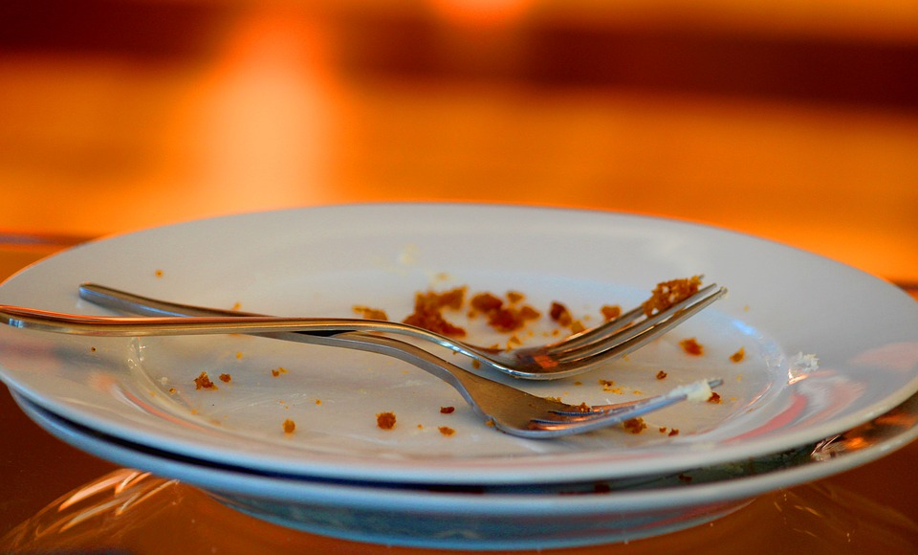
30
60
90
120

Slide 4
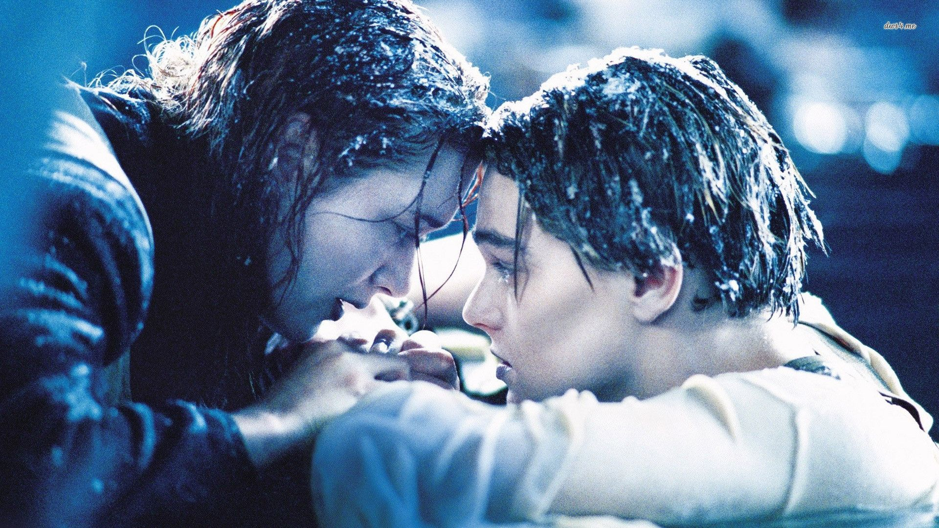
“ROMEO AND JULIET ON THE TITANIC”

Slide 5
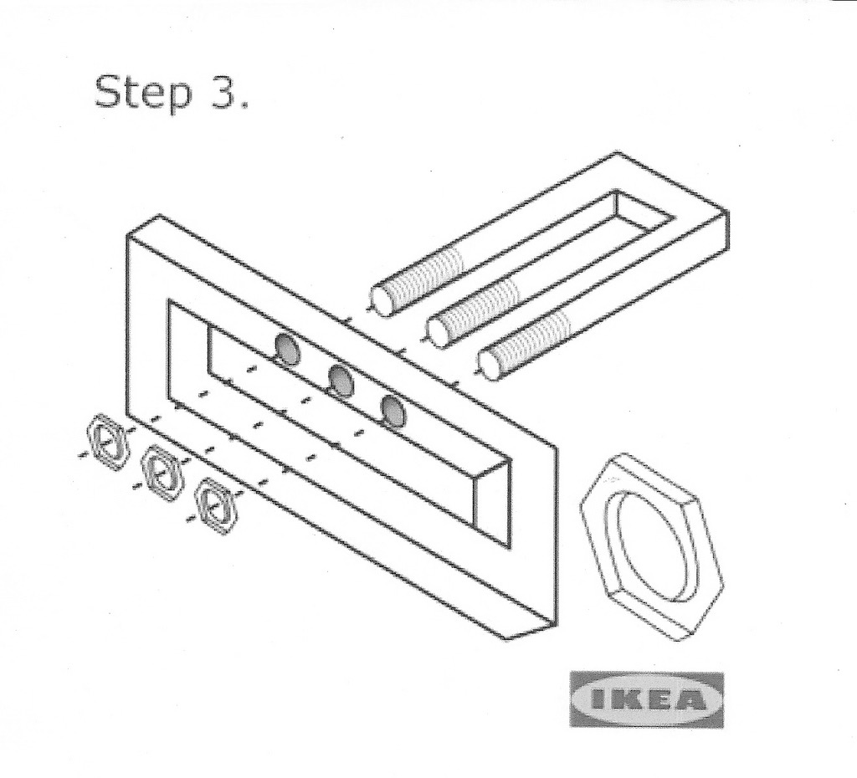
WHAT IS THE PROBLEM?
HOW ARE YOU GOING TO FIX IT?

Slide 6
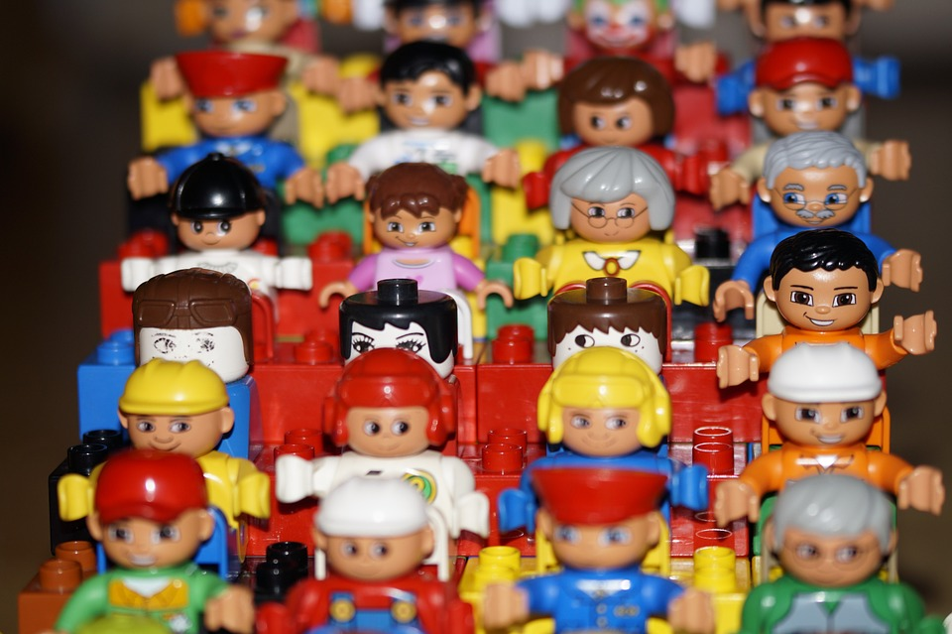
WHAT’S IN IT FOR ME?

Slide 7
PREPARATION

Slide 8

LESS EXECUTION TIME
=
MORE PREPARATION TIME

Slide 9

MULTITASKING IS A LIE

Slide 10







Slide 11


Slide 12

PRACTICE MAKES PERFECT

Slide 13
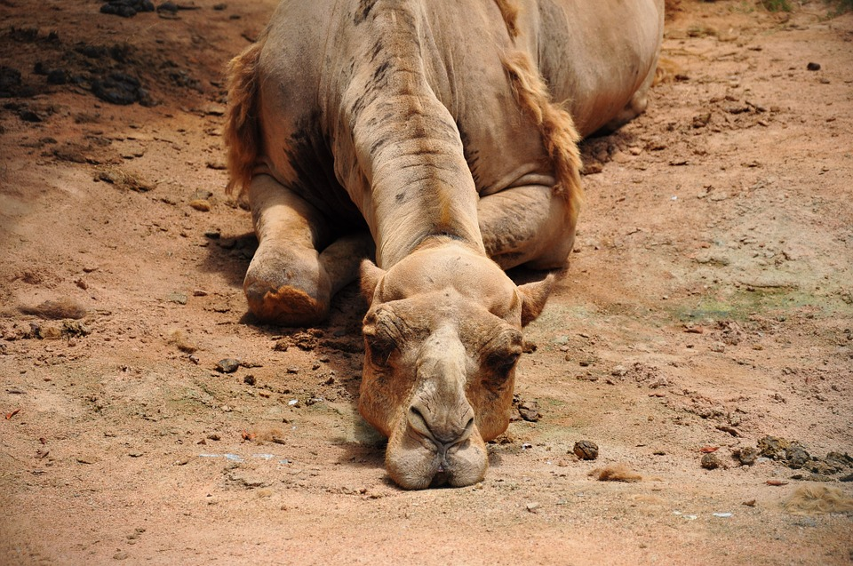
PREPARED, NOT BORING

Slide 14
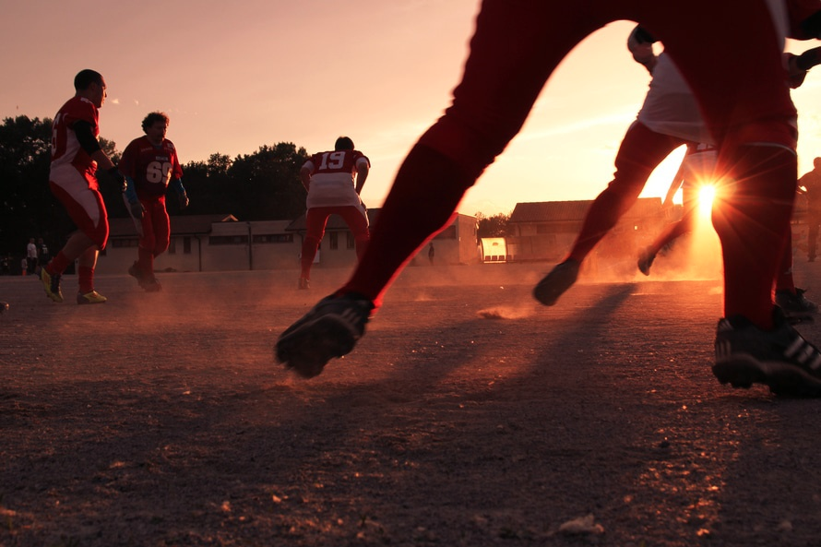
INVOLVE OTHERS

Slide 15
THE WHOLE PRESENTATION IN ONE SLIDE

Slide 16

PITCH TO SPARK INTEREST
DON’T WORRY ABOUT TIME
KEEP IT SIMPLE
STOP CATCHING POKÉMONS
PRACTICE MAKES PERFECT

Slide 17
THANK YOU

