Slide 1
From Grids to Clouds
Ian Fisk
CERN openlab Summer School
July 19, 2016

Slide 2













The phrase that pays
Follow the money
GRID
2000-2010
CLOUD
2010-2016
?
Open
Science
Cloud

Slide 3
“Technical” Choices
A lot of the choices we make are motivated by non-technical reasons
  What development can be supported at a particular moment in time
  Where people choose to work and where people choose to invest
Some choices are motivated by a need to scale at a determined or undetermined time in the future
Some choices are designed to push R&D in distributed computing that might be generally beneficial
As we discuss Grids and Clouds you will see that sometimes the simplest solution is not the one chosen
  All of the systems we will discuss have been successfully operated

Slide 4
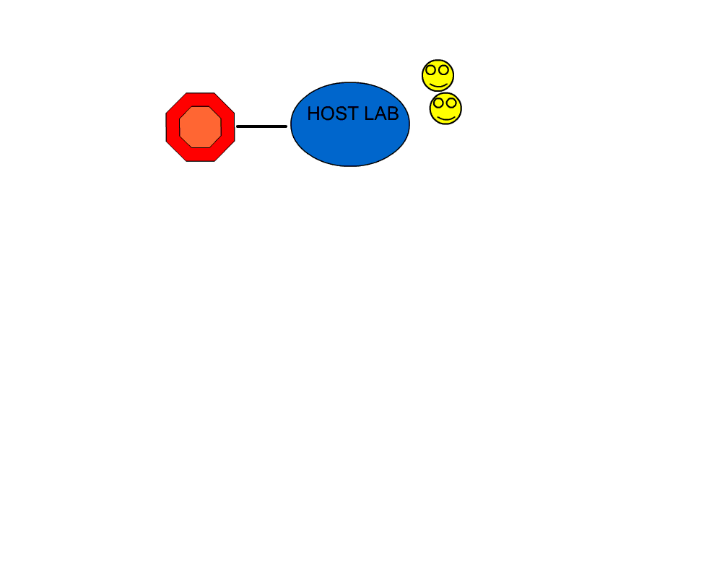
Beginning
Experiments began to develop distributed computing models
  Two examples: Babar had Tier-As that users could connect to for access to the data and resources. CDF had distributed analysis centers
  Distributed centers tended to come later as other items were better understood
In the beginning the computing was centralized

Slide 5
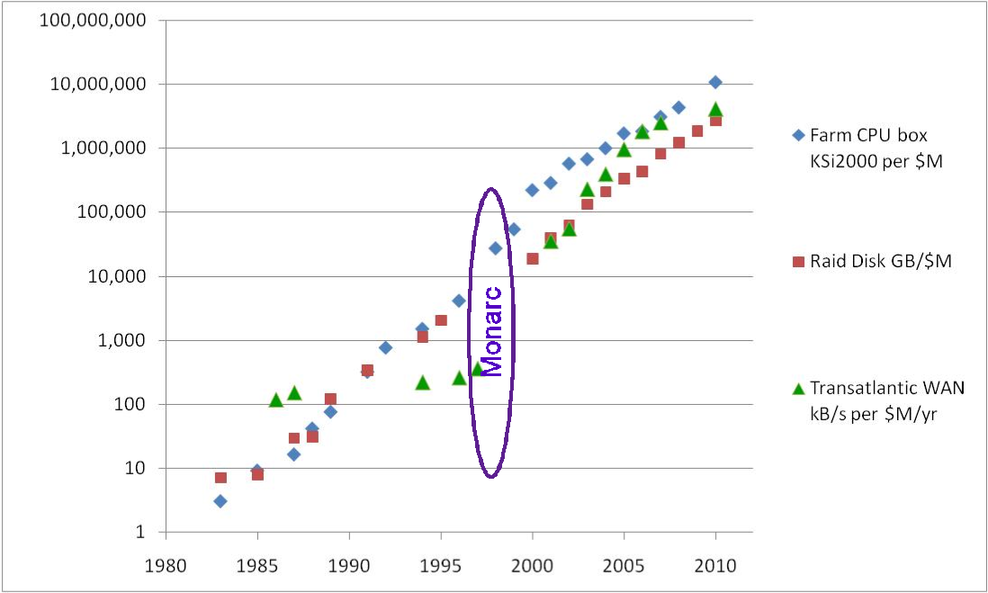
MONARC
All LHC Grid Computing Models are based on MONARC
Introduced the idea of hierarchical tiers of computing centers
Assumes poor networking on connectivity between sites
Motivated by investment
Countries were more willing to invest in local computing and local infrastructure
Rely on pool of distributed computing expertise

Slide 6
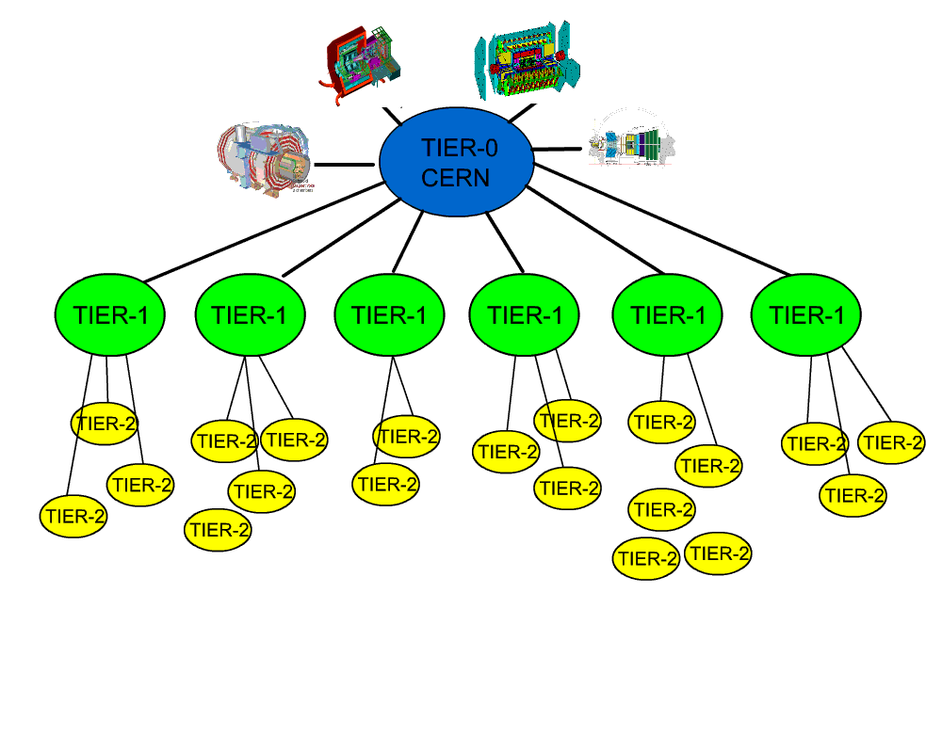
LHC Computing Models
Rate to Tier-1 varies by event size and trigger rate for each experiment. Aggregate rate from CERN of hundreds of MB to nearly 1GB
Tier-0 center at CERN used for prompt reconstruction, data archive, low latency work
Tier-1 centers are primarily at national labs or large universites
  Re-Reconstruction
  Stripping/skimming
  Data serving
  Archiving of simulation
MONARC Tiered computing model came in the late 90’s
  Level of distribution motivated by the desire to empower and leverage resources and to share load, infrastructure, and funding
Rate to Tier-2s depends on the experiment and the expectations for updating storage
  Can burst with activity
Tier-2 centers are primarily at universities
  Simulation
  User Analysis

Slide 7
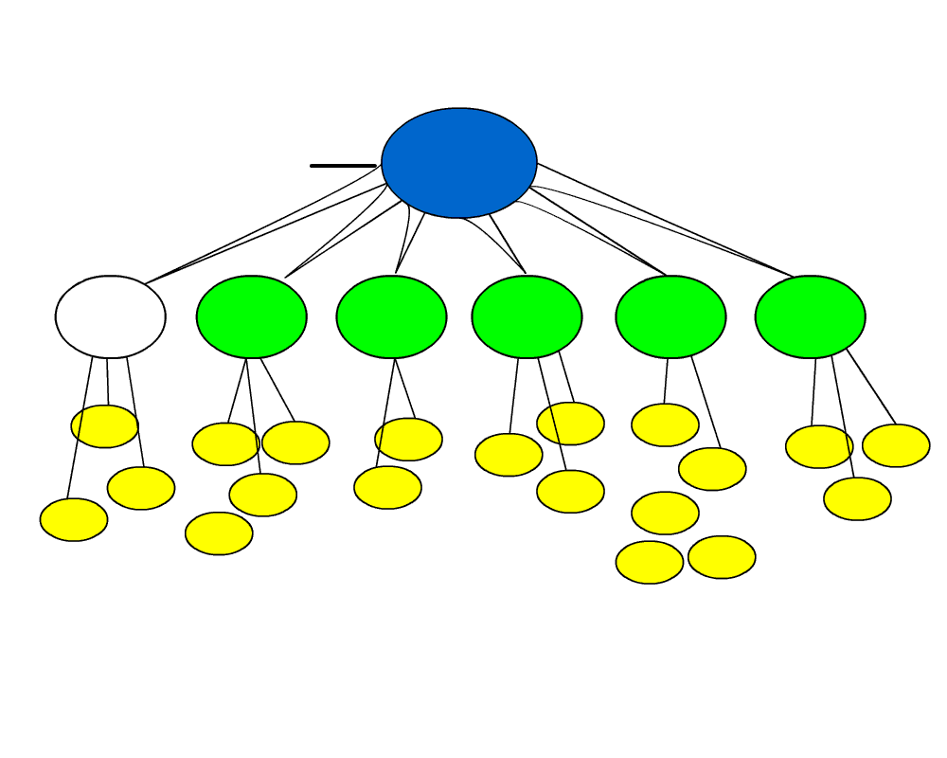
LHC Computing Models

Slide 8
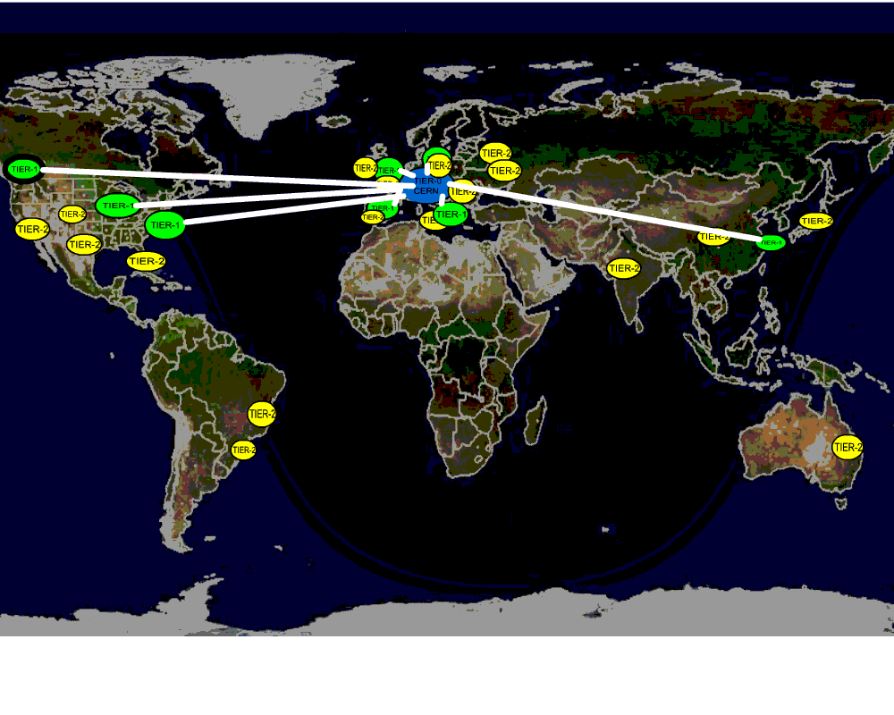
Networking
Optical Private Network (OPN) connects CERN and Tier-1. Other connections handled by shared networks

Slide 9

Grid Services
Connection to batch (Globus and CREAM based)
During the evolution the low level services are largely the same
Most of the changes come from the actions and expectations of the experiments
Site
WMS
CE
BDII
Experiment Services
Information
System
FTS
SE
VOMS
Connection to storage (SRM or xrootd)
Higher Level
Services
Lower Level Services
Providing Consistent
Interfaces to Facilities

Slide 10
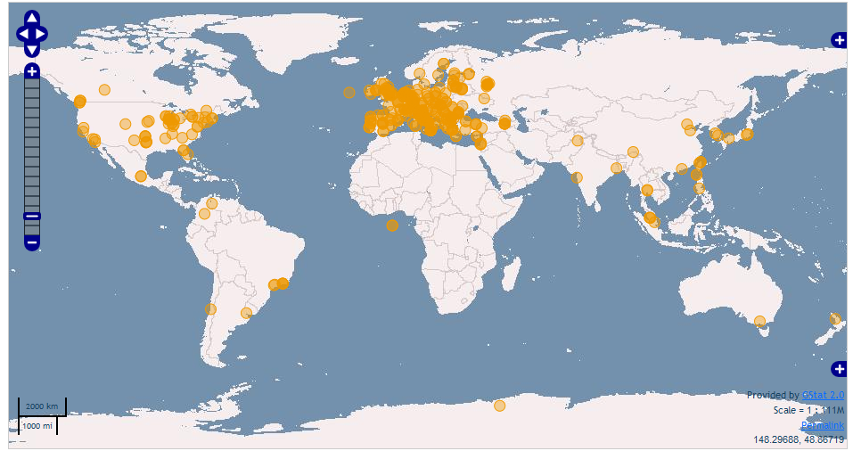
Problems with the Grid
A lot of services have to function to successfully execute a job
Much of the development effort has been to shield this complexity from the user
bsub
Choice of site(s) with the desired data files or resources
Success submission through site grid interface
Arrival at Batch farm
Discovery and open local data file or remote file
Communicate job status and write results somewhere
Local Environment Packaged
Find local environment
Authenticate User and VO
10

Slide 11
Reliability and Robustness
The level of distribution and the number of services requires an advanced system to check the health of the globally distributed system
  WLCG has developed a series of Site Availability Monitors (SAM) tests
  Series of automatically submitted and tracked tests
    Validate the processing services all the way down to worker nodes
    Validate storage services
    Information systems
  Tests run every few hours and results are tracked and published
Experiments (VOs) also introduced their own tests
  Verify the experiment workflows within the SAM framework
  Utilize the experiment submissions systems to update the SAM tests

Slide 12
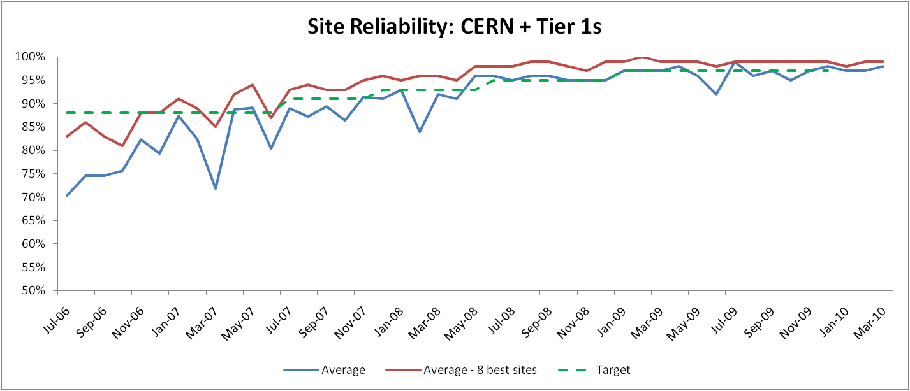
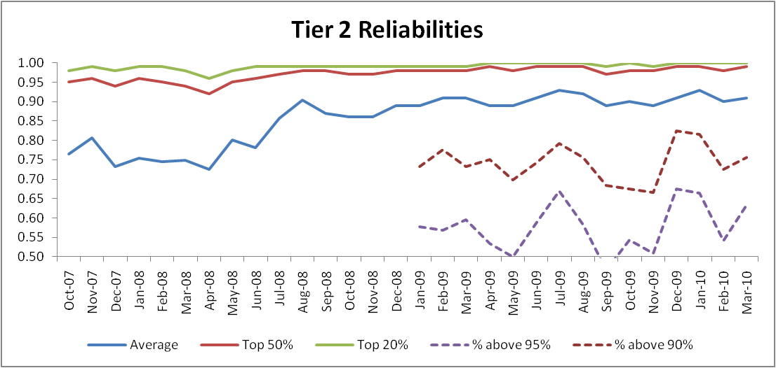
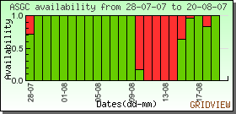
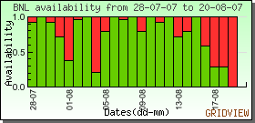
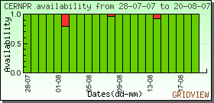
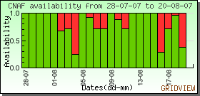
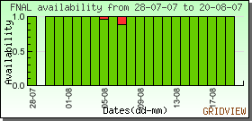
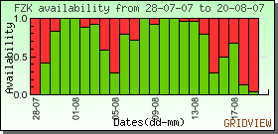
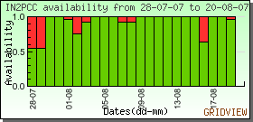
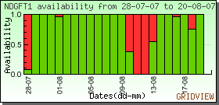
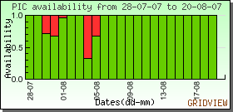
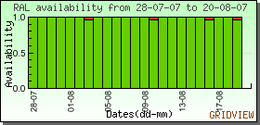
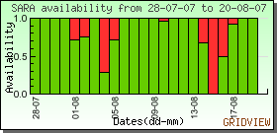
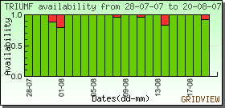
Results
Basic Monitoring of WLCG
Services

Slide 13
Now what?
So now you have a consistent set of sites with a consistent way to communicate with them
You still need
  A way to distribute the software environment
  A way to get common information like conditions
  A way to track and manage the input and output data

Slide 14

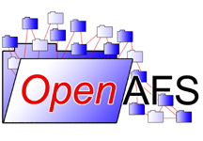

Distributing the Software Environment
At the start of Run 1 there were more solutions for software environment deployment than experiments
  Some used grid jobs to deploy the environment
  Site admins installed the software locally to NFS at some sites
BitTorrent used by ALICE
AFS used as a local file system and regionally between sites
Many of the solutions were seen as non-scalable, operationally intensive, and/or with high-latency
A better solution was sought
NFS

Slide 15
HEP Software Distribution and CernVM-FS
Developed (outside the Grid) for Cern Virtual Machines
Ideal for replicating the software environment to sites
  Minimization of file transfers
  Aggressive caching
  Deduplication and optimal identification of changes
    Only 10% of new files between releases
  Optimized encapsulation of metadata to offload to clients expensive operations (e.g. ls, stat)
CernVM-FS (gradually) adopted by the Grid
  ATLAS was an early adopter
In 2012, the WLCG Operations Technical Evolution Group recommended it
CVMFS: http://cernvm.cern.ch/portal/filesystem
M. Girone and J. Templon, Final Report on the Operations and Tools TEG http://wlcg.web.cern.ch/news/teg-reports

Slide 16
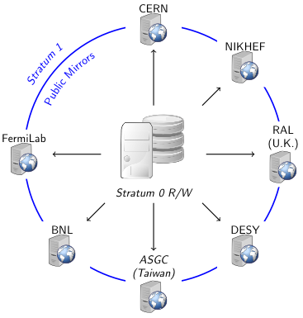
CVMFS Architecture
Central publication point (Stratum-0) R/W
Minimal transfer protocol requirements (HTTP)
Aggressive hierarchical cache strategy for scalability
  Stratum-1, squid at local sites, read-only
POSIX mount point on clients
  FUSE, local NFS share, Parrot
Automatic versioning
  "Time-machine" for experiment software
  E.g. Impact on data preservation

Slide 17
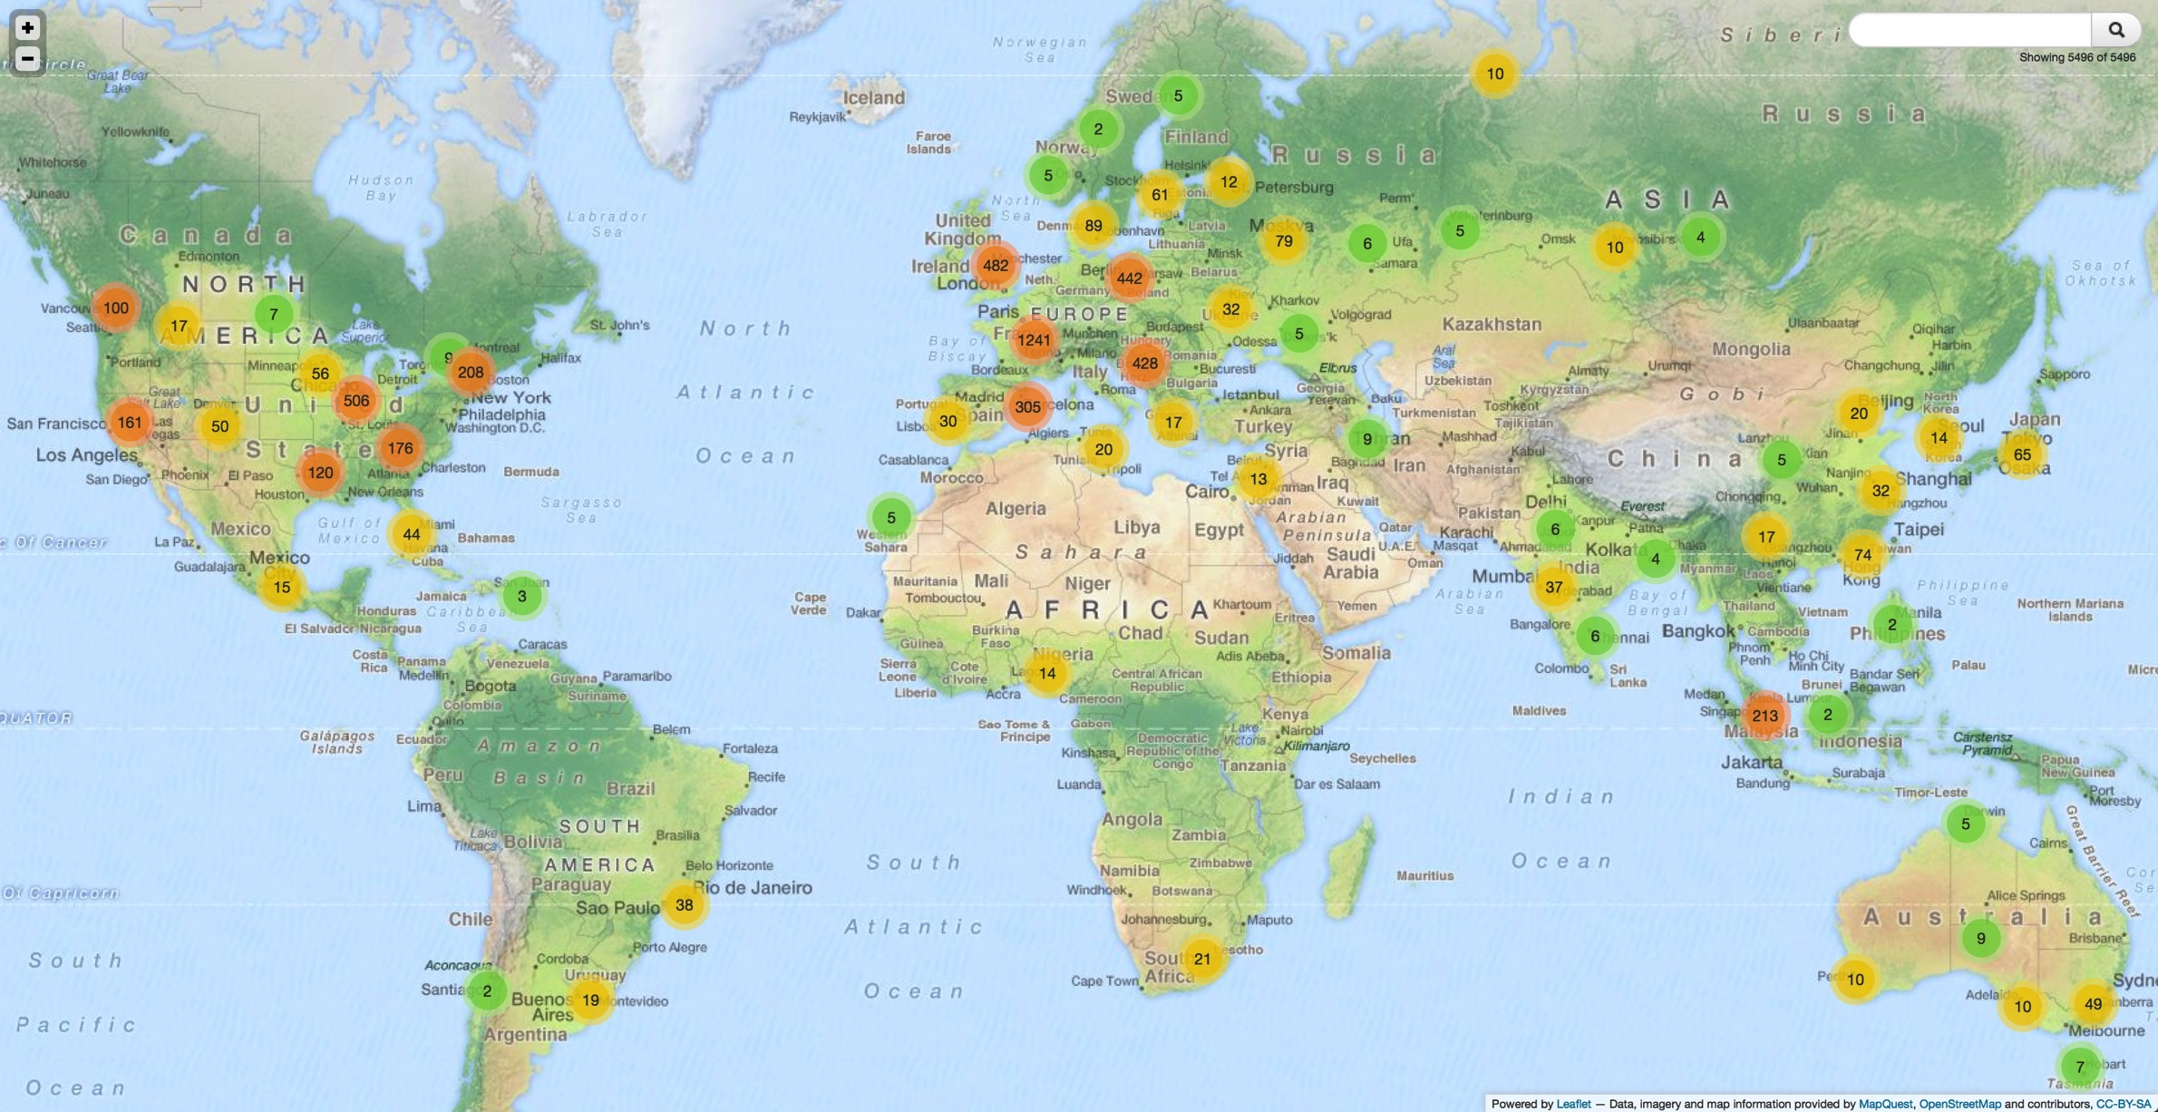
CVMFS Scale
For 5 years the contents of CVMFS have grew linearly
Number of experiments using the system continuously increasing
CERN and EGI stratum-0 host more than 30 repositories, including non-HEP experiments
CVMFS has spread to 5 continents and is used on all WLCG resources
There are at least 64k nodes at 160 sites
Is now a critical service in WLCG

Slide 18
Frontier
Frontier is an earlier example of introducing independent services (Distributed Database Cache as a Service)
Before Frontier many Tier-1 sites operated databases for the local processing needs
FRONTIER
CMSSW
POOL CORAL
Frontier Client
Squid
Squid
Frontier
Server
Oracle DB
HTTP
HTTP
HTTP
HTTP
Local Client
Squid
Stratum 1
Stratum 0
File
System
CERNVM-FS
Frontier:
http://frontier.cern.ch
Architecture of Frontier and CVMFS are similar

Slide 19
Software Distribution vs Data Management
 | Software Distribution | Data Management
Size of samples | ~10TB | ~100PB
Level of Replication | All sites | Average sample replication factor 2-3
Latency | Full synchronization in 1 hour | Completing a replica can take a week
Update rate | Packages are updated frequently (incl. nightly) | New datasets are created less frequently
Notes:
.

Slide 20
Evolution of LHC Data Management
Key stages marking the path to evolution of Data Management
Starting from tight services and static models, moving towards decoupling and dynamism
Flat Static Subscriptions
Data Federation and
Dynamic Data Delivery
2010 2011 2012 2013 2014 2015
Run1 LS1 Run2
2006
Mumbai Agreement for
SRM
Introduction
Of Dynamic Data
Placement
Data Management
Changes for Run2
The Future

Slide 21
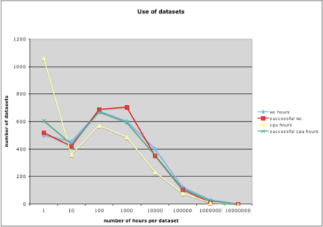
Flat Static Subscriptions
The primary method for pushing data to sites is by subscription
  Processing and storage are coupled and only data available locally is visible
CMS Early Use of Datasets
100-1000
CPU hours
Datasets
CPU
Hours
Hours of Access
Flat static subscriptions assume that most samples have a similar number of access, which unfortunately is wrong

Slide 22
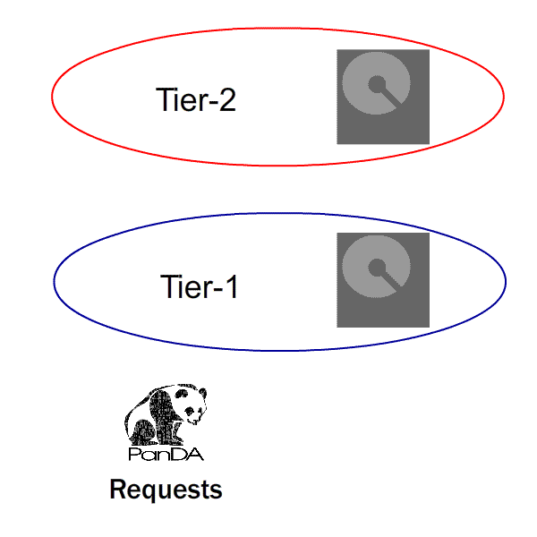
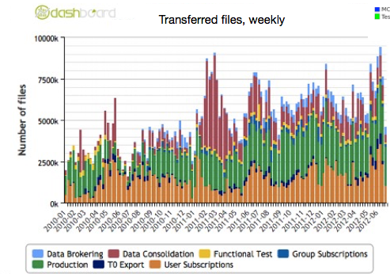
Introduction of Dynamic Data Placement
ALICE and ATLAS developed the Dynamic Data Placement that deploys samples in response to changing processing demands
The system is still based on subscriptions
  made when needed and removed when finished
ATLAS
Re-brokering allows jobs to move to another site if the first one is underperforming
ALICE
Goes to nearest replica based on network information
ATLAS

Slide 23
Data Management Commonalities
Each LHC experiment has developed a data management solution
There is a lot commonality in the underlying services and design elements
Service | ALICE | ATLAS | CMS | LHCb
File Transfer Tool | Xrootd | FTS/ SRM | FTS/ SRM | FTS/ SRM
Technology for Catalogs | MySQL | Central Oracle | Central Oracle | Central Oracle
Information System | ALIEN | AGIS | SiteDB | Dirac from BDII
Primary File Access Local Access Copy to disk Served Remotely | Xrootd Xrootd | Misc. Misc. Xrootd | Misc. Xrootd | Xrootd SRM Xrootd

Slide 24
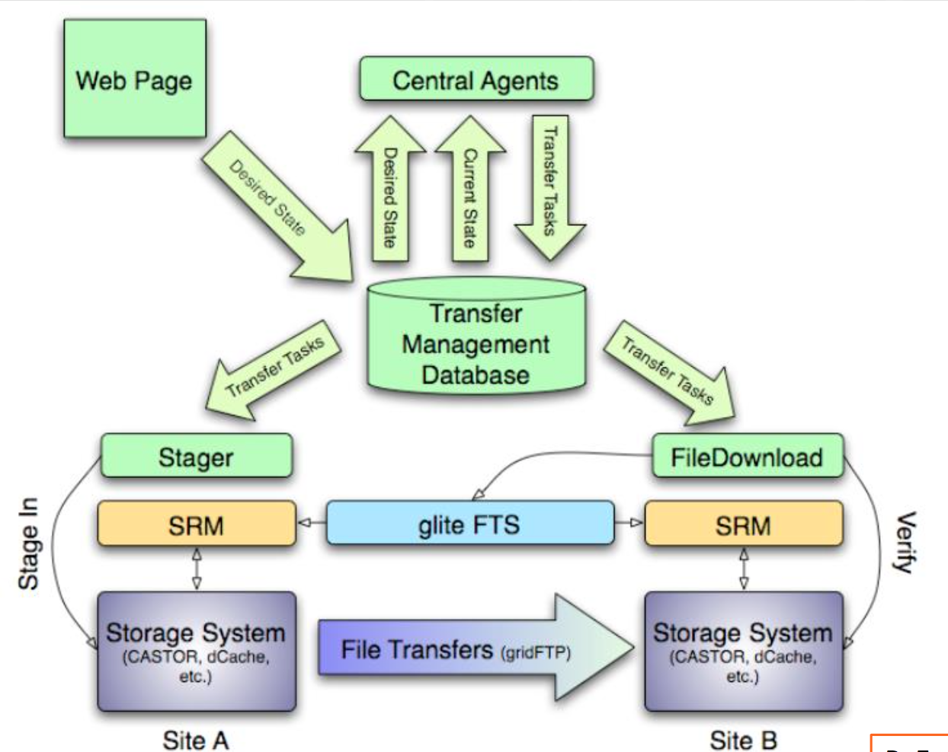
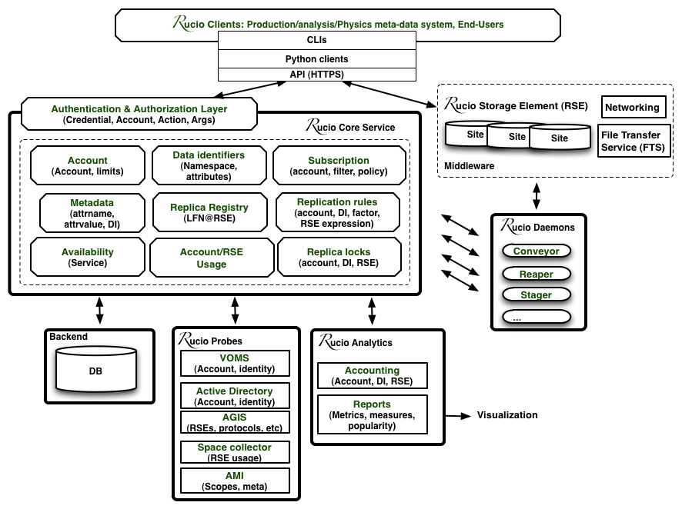
Data Management in Run 2
Bookkeeping
The functional elements of the Data Management system are similar for the 4 experiments
  Bookkeeping – how files relate to each other and what samples are contained (metadata)
  File catalogs – the list of files
    The independent file catalog LFC has largely been replaced by replica services integrated in the experiments DM system
  Replica catalogs – if a dataset is subscribed in multiple locations
  FTS – The file transfer system for moving files
  Requests - Interface to request subscriptions and file movement
  Accounting – system for generating reports of usage
Requests
Replicas
Accounting
Bookkeeping
Requests
Catalogs
ATLAS
CMS
Catalogs
Accounting
Replicas
FTS
Catalogs
Bookkeeping
Replicas
Requests
FTS
FTS
Accounting
LHCb

Slide 25
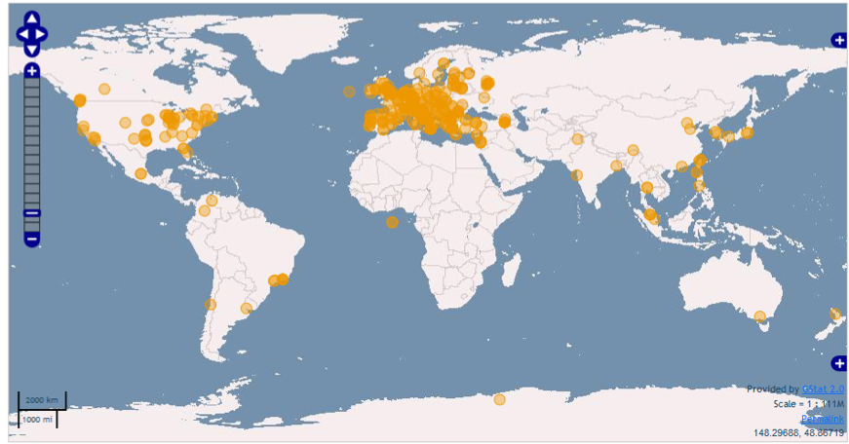
The Data Management Problem
There are close to 200 sites in WLCG
246 PB of disk
267 PB of tape
WLCG has 140PB of unique data and 280PB under management
  More than 1B files
  Average file size 0.2GB to 2.5GB

Slide 26
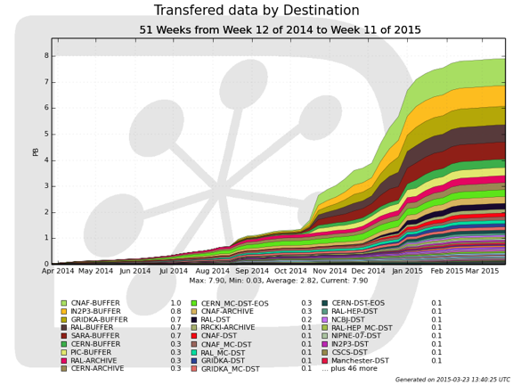
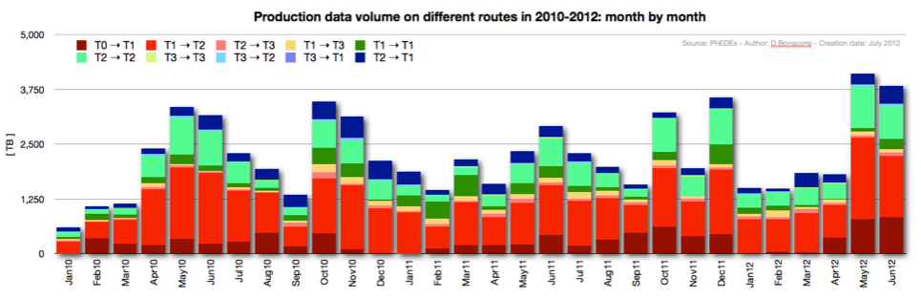
Scale of Movement
10GB/s
Over all of LS1 the LHC experiments (mostly ATLAS and CMS) have been moving more than 0.5PB/day
In total, 1 EB over the long shutdown
Throughput MB/s
Files
LHCb
PB
CMS
Full-mesh transfers

Slide 27
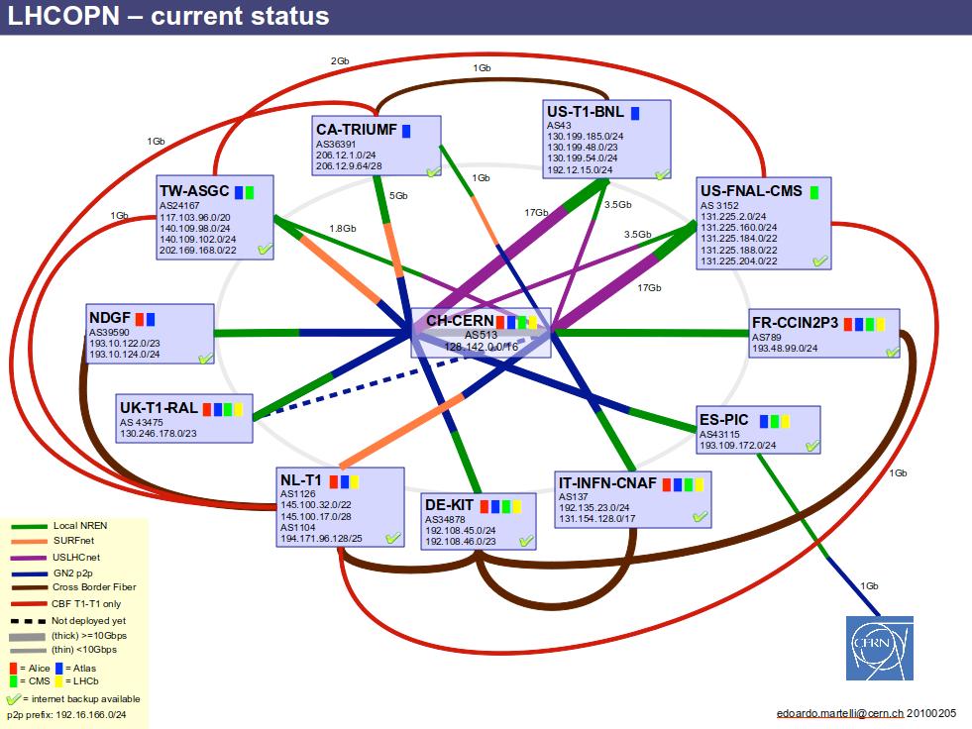
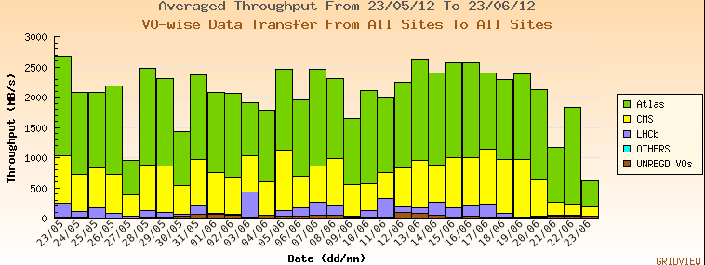
Networking
Wide Area networks allow us to move the data to remote sites for archiving and processing
  A dedicated network to for initial distribution
  Much shared use R&E networking to analysis centers
2.5GB/s
Ian Fisk

Slide 28
Submission Techniques
Both ALICE and LHCb have developed pull based job submission systems for both Production and Analysis
  Eventually all experiements did
Pilots
RB
CE
Central
Services
Site
Central Task Queue
Job Agent
WN
WN
WN

Slide 29
Processing Data
Most of what we do is process files of groups of files in embarrassing parallel high throughput computing (HTC)
With data it’s important to process every file
Important not to have systematic failures in the processing system
All the experiments have some sort of a DB that keeps track of the pieces of split workflows
Oracle, Couch. MySQL are all used
Ian Fisk

Slide 30
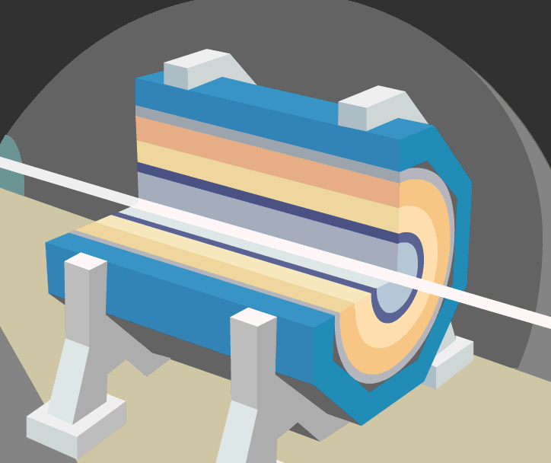
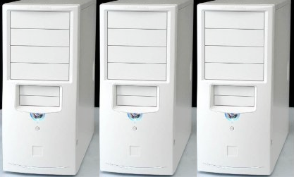
Data Path Through LHC
Data Path through LHC mostly servers to reduce the data to more manageable pieces
After HardwareTrigger (TB/s)
From Detector (1PB/s)
Analysis Selection
(100MB/s)
Data
Volume
Selected RAW
(1GB/s)
Derived Data
(2GB/s)
Derived Data
(2GB/s)
20k
cores
Reconstruction
Reprocessing
Organized Analysis
Final Selection
Processing and people
HLT
40k
cores
30k
cores
DAQ and Trigger (less than 200)
Operations
(less than100)
Analysis Users
(lMore than 1000)
Operations
(less than 100)
60k cores
Analysis Users
(lMore than 1000)
Notes:
Takes weeks and involves a big central operation team and large user community. Data is touched several times and by different sets of teams

Slide 31
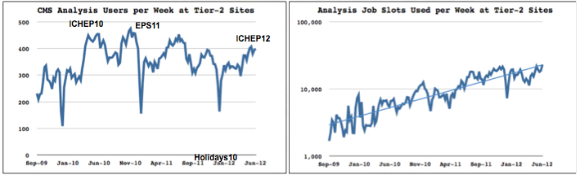
Analysis Centers
When the WLCG started there was a lot of concern about the viability of the Tier-2 Program
  A university based grid of often small sites
2009
Capacity
Grows by
factor 2.5
2013
Ian Fisk

Slide 32
Simulation Challenges
  Beams contain many particles and beam collisions are frequent
    For every signal event at High Luminosity there are 35 minimum bias events from that crossing. The calorimeters are sensitive to the preceding 10 and following 5 crossings
      For every event we simulate we provide 100MB of minimum bias events
e+
e-
e+
H
e-
Notes:
Just making the simulation is hard
The detector is sensative to multiple crossings

Slide 33
Scale of the final system
Progress in distributed computing and evolution of computing capacity
  WLCG processes ~4M jobs on the grid per day
  Disk and tape combined are now close to an Exabyte of storage
  Essentially a leadership class super computer distributed over 5 continents
Ian Fisk

Slide 34
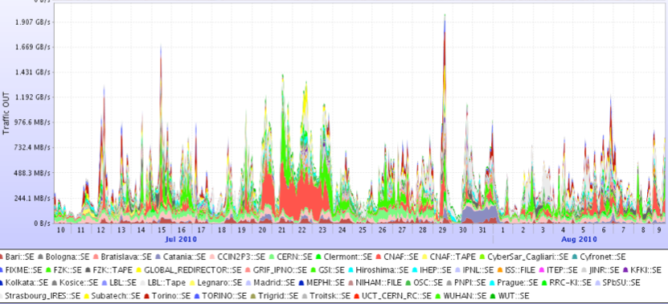
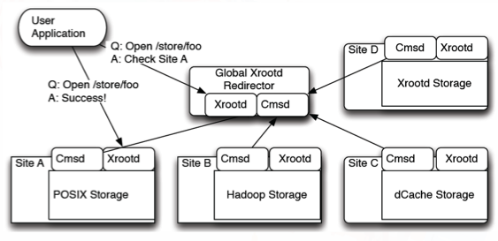
Introduction to Federation
From the beginning ALICE based their data management on Xrootd
  Other experiments have subsequently been deploying data federations and similar techniques
    ALICE and LHCb use experiments catalogs to identify the file location and mainly open files locally
    ATLAS and CMS have data federations fully based on Xrootd and separate from the data management and transfer systems
ALICE
1GB/s
Transfer Out (MB/s)

Slide 35
Xrootd as a Distributed File System
The way Xrootd maintains a file system is simple and clever
All servers have the same name space, though they don’t have to have the same contents
Site 1
/data/items/files/file1
Site 2
/data/items/files/file1
file2
Site 3
/data/items/files/file1
file3
file4
SINGLE SITE SCALING TEST
200Hz
Files can be opened at a rate of hundreds of Hz

Slide 36
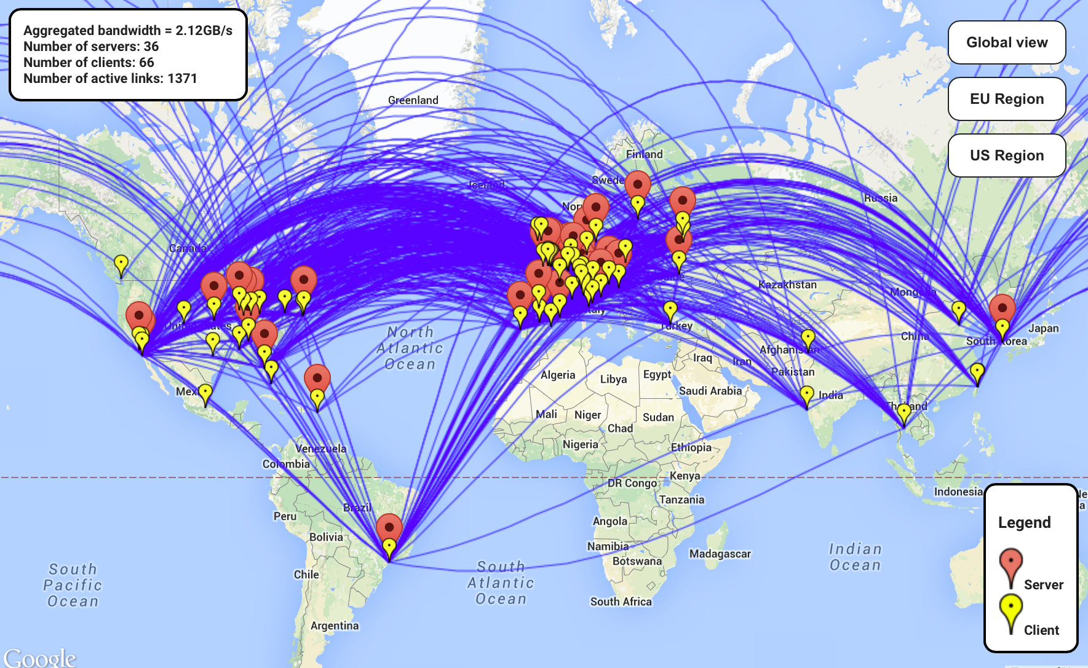
Successes in Connectivity
xxx
Aggregate bandwidth > 2GB/s
CMS
Each site has delivered PBs over the last year

Slide 37
Transitional Federation
The use of data federation adds enormous functionality but also complexity
  Now there is another site that has to successfully perform an action and not all sites are equal
Redirector
Redirector
PRODUCTION
COMMISSIONING
Redirector
Redirector
Site
Site
Site
Idea from A. Hanushevsky at the CMS Federation Workshop
Site
Site
Site
Site

Slide 38
To recap
On the positive side:
We now have a system where we can utilize a set of globally distributed computing centers
We have reached a very high scale
We can distribute a software environment and conditions
We can move data, discover data, and for a portion of the access even serve over the WAN

Slide 39
On the negative:
A lot has to go right for work to get done
  There are a lot of expectations of the resources when you arrive on a site
      Operating systems, configurations, and services
      Limits the resources that can be used
      Makes the resources more difficult to share
      Places a reasonably heavy load on site administrators
      The system remains mostly homogenous
      OS, hardware profiles, interfaces all need to stay in lock stepMore difficult to share resources with other communities
We have coupled the processing and the storage
  Systems with very different time scales are tied together

Slide 40
Thursday we talk about Clouds

Slide 41
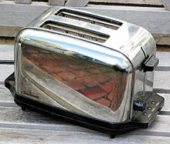

Clouds vs Grids
Grids offer primarily standard services with agreed protocols
  Designed to be as generic as possible, but execute a particular task
Clouds offer the ability to build custom services and functions
  More flexible, but also more work
Ian Fisk
FNAL/CD

