Slide 1
The Q4 magnet (MQYY) cold mass Series open items on for Hi Lumi-LHC
Impact of QUACO scheme
CEA-CERN meeting, 19th May 2016
Arnaud Foussat, MSC-LMF

Slide 2
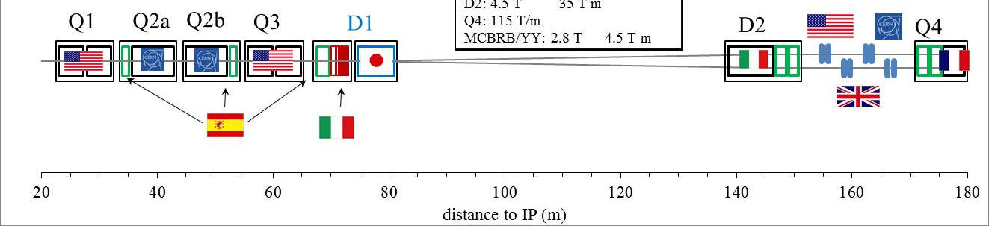
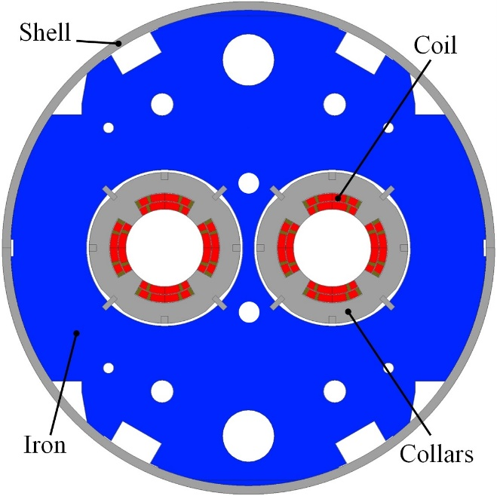
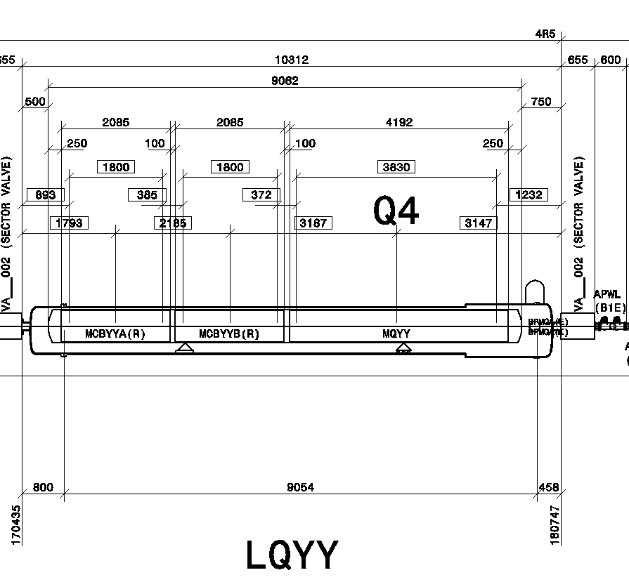
Q4 features & lattice layout
Double aperture Nb-Ti matching section magnet:
2 individual apertures powered independently in a common yoke (2PS per Q4)
Double layer cos2θ Quadrupole
Aperture: 90 mm
Integrated gradient : 440 T
Nominal gradient = 120 T/m
1,9 K Magnetic length : 3.67 m
Nominal gradient : 120 T/m
Temperature : 1.9 K
Nominal current : 4590 A
Stored energy : 0.81 MJ
2 layers of MQM cable
Inner blocks: 17 + 8 turns
Outer blocks: 16 +10 turns

Slide 3
Q4 procurement
One SINGLE APERTURE SHORT MODEL developed at CEA to be completed by end 2017
Two PROTOTYPES magnets (First-of-a-kind), double aperture and full length
  Scope of QuaCo from 03/2016 to 03/2020
  Options of design are open to contractors
  Q1: status of the resources plan (CEA, CERN, QUACO members) to perform follow up, deadlines shall be adapted and finalised in the PMT workpackages document
  QUACO «Buyers group » Consortium (CERN, CEA, CIEMAT, NCBG) provide possible magnetic design of the Q4, a configuration of coil ends and quench protection scheme based on CEA-CERN know-how.
  The technical solutions chosen by the awarded companies will be evaluated during each of the 3 phases;
  4 SERIES double aperture magnets + 2 spares; from 2020-2023
  The question of the facility where to perform the cold test is still open. There are some discussion between CEA and CERN (new collaboration contract covering 2017-2020) but no decision
  So far based on LHC experience it is unlikely that a prototype magnets can be integrated in the machine
  Series production plan based on deliverables-based industrial packages to be started considering the lead time for tools procurement and series first of kind manufacture procedure preparation.

Slide 4
Short model schedule
Detailed design phase: ongoing @ CEA Saclay
  Drawings, Mock-ups. Status of Prototype CAD model for next exchange
  Single aperture, RT coil length = 1350 mm , RT Magnetic length = 1217 mm
  Self supporting austenitic collars
  Non laminated yoke to speed up fabrication and lower cost
  Q1: can we test the manufacture of Q4 iron laminations on SM and assembly?
Procurement of tooling and components: April to Dec 2016
Coil fabrication should start in Fall 2016, work affected by QUACO as limited CEA resources
Collaring at CERN with CEA team in May 2017
  Use of Vertical collaring press in 927
  Q2: To which extend CERN is providing collaring support, what is the work arrangement ?
  Need to put in place a interface working group on SM. Effective feedback onto QUACO and series;
Yoking in Spring 2017, location to be defined
Cold test at Saclay in Summer 2017

Slide 5
QUACO procurement scheme
The QUAdrupoleCOrrector (QuaCo) project is funded by the European Union’s Horizon 2020 COFUND (PCP)
  Total QUACO budget 6.5M€. Total procurement budget 4.6M€
Ultimate goal is to manufacture two first-of-a-kind quadrupole magnet (MQYY) with two 90 mm aperture and a magnetic length of 3.67 m operating at 1.9 K.
Duplication in industry of magnet manufacture toolings
Development of the Q4 prototypes in 3 phases:
  Phase I: ‘Solution Design‘ = Conceptual Design (4 months)
  Phase II: Engineering Design & « CAD Prototyping » (10 months):
    Completion of the engineering detail design
  Phase III: Two First-of-a-kind (22 months):
    Fabricate two Q4 prototype magnets
    Baseline solution is based on self supporting collar structure
    Alternative solution is based on shell–based support structure (alternative Bladders and keys )
    There is a technological R&D interest to make a different technology based prototype although probably not mature enough for an accelerator type series coil.
    If contractor choose to develop shell based support structure he would need ot develop frist a First of kind Single aperture which is not compatible with ptresent PCP phasing .

Slide 6
QUACO phasing

Slide 7
Prototype Quaco scheme, risk
Magnet key parameters
Double aperture
RT/1,9K Magnetic length = 3681 / 3670 mm
Tender documents:
Functional specification co-written by CEA and CERN ( WP3)
Call for tender Annexes with selection/award table criteria based on Top Management Plan merit
Specificity of Pre-commercialization procurement (PCP), inherent risk
  EU finances 70% of the project but strong constraints on implementation
  Activity divided in 3 phases: conceptual design, engineering design, first-of-a-kind fabrication
  Firms in competition from one phase to the next: 4/3/2 firms selected in phases 1/2/3
  No garantee that the final company selected for the production participates in the Engineering phase
  QUACO committee to review all deliverables, assess the bidding offers at each phase
  Risk of procuring same tools at prototype and later series phases in different companies
  Tools property is part of companies
  Not a Built-to-Print
Time Frame
RFT in May 2016 – Decision on organisation of follow up collaboration team,
Start of the work in January 2017, attempt to start earlier in 11/2016 before CERN finance committee
Prototypes delivered for testing in Feb 2020

Slide 8
Spare LHC magnets procurement
In case of failure, short straight sections currently in the LHC machine would need to be removed from the tunnel. Building a stock of spare quadrupoles is considered to allow faster repair of SSS, if needed.
5 MQ magnets, 2020-2023
  Double aperture, 3.1 m magnetic length at 1.9 K, 56 mm aperture
5 MQY magnets, 2023-2025
  Double aperture, 3.4 m magnetic length at 4.5 K, 70 mm aperture
The procurement of those coils spares shall be in line with the Q4, D2 series procurement strategy.

Slide 9
Post PCP
Depending on QUACO success and timing, there is a proposal to launch the EC PPI to procure the Q4 series
Progress from R&D of pilots magnets to small series production → Public Procurement of Innovation (PPI) is expected to allow small series production following of the Quaco project ( see schedule impacts)
A Foussat MSC-LMF

Slide 10
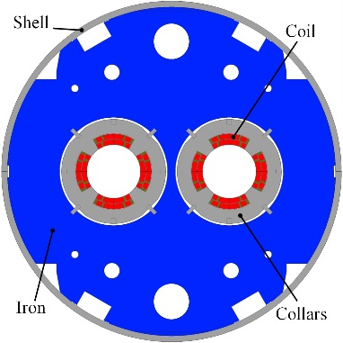
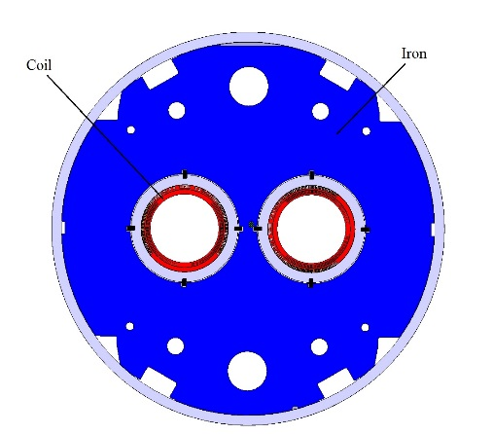
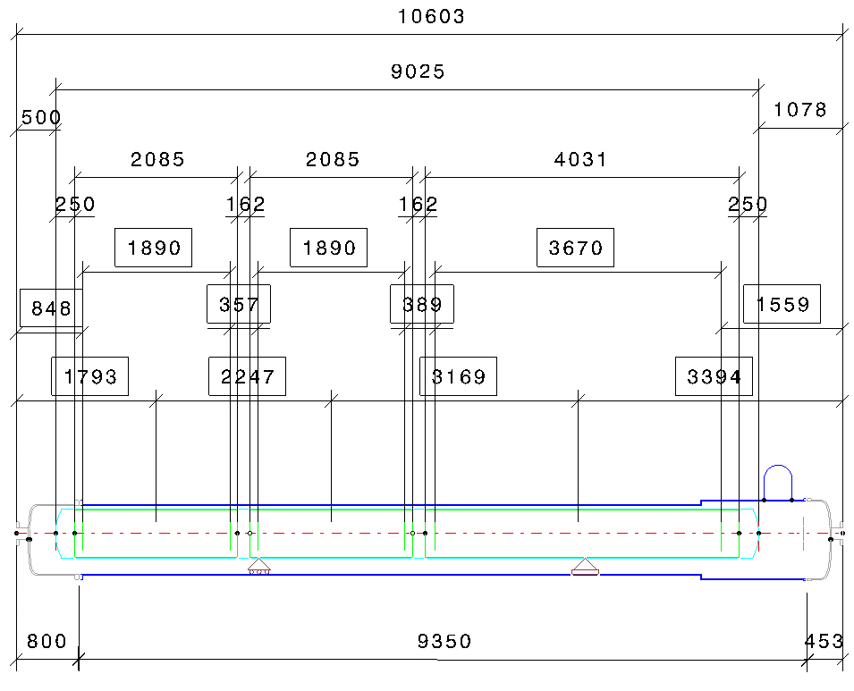
Q4 Layout drawing
May 2016 version

Slide 11
Design Interfaces
Recent progress on MCBYY final yoke shape, lifting feature, HEX tube alignmed with Q4
CERN wish to study and integrate Q4 cold mass CAD model of prototype interface items, proposal for shared study workpackages:
  Main busbars routing, decision on cross section, fixed point, lyra compensation loops, instrumentation wires, PH leads layout
  QQS cryogenic interface connections, thermal shields, cryostating
  Tooling vertical handling, lifting interfaces

Slide 12
Schedule of Q4 Cold mass assembly, analysis
Expected delivery Q4 prototype by Feb 2020
QUACO schedule impacted by intrinsic overhead in regular deliverables and updated offers assessments.
Risk from the estimate of industrial tooling procurement time and its compliance with final series design, to be confirmed ONLY at start of Phase 3 ( late milestone).
Considering estimate series production starting from 04/2021 and lead time of tools procurement, in worst case, the CfTs of Q4 series and new tools should be launched in 10/2018. Series schedule to be consolidated as highly parallelised
  Specific series tooling procurement then would start from 02/2020 ( timescale not yet compatible with possible PPI procurement scheme)
Assembly sequence schedule strongly depend on MCBYY correctors availability, does not seem an issue on the production schedule ( see talk by Torschanoff, Cold masses of Main Quadrupole in 04/2004)
Strategy on series to be validated by management as CEA and CERN strongly committed in QUACO. Importance of early resource plan
Start
Q4 CM design
Start
Cfts Q4 Series
Components and Series
tooling
QcO Phase 1
QcO Phase 2
QcO Phase 3

Slide 13
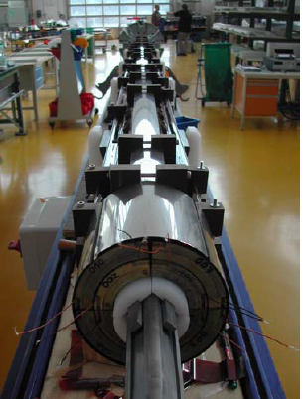
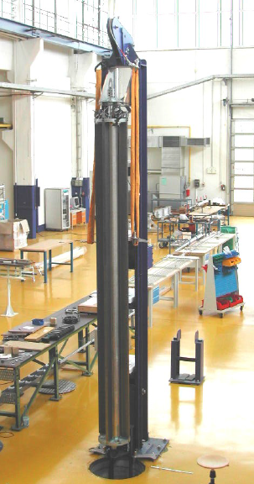
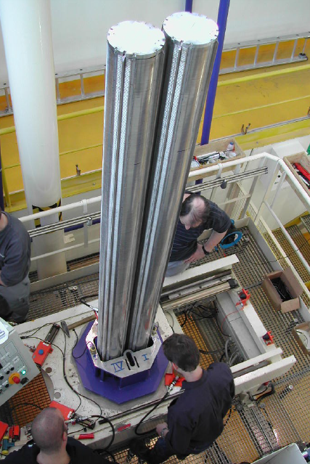
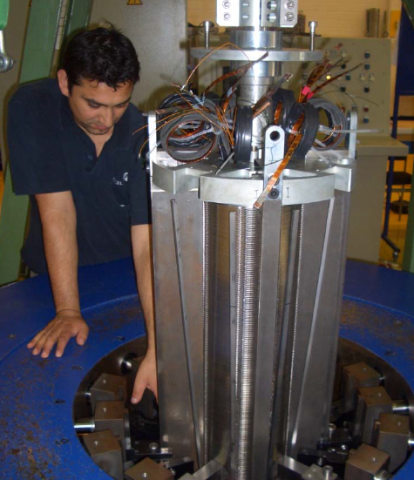
Specific tooling issues on prototype and Q4 series
Adaptation plan of B927 collaring press for the construction of the CEA short model (WP3)
  Next interface meeting on 2nd June at CERN. Clarification of work resources, action plan
How to guarantee compliance and value for allocated budget of prototype tools ?
  Winding machine for series should be identical to QUACO prototypes tool ( need a First of kind on the series)
    Cft Specifications for new series tooling shall be ready by 09/2018
    Option to combine winding facility procurement with Hi Lumi development tools in industry to maintain know how on Nb3sn coils ( ex: MQXF)
The Q4 He containment shells do not require preload and the assembly could be performed by contractor either at CERN site or external site.
  Horizontal assembly of 3 magnets ( MQYY+2 MCBYY) by developed longitudinal shells MIG /MAG welding method.
Collars positionning
ACCEL vertical yoke assembly
Aperture assembly
Collar keys insertion
A Foussat MSC-LMF

Slide 14
Open questions / items
Series production sites choice are not guaranteed until end of PCP (04/2020). This is a pending risk onto the series schedule.
Either Quaco built-to-print is ready on time (mid 2019) for the series or a mitigation plan has to be implemented. This alternate plan includes a detailed design completed by 09/2018 so to anticipate the design completion of Q4 design file ( see schedule).
Risk identified in case prototype feature differ from final series production specification
How to implement the feedback from prototype production ending beg. 2020 on the next series phase.
Due to strong parallelism of Q4 CMs production and common integration with correctors, we would benefit from integration site at CERN, preferably performed on standard tools with industrial resources.
  On the field QC and technical support CERN and partner teams
  Optimisation of CERN resources for in house workpackages follow up
  Winding of series could be performed by external company using QUACO tools development or third party bidder company. Such industrial resources could be coupled to possible external outsourced Nb3Sn magnet production efforts.
  A decision on the Q4 cold test station location shall be taken by end 2016 to plan related budget and the necessary test station upgrade work.

Slide 15
Thank you

