Slide 1

Network evolving (2019-2022)
Bruno Hoeft / DE-KIT

Slide 2
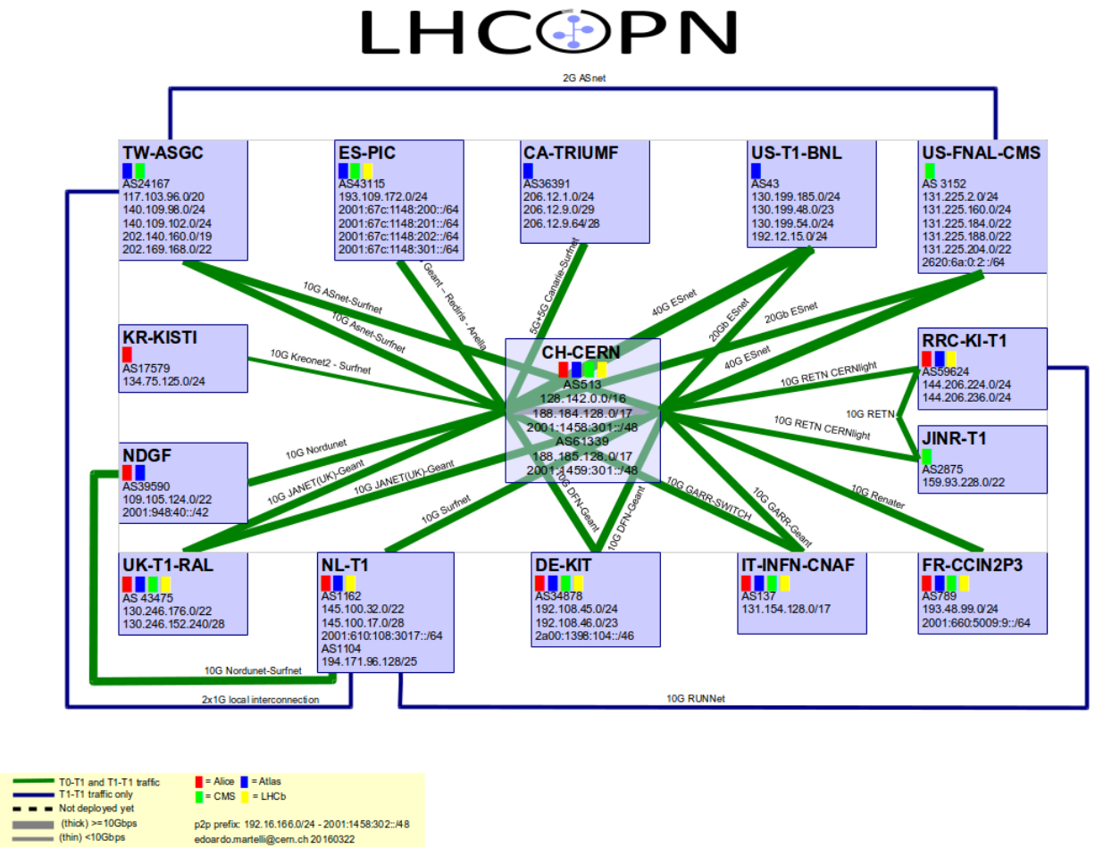
2001:760:4205::/48

Slide 3
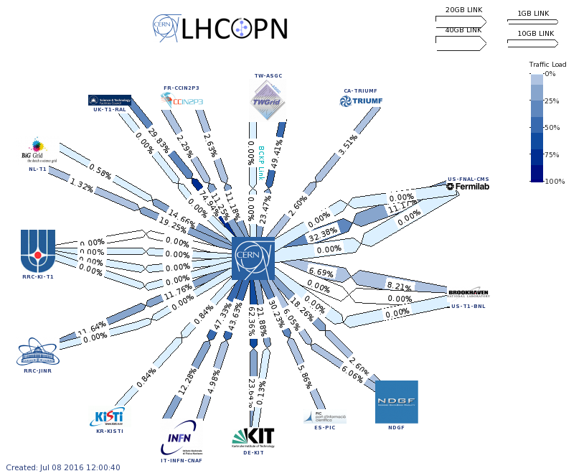

Slide 4
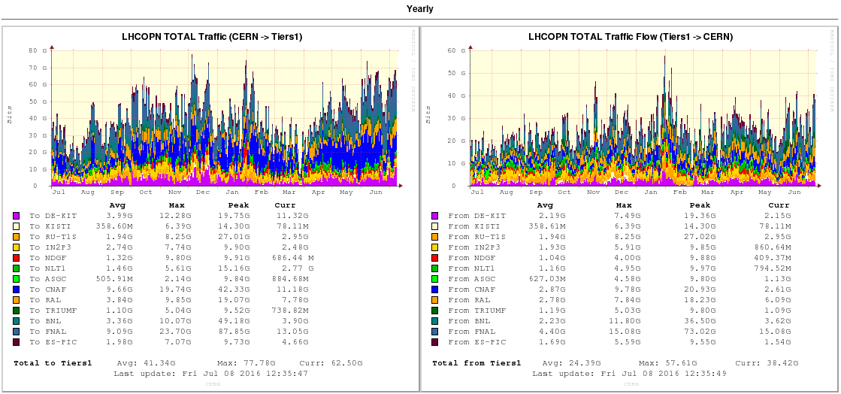

Slide 5

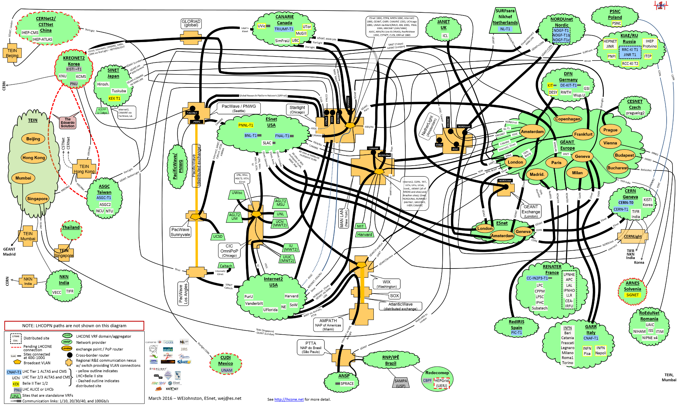
LHC ONE

Slide 6
LHC[OPN/ONE]
LHCOPN
  Optical Private Network (OPN)
  14 x Tier-1s
  link capacity between 10Gbps and 40Ggbps
  1 x Tier-0 : CERN
LHCONE
  Open Network Exchange (ONE)
  Approx. 30 NRENs
  175 CIDRs of more than 78 connected Tier-[0123]
    Steering enabled via community values (acept/deny)
  Still growing:
    Kharkov-KIPT-LCG2 → Ukraine
    currently ASIAN and American Tier-x joining
  German Tier-x:
    Desy, KIT, Uni-Wuppertal, RWTH-Aachen, GSI
  LHCONE covers more than only LHC
    Belle-2
    Pierre Auger Observatory
    NOvA
  Collaboration guidelines (url: https://twiki.cern.ch/twiki/bin/view/LHCONE/LhcOneAup)

Slide 7

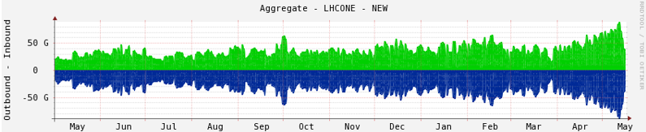
Aggregated LHCONE graph

Slide 8
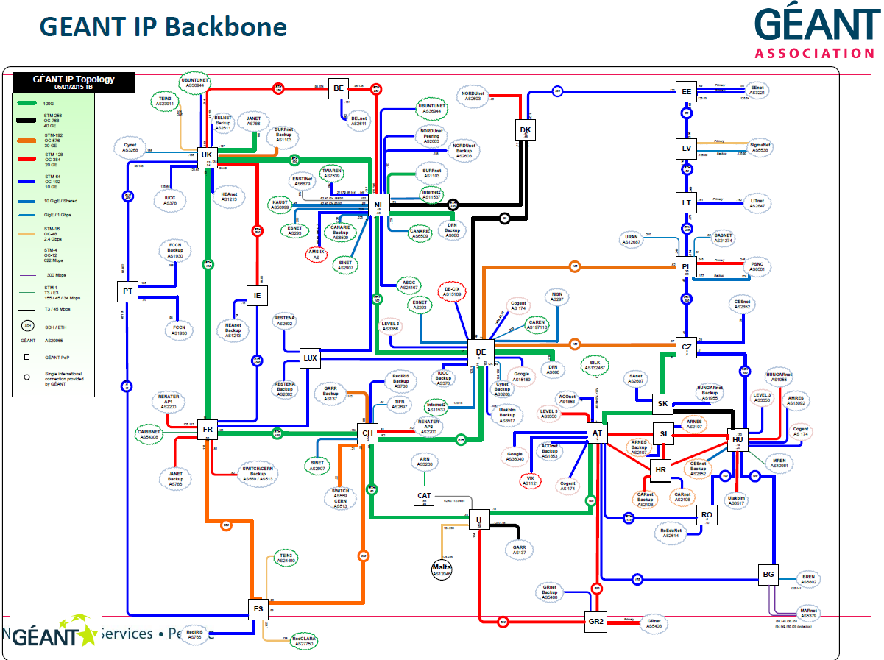

Slide 9
Evaluation of Network Architectures
IP over OTN
  Interconnect router with appropriate capacity trunk link
  Increase meshing between core routers
  Trunk links can be multiplexed by OTN layer into 500G super channel
  Transit traffic is kept at OTN layer instead of transiting through multiple routers
  Maximizes slot capacity at both IP and Optical layer
  Enables GÉANT to scale and converge the two networks
Testing of Infinera PXM (OTN) Cards completed
Will be rolled out in Eastern part of the network
Notes:
Super core or outer core topology

Slide 10
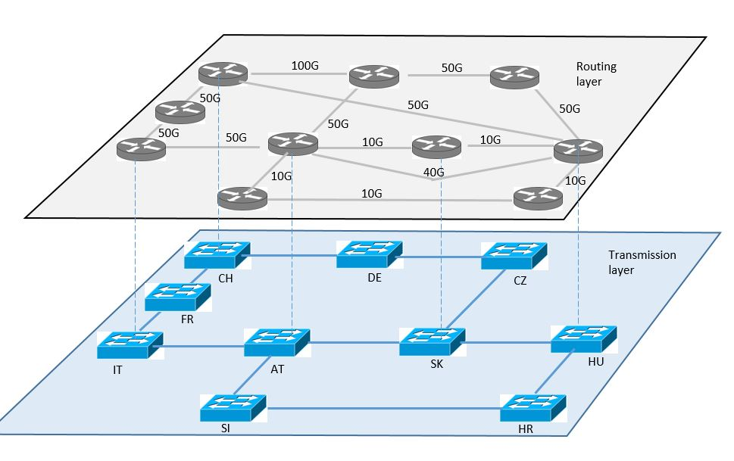
Current and Proposed Architecture
Current Architecture
  Follows the physical fibre
  Significant amount of transit traffic
  Requires two 100G interfaces per trunk
  Over provisioned
Proposed Architecture
  IP Trunks based on traffic requirements between the two PoPs
  Significantly reduces the amount of transit traffic through routers
  Multiple trunk links can be setup on a single 100GE interface
  Reduces the amount of 100GE interfaces required on both IP and DWDM layer

Slide 11
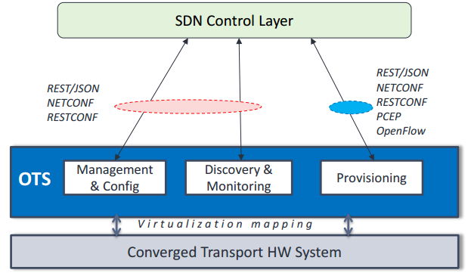

Transport SDN App
Working closely with Infinera to develop a solution for managing OTN (PXM) cards using an OpenFlow controller
  Paves the way to multi-layer interaction
  It uses standard open APIs
Enables us to bring more intelligence to the core network
  Reduce overprovisioning
  Reduce number of transit packets going through intermediate routers
  In future dynamically modify capacity on OTN layer to cater for peaky traffic on Layer 2 and 3

Slide 12
Transport SDN
Current network architecture
GÉANT
Router
NREN
GÉANT
WDM/OTN
NREN
GÉANT
Router
GÉANT
Router
ODU4/2e links
GÉANT
Router

Slide 13
Transport SDN
Revised architecture with PXM cards
GÉANT
Router
Legacy ODU4/2e links to routers via TIM ports
PXM cards support termination of EVPL circuits on vlans
NREN
100GbE
100GbE
GÉANT
WDM/OTN
100GbE
100GbE
NREN
GÉANT
Router
GÉANT
Router
IP trunks. ODUflex used to manage bandwidth between PXM cards. These are static (not OTS controlled)
100GbE
Trunks follow traffic rather than fibre
GÉANT
Router

Slide 14


SDN Phase 2
B/W management with transport SDN
SDN controller
GÉANT
Router
OTSv
OTSc
L2 SDN switch
L2 SDN switch
N x 10GbE
N x 10GbE
GÉANT
WDM/OTN
N x 10GbE
N x 10GbE
NREN
100GbE
100GbE
100GbE
100GbE
NREN
GÉANT
Router
GÉANT
Router
ODUflex and OTSv used to dynamically insatiate these links.
N x 10GbE
GÉANT
Router
Trunks now controlled by OTS
Notes:
We are working on developing a REST API for ONOS controller so it can talk to OTSv and manage and control the OTN layer.
What this give us is the ability to control and manage the OTN layer and layer 2 devices from the same controller
However there is no interaction between the two layers and NOC or Ops will still have to manually make changes from the controller to these layers.

Slide 15

SDN Vision
Integrated L2 and L3 services
WAN optimised switches operate as full layer 3 device and replaces the GÉANT router
Layer 2 service as developed in earlier phases continues to be supported.
GÉANT
Router
100GbE
100GbE
GÉANT
WDM/OTN
100GbE
100GbE
NREN
NREN
SDN Switch
SDN Switch
Switches connected to the WDM/OTN cloud via a 100GE port on a PXM card
Both IP trunks and p2p L2 circuits all are provisioned in the same way – ODU 4/2e or ODUflex circuits terminating on PXM or TIM
All circuits may be provisioned statically or dynamically via the OTSv
100GbE
Multi-layer SDN controller
GÉANT
Router
Notes:
If we look at these use cases in isolation they don’t seem very radical but if we bring all the different use cases SDN BoD, SDN IP and SDN at Transport layer together and have a multi-layer SDN controller as shown in the above diagram we get a very powerful backbone network.
As you can see from the diagram we can potentially remove the routers and use Wan Optimise Switches to deliver L2 and L3 services.
Using the multi-layer SDN controller we can enable the interaction between L2 and OTN layer and if more capacity is needed at Layer 2 it signals to the OTN layer to get more capacity and all this works dynamically.
We see future where we are not tied to a specific vendor hardware or Operating system and its all vendor agnostic. Changing the hardware won’t have impact on how we manage and operate the network or what services we are able to deliver

Slide 16
Summary
SDN enables R&E to differentiate from Commercial ISPs
Exponential Bandwidth Increase
Highly unpredictable traffic
  Brings application awareness in the network
  Integration with other e-Infrastrcture
Improve network visibility and reduce operational costs
Programmability, offers ability to use API to link applications to the network
Support for virtual networks
Remove dependence on vendor software ability to outsource/crowdsource service development - greater agility and speed of service development
Niche service development feasible – R&E no longer dependent on the wants and needs of the big service providers that vendors pander to – ATT, Verizon, BT, Telefonica et al
Notes:
It’s a given that IP traffic is growing exponentially. All industry analysts and bodies agree on the tremendous surge of traffic – IEEE estimates a rate of more than 30% compounded annually. This is impacting the infrastructure that serves to transport it in different ways – the IEEE 802.3 Industry Connections report from 2012 outlined how the core network and server input/output links are reacting to this deluge.
Unit cost for WAN is decreasing but not fast enough to match the traffic demands

Slide 17

Status und Entwicklung X-WiN

Slide 18
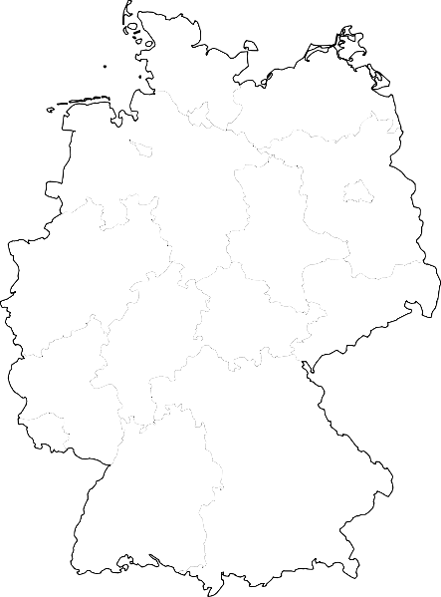
Fiber plattform 2016
KIE
AWI
DKR
ROS
GRE
DES
HWS
EWE
HAM
BRE
FFO
TUB
HAN
MAG
ZEU
POT
HUB
MUE
BIE
BRA
MDS
ZIB
ADH
PAD
DUI
BOC
GOE
DOR
FJL
FZJ
DUS
KAS
LAP
LEI
DRE/DRN
WUP
MAR
FRE
BIR
GIE
JEN
CHE
AAC
AAH
ILM
BON
FRB
FRA
WUE
BAY
GSI
KAI
HEI
ERL
REG
SAA
FZK
KEH
STU
GAR
AUG
FHM
BAS

Slide 19
IP-Plattform – SuperCore 2016

Slide 20
IP-Plattform 2016

Slide 21
Anbindung großer Anwender 2016

Slide 22
Außenanbindungen 2016

Slide 23
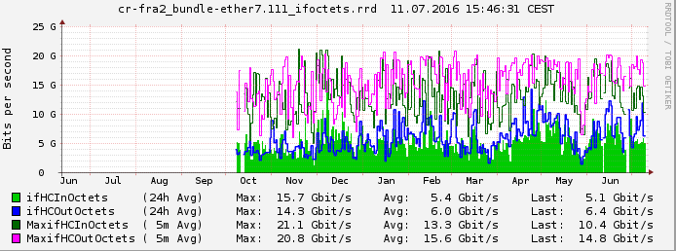
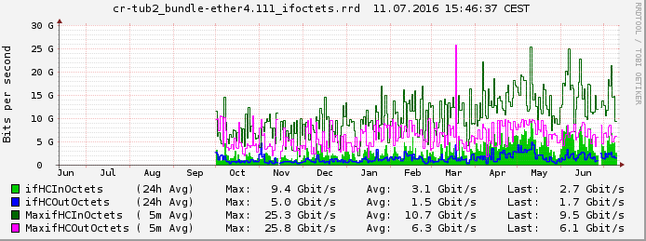
LHCONE troughput graphs

Slide 24
further Development
Generally
  Development of X-WiN is carried out on economical criteria
  New services and technologies must be financed by allocation of costs
  Considerable network upgrade realised between 2012 and 2016
Fibre platform
  No significant changes expected before 2025
Optical platform and IP-platform
  Adoption of 400Gbps and 1 Tbps is expected
  External peering will be upgraded (GÉANT, Peering) accordingly
  Deployment of SDN, currently too indistinct, might be consider in future
  (under observation)
  DoS-Mitigation at IP-platform is an important DFN-Service
Deployment of new aggregation platform planed in 2017 (router at PoP)

Slide 25
summary
Geant
  Envision of a OTV based network with routing at endpoints (low latency + scaling resources)
  Upgrade according to site/peering/throughput requirements
  → transatlantic + transeurasia capacities will get upgraded as needed
    Transatlantic
      ESnet 4 links 340G total + ANA-300G + RedClara
    Transeurasia + africa
      SInet 2*10G + TEIN 10G + Orient PLUS + UbuntuNet + Caren + …
DFN
  More conservative approach (routed supper core network)
  No changes at their optical network planned before 2025
  Throughput upgrade as required (and costs covered)
LHCONE → vpn still growing
Monitoring → PerfSONAR mesh
  LHC PerfSONAR mesh
  PerfSONAR (NREN/individual project/…) mesh
IPv6 has to be considered as dual-stack
  URL: http://hepix-ipv6.web.cern.ch/

Slide 26
Ideen Sammlung
International network map → GLIF
Esnet transatlantic/transpacific Ausbau
Dfn ausbauplan → ask google
  Dfn current map
  ECI aufbau (5*100G?)
  LHCONE covers more than only LHC
    Belle-2
    Pierre Auger Observatory
Summary
  Géant + DFN offered bandwidth capacity will increase to the requiered ammount
  LHCONE will may cover additional high data
Deutschland:
      None LHCONE: Uni-Siegen, Uni-Frankfurt, Uni-Freiburg, MainzGrid, mpi-hd, scai, itwm-fhg, rzg-mgp, lrz, tu-dortmund, tu-dresden, FZ-Jülich
      LHCONE: Aachen, Desy, GSI, Uni-Wuppertal, KIT
Ipv6 → LHC (in 2 to 3 years dual-stack fully deployed (may be)?)
URL: http://hepix-ipv6.web.cern.ch/

Slide 27
Ausblick
Grundsätzlich
  Ausbau X-WiN erfolgt stets nach wirtschaftlichen Kriterien
  auch neue Dienste und Technologien müssen über Kostenumlage finanziert werden
  erheblicher Netzausbau von 2012 bis 2016 erfolgt, mit Blick auf 2020
Faserplattform
  keine signifikanten Veränderungen bis ca. 2025 zu erwarten
Optische Plattform und IP-Plattform
  Einsatz von 400Gbps und 1Tbps zu erwarten
  entsprechend auch Ausbau von Außenanbindungen (GÉANT, Peerings)
  Einsatzmöglichkeiten SDN o.ä. derzeit noch unklar, unter Beobachtung
  DoS-Mitigation auf IP-Plattform als wichtiger DFN-Regeldienst
Aufbau Aggregations-Plattform für 2017 beabsichtigt

Slide 28
Backup slids

Slide 29
PerfSONAR
Umstrukruriert
  „länderspezifisches“ Perfsonar wurd aufgelöst
  Experiment spezifisches aufgebaut (ATLAS, CMS, LHCB)

Slide 30
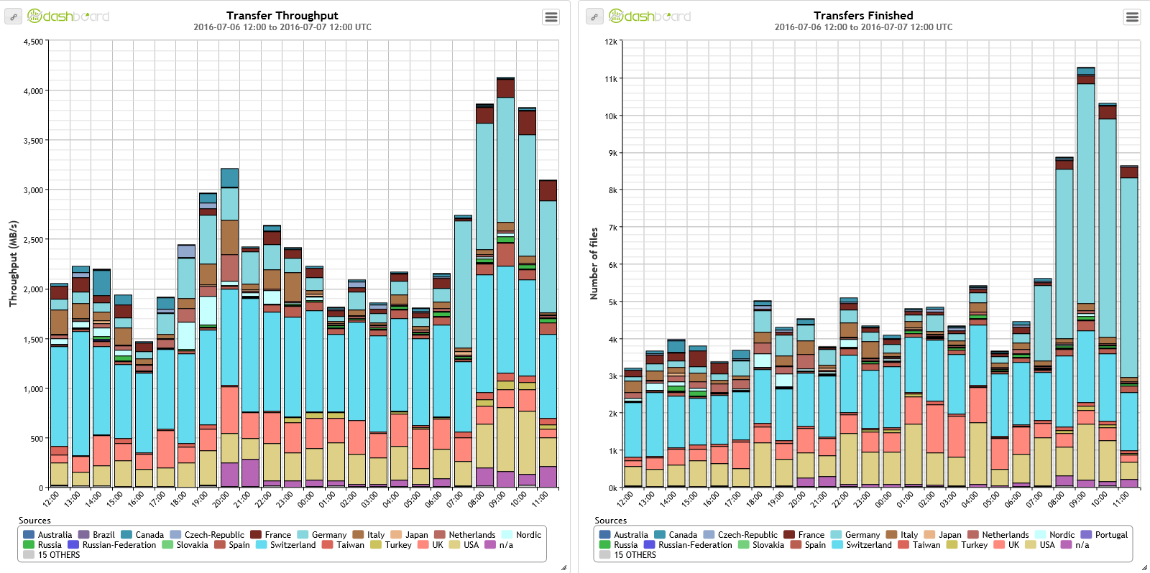

Slide 31
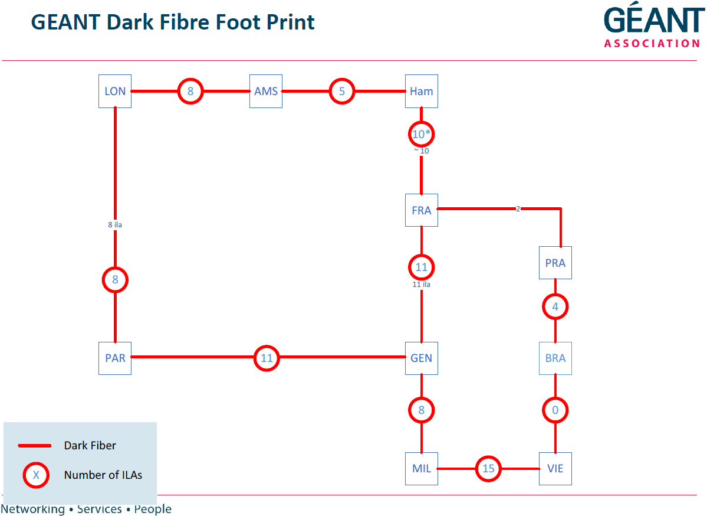

Slide 32
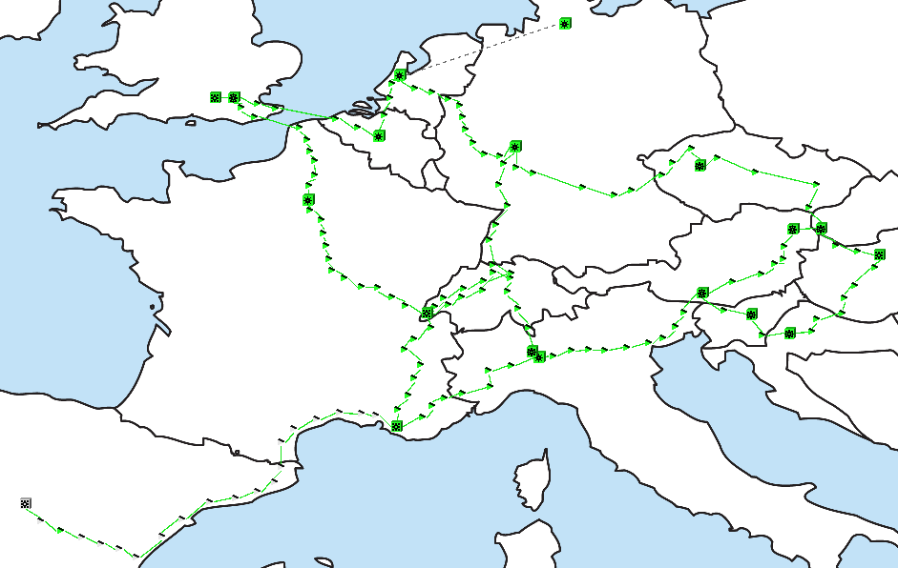
The DWDM network
Elements providing large capacity Point-to-point across defined fibre routes
10G and 100G Lambda services are provided directly on this infrastructure

