Slide 1
WP8: Outreach and Liaison
Dr Ricardo Torres

Slide 2
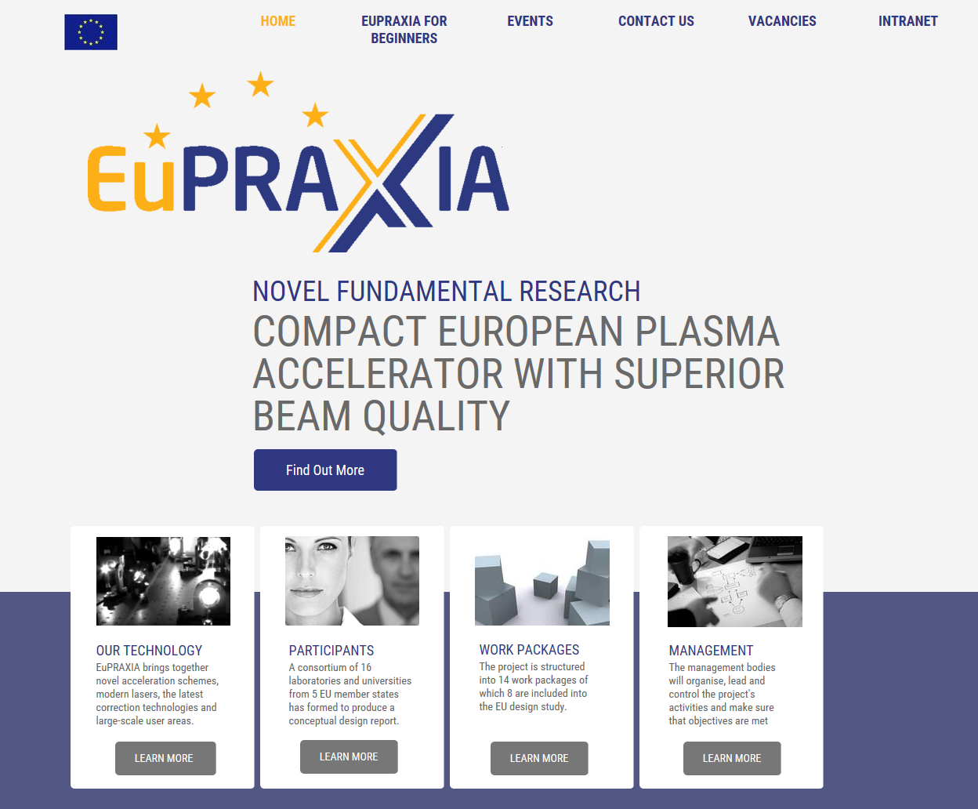


Internet and social media
The Cockcroft Institute
The QUASAR Group
@ cockcroft_news
@ QUASAR_6roup
#EuPRAXIA #plasma #accelerator
www.eupraxia-project.eu

Slide 3
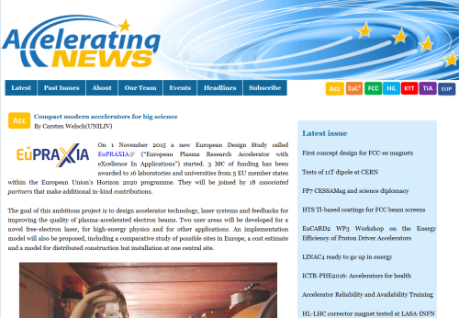
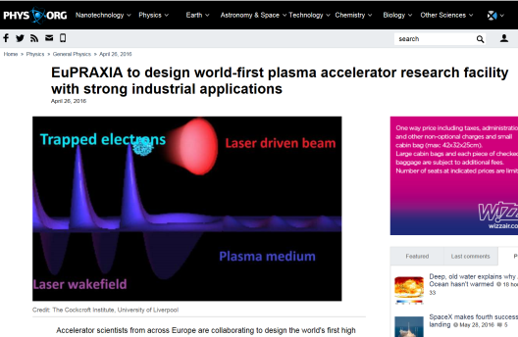
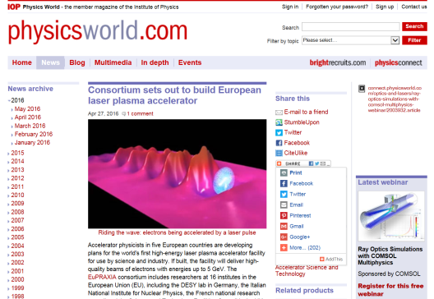
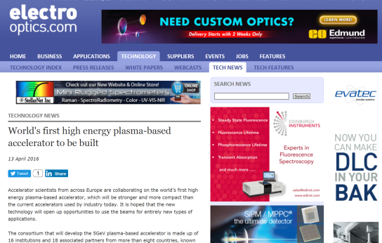
Feature articles
More than 20 feature articles in magazines, newsletters, and websites

Slide 4
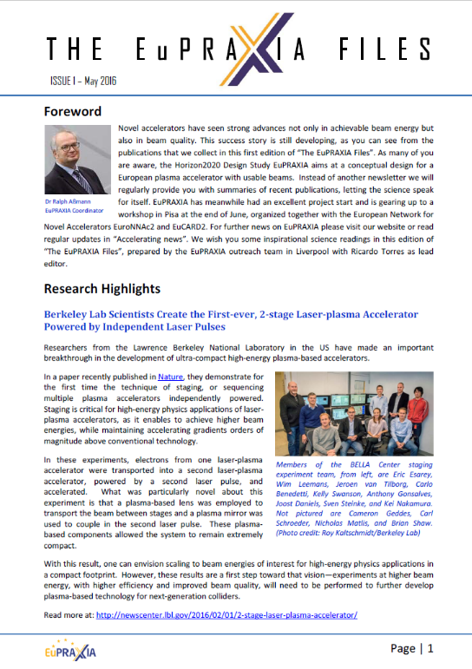
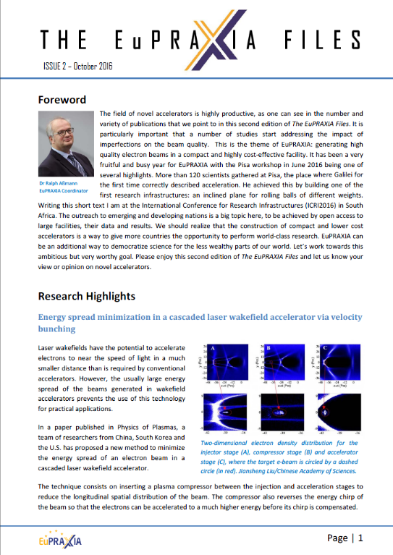
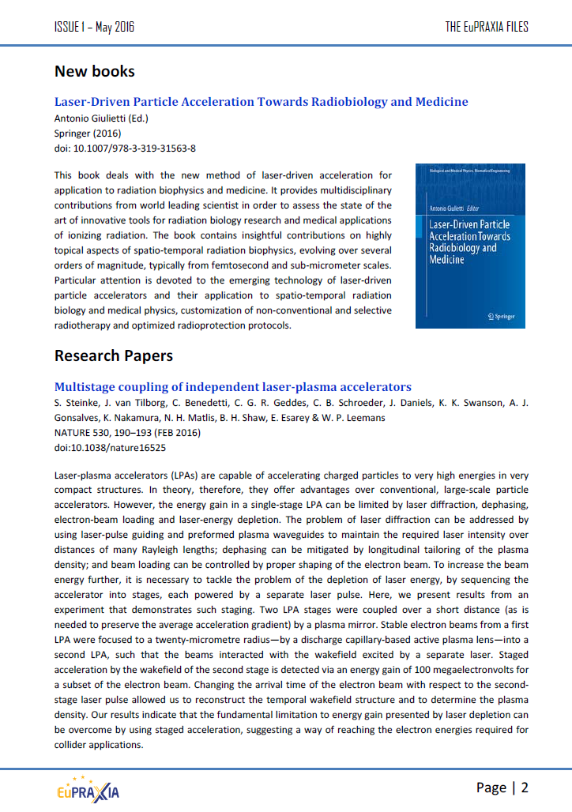
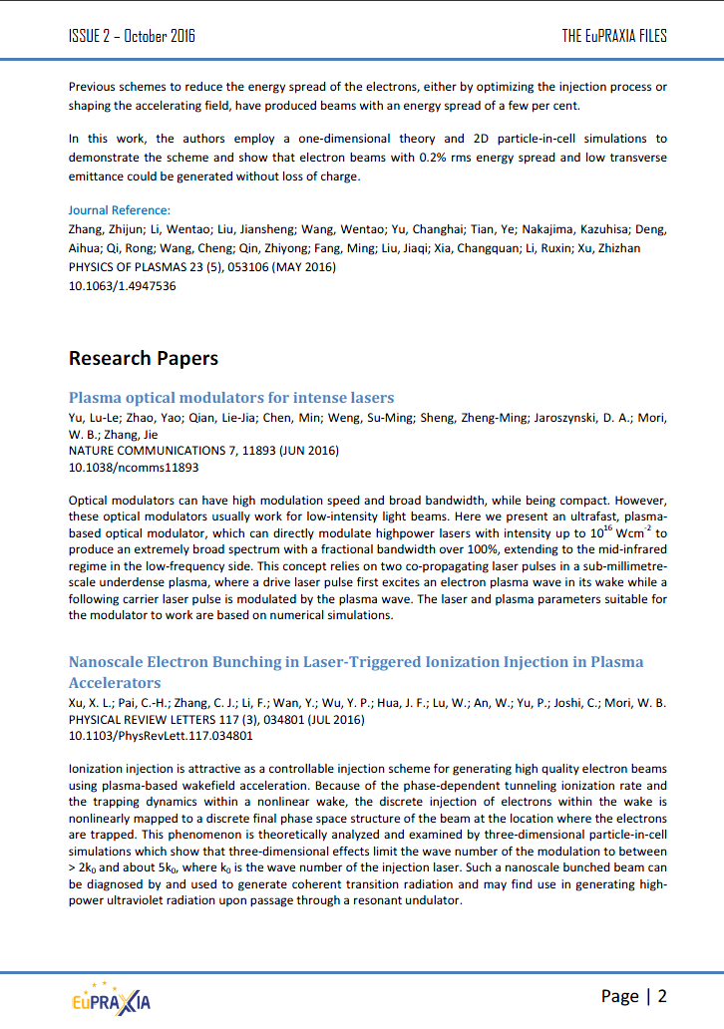
THE EuPRAXIA FILES
Collection of abstracts of recently published papers in laser-plasma acceleration
Quarterly
Distributed to all beneficiary and associate partners

Slide 5




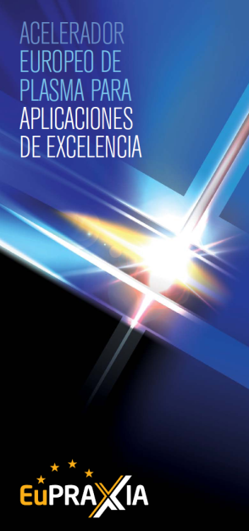


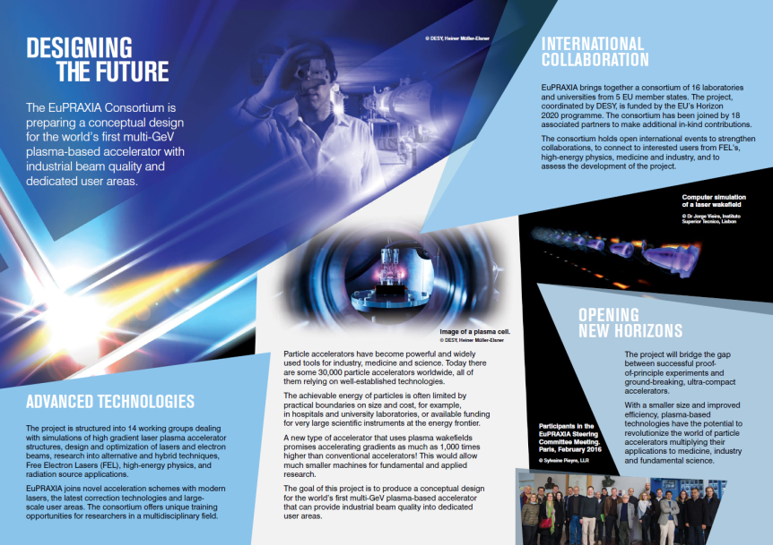





Promotional material
Banners
Leaflets
✓
✓
✓
Poster
Please take copies and distribute

Slide 6
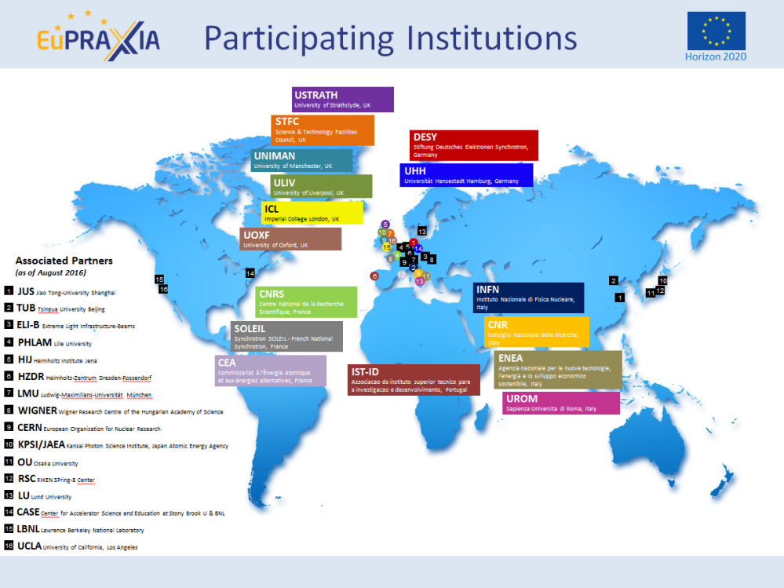
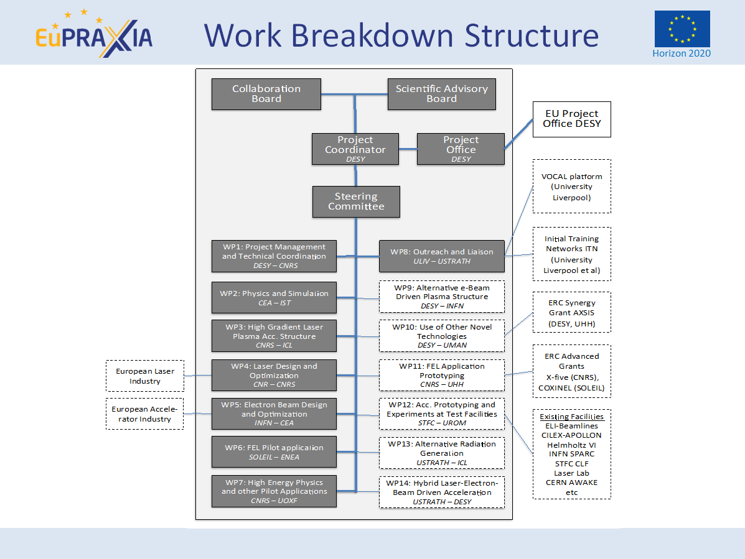
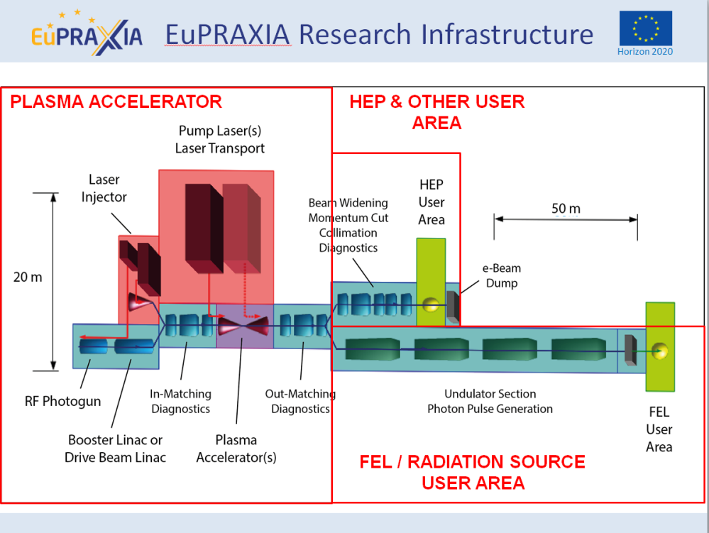
Presentation template

Slide 7
Future plans
Step up the publication of news
Leaflet versions
Brochure on key technologies
Continue the promotion in different conferences
Videos
Outreach symposium in 2018

