Slide 1
CERN developments of an optical readout for MPGDs
Filippo Resnati (CERN)
on behalf of the GDD team
MPGD Applications Beyond Fundamental Science - 15 September 2016 - Aveiro

Slide 2
Where to get the light from
Almost the same spectra
Primary
Excitation and ionisation
produced by the particle
interacting with the gas.
Some dependance
with the electric field.
Electroluminescence
Scintillation without charge
amplification.
Increase linearly with the field.
Easy in pure noble gases.
Avalanche
Exponential scaling with the field.
Proportional to the charge gain.
The extreme is the visible spark.
Filippo Resnati - MPGD Applications Beyond Fundamental Science - 15 September 2016 - Aveiro

Slide 3
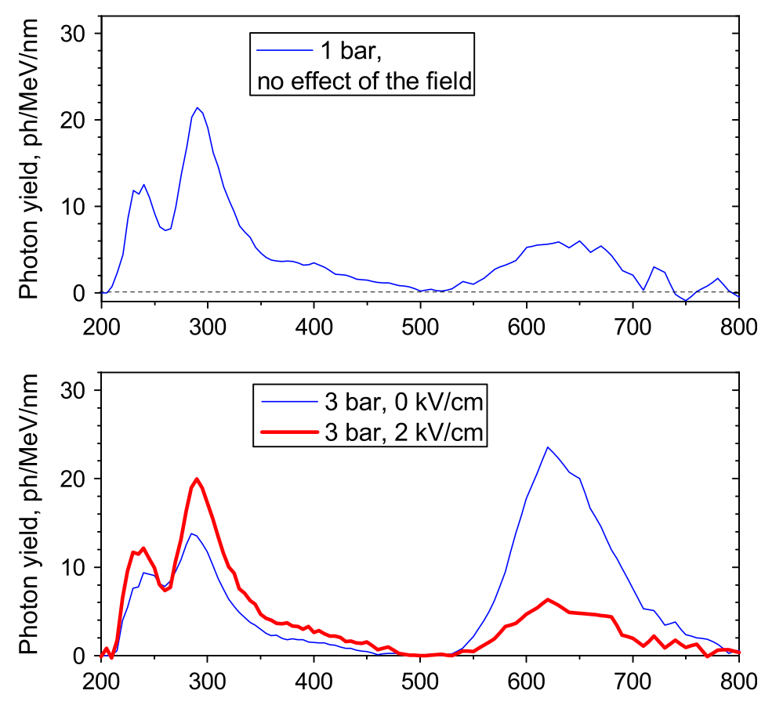
CF4
Admixtures which provide useful scintillation
(enough and near the visible range) are rare.
Pure CF4 primary scintillation
A. Morozov et al., NIM A 628 (2011) 360
CF4 is not transparent to the CF4 de-excitation to ground.
What scintillates must be something else: (CF3*), CF3^{+*} and CF4^{+*}
Filippo Resnati - MPGD Applications Beyond Fundamental Science - 15 September 2016 - Aveiro

Slide 4
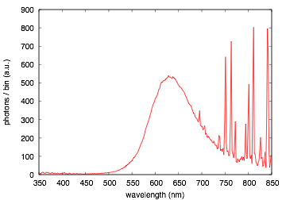
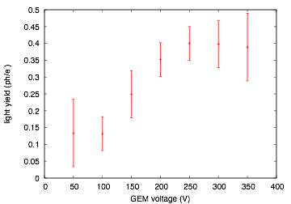
Ar/CF4 80/20
Plexiglass cuts below 400 nm
About 0.4 ph/e⁻ in the visible
ArI 4p 4s lines
CF4
Preliminary
Nicely matching the CCD efficiency curve
High charge gain -> high light gain
Light yield comparison
NaI: ~40 ph/keV
GEM at a gain of 10⁵: ~10⁶ ph/keV
Filippo Resnati - MPGD Applications Beyond Fundamental Science - 15 September 2016 - Aveiro

Slide 5
Optical readout
Record the light emitted during the Townsend avalanche with a camera:
use the detector as a scintillating plate.
Filippo Resnati - MPGD Applications Beyond Fundamental Science - 15 September 2016 - Aveiro

Slide 6
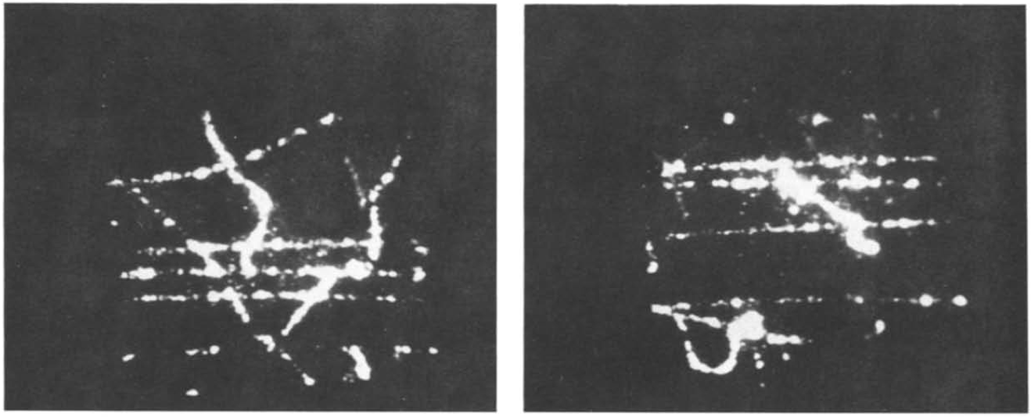
Only techniques are new
Parallel mesh chamber filled with Ar/CH4/TEA 80%/8%/2%
seen by an image intensifier and a camera
Muons and delta rays
G. Charpak et al., NIM A258 (1987) 177
Filippo Resnati - MPGD Applications Beyond Fundamental Science - 15 September 2016 - Aveiro

Slide 7
Advantages
Simplicity: like taking a picture
Robustness: as a device off-the-shelf
Versatility: several uses and environments
Filippo Resnati - MPGD Applications Beyond Fundamental Science - 15 September 2016 - Aveiro

Slide 8
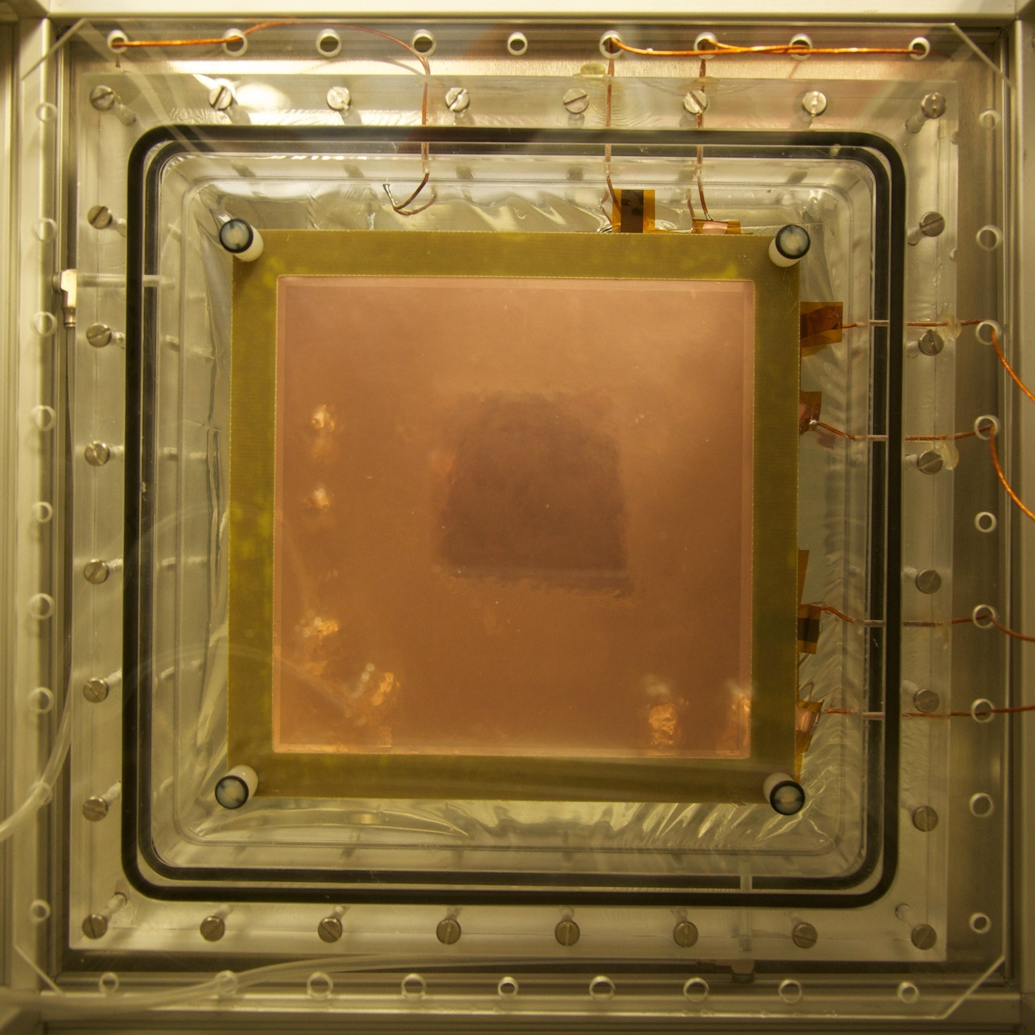

The setup
Ar/CF4 80/20
10 mm
10 cm
2 mm
2 mm
2 mm
Plexiglass
Geometrical acceptance
M = sensor size / image size
M ~ 0.1, Ω ~ 5x10⁻⁴
This implies:
- large sensor
- low noise
- fast lens
- a lot of light
+3 dioptre lens
25 mm f/0.95 lens
CCD camera
Filippo Resnati - MPGD Applications Beyond Fundamental Science - 15 September 2016 - Aveiro

Slide 9
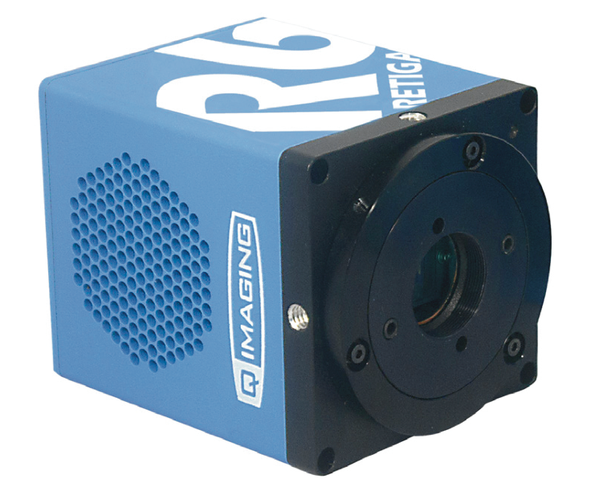
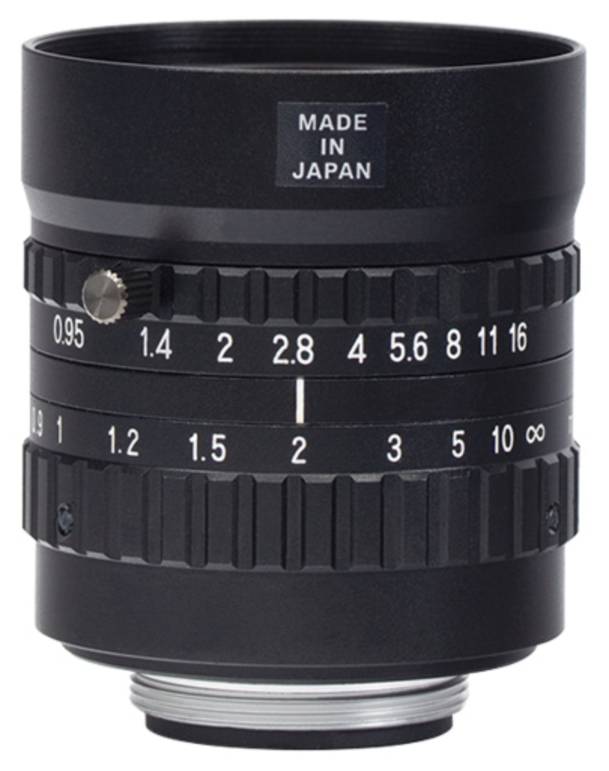
Camera and lens
QImaging Retiga R6
CCD: 2688x2200 4.54x4.54 um² pixels
ADC: 14 bit
rate: 6.9 fps (20fps with binning)
read noise: 5.7 e⁻ RMS
dark current: 0.0002 e⁻/p/s @ -20º C
trigger: external bulb + others
Navitar
focal length: 25 mm
aperture: f/0.95
Mount: C-Mount
Sensor type: 1’’ format
Filippo Resnati - MPGD Applications Beyond Fundamental Science - 15 September 2016 - Aveiro

Slide 10
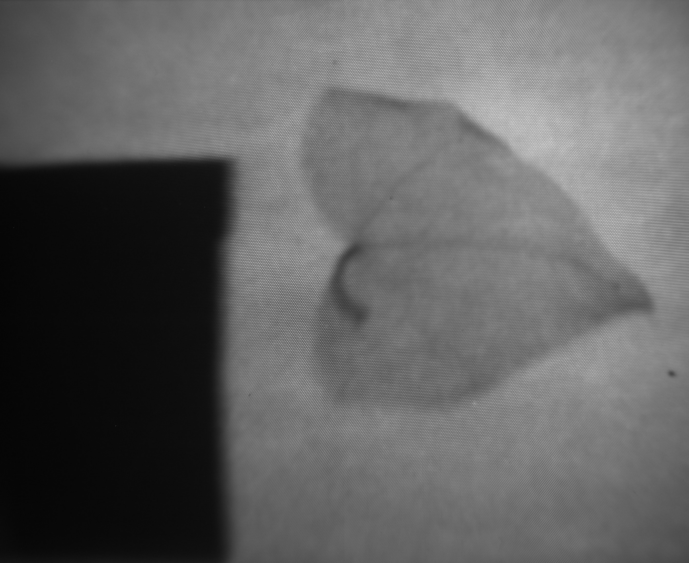

⁵⁵Fe X-ray imaging
4.4 cm
One of the first images
20 min exposure
70 um hole, 140 um pitch

Slide 11
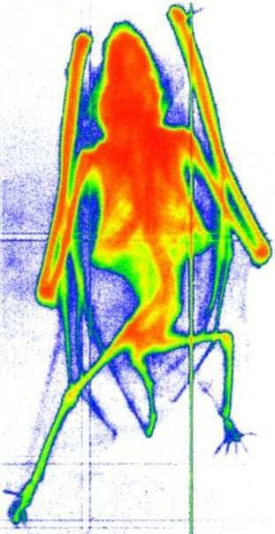
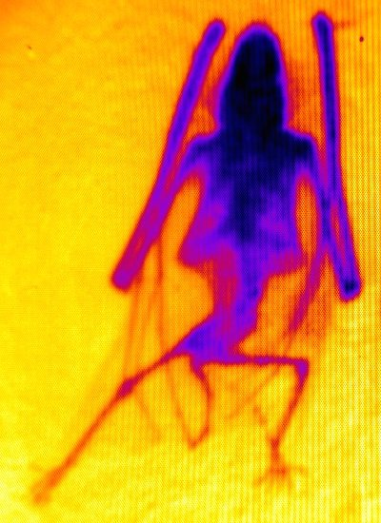
X-ray images
X-ray tube with W target at 20 kV - 40 kV at few mA
Charge acquisition (26/10/1998)
Light acquisition
~7 cm
Raw data:
fast (<1 s) acquisition
and no processing time
Filippo Resnati - MPGD Applications Beyond Fundamental Science - 15 September 2016 - Aveiro

Slide 12
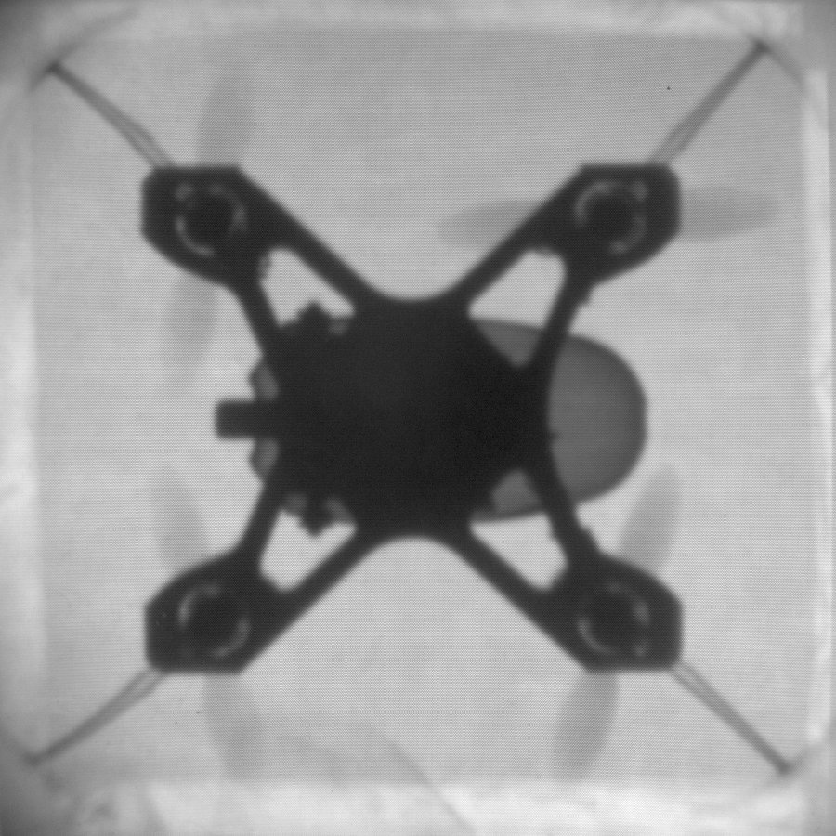
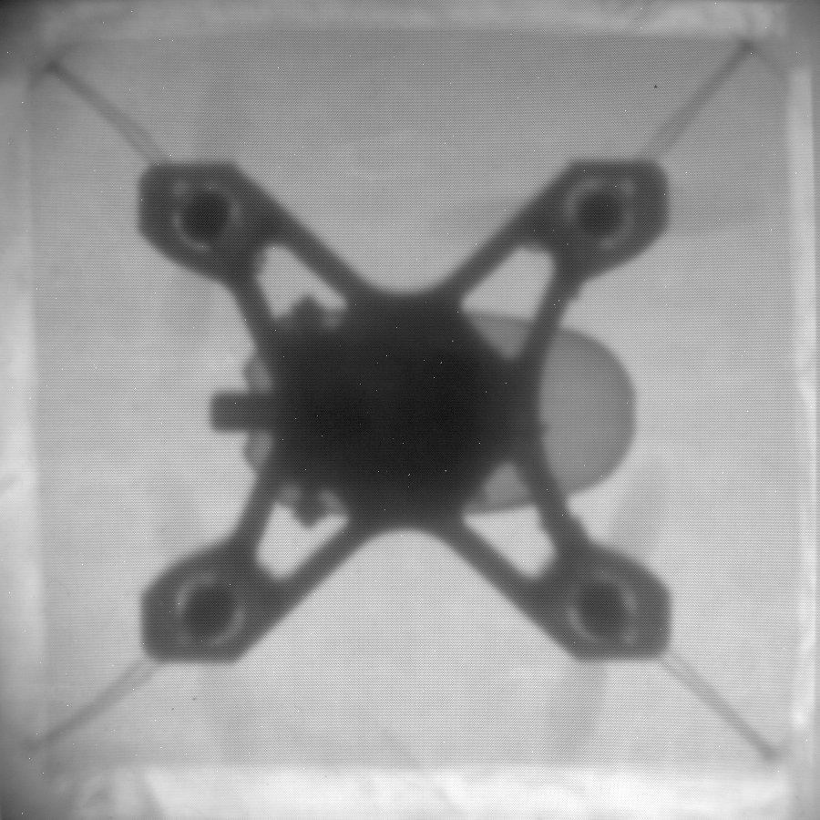
X-ray images
X-ray tube with W target
11 kV
40 kV
8 cm
Straight out from the camera, not even the flat field correction
Filippo Resnati - MPGD Applications Beyond Fundamental Science - 15 September 2016 - Aveiro

Slide 13
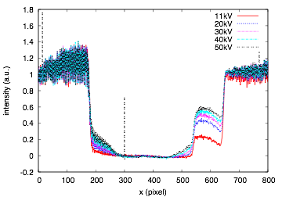
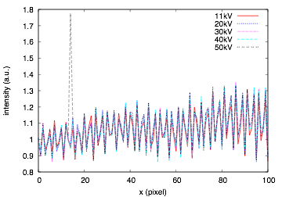
X-ray images
X-ray interacting
with the CCD
Increasing energy:
- X-ray more penetrating
- Worse position resolution (larger charge cloud)
Filippo Resnati - MPGD Applications Beyond Fundamental Science - 15 September 2016 - Aveiro

Slide 14
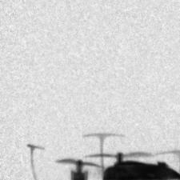
Fluoroscopy
50 ms exposure
10 Hz acquisition
Filippo Resnati - MPGD Applications Beyond Fundamental Science - 15 September 2016 - Aveiro

Slide 15
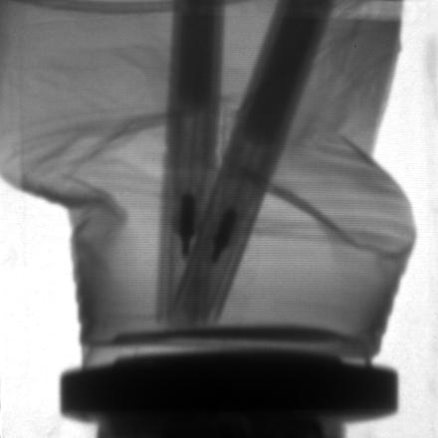
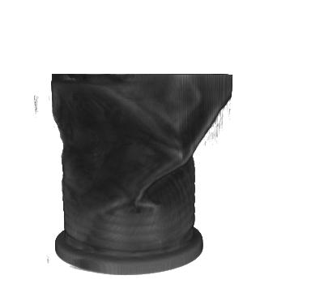
CT and 3D imaging
Image -> Sinograms -> Filtered Back Projection -> 3D image
Filippo Resnati - MPGD Applications Beyond Fundamental Science - 15 September 2016 - Aveiro

Slide 16
Fluorescence
17 cm
Contemporary
industrial painting
Pin-hole
X-ray tube
W target
40 kV, 1 mA
GEMs
Shielding
Camera and lens
Filippo Resnati - MPGD Applications Beyond Fundamental Science - 15 September 2016 - Aveiro

Slide 17
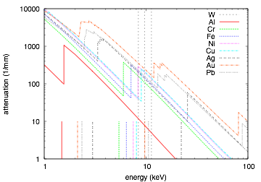
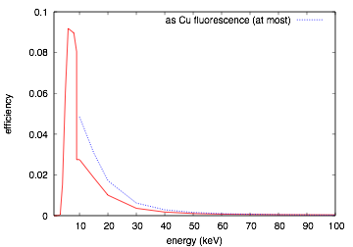
What should be expected
W target:
bremsstrahlung +
characteristic lines
Limiting factors (because not optimised):
- low energy -> window and cathode
- high energy -> gas
Lα Lβ Lγ
feasible:
Cr, Fe, Ni, Cu
difficult:
Au, Pb
more difficult:
Al, Ag
Filippo Resnati - MPGD Applications Beyond Fundamental Science - 15 September 2016 - Aveiro

Slide 18
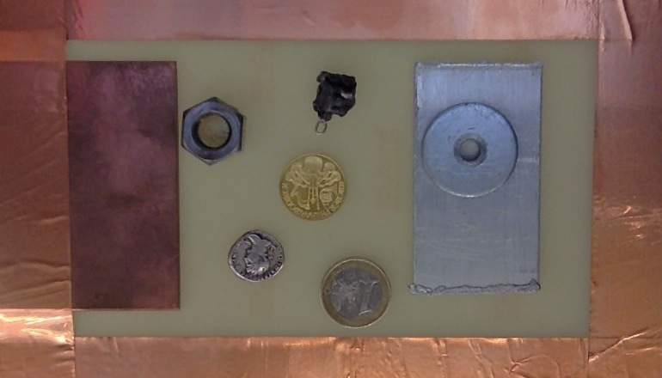
The painting (visible)
17 cm
Fe
SS
?
Cu
Cu
Au
Al
Ag
Filippo Resnati - MPGD Applications Beyond Fundamental Science - 15 September 2016 - Aveiro

Slide 19
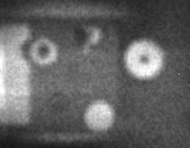
The painting (X-rays)
O(1 kHz) in 500 s exposure
Filippo Resnati - MPGD Applications Beyond Fundamental Science - 15 September 2016 - Aveiro

Slide 20
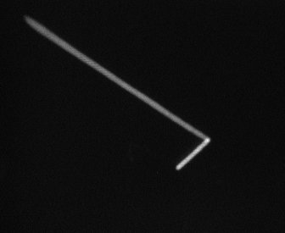
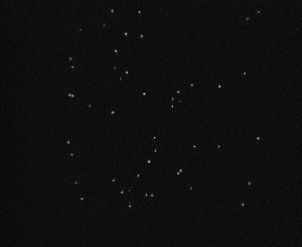
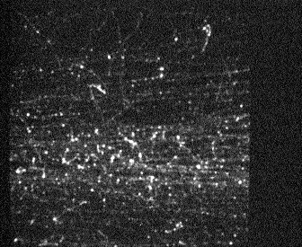
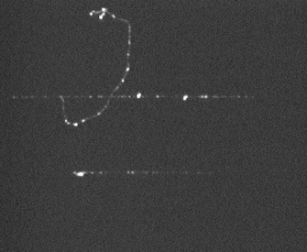
Event by event
α from ²²⁰Rn & ²¹⁶Po
X-rays from ⁵⁵Fe
For hours in sealed mode at test beam
shower from a charged pion
muon and δ-ray
Filippo Resnati - MPGD Applications Beyond Fundamental Science - 15 September 2016 - Aveiro

Slide 21
Event by event: X-rays
X-rays from ⁵⁵Fe source
Filippo Resnati - MPGD Applications Beyond Fundamental Science - 15 September 2016 - Aveiro

Slide 22
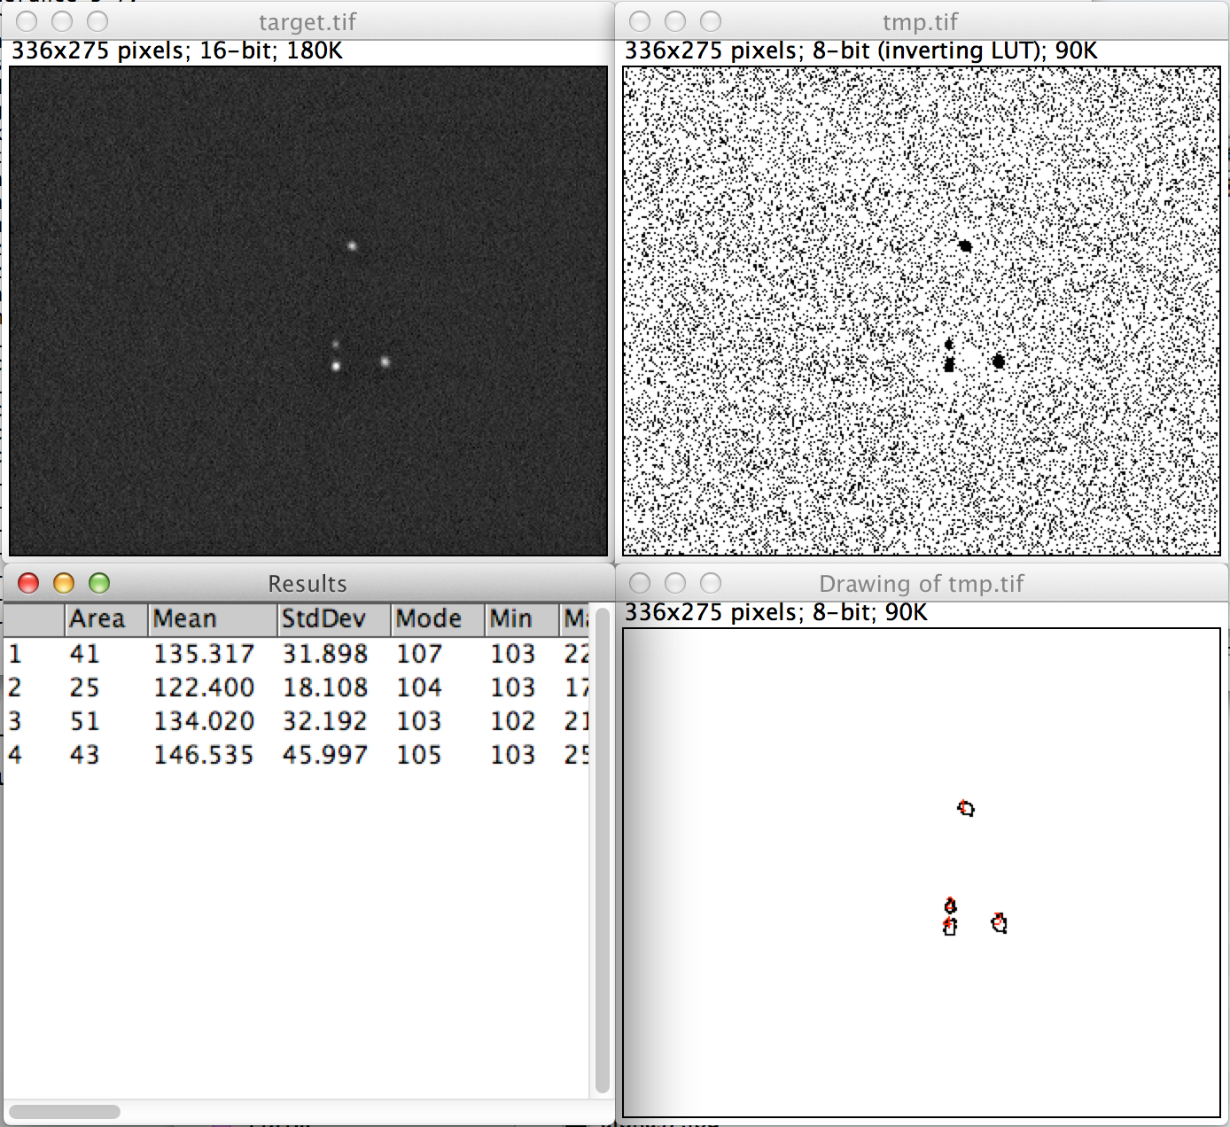
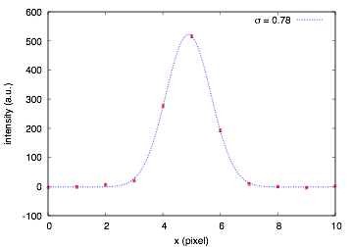
Analysis of single clusters
Average profile of 5.9 keV events
Spatial resolution in the limit of long exposure:
280 um for 1 cm drift and 5.9 keV X-rays.
Dominated by e⁻ diffusion and cluster size.
Spatial resolution improves using the barycentre of the cluster
Filippo Resnati - MPGD Applications Beyond Fundamental Science - 15 September 2016 - Aveiro

Slide 23
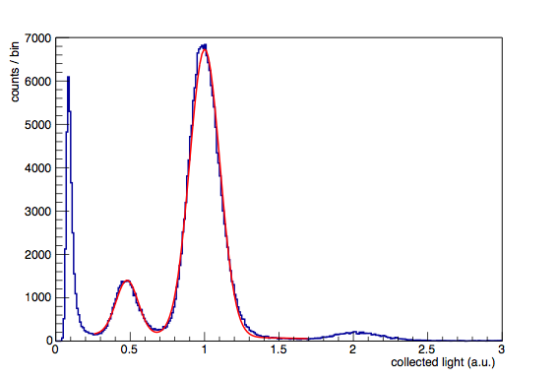
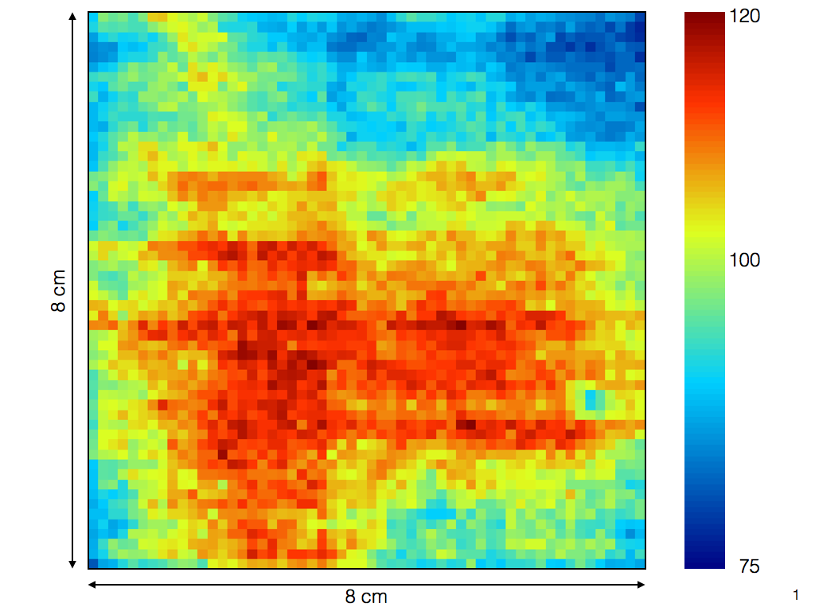
The spectrum
from CCD images
Gain uniformity, vignetting plays a role too
⁵⁵Fe source
Full energy
Escape
Pileup
FWHM at 5.9 keV over 8x8 cm²
~36% before gain uniformity correction
24.7% after gain uniformity correction
Filippo Resnati - MPGD Applications Beyond Fundamental Science - 15 September 2016 - Aveiro

Slide 24
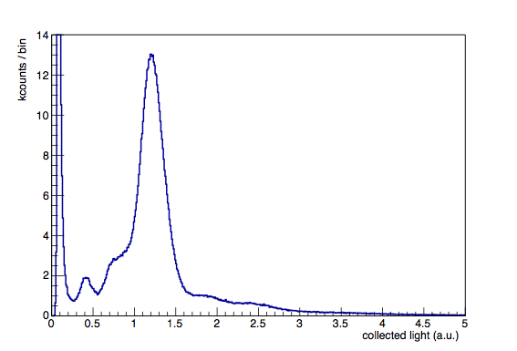
Fluorescence event by event
Filippo Resnati - MPGD Applications Beyond Fundamental Science - 15 September 2016 - Aveiro

Slide 25
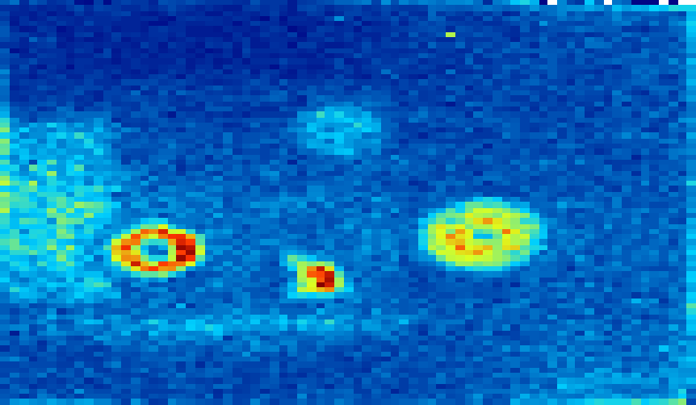
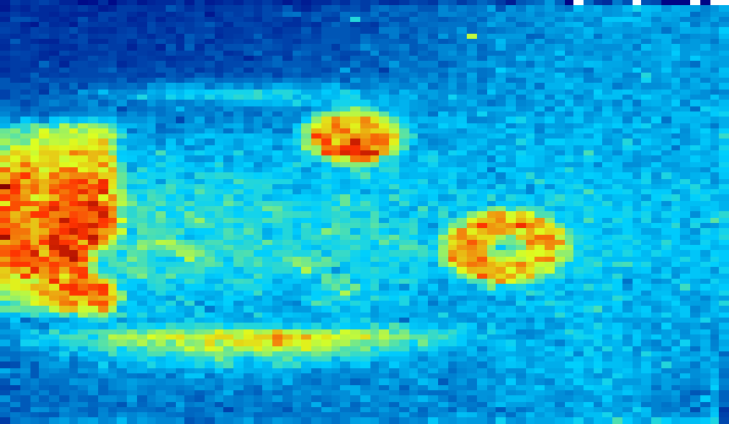
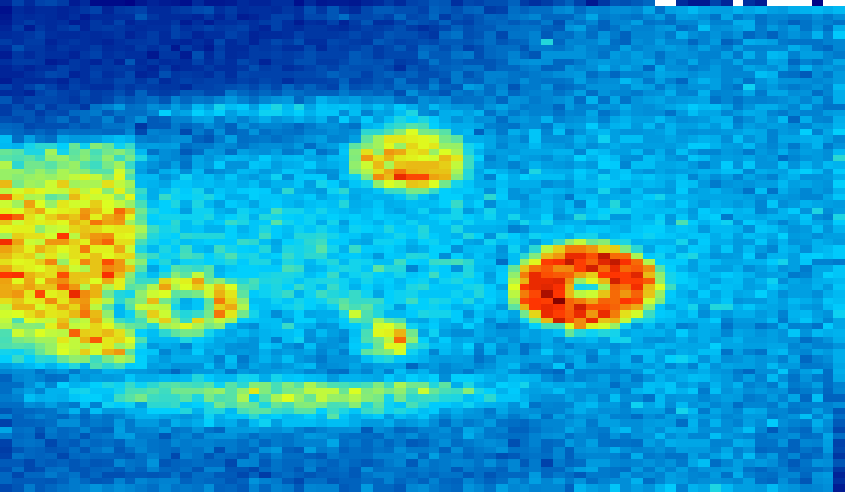
Fluorescence event by event
some color coding
Red
Green
Blue
Filippo Resnati - MPGD Applications Beyond Fundamental Science - 15 September 2016 - Aveiro

Slide 26

Fluorescence event by event
some color coding
Filippo Resnati - MPGD Applications Beyond Fundamental Science - 15 September 2016 - Aveiro

Slide 27
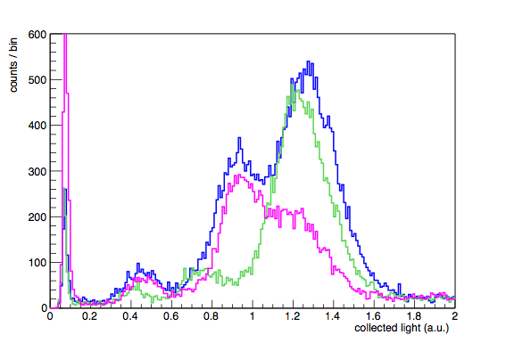
Fluorescence event by event
It’s Zinc
Filippo Resnati - MPGD Applications Beyond Fundamental Science - 15 September 2016 - Aveiro

Slide 28
Possible other application
X-ray crystallography
UV imaging
Neutron imaging
Gamma imaging
…
Filippo Resnati - MPGD Applications Beyond Fundamental Science - 15 September 2016 - Aveiro

Slide 29
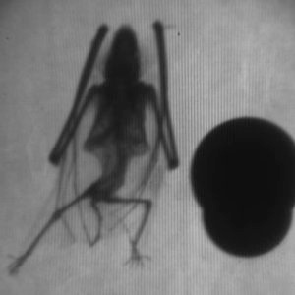
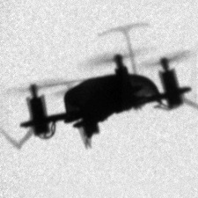
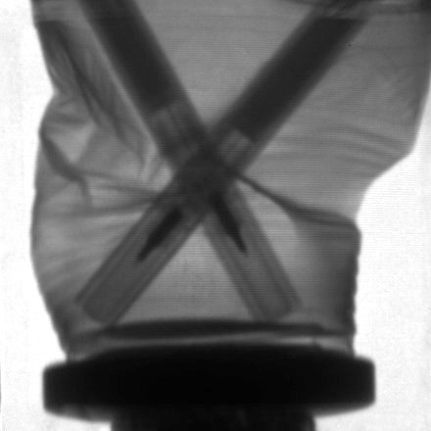
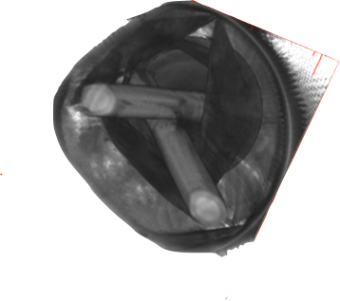
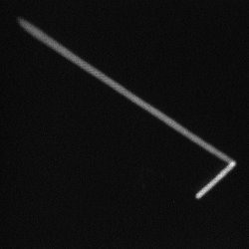
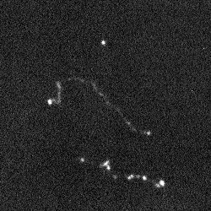
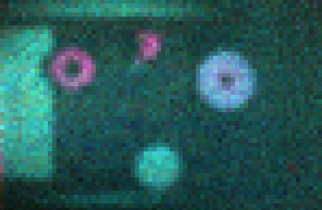
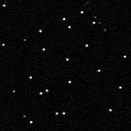
Radiography of a bat
and closeup of the GEM holes
Freeze-frame of an X-ray
movie of a flying drone
Radiography of a
crushed cup with pens and
its 3D tomographic reconstruction
O (100 keV) electrons
~MIPs
Cu
Visible picture of a painting
and its X-ray fluorescence image.
Different colours refer to different
materials (energy resolved)
SS
Fe
Al
Alphas from ²²⁰Rn decay
and its daughter ²¹⁶Po
Zn
Au
Cu
Ag
1€
Single X-rays from ⁵⁵Fe
and the energy spectrum
extracted from the images

