Slide 1

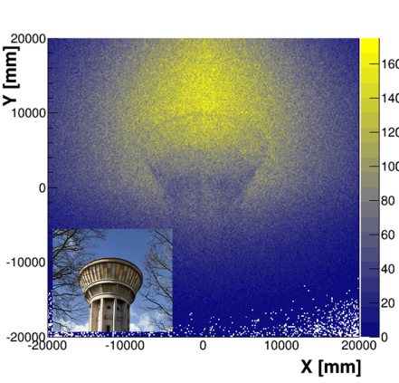
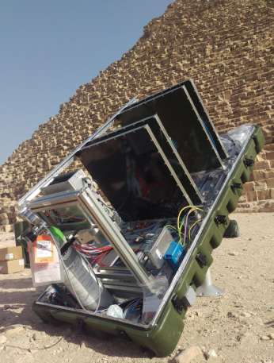
An exotic use of MPGD:
muography of Egyptian pyramids
IRFU/SPhN: S. Procureur, S. Bouteille (PhD)
IRFU/Sédi: D. Attié, D. Calvet, P. Magnier, I. Mandjavidze, M. Riallot
MPGD workshop, 15/09/2016
Notes:
Saisir les champs « Titre », « P. Nom » et « Date.
Laisser ou retirer le bandeau.

Slide 2
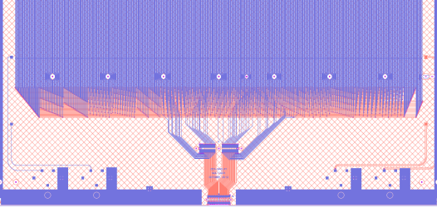
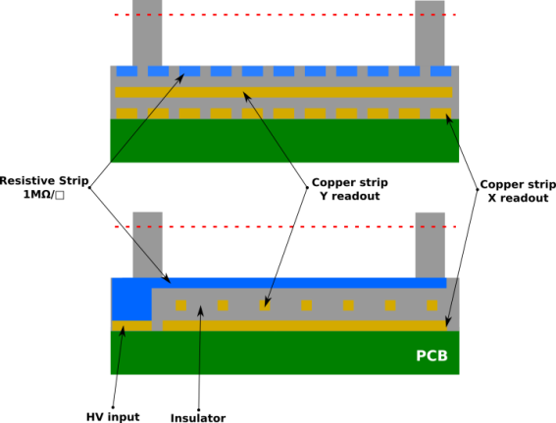
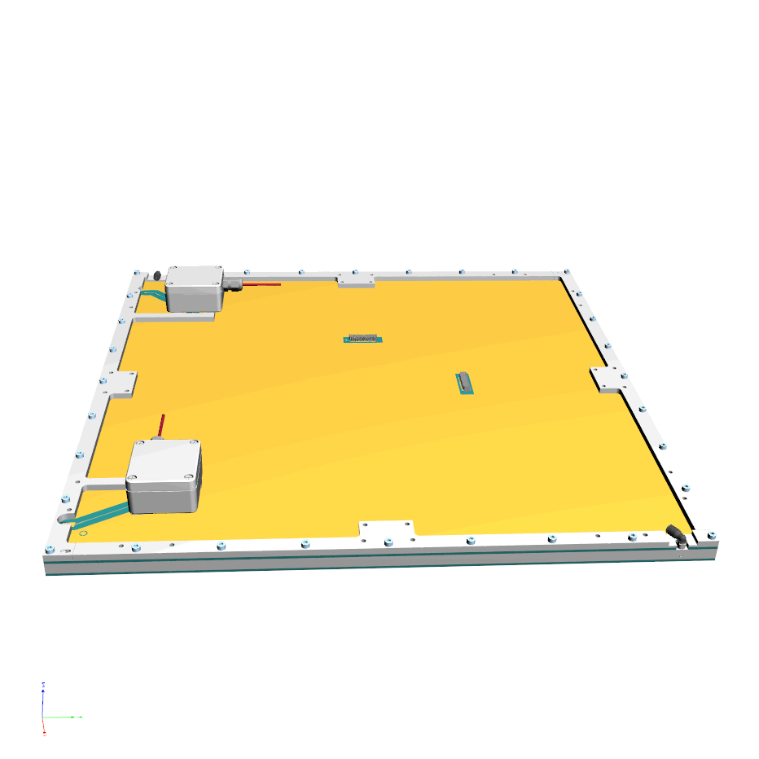
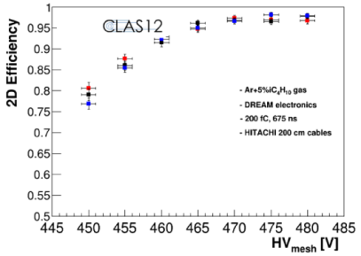
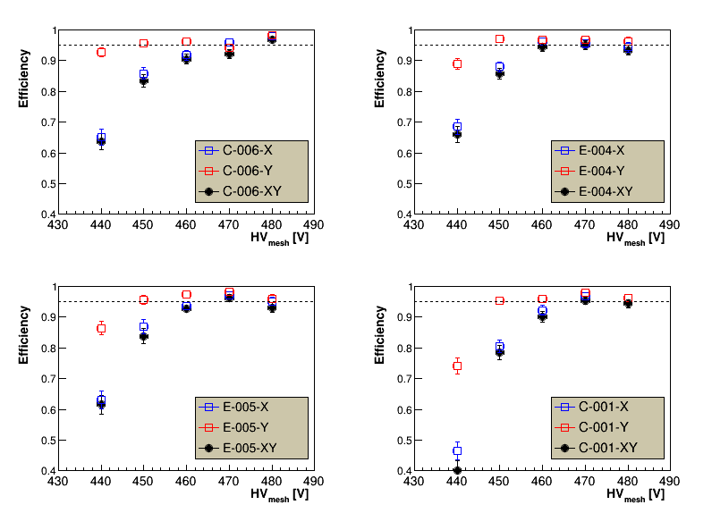


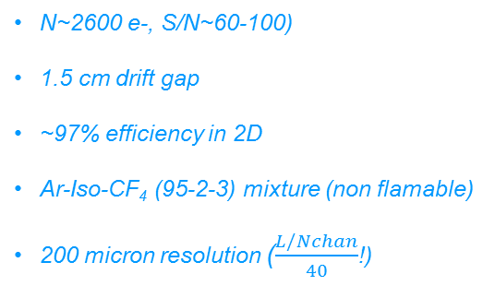
Background (1/2)
→ development of 50x50 cm² Micromegas with genetic multiplexing
1037 strips, 61 channels
Reduction of electronics (price, consumption) by factor of ~15
Use of resistive strips to increase S/N and efficiency
2D strip readout
CLAS12/DREAM electronics
→ first final prototypes available in 2015 (made @ CERN)
N~2600 e-, S/N~60-100)
1.5 cm drift gap
~97% efficiency in 2D
Ar-Iso-CF₄ (95-2-3) mixture (non flamable)
200 micron resolution ($\frac{L/Nchan}{40}$!)
CERN
ELVIA
→ know how transfer with ELVIA PCB company
ELVIA
CERN
S. Bouteille et al., NIM A 834 (2016), 187 (1st 2D version)

Slide 3
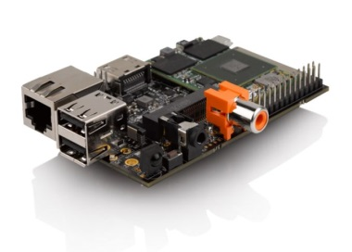
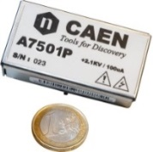
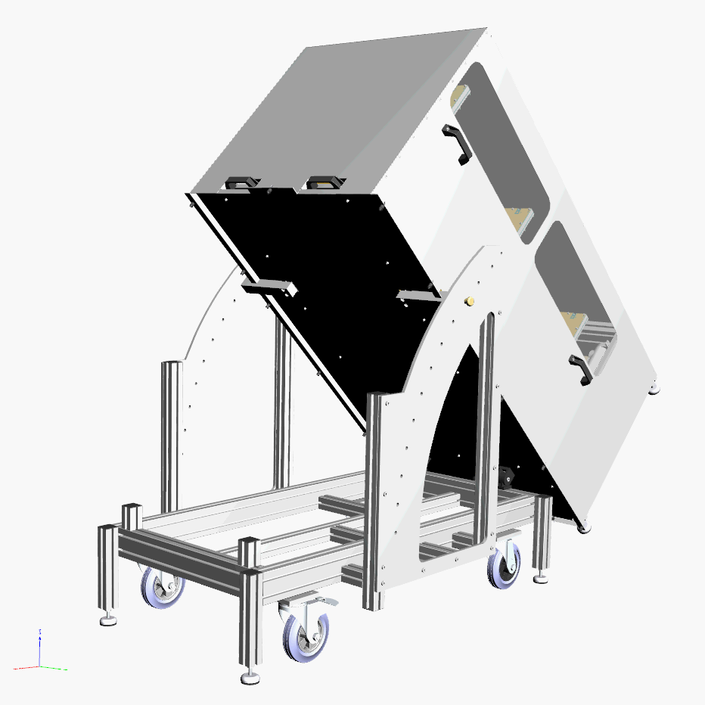
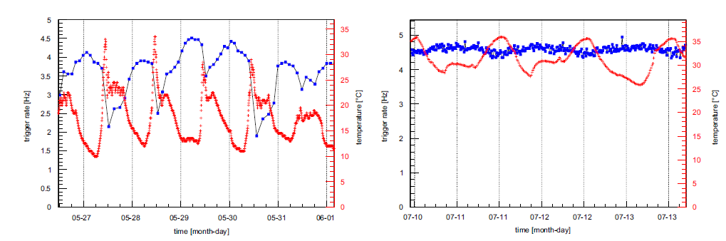
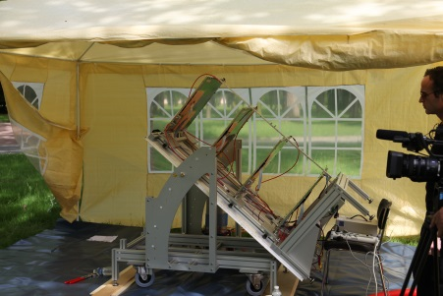
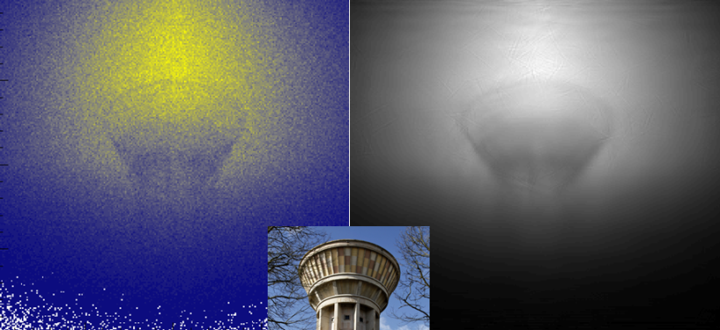
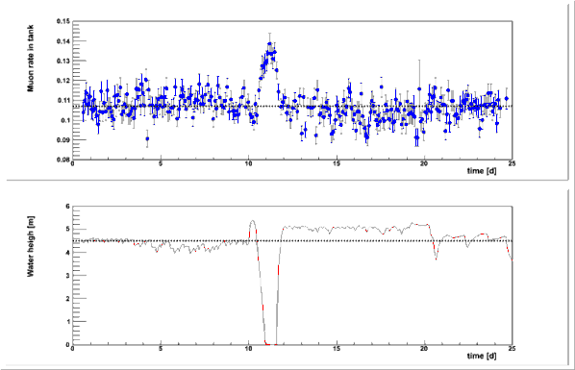
Background (2/2)
→ building & validation of the first MM-based muon telescope
Temperature fluctuations from 11 to 43°C
Online feedback on T (P)
Self-triggering mode
Miniaturized electronics box
30 W of total consumption (bulb)
Operated during 3.5 months…
… including 1.5 on solar boards + battery
Trigger rate and temperature
w/o T feedback
w T feedback
static
dynamic
S. Bouteille et al., NIM A 834 (2016), 223

Slide 4
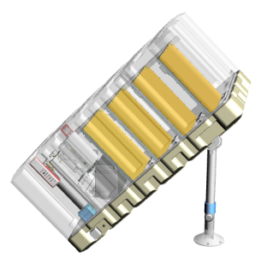
The ScanPyramids mission
→ Coordinated by Engineering faculty of Cairo & HIP Institute, under authority of antiquity ministry
→ Imaging of 4 Egyptian pyramids with muons, thermal studies and drones
→ Mission started in Oct. 2015 with 2 Japanese teams on muon program
Emulsions & scintillators
Only inside pyramids
→ Proposition to install MM telescopes outside
CEA joined the mission on April
→ Construction of 3 new telescopes of new generation
4 detectors / telescope for redundancy
1 FEU with DREAM asics (512 channels)
Thermal protection
Improved components => less noise for self-trig.
Powered by 220V AC or solar boards (35 W)
150 Ah battery with regulator
3G connexion
Online data analysis (nano-PC)
2 TB hard disk for each telescope to store raw data
2 B5 bottles for each telescope (T2K gas)
Simulation to optimize the sensitivity
Quite challenging schedule!

Slide 5
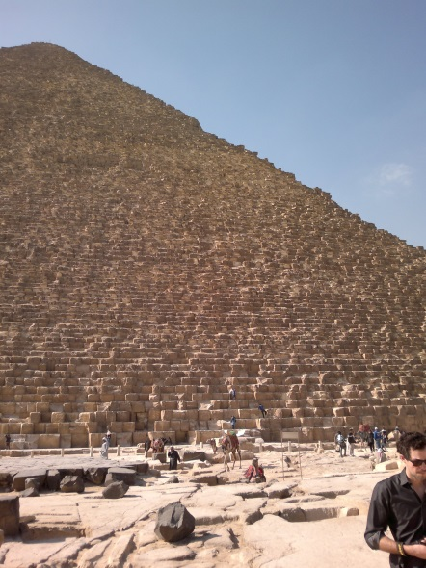
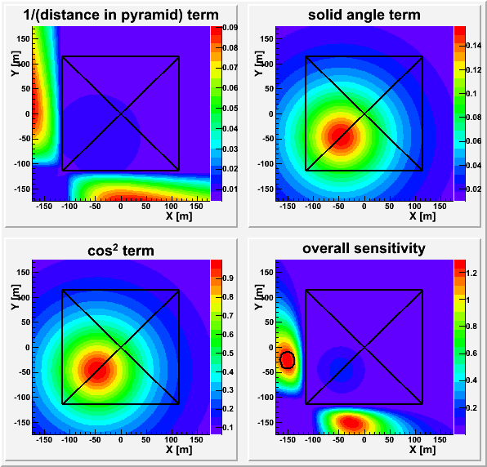
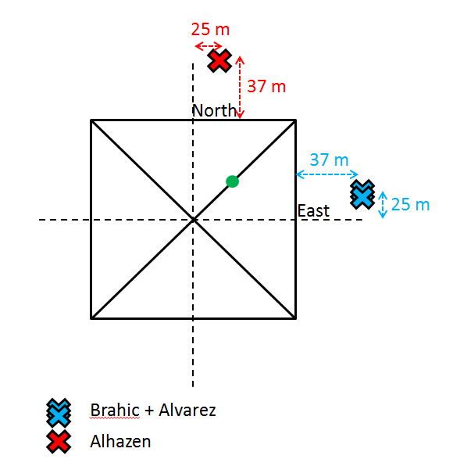
Goal of 1st campaign
→ Observe a known cavity on N-E edge to validate the performance
→ Simulation were performed to optimize the sensitivity for this room
Distance between room and telescopes (solid angle) (the closer the better)
Viewing angle (the higher the better)
Ratio of stone and cavity lengths (the further the better)
Already an enormous challenge: detection of a 3 m cavity in 20 m depth rocks, at 150 m distance!!!

Slide 6
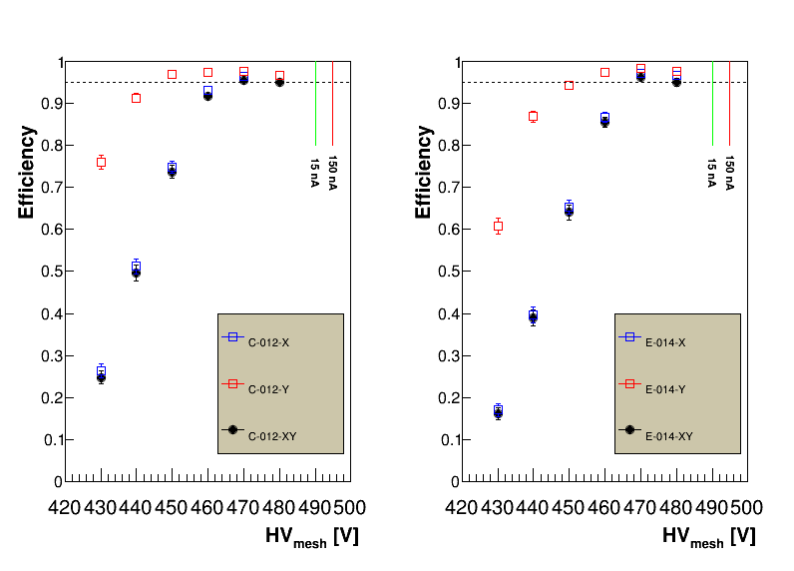
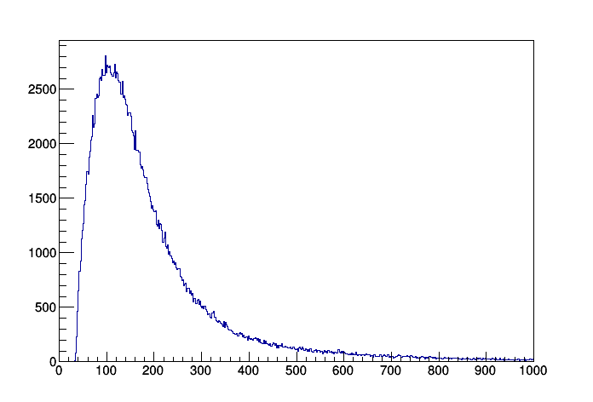
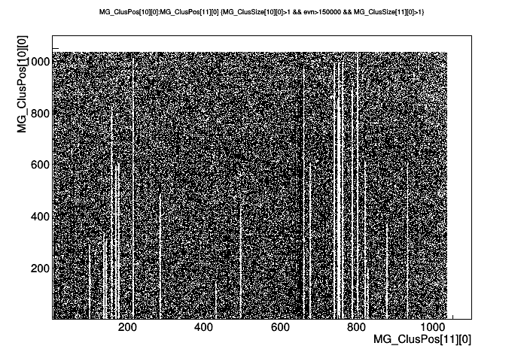
Preparation of telescopes (1/2)
→ Each detector was tested at Saclay before assembly
Efficiency
Spatial resolution
Gas tightness
→ Outstanding commitment of ELVIA who built 2/3 of the detectors (8) in tight schedule
→ All 12 showed good performance, with local defects on some (strip cuts)
MIP amplitude
distribution @
nominal HV

Slide 7
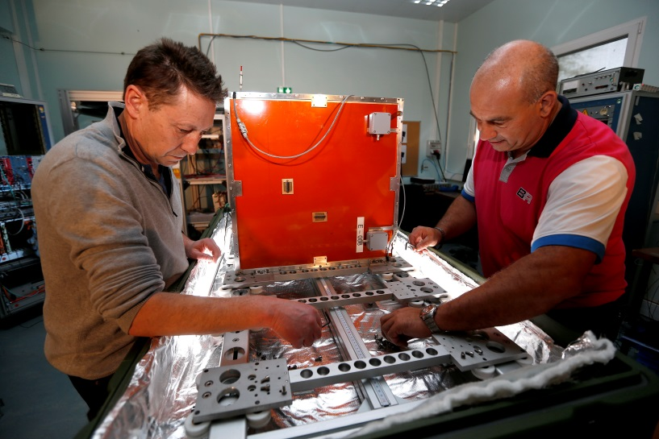
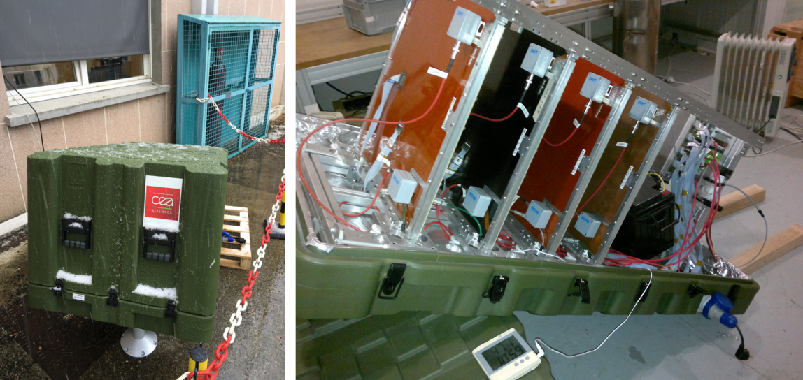
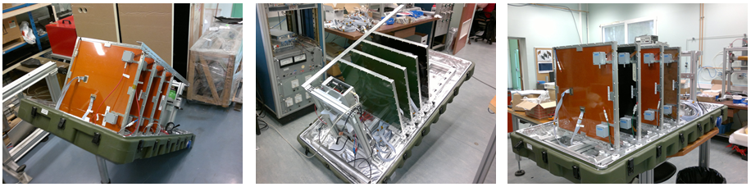
Preparation of telescopes (2/2)
→ Assembly at Saclay in fly-cases used for the transport & the acquisition
Snow!
47.1°C (whole setup tested up to 55°C)
Alhazen (n°1)
Alvarez (n°2)
Brahic (n°3)

Slide 8
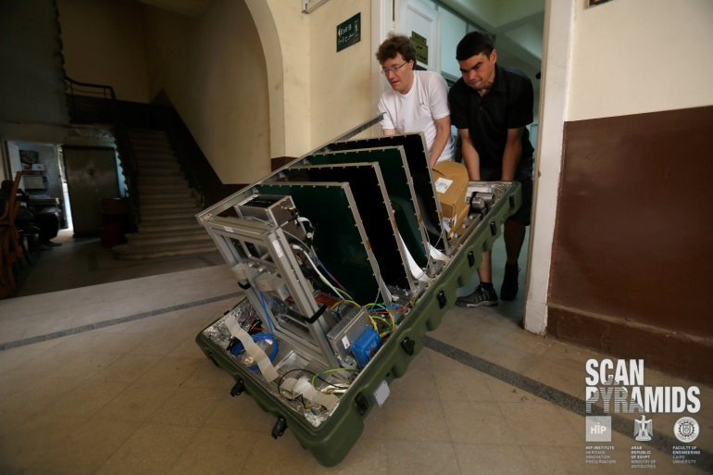
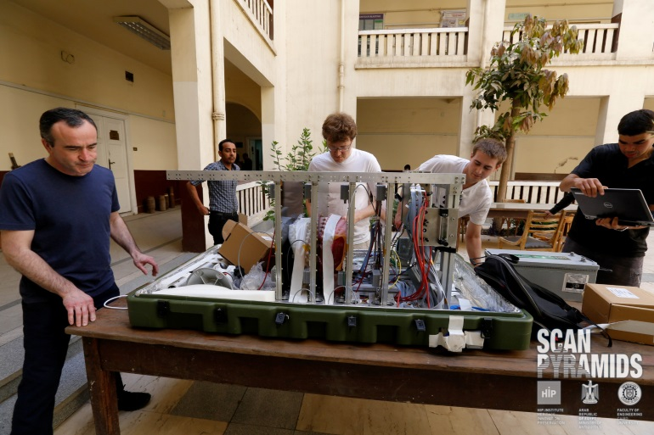
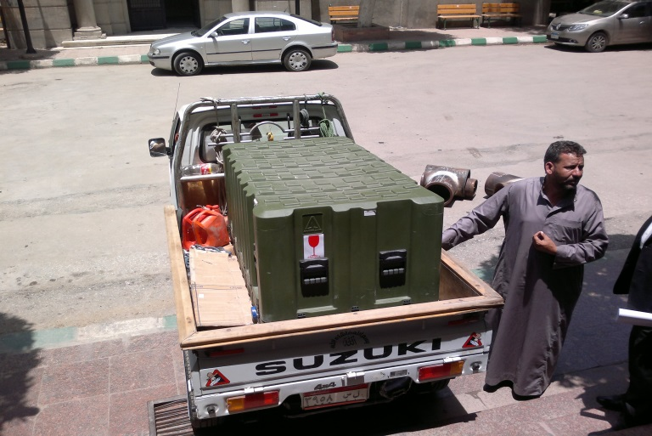
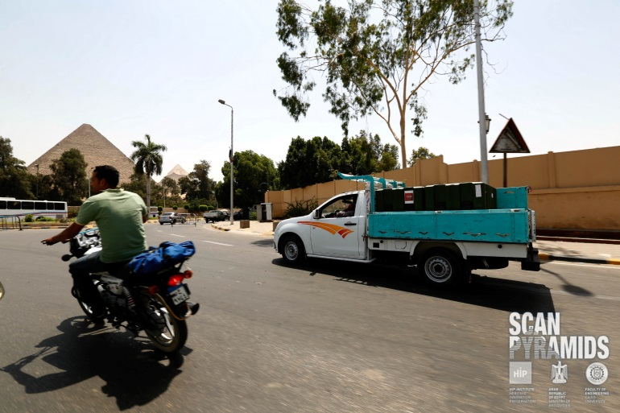
Cairo preparations
→ Check tests after transportation, doublet assembly, final plugs
→ Transportation from University to Giza

Slide 9
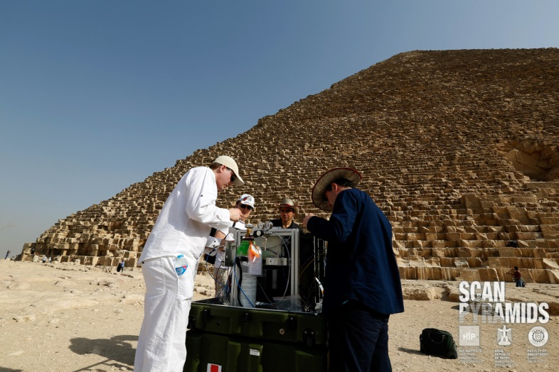
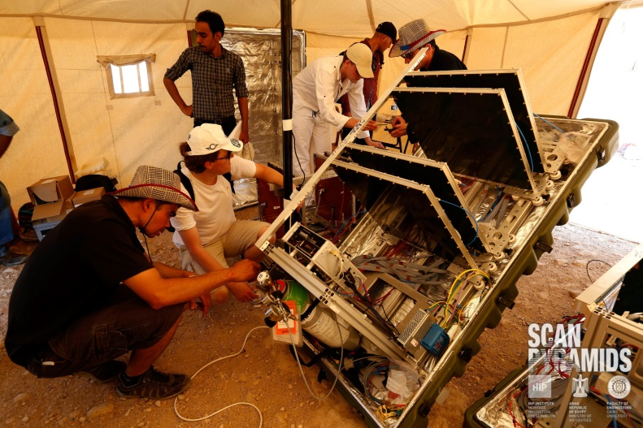
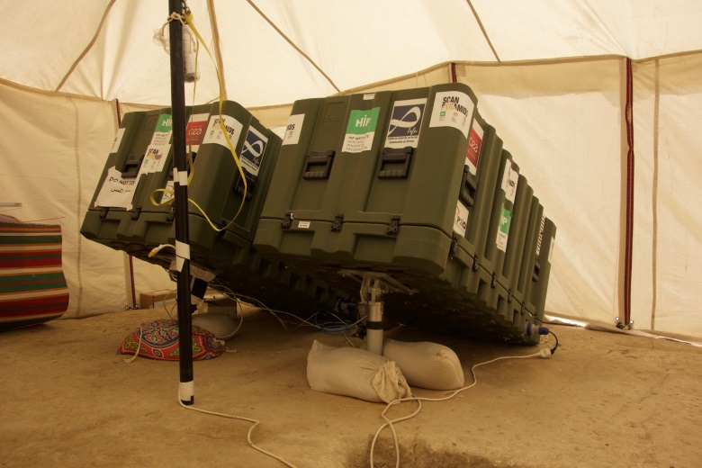
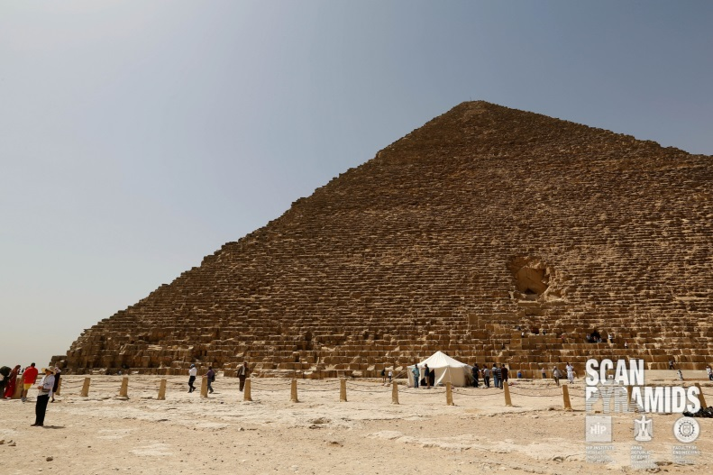
Giza installation
→ Telescopes under tents for safety: 2 on the East face, 1 on North

Slide 10
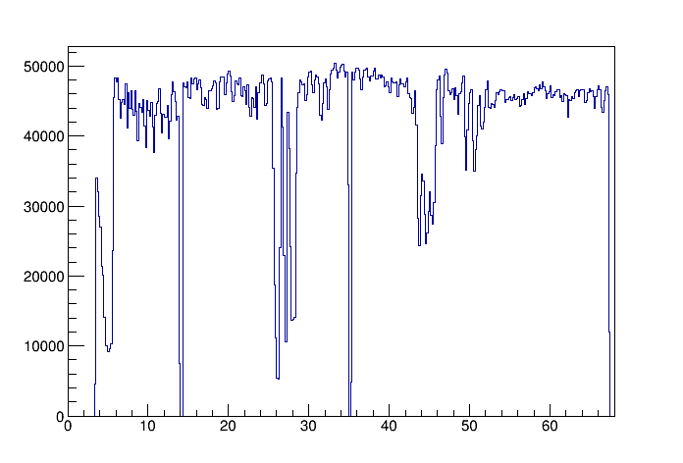
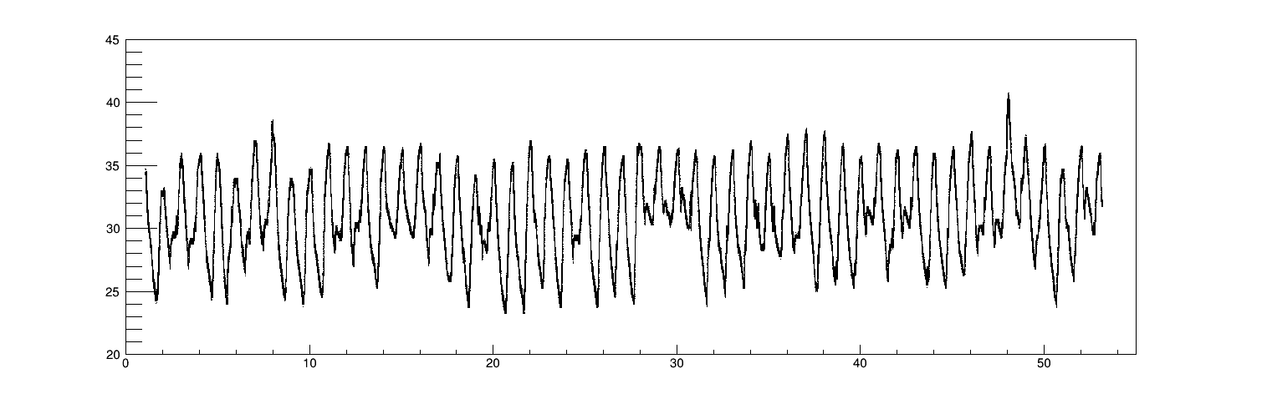
Data taking
→ Each detector was operated during 2 to 3 months (gas autonomy)
Temperature evolution
Number of reconstructed muons with time
T_{min} ~ 23°C; T_{max} ~ 40°C
Change of gas
bottles
days
→ self triggering: at least 5 planes out of 8
days
Relatively stable acquisition (thanks to T,P feedback)
Ensures at least 3 detectors, means signal from both doublets (lever arm)
→ alignment performed early June
Resolution around 300 microns for perpendicular tracks, less than 3 mm from -40 to +40°
3 mm resolution <=> 1 m uncertainty at 150 m
Contribution of MS in telescope, fly-case and air yield a few tens of centimeters at 150 m
→ overall statistics:
Alhazen (North): 30.8 million triggers (4.5 Hz)
Brahic (East): 24.6 million triggers (4.2 Hz)
Alvarez (East): 18.7 millions (3.3 Hz)
~70% are good muon tracks

Slide 11
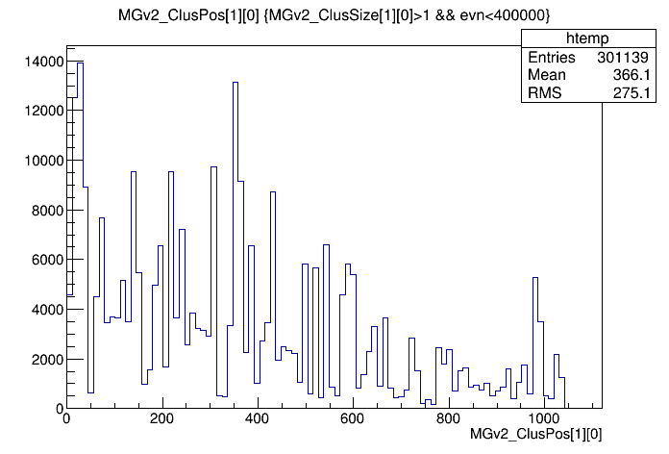
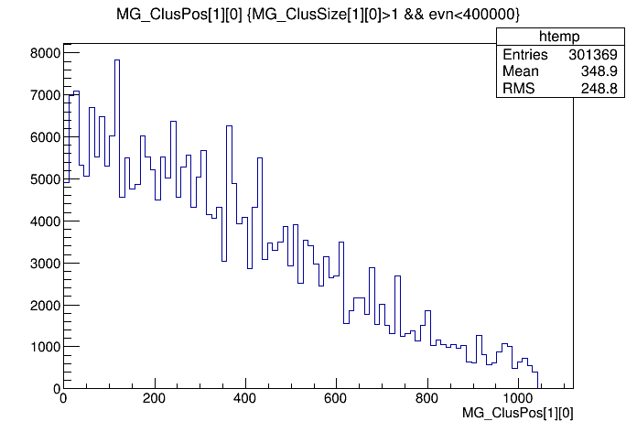
Data analysis (in progress)
→ Some dead channels
Brahic: 5 on a single detector
Alvarez: 4 on a single detector, 1 on a second one
→ Reprocessing of raw data with new algorithm (old: biggest cluster search)
Convolute the strip amplitude pattern with Gaussian of sigma ~ N_{chan}/3
Consider the highest values as cluster seeds
Grow the cluster seed allowing gaps with some criteria (based on number of new, unused channels in the cluster)
Jump dead channels
Muon position distribution in problematic Brahic plane
Old algo
New algo

Slide 12
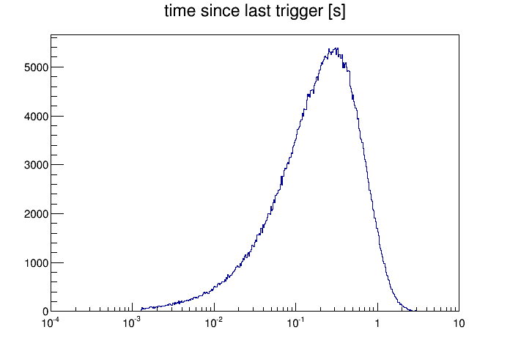
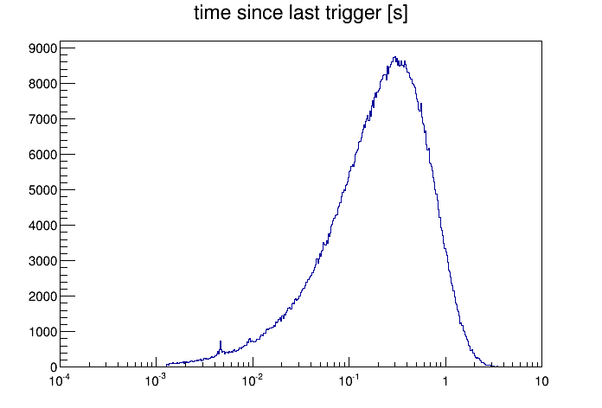
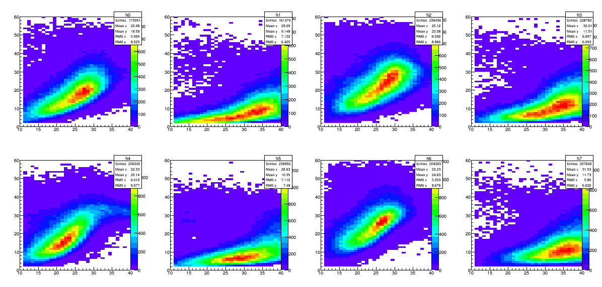
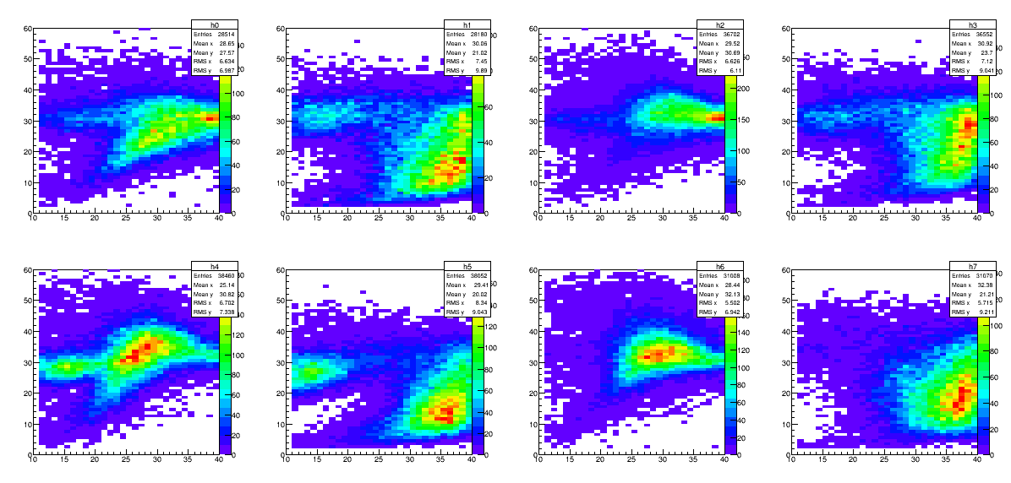
Data analysis (in progress)
→ Some artefacts in the image are observed (in particular at its center)
Largely due to small bursts of noise during some runs
Good run
« Bad » run
Also visible in N_{chan} vs TOT plots
Good run
« Bad » run

Slide 13
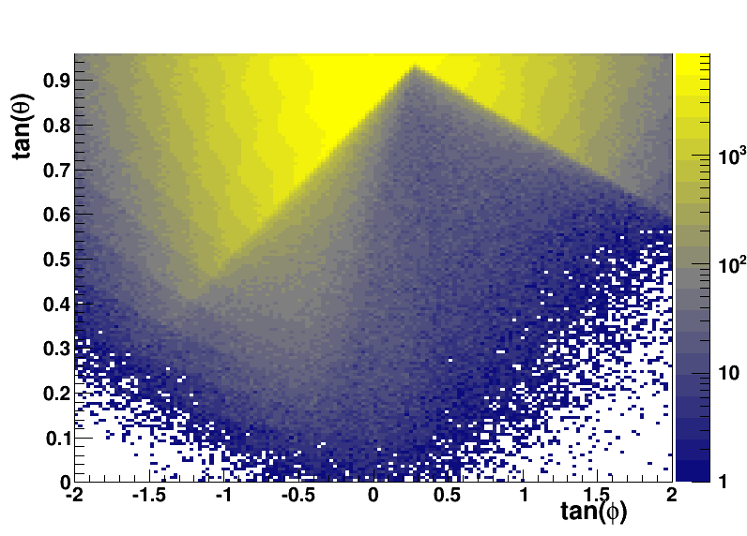
Ongoing activities
→ Misalignments appear with time, particularly on Alvarez
Not a day/night effect due to dilatation, but sudden misalignement followed by slow drift in time
Need to understand the origin and re-align without changing direction
→ Image treatment to find potential anomalies
Edge detection algorithm to check stability of telescopes in time
Slices below the edge at different depths to localize muon excess (or deficit)
→ Compare East and North projections to look for potential similarities
(Geant4 simulation of a perfectly
homogeneous pyramid)

Slide 14
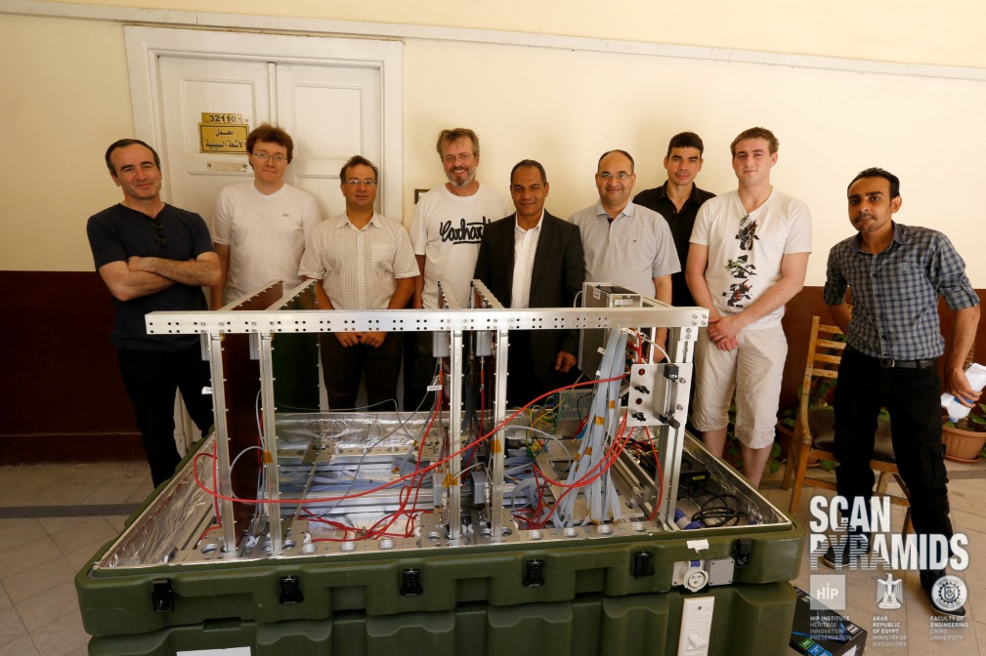
Conclusion
→ Fascinating experiment adventure
Btw, probably the first use of MPGD tracker in Africa (?)
Proves that MPGD can have applications really far from our daily work
→ Analysis is still ongoing, results should be soon available
→ Enormous thank to HIP institute, Cairo University…
Mehdi Tayoubi
Hany Helal, Yasser Elshayeb
→ … and fantastic local team!
Vincent Steiger, Eric Van Laere, Philippe Bourseiller
Hamada Anwar, Mostaffa Ezzy, Issam, Turbo, etc.,

