Slide 1
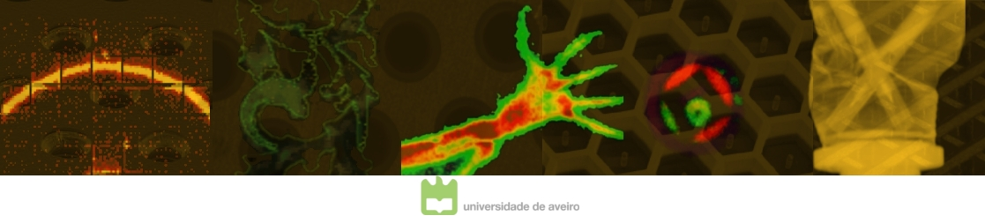
15
Set
MPGDs face2face with art and industry
- EDXRF imaging system
Ana Luisa Silva
C.D. Azevedo, L.F.N.D. Carramate, M.L. Carvalho and J.F.C.A. Veloso
I3N – Departamento de Física da Universidade de Aveiro
LIBPhys-UNL - Faculdade de Ciências e Tecnologia da Universidade Nova de Lisboa
Workshop MPGD Applications Beyond Fundamental Science

Slide 2
OUTLINE
Motivation
MPGDs and 2D-imaging
EDXRF imaging system
Applications/Proof of concept - face2face with art and cultural heritage
Next step - portable prototype / applications for industry

Slide 3
MOTIVATION
What we know about X-RAY FLUORESCENCE IMAGING?
… It is a powerful and non-destructive technique to obtain
elemental map distributions in materials.
Requires ...
Are commonly based on ...
Spatial-resolved information for elemental mapping;
Energy-resolved information for elemental identification;
Scanning systems;
FF-XRF systems

Slide 4
MOTIVATION
What we know about X-RAY FLUORESCENCE IMAGING?
… It is a powerful and non-destructive technique to obtain
elemental map distributions in materials.
Requires ...
Are commonly based on ...
Spatial-resolved information for elemental mapping;
Energy-resolved information for elemental identification;
Scanning systems;
FF-XRF systems
PROBLEM ?!
Expensive !
Small active area !
Some systems require
low temperature operation !

Slide 5

MOTIVATION
MPGDs present excellent single photon counting imaging capabilities:

Slide 6
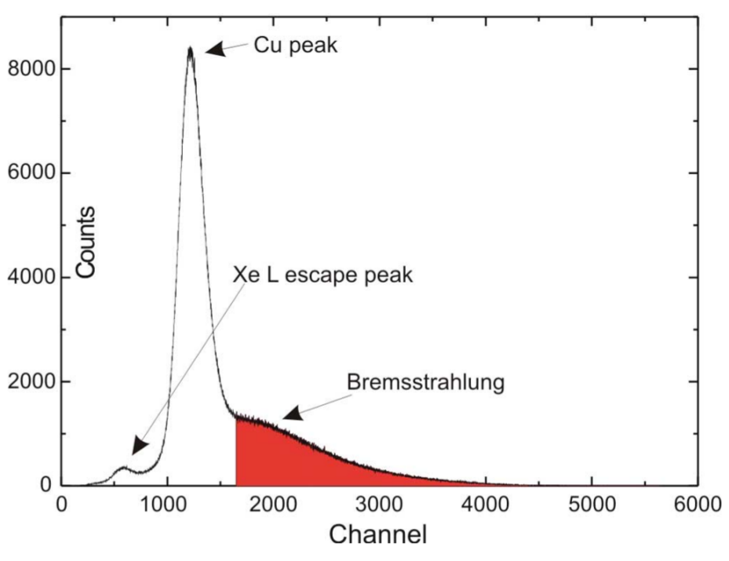
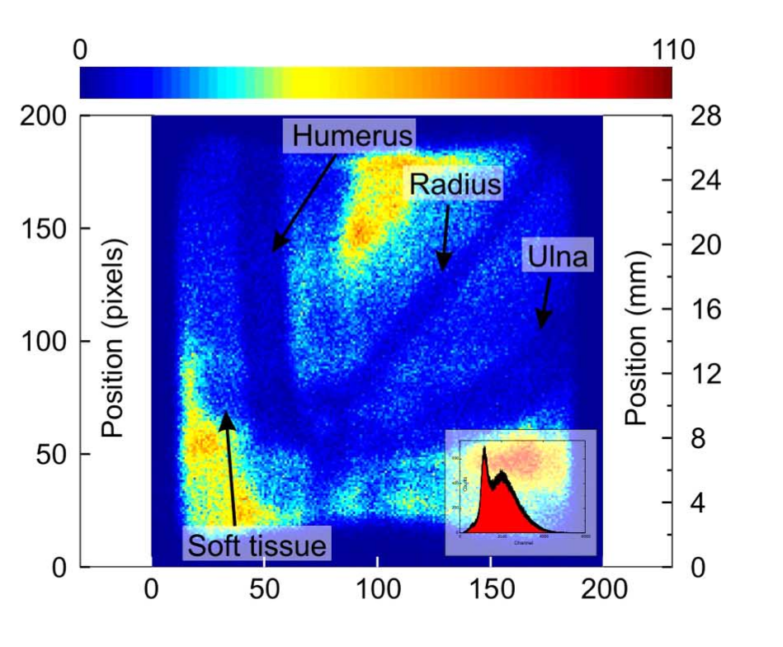
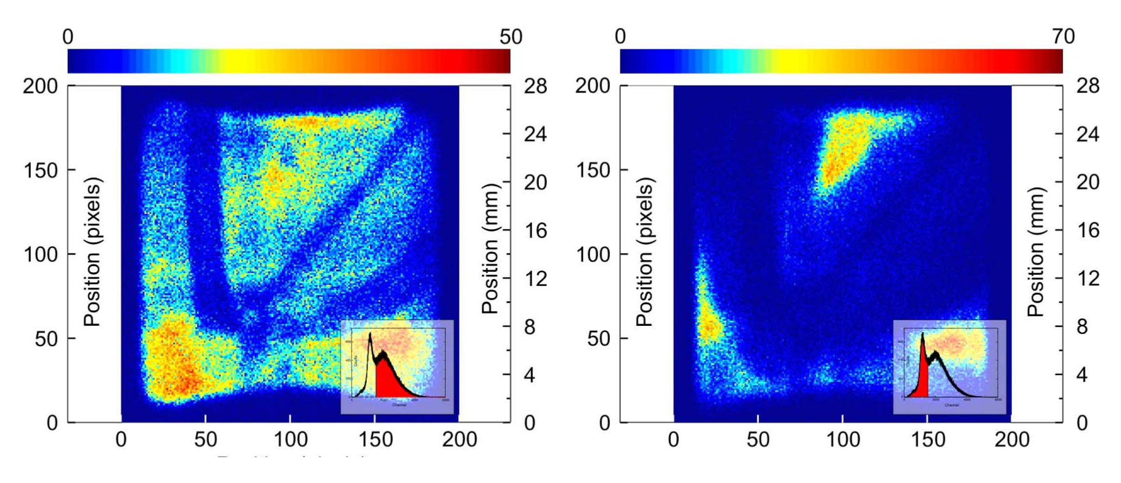
MOTIVATION
MPGDs present excellent single photon counting imaging capabilities:
Full field of view imaging operation (2D)
Possible Rp>50 um
No noise (set threshold)
High counting rate capability
Large area (up to 50x50 cm2)
Very soft X-rays detection capability (<1keV), due to its high gain
Room temperature operation
Versatility and portability
Low cost and low complexity

Slide 7
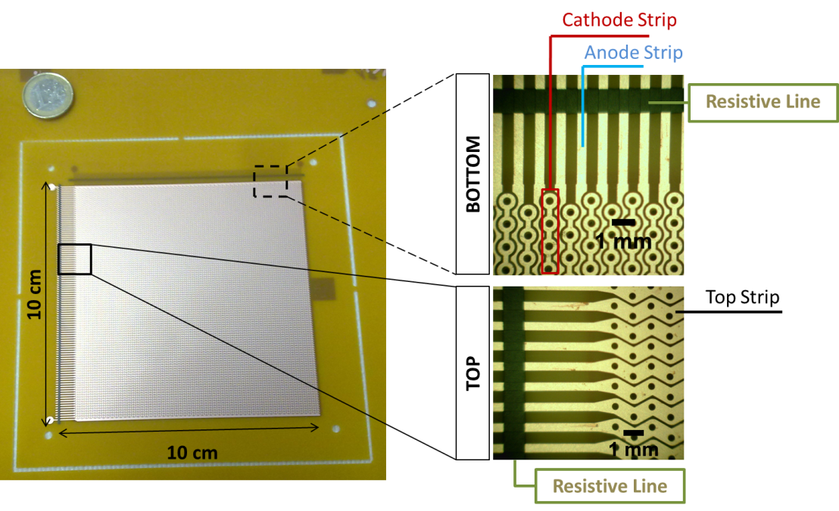
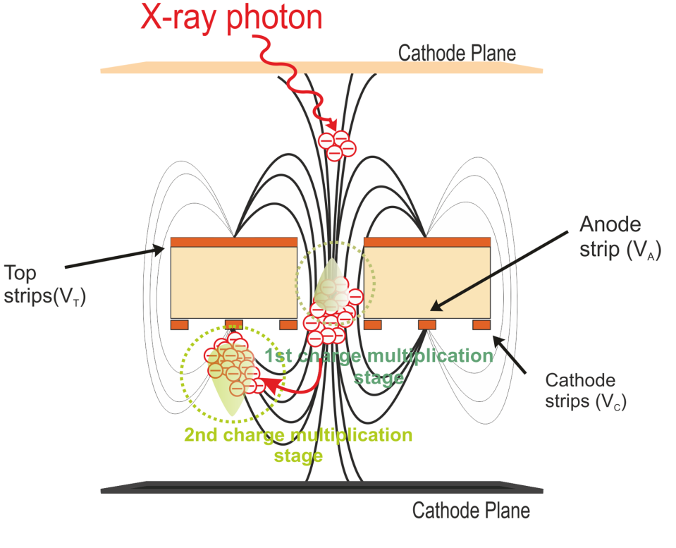
MPGDs and 2D-imaging
Example - THCOBRA detector (10x10 cm²)
operation principle
Cathodes 200 µm
Anodes 200 µm
Pitch 1 mm
Double side structure
Substract: PCB 400 µm
Holes ø = 300 µm
Notes:
So, concerning to the applications I will show in a minute the amplification device that is used is the so-called THCOBRA.
Schematically it looks like this. It is made a a 400 micrometers thick pcb, with thin copper layers deposited in both sides. The structure exhibites a pattern of holes and electrode. By applying suitable high voltages to the different sets of electrodes two high electric field regions are created where the electrons undergo avalanche. While moving, the electrons induce current signals in the electrodes.
7

Slide 8
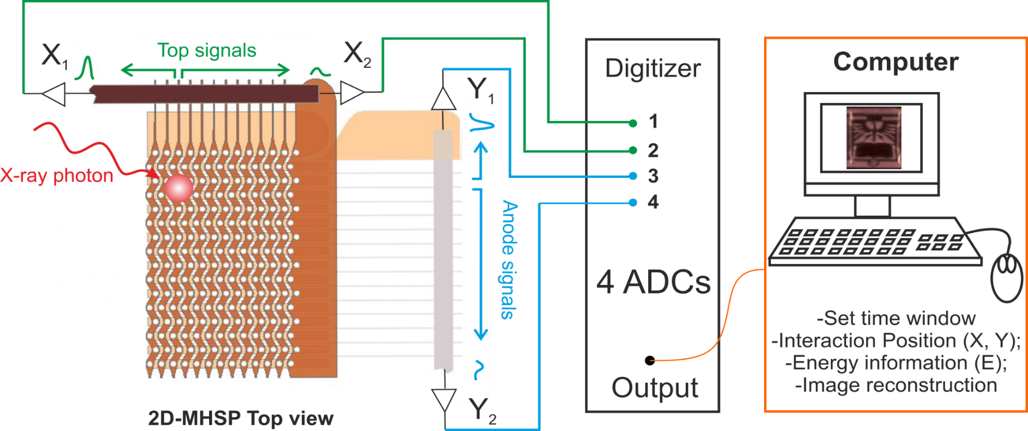
MPGDs and 2D-imaging
MPGDs and 2D-imaging
Notes:
This here is a picture of the bottom side of the microstructure the anodes and the cathodes aligned with the holes. On the top side there are zig-zag strips that follow the pattern and run orthogonally to the anodes.
The anodes in the bottom of the microstructure are connected through a resistive line as well as the zigzag strips in the top side. The 4 ends of the resistive lines are connected to an adc that digitizes and determines the amplitude of the pulses.
If an event deposited energy for instance here the amplitude of the pulse arriving to this resistive line end is higher than that arriving here because there is more resistance seen in this side than in this side. Taking this into consideration and applying center of mass algorithms it is possible to reconstruct both x and y coordinates. By adding the signals arriving to both ends of a single resistive line we can reconstruct the X-ray energy.
8

Slide 9
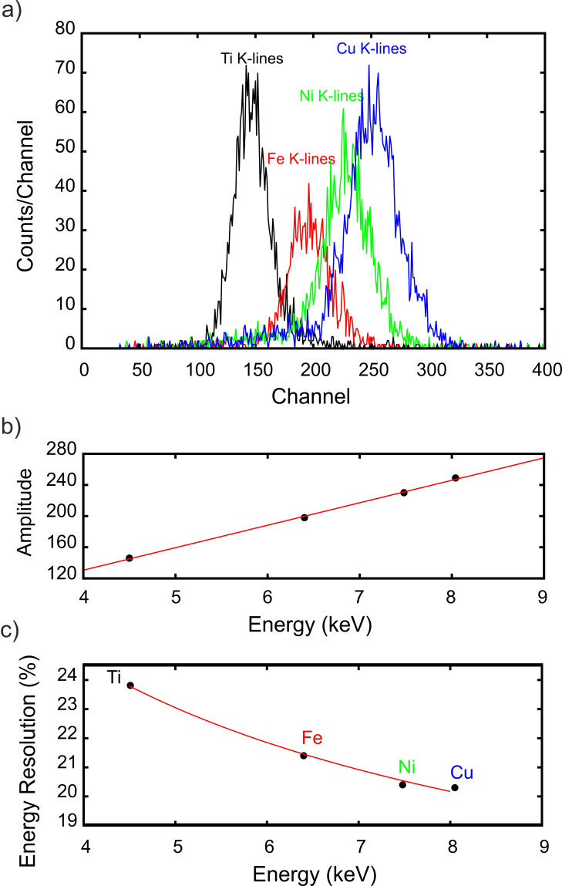
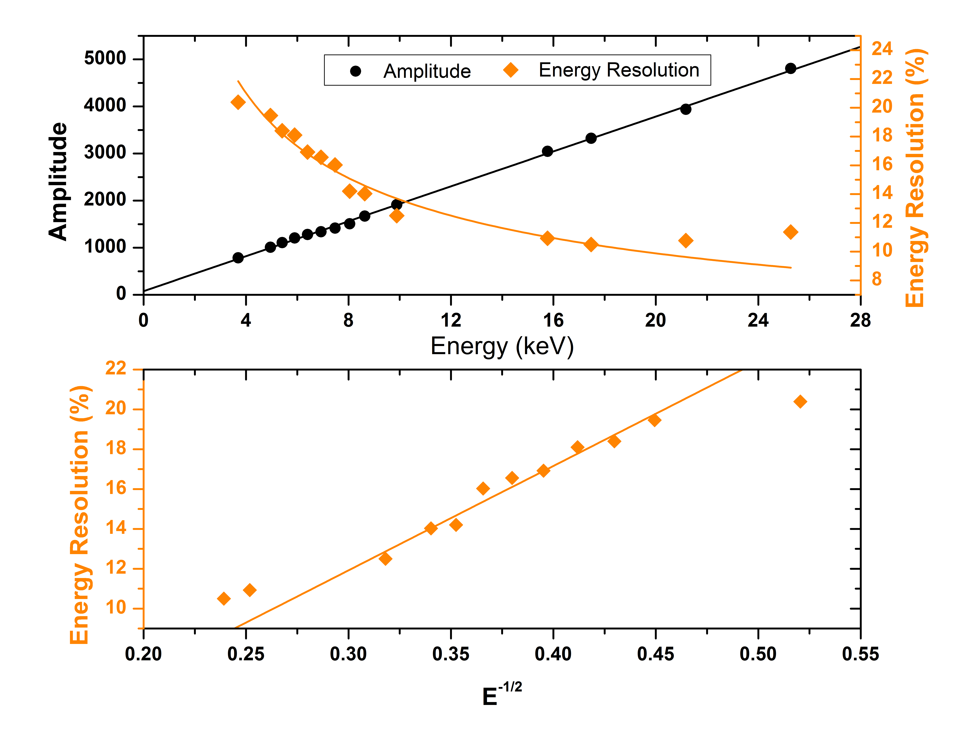
MPGDs and 2D-imaging
THCOBRA - Ne/5%CH₄@ 1 bar
Energy Resolution and linearity
MHSP - Xe @ 1 bar
Notes:
In gaseous detectors the position resolution depends not only on the photoelectron range but also on the energy loss mechanisms during the photoelectron drift and thermalization in the gas.
9

Slide 10
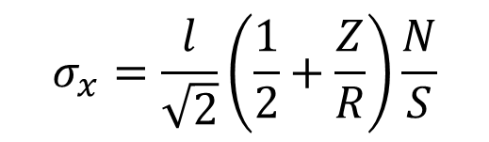
MPGDs and 2D-imaging
Position resolution
Depends on…
Signal-to-Noise Ratio
Photoelectron range – gas dependence
Notes:
In gaseous detectors the position resolution depends not only on the photoelectron range but also on the energy loss mechanisms during the photoelectron drift and thermalization in the gas.
10

Slide 11
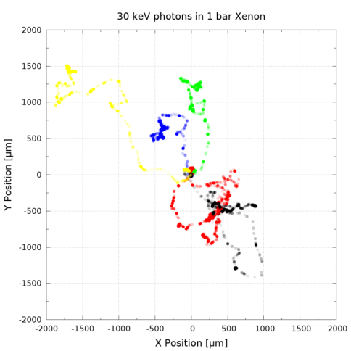
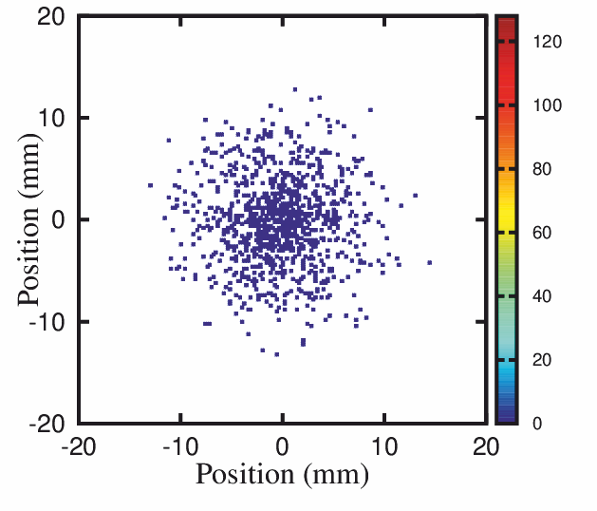
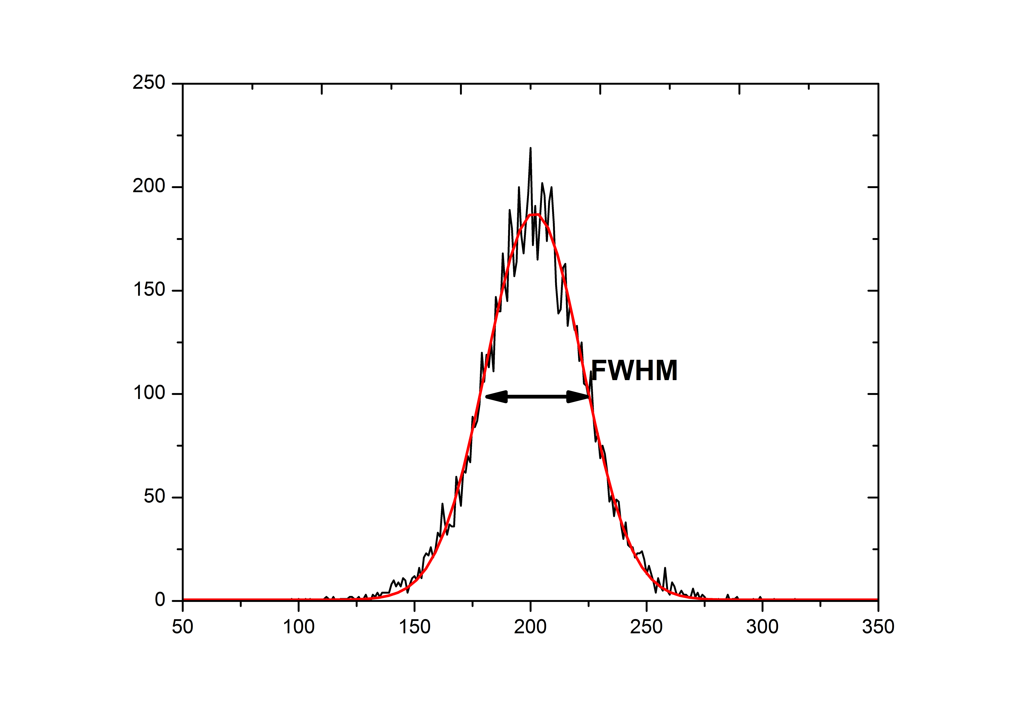
MPGDs and 2D-imaging
Position resolution
Depends on…
Signal-to-Noise Ratio
Photoelectron range – gas dependence
Simulations - Degrad
Gaussian distribution FWHM
uncertainty in the position of interaction.
primary cluster spatial distribution
in gas mixtures for X-rays
Average
Position
1D
Projection
Notes:
In gaseous detectors the position resolution depends not only on the photoelectron range but also on the energy loss mechanisms during the photoelectron drift and thermalization in the gas.
11

Slide 12
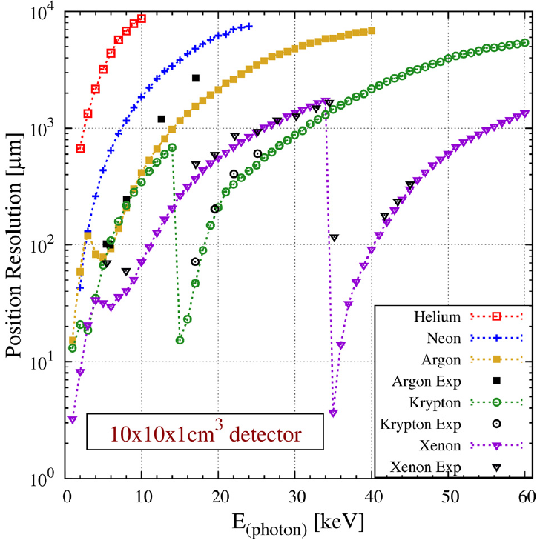
MPGDs and 2D-imaging
Imaging Capability and Spatial Resolution
for X-rays in He, Ne, Ar, Kr and Xe; 1atm
Detector: 1 x 10 x 10 cm³
C. Azevedo et al., PLB 741(2015)272; Exp. - G. Smith 2013
Notes:
In gaseous detectors the position resolution depends not only on the photoelectron range but also on the energy loss mechanisms during the photoelectron drift and thermalization in the gas.
12

Slide 13
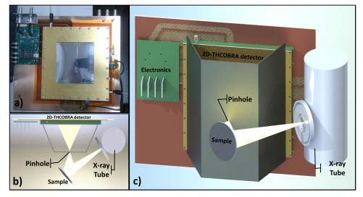
EDXRF Imaging System
X-RAY FLUORESCENCE IMAGING - THCOBRA
Notes:
The X-rays coming from the X-ray tube eject electrons from the atoms that are in the sample leaving these kind of vacancies. The vacancy is promptly replaced by a more external electron and accompanied by the emission of another X-ray with a very specific energy that is related with the atomic transition. Those characteristic X-rays are the photons seen by the detector. The pinhole is used to magnify and collimate the image.
Each element has a very well defined spectrum for the energy of these transition X-rays that works as a signature of the element.
By analysing the detected spectrum it is possible to determine which elements are present in the sample and even map their distribution.
Here are two examples.
We have constructed this sample, made of known elements as Copper, Titanium, Iron, Zirconium and Germanium and these are the kind of images we are able to get.
In the top is the raw image, reconstructed using all the the detected photons and then, images of the distribution of some elements, shown at different colors.
And in the last row, a combination of such images showing the elemental distributions simultaneously.
The columns refer to different pinhole apertures in a characterizations study we made of the response of the detector.
13

Slide 14
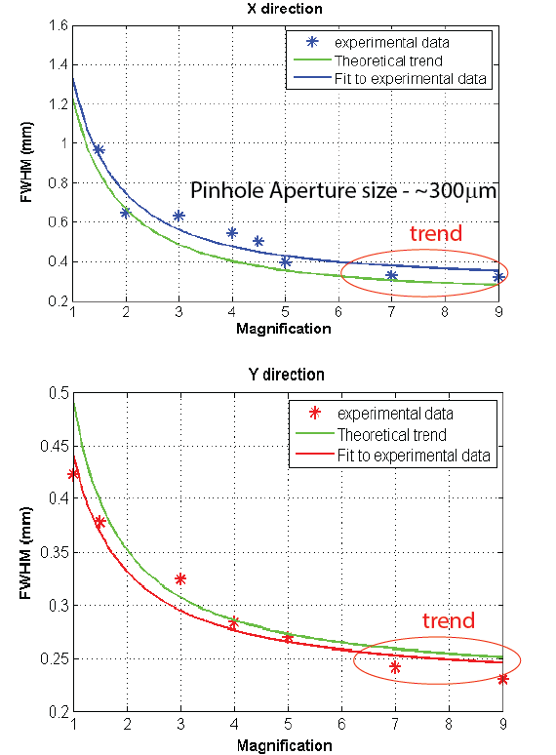
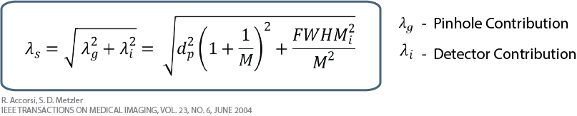
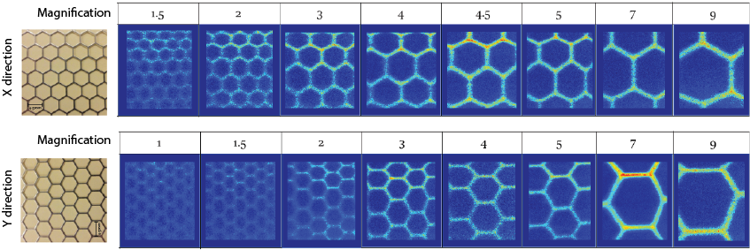
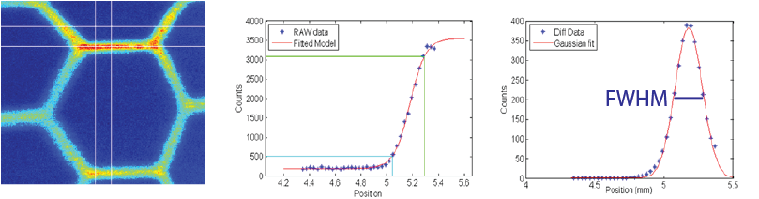
EDXRF Imaging System
Pinhole influence on the system spatial resolution:
Selected Region
ESF
LSF
Method
Notes:
14

Slide 15
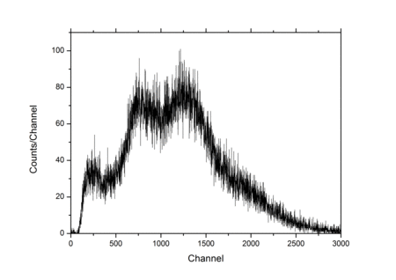
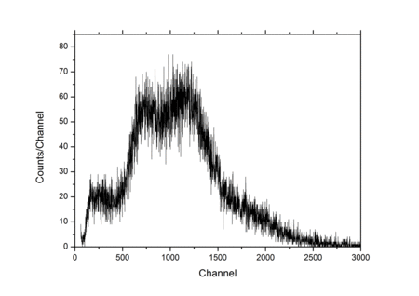
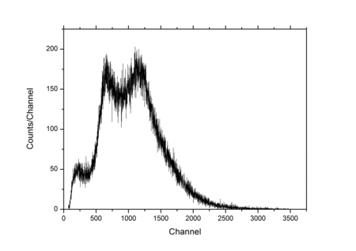
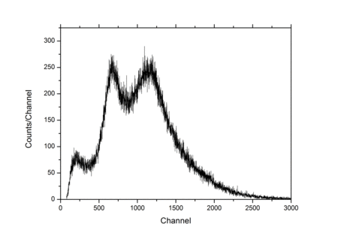
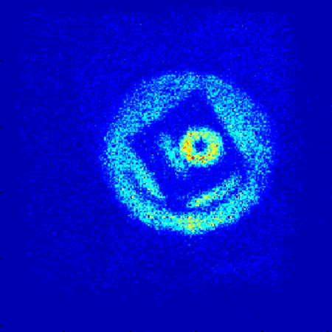
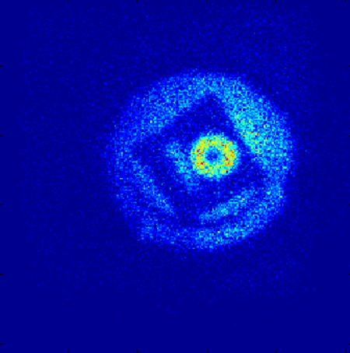
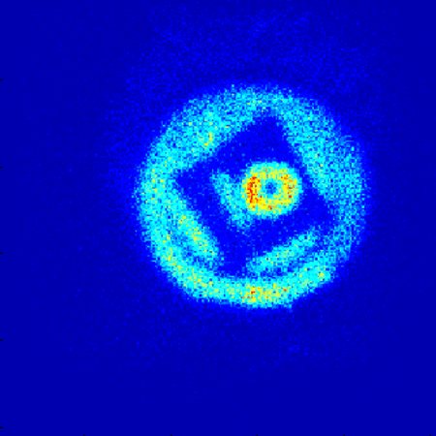
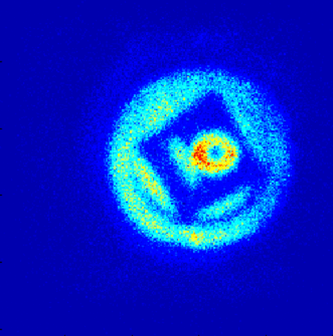
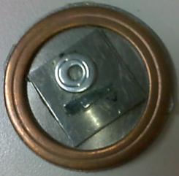
EDXRF Imaging System
500 µm
1 mm
1.6 mm
2 mm
Cu
Higher pinhole efficiency – More photons detected per second
Fe
Ge
Ti
Image Quality – Spatial Resolution increases
Notes:
15

Slide 16
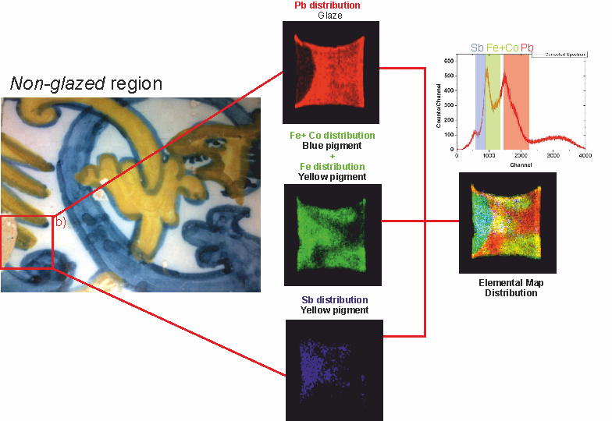
face2face with cultural heritage - MHSP detector
Cultural heritage Application
Glazed tile from the XVII century, Odivelas Convent, Portugal
X-ray tube
Pinhole Magnification
Voltage | 28 kV
Anode Current | 1 mA
M= × 1.2
Notes:
16

Slide 17
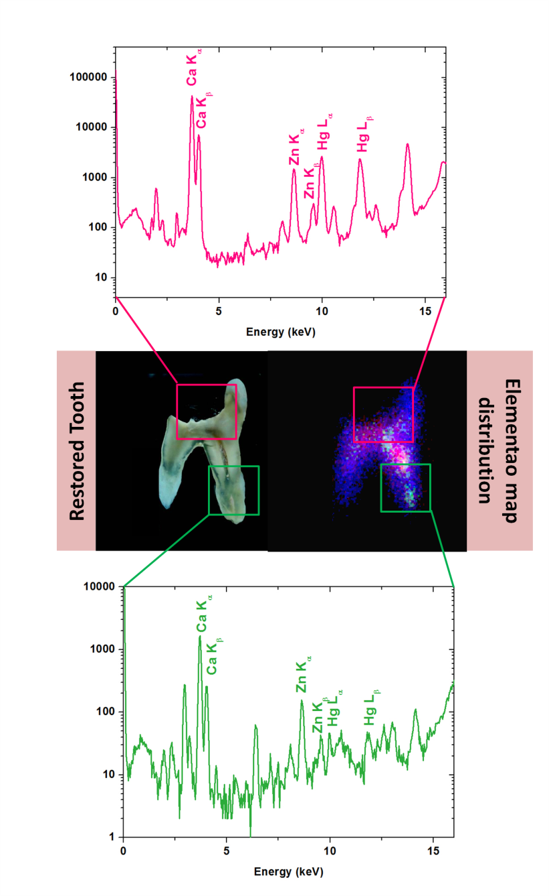
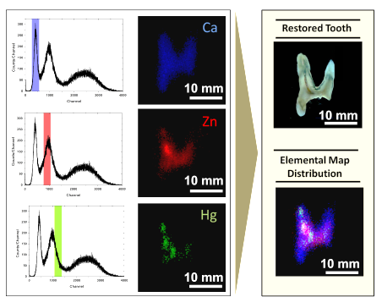
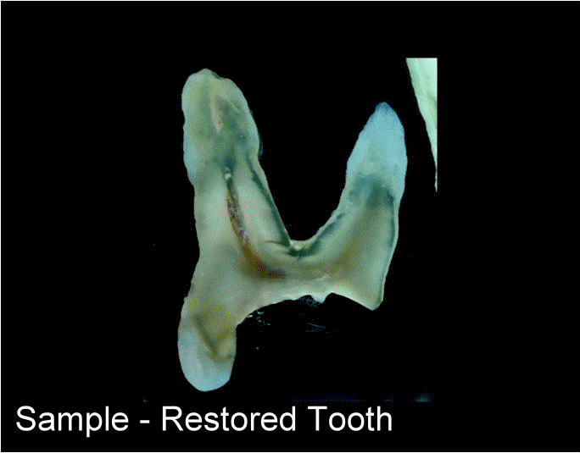
face2face with biomedical applications - MHSP detector
Biomedical Application
Distribution of Hg due to the metallic amalgam treatment
Magnification
M= × 1
X-ray tube
Voltage | 27.5 kV
Anode Current | 1 mA
Restored Tooth
Hg in the region surrounding the amalgam, due to contamination
Hg in the root region of the tooth, due to occasional hydroxyapatite network lattice defects
Notes:
17

Slide 18

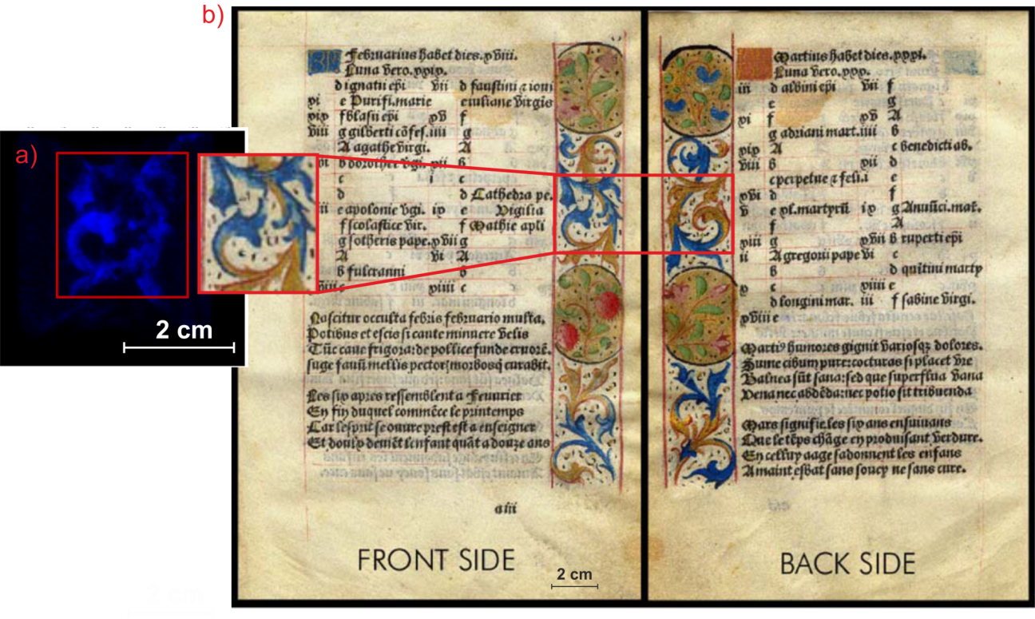
face2face with cultural heritage /art- THCOBRA detector
Sample: Illuminated manuscript from the 15th-16th century
FRONT COVER - 2015
Notes:
18

Slide 19
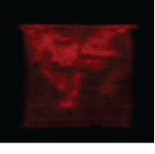
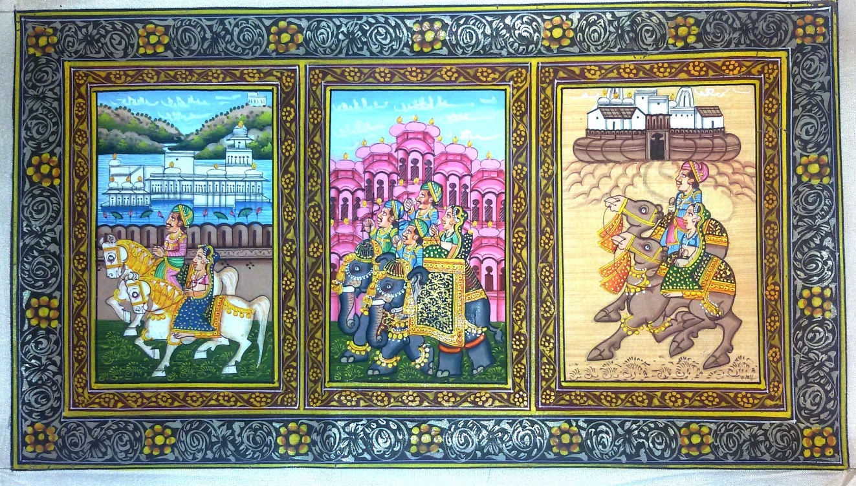
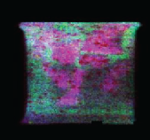
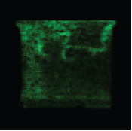
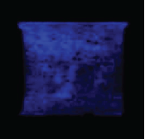
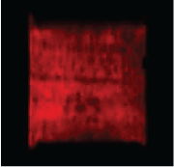
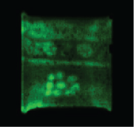
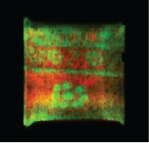
face2face with cultural heritage /art- THCOBRA detector
Contemporary Indian Miniature
Ba
=
Pb
Elemental Distribution
Zn
Tube-50 kV; 1 mA
(whole area)
M - x2.7
Acq.time - 1.5 h
=
Tube – 50 kV; 1 mA (whole area)
M - x2.7
Acquisition time – 3.5 h
Fe + Zn
Pb
Elemental Distribution
Notes:
19

Slide 20
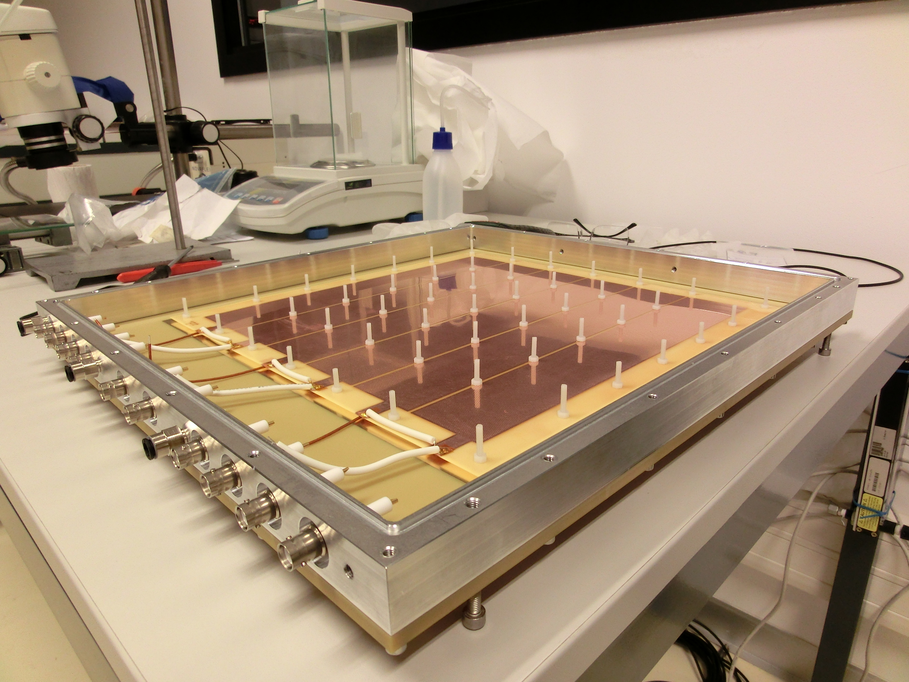
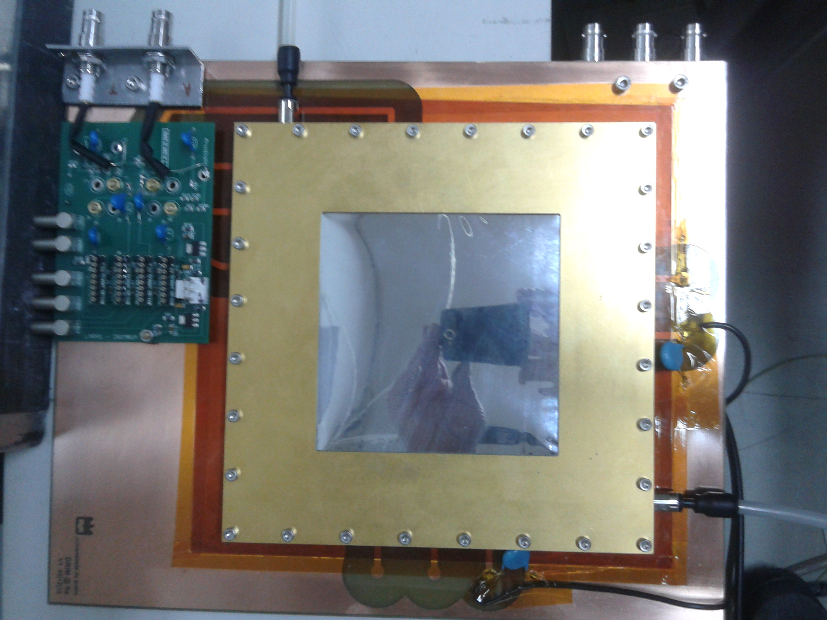
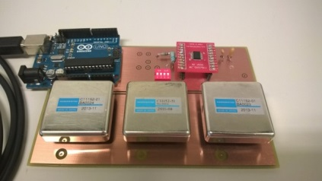
Next step
Explore possible applications in Industry – eg. welding point quality evaluation to be applied in the automobile industry.
Xe/Kr gas mixtures –improve detection efficiency, gain and spatial resolution;
Multi-pinhole alternatives – increase sensitivity to decrease acquisition time;
Development of a 30x30 cm2 THCOBRA detector for EDXRF applications
Portability
active area - 30x30 cm²
Notes:
20

Slide 21
Thank you very much !!

