Slide 1


Investigating the Effect of Solar Modulations on Cosmic Ray Flux
Isabelle Bunge
Mentors:
Professor Veronica Bindi
Cristina Consolandi
Julia Hoffman

Slide 2
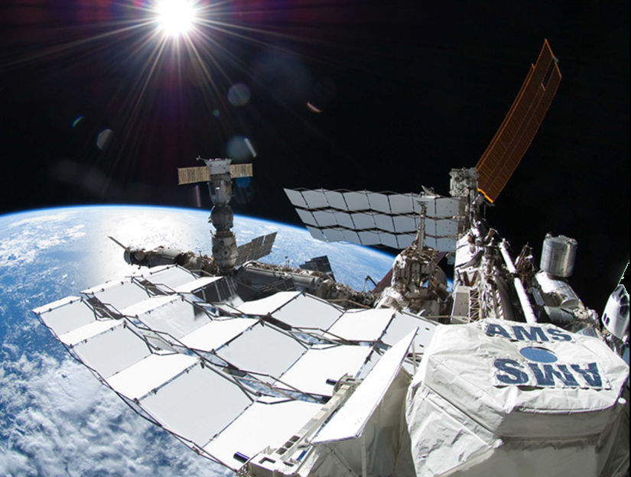
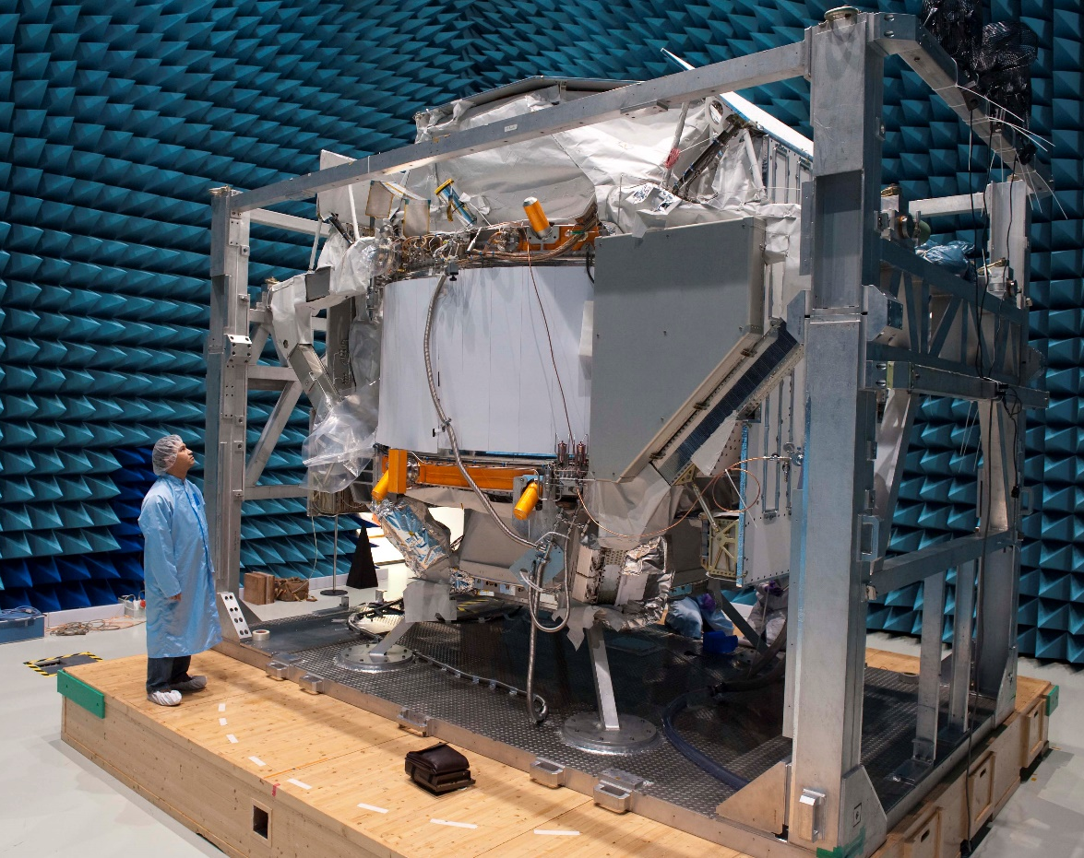
AMS-02
In operation since May 19, 2011 and will run until the end of ISS’s lifetime (~2024)

Slide 3
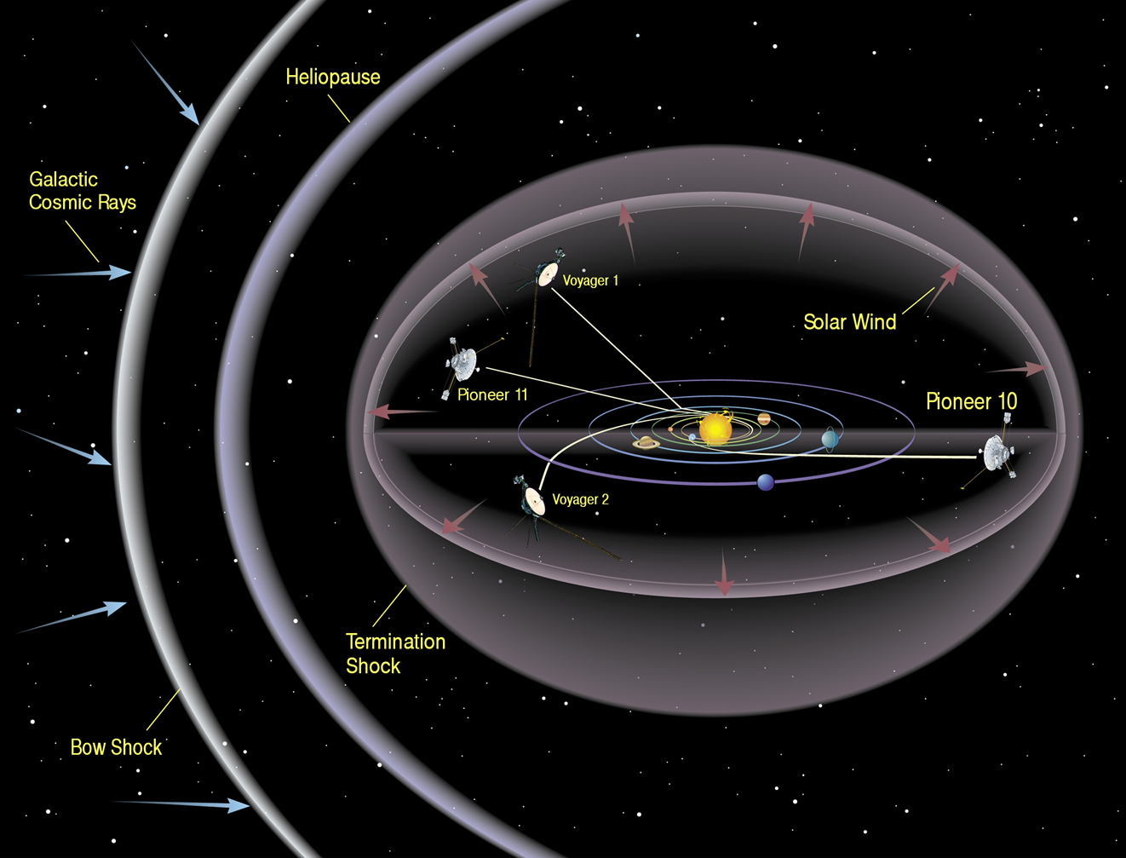
Cosmic Ray Propagation
Solar events and the solar wind (SW) have an effect on cosmic ray propagation.
Within the heliosphere, GCRs interfere with the SW.
Solar Wind and protons ~ MV.
Studying GCRs within the heliosphere helps us to understand how they propagate through space.

Slide 4
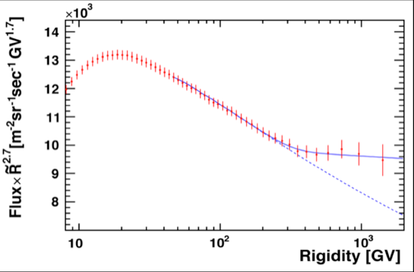
My Project
Goal
Identify differences between ‘Night’ and ‘Day’ Proton Flux.
Methods
Defining ‘Day’ and ‘Night’ Periods
Finding trends of deviations between ‘Night’ and ‘Day’ data
Comparing Flux and parameters between the two periods.
Create statistical analysis of ratios
Integrated Proton Flux over Rigidity (May 2011-Nov 2013) published by AMS in PRL

Slide 5
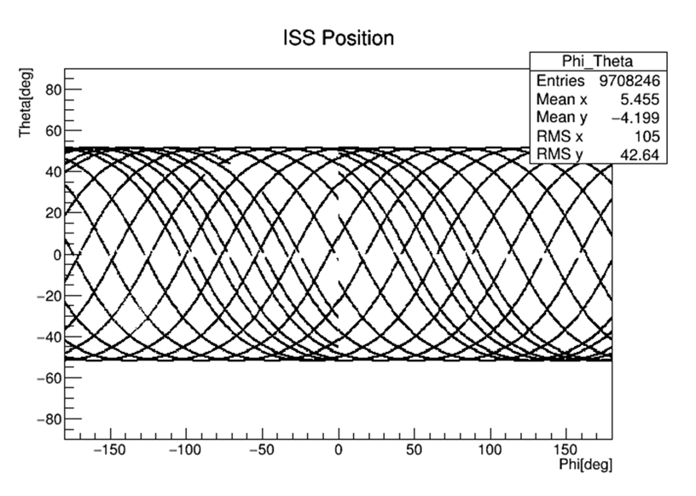

Definition of ‘Day’ and ‘Night’ Periods
In order to create an effective description of ‘Day’ and ‘Night’ periods, we used GSE coordinates.
Using the ISS position, defined in GTOD coordinates, we translated its position into GSE coordinates.
Latitude
Longitude

Slide 6
Geocentric Solar Ecliptic Coordinates
y
Earth
ф
Sun
x
‘Day’ Periods
If the absolute value of ф < 90, then we define this as an on-sunlight period
‘Night’ Periods
If the absolute values of ф > 90, then we define this as an off-sunlight period.

Slide 7
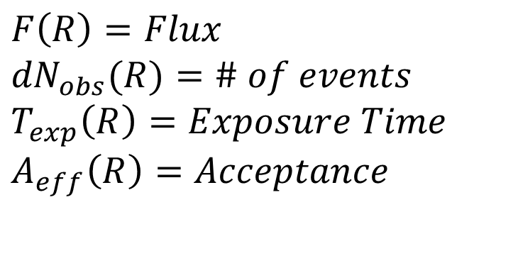
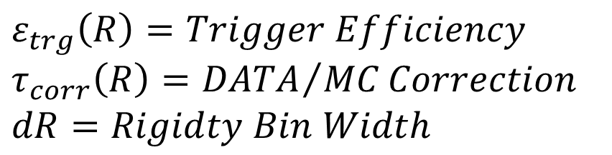
Proton Flux
$$F\left(R\right)=Flux$$
$${dN}_{obs}(R)=\# of events$$
$$T_{exp}\left(R\right)=Exposure Time$$
$$A_{eff}\left(R\right)=Acceptance$$
$$ε_{trg}\left(R\right)=Trigger Efficiency$$
$$τ_{corr}\left(R\right)={DATA}/{MC}Correction$$
$$dR=Rigidty Bin Width$$

Slide 8
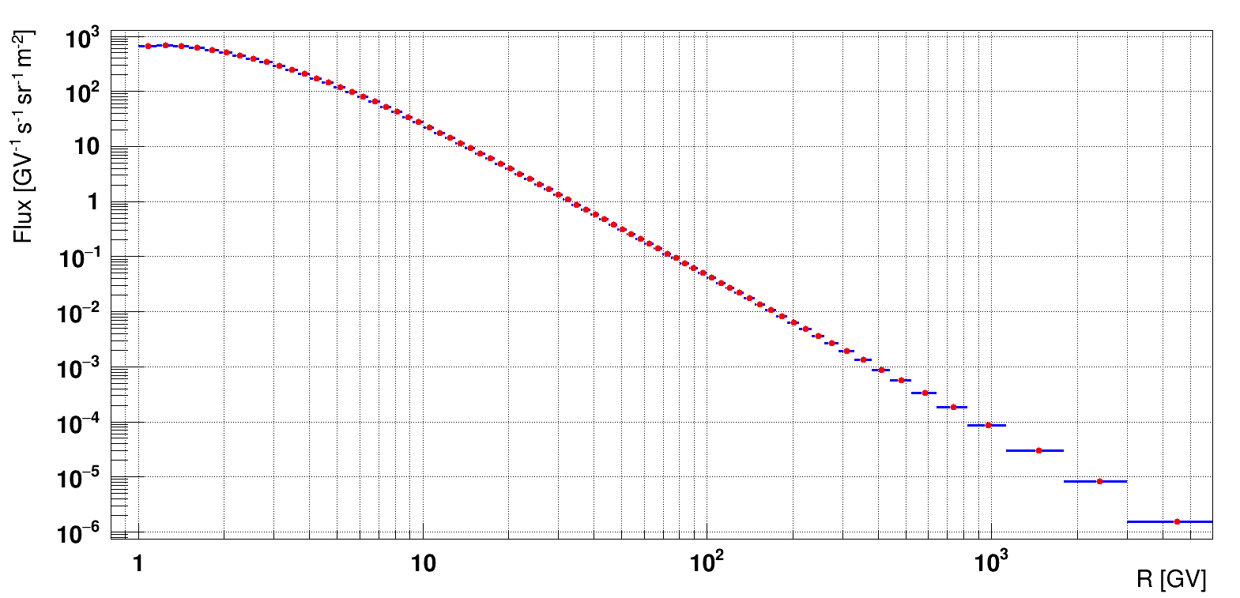
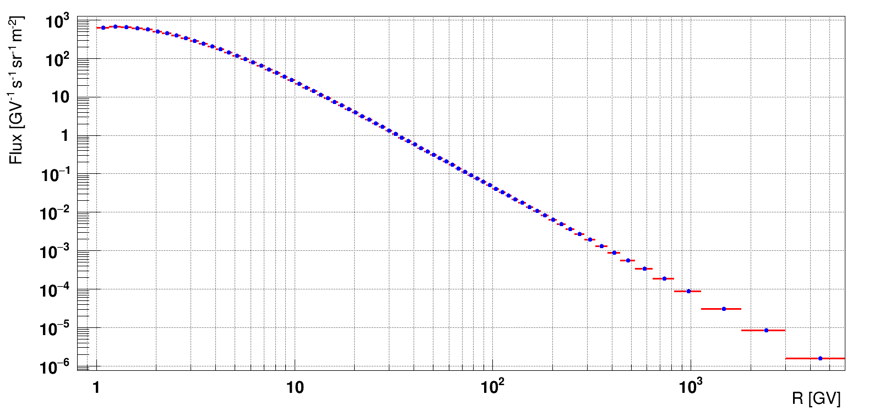
Proton Fluxes
Integrated ‘Day’ Flux over Rigidity
Integrated ‘Night’ Flux over Rigidity
May 2011 – May 2016

Slide 9
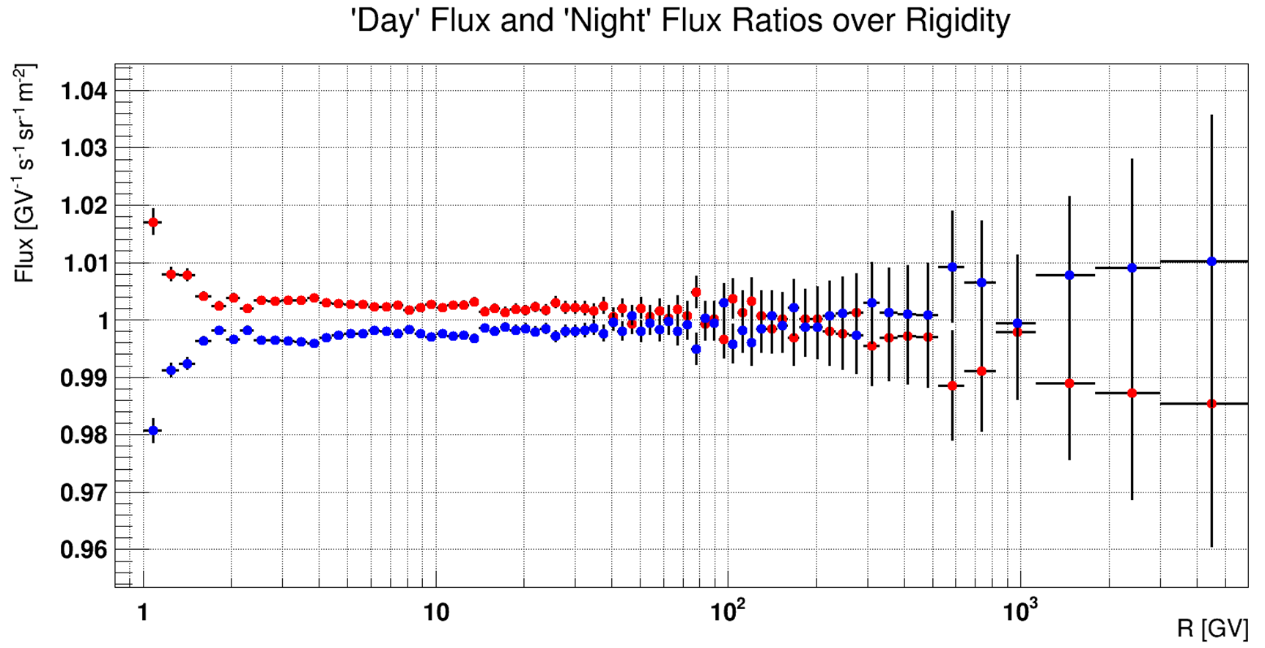
: ‘Day’ data
: ‘Night’ data

Slide 10
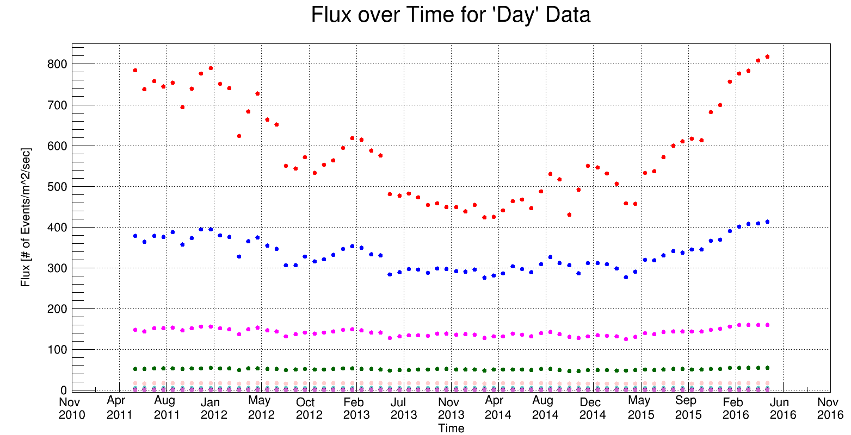
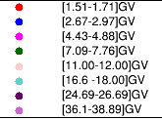
Flux over Time
The data for ‘Day’ and ‘Night’ events were separated into individual Bartels Rotation cycles (~27 days) for analysis of Flux over Time.
Deviations at lower Rigidities( < 10GV) are due to short term solar activity

Slide 11
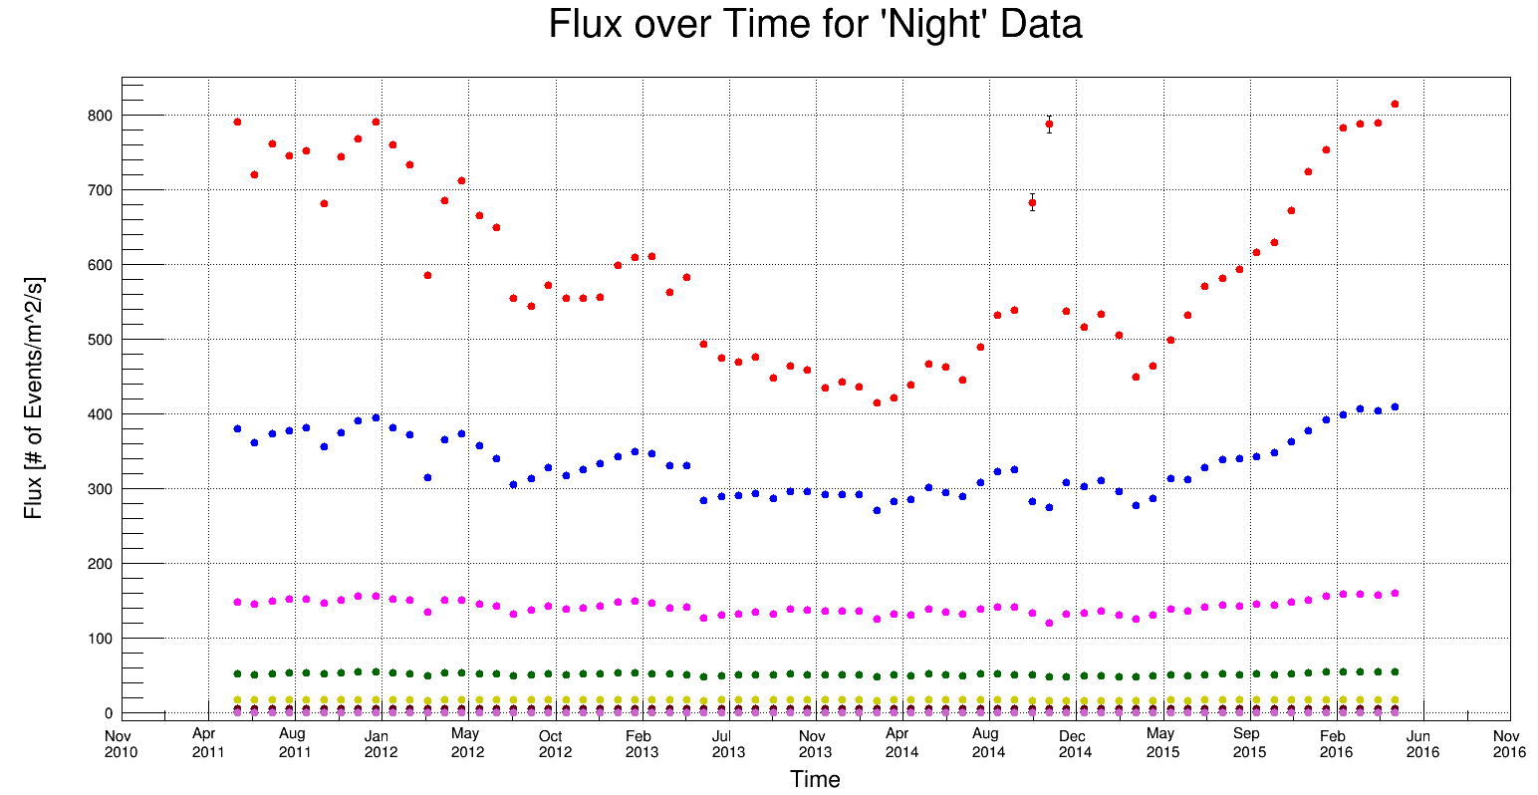
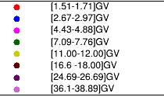
Flux over Time
The data for ‘Day’ and ‘Night’ events were separated into individual Bartels Rotation cycles (~27 days) for analysis of Flux over Time.
Deviations at lower Rigidities( < 10GV) are due to short term solar activity

Slide 12
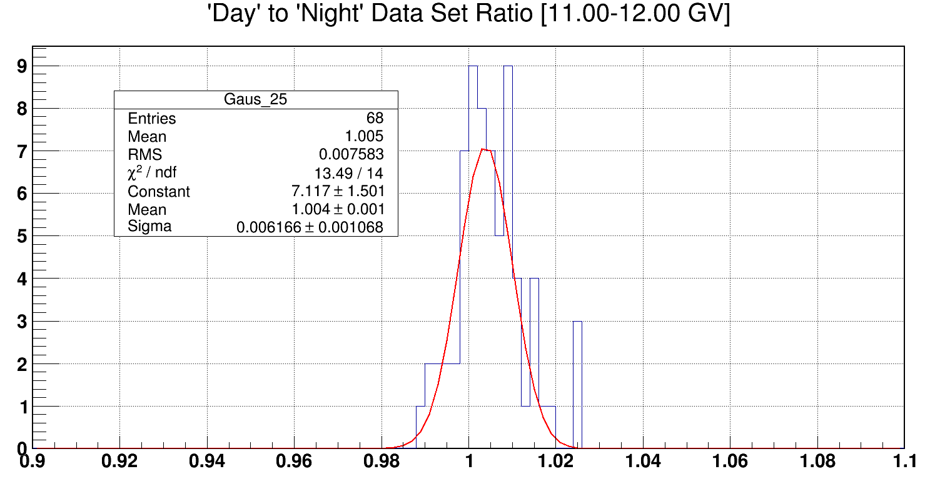
‘Day’ to ‘Night’ Flux Ratios over Time
Due to higher deviations at lower rigidities, we focused on bins with R < 100 GV
Check of ‘Day’ to ‘Night’ Flux Ratios over Time
Bin | Rigidity
5 | 1.51 – 1.71 GV
10 | 2.67 – 2.97 GV
15 | 4.43 – 4.88 GV
20 | 7.09 – 7.76 GV
25 | 11.00 – 12.00 GV
30 | 16.6 – 18.00 GV
35 | 24.69 – 26.69 GV
40 | 36.1 – 38.89 GV
45 | 52.2 – 56.1 GV
50 | 74.9 – 80.5 GV

Slide 13
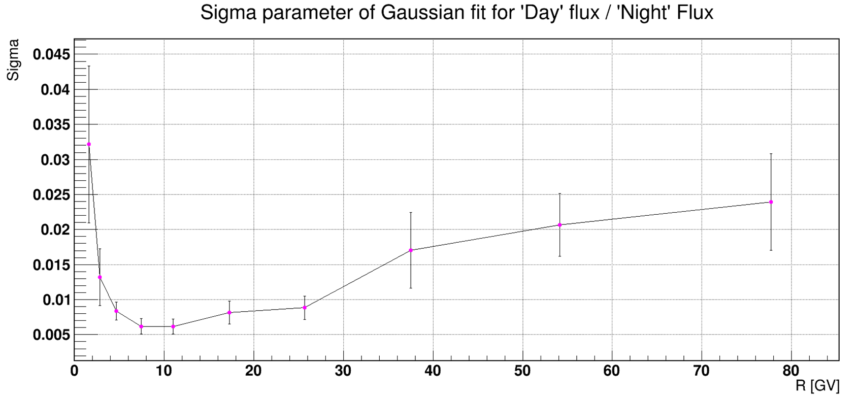
Statistical Comparisons
From the fit of the distribution of the ratios, we found that the deviation from the mean is consistently less then 0.6%, and that our sigma values are less than 0.035. Therefore, the ‘Day’ to ‘Night’ Flux difference is stable over time.

Slide 14
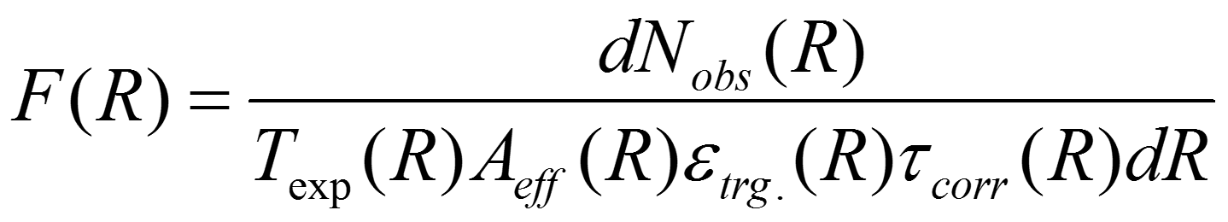
Further Investigations
To find the cause of the small fluctuations between proton fluxes during the two periods, it was necessary to study the parameters of Flux.
Step 1: Integrate Flux and other parameters over time (all BRs)
Step 2: Create ratios comparing parameters in ‘Day’ and ‘Night’ periods
Step 3: Create correlation graphs between the Flux ratios and parameter ratios
Step 4: Use T-Test for comparison of ‘Day’ to ‘Night’ periods over rigidity

Slide 15
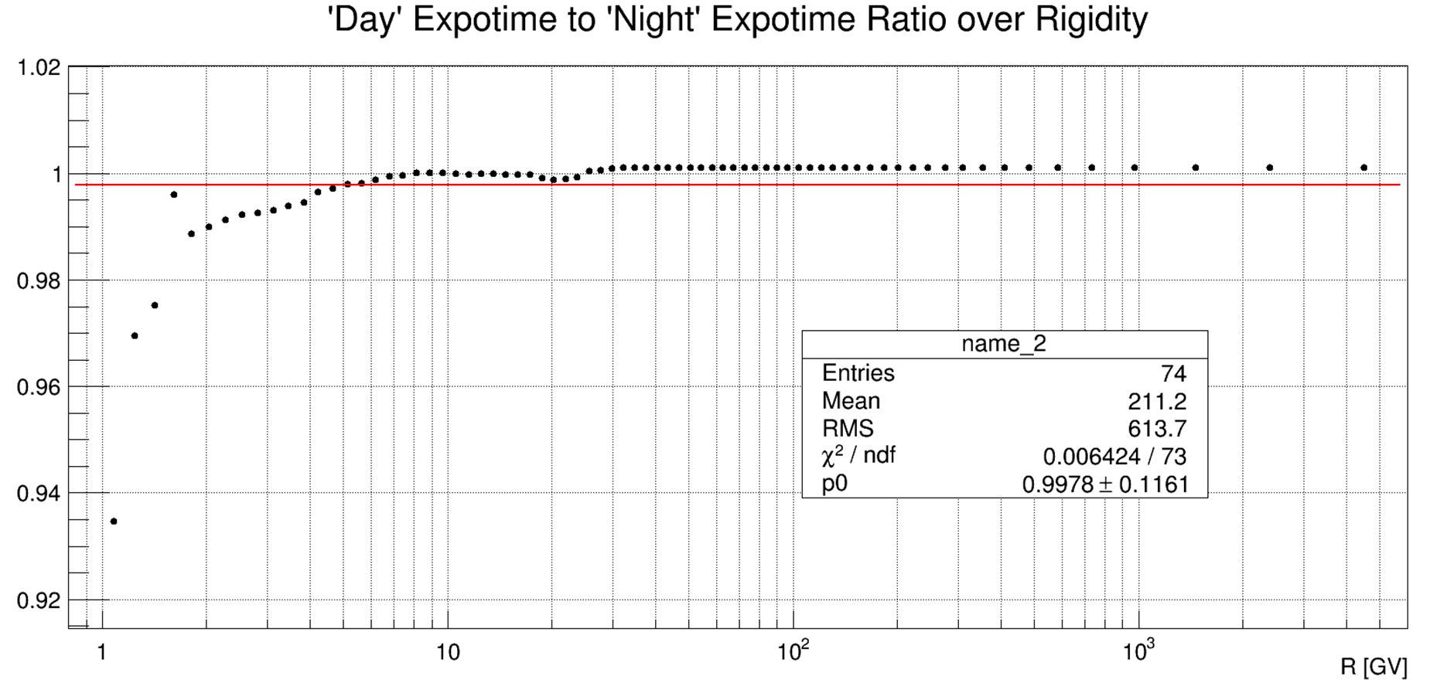
Further Investigations: Exposure Time

Slide 16
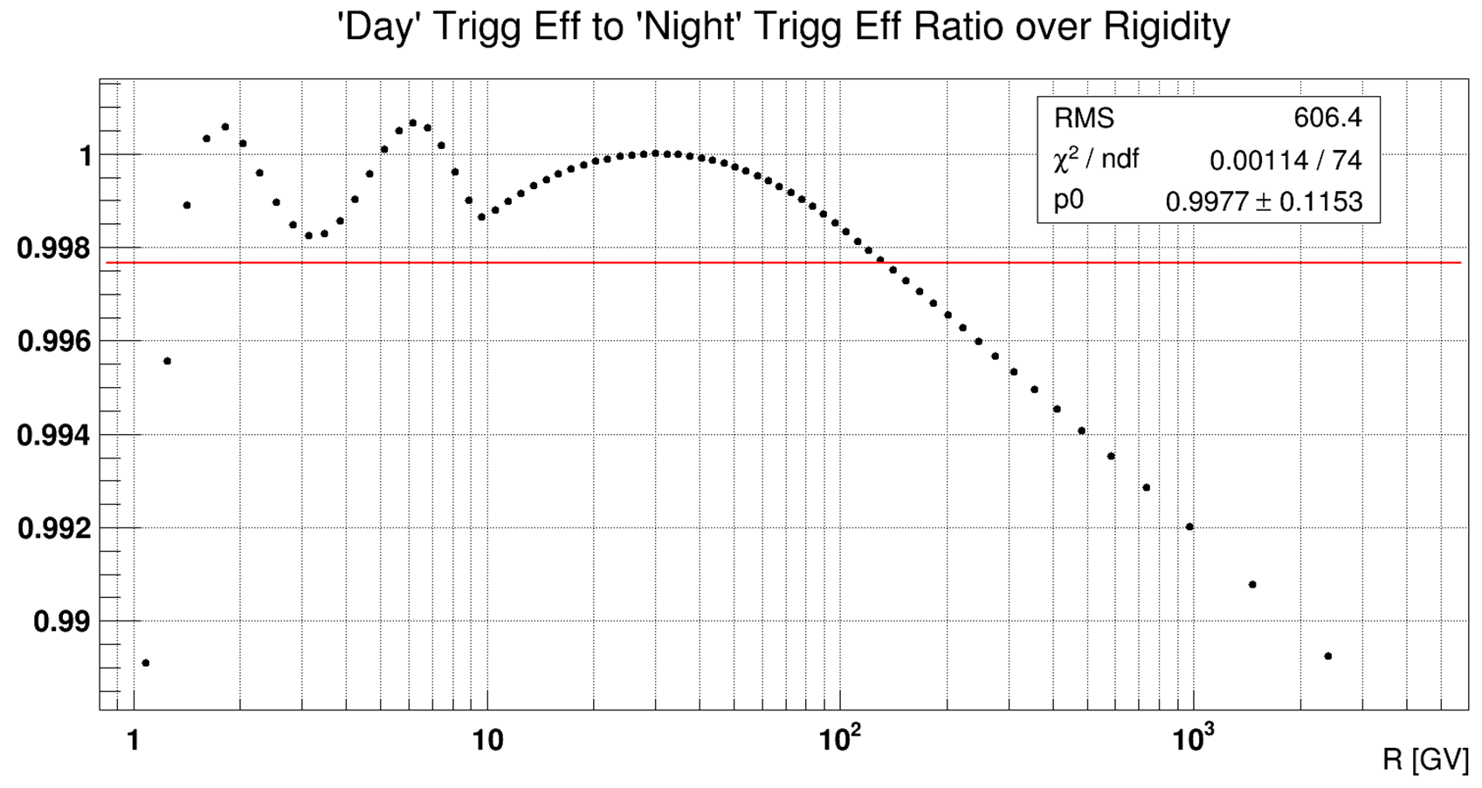
Further Investigations: Trigger Efficiency

Slide 17
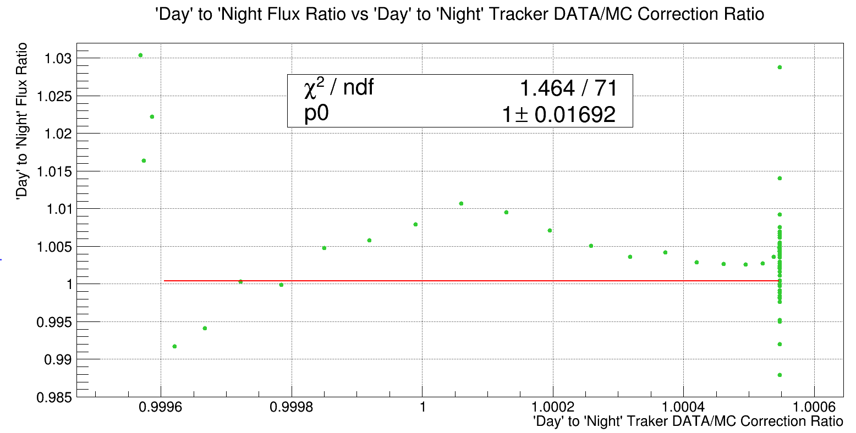
Further Investigations: DATA/MC Correction

Slide 18
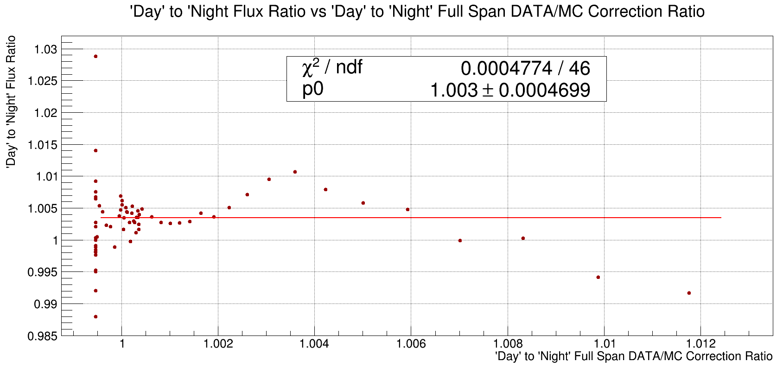
Further Investigations: DATA/MC Correction

Slide 19
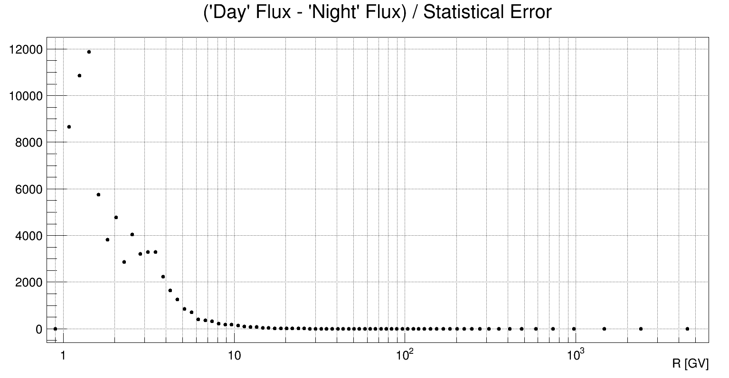
T-Test
Largest deviations in 2 – 10 GV range
Points in first few rigidity bins can be ignored
No significant deviations above 10 GV

Slide 20
Conclusion
According to my ratios and fits, there does not seems to be any large difference between the parameters (Trigg Eff, TRK Correction, FS Correction, and Exposure Time) of both periods to account for the difference in flux.
The larger deviations at lowest rigidity bins are most likely due to unfolding.
Although there appears to be a slight difference between the ‘Day’ and ‘Night’ Fluxes, these differences are not caused by the efficiency of AMS system or differences in the DATA/MC corrections.
The next step in this project would be to investigate other factors, unrelated to the detector, which might cause the difference in proton flux.

Slide 21
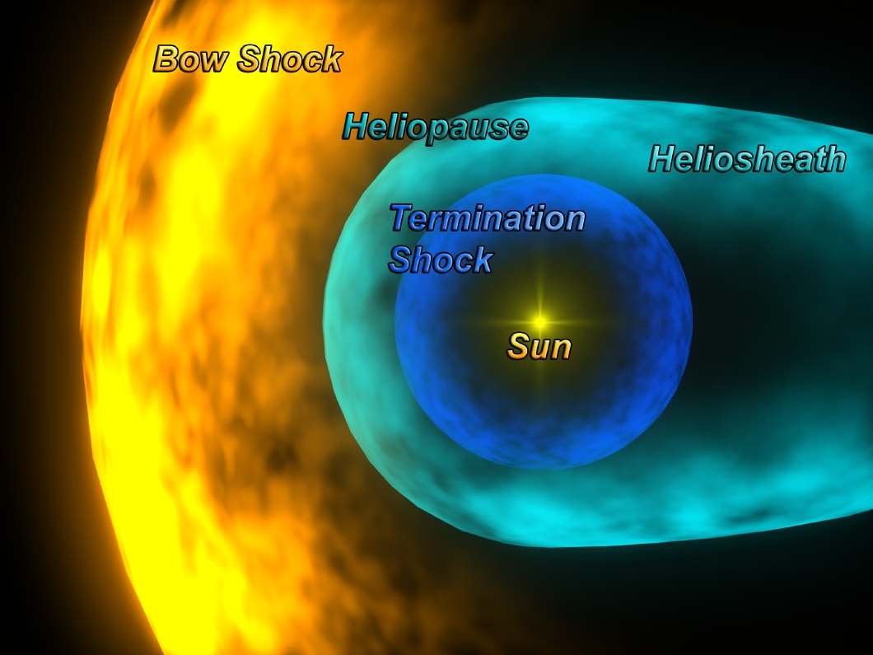
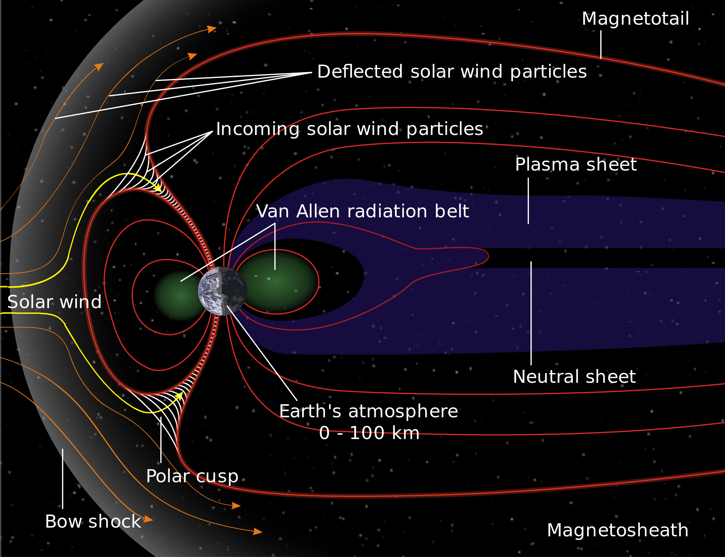
Possible Causes

Slide 22
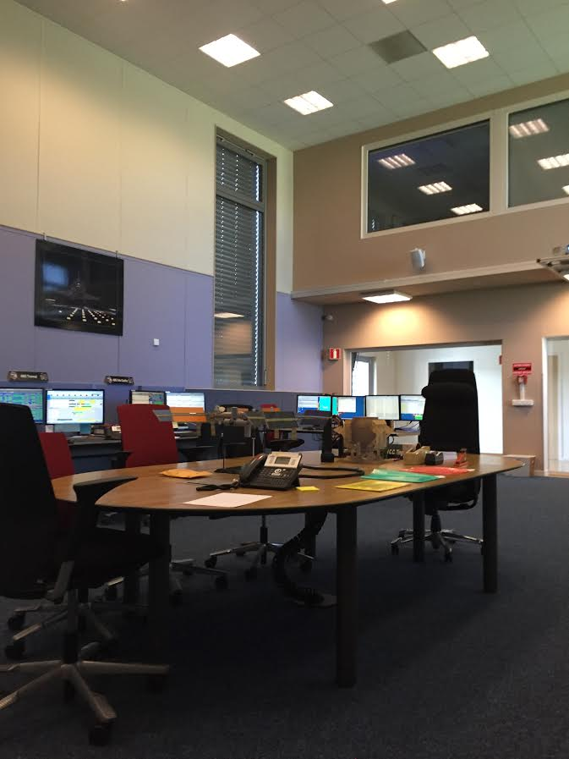
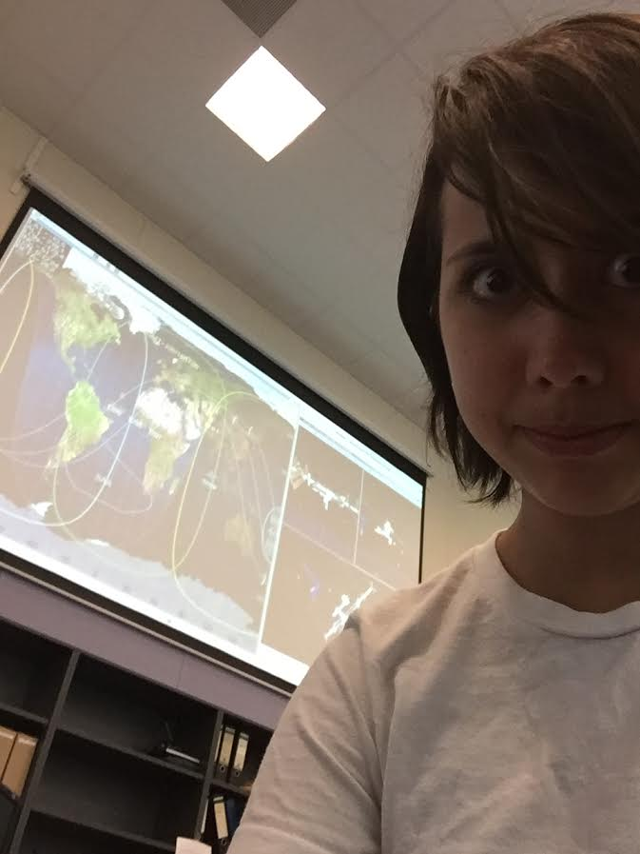
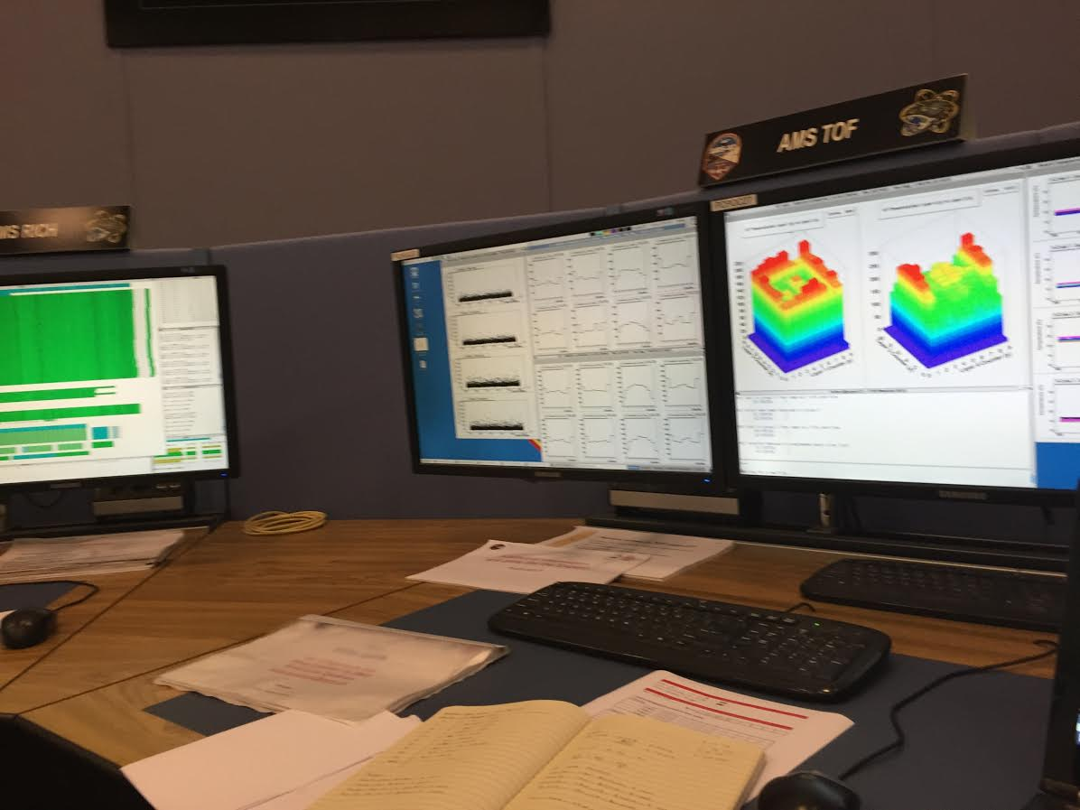
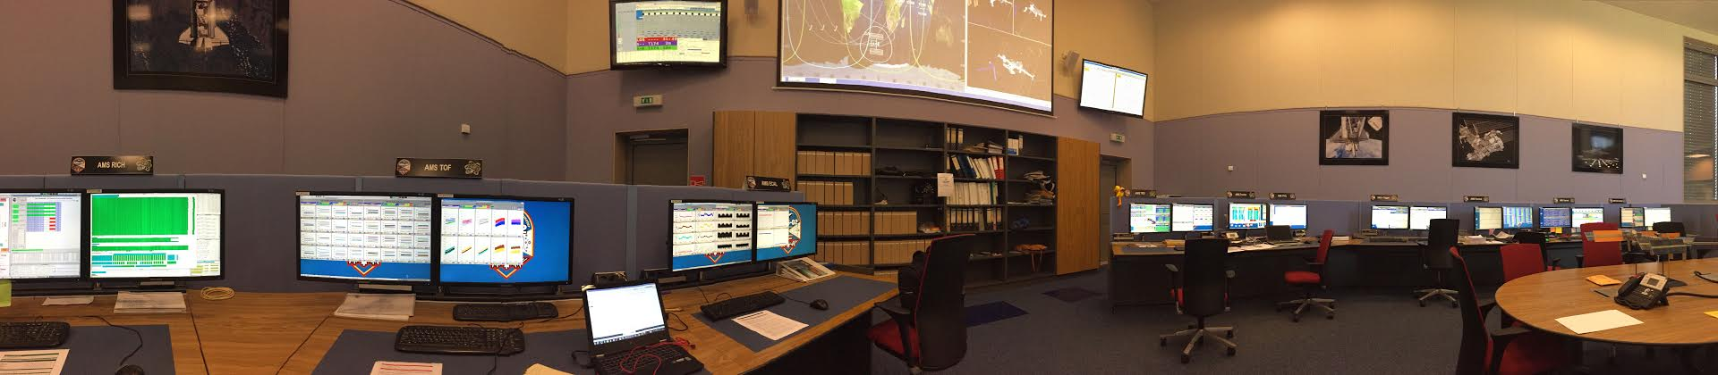
Shifts

Slide 23
Acknowledgements
I would like to thank the following for this opportunity:
The University of Hawaii AMS Group
The University of Michigan REU
The National Science Foundation

