Slide 1




NA62 Hidden Sector Search: Background Discrimination Studies
Cari Cesarotti, Babette Döbrich, Tommaso Spadaro
10.08.16

Slide 2
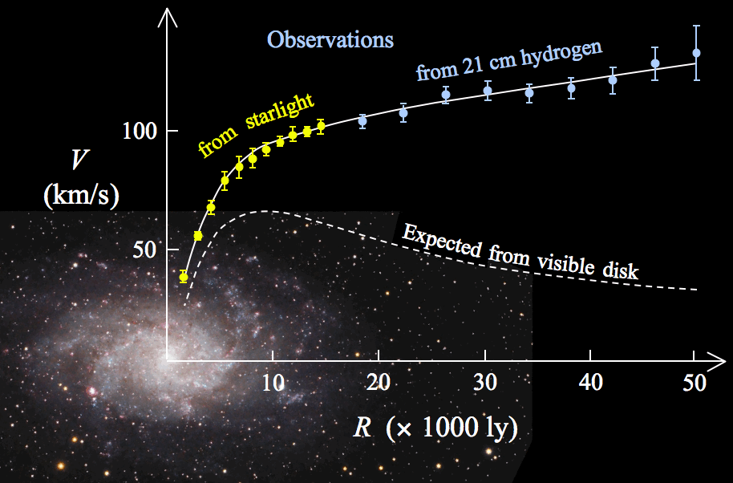
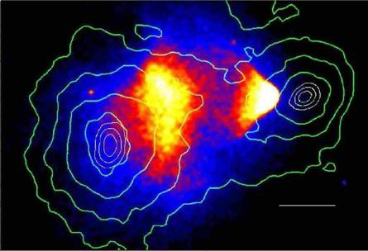
Physics Motivation
Cosmological observations unexplained by SM
  Bullet Cluster
  Galaxy Rotation Curves
  Gravitational Lensing
Dark matter dominance: could exist entirely hidden sector
To observe directly, coupling to visible matter
That what we are looking for: portals!
Galaxy Rotation Curve
Bullet Cluster: visible matter and gravitational equipotential contour

Slide 3
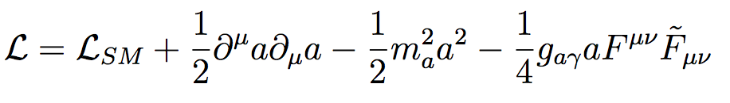

Phenomenology
Lagrangian → EOM
How do you construct a Lagrangian?
  Choose a field, impose a symmetry, include everything you can!
  ALP : pseudo scalar field, PNGB from broken U(1)
  Dark photon: U(1)
ALP portal (a)
Dark Photon
(A’)

Slide 4
Phenomenology
Lagrangian → EOM
How do you construct a Lagrangian?
  Choose a field, impose a symmetry, include everything you can!
  ALP : pseudo scalar field, PNGB from broken U(1)
  Dark photon: U(1)
Order 5 operator
[g_{aγ}] = GeV⁻¹
ALP portal (a)
Dark Photon
(A’)

Slide 5
Phenomenology
Lagrangian → EOM
How do you construct a Lagrangian?
  Choose a field, impose a symmetry, include everything you can!
  ALP : pseudo scalar field, PNGB from broken U(1)
  Dark photon: U(1)
ALP portal (a)
Kinetic Mixing
Dark Photon
(A’)
Dilepton Channel

Slide 6
Background Studies Overview
Study backgrounds for
  K ⁺ → πνν
  ALP → 2γ
  DP → l⁺ l⁻
Single track reconstruction & two track vertexing
Why?
  Improve πνν bgd rejection
  2 Track vertexing for hidden sector and πνν
  Estimates on hidden sector backgrounds and dump mode trigger sensitivity normalization

Slide 7
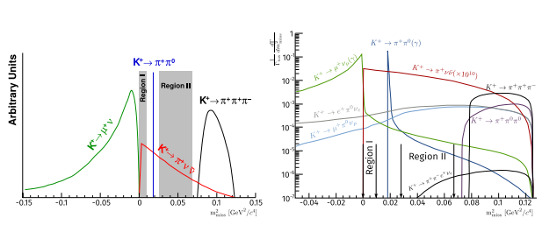
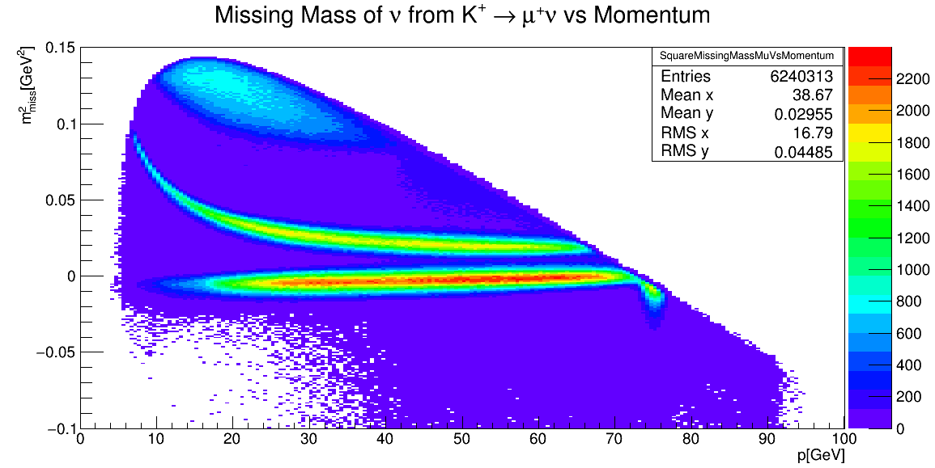
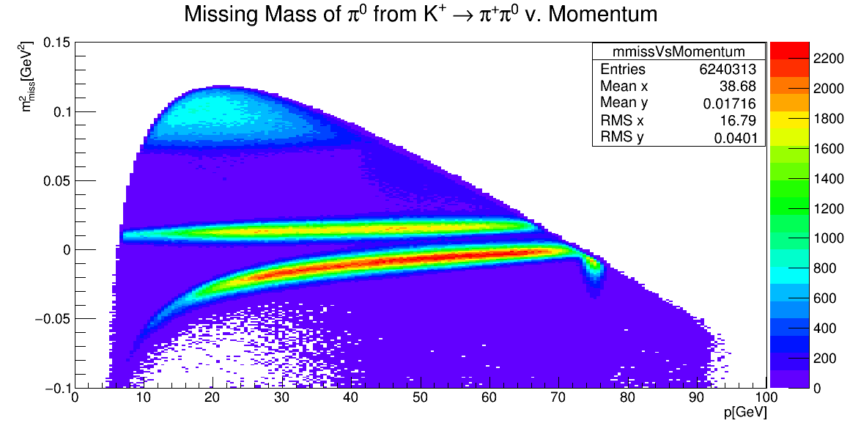
πνν
Discriminating variable is
  m²_{miss} = (p_{K} - p_{π})²
Any positive track could be π⁺ track
Veto by kinematics & acceptances
Region of Dominant Signal
p_{π} is from μ⁺
p_{π} is wrong π⁺

Slide 8
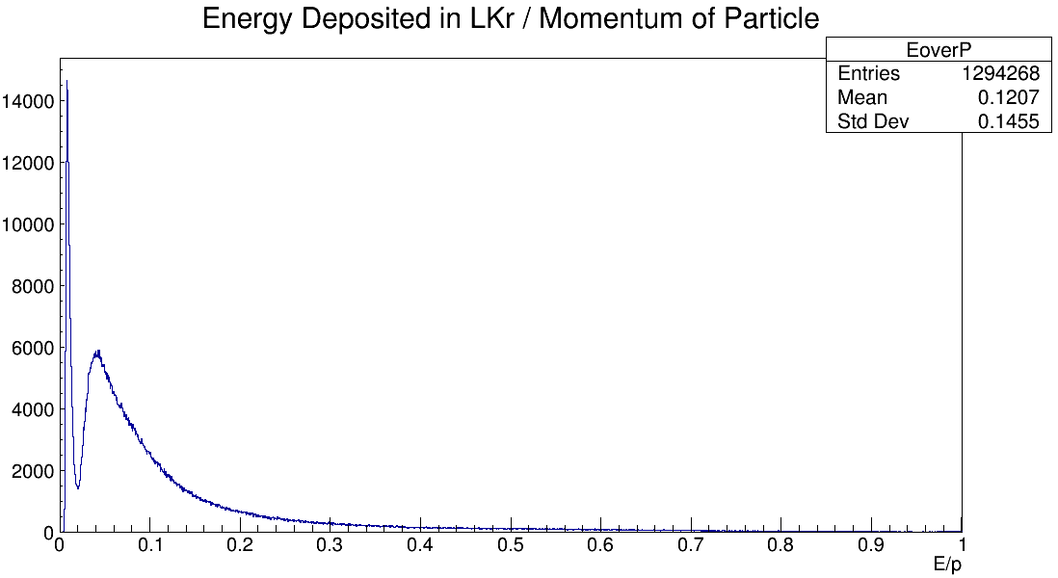
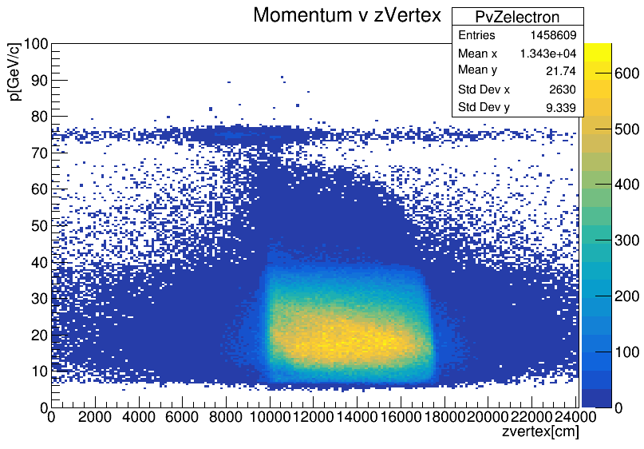
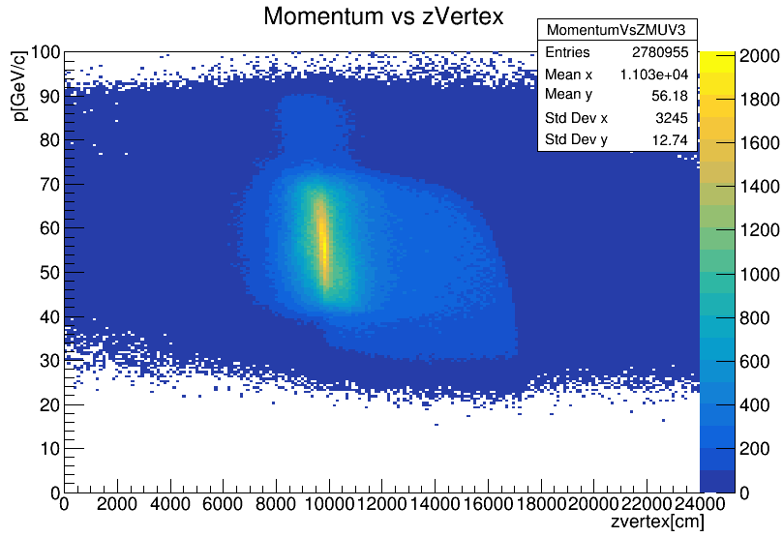
Muon Background
μ⁺ from K⁺ decay, muon halo
Separate from other leptons & hadrons kinematically
Acceptances in CHOD x Spectrometer x LKr x MUV3
E/p cuts in LKr
Electron and muon momentum vs. point of production
E/p for accepted particles

Slide 9
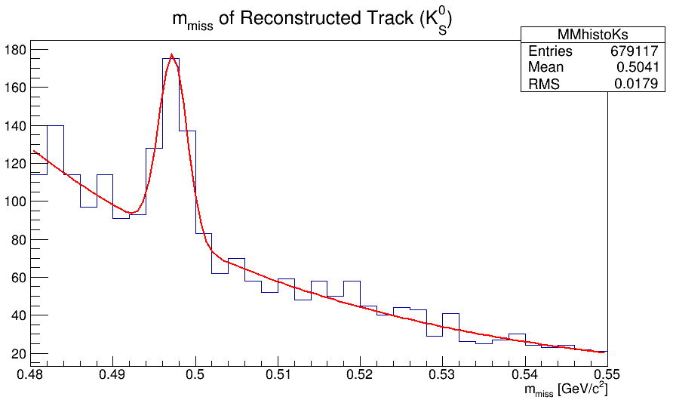
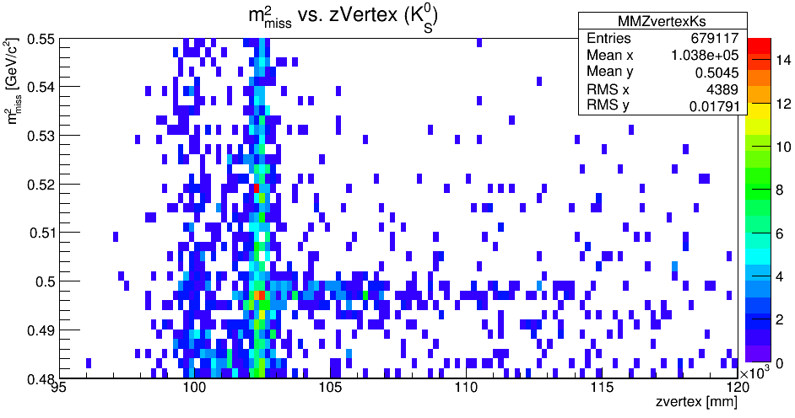
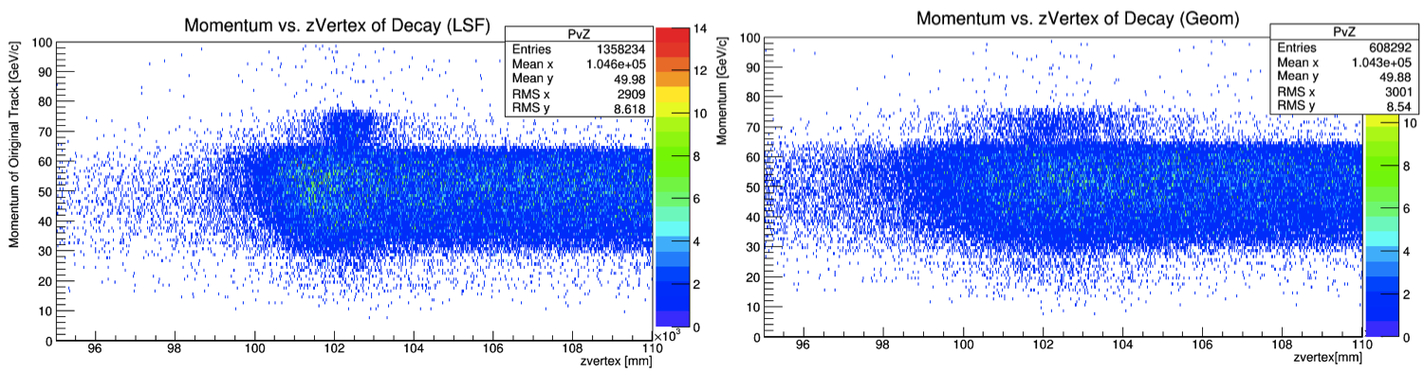
2 Track Vertexing
Minimum bias run – CHOD trigger
Quality condition of tracks
CDA of oppositely charged tracks < 15 mm
Method: Least squares fitting (Minucci) vs. Geometric Extrapolation (Spadaro)
Discriminate Λ, K⁰_{S} (SHiP)
K⁰_{S} peak from LSF vertex of π⁺ π⁻
(left) LSF 2 track vertexing compared to (right) geometric vertexing

Slide 10
Summary
Studied novel πνν background (K⁰_{S})
Compared MC to data (Order 1 success)
Developed new one-track and two-track analysis methods
Studied muon kinematics

Slide 11
What’s next?
Model building & hidden sector phenomenology!
  Back at CERN, 2017
MC hadronic inelastic cross section study
Create vetoes for K⁰_{S} backgrounds

Slide 12
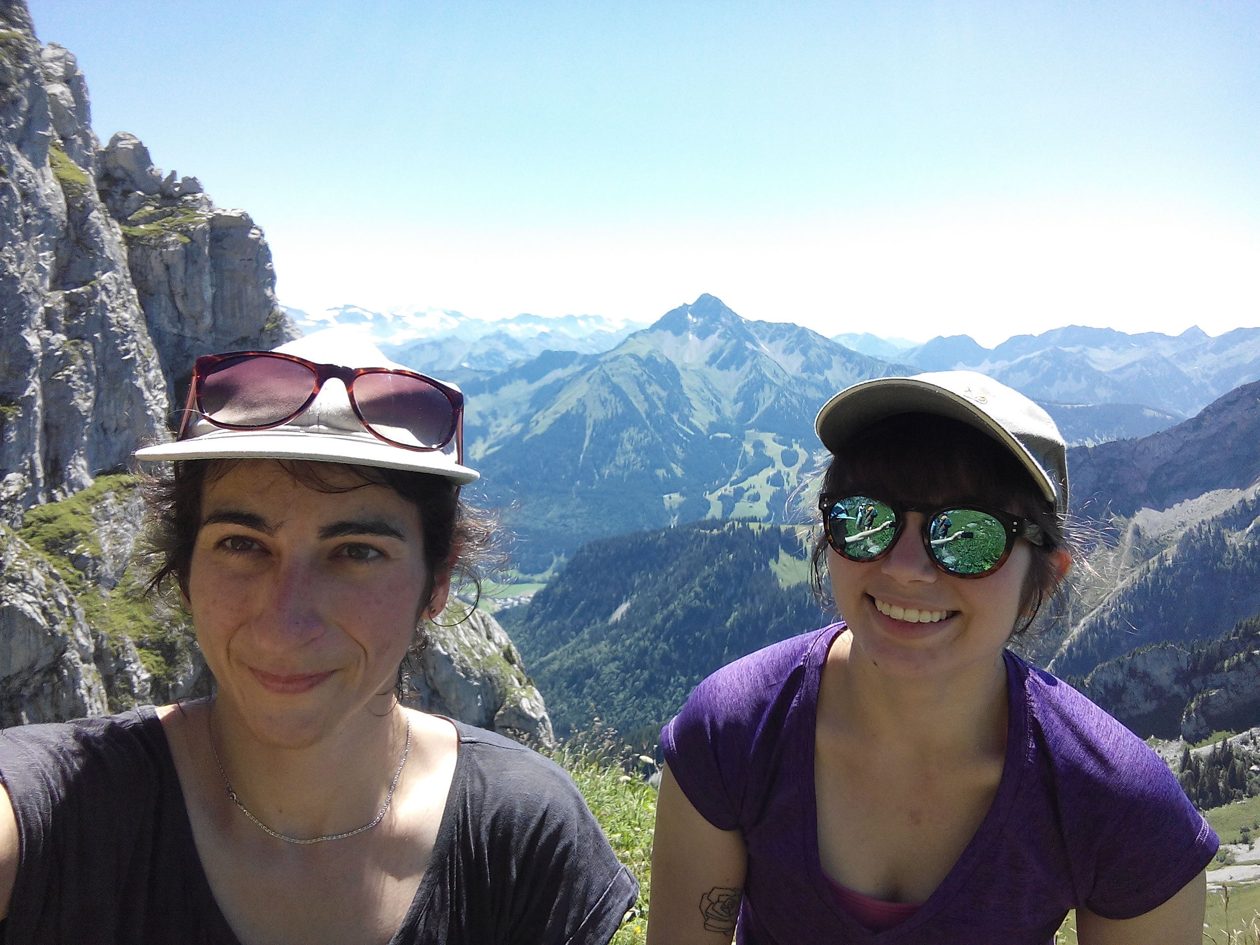
Thank you, NSF & UMich!

