Slide 1
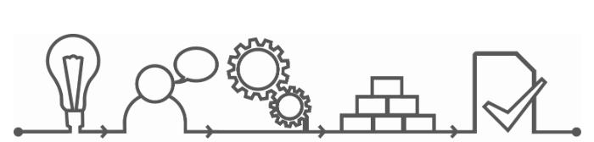
Basics of Project Management
Nadia Circelli June 1, 2016

Slide 2
techniques
tools
Project Management
skills
processes
Deliver products that meet stakeholders requirements
in a timely and efficient way

Slide 3



What is a project?
We do projects all the time.
At work
→ building a bridge
→ creating a new device
At school
→ preparing a report
In everyday life
→ organizing a party or a trip
It is about solving a problem or creating something
A project :
Is temporary with a specific start and end date
Has an end result that must be created

Slide 4
Key elements of a project
Risk
Risk
Cost &
Resources
Définition
Quality
Product
Time

Slide 5

Key people in a project
Project Team
Project Sponsor
Project Manager
Users
Suppliers
The success of the project will depend mostly on people
Notes:
Many people will be actively involved or will be impacted (positively or negatively) by the project
- Identify them (management, team, users, suppliers)
- Understand their impact or influence
- Collect their requirements and expectations. How will the project be considered successful by them?
- Establish which information they need and how to communicate to them

Slide 6
Project life cycle
Monitoring & Control
Definition
Plan
Execution
Closure
Product delivery
Define product(s), requirements and constraints
Define project plan
Execute project monitor and communicate status and progress
Review project & process
Definition
Plan
Execution & Monitoring
Closure
Effort during project life cycle

Slide 7
Definition
Monitoring & Control
Definition
Plan
Execution
Closure
Product delivery
Define
Product and scope
Understand
Requirements, constraints
Reasons for the projects and benefits
Key players, customers, users
Identify
Feasibility

Slide 8
Define the project in a complete way
Reasons for the project
What if?
Why?
Risks
Deliverables
& material needed
How much?
What?
Project
Budget
Key players
How?
Who?
Process
Where?
When?
Timing
Location(s)

Slide 9
SMART objectives and criteria for success!
SMART objectives to know where you go
Criteria for success to know when you reached it
Specific
Measurable
Actionable / Agreed upon / Ambitious
Realistic / Reachable
Time-bound
Notes:
The objective of the slide is to remind you of tips for defining goals with a good degree of quality.
To comment on the slide, you can say:
This is true for the overall top level project goals and for the more detailed project requirements that make up the specification of the project.
Potential pitfall: there are 2 or 3 definitions for the acronym “SMART” goals, which differ slightly from each other.

Slide 10

Good communication
Life and work experiences affect the way we communicate and interact
Failure in the communication often results in the failure of a project
BARRIERS to good communication
Assumptions
Unclear message content / actions
Different communication styles / culture
….
ENABLERS for good communication
Active listening
Rephrasing, summarizing
Respect, time, willingness
…..
Notes:
Communication is paramount because the success or failure of a project often rests with the success or failure of the communications among all the project players.remember playing the game “Telephone” as children where a message is whispered into the ear of one person, then another. The message is passed around the room until the last person in the chain verbalizes the message out loud. Everyone laughs when they find that the message is far different from the one first whispered. Those involved in project management know, however, that this kind of miscommunication between team members is no laughing matter. It can be costly, if not fatal to the project.
http://www.projectcartoon.com/cartoon/356170

Slide 11
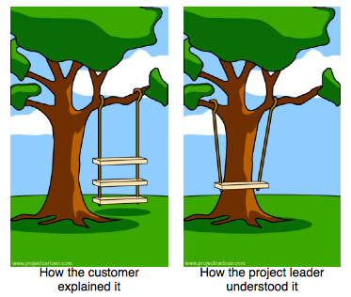
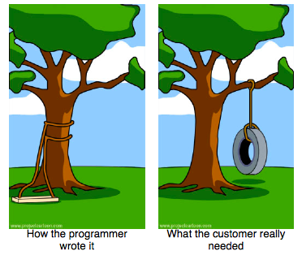
Clear requirements…
… and good communication
Notes:
pmi’s 2014 annual global Pulse of the Profession® study revealed that “inaccurate requirements gathering” remained a primary cause of project failure(37percent)in2014
when projects do not meet their original goals and business objectives, inaccurate requirements management is the primary cause of that outcome almost half of the time (47 percent).
http://projectcartoon.com/cartoon/1569852

Slide 12
Planning
Monitoring & Control
Monitoring & Control
Definition
Plan
Execution
Closure
Product delivery
Products
Time
Reqs
People
Project plan
Budget
Risks
Resources

Slide 13
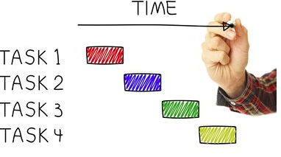
Prepare project plan
Define the product you need to produce
Breakdown the product into sub-products
+
+
=
+
Define the activities sequence and their relationships
Decide who will perform the activities + how long they will take
+
Notes:
Faire l’example de preparer son CV ou son profil Linkedin
Faire voir que il y a des activites qui sont en sequences, des autres que sont en parallel et necessaire que a la fin
Concorder avec toutes les parties prenantes des taches a faire (ex. Celui qui doit reviser notre CV)
En parler et le condiviser avec des autres pour avoir aussi des inputs et des feedbacks
Ne pas faire tout tout seul et ne pas rester enferme en soi meme

Slide 14
Project constraints
Quality
Understand which are the constraints
  Time
  Cost
  Quality
  Scope
  Resources or competences
  Technology
  …
Identify criticality and possible margins
Project
constraints
Cost
Time
Good
Cheap
Expensive!
Fast
Slow!
Scope
Bad!

Slide 15
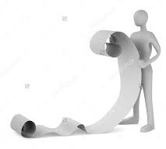
Project plan – some tips
Focus on products / deliverables
Go only till the detail level you need to keep track
Do it together with the team
value
an added
introduce
should
task
Each
You should be able to see the big picture!
All the team should feel the ownership

Slide 16
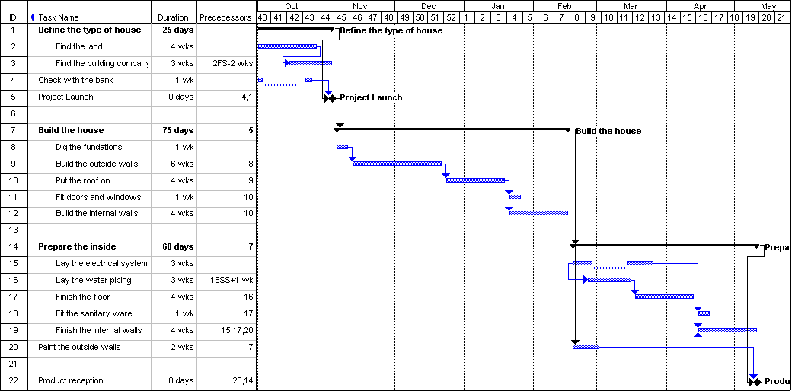
Example of a Gantt chart
Lag
Milestone
Summary task
Finish-to-start link
Start-to-start link
Split task
The planned status should be stored as baseline.
The current status can then be compared to the baseline to check the progress of the project, the differences or the delays.
Notes:
The objective of the slide is to provide an example of Gantt chart.
To comment on the slide, you can say:
Henry L. Gantt, from whom the Gantt chart is named, was employed at the Aberdeen Proving Grounds (US Department of Defense) as an ordinance engineer during the First World War. Although nearly a century has passed, the Gantt chart remains widely recognized as a fundamental, highly applicable tool for project managers everywhere.
Tasks are represented by a bar extending from start to stop or a line with triangles as start/stop
Milestones are often represented by diamonds, circles, etc
The links are represented by arrows showing the direction of the link
In the chart some of the features about tasks relationships (FS link, SS link, lag) are also shown and how a summary task and a split task are represented.
This is a Gantt chart produced with MSProject. Other SW have a slightly different aspect
In mod 4 the technical details of building a Gantt chart will be explained, here we will see more what the Gantt chart can be used for.

Slide 17
Risk prioritization
Risk
Identify risks that have a probability of impacting the project and define their impact
Address first the most important ones, establish priorities
Simplest method of risk prioritization:
Rate 1 to 3 both Probability and Impact
  (1 = lowest, 3= highest)
Evaluate Probability x Impact
 |  | Probability
 |  | 3 Very likely | 2 Probable | 1 Improbable
Impact | 3 High | 9 | 6 | 3
 | 2 Medium | 6 | 4 | 2
 | 1 Low | 3 | 2 | 1
Actions MUST be taken
Establish actions to :
  Avoid the risk
  Reduce the probability or impact
Actions might be taken
or
  Prepare alternative scenarios
  Transfer risk (ex: insurance)
  Accept the risk…. cost vs result
Actions not needed
Notes:
The objective of the slide is to explain how the risk factor is calculated.
To comment on the slide, you can say:
You then multiply the 2 numbers together (probability by impact) to get a risk factor.
This activity results in a prioritization of the identified risks.
This information is captured in the Risk Register and enables management to monitor the risk factors and take action.

Slide 18

Execution and monitoring
Monitoring & Control
Definition
Plan
Execution
Closure
Product delivery
Execute tasks
Check progress and risks
Modify plan

Slide 19
Checking the progress
Monitoring and controlling
  To obtain an objective view of the status of the project:
    Know where the projects stands vs the plan
    To anticipate corrective actions
    To communicate to management and team.
How often to check the progress?
  It depends from …
    average duration of the tasks involved
    identified risks
    complexity / criticality
Progress check
Progress check
Progress check
Progress check
Progress check
Time
Bad
Tasks
Not efficient
Good
Notes:
Mention that you can have different checking period for different workpackages
The objective of the slide is to graphically explain the optimal frequency of progress periods.
To comment on the slide, you can say:
The horizontal lines represent the task duration.
Pink Line: The progress period is too large and all tasks will be completed in between review points. We have to anticipate the potential problems: it’s necessary to check the progress during the task duration
Red line: It’s impossible to have an effective idea of the progress: the progress period is too short in relation to the duration of the task. If the period is too long, the increase in progress during the progress period is hardly sensible
Blue line: Usable, at each progress tracking point you can get a representative quantification of your progress
Green line: If the period is similar to one average work package, the progress is tracked using only 3 states:
not started
in progress
completed

Slide 20

Communication and reporting
Project Team
Project Sponsor
Project Manager
Users
Suppliers
Establish which information they need and how to communicate with them

Slide 21
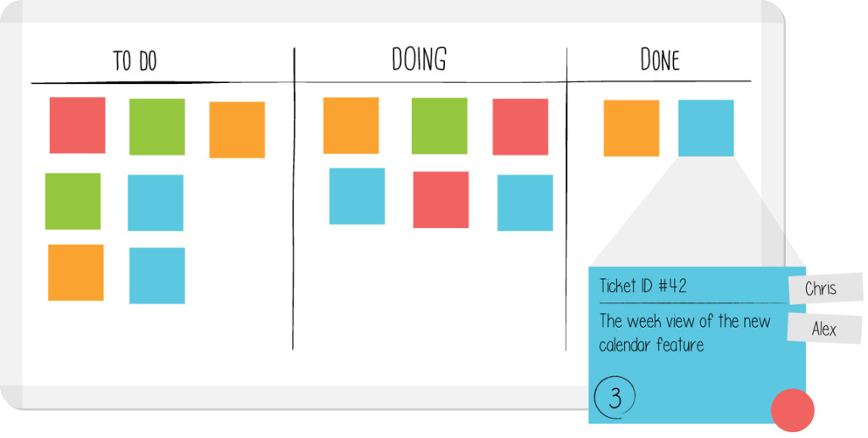
Examples of reporting

Slide 22
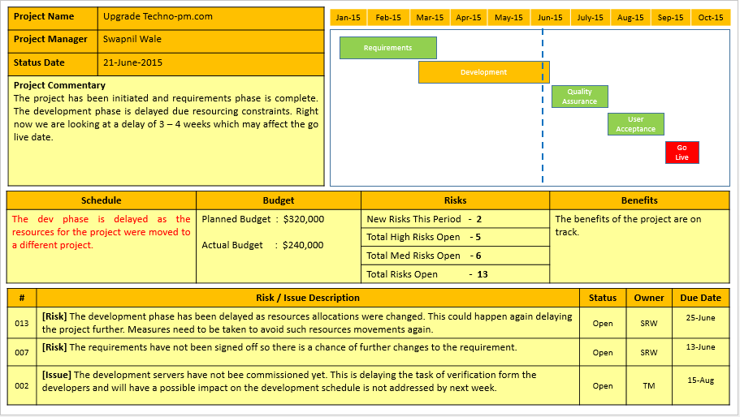
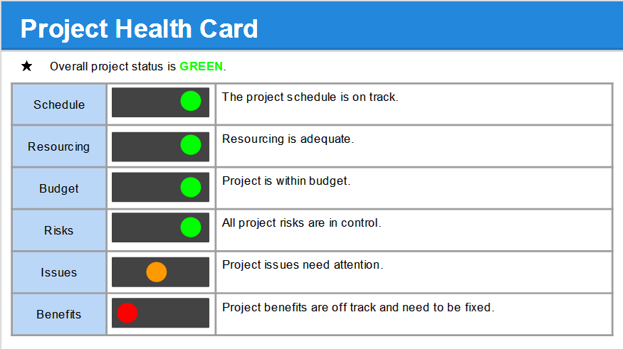
Examples of reporting

Slide 23
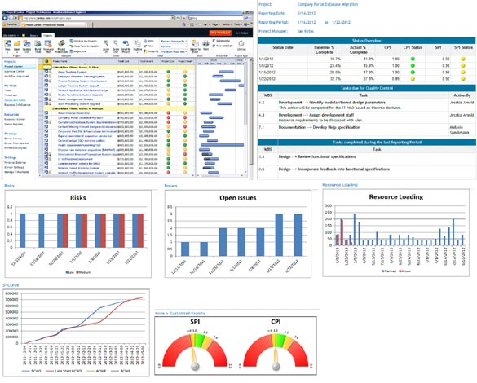
Examples of reporting

Slide 24

Product delivery
Monitoring & Control
Definition
Plan
Execution
Closure
Product delivery

Slide 25
A successful product
The product is the reason for the project's existence.
A successful product creates value / benefits for the customer
Manage changes
Needs
Requirements
Criteria for success
Plan
Execute
Benefits
wanted
Intermediate validations
Quality

Slide 26
Closure
Monitoring & Control
Definition
Plan
Execution
Closure
Product delivery
  What has been done well? ?
  What could have been changed?
  What could have been improved?

Slide 27
Review to do better next time!
When the project or a module is completed
Review:
  Product vs requirements
  Project execution vs plan
  Risks
Apply lesson learnt in next module /project
  AND… don’t forget to celebrate!

Slide 28
Main methodologies

Slide 29
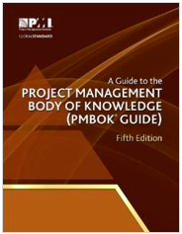

Founded in US in 1969
650,000+ members in 204 countries.
PMI produced the first Project Management Body of Knowledge (PMBOK) in 1996. Now arrived to 5th release
The Project Management Body of Knowledge is a set of standard terminology and guidelines (a body of knowledge) for project management
PMI introduced many credentials and a certification.
http://www.pmi.org

Slide 30
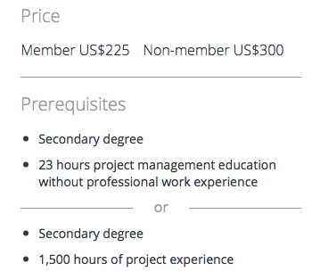
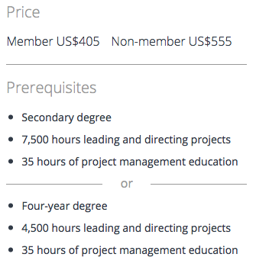
Credentials:
  Certified Associate in Project Management (CAPM) - 3 days
    understanding of fundamental project management theory, principles, techniques and methods.
  Project Management Professional (PMP) - 5 days
    Validates the competence to perform in the role of a project manager
    Preliminary experience required
Other credentials
  Program Management Professional (PgMP)
  Portfolio Management Professional (PfMP)
  PMI Agile Certified Practitioner (PMI-ACP)
  PMI Risk Management Professional (PMI-RMP)
  PMI Scheduling Professional (PMI-SP)
  PMI Professional in Business Analysis (PMI-PBA)

Slide 31
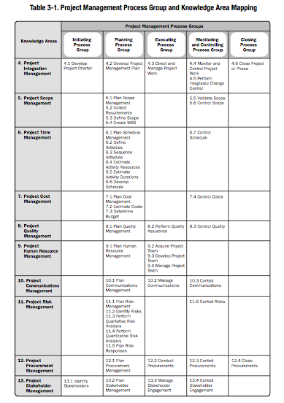
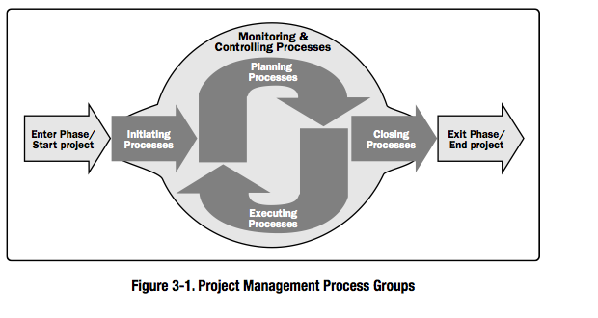
PMI methodology is based on
5 Process Groups to describe the flow of the work
10 Knowledge Areas to cover what a project manager needs to know in order to successfully manage a project
Notes:
Knowledge Areas cover what you need to KNOW.
Process Groups cover what you need to DO.
The general consensus (or we could call it project management best practice) is that you have to be able to work across these areas in order to get your project done. The Knowledge Areas are a handy way to group together theory and practical techniques.

Slide 32

PRINCE2 : Projects In Controlled Environments, version 2
Founded In 1989 by the Central Computer and Telecommunications Agency (CCTA) and then adopted more widely in UK government and in the private sector
PRINCE2 is now a de facto standard for project management in many UK government departments and across the United Nations system.
1.000.000+ exams taken worlwide
https://www.prince2.com/eur

Slide 33
Qualifications:
PRINCE2 Foundation :
PRINCE2 principles, terminology - 3 days
PRINCE2 Practitioner :
apply PRINCE2 to the running and managing of a project – 5 days
(Foundation + 2 days)
No preliminary experience required
Others qualifications:
PRINCE2 Agile™

Slide 34
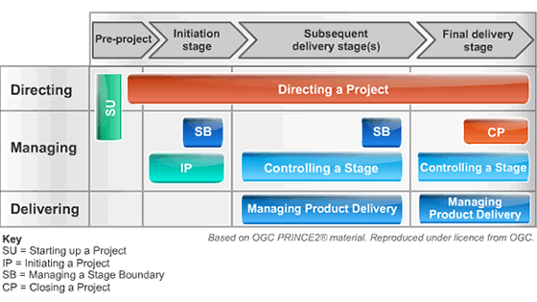
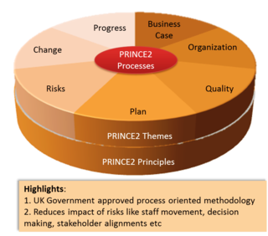
PRINCE2® is a process-driven project management methodology based on 7 processes
PRINCE2® covers the management, control and organization of a project. It devotes a special attention to roles and responsibilities
Notes:
It helps you work out who should be involved and what they will be responsible for

Slide 35

Agile
In Feb 2001, a number of leading thinkers who were using “Lighter” software development methods (The Agile Alliance) agreed on the Manifesto for Agile Software Development
Agile software development is a set of principles in which requirements and solutions evolve through collaboration between self-organizing, cross-functional teams.
Agile project management is used widely in the world not only in software development but also in other areas.
Agile methods include SCRUM, DSDM, Extreme Programming (XP), FDD , Lean…
https://www.agilealliance.org

Slide 36

Agile certifications
The Scrum Alliance offers a number of professional certifications:
  Certified Scrum Master (CSM)
  to gain an understanding of the Scrum framework – 2 days
  Certified Scrum Developer (CSD)
  CSM + “Agile Engineering Practices” technical course - 3 days
  Certified Scrum Professional (CSP)
  one of the above + 36 months of successful Agile/Scrum work experience
Other certifications:
PMI Agile Certified Practitioner (PMI-ACP) – 3 days + experience
experience : 2,000 hours of general project experience + 1,500 hours working with agile methodologies.
PRINCE2Agile Practitioner Certificate – 3 days + being a PRINCE2 practitioner

Slide 37
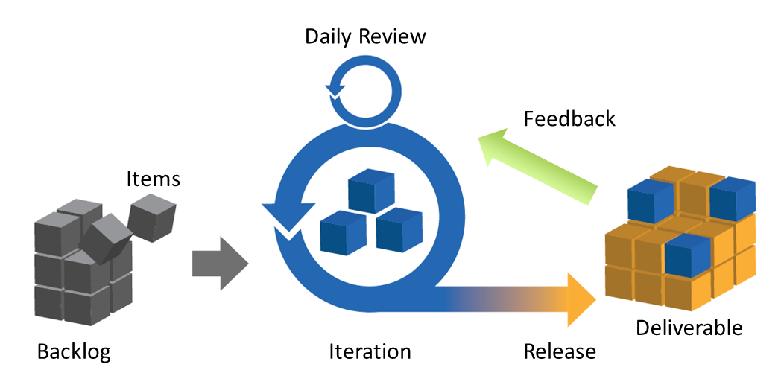
Agile
1-4 weeks
Agile is based on an iterative, incremental method of managing the design and build activities.
Agile is based on the team committing to achieve a goal, organizing itself and delivering at regular small intervals

Slide 38
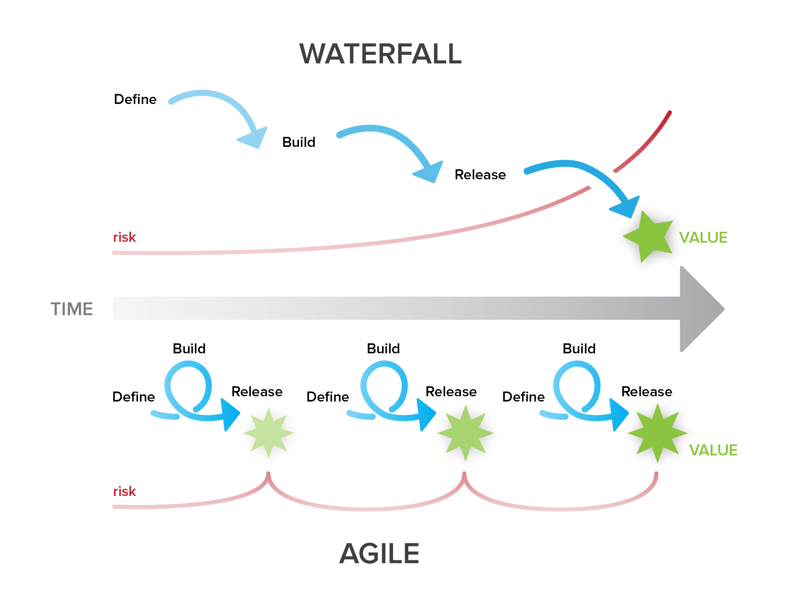
Development methodologies comparison
TRADITIONAL
AGILE

Slide 39
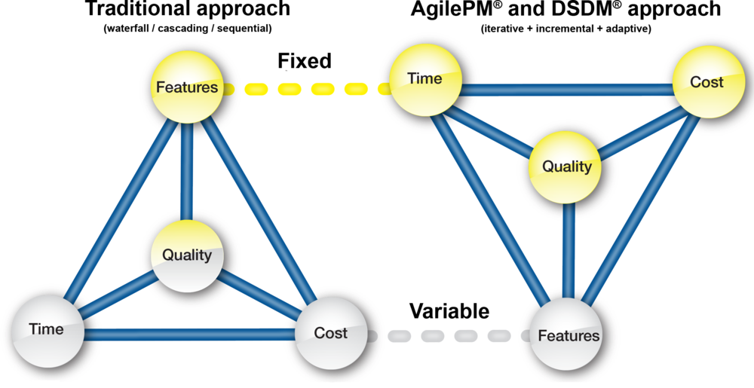
Focus comparison

Slide 40
… and for the future?
Blended methodologies
Product value and benefits more central
Business Model Canvas
Lean Start Up

Slide 41
THANK YOU!
Nadia Circelli
nadia.circelli@gmail.com

