Slide 1
GBT-SCA Updates
Alessandro Caratelli, Rui Francisco, Kostas Kloukinas, Alessandro Marchioro,
(alphabetic order)
LHCb Upgrade Electronics meeting
Thursday, 09 June 2016

Slide 2
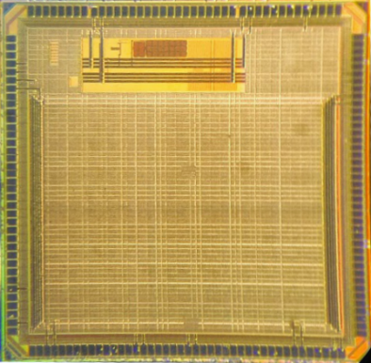
GBT-SCA
I2C master
X 16
E-PORT
I2C master
X 16
CLK
CLK
SDA x16
I2C master
X 16
RX FIFO
RX
SCL x16
I2C master x16
RX
TX
SERDES
SLVS
Cm: +0.2V
Dif: ±0.2V
TX FIFO
TX
SCLK
SPI master
Config
MISO
MOSI
SS x8
AUX_E-PORT
TCK
JTAG master
TDI
CLK
Network controller
TDO
CLK
RX
TMS
RX FIFO
TX
RES
RX
SERDES
SLVS
Cm: +0.2V
Dif: ±0.2V
General purpose I/O
Interrupt inputs
TX FIFO
GPIO
x32
TX
Config
Analog IN
x31
ADC
Aux serial port
Interface
Serial interface
SDA
SCL
sync
Calibration
Clock ctrl
Temperature sens.
E-FUSEs bank
Arbiter
DAC
SEU counter
Analog OUT
x4
DAC
Interface
DAC
DAC x4

Slide 3
Changes of the GBT-SCA V2
A new version of the SCA was prototyped in October 2015
with minor changes
Improved ADC performances
  The ADC of the SCA was modified to improve the TID tolerance
  Better linearity, better noise performances,
Allowed higher voltages supply for the periphery VDD
Minor changes on the I2C masters
  The SDA line can now be tristate

Slide 4
E-port communication
Status:
Start-up and communication ← Tested
Connect and reset commands ← Tested
Switching between primary and auxiliary port ← Tested
Core Logic
Status:
Digital functionalities ← Tested
Receive/Reply and communication related ← Tested
Enable/Disable (clk gating) of all ← Tested
communication interfaces

Slide 5
I2C ports
Status:
Read operations in 7bit addressing mode ← Tested
Read operations in 10bit addressing mode ← Tested
Write operations in 7bit addressing mode ← Tested
Write operations in 10bit addressing mode ← Tested
SPI port
Status:
Read and write operations with different ← Tested
settings and frequencies
Read and write operations on ← Tested
commercial hardware (memory)

Slide 6
JTAG port
Status:
Operations with different settings and frequencies ← Tested
GPIO port
Parallel port as output ← Tested
Parallel port as input/tristate ← Tested

Slide 7
ADC
Conversion operation and reply on all the 31 inputs ← Tested
Crosstalk between the 31 Inputs ← Tested
Gain Calibration logic ← Tested
Internal temperature sensor ← Tested
100 μA Current sources on the ADC pads ← Tested
Offset ← Tested

Slide 8
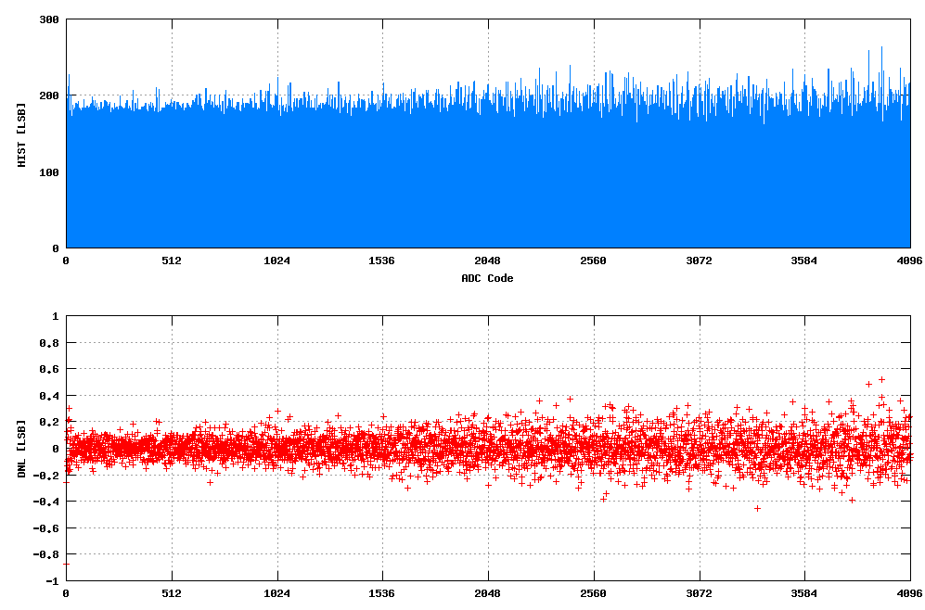
ADC Differential Nonlinearity
Figure 3: ADC DNL extrapolated with Instagram method with linear ramp in input, 1600 average samples per bin, source voltage from 16 bit DAC.

Slide 9
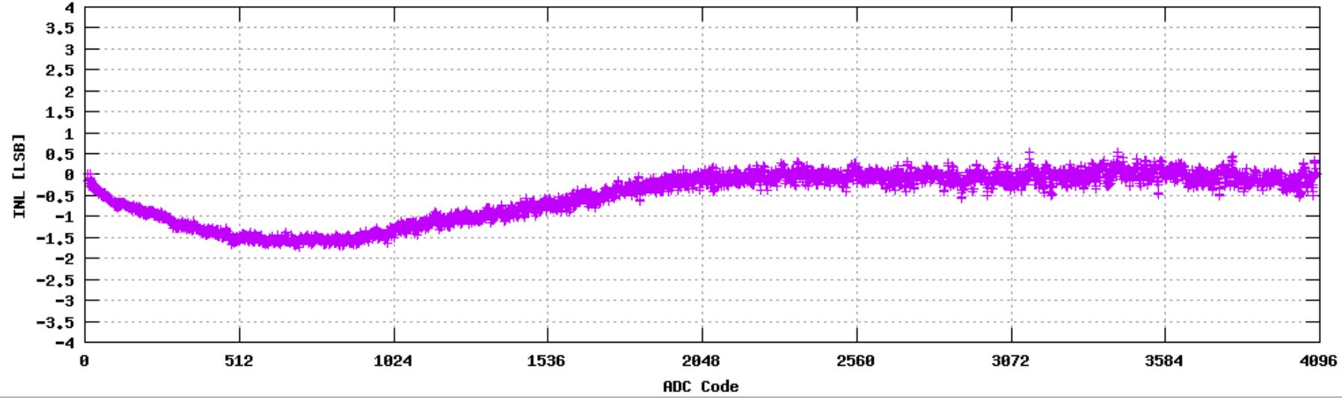
ADC Integral Nonlinearity
Figure 4: ADC INL extrapolated with Instagram method with linear ramp in input, 1600 average samples per bin, source voltage from 16 bit DAC.

Slide 10
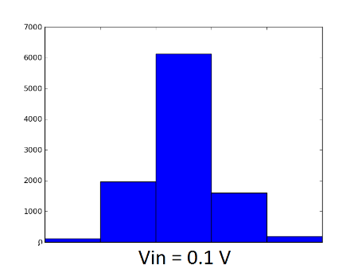
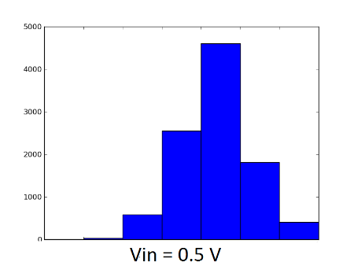
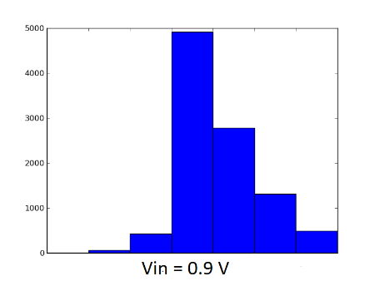
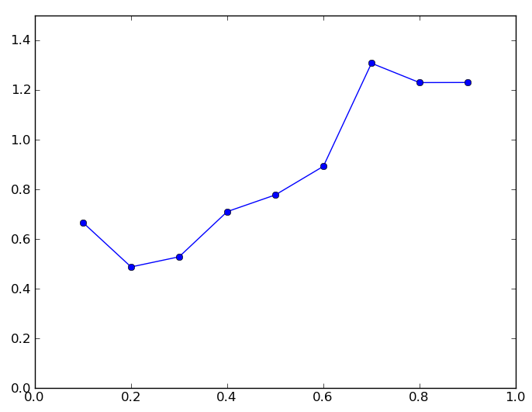
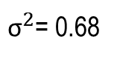
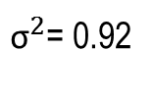
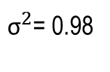
ADC noise performances
${\text{σ}}^{2}$= 0.68
${\text{σ}}^{2}$= 0.92
${\text{σ}}^{2}$= 0.98
Figure 5: Conversion result distribution with fixed input voltage at 0.1V, 0.5V and 0.9V.
One been represents 1 count of the ADC

Slide 11
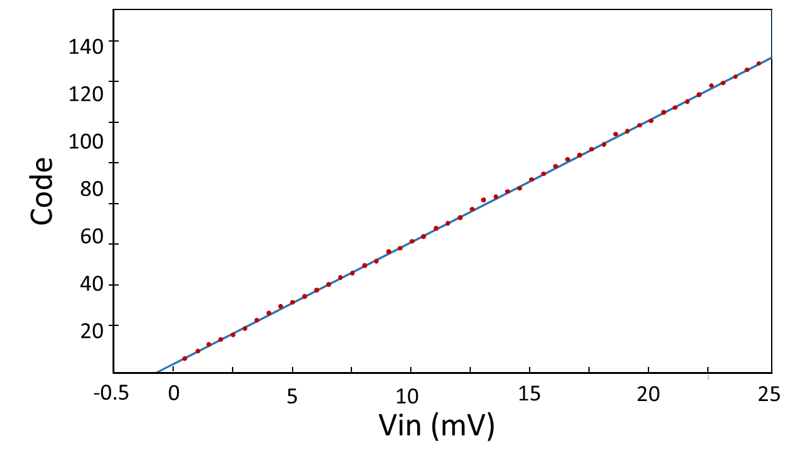
ADC Offset
Figure 6: ADC Samples close to 0.0 V. From the fitting of the samples (uncalibrated data without offset and gain correction) it is possible to extrapolate the offset due to the comparator. This offset is correctly evaluated and subtracted by the ADC internal state machine, giving the expected correct result.

Slide 12
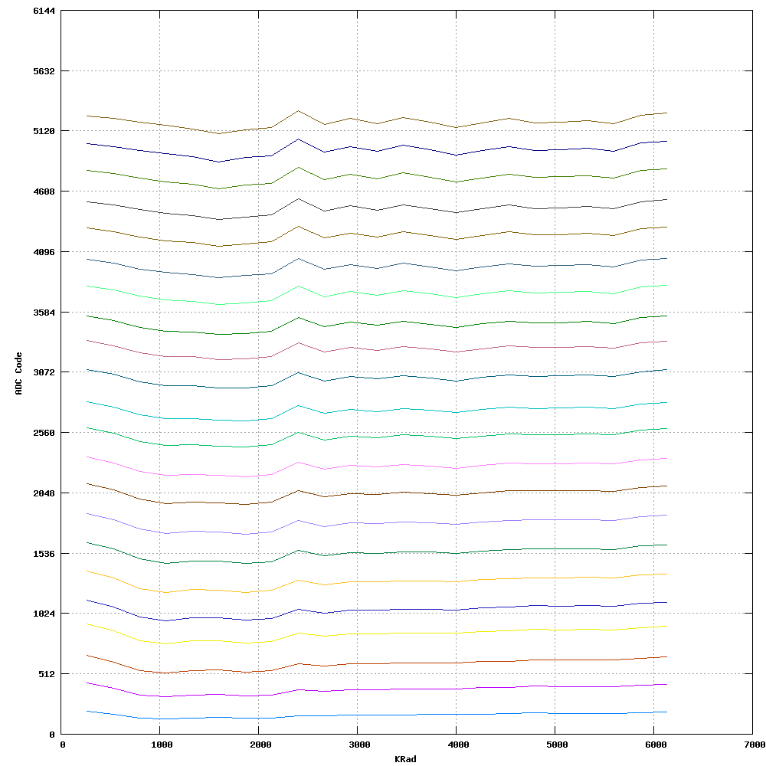
ADC TID tests 1/2
5210
4096
3072
Conversion Result
2048
1024
0 1 2 3 4 5 6
Mrad
Figure 7: ADC conversion result with input voltage from 0.0V to 1.0V with steps of 0.1V.
A set of measurements is taken every 200 Krad. Dose rate of 800 Krad/h.

Slide 13
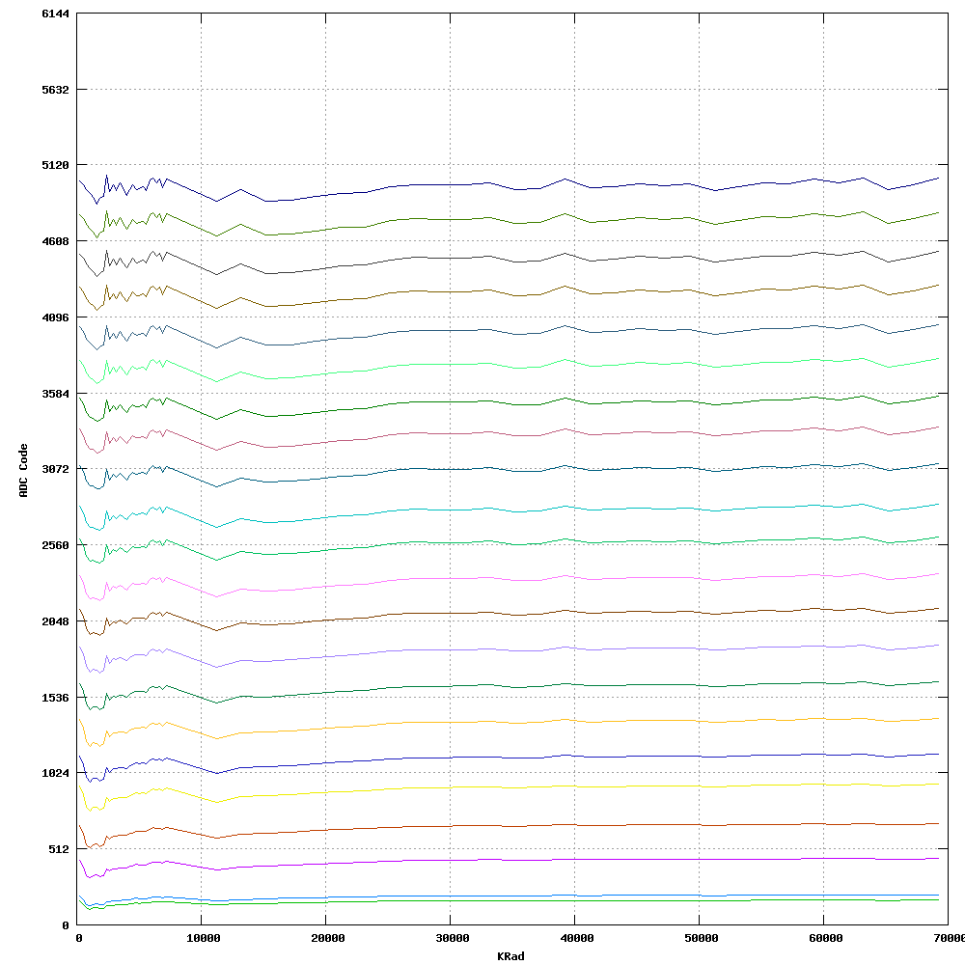
ADC TID tests 2/2
5210
4096
3072
Conversion Result
2048
1024
0 10 20 30 40 50 60
Mrad
Figure 7: ADC conversion result with input voltage from 0.0V to 1.0V with steps of 0.1V.
Dose rate of 800 Krad/h up to 6 Mrad and 8 Mrad/h up to 70 Mrad

Slide 14
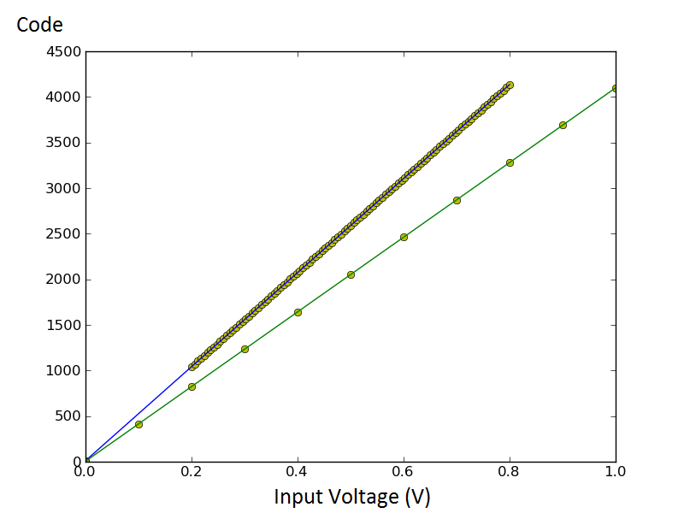
ADC Calibration Procedure
Figure 9: calibration procedure implemented on the chip. The blue line represents the linear interpolation of several samples on the ADC before to apply the calibration procedure, while the green line represent the slope after calibration.

Slide 15
Production plans
Engineering run Scheduled for the 1st July 2016
Volume of 20 000 samples
Unpackaged cheeps will come back in October 2016
Packaged chips will be ready for early 2017

