Slide 1
BI ELENA software
Introduction
  Recent review of BI systems at ELENA
    G. Tranquille to report
Goal today - put people in contact
    Discuss OP requirements
    Agree on interfaces
List of ELENA timing events
  Next slide
List of BI systems for ELENA
  Next slide +1
Follow-up
  Clarify scheduling (events) and data publication (OP/BI)
  Diogo to coordinate integration
AOB
  Likely no beam in ELENA before September

Slide 2
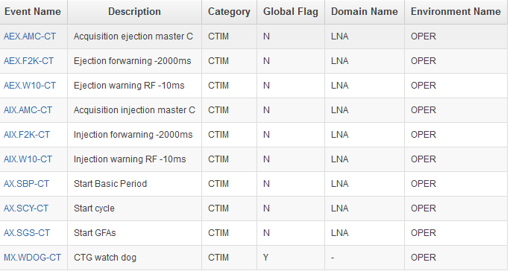
ELENA timing events
Choices to be made (LTIM load-events)

Slide 3
BI ELENA software
BTVs (Ana)
  2D Image with H/V projections and beam sizes
  Injection devices (AD or ELENA timing signals)?
  OP application (Fabio BTV or?)
Tune (Stephen)
  Tune-peaks (H/V) = f(cycle-time)
  OP application (Pierre or?)
BPM (Diogo/Ewa)
  Position (H/V) = f(cycle-time)
  OP application (YASP or Sampler or ?)
Emittance (John)
  Priority for protons (ion source) (MCP)
  Intensity signal = f(time)
  BI electronics yet to be clarified (BI-EA)
  Application (Bruno ?)
Extraction BCTs (Athanasios)
  Total extracted beam intensity (scalar)
  Application?
Low intensity profile (?John?)
  BI electronics unclear (Japan)
  More news when available

