Slide 1


REX re-commissioning
Jose Alberto Rodriguez, BE-OP-ISO

Slide 2
Content:
Status of the REX low energy
Initial Commissioning Plan for the REX Linac
Delay and Mitigation Plan
First Results of the Beam Commissioning
Summary
Jose Alberto Rodriguez – 17th HIE-ISOLDE Steering Committee – 2016/06/27

Slide 3
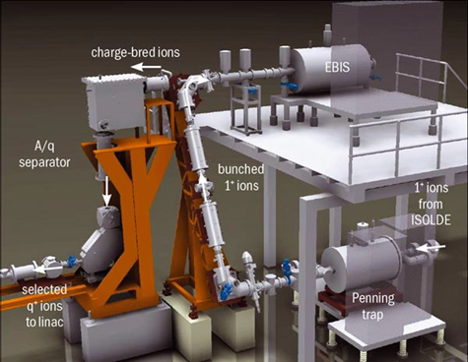
Status of the REX low energy:
All REX low energy activities managed by Fredrik Wenander (BE/ABP)
All activities during TS completed (Vacuum, Controls…)
Ion source, REX-TRAP and REX-EBIS up and running as scheduled (F. Wenander, M. Lozano)
New timing system commissioned (Controls, F. Wenander, M. Lozano, E. Fadakis)
Emittance measurements with Pepperpot meter completed (J. Pitters, F. Wenander)
Slow extraction development completed (N. Bidault, F. Wenander, J.A. Rodriguez)
REX low energy ready for beam commissioning of REX linac since before week 22
Jose Alberto Rodriguez – 17th HIE-ISOLDE Steering Committee – 2016/06/27

Slide 4
Content:
Status of the REX low energy
Initial Commissioning Plan for the REX Linac
Delay and Mitigation Plan
First Results of the Beam Commissioning
Summary
Jose Alberto Rodriguez – 17th HIE-ISOLDE Steering Committee – 2016/06/27

Slide 5
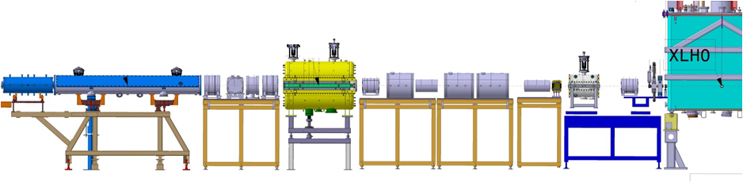
Initial Commissioning Plan for the REX Linac:
Week | Main activities
23 | ** REX LINAC HARDWARE COMMISSIONING COMPLETED (A/q = 3.5, 0.5 ms, 50 Hz)** RFQ beam transmission measurements and calibration Beam commissioning of the first HIE-ISOLDE diagnostics box Beam commissioning of the suite of applications for the beam diagnostics of HIE-ISOLDE
RFQ
Diagnostics
Diagnostics
Jose Alberto Rodriguez – 17th HIE-ISOLDE Steering Committee – 2016/06/27

Slide 6
Initial Commissioning Plan for the REX Linac:
Week | Main activities
23 | ** REX LINAC HARDWARE COMMISSIONING COMPLETED (A/q = 3.5, 0.5 ms, 50 Hz)** RFQ beam transmission measurements and calibration Beam commissioning of the first HIE-ISOLDE diagnostics box Beam commissioning of the suite of applications for the beam diagnostics of HIE-ISOLDE
24 | Phasing of the buncher, the IH, the three 7gap and the 9gap accelerating structures RF systems up to A/q = 4.0, 0.5 ms, 30 Hz. Cavities conditioning over the weekend
25 | Phasing of the buncher, the IH, the three 7gap and the 9gap accelerating structures Beam transmission optimization RF systems up to A/q = 4.5, 0.5 ms, 10 Hz. Cavities conditioning over the weekend
RFQ
IHS
7gap 1
7gap 2
7gap 3
9gap
Buncher
Diagnostics
Jose Alberto Rodriguez – 17th HIE-ISOLDE Steering Committee – 2016/06/27

Slide 7
Initial Commissioning Plan for the REX Linac:
Week | Main activities
23 | ** REX LINAC HARDWARE COMMISSIONING COMPLETED (A/q = 3.5, 0.5 ms, 50 Hz)** RFQ beam transmission measurements and calibration Beam commissioning of the first HIE-ISOLDE diagnostics box Beam commissioning of the suite of applications for the beam diagnostics of HIE-ISOLDE
24 | Phasing of the buncher, the IH, the three 7gap and the 9gap accelerating structures RF systems up to A/q = 4.0, 0.5 ms, 30 Hz. Cavities conditioning over the weekend
25 | Phasing of the buncher, the IH, the three 7gap and the 9gap accelerating structures Beam transmission optimization RF systems up to A/q = 4.5, 0.5 ms, 10 Hz. Cavities conditioning over the weekend
26 | Machine A/q scaling tests and measurements
27 | Machine A/q scaling tests and measurements Preparation of machine tunes for beams with A/q = 4.0 and 4.5 RF systems up to A/q = 4.5, 1-2 ms, 3 Hz. Cavities conditioning over the weekend
RFQ
Triplet
Triplet
IHS
Triplet
Triplet
Doublet
7gap 2
7gap 3
Triplet
9gap
Triplet
Buncher
7gap 1
HV Steerer
Diagnostics
Diagnostics
Jose Alberto Rodriguez – 17th HIE-ISOLDE Steering Committee – 2016/06/27

Slide 8
Initial Commissioning Plan for the REX Linac:
Week | Main activities
23 | ** REX LINAC HARDWARE COMMISSIONING COMPLETED (A/q = 3.5, 0.5 ms, 50 Hz)** RFQ beam transmission measurements and calibration Beam commissioning of the first HIE-ISOLDE diagnostics box Beam commissioning of the suite of applications for the beam diagnostics of HIE-ISOLDE
24 | Phasing of the buncher, the IH, the three 7gap and the 9gap accelerating structures RF systems up to A/q = 4.0, 0.5 ms, 30 Hz. Cavities conditioning over the weekend
25 | Phasing of the buncher, the IH, the three 7gap and the 9gap accelerating structures Beam transmission optimization RF systems up to A/q = 4.5, 0.5 ms, 10 Hz. Cavities conditioning over the weekend
26 | Machine A/q scaling tests and measurements
27 | Machine A/q scaling tests and measurements Preparation of machine tunes for beams with A/q = 4.0 and 4.5 RF systems up to A/q = 4.5, 1-2 ms, 3 Hz. Cavities conditioning over the weekend
28 | Measurements of the transverse emittance and the Courant-Snider parameters of the beam Optics model benchmarking ** REX READY TO START THE BEAM COMMISSIONING OF HIE-ISOLDE **
RFQ
Triplet
Triplet
IHS
Triplet
Triplet
Doublet
7gap 2
7gap 3
Triplet
9gap
Triplet
Buncher
7gap 1
HV Steerer
Diagnostics
Diagnostics
Jose Alberto Rodriguez – 17th HIE-ISOLDE Steering Committee – 2016/06/27

Slide 9
Content:
Status of the REX low energy
Initial Commissioning Plan for the REX Linac
Delay and Mitigation Plan
First Results of the Beam Commissioning
Summary
Jose Alberto Rodriguez – 17th HIE-ISOLDE Steering Committee – 2016/06/27

Slide 10

Delay and Mitigation Plan:
REX linac hardware commissioning was not completed on time:
All systems other than the 9gap amplifier ready as scheduled (101 MHz RF systems, vacuum, power converters, magnets, diagnostics, controls…)
Start-up of 9gap RF delayed (originally planned for Monday wk. 23, ready on Tuesday wk. 25)
  Causes: availability of equipment experts & interventions in other machines
  Impact: probably none (on the shadow of the cryomodule cooling delay)
Jose Alberto Rodriguez – 17th HIE-ISOLDE Steering Committee – 2016/06/27

Slide 11
Delay and Mitigation Plan:
REX Initial Beam commissioning Plan:
Week | Main activities
23 | ** REX LINAC HARDWARE COMMISSIONING COMPLETED (A/q = 3.5, 0.5 ms, 50 Hz)** RFQ beam transmission measurements and calibration Beam commissioning of the first HIE-ISOLDE diagnostics box Beam commissioning of the suite of applications for the beam diagnostics of HIE-ISOLDE
24 | Phasing of the buncher, the IH, the three 7gap and the 9gap accelerating structures RF systems up to A/q = 4.0, 0.5 ms, 30 Hz. Cavities conditioning over the weekend
25 | Phasing of the buncher, the IH, the three 7gap and the 9gap accelerating structures Beam transmission optimization RF systems up to A/q = 4.5, 0.5 ms, 10 Hz. Cavities conditioning over the weekend
26 | Machine A/q scaling tests and measurements
27 | Machine A/q scaling tests and measurements Preparation of machine tunes for beams with A/q = 4.0 and 4.5 RF systems up to A/q = 4.5, 1-2 ms, 3 Hz. Cavities conditioning over the weekend
28 | Measurements of the transverse emittance and the Courant-Snider parameters of the beam Optics model benchmarking ** REX READY TO START THE BEAM COMMISSIONING OF HIE-ISOLDE **
Jose Alberto Rodriguez – 17th HIE-ISOLDE Steering Committee – 2016/06/27

Slide 12
Delay and Mitigation Plan:
REX Initial Beam commissioning Plan:
(if beam commissioning of REX needs to completed by week 28) :
Week | Main activities
23 | RFQ beam transmission measurements and calibration
24 | Beam commissioning of the first HIE-ISOLDE diagnostics box Beam commissioning of the suite of applications for the beam diagnostics of HIE-ISOLDE RF systems up to A/q = 4.0, 0.5 ms, 30 Hz. Cavities conditioning over the weekend
25 | ** REX LINAC HARDWARE COMMISSIONING COMPLETED (A/q = 3.5, 0.5 ms, 50 Hz)** Beam commissioning of the suite of applications for the beam diagnostics of HIE-ISOLDE Phasing of the buncher
26 | Phasing of the IH, the three 7gap and the 9gap accelerating structures Beam transmission optimization RF systems up to A/q = 4.5, 0.5 ms, 10 Hz. Cavities conditioning over the weekend
27 | Beam transmission optimization Machine A/q scaling tests and measurements RF systems up to A/q = 4.5, 1-2 ms, 3 Hz. Cavities conditioning over the weekend
28 | Machine A/q scaling tests and measurements Preparation of machine tunes for beams with A/q = 4.0 and 4.5 ** REX READY TO START THE BEAM COMMISSIONING OF HIE-ISOLDE ** Measurements of the transverse emittance and the Courant-Snider parameters of the beam Optics model benchmarking
Activities may need to be dropped
Jose Alberto Rodriguez – 17th HIE-ISOLDE Steering Committee – 2016/06/27

Slide 13
Content:
Status of the REX low energy
Initial Commissioning Plan for the REX Linac
Delay and Mitigation Plan
First Results of the Beam Commissioning
Summary
Jose Alberto Rodriguez – 17th HIE-ISOLDE Steering Committee – 2016/06/27

Slide 14
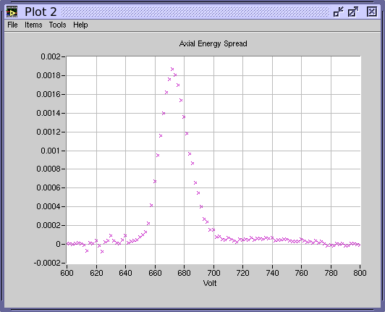
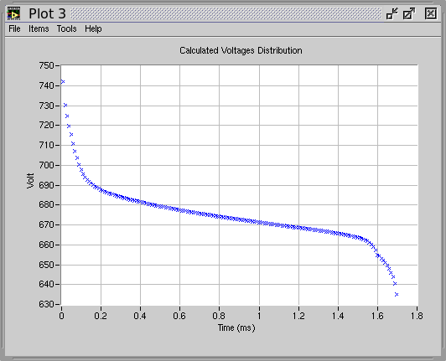
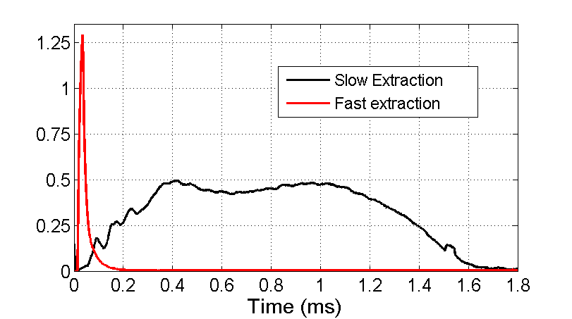
First Results of the Beam Commissioning:
Slow extraction development (worked completed by N. Bidault):
Signal of the beam in an MCP used to characterize the extraction
Slow extraction set-up procedure developed
  Measurement of the beam axial distribution
  Initial voltage modulation calculated and applied
  Final adjustment possible
Axial beam energy distribution
Voltage modulation
Voltage of EM trap modulated for slow extraction
MCP used for measurements
Slow extraction measured in MCP
I (a.u)
Jose Alberto Rodriguez – 17th HIE-ISOLDE Steering Committee – 2016/06/27

Slide 15
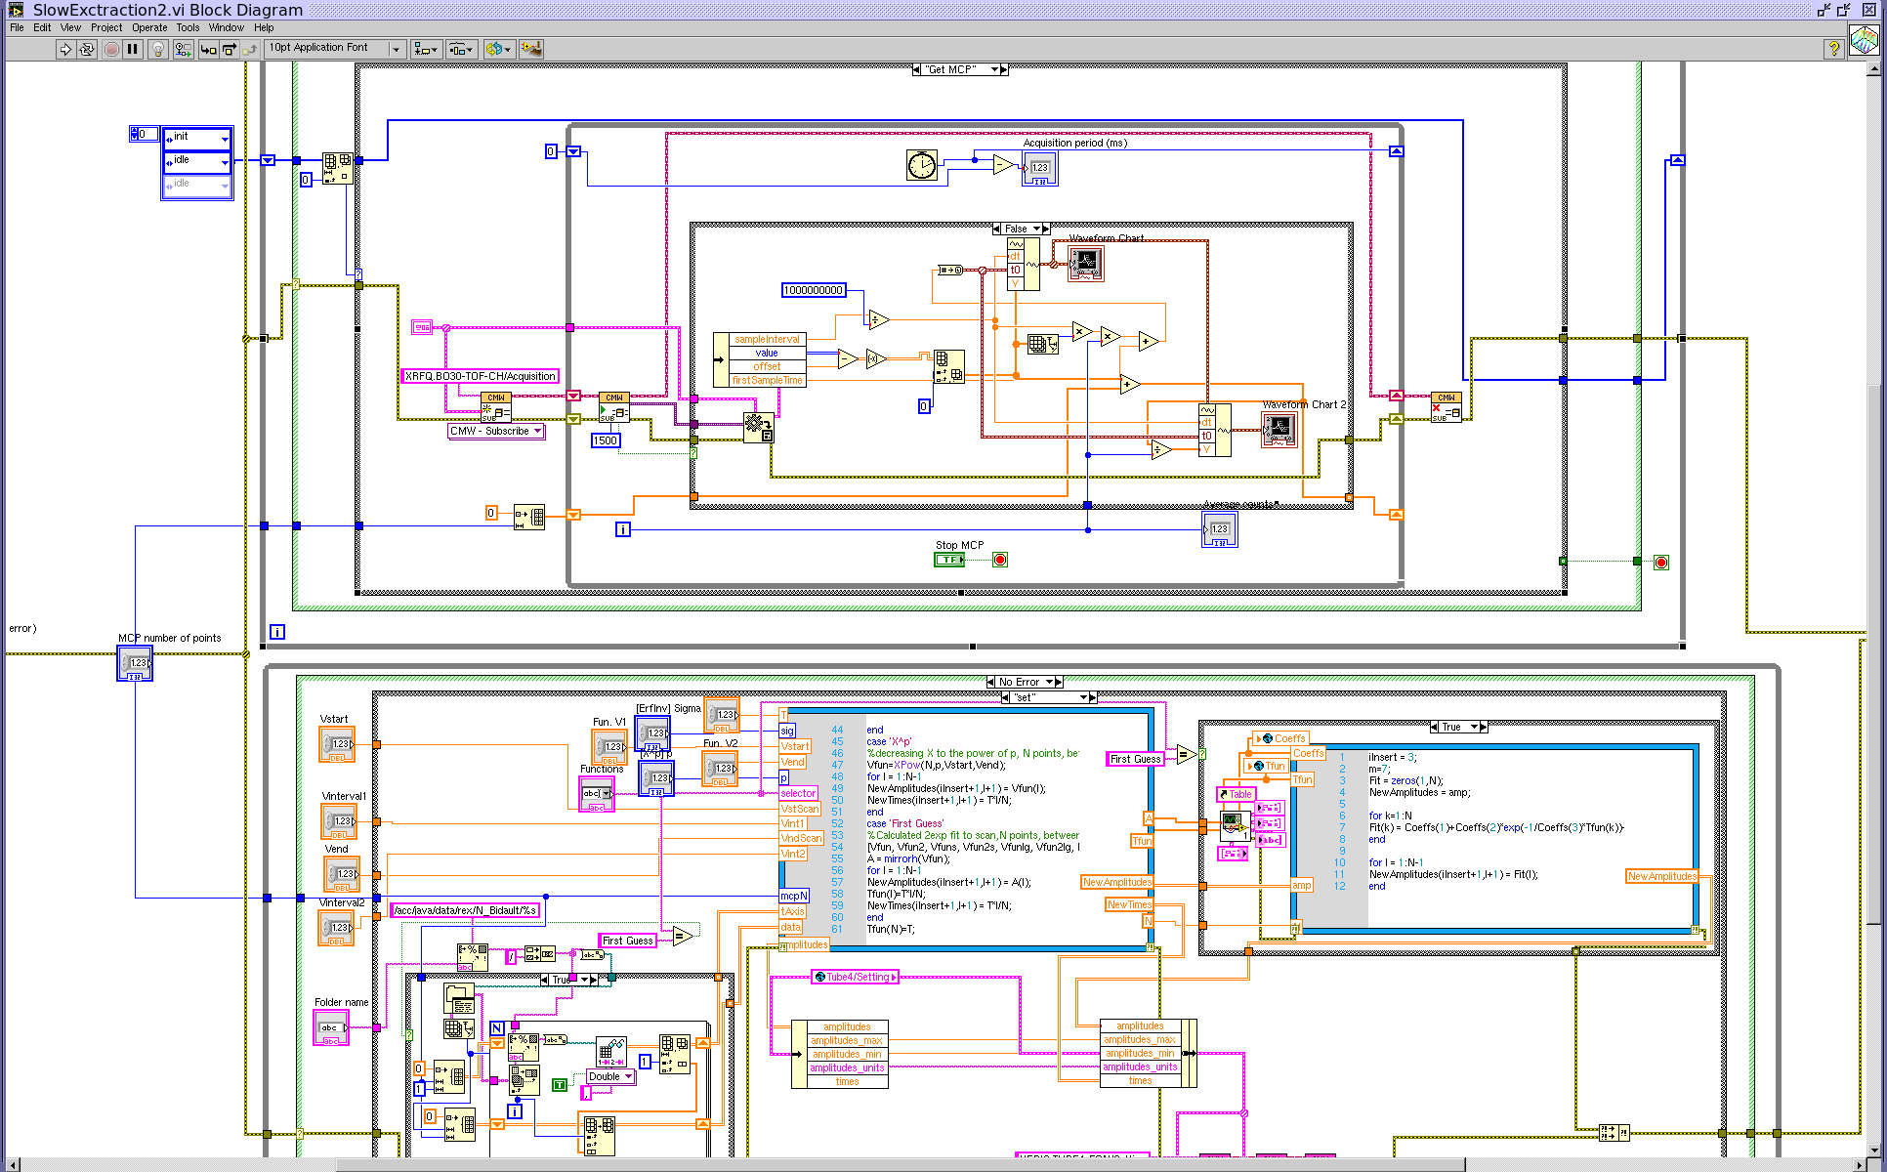
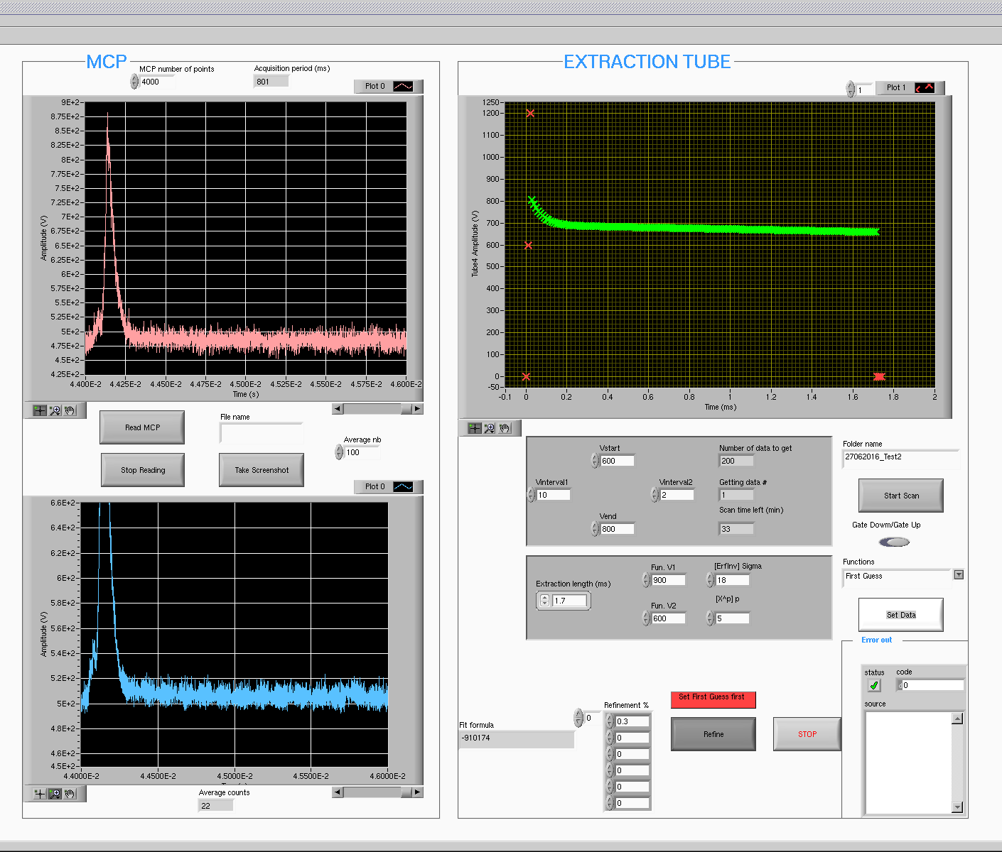
First Results of the Beam Commissioning:
Slow extraction development (worked completed by N. Bidault):
Development of a prototype LabVIEW application for operations this year is almost completed
Systematic measurements will be done afterwards (different A, A/q, breeding times…)
Prototype LabVIEW application being developed
Jose Alberto Rodriguez – 17th HIE-ISOLDE Steering Committee – 2016/06/27

Slide 16
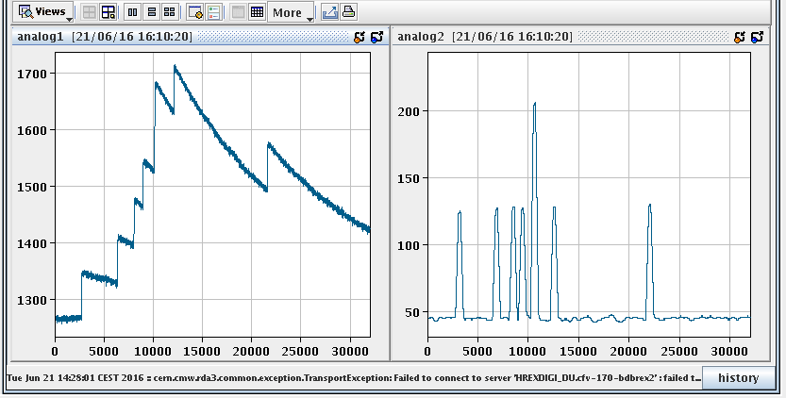
First Results of the Beam Commissioning:
Slow extraction development (worked completed by N. Bidault):
Independent validation of slow extraction using Si detector in HIE-ISOLDE diagnostics box (digital vs. analog)
  Proof of concept completed (pulse stretched to ~400 us)
  Software still needs to be developed
Voltage of EM trap modulated for slow extraction
Slow extraction validation using Si detector
Jose Alberto Rodriguez – 17th HIE-ISOLDE Steering Committee – 2016/06/27

Slide 17
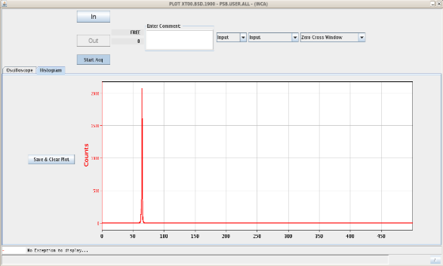
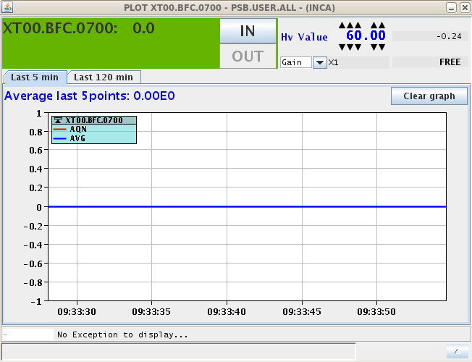
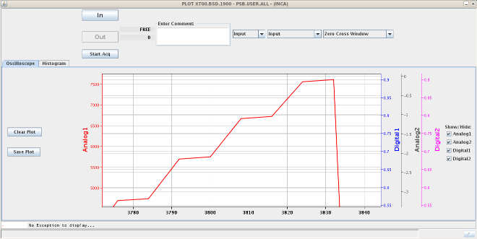
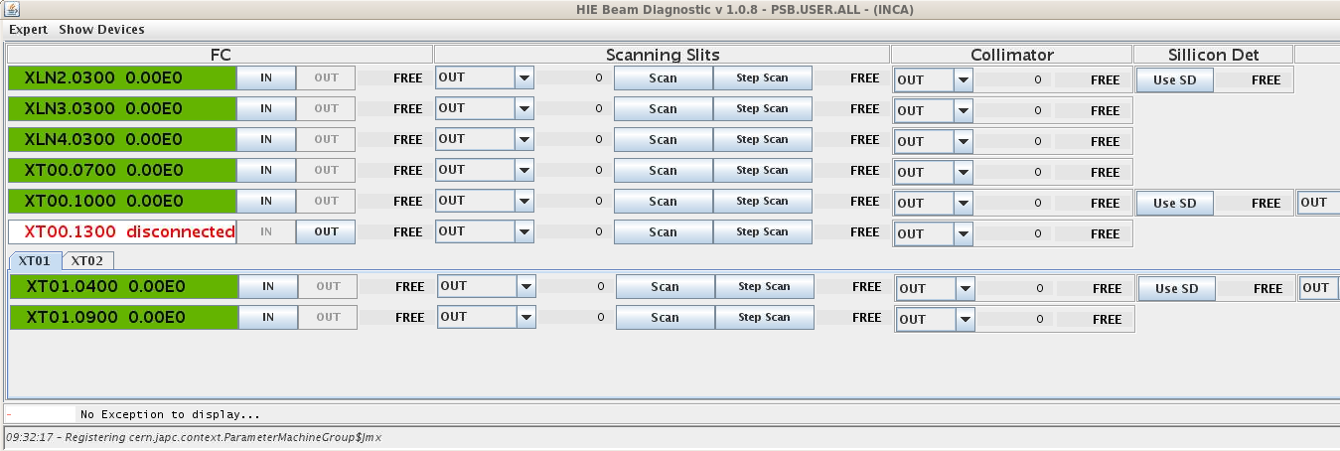
First Results of the Beam Commissioning:
Suite of applications for the HIE-ISOLDE beam diagnostics (E. Fadakis):
FC and new Si detector hardware re-commissioned (BI, S. Sadovich, OP)
  Occasional issue touching the limit switch when retracted
FESA classes tested. A few modifications/issues being implemented/solved:
  Calibration of the FC (pC / pulse)
  Enabling partial setting of properties
  Voltage of the e- suppressor
High-level application tested and mostly functional. Still missing:
  Enable/disable stepper motors
  Adding more configuration properties for Si detector
  Scanning slits application
Suite of HIE-ISOLDE beam diagnostics applications (E. Fadakis)
Jose Alberto Rodriguez – 17th HIE-ISOLDE Steering Committee – 2016/06/27

Slide 18
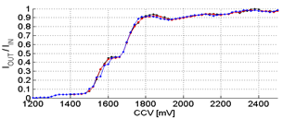
First Results of the Beam Commissioning:
RFQ new operational point found for A/q = 3.5:
A/q limited to 3.6 during the 2015 Physics Campaign because of the temporary 9gap amplifier
Less constrains to define the RFQ operational point
A/q up to 4.5 during the 2016 Physics Campaign
We need to find a new operational point compatible with scaling to A/q = 4.5
Some additional work left: need to check beam transmission for beam with A/q = 4.5
2015 operational point
2016 operational point
Beam transmission through the RFQ for different RF power levels (2015)
Jose Alberto Rodriguez – 17th HIE-ISOLDE Steering Committee – 2016/06/27

Slide 19
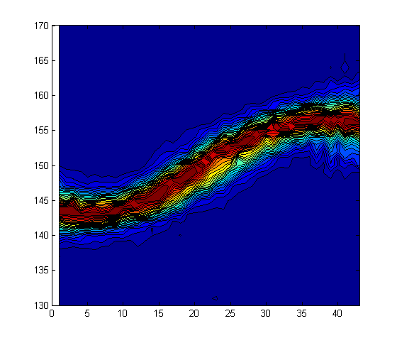
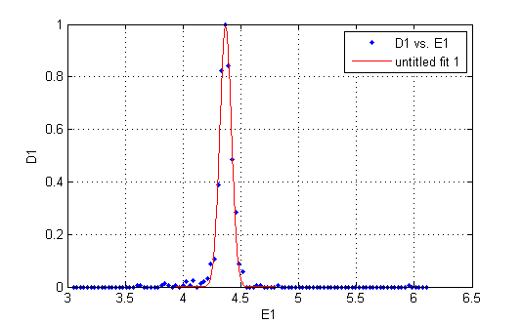
First Results of the Beam Commissioning:
Phasing of the buncher:
Operational phase has been determined
It has changed respect to 2015. Needs to be investigated to find the source of this change
Energy spectrum of the beam for different phases
Jose Alberto Rodriguez – 17th HIE-ISOLDE Steering Committee – 2016/06/27

Slide 20
Content:
Status of the REX low energy
Initial Commissioning Plan for the REX Linac
Delay and Mitigation Plan
First Results of the Beam Commissioning
Summary
Jose Alberto Rodriguez – 17th HIE-ISOLDE Steering Committee – 2016/06/27

Slide 21
Summary:
Status of the REX low energy (managed by F. Wenander):
All systems ready for beam commissioning of the REX linac since before week 22
REX linac (hardware commissioning):
All systems other than the 9gap amplifier ready as scheduled (101 MHz RF systems, vacuum, power converters, magnets, diagnostics, controls…)
Start-up of 9gap RF delayed by 2.4 weeks
  Causes: availability of equipment experts & interventions in other machines
  Impact: probably none (on the shadow of the cryomodule cooling delay)
REX linac (beam commissioning):
Slow extraction development completed
Software application close to be completed
Hardware in first HIE-ISOLDE diagnostics box is working well
Most of the FESA classes and high-level control applications completed
(a bit more work needed (particularly on the scanning slits))
New operational point for the RFQ found
Buncher has been phased
Phasing of the rest of the RF systems will continue this week
Jose Alberto Rodriguez – 17th HIE-ISOLDE Steering Committee – 2016/06/27

Slide 22
Back-up slides:
Jose Alberto Rodriguez – 17th HIE-ISOLDE Steering Committee – 2016/06/27

Slide 23
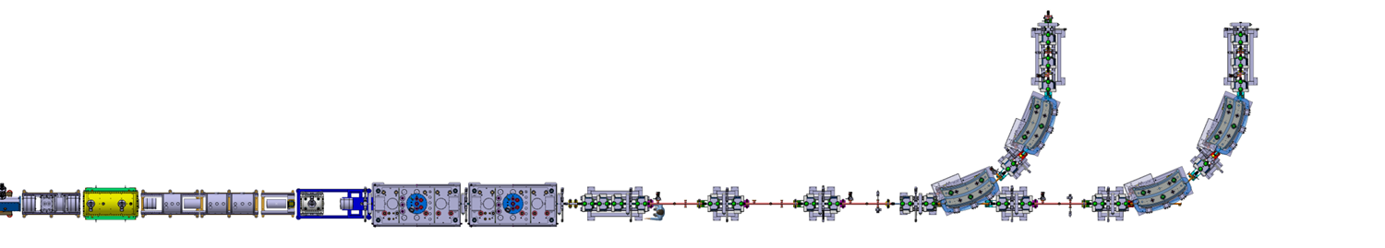
Beam Commissioning Plan for HIE-ISOLDE:
Week | Main activities
29 | Beam commissioning of optical elements and diagnostic boxes of the linac and HEBTs
Beam with REX energy (~20 epA of ¹⁴N⁴⁺ at 2.85 MeV/u) to the end of XT01
  Confirm that there are no major problems with the SC solenoids, quads and dipoles
  Test the FCs in the linac and XT01
  Test the collimator apertures and the scanning slits
  Check the polarities of the steerers using the scanning slits
  Check the polarities and focusing strengths of the quads using the scanning slits
  Check the field regulation of the dipoles
Degauss of the first dipole of the XT01 line
Beam to the end of XT02
  Similar tests as for XT01
  Testing the stripping foils. Measurement of the Charge State Distribution (CSD)
Diagnostics
Diagnostics
SC Solenoid
SC Solenoid
End Tunnel
Diagnostics
Diagnostics
Diagnostics
Diagnostics
Diagnostics
Diagnostics
Diagnostics
Diagnostics
Diagnostics
Diagnostics
Diagnostics
Quads
Steerers
CM1
CM2
Jose Alberto Rodriguez – 17th HIE-ISOLDE Steering Committee – 2016/06/27

Slide 24
Beam Commissioning Plan for HIE-ISOLDE:
Week | Main activities
29 | Beam commissioning of optical elements and diagnostic boxes of the linac and HEBTs
30 | Beam commissioning of the silicon detectors Beam commissioning of TOF energy measurement system
31 | Beam commissioning of TOF energy measurement system
Silicon detector
Silicon detector
Energy and TOF
Silicon detector
Energy and TOF
End Tunnel
CM1
CM2
Jose Alberto Rodriguez – 17th HIE-ISOLDE Steering Committee – 2016/06/27

Slide 25
Beam Commissioning Plan for HIE-ISOLDE:
Week | Main activities
29 | Beam commissioning of optical elements and diagnostic boxes of the linac and HEBTs
30 | Beam commissioning of the silicon detectors Beam commissioning of TOF energy measurement system
31 | Beam commissioning of TOF energy measurement system Phasing and energy gain measurements for each SRF cavities
32 | Phasing and energy gain measurements for each SRF cavities
Silicon detector
Energy and TOF
Collimator apertures
Silicon detector
Collimator slits
Silicon detector
Energy and TOF
SRF Cavities
SRF Cavities
SRF Cavities
Collimator slits
SRF Cavities
End Tunnel
CM1
CM2
Jose Alberto Rodriguez – 17th HIE-ISOLDE Steering Committee – 2016/06/27

Slide 26
Beam Commissioning Plan for HIE-ISOLDE:
Week | Main activities
29 | Beam commissioning of optical elements and diagnostic boxes of the linac and HEBTs
30 | Beam commissioning of the silicon detectors Beam commissioning of TOF energy measurement system
31 | Beam commissioning of TOF energy measurement system Phasing and energy gain measurements for each SRF cavities
32 | Phasing and energy gain measurements for each SRF cavities
33 | Machine scaling tests and measurements
Beam transmission optimization
HEBTs energy scaling tests and measurements (constant A/q)
Linac and HEBTs A/q scaling tests and measurements (constant E/u)
Diagnostics
SRF Cavities
SRF Cavities
Diagnostics
Diagnostics
SRF Cavities
SC Solenoid
SRF Cavities
End Tunnel
Diagnostics
SC Solenoid
Diagnostics
Diagnostics
Diagnostics
Diagnostics
Diagnostics
Diagnostics
Diagnostics
Diagnostics
CM1
CM2
Jose Alberto Rodriguez – 17th HIE-ISOLDE Steering Committee – 2016/06/27

Slide 27
Beam Commissioning Plan for HIE-ISOLDE:
Week | Main activities
29 | Beam commissioning of optical elements and diagnostic boxes of the linac and HEBTs
30 | Beam commissioning of the silicon detectors Beam commissioning of TOF energy measurement system
31 | Beam commissioning of TOF energy measurement system Phasing and energy gain measurements for each SRF cavities
32 | Phasing and energy gain measurements for each SRF cavities
33 | Machine scaling tests and measurements
34 | Optics model benchmarking ** REX/HIE-ISOLDE READY TO START THE PHYSICS CAMPAIGN **
Only some possible in a week:
Beam profiles in all diagnostic boxes for different settings in SC solenoids, quads and steerers
Measurements of the transverse emittance and the Courant-Snider parameters of the beam
Longitudinal emittance measurements
Bunch length measurements
Measurements of the Transit Time Factor (TTF) of the QWR
  Measure focusing strength and x-y plane coupling for the SC solenoid
Characterize the transverse quick of the QWRs
SRF Cavities
SRF Cavities
Diagnostics
Diagnostics
SRF Cavities
SC Solenoid
SRF Cavities
End Tunnel
Diagnostics
SC Solenoid
Diagnostics
Diagnostics
Diagnostics
Diagnostics
Diagnostics
Diagnostics
Diagnostics
Diagnostics
CM1
CM2
Jose Alberto Rodriguez – 17th HIE-ISOLDE Steering Committee – 2016/06/27

Slide 28
Beam Commissioning Plan for HIE-ISOLDE:
Week | Main activities
29 | Beam commissioning of optical elements and diagnostic boxes of the linac and HEBTs
30 | Beam commissioning of the silicon detectors Beam commissioning of TOF energy measurement system
31 | Beam commissioning of TOF energy measurement system Phasing and energy gain measurements for each SRF cavities
32 | Phasing and energy gain measurements for each SRF cavities
33 | Machine scaling tests and measurements Probably stable beam to users if requested (some evenings, nights and weekend)
34 | Optics model benchmarking ** REX/HIE-ISOLDE READY TO START THE PHYSICS CAMPAIGN ** Stable beam to users if requested (some evenings, nights and weekend)
35 | Set-up for first physics experiment Stable beam to users if requested (some evenings and nights) ** START OF THE FIRST PHYSICS EXPERIMENT **
Diagnostics
Diagnostics
SRF Cavities
SRF Cavities
Diagnostics
Diagnostics
SRF Cavities
SC Solenoid
SRF Cavities
End Tunnel
Diagnostics
SC Solenoid
Diagnostics
Diagnostics
Diagnostics
Diagnostics
Diagnostics
Diagnostics
Diagnostics
Diagnostics
CM1
CM2
Jose Alberto Rodriguez – 17th HIE-ISOLDE Steering Committee – 2016/06/27

Slide 29
Delays and Mitigation Plan:
HIE-ISOLDE Beam Commissioning Initial Plan:
Week | Main activities
29 | Beam commissioning of optical elements and diagnostic boxes of the linac and HEBTs
30 | Beam commissioning of the silicon detectors Beam commissioning of TOF energy measurement system
31 | Beam commissioning of TOF energy measurement system Phasing and energy gain measurements for each SRF cavities
32 | Phasing and energy gain measurements for each SRF cavities
33 | Machine scaling tests and measurements Probably stable beam to users if requested (some evenings, nights and weekend)
34 | Optics model benchmarking ** REX/HIE-ISOLDE READY TO START THE PHYSICS CAMPAIGN ** Stable beam to users if requested (some evenings, nights and weekend)
35 | Set-up for first physics experiment Stable beam to users if requested (some evenings and nights) ** START OF THE FIRST PHYSICS EXPERIMENT **
Delays in the start of the beam commissioning of HIE-ISOLDE:
Cooling down of cryomodules slower than originally planned
Jose Alberto Rodriguez – 17th HIE-ISOLDE Steering Committee – 2016/06/27

Slide 30
Delays and Mitigation Plan:
HIE-ISOLDE Beam Commissioning Initial Plan:
Week | Main activities
29 | Hardware commissioning
30 | 0.5 weeks for Hardware commissioning Beam commissioning of optical elements and diagnostic boxes of the linac and HEBTs (0.5 weeks if number of tasks are limited to essential for start of Physics campaign)
31 | Beam commissioning of the silicon detectors Beam commissioning of TOF energy measurement system
32 | Beam commissioning of TOF energy measurement system Phasing and energy gain measurements for each SRF cavities
33 | Probably stable beam to users if requested (some evenings, nights and weekend) Phasing and energy gain measurements for each SRF cavities (limited to the cavities needed for first Physics experiment)
34 | Optics model benchmarking Machine scaling tests and measurements ** REX/HIE-ISOLDE READY TO START THE PHYSICS CAMPAIGN ** Stable beam to users if requested (some evenings, nights and weekend)
35 | Set-up for first physics experiment Stable beam to users if requested (some evenings and nights) ** START OF THE FIRST PHYSICS EXPERIMENT **
Jose Alberto Rodriguez – 17th HIE-ISOLDE Steering Committee – 2016/06/27

