Slide 1
HIE-ISOLDE Project:
Phase 3
Y. KADI
for the HIE-ISOLDE Project Team
ISOLDE Collaboration Committee Meeting
CERN, 28 June 2016

Slide 2

Staged Installation of Linac
REX accelerator (existing): W = 3 MeV/u
HIE Phase 1 (2015/2016): W = 5.5 MeV/u
HIE Phase 2 (2017/2018): W = 10 MeV/u
HIE Phase 3 (??): 10 MeV/u
6x cryomodules
32x QWRs
8x solenoids
Hβ-0
Hβ 1
Hβ-0
Hβ-1
Hβ-2
Hβ-3
Lβ-1
Lβ-2
Hβ-1
Hβ-2
Hβ-3
Hβ-4
10 MHz PRE-
BUNCHER
CHOPPER
LINE
Undergoing design study for 10 MHz beam frequency
for time-of-flight particle ID requested by experiments.
Cryoline “jumper” positions
KEY:
β_{g} = 6.3%
β_{g} = 10.3%
RFQ
IHS
7G1,2,3
9GP
LOW-β CRYO.
HIGH-β CRYO.

Slide 3
Cost of the Machine
Phase 3
R&D | Design | SC linac | HEBT | I & C
0 | 0 | 265 | 0 | 30
0 | 0 | 100 | 0 | 20
0 | 0 | 80 | 0 | 20
50 | 50 | 30 | 0 | 0
0 | 0 | 1'373 | 0 | 0
0 | 0 | 415 | 0 | 0
0 | 105 | 0 | 0 | 75
0 | 0 | 1'525 | 0 | 0
0 | 0 | 255 | 0 | 0
0 | 0 | 0 | 0 | 0
0 | 0 | 59 | 119 | 0
0 | 0 | 10 | 525 | 0
0 | 0 | 0 | 0 | 0
0 | 0 | 250 | 166 | 0
0 | 0 | 50 | 0 | 0
0 | 0 | 0 | 0 | 0
0 | 0 | 0 | 0 | 0
0 | 0 | 0 | 0 | 0
50 | 155 | 4'412 | 810 | 145
5'572

Slide 4
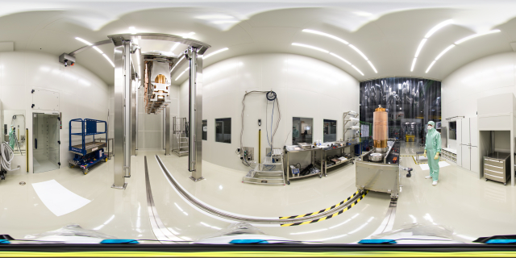
Thank you!

