Slide 1
HIE-ISOLDE Project:
Phase 2 Planning
Y. KADI
for the HIE-ISOLDE Project Team
ISOLDE Collaboration Committee Meeting
CERN, 28 June 2016

Slide 2
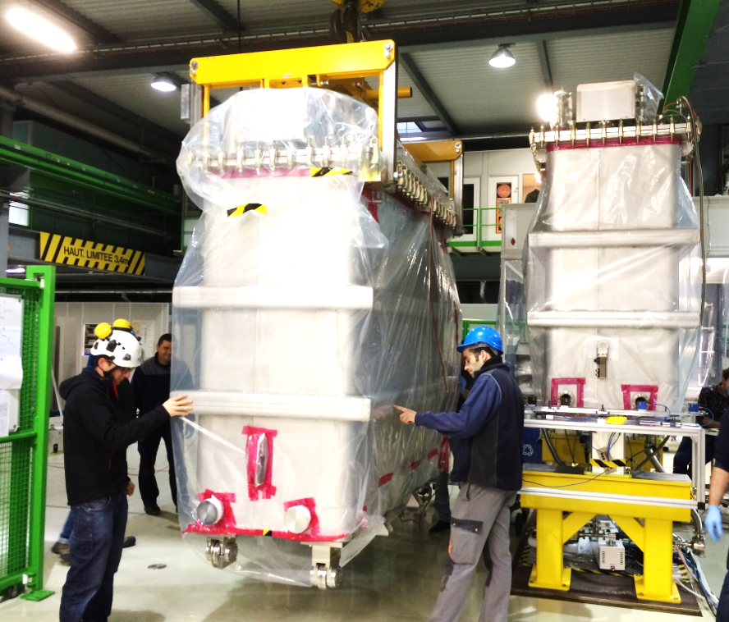
Planning overview
August – December 2015:
Design and manufacturing of coupler thermalisations
CM2 assembly pursued until cavities assembly
2016:
January: restart CM2 assembly with upgraded design
February: start refurbishment CM1 in parallel
End April:
  CM1 & CM2 installed in the Linac
  Start CM3 assembly
Co-activity CM1 refurbishment / CM2 final testing at SM18
Design complete
Refurbishment CM1
Beam run
Beam run
2013 | 2014 | 2015 | 2016 | 2017
Commissioning
Com.
Assembly CM1
Assy CM2
Assy CM3
Assy CM4
Procurement Phase1
Procurement Phase2

Slide 3
CM3 assembly
Planning:
  Baseline 24w (+2w contingency) as for CM2
  + 2 weeks final testing (initially planned in bunker)
  On schedule so far
Organisation
  Same team as for CM1-CM2
  All parts ready before assembly start
  Use of upgraded procedures
Installation solenoid
Installation cavities

Slide 4
4 out of 5 cavities available (tested) for CM3
QS15 coated in week 25
QS6 and QS16 in the pipeline, still in time for CM3

Slide 5
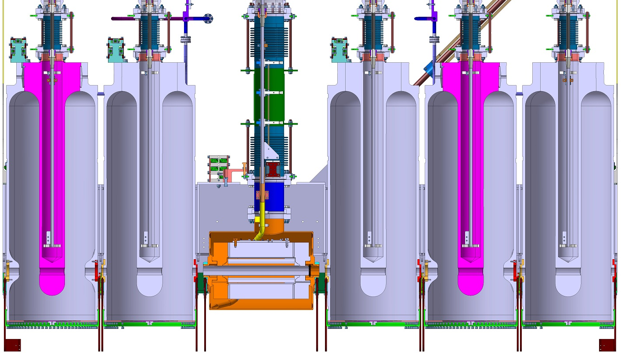
CM4 configuration

Slide 6
Forecast for HIE-ISOLDE Phase 2 (2016-2017)
Cav CM3
HELIOS ?
Cav CM4
F. Formenti

Slide 7
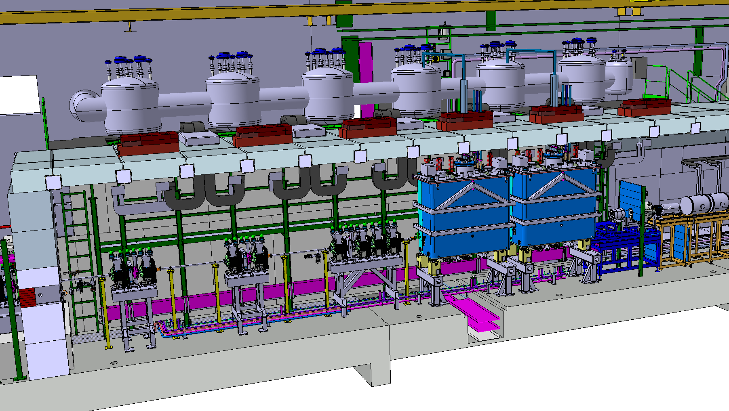
HIE-ISOLDE SC LINAC: Phase 1
S. Maridor

Slide 8
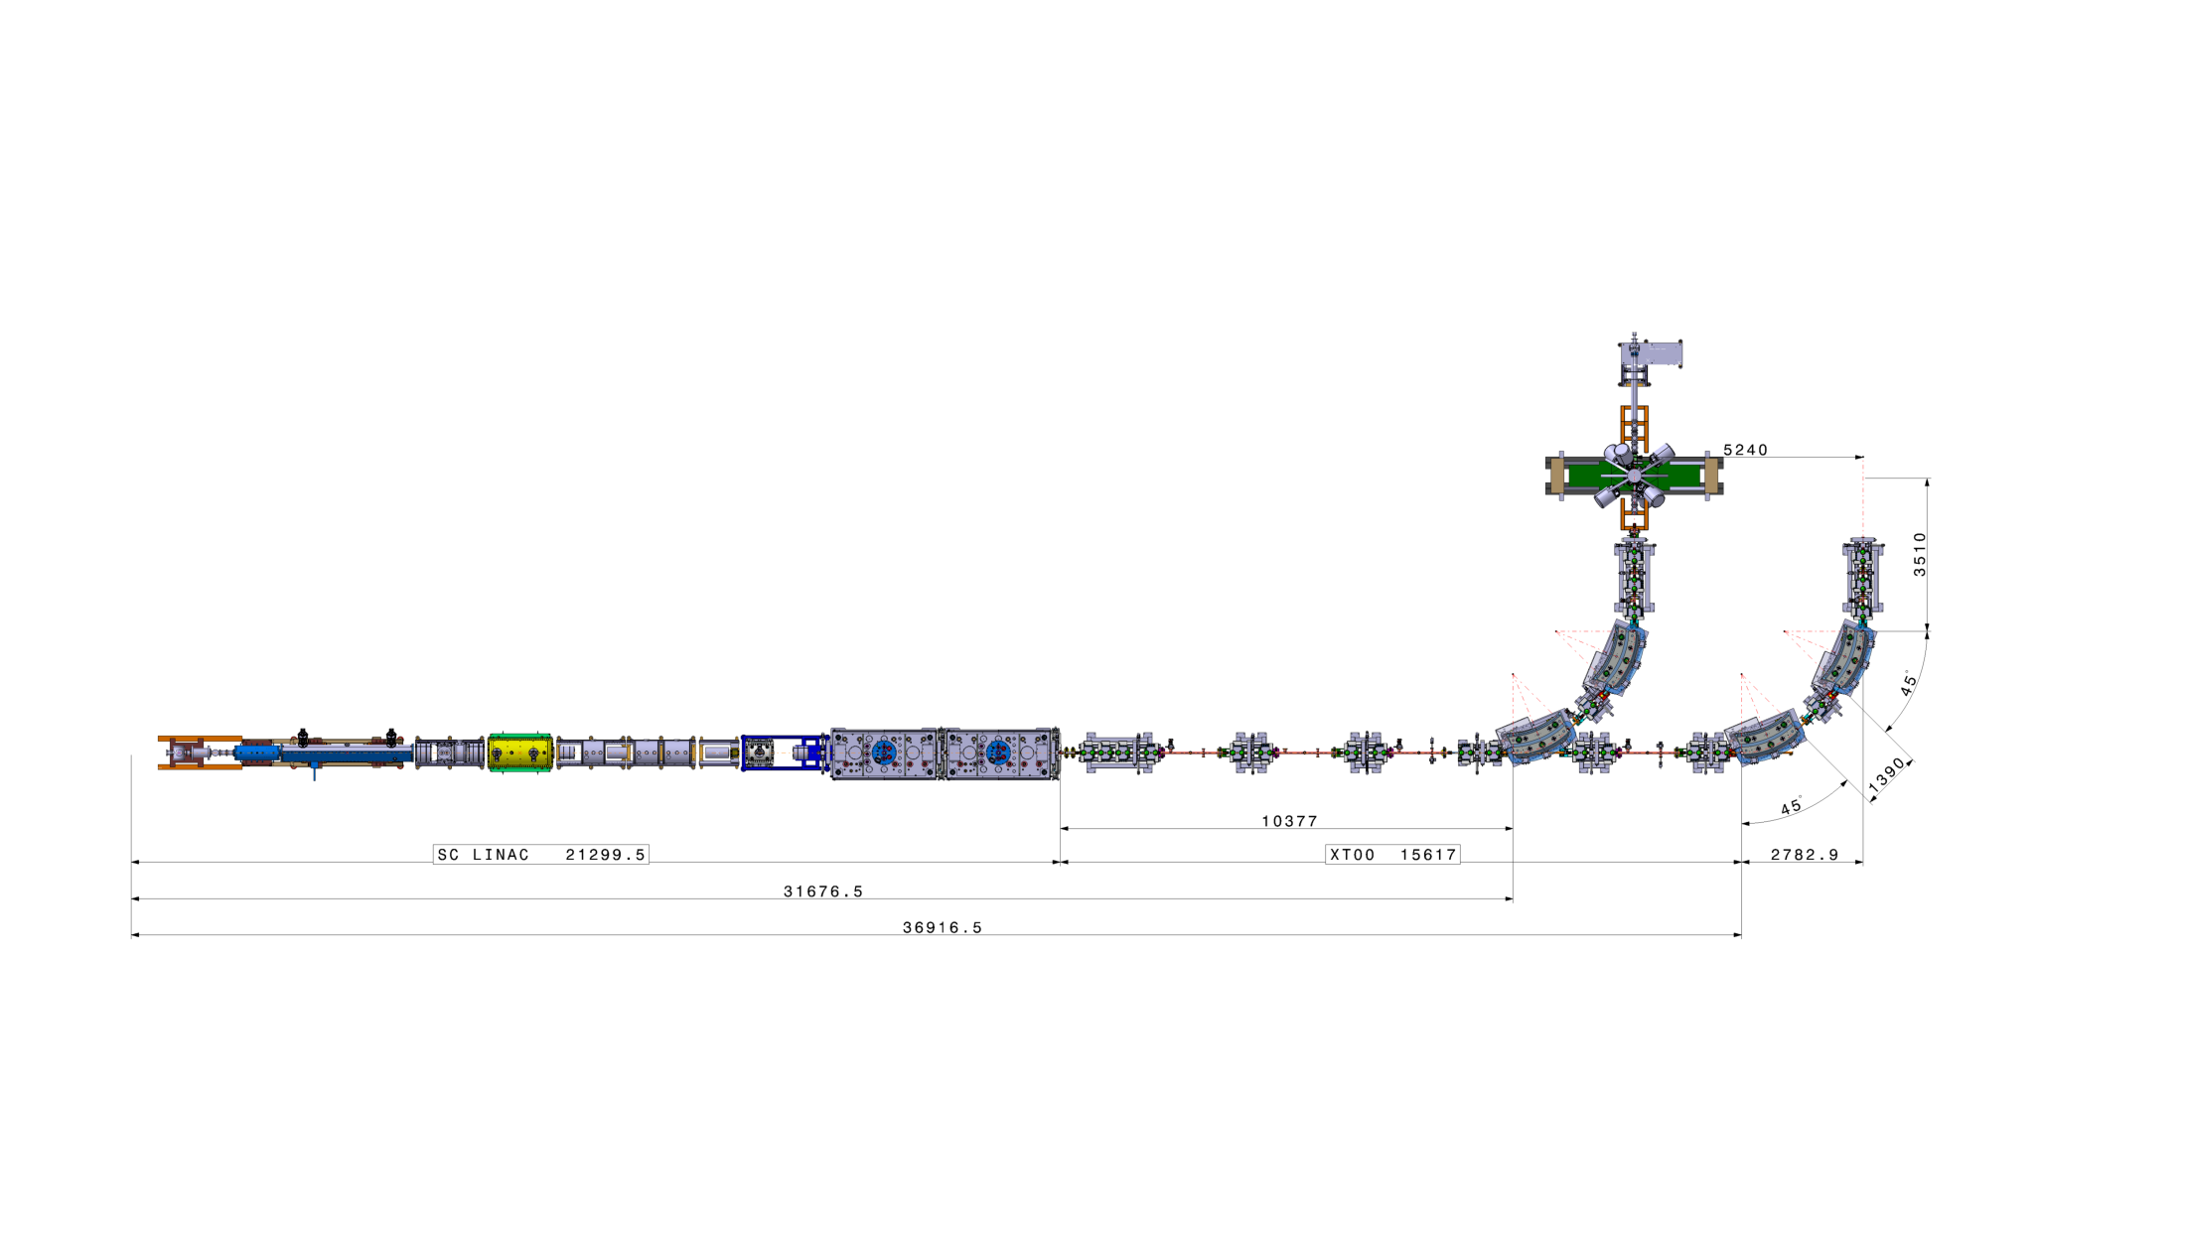
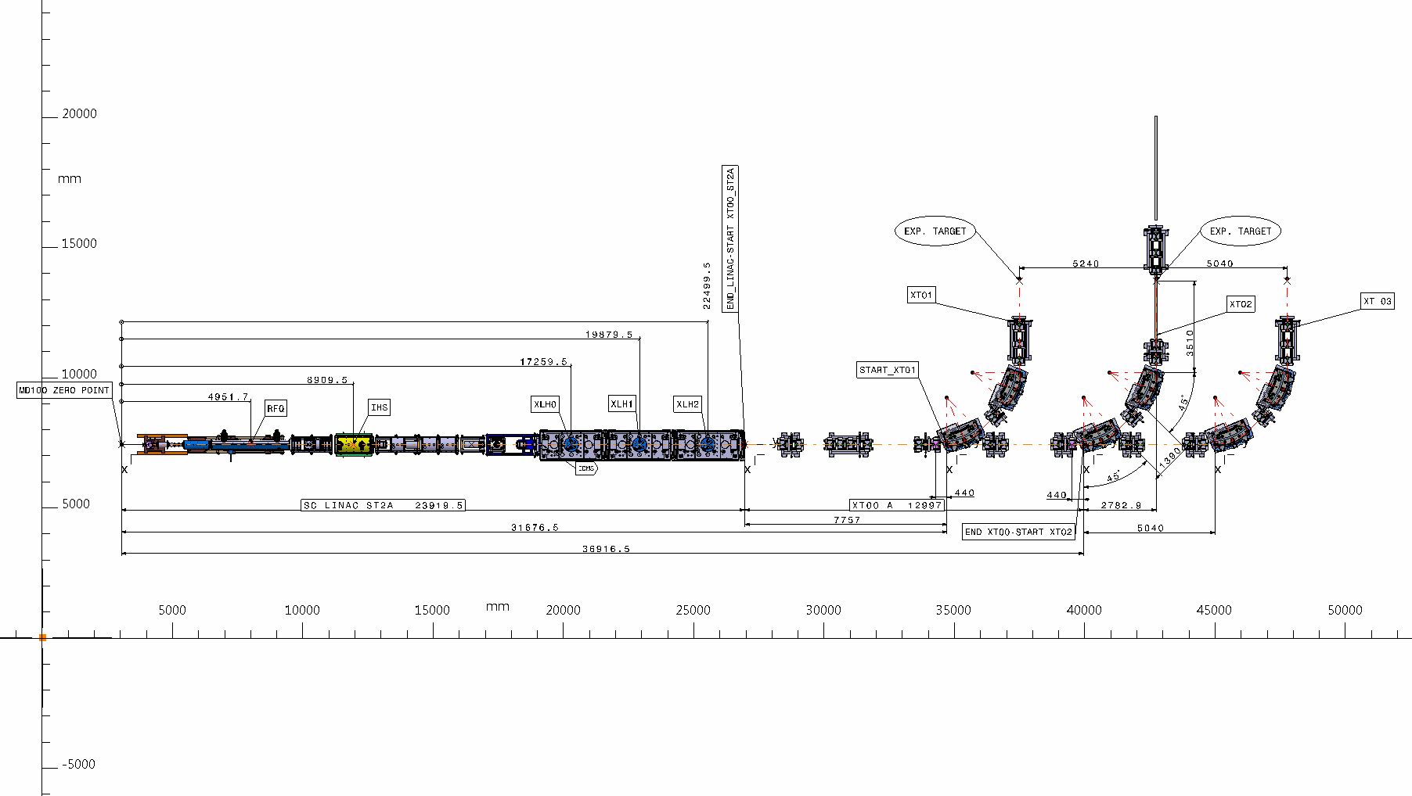
Phase 1
Phase 2A

Slide 9
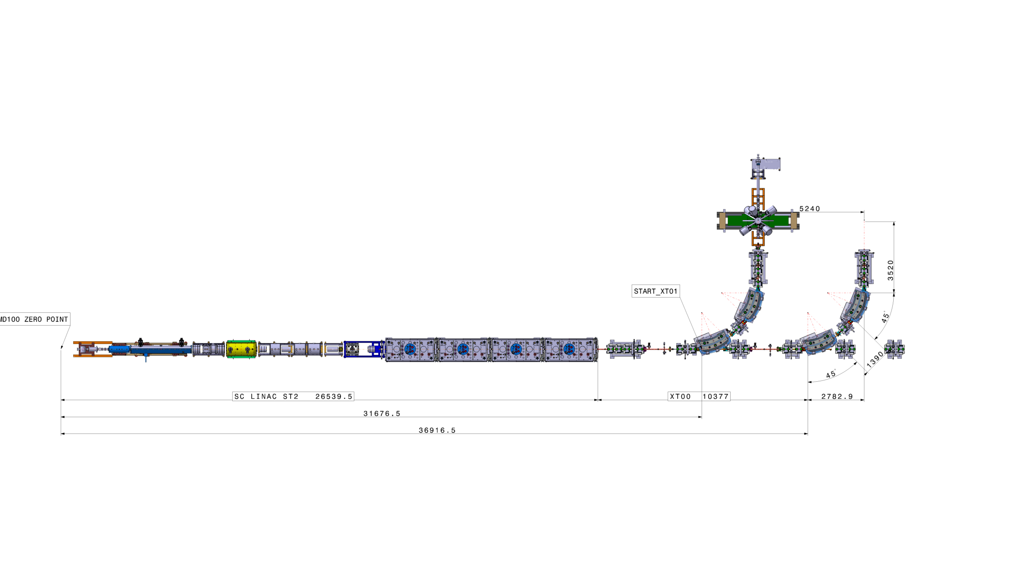
Phase 2B
Phase 2A

Slide 10
Overall Summary
Planning for Physics with 3 and then with 4 cryomodules chosen such as to maximise beam time in 2017 and 2018 respectively (> 25 wks)
Main limitation in installing CMs during YETS = restart of cryo plant on time
    Limit cryo plant shutdown works => early maintenance (incl. cooling plant)
    Keep SC Linac cold during EYETS => availabilty of cooling plant
    Cooldown with 2 CMS this year: 3 wks -> 6 wks
    Cooldown with 3 or 4 CMs: ?? => rely on experience gained this year !
Install XT03 during EYETS 2016-2017
Keep XT02 as is until ISS is installed

Slide 11
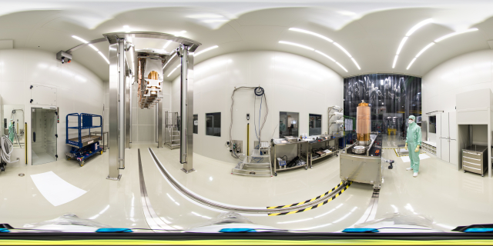
Thank you!

Slide 12
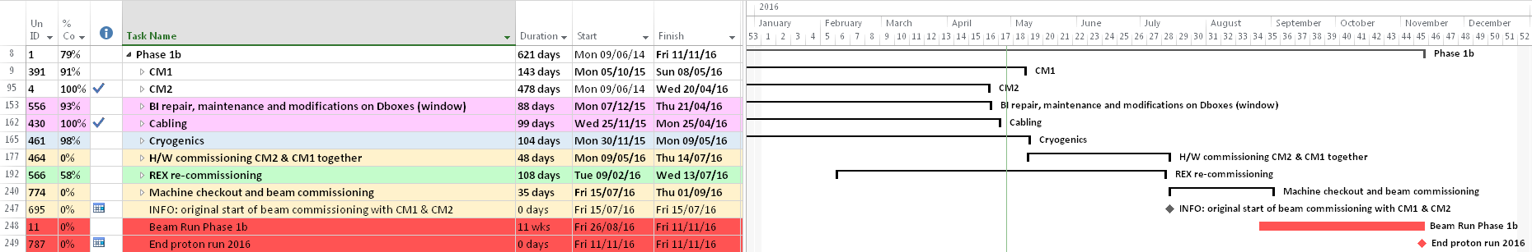
PLANNING FOR PHASE 1
MILESTONE 1: CM1+2 & CRYOGENICS
MILESTONE 2: HIE H/W COMMISS. & REX H/W + B. COMMISS.
MILESTONE 3: HIE B. COMMISS.
TODAY
BEAM START
Extended overhaul of cryo-plant, polution, fixing leaks, automatization of the process, training of cryo operators => main cause of delay
HW commissioning on stand by since 3 weeks waiting for cavities to be cold
On time achievement of last two milestones is not still possible unless we consider limiting the HW & B commissioning activities
First (stable) beam for machine and experiment setup initially planned for end wk35 => now end wk38

