Slide 1

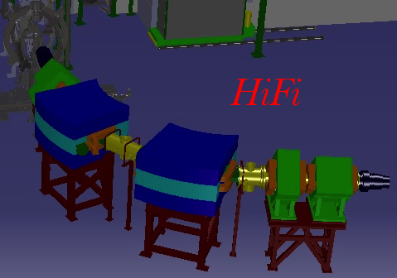
HiFi
Hie Isolde Fragment Identifier
Olof Tengblad & Joakim Cederkäll
ISCC 28th June 2016

Slide 2
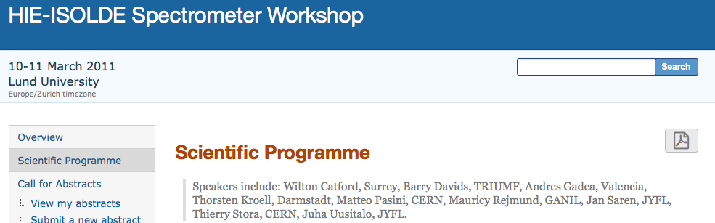
History
Action committee: O. Tengblad, J.Cederkall & W. Catford
Put on ice when the TSR projected started
Oct. 2013 O. Tengblad was asked by Yorik Blumenfeld to look into the possibillity to move TRImuP to ISOLDE.
Discussion stalled due to re-organisation at KVI-CAR – RUG
2015-16 retaken the contacts

Slide 3
Zero-degree spectrometer @ Hie-Isolde
Why a zero degree spectrometer:
  identification of reaction products
  physical separation of isobaric beams or other beam contaminants
Design Parameters
  large enough angular acceptance to pick up sequential decay products
  excellent angular resolution to allow kinematic reconstruction – missing momentum
2011: 35 LoIs for HIE-ISOLDE
15 claims to profit from spectrometer or separator
mostly to identify beam-like particles
1 explicitely mentions the use of a spectrom. for reactions with light particles.
most request the MINIBALL + CD or T-REX set-up
2016: 16 approved proposals would profit from a Spectrometer

Slide 4
Why a Zero-degree spectrometer
USING RADIOACTIVE BEAMS in INVERSE KINEMATICS
transfer products on
neutron-rich side can
sequentially n-decay
(d,p)
from 180° to
forward of 80°
(d,t)
forward of 45°
INCIDENT BEAM
isobaric beams can be
identified and/or physically
separated (possibly further
stripped, e.g. ¹⁵N³⁺/²¹O⁴⁺)
(d,d)
just
forward of 90°
fusion-evaporation
products from reactions
on C in CD₂ targets
Wilton Catford
University of Surrey, UK

Slide 5

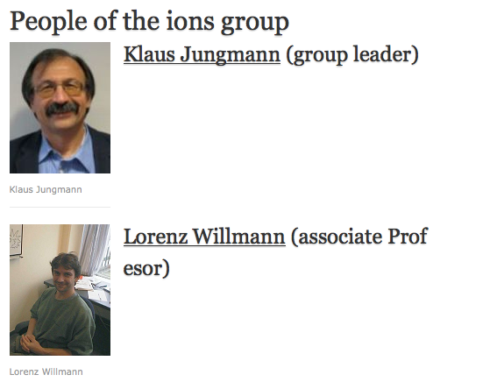
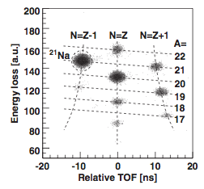
Van Swinderen Institute for Particle Physics and Gravity, University of Groningen
Researchgroup Ions:
Existing machine not in use @ KVI-CAR Built 1994 Should be scrapped!?
VSI interest at ISOLDE:
Radium isotopes for ATOMIC Fundamental Symmetries Studies (i.e. at low energy Isolde)
Time of flight vs. energy loss in a 100 mm silicon detector shows various nuclides at the intermediate plane T2.
+ 4 PhD students

Slide 6
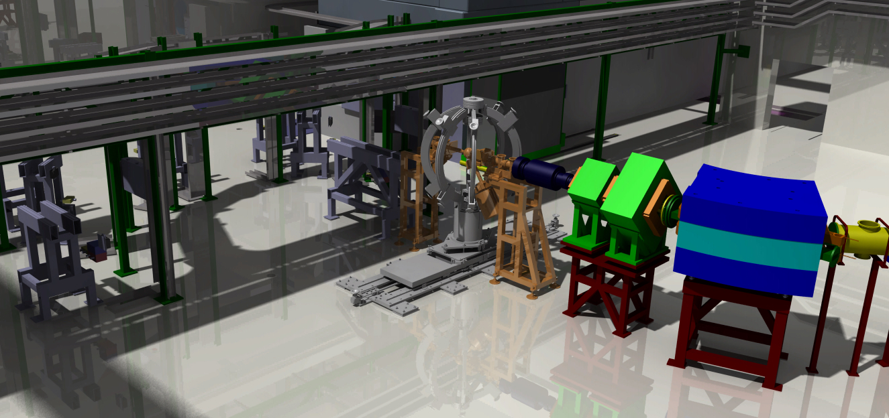
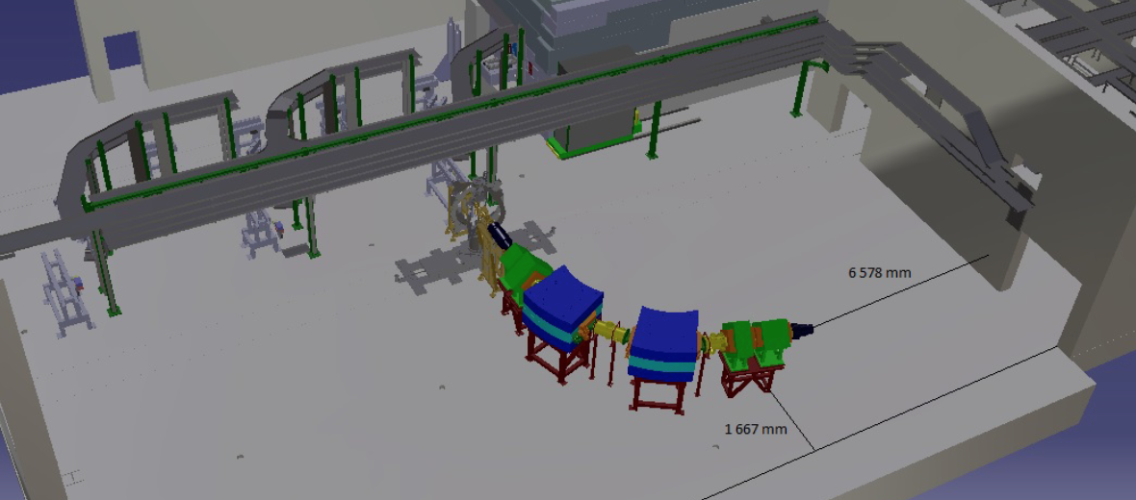
HiFi with MiniBall @ XT01
HiFi with MiniBall @ XT01
Catia drawings exact dimensions

Slide 7

HiFi - the Hie isolde Fragment identifier
TRImP as 0-degree spectrometer at HIE-ISOLDE
Minutes meeting at RUG/VSI 15.04.2016
Present: RUG/VSI -- Klaus Jungmann, Lorenz Willmann, Hans Wilschut,
ISOLDE -- María José García Borge, Joakim Cederkall, Olof Tengblad
Move and installation at CERN
2016:
Power-supplies exist already at CERN as a donation from LUND University.
Dismount at KVI-CAR and transported to CERN Oct. – Dec.
The equipment will first be mounted at CERN in building B180.
2017 B180 CERN:
Where all the tests of vacuum, power supplies etc. will be performed.
The detection system, will consist in a row of Double sided Si strip detectors this will be mounted and tested with alpha source and if possible to mount an external ion-source.

Slide 8
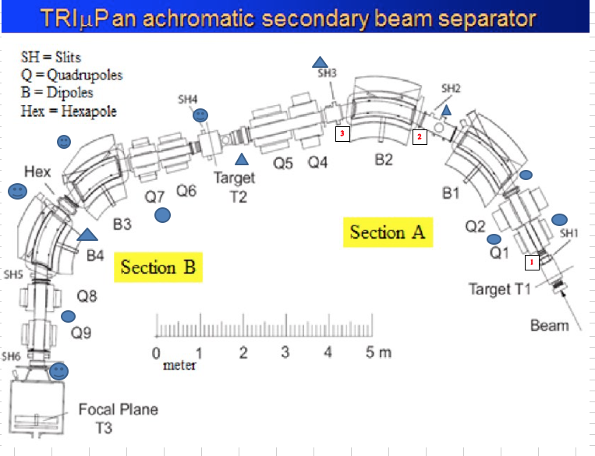
Survey of Radioactivity and plan for dismount at KVI-CAR before transport
Survey of activity
A first survey was made along the separator. The main activity are located at the primary target (1) and the frequently used slit SHT2 right (2). The background in the room is about 50-200 nSv/h allowing only reliable measurements above that value. At location (3) some activity was found.
The remaining separator did not show any activity..
Summary of activity:
The exit and entrance of the gas cell inside chamber T1 was 12µSv/h, at various places outside the cell were mostly a background level with some points 0.4 -0.5 12µSv/h, where the target is nearby.
Near slit SHT2 6-7 µSv/h along the intermediate chamber 0.2-1 µSv/h.
Exit vacuum box BT2 1 µSv/h

Slide 9
Phases of the ISOLDE HiFi Separator Project
Timeline and Milestones
Phase A 1 January 2016 to 31 December 2016
2016: Identifying radioactive and non-radioactive components of the TRIMUP separator. Preparation for and transport of non-radioactive components to CERN and installation in test area.
Phase B 1 January 2017 to 31 July 2018
2017-2018: Testing hardware for the HiFi separator, including cooling and power, in test area at CERN. Installation of new detector systems and tests of these.
Phase C 1 August 2018 to 31 July 2019
2018-2019: Installation in ISOLDE experimental area and in situ testing

Slide 10
Already approved HIE-ISOLDE experiments that could profit from a Spectrometer
IS591 P377 18N: a challenge to the shell model and a part of the to r-process element production in Type II supernovae
Matta, A / Catford, W http://cds.cern.ch/record/1551744/files/INTC-P-377.pdf?version=1
“We plan to employ a device such as the Trifoil detector in the beam at zero degrees, beyond the target chamber. Immediately in front of the trifoil, the use of an appropriate thickness of aluminium, typically a few tens of micrometers, allows the products from compound nuclear reactions to be stopped, and lets the beam and transfer reaction products pass.”
IS606 P440 Studies of unbound states in isotopes at the N = 8 shell closure [11Be(t,p)13Be] Tengblad O. / Mücher, D.
IS554 P350 Search for higher excited states of 8Be* to study the cosmological 7Li problem Gupta, D.
IS587 P398 Characterising excited states in and around the semi-magic nucleus\n 68 Ni using Coulomb excitation and one-neutron transfer Gaffney, L./Flavigny, F./Zielinska, M./Kolos, K.
IS553 P348 Determination of the B(E3,0+->3-) strength in the Scheck, M. / Joss, D.
IS551 P345 Coulomb excitation of doubly magic 132Sn with MINIBALL at HIE-ISOLDE Reiter, P.
IS566 P370 Probing intruder configurations in 186,188Pb using Coulomb excitation Pakarinen, J. .
IS562 P362 Transfer Reactions and Multiple Coulomb Excitation in the 100Sn Region Cederkäll, J.
IS549 P343 Coulomb Excitation of Neutron-rich 134;136Sn isotopes Kröll, T. / Simpson, G.
IS561 P361 Transfer reactions at the neutron dripline with triton target Riisager, K. / Mücher, D.
IS548 P342 Evolution of quadrupole and octupole collectivity north-east of 132Sn: the even Te and Xe isotopes Kröll, T. / Simpson, G.
IS556 P352 Spectroscopy of low-lying single-particle states in 81Zn populated in the 80Zn(d,p) reaction Orlandi, R. / Raabe, R.
IS547 P340 Coulomb excitation of the two proton-hole nucleus 206Hg Podolyak, Z.
IS555 P351 Study of shell evolution in the Ni isotopes via one-neutron transfer reaction in 70Ni Valiente Dobon, J. / Orlandi, R. / Mengoni, D
IS546 P339 Study of the effect of shell stabilization of the collective isovector valence-shell excitations along the N=80 isotonic chain Bauer, C. / Pietralla, N. / Rainovski, G.

