Slide 1
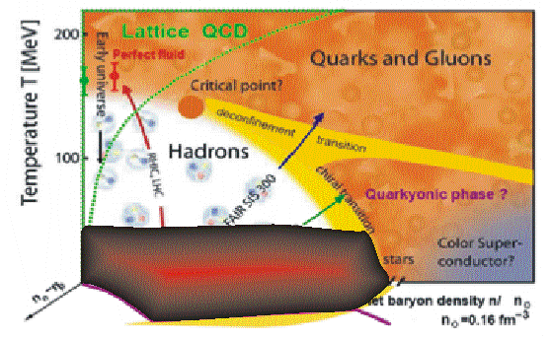
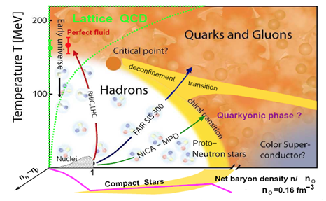
Probing the EoS of Asymmetric matter
W. Lynch: NSCL and Department of Physics and Astronomy
Michigan State University and the HiRA and SπRIT collaborations
Symmetry energy, EoS and neutron stars.
Laboratory constraints on the symmetry energy at ρ<ρ₀
Extension of constraints to ρ>ρ₀
New experiment with the SπRIT TPC at RIBF
Notes:
Thank the of this workshop for opportunity to present this talk, and to have reason to come to very nice place and listen to so many interesting talks.
I will discuss the successful EoS that was obtained for symmetric and the uncertainty posed by the symmetry energy when trying to extrapolate that to neutron stars.
then I will go to the experiment efforts to constrain the symmetry energy at supra-saturation densities.

Slide 2
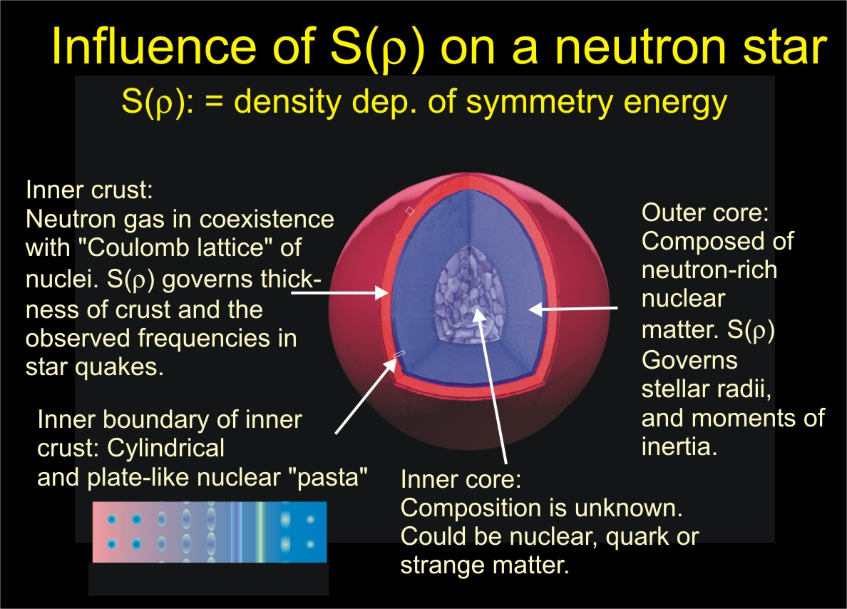
c
ρ < ρ₀
c
ρ > ρ₀

Slide 3
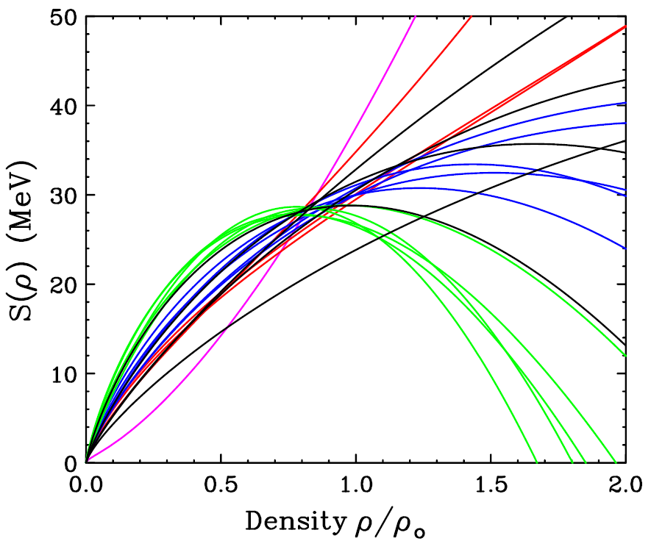
ε(ρ,0,δ)= E/A: How does it depend on ρ and δ?
nuclear binding energy
B_{A,Z} = a_{v}[1-b₁((N-Z)/A)²]A - a_{s}[1-b₂((N-Z)/A)²]A^{2/3} - a_{c} Z²/A^{1/3} + δ_{A,Z}A^{-1/2} + C_{d}Z²/A
δ=0 ρ_{n}=ρ_{p}
Symmetry energy at
δ=1ρ_{p}=0
Curvature given by
Giant Monopole Resonance
Brown, Phys. Rev. Lett. 85, 5296 (2001)
ρ₀
ε (ρ,δ)=(E/A (ρ,δ) = E/A (ρ,0) + δ²•S(ρ)
δ= (ρ_{n}- ρ_{p})/ (ρ_{n}+ ρ_{p}) = (N-Z)/A
Symmetry energy calculated here with effective interactions constrained by Sn masses
This does not adequately constrain the symmetry energy at higher or lower densities
Notes:
Today we will be discussing the EOS and in particular its isospin dependence.
We focus on the potential energy contribution to the EOS and not on its temperature dependence, because is most uncertain.
If we express the EOS as an energy functional, we can isolate the isospin dependence of the EOS by decomposing it into symmetric matter EOS and a symmetry energy term that depends quadratically on the asymmetry.
The symmetric matter EoS describes how the bulk term of the liquid drop mass formulae depends on density.
The symmetry energy describes how the bulk symmetry energy of the liquid drop mass formulae depends on density
The symmetric matter EOS has minimum at saturation density. The curvature about the minimum largely dictates the monopole resonance energy.
The symmetric matter EOS shows a selection of different models to illustrate the questions concerning the density dependence, some more realistic than others.
The Symmetry energy are predictions using 17 Skyrme intereaaction adjusted to reproduce the masses of Sn isotopes. The crossover has to do with what density the masses are sensitive to on the average
The symmetry energy does not have a stable minimum that we know of, is increasing at saturation density
Both are uncertain away from saturation density, with the largest uncertainty at high density.
.

Slide 4
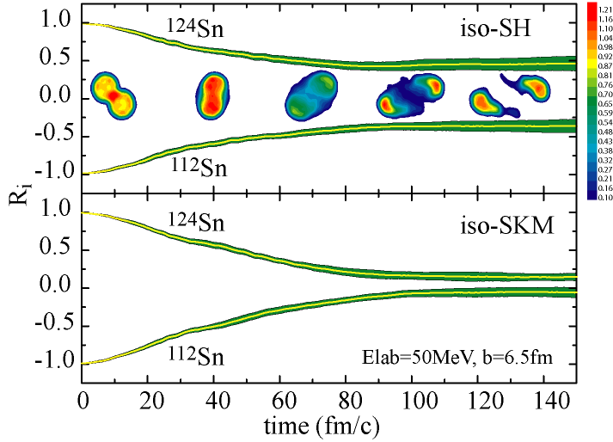
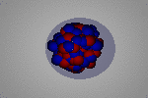
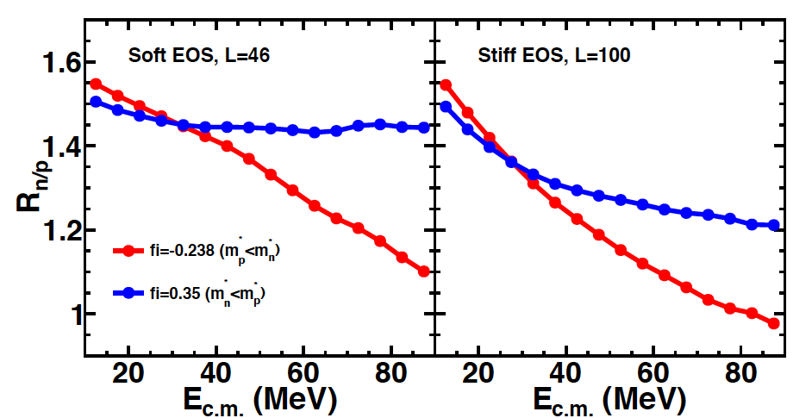
Observables to constrain low density EoS
B_{A,Z} = a_{v}[1-b₁((N-Z)/A)²]A
- a_{s}[1-b₂((N-Z)/A)²]A^{2/3}+....
R=2(δ-<δ>)/(δ_{P}-δ_{T})
L. Shi, P. thesis, (2003)
Binding energies of nuclei, Isobaric analog states.
diffusion between nuclei of different δ
Y(n)/Y(p)
P. Mrofouace, (2017)
Asymmetry and dynamics of nuclear surfaces: E1 excitations
Ratios of neutron/proton spectra in central ¹²⁴Sn+¹²⁴Sn collisions (δ dep. of radial flow)

Slide 5
Laboratory constraints on Symmetry energy at ρ<ρ₀
Such Experimental observables have been analyzed to provide constraints on S₀=S(ρ₀) and L.
Some sensitive observables:
  masses
  Isobaric Analog States (IAS)
  Electric dipole polarizability (α₀)
  Diffusion of neutrons and protons between nuclei of different N/Z in peripheral collisions HIC (Sn+Sn)
These values for S₀ and L reflect non-linear terms in the functional dependences of S(ρ)
Horowitz, et al., J. Phys. G: Nucl. Part. Phys. 41 (2014) 093001
Slope of constraint indicates the sensitive density
M is monotonic function of density ➔ Can determine density ρ_{s} from slope and then get S(ρ_{s})
➔ use each contour to obtain S(ρ_{s}) at the density ρ_{s} probed by that measurement
Notes:
There have been a lot of work trying to constrain the symmetry energy.
Most of this concentrated on the properties of nuclei that are sensitive to the symmetry energy. This provides sensitivity to the symmetry energy at subsaturation density (S and L)
The relative observables are are (read them)
By comparing data to calculations in which the interactions are varied, varying L and S, we can get the ranges of L and S allowed by the data. Point them out.
The contours are regions about a straight line. This occurs because the observable is sensitive mainly to one average density. we saw that for masses here it appears again. Steeper slopes mean high densities. Masses here appear to be sensitive to (read it)
Polarizability is sensitive to somewhat lower density.
Isospin diffusion (describe it) is sensitive to densities less that 0.45 rho0. It is even a more flat contour
neutrons skins are sensitive only to l
intersection of these constrains can provide simultaneous constraints on l and S
but it is very sensitive to the theoretical error bars.

Slide 6
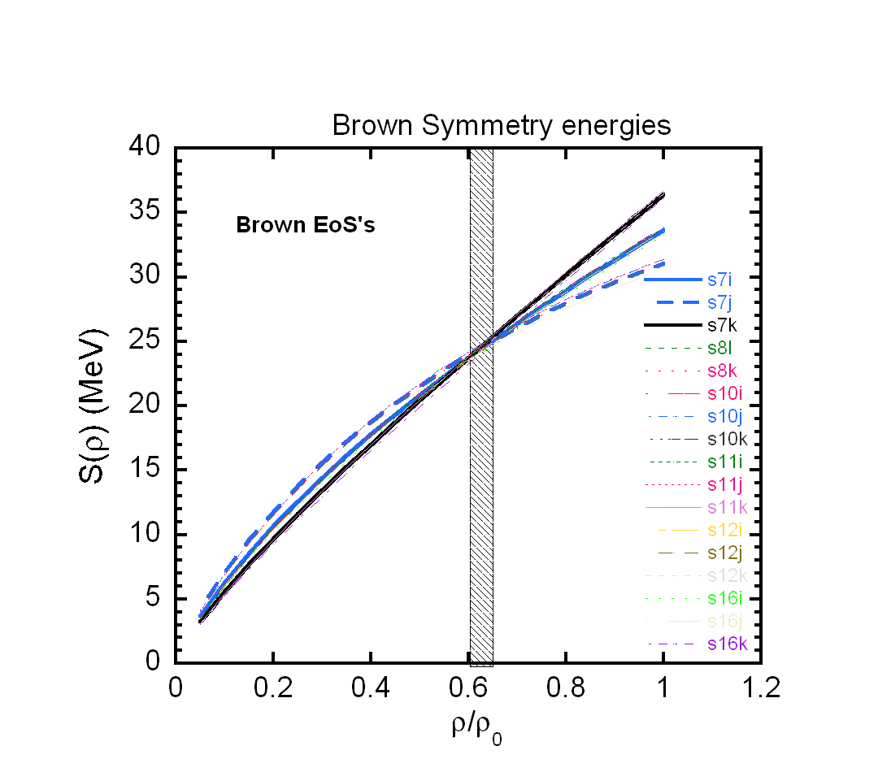
Demonstration for Mass analyses of Brown
BA Brown PRL 111, 232502 (2013)
Adapted from Horowitz, et al.,
J. Phys. G: Nucl. Part. Phys. 41 (2014) 093001
M_{exp}= -0.100± 0.008
Brown directly examined the functions S(ρ) that fit masses of closed shell nuclei. These functions agreed at
ρ_{S}/ρ₀= 0.63±0.3 where they had the value S(ρ_{S}) = 25.4±0.8 MeV
Now we redo this analysis with the slope technique.
Using M_{exp}= -0.100± 0.008 and the functional dependence of S(ρ_{S}) provides: ρ_{S}/ρ₀= 0.65±0.3 and S(ρ_{S}) = 25.1±0.8 MeV.
We used the slope technique to obtain ρ_{S}/ρ₀= 0.76±0.2 and S(ρ_{S}) = 27.1±1.1 MeV for the DFT constraint. Similarly, we obtain ρ_{S}/ρ₀= 0.74±0.3 and S(ρ_{S}) = 27.3±0.9 MeV for the IAS constraint.

Slide 7
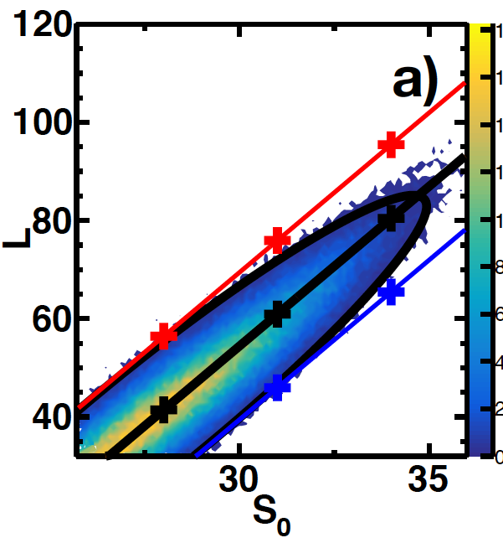
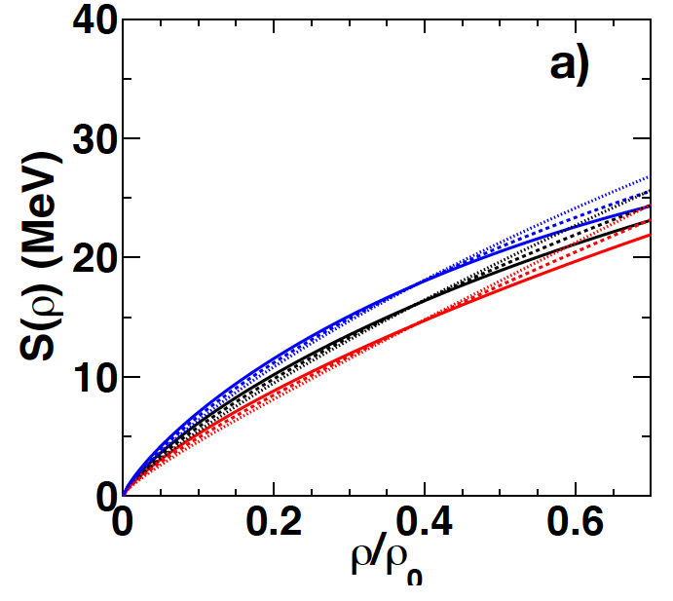
Constraints from ratios of neutron/proton spectra in central ¹²⁴Sn+¹²⁴Sn and ¹¹²Sn+¹¹²Sn collsions
P. Morfouace et al., (2017
P. Morfouace et al., (2017
We obtain ρ_{S}/ρ₀= 0.39±0.6 and S(ρ_{S}) = 16.1±1.8 MeV.
Best fit : S₀= 16.1±1.8 MeV, L= 16.1±1.8 , =0.77±0.11 and
The effective masses are very important for neutron-star cooling.
Four dimensional Bayesian analyses of spectral ratios using Madai:
Parameters: S₀, L, and

Slide 8

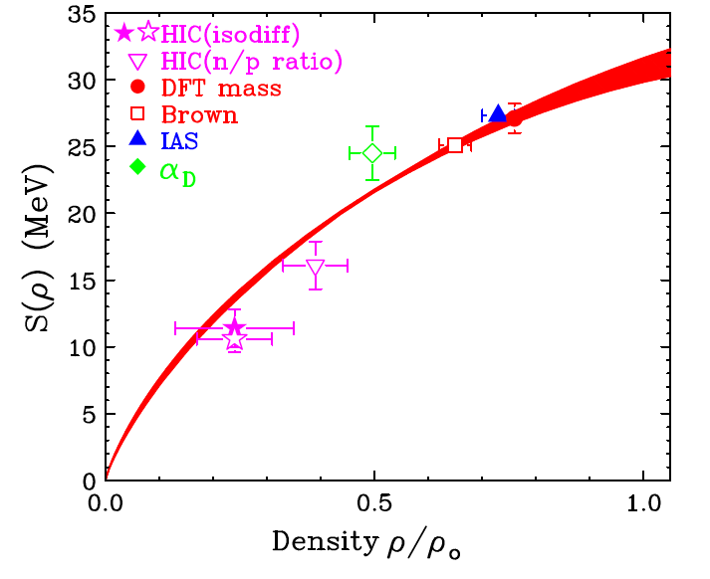
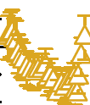
Density dependence of symmetry energy
Figure shows the values for S(ρ) obtained by these analyses.
The best constrained values are at 0.6<ρ/ρ₀<0.80. Little or no constraints above ρ/ρ₀≈0.8.
Red curve is the ab-initio calculation by C. Drischler et al. (2014)
W.G. Lynch and M.B. Tsang, (2017
Constraints are similar to the dessity dependence from IAS recently published by Danielewicz and Lee (2017) shown by blue contour.
Probing ρ/ρ₀<0.25 is the domain of correlation studies because matter in this region is mechanically unstable with respect to the formation of clusters. That is why the symmetry energy in nature does not go to zero. .

Slide 9
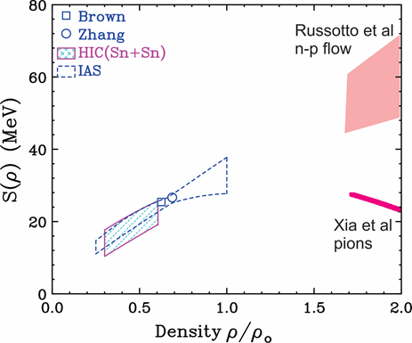
Status of symmetry energy
Xiao et al., pions
Russotto et al., PLB, 697, 471 (2011)
Xiao et al., PRL 102, 062502 (2009).
Many nuclear stucture and reactions have constrained the symmetry energy at ρ<ρ₀, as I have discussed.
  At ρ<ρ₀, situation improving rapidly.
At ρ>ρ₀, work just beginning.
  Important to constrain all theoretical unknowns and reconcile discrepancies.
Notes:
In the past decade or more, considerable progress has been made towards constraining the density dependence of the symmetry energy.
The figure here shows the constraints in a recent report (2014). Data at subsaturation density, masses, Isobaric analog resonances and HIC have really tightened. Not shown are the new results from polarizability. The current situation is probably tighter still. Theoretical error bars are key to this enterprise.
THe situation at high denity is up in the air. and leaves room for experimental and probably theoretical improveme
Two results n/p elliptial flow almost linear
pions: paper suggested considerabl softening.

Slide 10
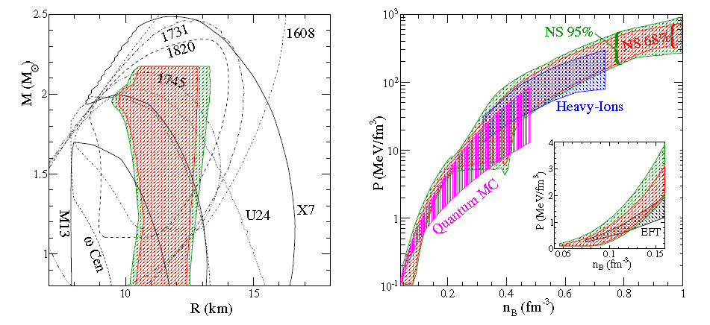
Constraining the EoS and Symmetry Energy at ρ>ρ₀
M/M_{Sun}
Steiner et al., ApJ 722, 33 (2012)
  Steiner et al., ApJ 722, 33 extract R=11.5±1.5 km from X-ray bursters and quiescent binary systems. Other radius measurements have differed by the order of 2 km.
  Comparable constraints on pressure of 30 MeV/fm³ < P < 86 MeV/fm³ at n_{B} =0.43 /fm^3 from neutron star R vs. M correlation and Heavy ion collisions. (Factor of 3). Uncertainties are large, yet constraints are useful. Heavy ion “constraints” appear much tighter at 0.3<n_{B}<0.4 /fm^3
Notes:
New neutron star observations since 2000 have really stimulated efforts to constraint the EoS from them.
I show two figures from the work of Steiner, Lattimer and collaborators where observations of extra bursters, and quiescent x-ray binary systems were used to constain the eos. The mass versus radii regions are shown in the lsft figure. Curve obtained by solvign the Tolman Oppenheimer Volkov equation for different EoS’s are shown as lines. From such comparisons, a contour of likely EoS was obtained brown and gree regions. Red shows that it is probably inaccurate to try to expolate from nucleaer propeties. The blue region is the constrainf from HIC. Before passing on to how that was obtained and its uncertainties, it useful to note that the uncertainty is about a factor o 3 in pressure, which represents a huge improvement in understand. But clearly there is noom to improve.

Slide 11
Laboratory Constraints on symmetric matter EOS at ρ>2 ρ₀.
E/A (ρ, δ) = E/A (ρ,0) + δ²•S(ρ) δ = (ρ_{n}- ρ_{p})/ (ρ_{n}+ ρ_{p}) = (N-Z)/A
Boundary determined by comparing relativistic Au+Au transverse and elliptical flow data to transport calculations
Lynch Prog. Part. Nucl.
Phys. 62,427 (2009)
Danielewicz et al.,
Science 298,1592 (2002).
gold
Flow confirms the softening of the EOS at high density.
Constraints from kaon production are consistent with the flow constraints and bridge gap to GMR constraints.
Note: analysis requires additional constraints on m* and σ_{NN}.
The symmetry energy dominates the uncertainty in the n-matter EOS.
Neutron star matter “constraint” includes symmetry energy uncertainties
Improved laboratory constraints on the density dependence of the symmetry energy are needed to verify and tighten the constraints.
Notes:
Transverse and elliptical flow data were compared to transport calculations with different EOS;s in order to determine which EOS describes the data best.
other quantities such as the effective masses and in-medium cross sections were varied to understand the model dependence of the calculations.
The boundary shows the pressure at 0 temperature consistent with these constraints. the line shows a quadratic EOS consistent with the monopole resonance. This shows that higher order terms soften the symmetric matter EOS.
These constraints though conservative, do rule out various theories.
If you add the constraint from kaon production, you get a consistent picture and an existence proof that such constraints can be obtained from nucleus-nucleus collisions.
However, when you add the pressure from the symmetry energy to get the pressure in neutron matter, you see that the uncertainties in the symmetry energy outweigh the remaining uncertainties in the symmetric matter eos Because the symmetry energy has not been experimentally constrained at high densities the contour lable HIC in Andrew Steiner’s graf is much wider our goal is to provide contraints on th e symmetry energy and strink it. .

Slide 12
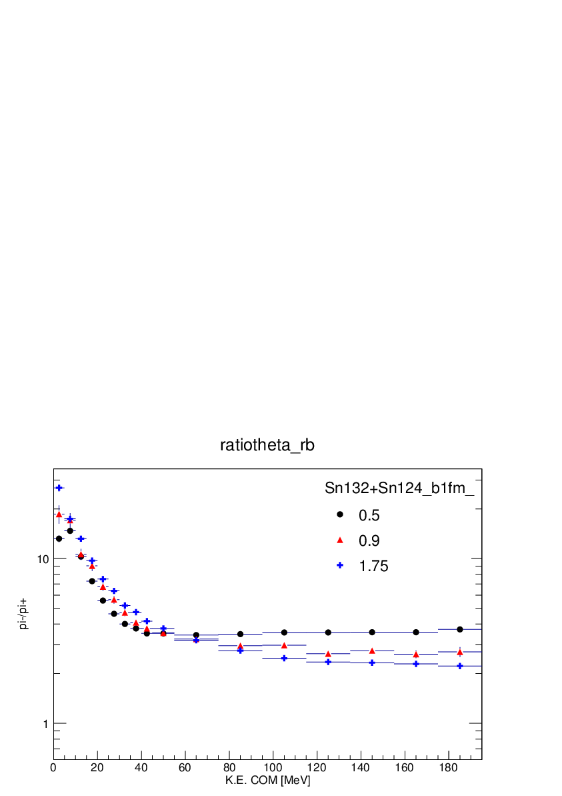
Probing ρ>ρ₀ via pion production
Stiff S(ρ) drives neutrons out and pulls protons into dense neutron-rich matter. Effect less for soft S(ρ) . Can be probed by comparing n to p emission .
Larger values for ρ_{n}/ ρ _{p} at high density for the soft asymmetry term (x=0) causes stronger emission of negative pions for the soft asymmetry term (x=0) than for the stiff one (x=-1).
Expectations for Y(π⁻)/Y(π⁺)
  In delta resonance model,
  Y(π⁻)/Y⁺)~(ρ_{n,}/ρ_{p})²
  In equilibrium,
  μ(π⁻)-μ(π⁺)=2(μ_{n}-μ_{p})
E/A = 300 MeV
=
Y(π ⁻ )/Y(π ⁺ )
M.B. Tsang et al., PRC (2017).
There are two key observables
  Comparing the spectra multiplicities and flows of π⁻ to π⁺.
  Comparing the spectra and flows of neutrons to protons. Effects are opposite to pions and are predicted to be smaller.
  Both are measured in the SπRIT experiment at RIKEN.
Notes:
Looking forward to probing higer densities, we would like to explore pion production. We follow a suggestion of BAL that the ratios of pion- to pi+ spectra are of the order of 5 times more sensitive to the symmetry energy than the ratio of the integrated pi+ to pi- yield, that that is true because the shape of these two spectra and how they depend on the symmetry neregy are very different. we should this ratio at two incident energies and we see factors of three diffrence inhe ratios at low energies that flip sign at higher energies. THis is an easily measurable effect.

Slide 13
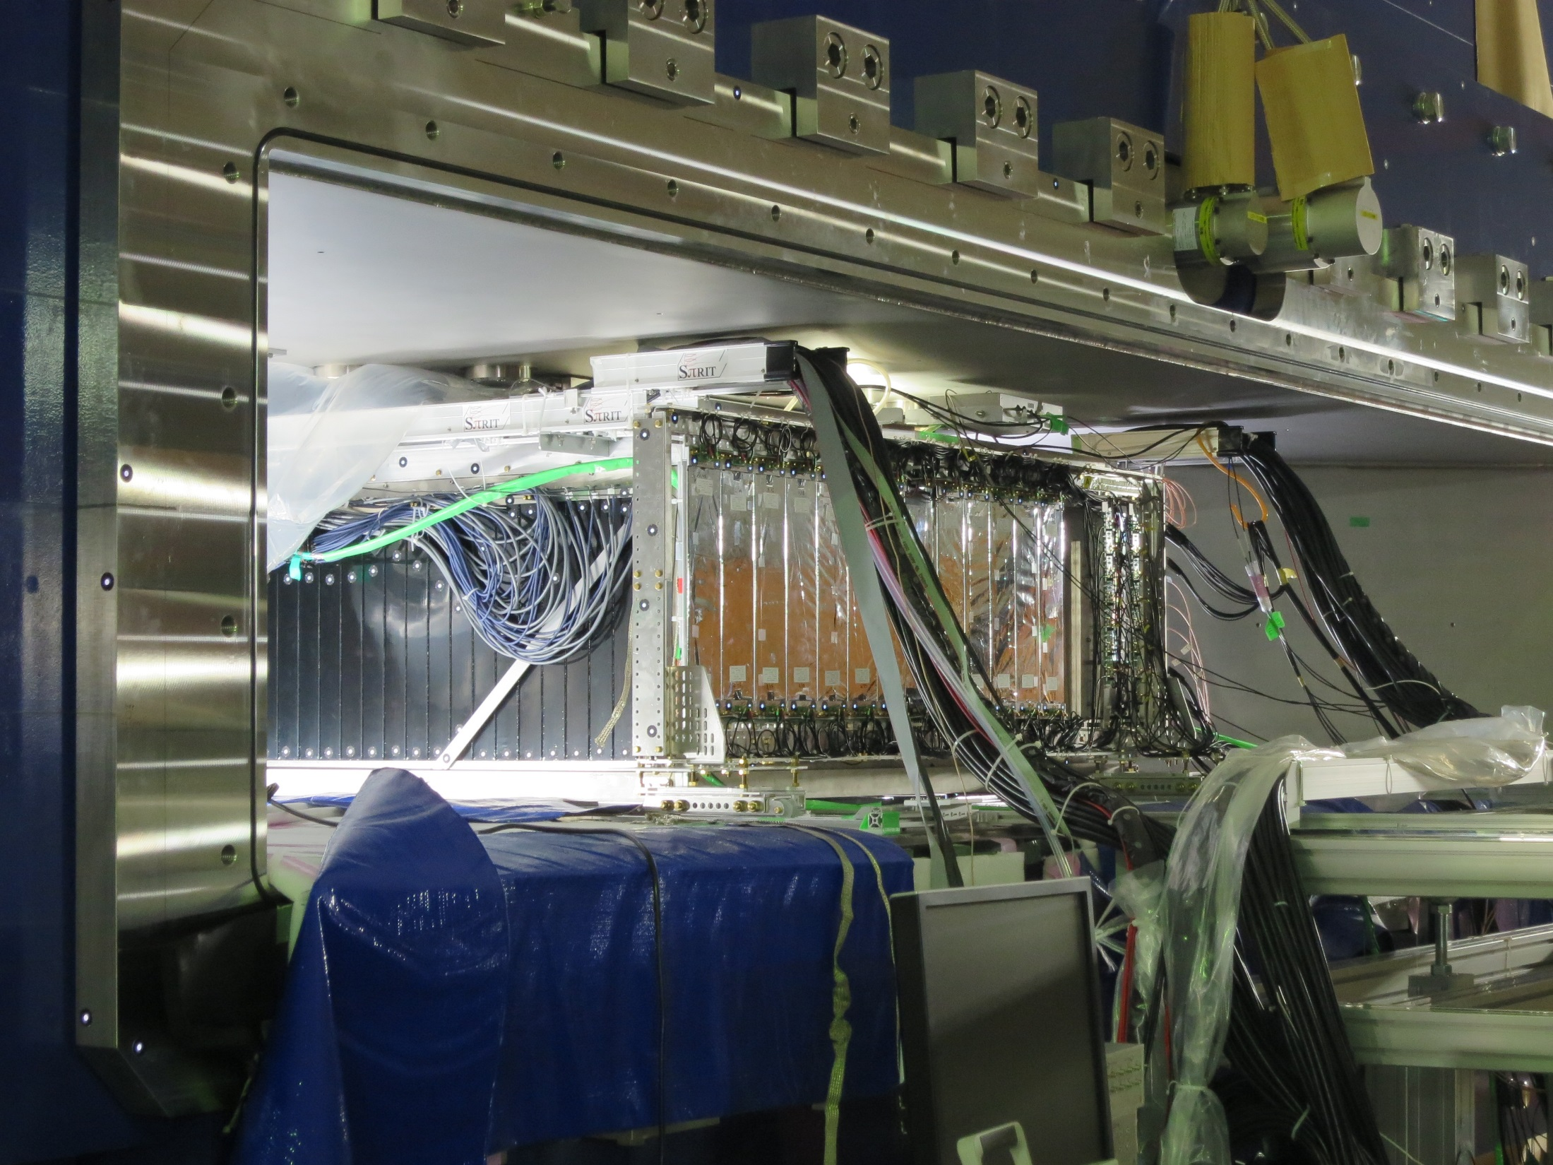
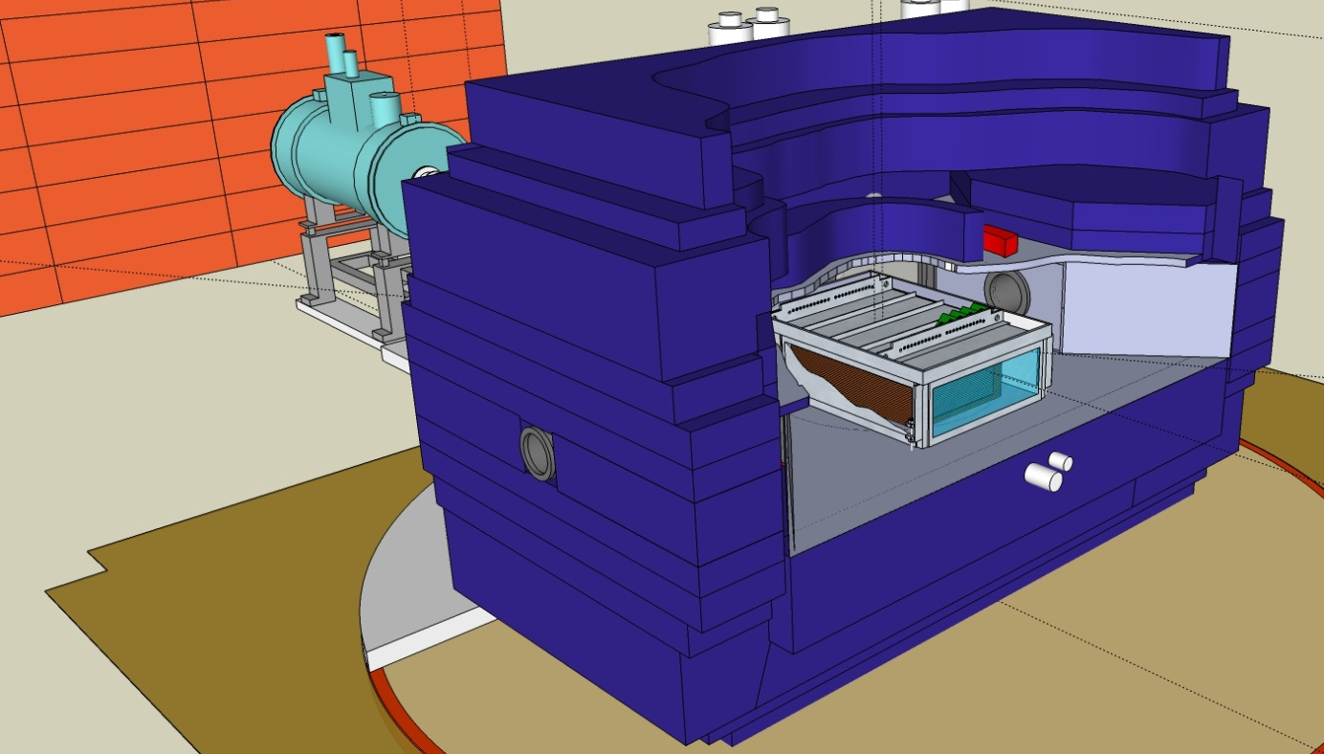
SPπRIT-Time Projection Chamber exp. at RIBF
Shane et al., NIMA 784 (2015) 513
SAMURAI dipole magnet
80cm
134 x 86 x 53 cm³ effective volume
dE/dX – Bρ particle identification.
Target at the entrance of chamber.
Readout with ~12000 pads.
Neutrons 15°<θ<30° meas. by NeuLAND
Experiment completed 6/1/2016
E/A MeV | Reaction |  | focus
280 | ¹³²Sn+¹²⁴Sn | .22 | S(ρ), m*_{n}- m*_{p}
280 | ¹⁰⁸Sn+¹¹²Sn | .08 | S(ρ), m*_{n}- m*_{p}
280 | ¹²⁴Sn+¹¹²Sn | .15 | σ_{nn}, σ_{np}, σ_{pp}
280 | ¹¹²Sn+¹²⁴Sn | .15 | σ_{nn}, σ_{np}, σ_{pp}

Slide 14
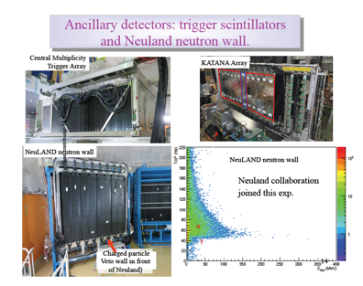

Slide 15
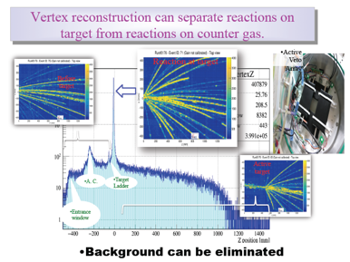

Slide 16
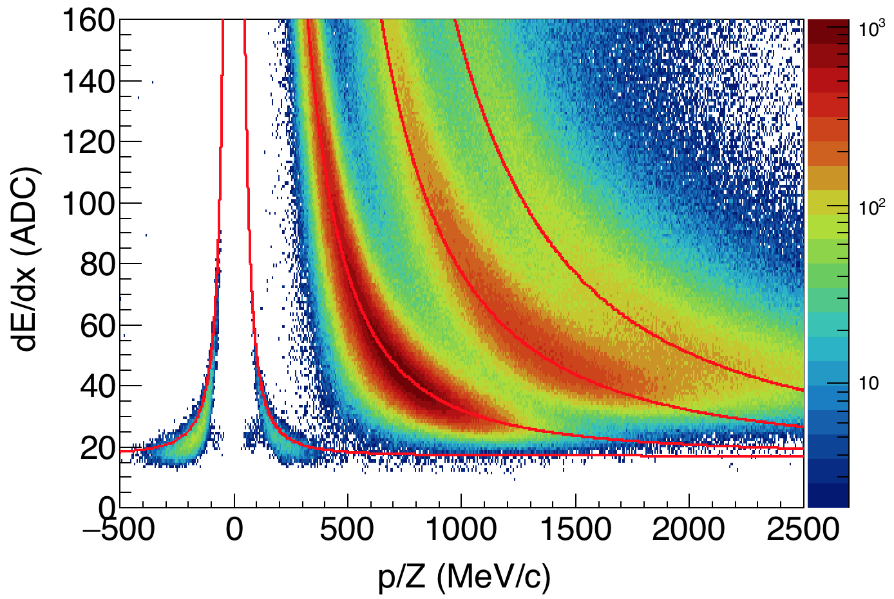
PID for minimum ionizing particles (pions) is good.

Slide 17
Summary and outlook
Significant constraints on the symmetry energy are emerging for ρ<ρ₀.
Key issue is to determine the sensitive density probed by each observable and then extract the symmetry energy at that density.
  Have constraints on S(ρ) at 0.25<ρ/ρ₀<0.75.
Key issues are to constrain the symmetry energy at 0.80<ρ/ρ₀<2.0.
  There is an inconsistency between the conclusions from previous measurements of π⁻/π⁺ spectral ratios and the conclusions drawn from the comparison of n vs. p elliptical flows.
  Additional experimental and theoretical work is needed to address this discrepancy.
New SπRiT TPC experiment should be able to explore both observables and provide new constraints on S(ρ) in the region of at 0.80<ρ/ρ₀<2.0.

Slide 18
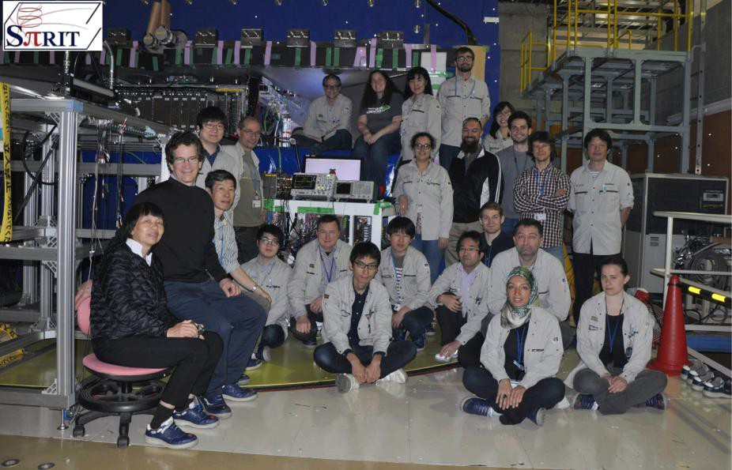
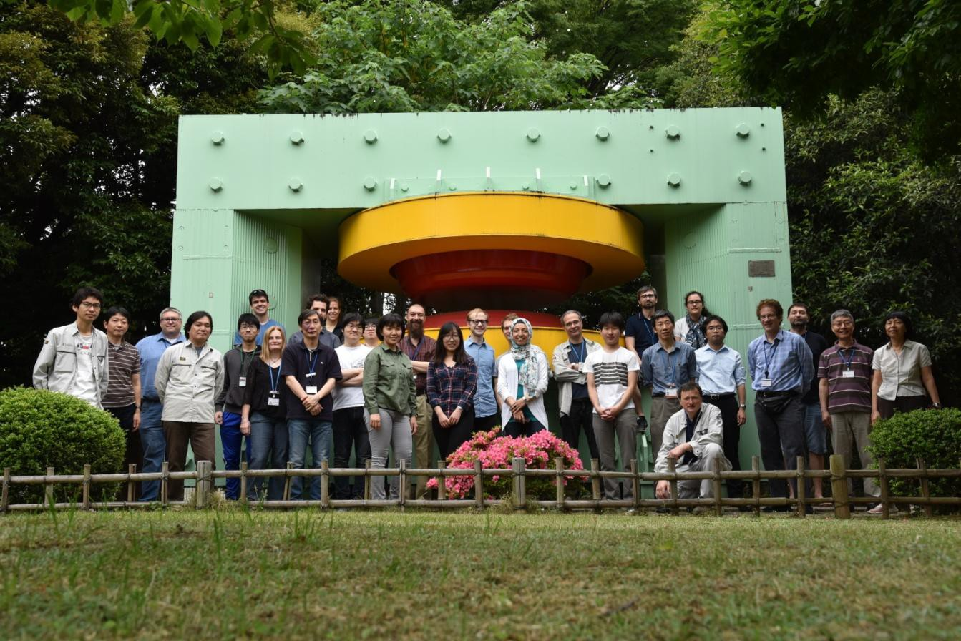


SπRIT
SAMURAI Pion Reconstruction and Ion Tracker
Collaboration of 50+ scientists from China, Japan, Korea, Poland and U.S.
SπRIT TPC is designed to probe the symmetry energy at ρ>ρ₀ at the RIBF facility in Wakoshi, Japan.

