Slide 1


FCC RF Coordination Meeting
September 23, 2016

Slide 2
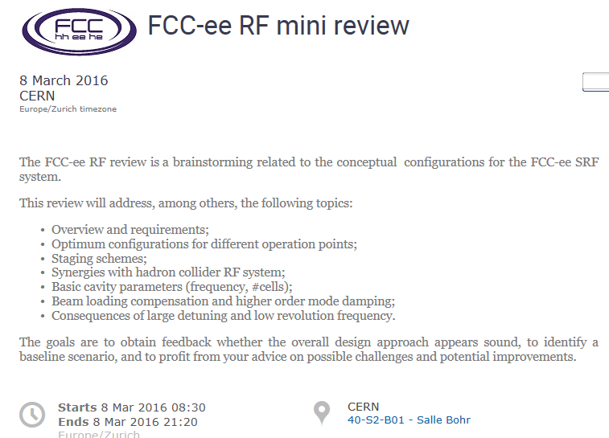
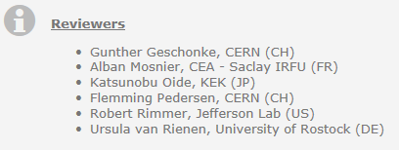
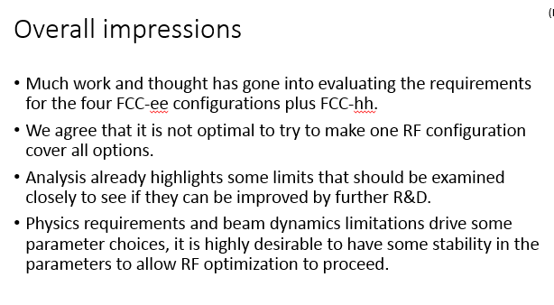
2016 in a nutshell (1)
Program
Welcome and reviews goals (M. Benedikt)
Introduction to FCC and the main beam parameters for ee and hh (F. Zimmermann)
Beam dynamics issues for FCC-hh (E. Shaposhnikova)
Beam dynamics issues for FCC-ee (R. Calaga)
Status of coating technologies for superconducting applications (A. Sublet)
Operating SC cavities in CW (S. Aull)
Interelationships and limits (N. Schwerg)
Cavity design approaches and HOM damping (S. Gorgi Zadeh)
RF concepts (O. Brunner)
(from the reviewers)

Slide 3
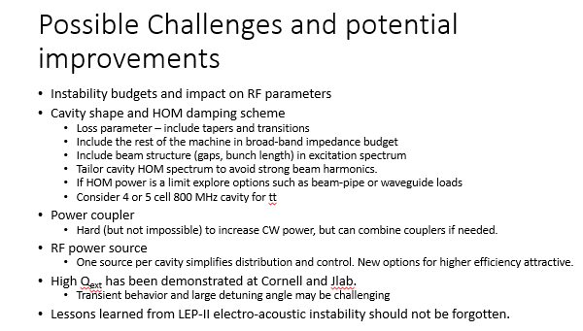
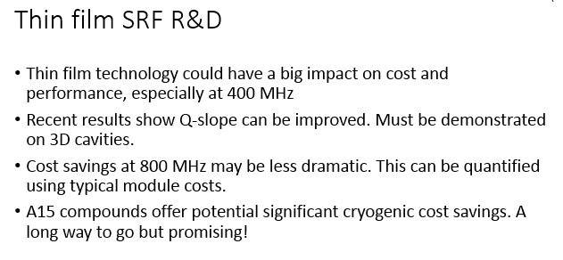
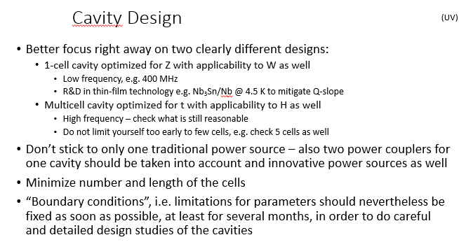
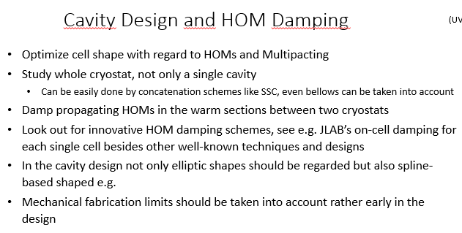
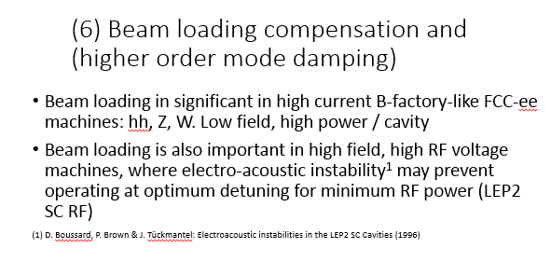
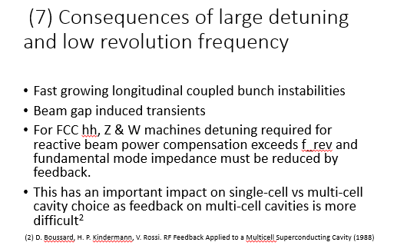
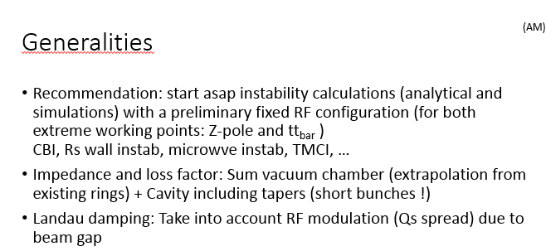
Recommendations – a selection
that’s why the WP was reshuffled!
  - more emphasis on RF scenarios, parameter layout, cavity design and beam interaction

Slide 4
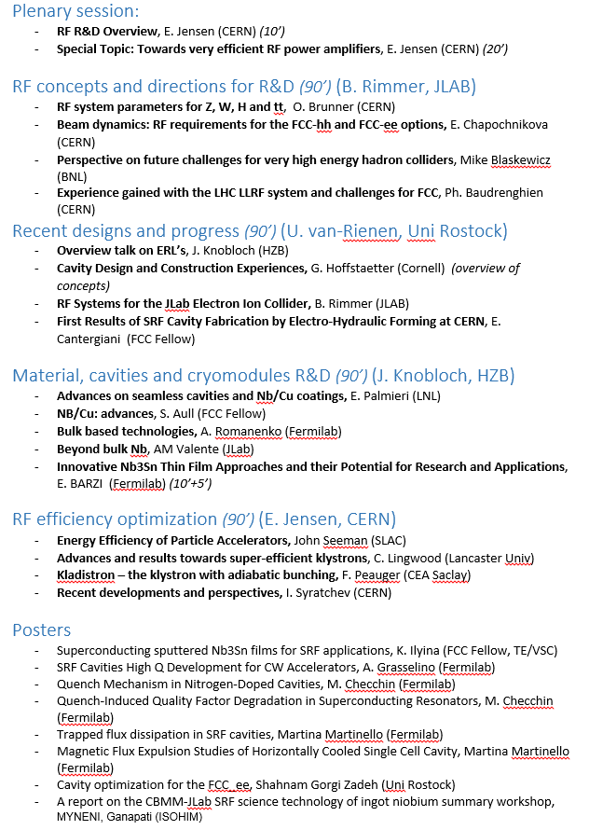
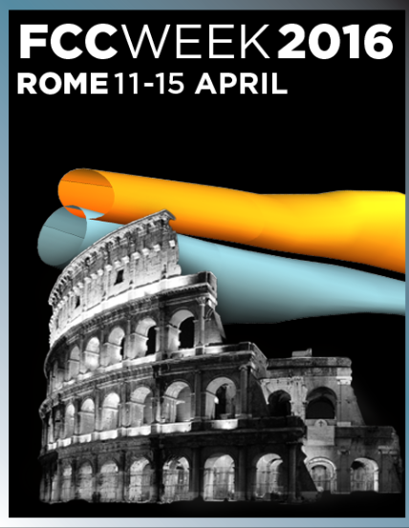
2016 in a nutshell (2)
4 ½ day sessions: 18 talks
10 posters

Slide 5
Work Package Structure and Collaborations
N. Schwerg
WP 5: CERN/LNL/STFC collaboration (P. Chiggiato)
coating
cavity fabrication
material analysis
University of Rostock
H-machine Cavities
Lancaster University
JLAB
800 MHz 5-cell
Cryomodule optimization
MEPHY
HOM damping for the Z-machine
CEA Saclay
Cryomodule production
BINP
400 MHz Cavity
Collaboration
WP 4: Cavity Fabrication (Karl)
High velocity forming
WP 6: Cryomodule challenges (Karl)
Cost estimate
FPC
WP 2: Cavity design & beam interaction (Andy)
Cavity Design
LLRF studies
Beam Dynamics
Specific Beam – Cavity interaction
WP 7: High efficiency power sources (Igor)
HEIKA collaboration
Resotrode effort
Design and Technology
WP 1: RF system, RF scenarios and parameters layout (Nikolai)
Model of the RF system and collection of design constraints
Machine comparison
WP 3: Cavity Material and Performance (Walter)
SRF material development and optimization
Generic

Slide 6
FCC RF WP news
1 RF SCENARIOS AND PARAMETERS LAYOUT (N. SCHWERG)
    1.1 RF SCENARIOS AND PARAMETERS LAYOUT FOR FCC_EE
    1.2 RF SCENARIOS AND PARAMETERS LAYOUT FOR FCC_HH
2 CAVITY DESIGN AND BEAM INTERACTION (A. BUTTERWORTH)
2.1 CAVITY IMPEDANCE AND HOMS
2.2 ACCELERATING CAVITY DESIGN AND HOM COUPLERS
2.3 2ND HARMONIC CAVITY DESIGN AND HOM COUPLERS
3 CAVITY MATERIAL AND PERFORMANCE (WALTER VENTURINI DELSOLARO)
3.1 CAVITY MATERIAL AND PERFORMANCE
4 CAVITY FABRICATION (KARL SCHIRM)
4.1 CAVITY FABRICATION
4.2 HIGH VELOCITY FORMING OF SUPERCONDUCTING RF STRUCTURES
5 COLLABORATION AGREEMENT CERN/LNL/STFC (KE2722/BE/FCC) (P. CHIGGIATO)
5.1 FRAMEWORK FOR SCIENTIFIC COLLABORATION IN SUPERCONDUCTING RF CAVITIES TECHNOLOGY
6 CRYOMODULE CHALLENGES (KARL SCHIRM)
6.1 CRYOMODULE DESIGN
6.2 FUNDAMENTAL POWER COUPLERS
6.3 CRYOMODULE DESIGN
7 EFFICIENCY OF RF POWER GENERATION (I. SYRATCHEV)
7.1 DEVELOPMENT OF VERY HIGH EFFICIENCY KLYSTRONS (HEIKA)
7.2 DEVELOPMENT OF ALTERNATIVE HIGH EFFICIENCY RF POWER DEVICES – THE RESOTRODE INITIATIVE
7.3 HIGH EFFICIENCY KLYSTRONS DEVELOPMENT & CONSTRUCTION

Slide 7
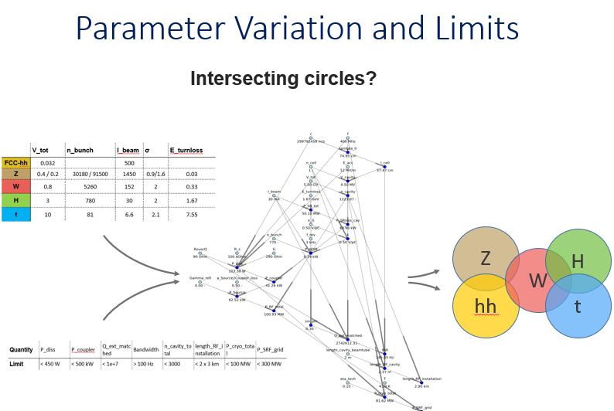
WP1: RF SCENARIOS AND PARAMETERS LAYOUT (N. SCHWERG)
1 RF SCENARIOS AND PARAMETERS LAYOUT (N. SCHWERG)
    1.1 RF SCENARIOS AND PARAMETERS LAYOUT FOR FCC_EE
    1.2 RF SCENARIOS AND PARAMETERS LAYOUT FOR FCC_HH
in preparation/ongoing
Scope:
- define the machine aspects of the ee and hh-machine
- provide parameters and inputs for other WP
- examine limits to see if they can be improved by further R&D
Status:
- WP document in preparation
- Work in progress
- Weekly brainstorming meetings

Slide 8
WP2: CAVITY DESIGN AND BEAM INTERACTION (A. BUTTERWORTH)
2 CAVITY DESIGN AND BEAM INTERACTION (A. BUTTERWORTH)
2.1
2.2
2.3
in preparation
Scope:
- Impedance budget estimates from RF cavities and stability limits for the different lepton and hadron schemes
- Cavity design
- HOM damping
- Beam dynamic challenges
- LLRF challenges
Status:
- WP document in preparation
- Collaboration with Rostock University ongoing (PHD student)
Collaborations:
    Rostock University (Shahnam): focus on 800MHz cavities for the Higgs machine
MEPHY (to be defined): focus on 400MHz cavities for the Z machine + damping schemes (?)
RF-BR (Juan/Elena): filling schemes, stability limits, etc (to be detailed)
RF-FB (Wolfgang/Philippe?): concentrate on defining the challenges for the LLRF systems

Slide 9
WP3: CAVITY MATERIAL AND PERFORMANCE (WALTER VENTURINI DELSOLARO)
3 CAVITY MATERIAL AND PERFORMANCE (WALTER VENTURINI DELSOLARO)
3.1 CAVITY MATERIAL AND PERFORMANCE
ongoing
Scope:
- Investigation of classical and novel materials for their RF performance limits at moderate to high fields, at frequencies in the 400–800 MHz range.
Status:
- WP description up to date
- Weekly meeting organized (?)
Collaborations:
University of Geneva: Collaboration signed recently
Wien TU?

Slide 10
WP4 CAVITY FABRICATION (KARL / MIKKO)
4 CAVITY FABRICATION (KARL SCHIRM)
4.1 CAVITY FABRICATION
4.2 HIGH VELOCITY FORMING OF SUPERCONDUCTING RF STRUCTURES
in preparation
ongoing
Scope:
- Investigation of innovative cavity fabrication processes
Status:
- Complete WP description
- Collaboration agreement signed with Jlab -> detailed discussion shall start soon
- Collaboration with BINP to be investigated
- Collaboration with Bmax ongoing smoothly. Elisa leaving!?
- need to complete WP document asasp
Collaborations:
TE/MME (Bmax)
JLAB
BINP?

Slide 11
WP5 COLLABORATION AGREEMENT CERN/LNL/STFC (KE2722/BE/FCC) (P. CHIGGIATO)
5 COLLABORATION AGREEMENT CERN/LNL/STFC (KE2722/BE/FCC) (P. CHIGGIATO)
5.1 FRAMEWORK FOR SCIENTIFIC COLLABORATION IN SUPERCONDUCTING RF CAVITIES TECHNOLOGY
in peparation
Scope:
- Fabrication, coating and characterisation of seamless cavities
Status:
- WP document to be updated
- Addendum to the collaboration under signature (waiting for INFN’s green light)
- Design of the 800MHz 2 cell cavity defined (Rama’s 5 cells without inner 3 cells)
Collaborations:
INFN
STFC

Slide 12
WP6 CRYOMODULE CHALLENGES (KARL SCHIRM)
6 CRYOMODULE CHALLENGES (KARL SCHIRM)
6.1 CRYOMODULE DESIGN
6.2 FUNDAMENTAL POWER COUPLERS
6.3 CRYOMODULE DESIGN
in preparation
Scope:
- Identify and address cryomodule challenges
- cost study (Nb/Cu @ 4.5K vs bulk Nb @ 2K)
- FPC challenges (movable couplers for FCC-hh, FPC impact on CM design for the Higgs machine
Status:
- WP document to be produced
- Discussions with JLab to be restarted
- Contact lost with CEA Saclay
- WP1 & 2 need to provide FPC parameters
Collaborations:
JLAB
CEA Saclay

Slide 13
WP7 EFFICIENCY OF RF POWER GENERATION (I. SYRATCHEV)
7 EFFICIENCY OF RF POWER GENERATION (I. SYRATCHEV)
7.1 DEVELOPMENT OF VERY HIGH EFFICIENCY KLYSTRONS (HEIKA)
7.2 DEVELOPMENT OF ALTERNATIVE HIGH EFFICIENCY RF POWER DEVICES – THE RESOTRODE INITIATIVE
7.3 HIGH EFFICIENCY KLYSTRONS DEVELOPMENT & CONSTRUCTION
ongoing
Scope:
- Identify and address cryomodule challenges
- cost study (Nb/Cu @ 4.5K vs bulk Nb @ 2K)
- FPC challenges (movable couplers for FCC-hh, FPC impact on CM design for the Higgs machine
Status:
- WP document to be updated/completed
- FCC support to EIKA (ULAN) under study (coll. agreement in discussion)
- Resotrode initiative: first round of discussions with THALES
- Fabrication of a high efficiency tube – scenarios under study
Collaborations/participants:
THALES, ULAN, CPI, ESS, THOSHIBA,

Slide 14
Conclusion and next steps
Coherent WP
Complete WP description -> “publishable” by November
Progress with MEPHY, CEA SACLAY, JLAB (?)
WP meetings
- Weekly brainstorming meetings (WP 1&2)
- Collaboration with LNL/STFC – design and material preparation (Sergio?)
- WP 4 & 6: common meeting? Karl/Mikko
Define the goals for the next FCC week in Berlin
“Start thinking” CDR

