Slide 1
WP5: Cavity fabrication
21.09.2016

Slide 2
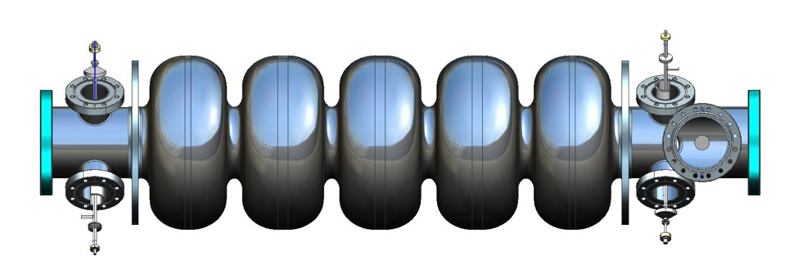
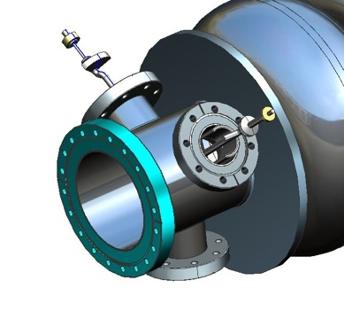
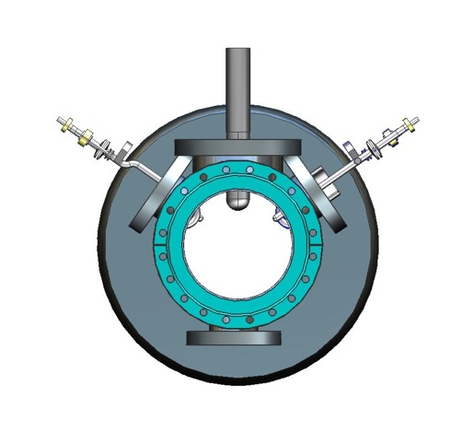
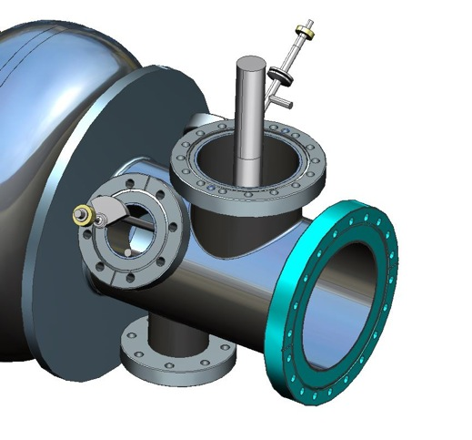
KE3080/ATS: 802 MHz five-cell cavity production and testing at JLAB

