Slide 1
CERN – WDL coordination
3rd weekly meeting
02.06.2016 – Sebastien Bustamante EN/EA/EC

Slide 2
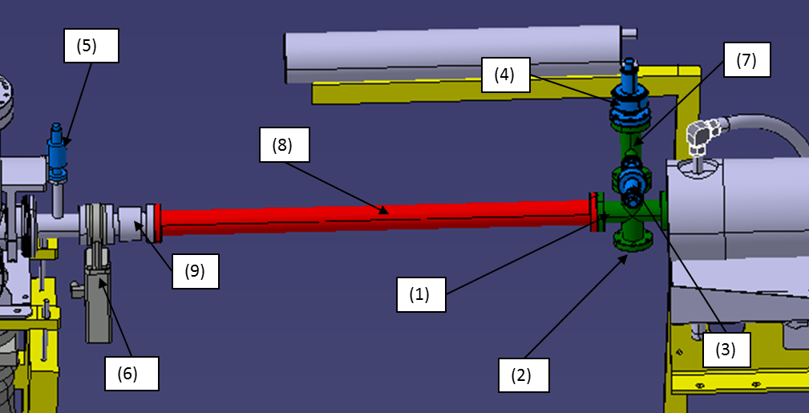
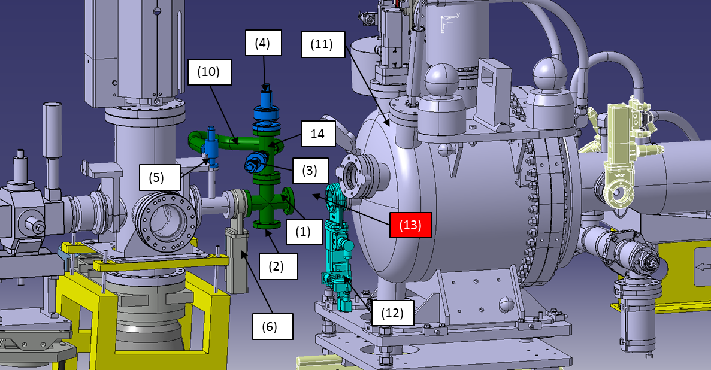
Vapor Chamber integration (1/3)
Beamline components to be reused
Config1: Actual downstream layout on site
Config2: Downstream layout with vapor chamber
Same component list for upstream layout

Slide 3
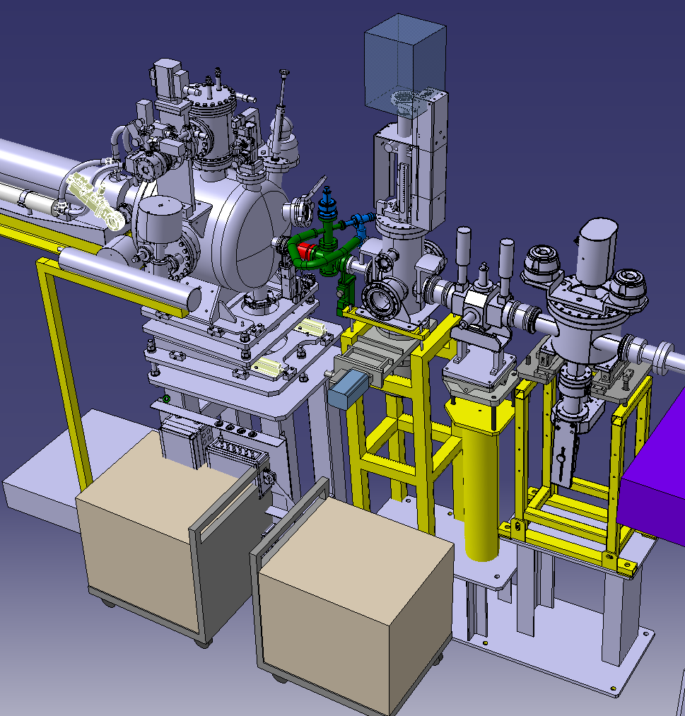
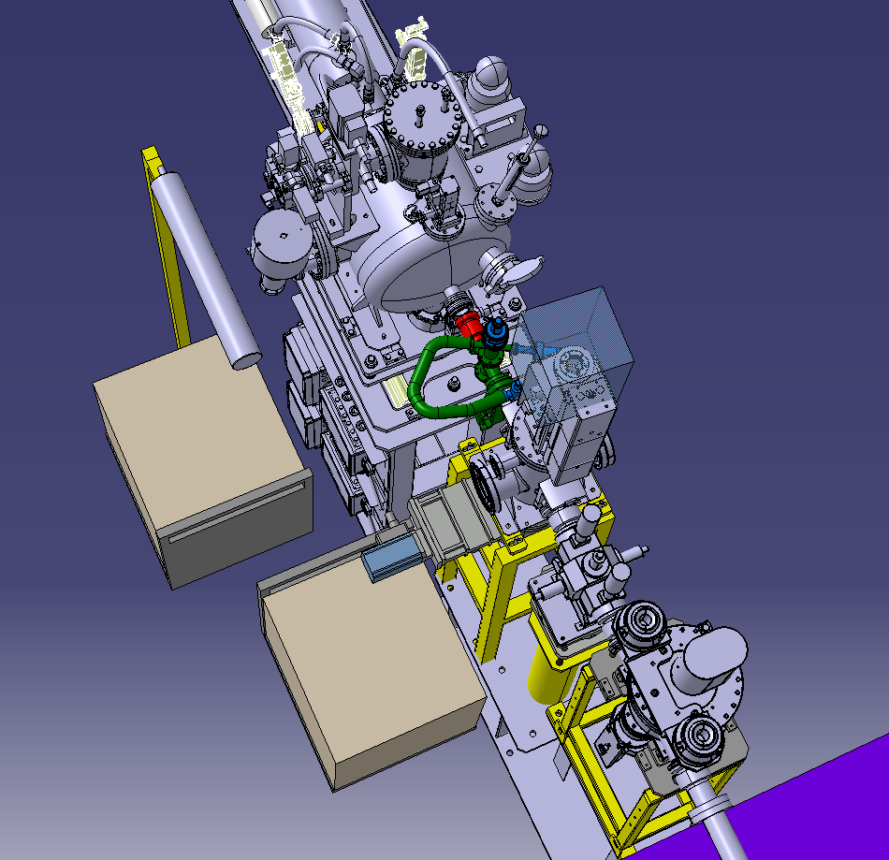
Vapor Chamber integration (2/3)
Vapor chambers supports location and volume requires repositioning of the vacuum trolley and BPM

Slide 4
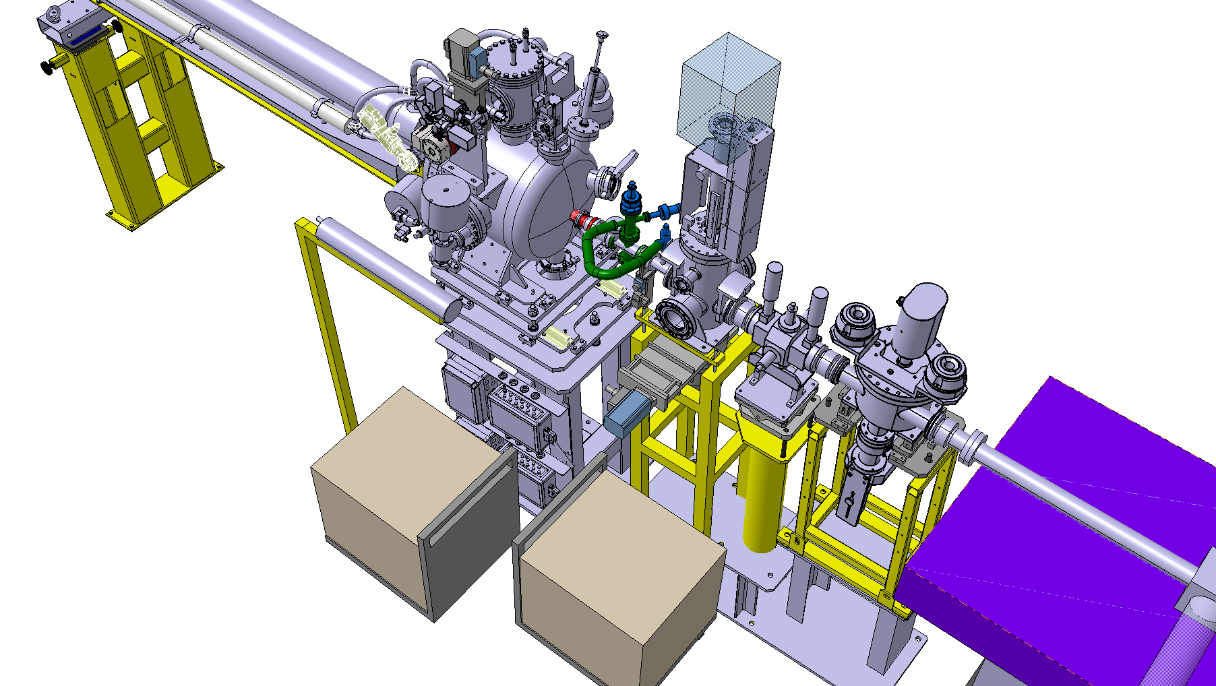
Vapor Chamber integration (3/3)
Does the racks require easy access? If yes then it is recommended to be placed in an other location

Slide 5
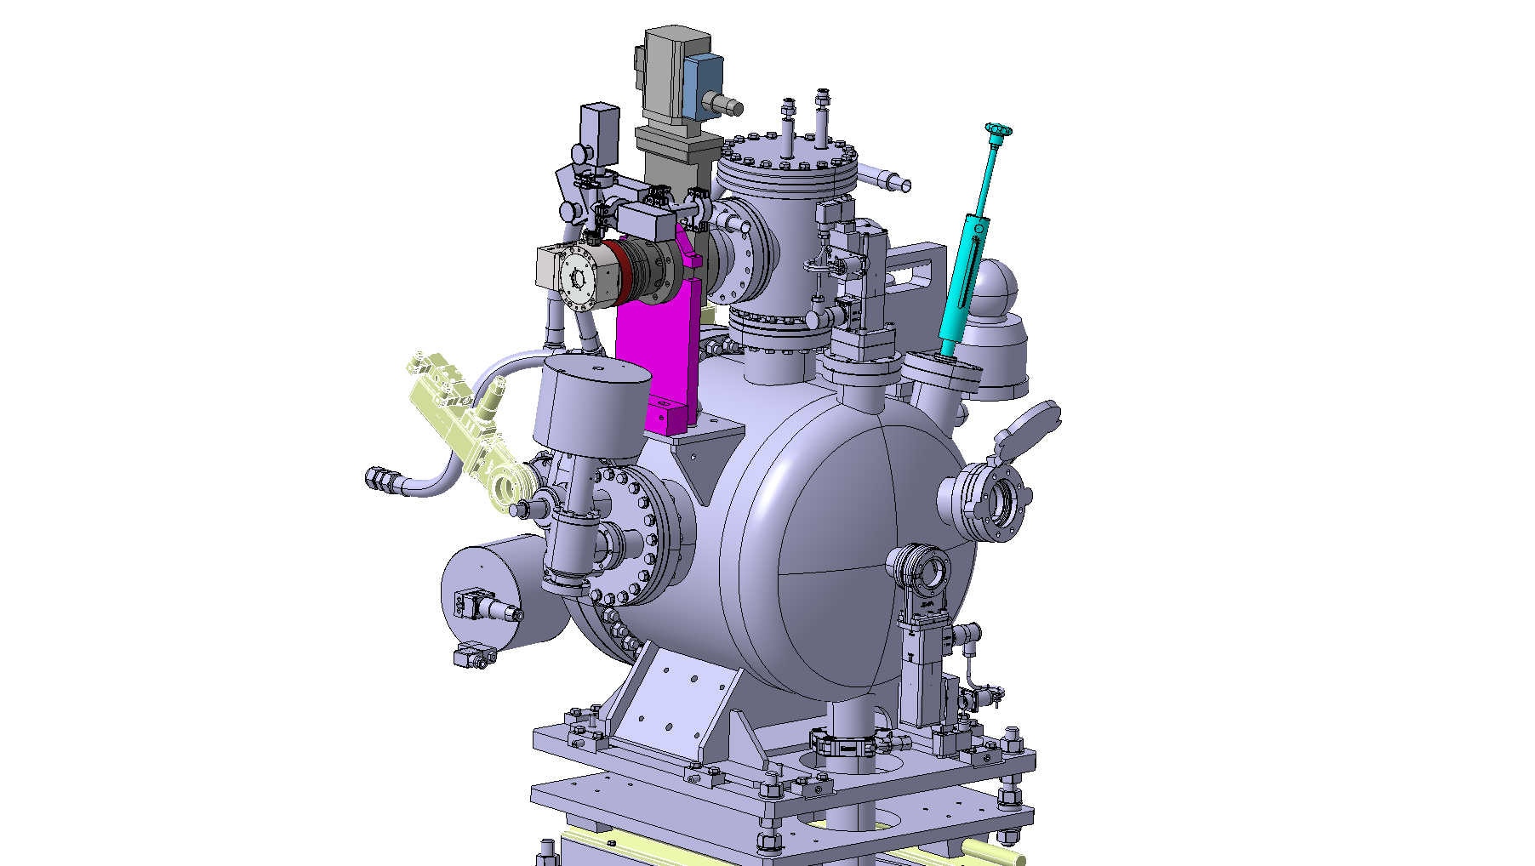
Vapor Chamber Design CERN open points
CERN needs more detailed technical specifications to validate plunger selection
Pumping group -> CERN ok
Who is in charge to design the support?

Slide 6
Chiller unit integration
1) Check if water cooled chiller unit can be PN10 or PN16 compliant (?)
2) If it cannot be modified to be PN10 or PN16 compliant -> CERN investigate feasibility to plug the chiller on the Laser water network : Still on going
3) Other solutions?

