Slide 1


Q4 update
Q4 cold mass
CERN CEA Collaboration meeting
02/06/2016
H. Felice, M. Segreti, D. Simon

Slide 2
Status of the MQYY development
MQYYM: 1 short model, single aperture, 1,2 m magn length, 1,4m phys. length
  Design at CEA
  MQM cable provided by CERN
  Coil fabrication at CEA
  Mechanical measurements on conductor (location TBD)
  Collaring at CERN (vertical press in 927)
  Yoking to be defined
  Warm magnetic measurements to be defined
  Cold test at CEA Saclay
2 prototypes (double aperture) designed and built in industry (2016-2020)
  QuaCo project (EU PCP): firms in competition (4/3/2), 2 prototypes from industry,
1 serie of 4 magnets + 2 spares built in industry
  After Quaco
  Or started earlier than QuaCo

Slide 3
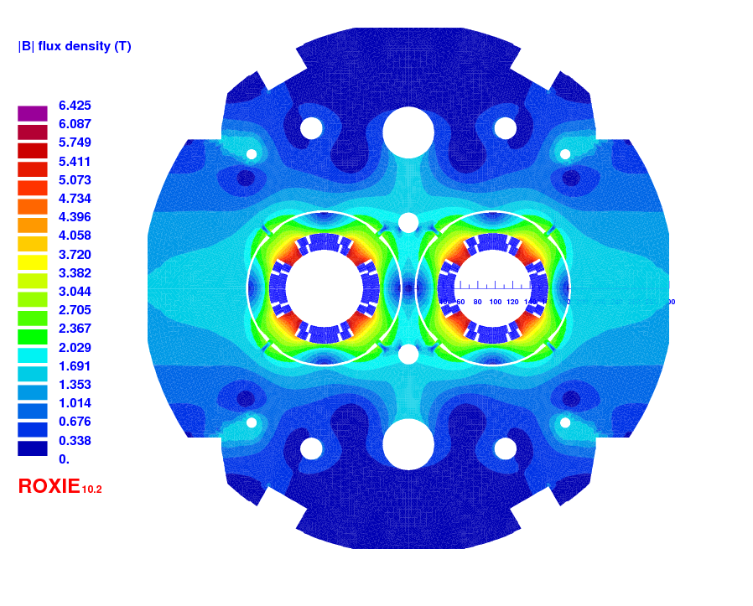
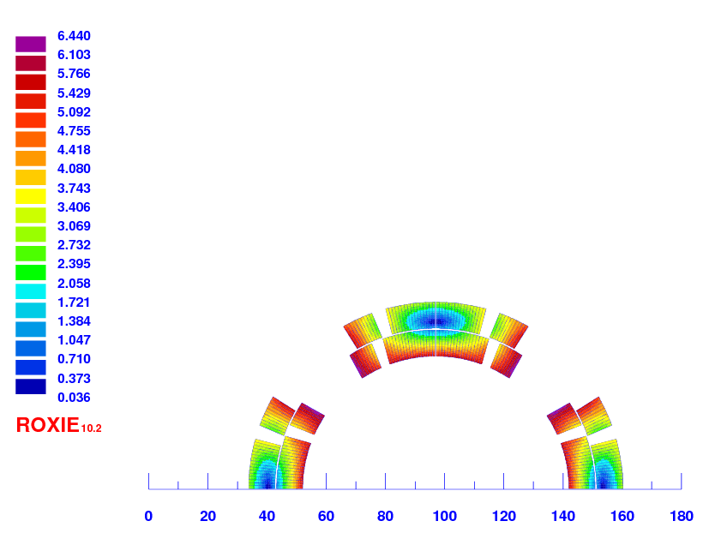
Update of the cross-section (V3)
Different sources showed a slight difference in MQM conductor dimension
Cable Specification IT-2631
  8,8 mm x 0,77 / 0,91 mm (instead of 0,78/0,91 used so far)
HEX position in agreement with corrector (180 mm, 60 mm in diameter)
Yoke diameter = 614 mm
All b_{n} harmonics < 1 unit
b₁₄ = 1,32
To be updated after discussion

Slide 4
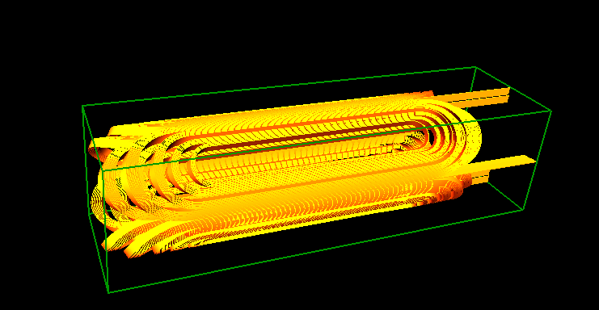
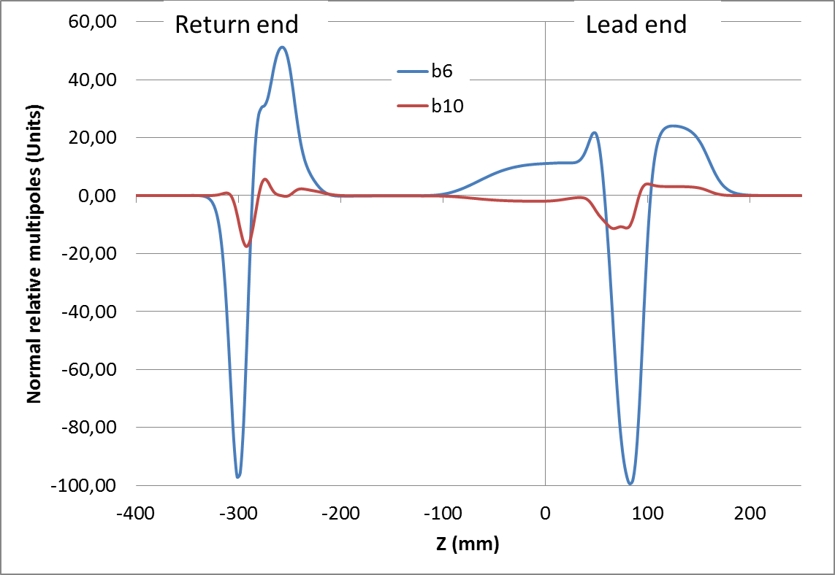
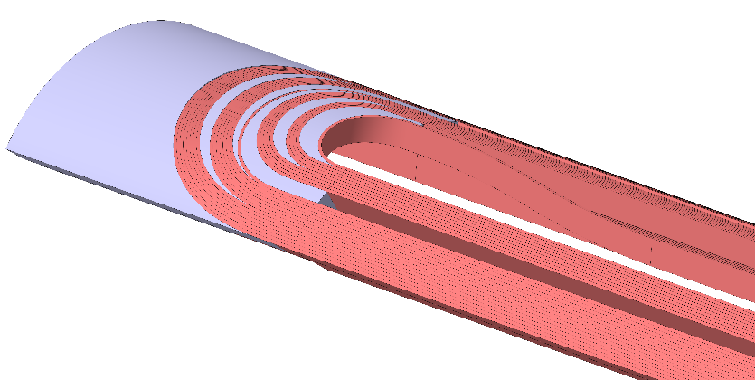
Update of the coil ends (V3)
End optimisation on single aperture to minimize integrated b6
  Layer jump with bending radius of 300 mm (based on practice winding)
Model Opera 3D started
  Question on coil export from roxie to opera3D

Slide 5
Conductor needs
Short model
  ULSM = 140 m including 10 m provision
  10 ULSM planned in the collaboration CERN-CEA
  Insulated Conductor at CEA: december 2016
Prototypes
  ULP = 400 m including 10 m provision
  10 ULP per company (1 practice coil, 9 real coils)
  2 ULP for additionnal test (winding test)
  4 ULP for 1 aperture back-up
  Total of 26 ULP
  Insulated conductor at companies spring 2019 (according to preliminary QuaCo schedule)
Series
  ULS=ULP
  4 magnets + 2 spare magnets => 6x8= 48 ULS
  8 ULS for 2 aperture back-up
  2 ULS for practice coils
  => Total of 58 ULS

Slide 6
Collaring of MQYYM
MQYYM: 1 short model, single aperture, 1,2 m magn length, 1,4m phys. length
  Design at CEA
  MQM cable provided by CERN
  Coil fabrication at CEA
  Mechanical measurements on conductor (location TBD)
  Collaring at CERN (vertical press in 927) foreseen in spring 2017
  Yoking to be defined
  Warm magnetic measurements to be defined
  Cold test at CEA Saclay (summer 2017)
Collaring: Drawings of the vertical press from CERN received today
compatibility with the design of the collars will be checked.
Meeting at CERN will be planned as soon as strike will be over… so we can have a face-to-face meeting in 927.
Yoking: discussion to be postponed to next meeting

Slide 7
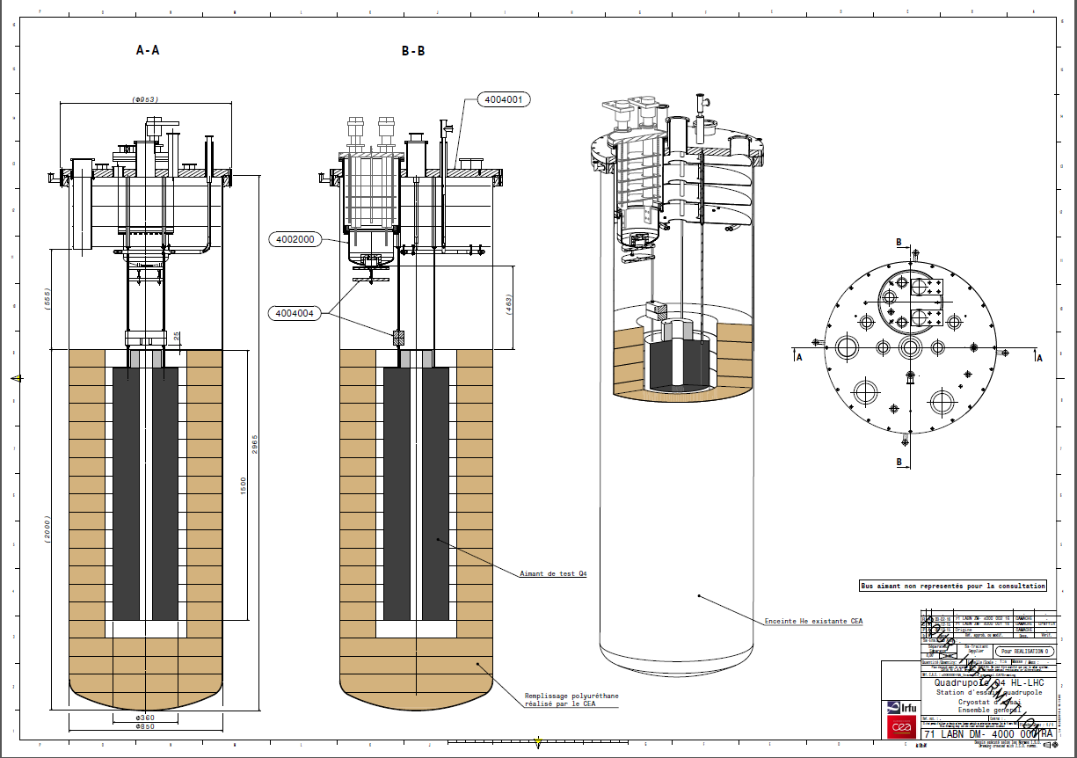
Magnetic measurement for MQYYM
For the short model: MQYYM
  Warm measurements
    Horizontally
    Type of probe:
      Is the warm probe different from the cold measurement probe?
  Measurements at cold
    Compatibility with the vertical test station
      Type of probe (rotating in LHe, need for anticryostat?)
      Positionning system
      Status of the design at CERN?
      How to move forward?

Slide 8
Magnetic measurement for MQYYM
Name of the engineer at CERN technically in charge of the project: E. Todesco/ A Foussat
Name of the engineer at CEA technically in charge of the project: H. Felice
Official name of the magnet : MQYYM
Magnet type : Quadrupole
Number of magnets to be measured 1 single aperture
Aperture diameter (total and free) 90 mm, 70 mm free?
Length (magnetic and total (physical)) 1.2 m magnetic, 1.5 m total
Nominal and max. field or gradient 120 T/m nominal
Location of the measurements:
  To be discussed for the collared coil
  CEA Saclay, summer 2017 at room temperature and 1,9 K
Foreseen date of arrival of first magnet at CERN : NA
A clear indication in case the magnet should be measured outside of CERN (partner institute) together with information about the measurement equipment to be provided (probe only or complete system) complete system needed
Measurements at warm and/or at cold: both room temperature (collared coil and magnet) and 1.9 K
Tests and measurements to be performed: Gradient and field multipoles

Slide 9
Magnetic measurement for MQYY
Prototype (within quaco)
Name of the engineer at CERN technically in charge of the project: E. Todesco/ A Foussat
Name of the engineer at CEA technically in charge of the project: H. Felice
Official name of the magnet : MQYY?
Magnet type : Quadrupole
Number of magnets to be measured 1 double aperture
Aperture diameter (total and free) 90 mm, 70 mm free?
Length (magnetic and total (physical)) 3,67 m magnetic, m total
Nominal and max. field or gradient 120 T/m nominal
Location of the measurements:
  Warm: At the two company premises
  Cold: at CERN or CEA Saclay
Foreseen date of arrival of first magnet at CERN / CEA: Spring 2020
A clear indication in case the magnet should be measured outside of CERN (partner institute) together with information about the measurement equipment to be provided (probe only or complete system) warm system TBD / cold complete system needed
Measurements at warm and/or at cold: both room temperature (collared coil and magnet) and 1.9 K
Tests and measurements to be performed: Gradient and field multipoles

Slide 10
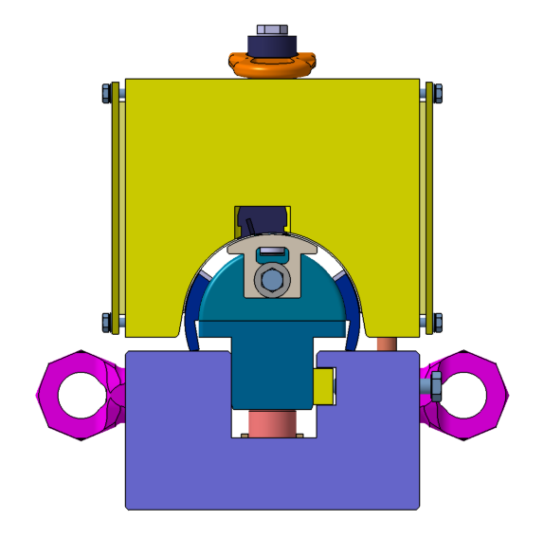
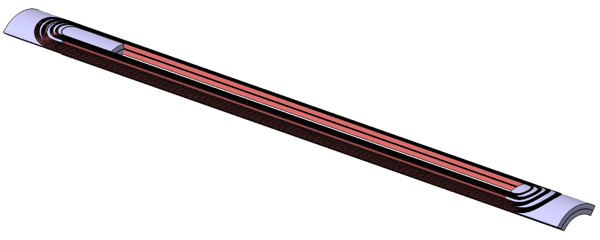
CAD STATUS
MQYYM
Coil fabrication Tooling (mandrel, side pushers, curing cavity…)
  2D drawings are ready
  Layer jump is being updated
  Waiting to hear from CERN about the procurement of the components (who does what and how)
Collars are updated with MQM cable based design
  Need to check the compatibility with the press (drawings received 02/06)
Coil V3 is being worked on right now
Connection box is next
Yoke: to be done. Assembly concept to be worked on.
Prototype CAD model
DRAFT model of the double aperture for integration study purpose should be ready by the end of June
Action item CEA: Review and approval process to be defined

Slide 11
Status on Magnet Protection Study
D. Simon

Slide 12
Introduction
This presentation talks about the protection of the Q4 quadrupole.
A first study of the quench protection for the current design of the quadrupole is proposed. Results are shown for one aperture
The study is performed with the ROXIE and Qtransit softwares
The Qtransit code is based on the M.N.Wilson quench code and which have been developed by CEA for performing quench simulation

Slide 13
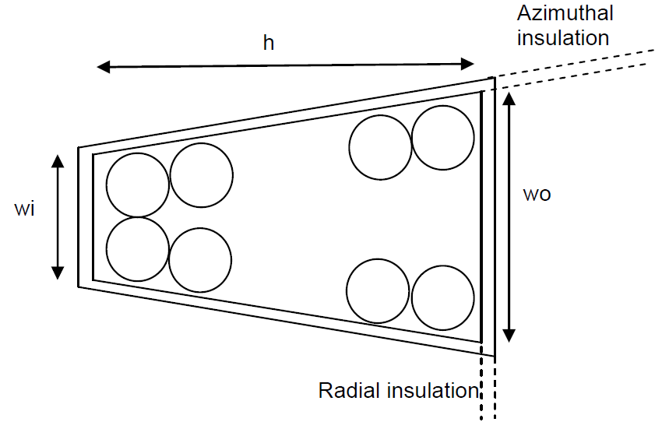
INPUTS
Q4 Cable
h | 8.8 mm
wi | 0.78 mm (V2)
wo | 0.91 mm
Strand diameter (d) | 0.475 mm
N strand | 36
Radial insulation (e) | 0.08 mm
Azimuthal inslation (e) | 0.08 mm
Insulated cable crosss section | 8.960 mm²
Detection threshold | 0,1 V | These values have been confirmed by CERN (Email from E.Todesco 08/03/2016)
Validation time | 10 ms
Maximum Hotspot temperature allowed | < 250K | These values are conservatives (Email from B. Auchmann 09/03/2016)
Maximum voltage to ground allowed | 800 V

Slide 14
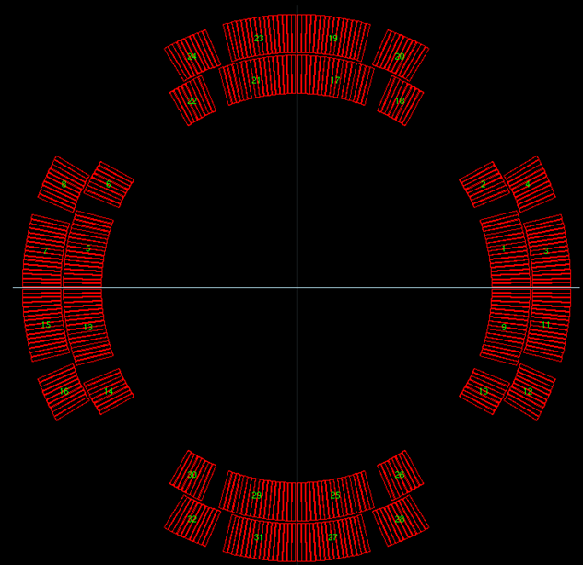
2D Cross section With roxie
The ROXIE software has a module that allows the quench simulation. To perform the “2D” quench simulation on ROXIE the cross section of the magnet has to be built in order to describe the quench propagation in the coil (ie the number of the blocks and the conductor that follow the winding)

Slide 15
HYPOthesis
The ROXIE quench’s simulations have been made for two different cases. The first case simulate a the behavior of the magnet if a quench occur in the magnet without protection (ie without quench heaters). The second case simulate the behavior of the magnet with quench heaters.
The Qtransit’s simulation have been made for the two past cases in order to check the ROXIE results

Slide 16
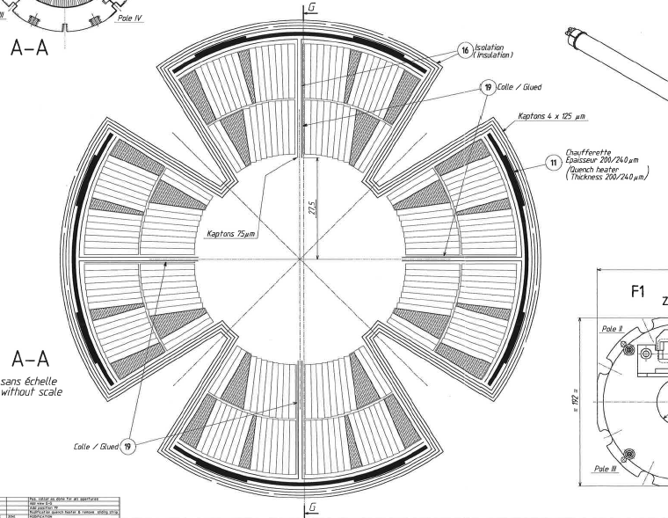
HYPOthesis
To be in agreement with operating condition in LHC, the protection system of the MQYY will be carried out with Protection Heaters (and no dump resistor)
The design of the Protection Heaters will be inspired by the MQ Protection Heaters: outer layer
LHCMQ_CS0021

Slide 17
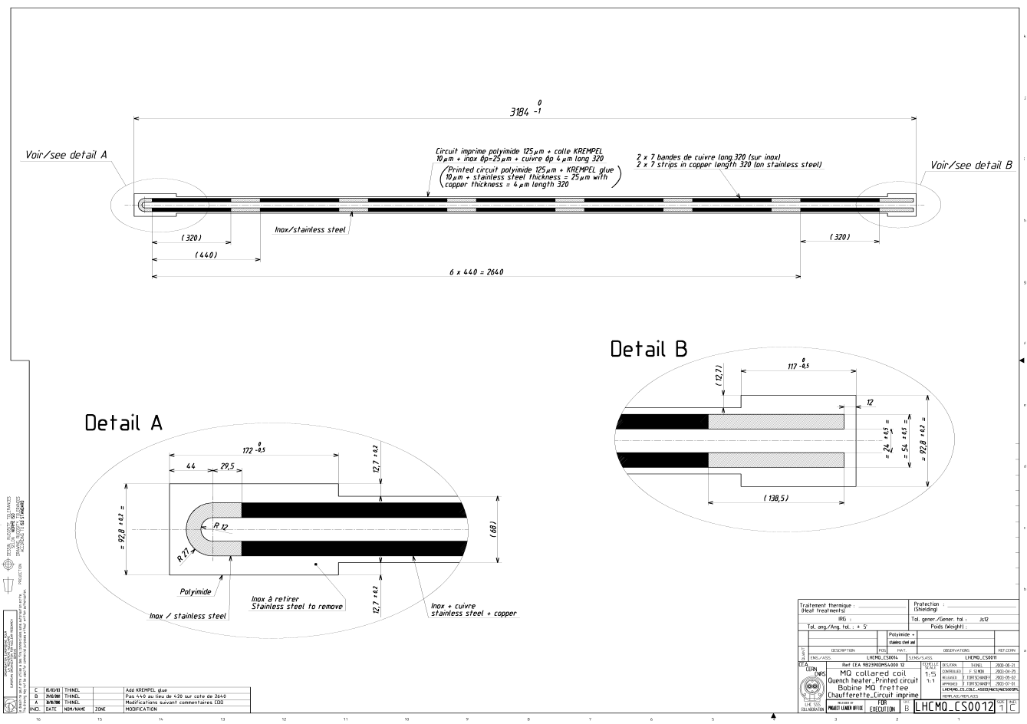
quench heaters of the MQ

Slide 18
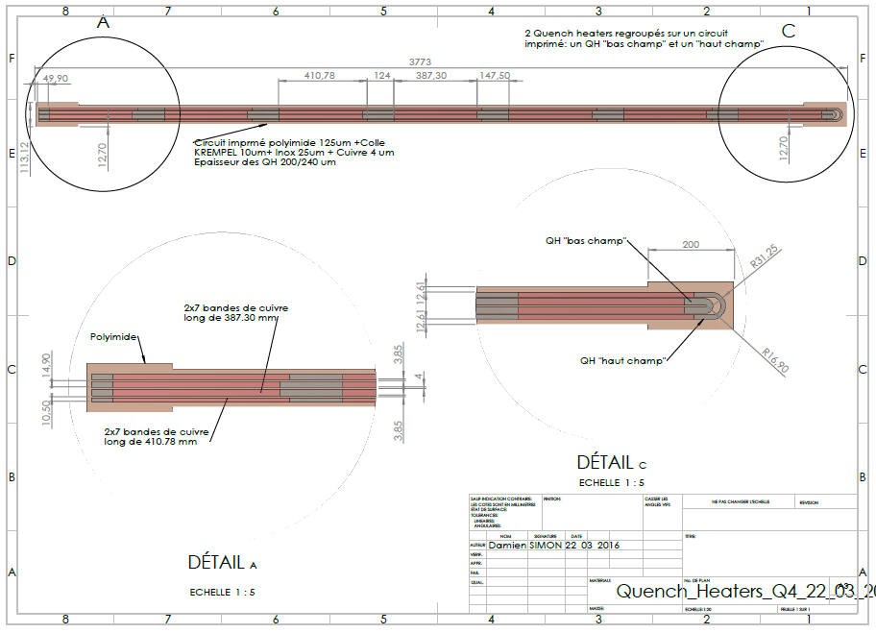
Preliminary DESIGN OF THE Quench heaters for THE MQYY

Slide 19
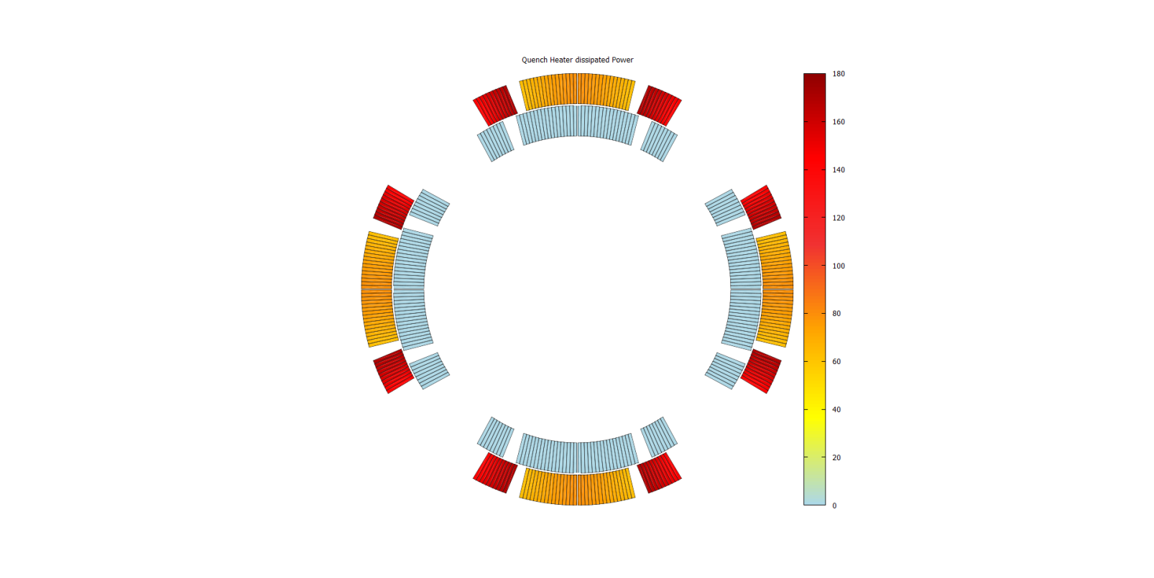
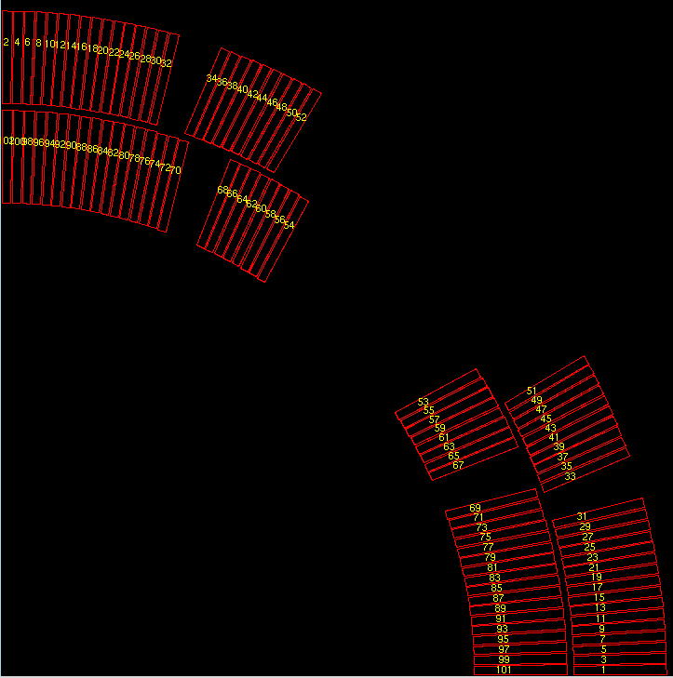

Comparison of Mq and mqyy Protection heaters
 | MQ | MQYY LF v1 | MQYY HF v1
I (A) | 80 | 80 | 80
U (V) (for 4 QH) | 900 | 900 | 900
R1/m (no copper = stainless steel) à 1,9K (Ω/m) | 1,5 | 1,5 | 1,5
R2/m (copper plated) à 1,9K (Ω/m) | 0,43 | 0,38 | 0,38
Local power of the heating stations (W/cm²) | 64 | 63 | 125
Surface of the heating stations (mm²) | 1800 | 2003 | 998
Power density in W/cm²
QH High field
QH Low Field
Local Power of the protection heaters

Slide 20
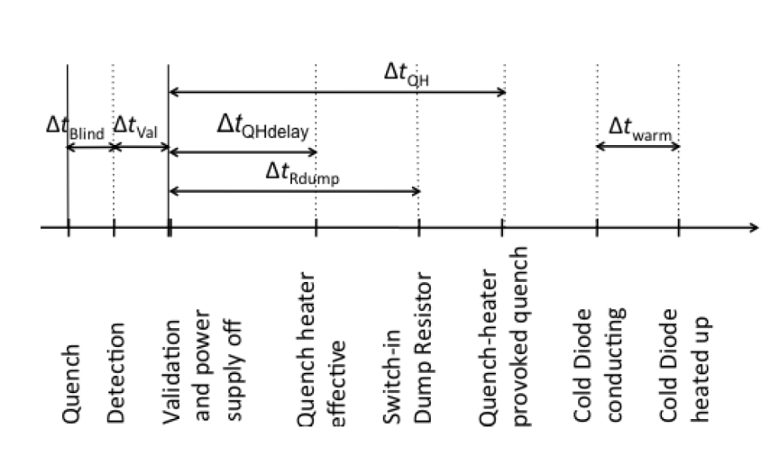
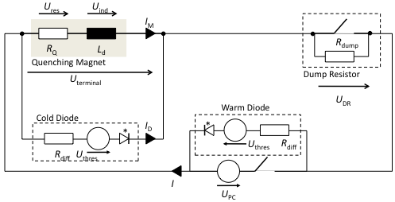
Hypothesis
 | MQYY
I₀ | 4590A
QMDCC | 0,00085m
MAGLEN | 3,744m
MAGMLE | 3,671m
WARMDIO | U_{threshold} = 1V; R_{diff} = 0
PCREGUL | V_{max} = 8V
Δt (BLINDTIME) | 6 ms
Δt_{val} | 10 ms

Slide 21
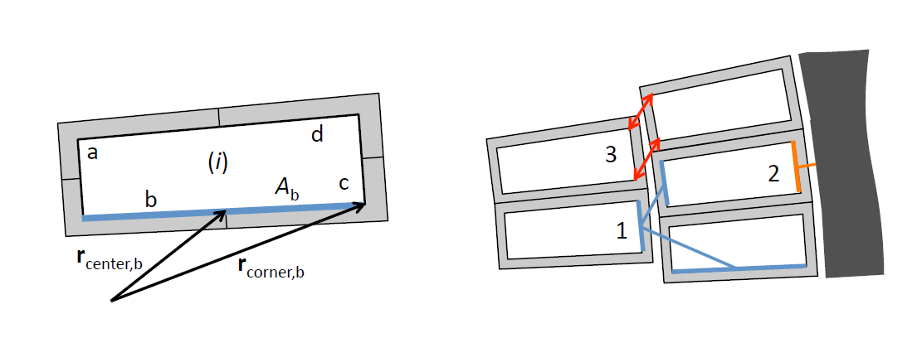
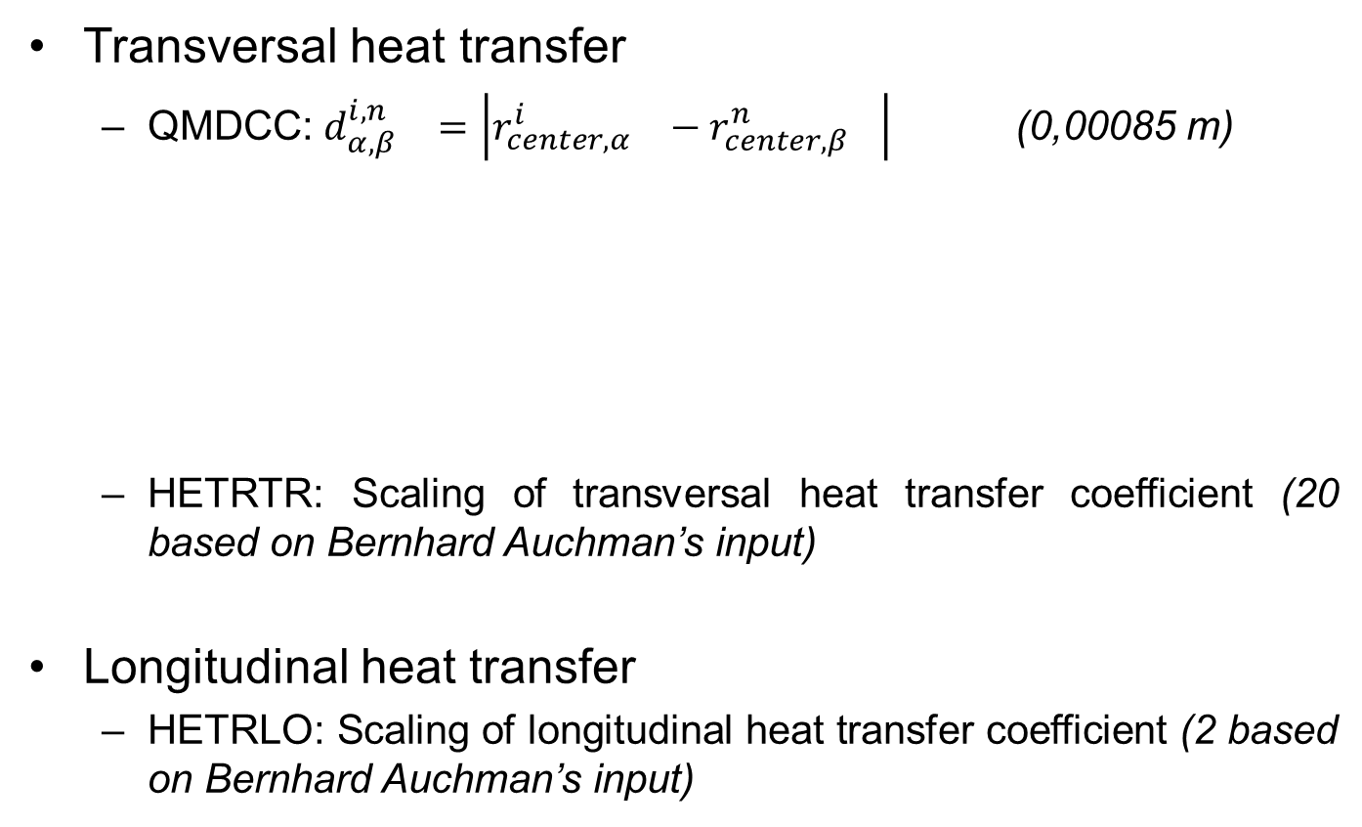
Thermal contact
Transversal heat transfer
  QMDCC: ${d_{α,β}^{i,n}}_{}=\left|{r_{center,α}^{i}}_{}−{r_{center,β}^{n}}_{}\right|$ (0,00085 m)
  HETRTR: Scaling of transversal heat transfer coefficient (20 based on Bernhard Auchman’s input)
Longitudinal heat transfer
  HETRLO: Scaling of longitudinal heat transfer coefficient (2 based on Bernhard Auchman’s input)
Extracted from Juljan Nikolai Schwerg’s thesis

Slide 22
SIMULATIONS
Case n°1: Without QH
« Hot spot»

Slide 23
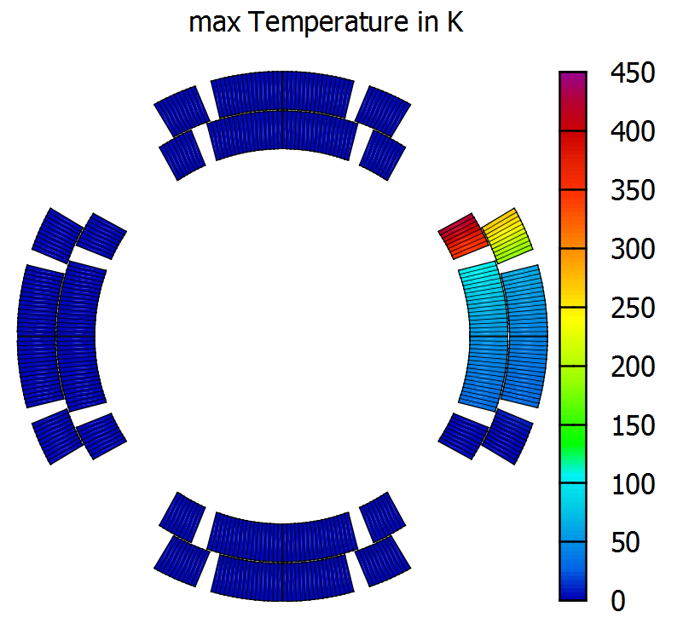
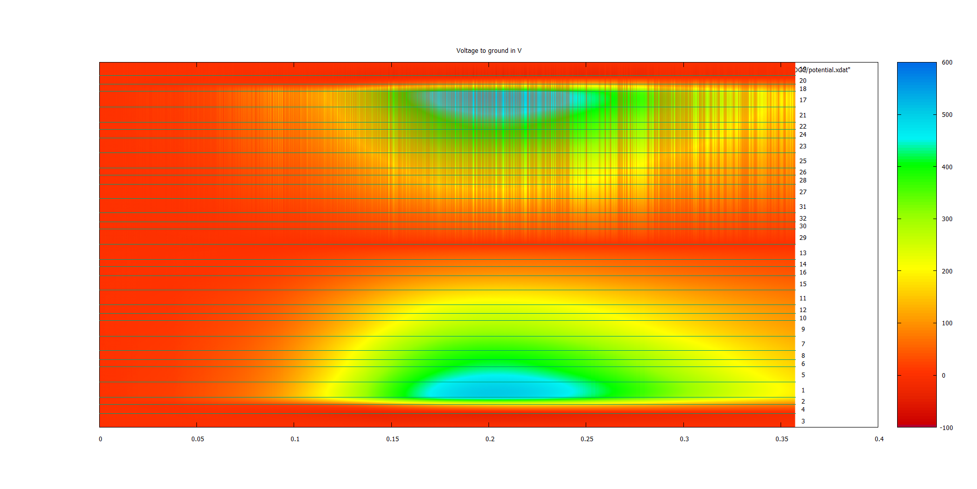
Preliminary RESULTS
Temperature Maximum: 450 K
  Anomaly in the temperature distribution (absence of longitudinal propagation in the symmetric block of the coil)
Max Voltage to ground: 600 V
Max voltage in the coil: 700 V

Slide 24
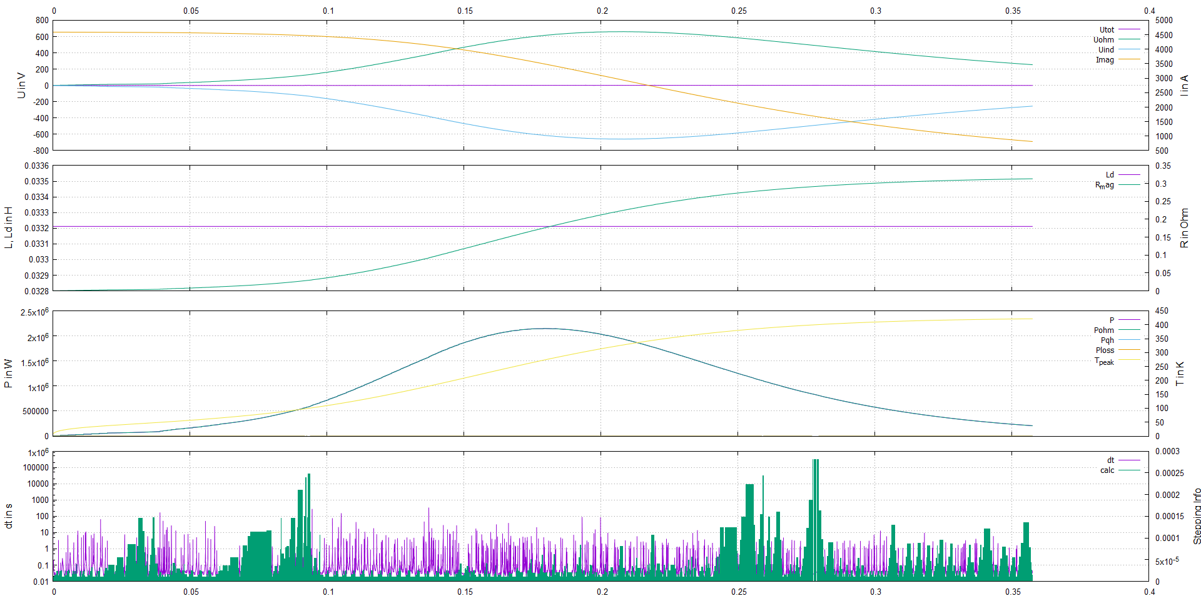
RESULTS

Slide 25
2D Cross section With qh
QH low field
QH high field
« Hot spot »

Slide 26
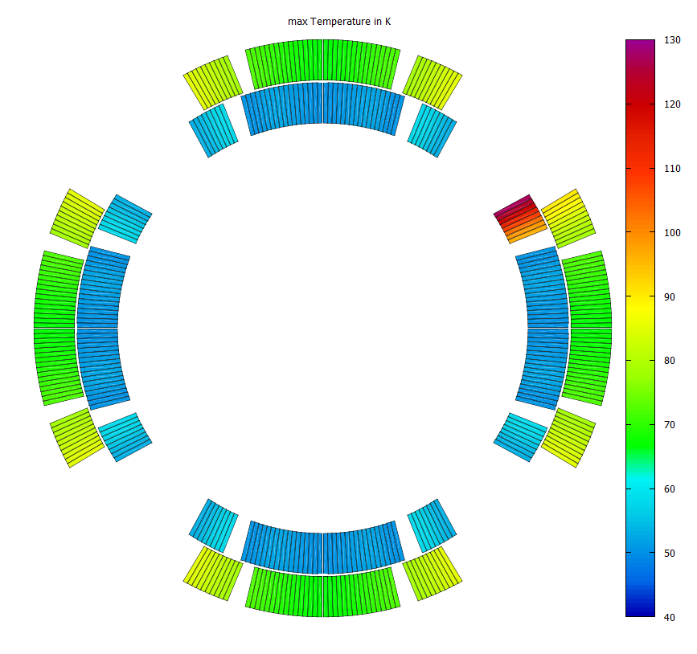
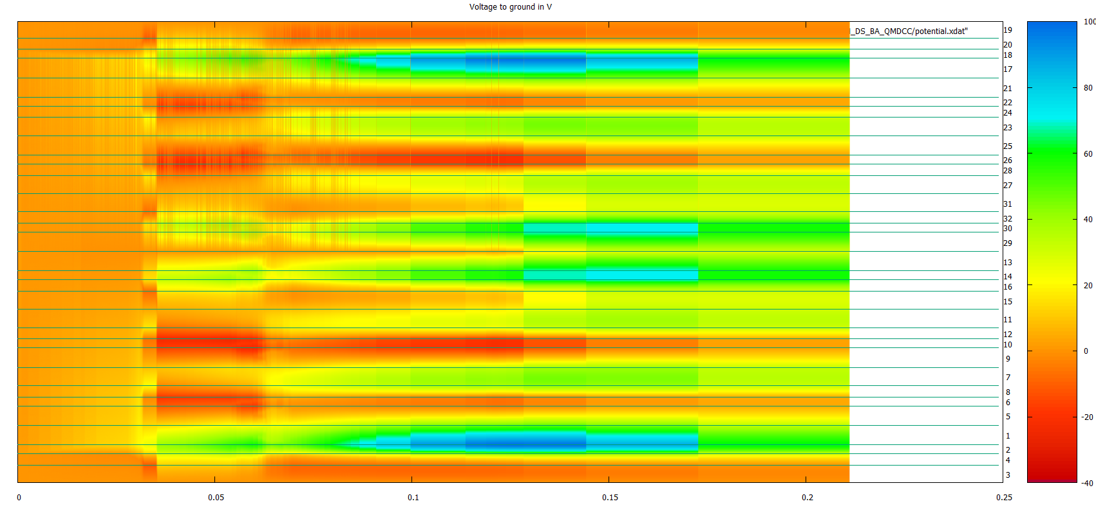
RESULTS
Maximum Temperature : 130K
  Anomaly in the temperature distribution (absence of longitudinal propagation in the symmetric block of the coil)
Max voltage to ground: 100 V

Slide 27
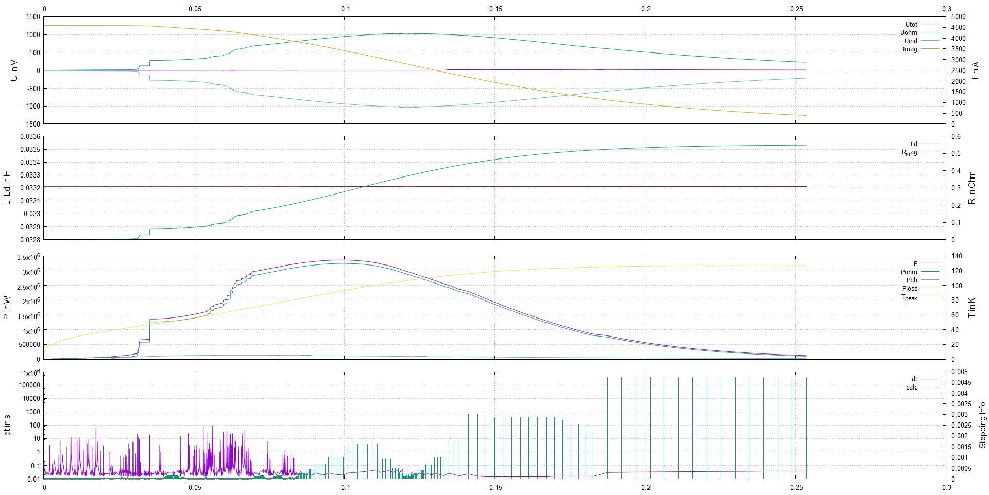
RESULTS

Slide 28
Quench heaters CONNECTION
Main principle: Make the system redundant
=> Next steps: study different failure cases of the protection heaters
1
5
4
2
8
6
3
First power supply: 1H; 2H; 5H; 6H
Second power supply: 1L; 3L; 5L; 7L
Third power supply: 3H; 4H; 7H; 8H
Fourth power supply: 2L; 4L; 6L; 8L
H: High field protection heaters
L: low field protection heaters
7
Under discussion

Slide 29
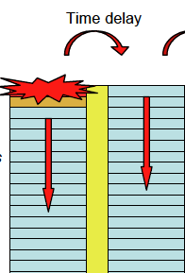
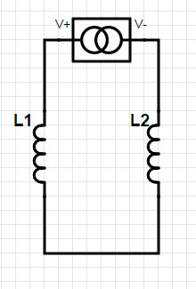
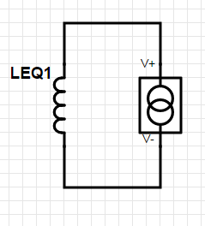

COMPARISON With qtransit
To simulate the quench propagation for the Q4 magnets we used a model of two coils where the first coils represent the inner layer of the 4 coils and the second coils represent the outer layers.
The two layers are separated by a G10 shim of 0,5 mm which delays the thermal conduction between the two layers.
The total volume of the 4 coils and the total energy are accounted for. QH are fired on all coils.
=
M12
L1
L2
$$L_{eq1}≈L_{1}+L_{2}+2M_{12}$$

Slide 30
COMparison With qtransit
 | ROXIE | Qtransit
Without protection heaters
Hot Spot | ≈445K | ≈300K
Voltage to ground | ≈600V | ≈634V
With protection heaters
Hot Spot | ≈130K | ≈180K
Voltage to ground | ≈100V | ≈340V

Slide 31
Conclusion
The QTRANSIT and ROXIE codes have been used to perform preliminary Quench simulation.
Simulations with and without protection heaters have been carried out.
The highest hot spot temperature in absence of protection heaters is around 450K with ROXIE (conservative).
With QH:
  the hotspot is limited to ~180K with ROXIE.
  The max V to ground is ~100 V with ROXIE.
  A preliminary design of the protection heaters for the MQYY have been made.

Slide 32
next steps
Continue to fine tune the ROXIE inputs.
Study different failure cases of the protection heaters.
Perform 2+1D simulation with ROXIE (discretisation of MAGLEN).
Perform ROXIE simulation with coupling-current losses in the coil.
Perform simulation for the 2 apertures with the yoke.

Slide 33
Reference
ROXIE USER CASE: QUENCH SIMULATIONS « Susana Izquierdo Bermudez »
Numerical Calculation of Transient Field Effects in Quenching Superconducting Magnets « Juljan Nikolai Schwerg »
ROXIE User’s Documentation « Bernhard Auchmann »

Slide 34

HYPOthesis
MAGLEN: Average half-turn length (m), i.e. length of the windings (electrical, thermal and magnetical)
MAGMLE: Magnetic length of the magnet at nominal current (m) (used for inductance voltages and inductance)
QUENCH:
    Time: Time when a conductor quenches
    Cond: Conductor where quench starts
    Piece: Longitudinal position where quench starts for 3D simulations
The magnetic length have been made determined with ROXIE by the CEA team (Michel Segreti & Hélène Felice)

Slide 35
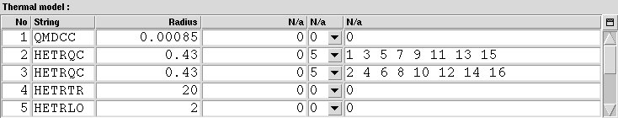
HYPOthesis
QMDCC: Max. radius of effective inter-cable heat transfer (m) (default: 0.0005). The QMDCC plays an important role on the results of the quench simulation
HETRQC: Scaling of radial transfer coefficient from the quench heater to conductor (default: 1)
HETRTR: Scaling of transversal transfer coefficient (20)
HETRLO: Scaling of longitudinal transfer coefficient (2)

Slide 36
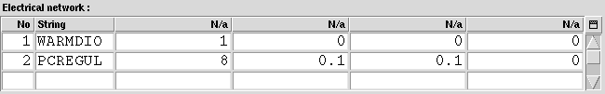
HYPOthesis
WARMDIO: Warm diode definition
PCREGUL: Maximum output voltage for the power converter

Slide 37
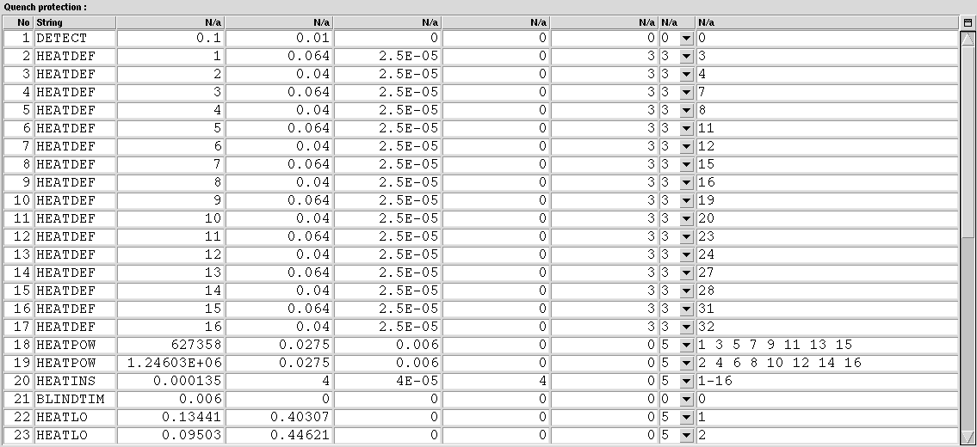
HYPOthesis WITHOUT QH
DETECT: Detection voltage (LHC circuits 0.1V-0.5V) and validation delay Δtval (LHC circuits 10 ms)
BLINDTIM:Time to get over the threshold (Δtblind). Delay of detection blindness after quench start (s), useful in case of 2D simulations to account for the initial growth of the resistive zone.

Slide 38

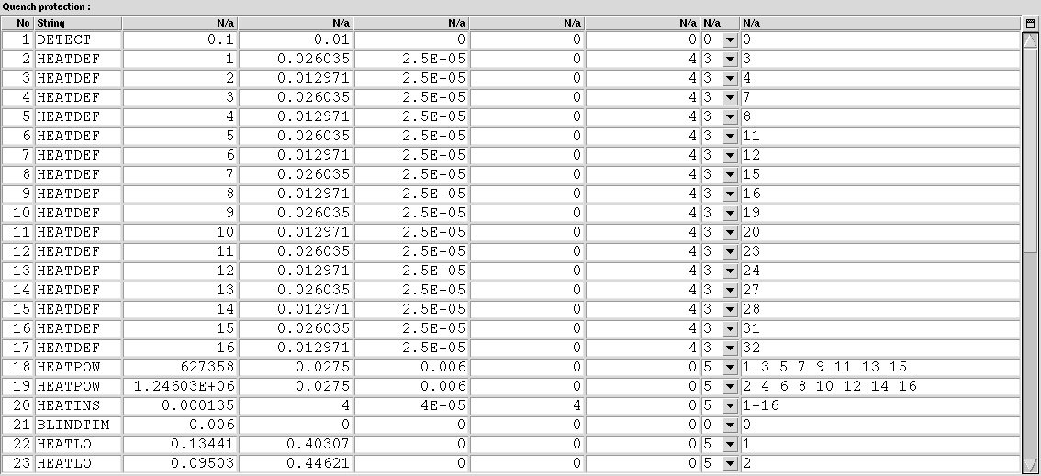
HYPOthesis With qh
  HEATDEF: Definition of the heater geometry and placing in the coil
HEATLO: Heater layout. In case of heater stations, defines the length covered by the heating station (cov) and the distance between heater stations (dist).

Slide 39
Definitions of the various time delays
Case 1:The outer layer quenches before the quench heaters provok a quench
T_{blind}
Time delay
T_{validation}
Inner layer
QUENCH HEATERS PROVOKED THE QUENCH OF THE INNER LAYER
QUENCH
T_{Quenchcoil1}
DETECTION
T_{Quenchbackcoil1}
Time delay
T_{QHdelay}
T_{QH}
Outer layer
QUENCH HEATERS PROVOKED THE QUENCH OF THE OUTER LAYER
T=0s
VALIDATION &
POWER SUPPLY OFF
QUENCH HEATERS FIRED
T_{Quenchcoil2}
T_{Quenchbackcoil2}

Slide 40
Definitions of the various time delays
Case 2: The outer layer quenches when the quench heaters provok a quench
T_{blind}
Time delay
T_{validation}
Inner layer
QUENCH HEATERS PROVOKED THE QUENCH OF THE INNER LAYER
QUENCH
T_{Quenchcoil1}
DETECTION
T_{Quenchbackcoil1}
T_{QHdelay}
T_{QH}
Outer layer
QUENCH HEATERS PROVOKED THE QUENCH OF THE OUTER LAYER
T=0s
VALIDATION &
POWER SUPPLY OFF
QUENCH HEATERS EFECTIVE
T_{Quenchbackcoil2}

