Slide 1
Triplet Design
JAI FCC team:
Jose Abelleira, Androula Alekou, Emilia Cruz,
Leon van Riesen-Haupt, Andrei Seryi (JAI-OX),
Laury Nevay (JAI-RHUL)
17th June 2016

Slide 2
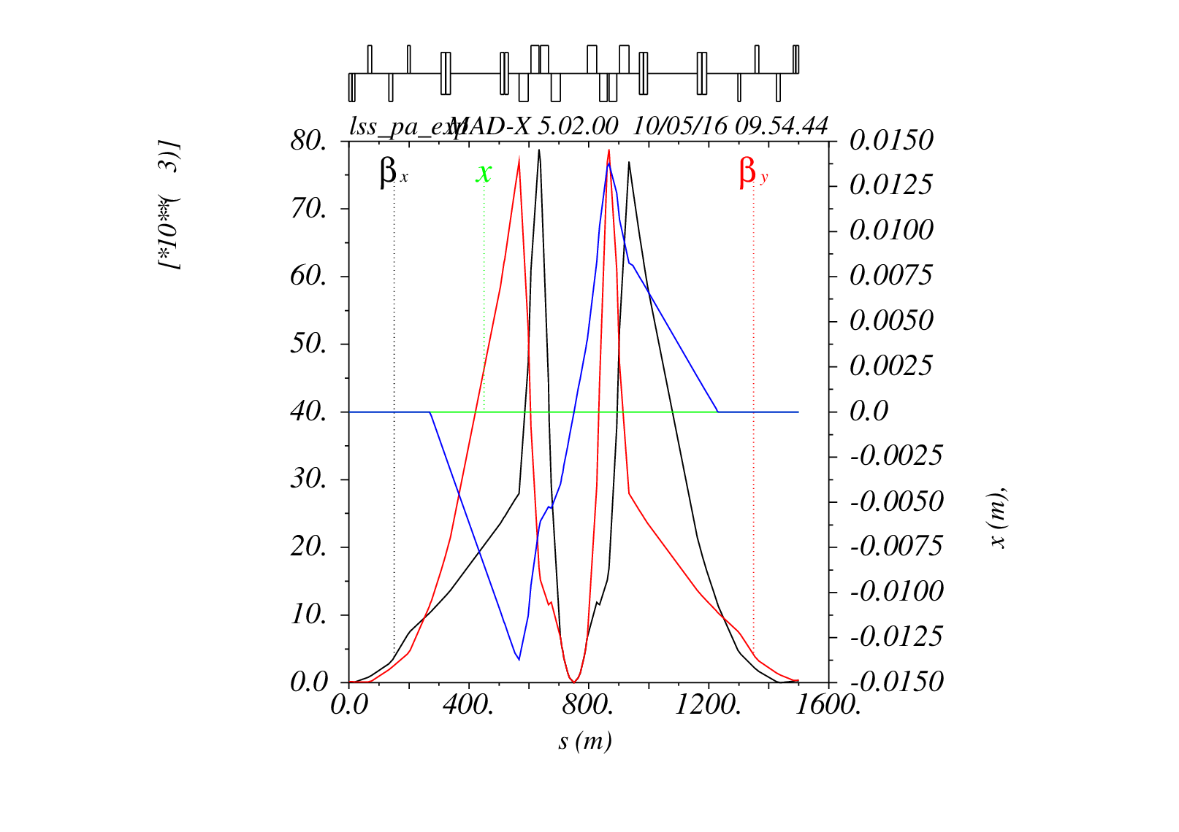
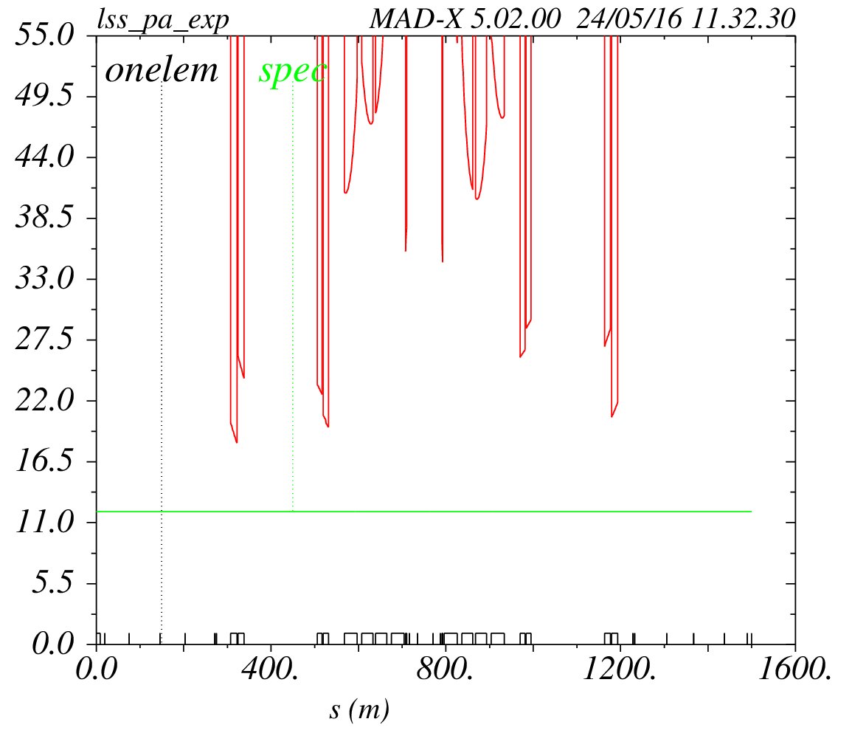
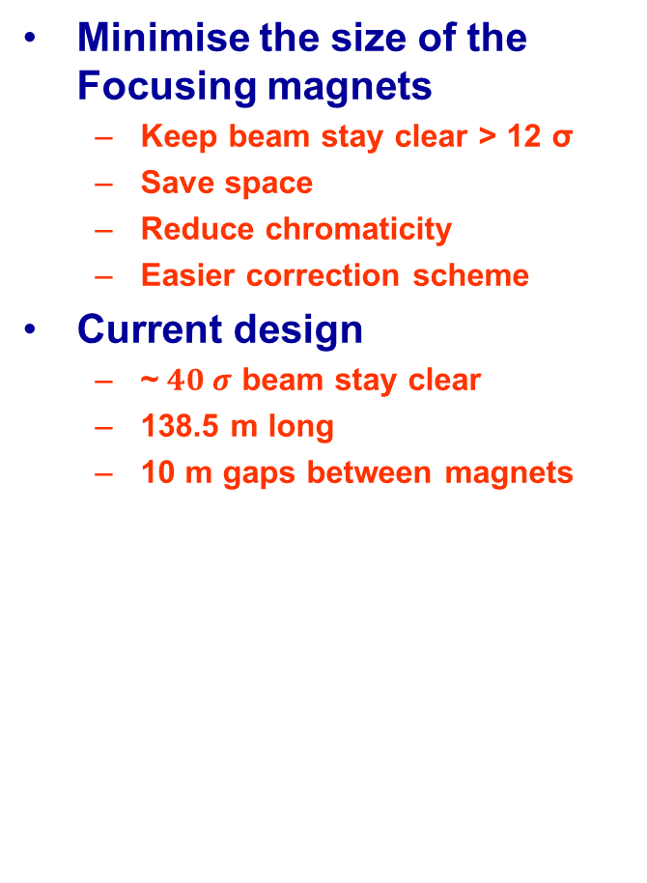
Interaction Region
Minimise the size of the Focusing magnets
  Keep beam stay clear > 12 σ
  Save space
  Reduce chromaticity
  Easier correction scheme
Current design
  ~$40 σ$ beam stay clear
  138.5 m long
  10 m gaps between magnets

Slide 3




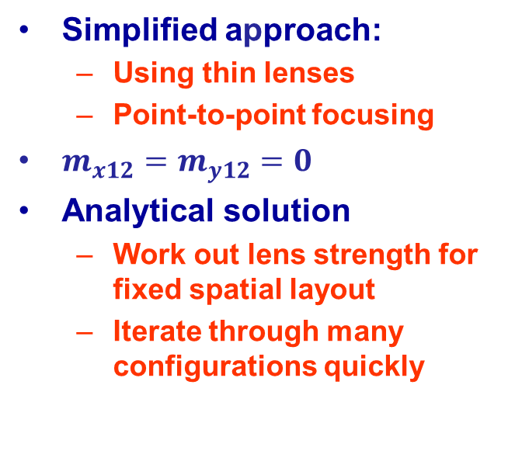

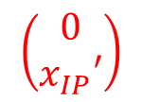

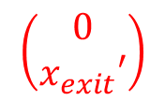


Inner Triplet
$$g_{1}$$
$$g_{2}$$
$$g_{3}$$
$$\left(\begin{matrix}0 \\ x_{exit}′\end{matrix}\right)$$
$$\left(\begin{matrix}0 \\ x_{IP}′\end{matrix}\right)$$
$$\left(\begin{matrix}m_{11} & m_{12} \\ m_{21} & m_{22}\end{matrix}\right)$$
$$l_{1}$$
$$l_{2}$$
$$l_{3}$$
$$l_{4}$$
Simplified approach:
  Using thin lenses
  Point-to-point focusing
$m_{x12}=m_{y12}=0$
Analytical solution
  Work out lens strength for fixed spatial layout
  Iterate through many configurations quickly

Slide 4


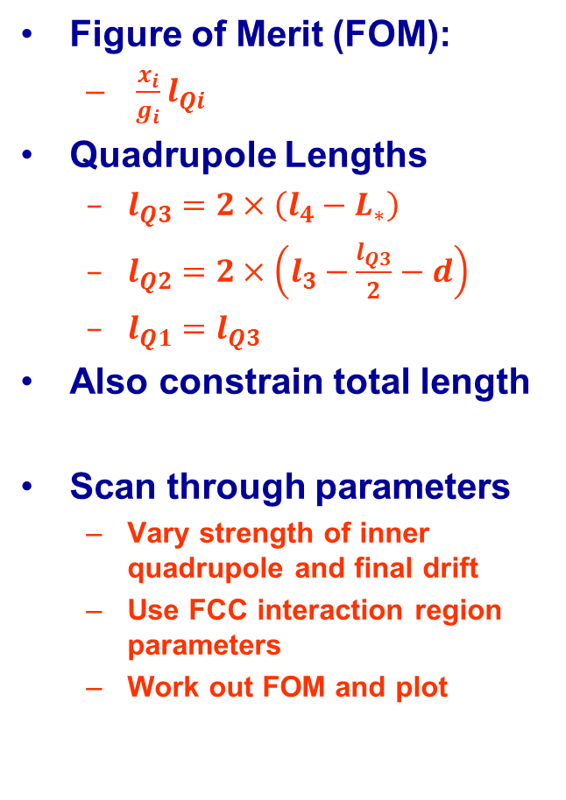




Figure Of Merit
Figure of Merit (FOM):
  $\frac{x_{i}}{g_{i}}l_{Qi}$
Quadrupole Lengths
  $l_{Q3}=2×\left(l_{4}−L_{∗}\right)$
  $l_{Q2}=2×\left(l_{3}−\frac{l_{Q3}}{2}−d\right)$
  $l_{Q1}=l_{Q3}$
Also constrain total length
Scan through parameters
  Vary strength of inner quadrupole and final drift
  Use FCC interaction region parameters
  Work out FOM and plot
$$d$$
$$l_{1}$$
$$l_{2}$$
$$l_{3}$$
$$l_{4}$$
$$L_{∗}$$

Slide 5
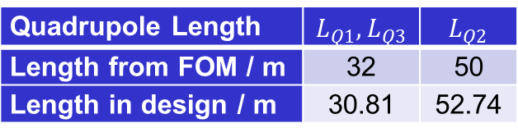
Testing Accuracy of FOM
Verify by repeating aperture scan with MadX
  Much slower – lower resolution
  Good agreement for length
  Need MadX for optimum strength
Use fast scan to find optimum layout for current length inner triplet
  Very good agreement
Quadrupole Length | $$L_{Q1},L_{Q3}$$ | $$L_{Q2}$$
Length from FOM / m | 32 | 50
Length in design / m | 30.81 | 52.74

Slide 6
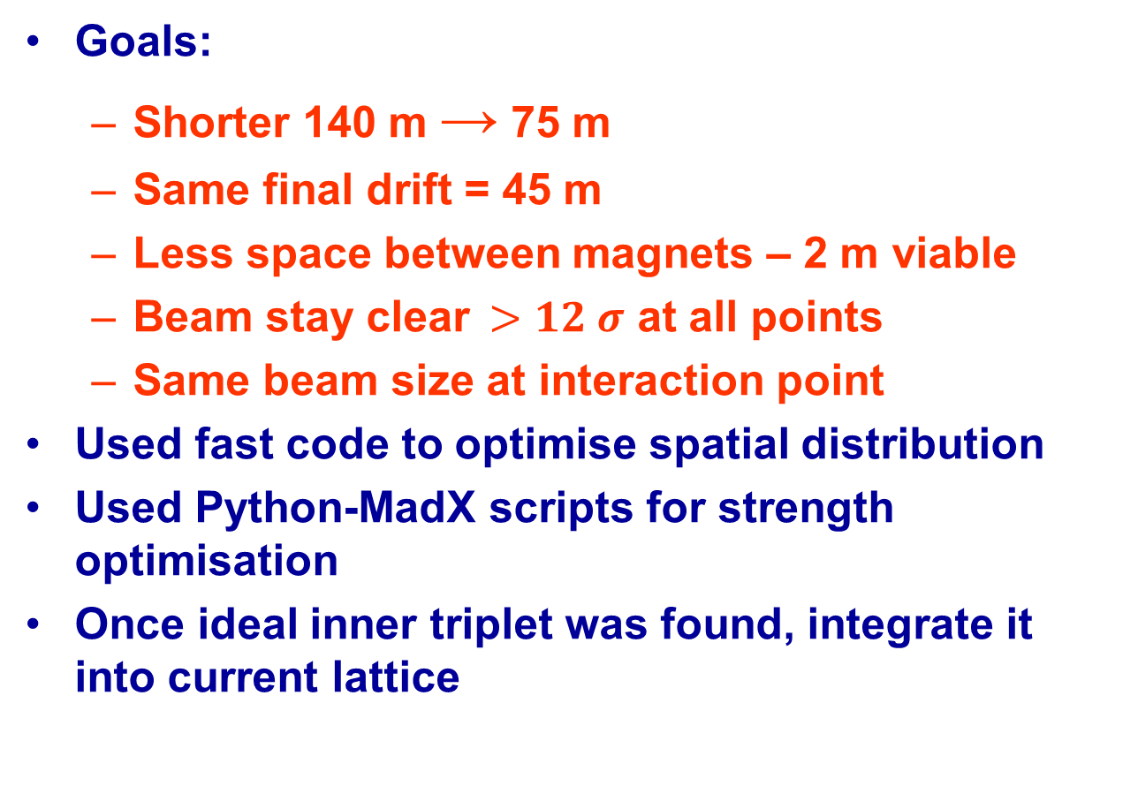
New Design
Goals:
  Shorter 140 m → 75 m
  Same final drift = 45 m
  Less space between magnets – 2 m viable
  Beam stay clear$>12 σ$ at all points
  Same beam size at interaction point
Used fast code to optimise spatial distribution
Used Python-MadX scripts for strength optimisation
Once ideal inner triplet was found, integrate it into current lattice

Slide 7
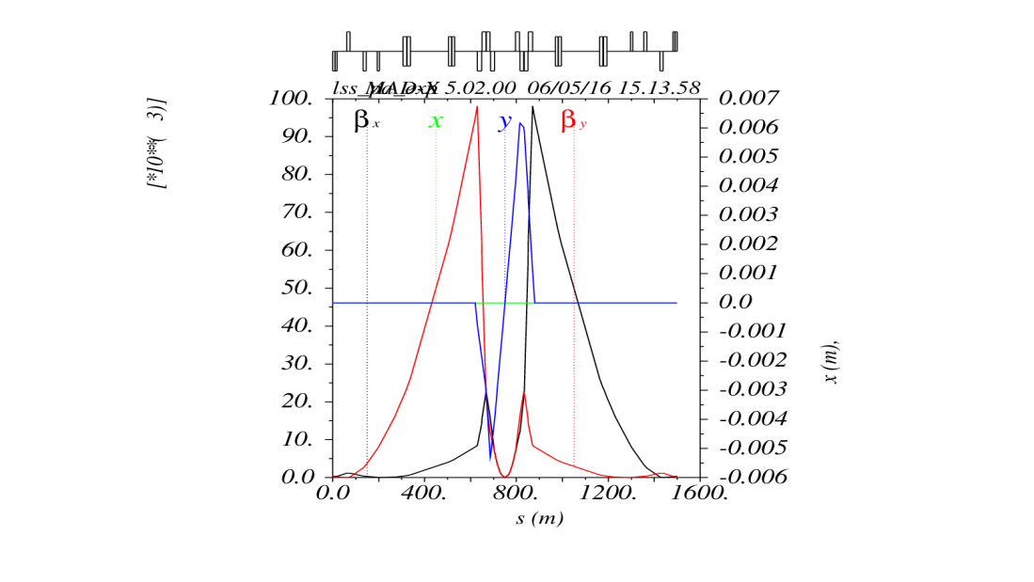
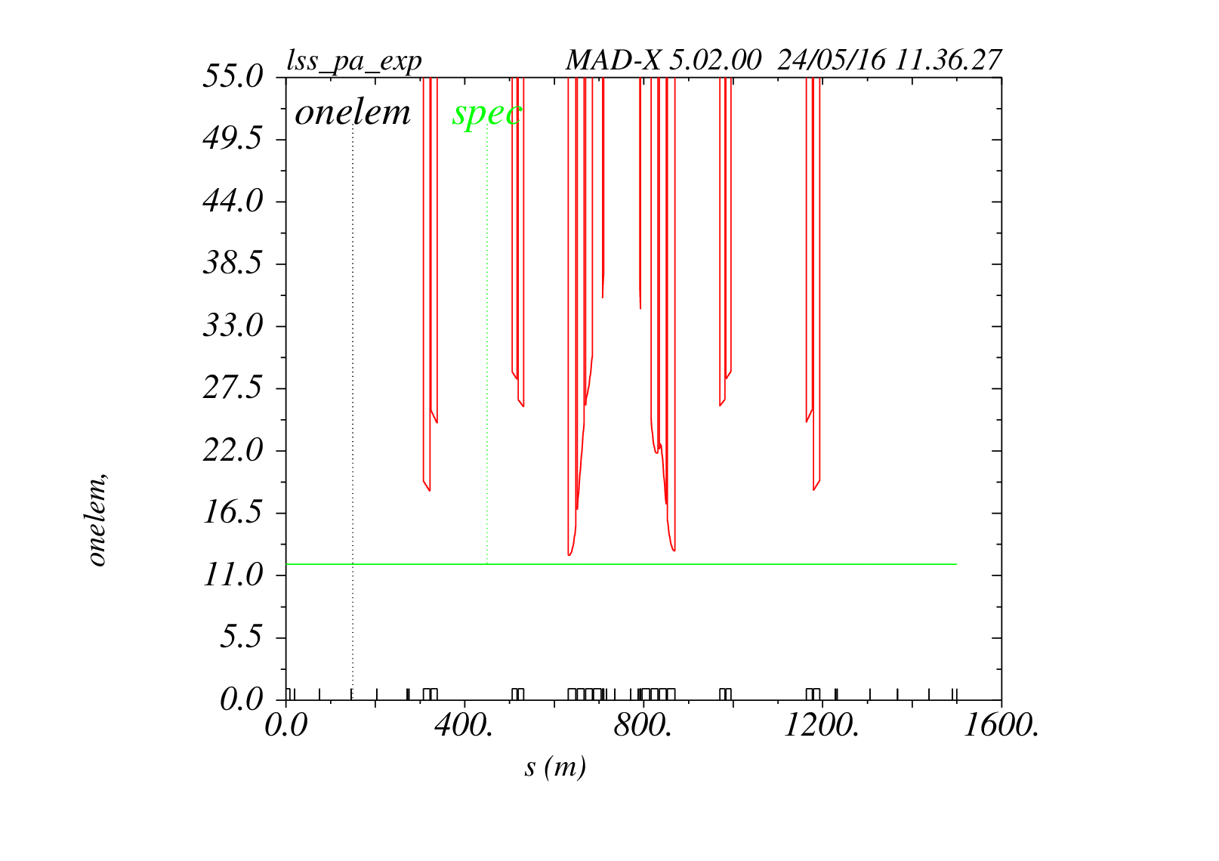
Comparison
Original Design
New, shorter design

Slide 8
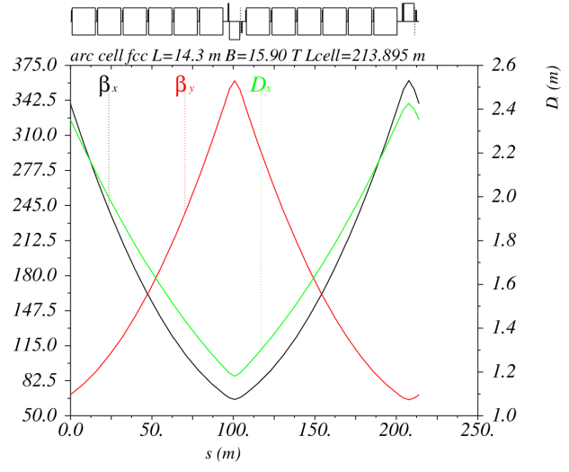
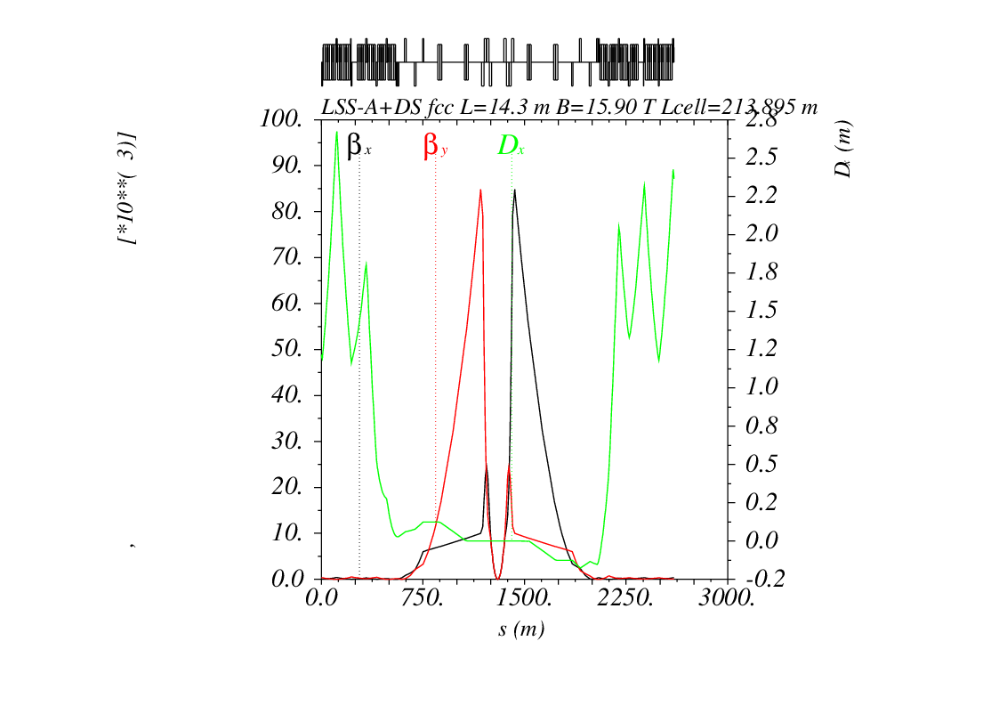
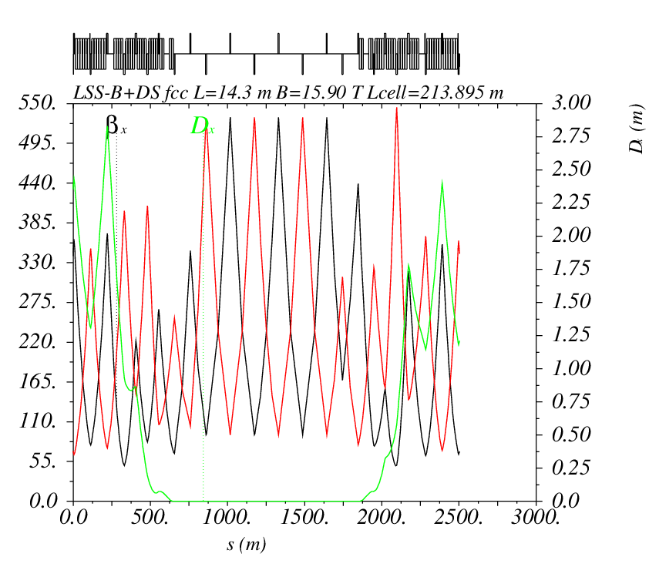
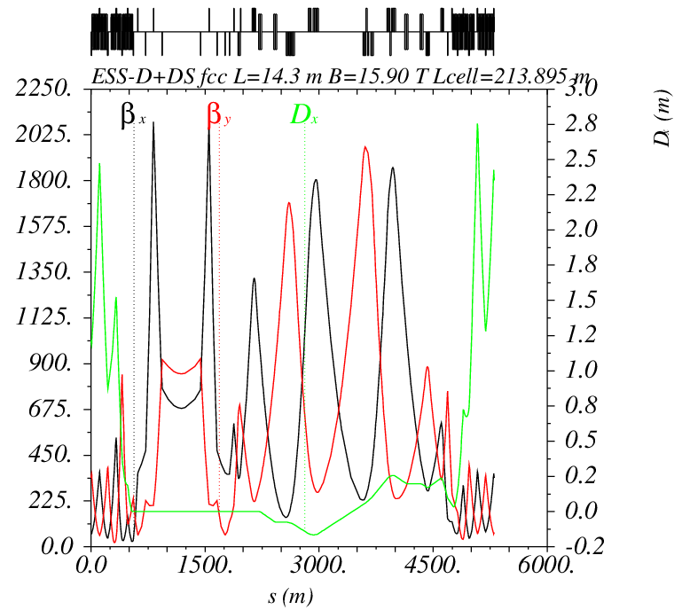

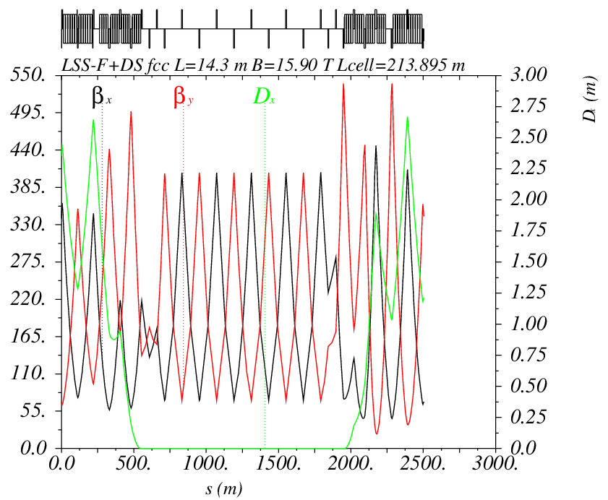


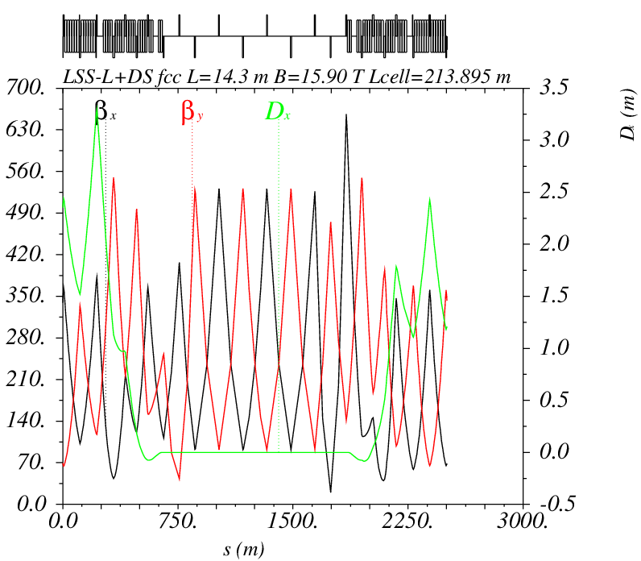

Slide 9
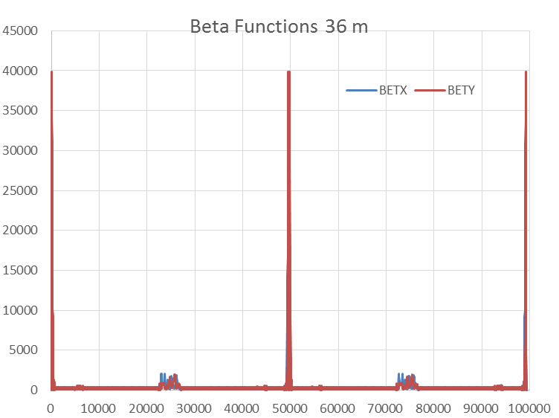
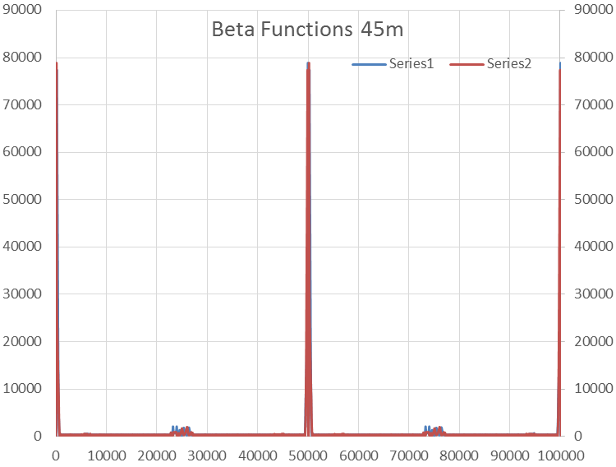
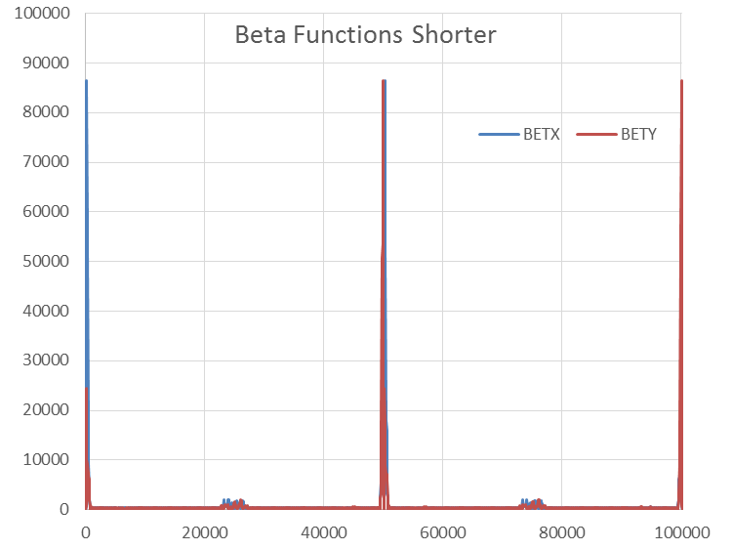

Slide 10
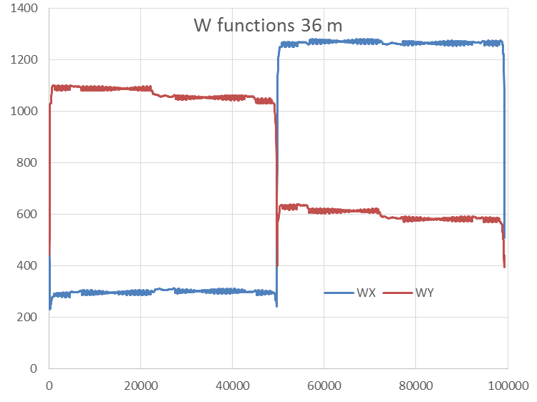
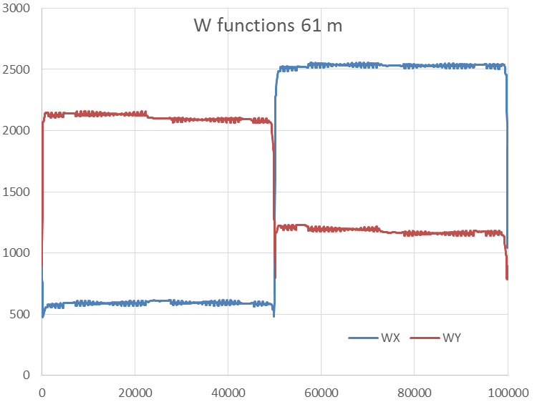
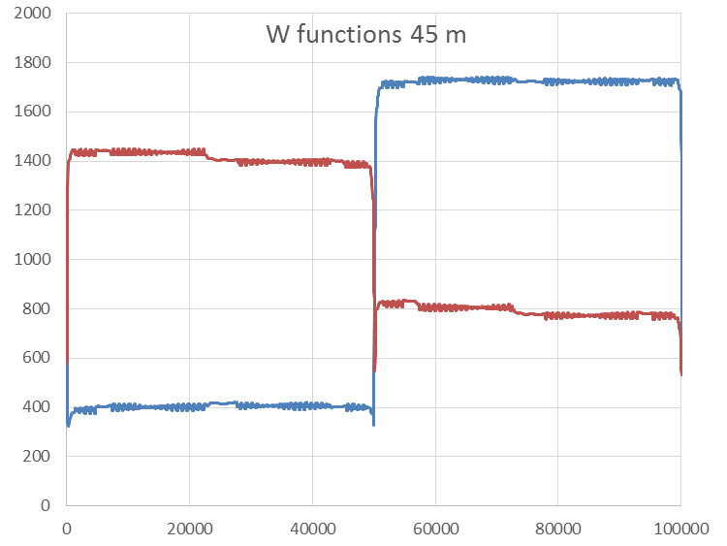
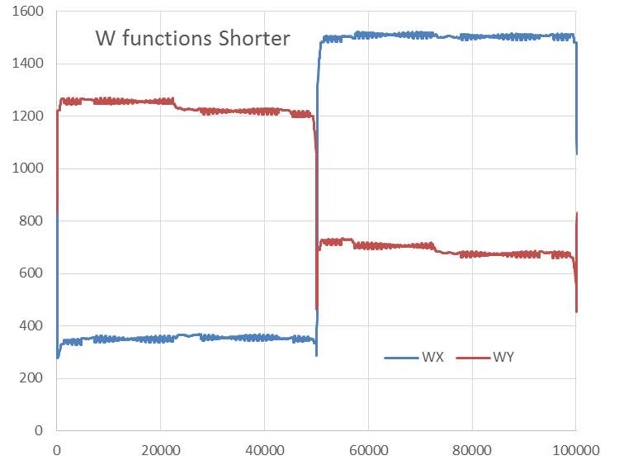

Slide 11
Conclusions
Came up with a fast method to find an optimal inner triplet
  Thin lenses to scan for spatial distribution
  More accurate MadX scans for ideal strength
Used this to design a new inner triplet for the FCC
  Significantly shorter
  Still fulfils requirements and can be integrated into lattice
  Further studies needed – e.g. radiation
  Might need slightly longer for smaller beam size

Slide 12
Thank you!
Questions?

Slide 13
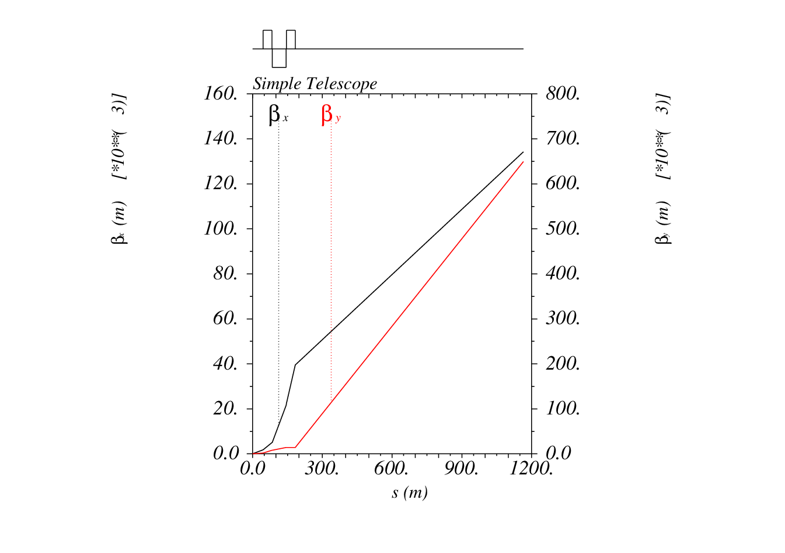
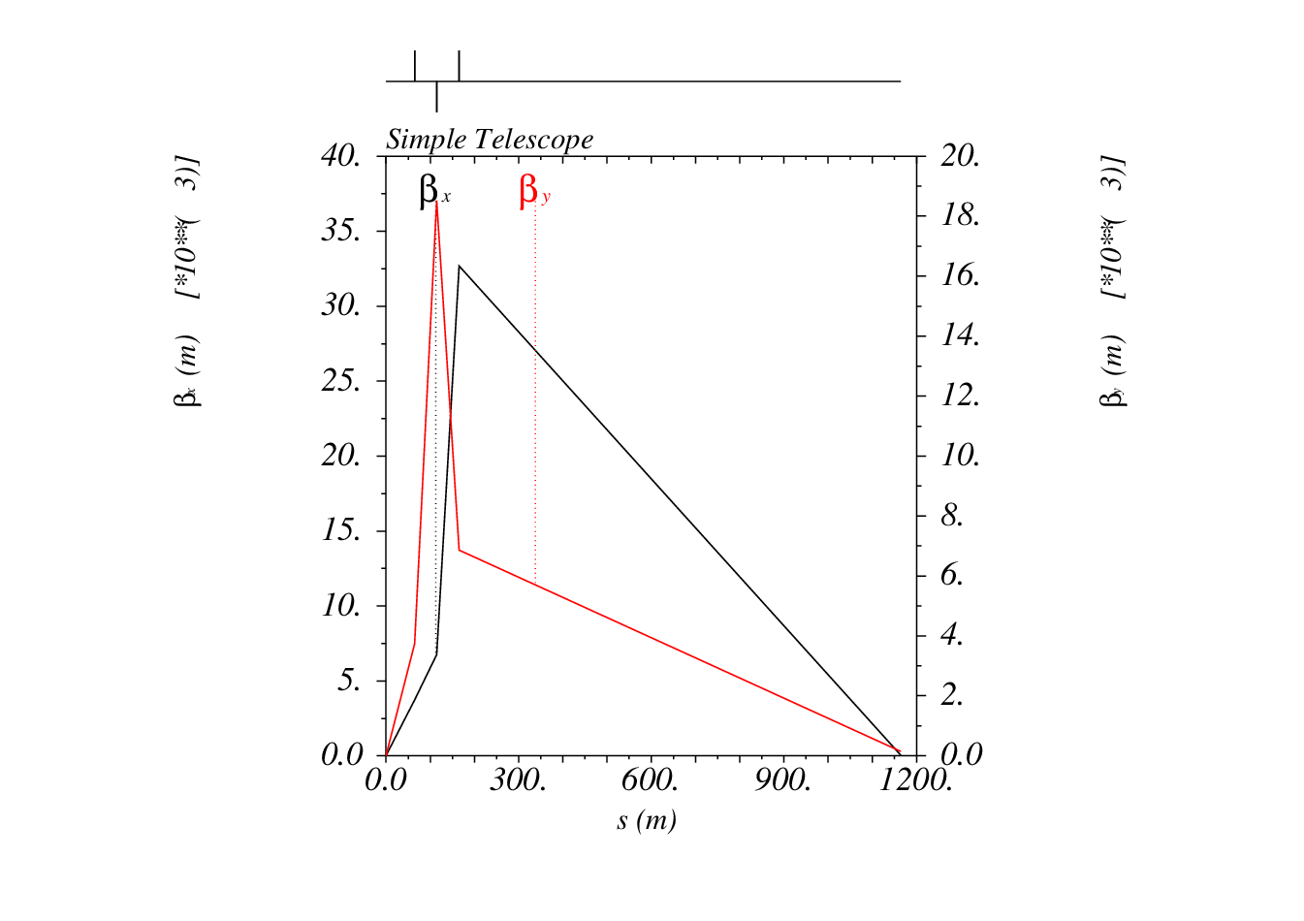
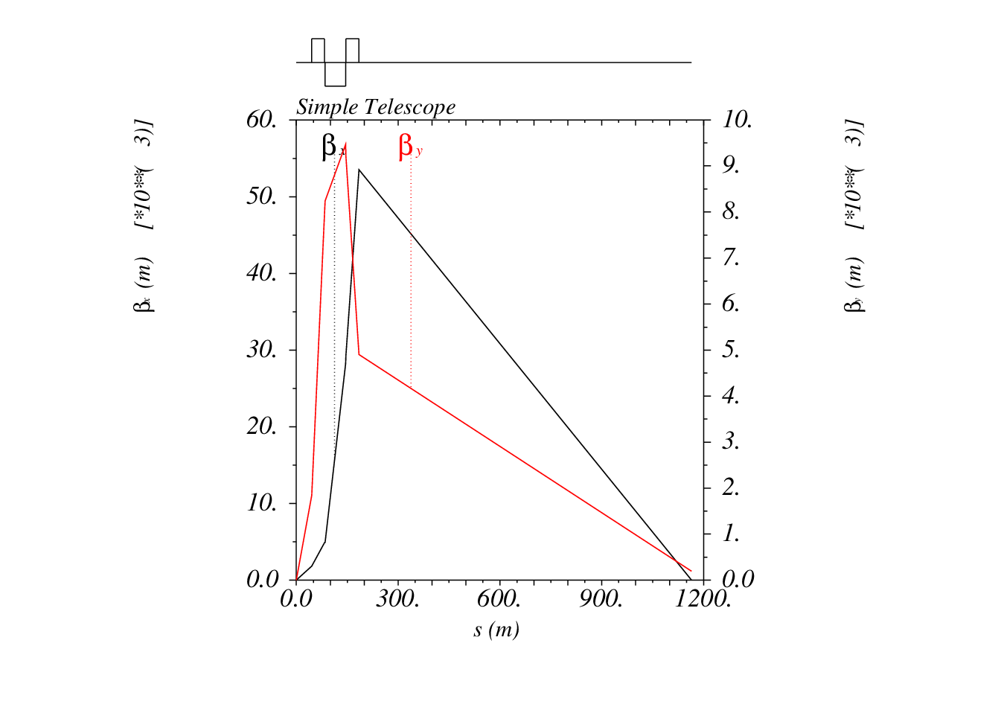
From thin to finite

Slide 14
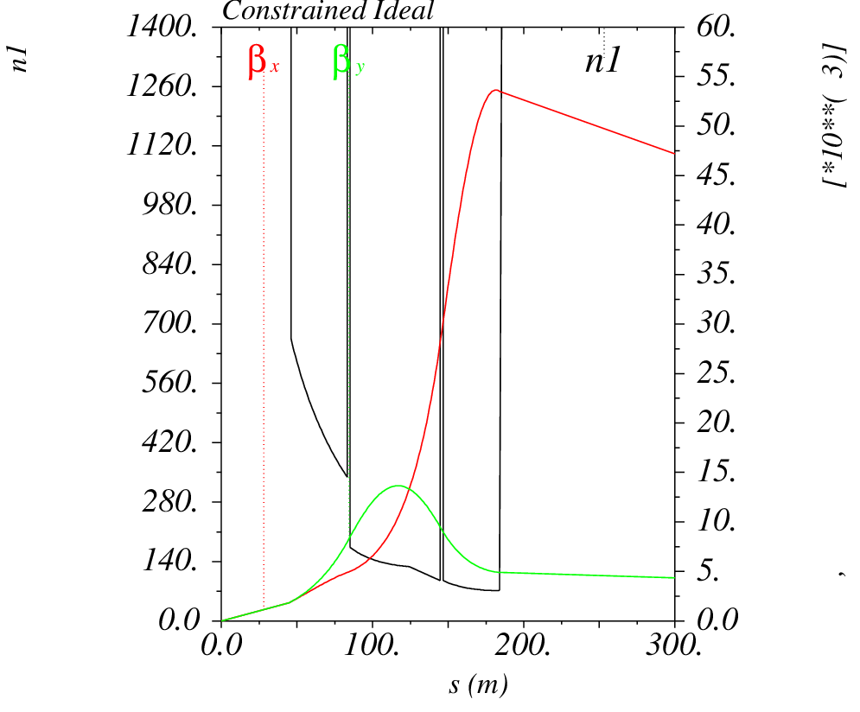
Aperture Module

Slide 15
Initial Drift

