Slide 1
WLCG IPv6 deployment:plans and next steps
Alastair Dewhurst
Andrea Sciabà
29/09/2016, WLCG Ops Coord

Slide 2
News
At the latest MB, WLCG approved the IPv6 deployment plan proposed on July, after receiving favourable feedback from the Tier-1 sites
As a reminder, the main aims are:
  To provide a viable migration path for sites needing to switch to IPv6
  To allow sites to make long term planning decisions regarding their network setup
  To allow VOs to make use of IPv6-only CPU resources should they become available in future

Slide 3
Proposed timeline
By April 1st 2017
  Sites can provide IPv6-only CPUs if necessary
  Tier-1’s must provide dual-stack storage access with sufficient performance and reliability
    At least in a testbed setup or with reduced performance/reliability
  Stratum-1 service at CERN must be dual-stack
  A dedicated ETF infrastructure to test IPv6 services must be available
  ATLAS and CMS must deploy all services interacting with WNs in dual-stack
  All the above, without disrupting normal WLCG operations
By April 1st 2018
  Tier-1’s must provide dual-stack storage access in production with increased performance and reliability
  Tier-1’s must upgrade their Stratum-1 and FTS to dual-stack
  The official ETF infrastructure must be migrated to dual-stack
  GOCDB, OIM, GGUS, BDII should be dual-stack
By end of Run2
  A large number of sites will have migrated their storage to IPv6
  The recommendation to keep IPv4 as a backup will be dropped

Slide 4
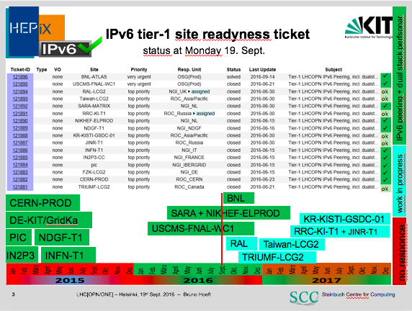
UPDATE: TRIUMF now peered

Slide 5
Tier-1 summary
NDGF: plan OK, dCache already dual-stack
PIC: plan OK, dCache already dual-stack
IN2P3: plan OK, dual stack storage within proposed timescale
RAL: plan OK, IPv6 testbed by April 2017, production storage IPv6 well before April 2018
TRIUMF: still working on timeline
SARA-MATRIX: postponed after data centre move in October
FNAL: actively preparing to enable IPv6
KIT, Taiwan, RRC-KI, NFN, NIKHEF, BNL, KISTI: no official feedback

Slide 6
Next steps for the Task Force
Task Force will become significantly more active. Aims:
  Ensure that approved plan is implemented
  Regularly follow up with T1s, via GGUS if necessary
  Alastair, Andrea, Costin, Raja will follow up with their experiments
  For T2, aim is “as many as possible by the end of Run2”
    Still discussing how we are going to achieve it
      Early adopters by 2017? Everybody else by 2018?
Interplay between WLCG TF and HEPiX WG:
  The TF is the contact point for sites which want to deploy IPv6-only CPUs
  The HEPiX WG is the place for technical questions while the TF ensures that things get deployed from the WLCG perspective
Need to review the composition of the TF: representatives of OSG/EGI/NorduGRID/GridPP, regional site representatives are very desirable

Slide 7
BACKUP SLIDES

Slide 8
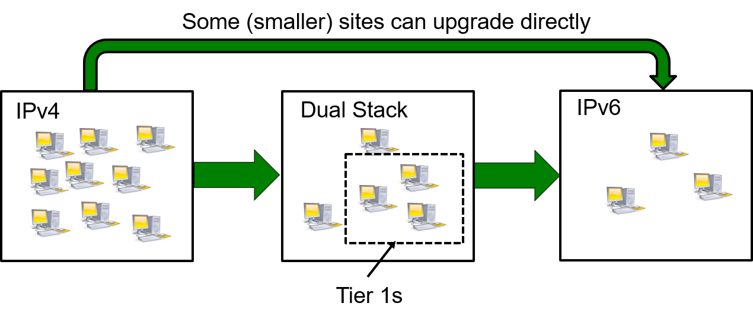
Typical migration path for a site
Deploy IPv6 on the network infrastructure
Deploy a dual-stack perfSONAR instance
Make storage dual-stack
  Applies to all sites, for the sake of allowing others to remotely access data via IPv6
Make local services dual stack
  Eventually it should not be necessary, e.g. IPv4 could be decommissioned
Make all WNs IPv6-only
  Allow for a “grace period” during which IPv4 is kept as backup
  Use IPv4 private addresses if needed (e.g. by batch system)

Slide 9
Role of Tier-0/1 sites
Extremely important as they provide access to, and distribute, a lot of data
They run several central Grid and VO services
  FTS, Frontier, Stratum-0/1, VOMS, MyProxy, WM/DM services, ETF, Dashboard monitoring…
Therefore, critical to make services dual-stack
  Even if availability of IPv4 addresses is not an issue at the site
Storage performance and reliability should not depend on the IP protocol version used. Proposed targets:
  At least 1Gb/s and 90% reliability by April 1st 2017
  At least 10 Gb/s and 95% reliability by April 1st 2018

