Slide 1
On the Possible use of Califes for Beam Instrumentation tests
T. Lefevre on behalf on the BI group
BI Technical Board, 1st September 2016

Slide 2
Outline
Motivation for a Beam instrumentation Test Facility on Califes
Requirements for the infrastructure
Few examples of possible tests
Conclusions
T. Lefevre, BI Technical Board, 1st September 2016

Slide 3
Motivations
Why do we need a(nother) test facility at CERN for beam Instrumentation R&D ?
What can be achieved on Califes ?
How relevant is it for CERN accelerator projects ?

Slide 4
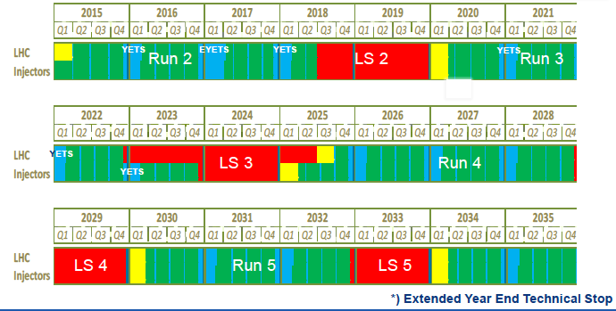
Why ?
Machine operation schedule @ CERN
Long periods with no beam available
Limited beam time available for Machine Developments

Slide 5
Why ?
Hardware installation periods on OP machines are limited
Any improvements/modifications can not be implemented quickly
Testing on test Facility will faster the developments and ensure that we installed well-understood devices on operation machines
Developing new concept versus Reliable operation
Operational machines have strict requirements in terms of vacuum-outgassing performance/ bakeability not always compatible with R&D needs
e.g. Testing gas ionization monitor and their performance as function of gas pressure
Very limited opportunities to make changes on beam line equipements

Slide 6
What for ?
A Test facility can not address all issues. But ….
Address system’s performance under realistic conditions (not achievable in laboratory)
Testing state of the art electronic with realistic signals
i.e. Response to short pulses with high signal amplitude
Testing of UV, optical, X-ray monitors where no other source can reproduce beam induced radiation
Imaging technique and Beam halo monitoring, …
Validation of particle detector design (e.g. Beam loss monitor/ Luminosity monitor, detector for Experimental Areas)
Sensitivity checks, linearity (or non-linearity) checks, ..

Slide 7
What for ?
All CERN accelerators and possibly interest from other labs
OP machines including Experimental Areas
Projects: HL-LHC, LIU (SPS, PS, PSB)
Studies, i.e. CLIC/ILC, AWAKE, FCC-hh/ee …
Beam tests for
Calibration of existing BI OP instruments during long Shutdowns
Upgrades of existing devices and/or understanding of OP issues
e.g. behavior of devices to bunch length or beam position ..(fBCT@LHC)
Development of new systems/concepts
e.g. Electro-optical BPM or Optical Transition Radiation Interferometry

Slide 8
What for ?
Future Challenges in BI
Unprecedented request for precision
Positioning down to below the micron level
Treatment of increasingly more data
Bunch by bunch measurements for all parameters:: Test of state of the art acquisition system (electric or optical domain)
Dealing with high beam powers
Non-invasive techniques (Gas profile monitor, Quadrupolar PU, ..)
Robust and reliable machine protection and beam loss monitoring systems
Dealing with the (ultra) fast
Sub-picosecond bunch lengths in AWAKE and CLIC
Longitudinal tomography in LHC (picosecond range)
Fast transverse beam position monitors (beam Instability diagnostics)

Slide 9
Why Califes ?
Electron linac is the cheapest way to provide relativistic beams
Beam energy higher than 200MeV (3.5GeV max) – similar γ as on SPS (LHC)
Photo-injector provides a modular bunch spacing
Single bunch capability for impulse response
Bunch spacing similar to CERN beams (1ns, 5ns, 25ns, 50ns, .. )
Pump – probe experiment (wakefield study, impedance measurement, ..)

Slide 10
Why Califes ?
Achievable Beam parameters
Good emittance to reach small beam size (<50um)
Short and long bunches (300fs up to 50ps)
requiring add. Magnetic chicane
Easy and full control the beam position over large distance
Large range of bunch intensity and density
Possibility to have very weak beams (below 10⁵part/cm²) as for SEU study
Applications requiring high beam current can be performed on Hiradmat@SPS that has been designed for High intensity beam tests

Slide 11
Modifying Califes
Short and long bunches (100fs up to 200ps)
Time to position correlation
Large range of Bunch intensity
Magnetic chicane
Shorten or lenghthen
RF deflector
for crabbing
Collimator
Reducing the bunch intensity
+ Adequate beam monitors for beam tuning and cross-calibration
Beam current monitor
Beam position monitor
Beam profile monitor

Slide 12
BI test stand
Synchrotron radiation test stand
Under vacuum DUT area
Synchrotron radiation test stand
In-air DUT area
DUT: Device under Test
Including SR test stand for mm, infrared, visible, UV light, X-ray generation
Including Electronic test stand using Pick-up (BPM, WCM) and seg-Dump for Electrical signal generation (short cable to the location of electronic under test)
Permanent installation for testing beam screens and EM devices (ceramic vacuum chamber)
Including Testing area for beam instruments – Under Vacuum DUT -
Including Testing area for particle detectors – In-air DUT – low intensity option

Slide 13
Possible Applications
Synchrotron radiation Test Stand
Imaging system for HL-LHC and FCC (visible, UV, X-ray ?..)
Beam halo monitor, longitudinal density monitors, …
Electrical signal Test Stand
Electronic for bunch-by-bunch BPM acquisition system of HL-LHC, ….
Under vacuum DUT area
Independent vacuum zone with easy access and fast pumping capabilities
Including steering magnets to move the beam around
Equipped with a permanent instrumentation test stand
Used for beam cross calibration: beam size, position and bunch length
Station for screen and imaging system development
Testing Gas ionization monitors for PS and SPS, new LHC IR BPM strip-line, fast BPM for LHC crab cavity monitoring, Longitudinal tomography for LHC, Quadrupolar pick-up, …

Slide 14
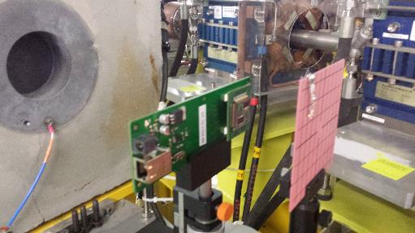
In-Air DUT Area on Califes
Possibility to decrease the beam intensity to low or very low values (large beam sizes)
Possible use for developing Beam Loss monitors and Particle detectors
Study of MIP response, Time response, Signal saturation
Radiation hardness (Total Integrated Dose or Single Event)
Dark current from gun is used for irradiation
Stability, low bunch charge (< 0.2 pc), long train 600 ns FWHM: 1800 bunches, higher emittance
Rep. rate 5 Hz, 0.3 nC per pulse, 16 x 21 mm² Gaussian size downstream to scattering screen

Slide 15
Conclusion
Strong motivation for having a test facility at CERN beam instrumentation needs
All CERN (and outside CERN) projects and studies could benefit from such facility
It should be easily accessible, offering flexible set of beam parameters and reliable operation
A modified version of CALIFES could be implemented re-using existing CTF3 hardware (layout and cost have to be worked out in detail)
Excellent training ground for ‘young’ scientists (CERN and collaborators) and students

Slide 16
Thanks for your attention

Slide 17
Motivation for Testing screens
To compare light yield/saturation and spatial resolution of screens made of different materials (scintillators, Optical Transition Radiation) and thickness;
To choose an appropriate screen for a beam halo measurement in AWAKE experiment → same beam type (single p⁺ bunch of 400 GeV/c, 5·10¹⁰/2·10¹¹ protons, RMS ~2 mm);
One first test in October 2015 – Now HRMT32

Slide 18
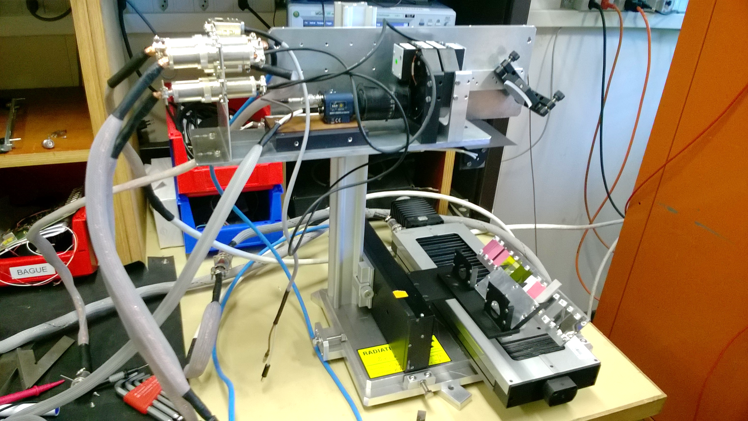
Measurement setup
Oct 2015 – HRMT30
June 2016 – HRMT32
beam
Diaphragm
Al foils

Slide 19
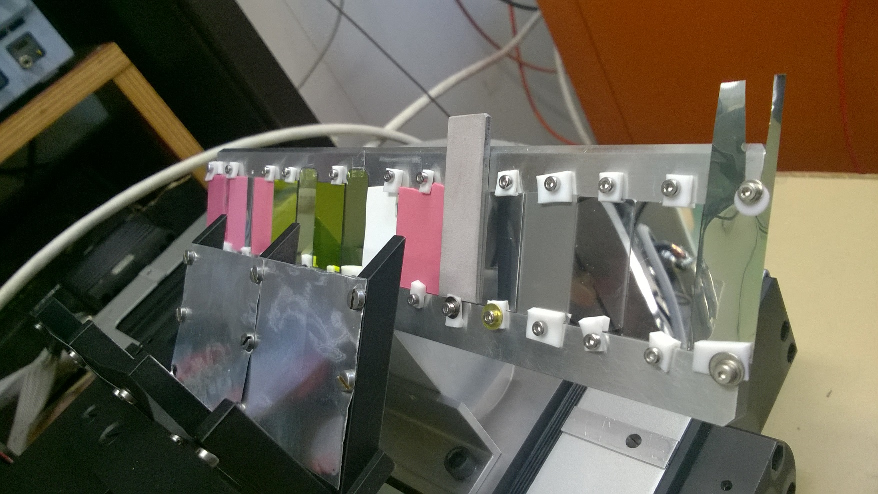
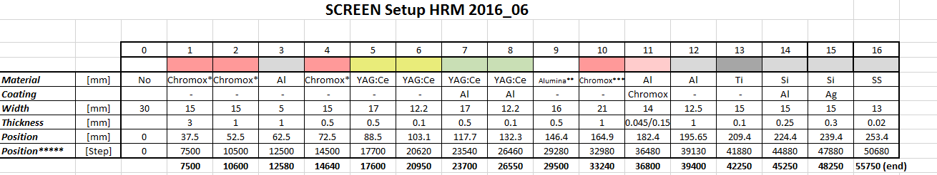
Screens tested
Scintillator:
Alumina (Al₂O₃) – Purity: 96% & 99%
Chromox (Al₂O₃:Cr₂O₃)
thicknesses: 3 mm, 1 mm, 0.5 mm
YAG – thicknesses: 0.1 mm, 0.5 mm
both coated and uncoated
OTR
Titanium, Aluminium, Silicon coated by aluminium & silver

Slide 20
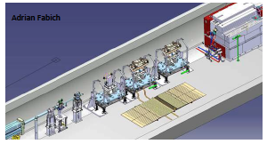
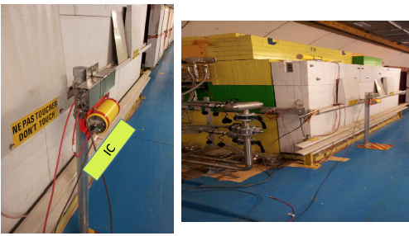
BLM test @ HRMT19-BLM2
LHC ionization chamber (IC) : 1.5l active vol.@ 1.1bar
Little Ionization Chamber (LIC) : 0.05l active vol.@ 1.1bar
for LHC in high losses region
Flat Ionization Chamber (FIC) : 0.05l active vol.@ 1.1bar
new detector for Booster
Tested with 3-5 shots using respectively
1, 36, 72, 144, 216, 288 nominal bunches
Measuring linearity and dynamic range

Slide 21
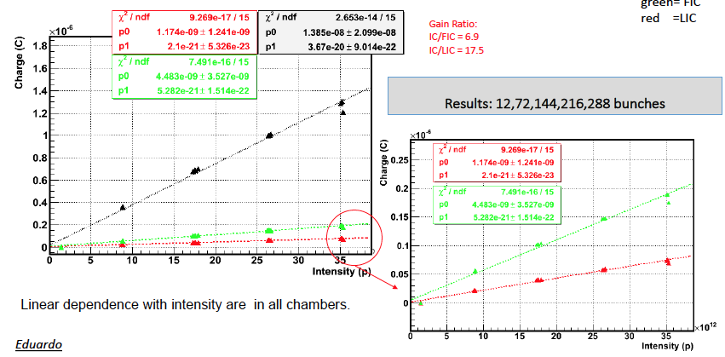
BLM test @ HRMT19-BLM2
IC
FIC
LIC
FIC
LIC

Slide 22
Possible Future BI tests @Hiradmat
Continue the test and characterization of new BLM sensor
Continue the test and characterization screens for BTV
Limitation with in-air assembly system
BTV system in secondary vacuum ?
Reusing the last BTV in the line – adding a valve ?
Consider as a permanent installation just upstream of the Exp. tables
Characterizing screens better with an Optical line and Spectrometry and decay measurement
Measurements in IR for Diffraction radiation monitoring for HL-LHC, FCC studies
Permanent installation for WCM, WCT, inductive BPM development
Need a 30cm long Ceramic chamber
Permanent installation of BI DUT for new developments : 50cm reserve chamber
SEM detector for TBIU/TBID renovation
Electro-optical monitors for HL-LHC (pulling of optical fiber)

Slide 23
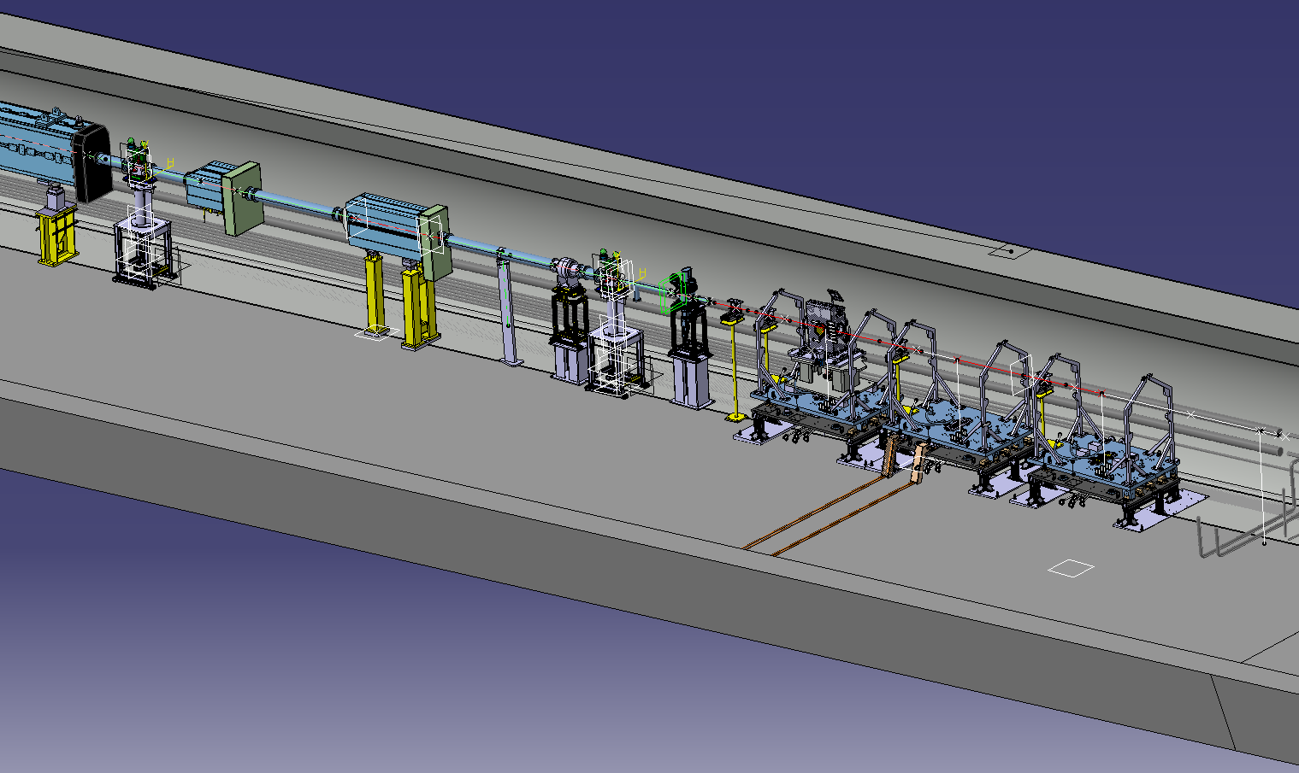
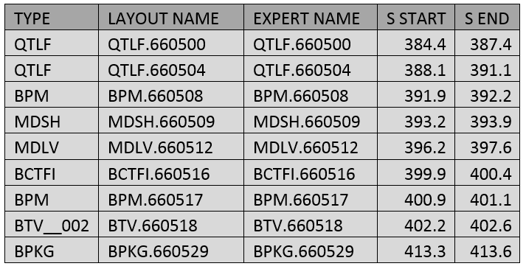
Possible Future BI tests @Hiradmat
Quad
BPM
Modifying this zone ?
Trim
Trim
BPM
BCT
BTV
BPKG
Exp. A
Exp. B
Exp. C

Slide 24
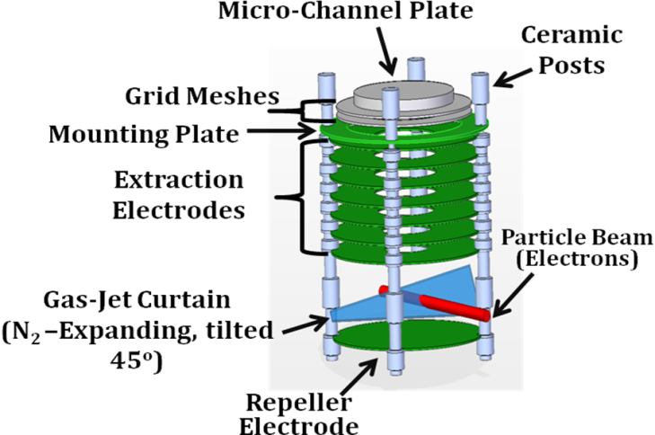
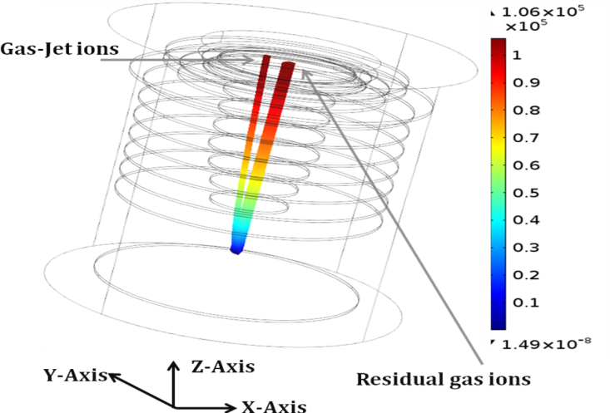
Gas-jet R&D with ULIV
Beam ionises gas molecules, ions are extracted by electric field
Sufficiently thin gas jet would allow 2D image: if not used as a gas scanner
Initial forwards momentum of gas jet separates gas jet ions from residual gas ions

Slide 25
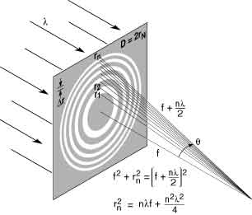
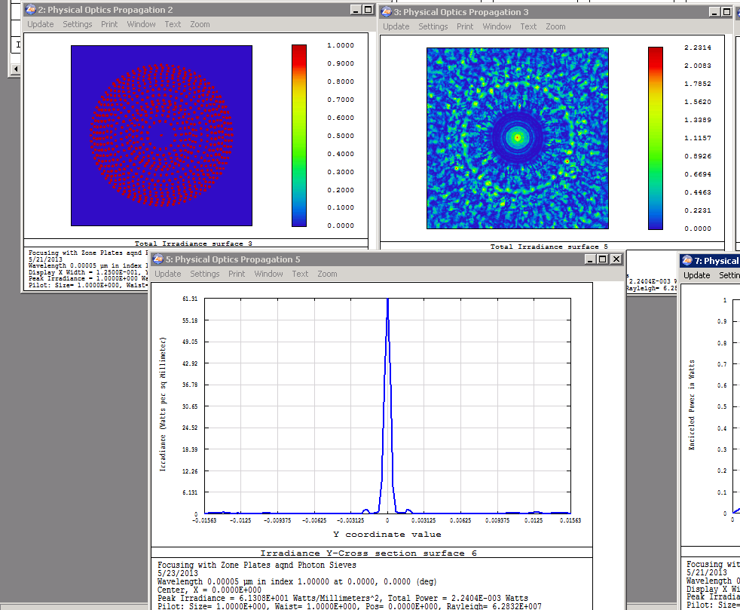

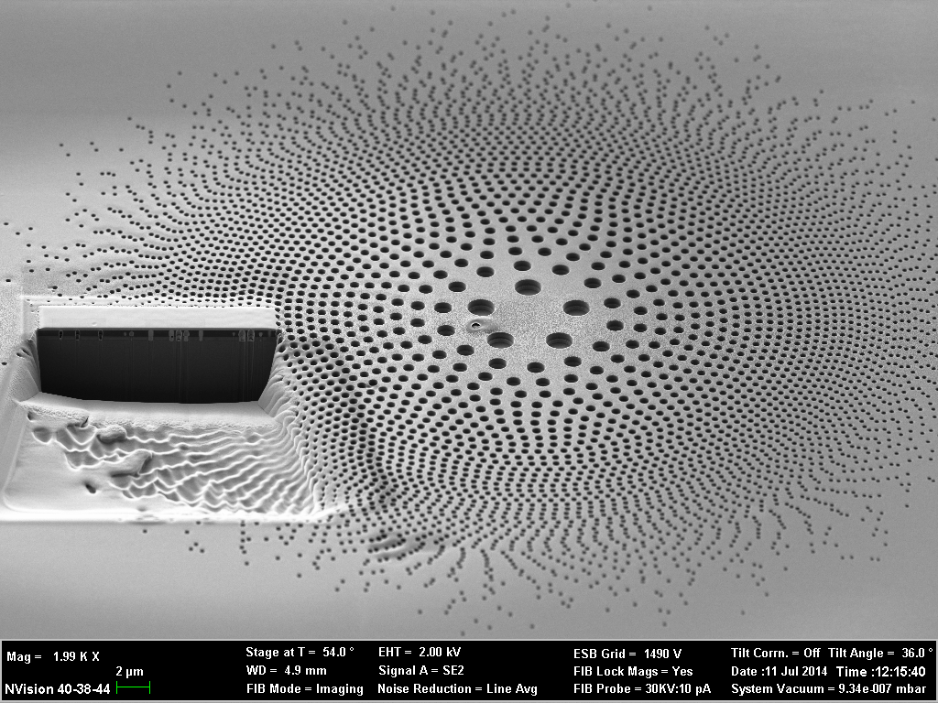
Gas-jet R&D with ULIV
Matter-wave focusing for a thin gas jet (down to Tens of micrometers) – Fresnel Zone plate principle
Design (ZEMAX) and fabrication of Apodised Photon Sieve reduces higher order diffraction, increases central maximum
The path difference between each successive light ring is equal to 1 wavelength (at the focal point) constructive interference.
Each zone is equal in area
Focal spot size is roughly the width of the narrowest (outer) zone
Compared to traditional lens: no spherical aberration, large chromatic aberration

Slide 26
CLIC related BI developments
Transverse beam profile monitoring
Developing OTR / ODR emittance station at ATF2
R&D on gas jet technology at Cockcroft and CTF3
BLM developments
Detector developments i.e. cherenkov fibers, MPPC, ..
Understand the influence on BLM performances of
RF breakdown in Acc. Cavity
X-ray background in damping rings
Finalising developments at CTF3
High resolution Cavity BPM
DB strip-line BPM

Slide 27
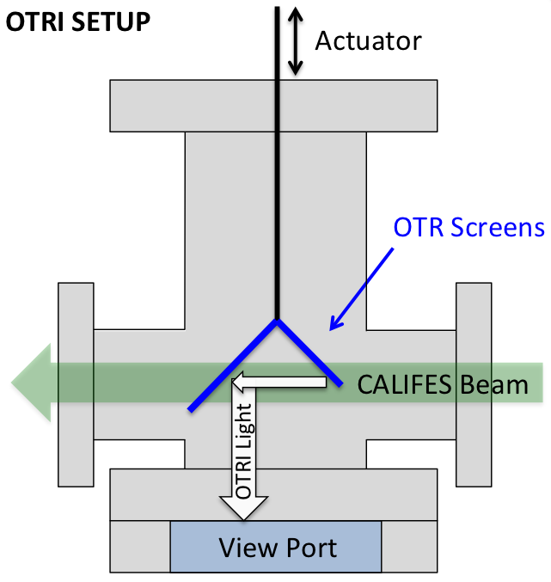
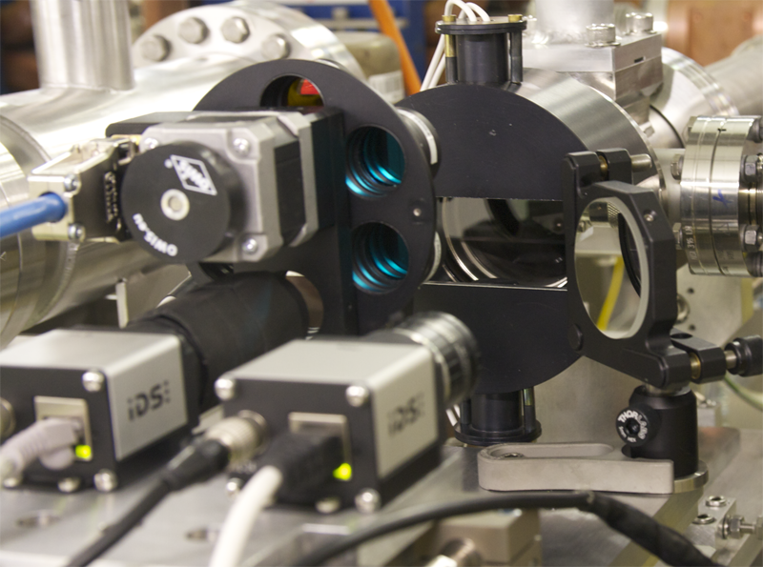
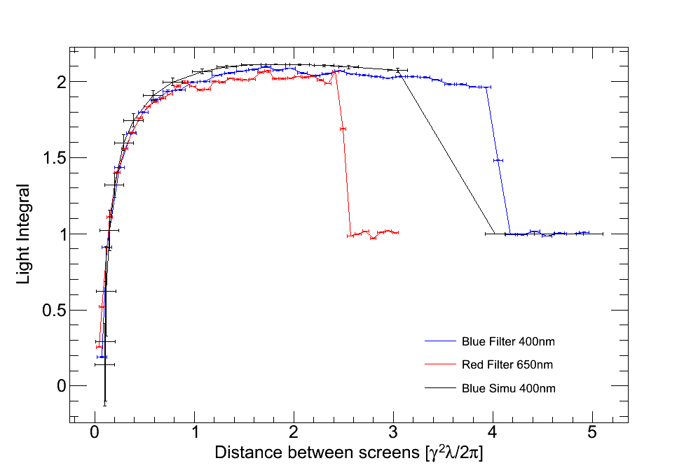
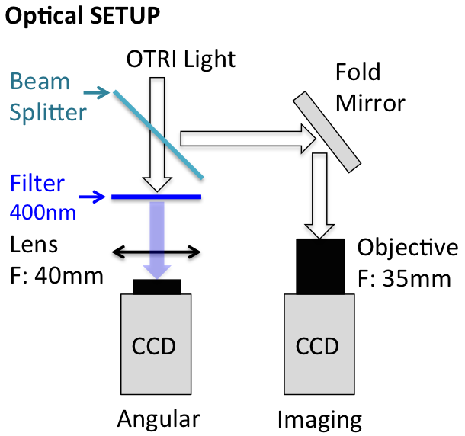
OTR interference studies
Experimental measurement of the shadowing of the electromagnetic field.
R. Kieffer

