Slide 1
Micromegas detector applications for beam diagnostics
Thomas Papaevangelou
CEA Saclay

Slide 2
Outline
The Micromegas detector
Description
Micromegas types
Micromegas as a beam loss monitor
Desired sensitivity
Fast neutron flux monitoring with high sensitivity
A directional fast neutron detector
Fast neutron detection at high flux / high background environment
The proposed configuration
Micromegas for high time precision tracking
The detection principle
Time resolution measurements with fs laser
Beam test with muons
Future plans and prospects
Conclusions

Slide 3


Slide 4
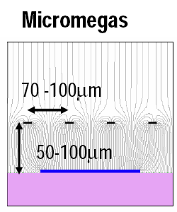
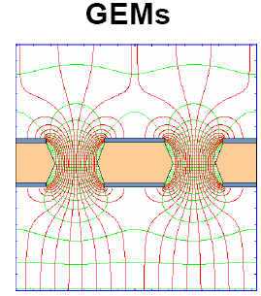
Micro Pattern Gaseous Detectors (MPGD)
Best technology for gaseous detector readout:
Micro Pattern Gaseous Detectors
more robust than wires
no E×B effect
fast signal & high gain
low ion feedback
better ageing properties
easier to manufacture
lower cost
big surfaces
Notes:
Giomataris et.al., NIM A376 (1996) 29
F. Saul, NIM A386 (1997) 531

Slide 5
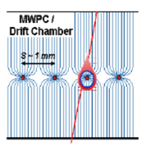

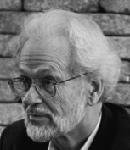
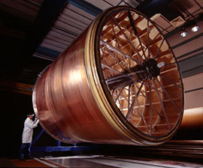
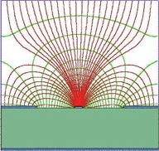
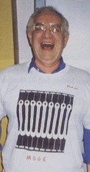

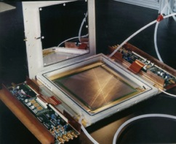
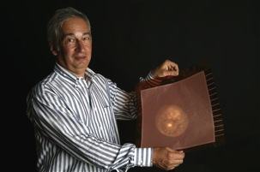
Genealogy of MPGDs
MWPC
Multi-Wire Proportional Chamber
G. Charpak et al., 1968
TPC
Time Projection Chamber
D. R. Nygren et al., 1974
MSGC
Micro-Strip Gas Chamber
A. Oed, 1988
CATHODE
ANODE
CATHODE
200 µm
Micro Pattern
Gaseous Detectors: MPGD
GEM
Gas Electron Multiplier
F. Sauli, 1997
MICROMEGAS
MICRO-MEsh GAseous Structure
I. Giomataris et al., 1996
STANDARD
1996
BULK
2003
INGRID
2005
MICROBULK
2006
RESISTIVE ANODE
2005-2013
PIGGYBACK
2012
SEGMENTED MESH
2013

Slide 6
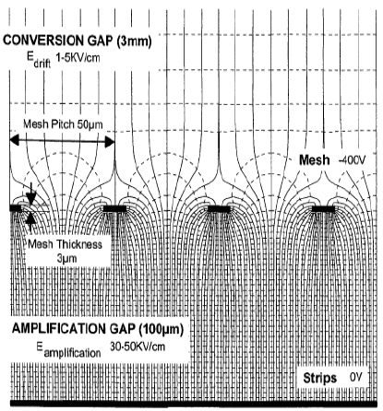
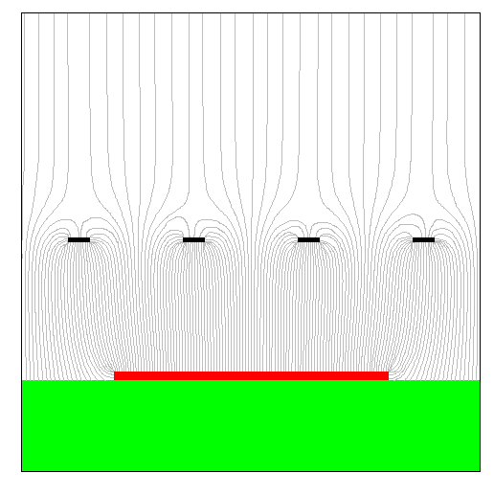
Micromegas concept
Drift field
typical 10²⁻³ V/cm
γ
Two-region gaseous detector separated by a Micromesh :
Conversion region
  Primary ionization
  Charge drift towards A.R.
Amplification region
  Charge multiplication
  Readout layout
    Strips (1/2 D)
    Pixels
➔Very strong and uniform electric field
Amplification field
typical 10⁴⁻⁵ V/cm
Amplification
gap: 50-100 μm
MICROMEsh GAseous Structure
Giomataris, Charpak (1996)
Y. Giomataris et al., NIM A 376 (1996) 29
In 1st Micromegas
Fishing line spacers have been used
metallic micromesh (typical pitch 50μm)
sustained by 50-100 μm pillars
simplicity
single stage of amplification
fast and natural ion collection
discharges non destructive
Mesh signal
Pixels / strips
signals

Slide 7
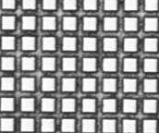
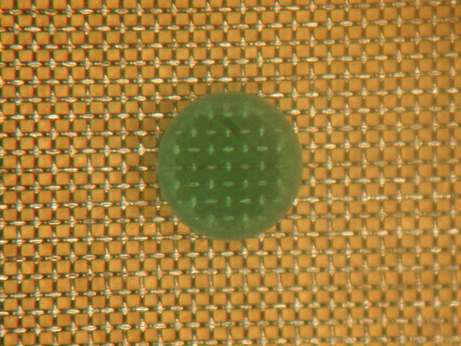
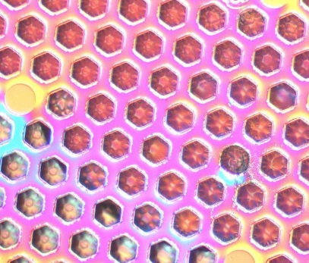
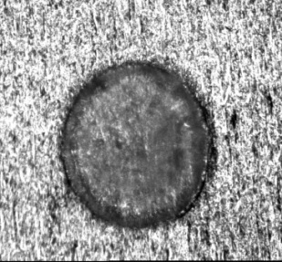
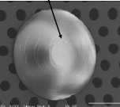
Building a Micromegas
Meshes
Many different technologies have been developped for making meshes
(Back-buymers, CERN, 3M-Purdue, Gantois, Twente…)
Exist in many metals: nickel, copper, stainless steel, Al,… also gold, titanium, nanocristalline copper are possible.
Electroformed
Chemically etched
Wowen
Deposited by vaporization
Laser etching, Plasma etching…
Pillars
200 μm
Can be on the mesh (chemical etching) or on the anode (PCB technique with a photoimageable coverlay).
Diameter 40 to 400 μm

Slide 8
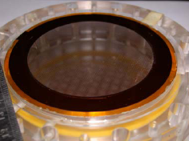
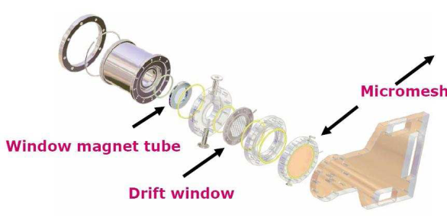
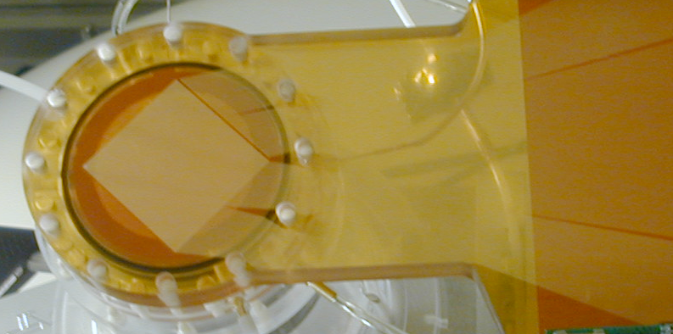
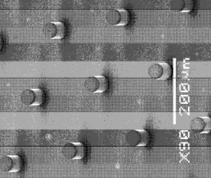
The conventional Micromegas
Conventional Micromegas
  The pillars are attached to the mesh or the readout plane. A supporting ring or frame is adjusting the stretched mesh on top of the readout plane
  Typical dimensions: mesh thickness 5 μm, gap 50 μm
  material selection, spatial resolution, field uniformity, stability…
  Good energy resolution (mesh quality)
  Mesh can be replaced easily
  Mesh not attached + support frame:
  Dimension limitations / large detectors
  Large scale production
  Mosaic with dead space
  Curved surfaces

Slide 9
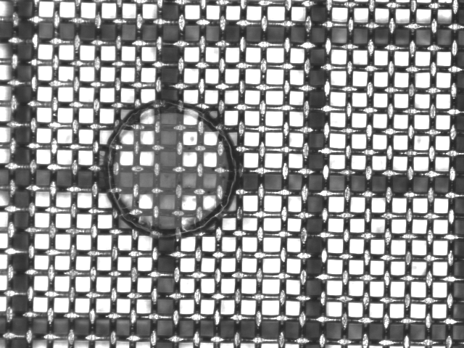
Bulk Micromegas technology
pad
Readout plane + mesh all in one
Woven Inox mesh 30 µm
pillar
Pyralux 128 µm
Well established technique
Readout pads
  Result of a CERN-Saclay collaboration (2004)
  Process to encapsulate the mesh on a PCB
  (mesh = stretched wires)
  Motivations for using bulk Micromegas
  the mesh is held everywhere:
  the mesh is held everywhere
  robustness (closed to dust)
  can be segmented
  repairable
  large area detectors feasible and robust!
Base Material
FR4
Lamination of Vacrel
Photo-imageable
polyamide film
Positioning of Mesh
Stainless steel
woven mesh
Encapsulation
Border frame
Development
Spacer
Contact to Mesh
I. Giomataris et.al., NIM A560 (2006) 405

Slide 10
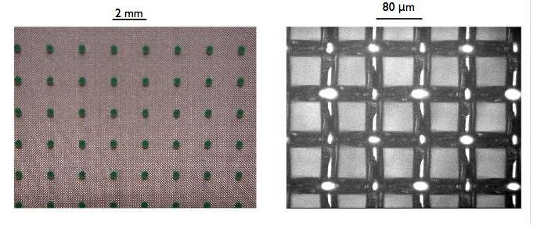
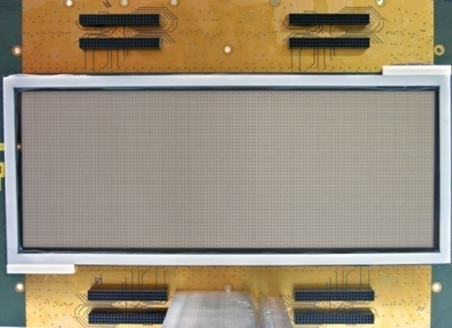
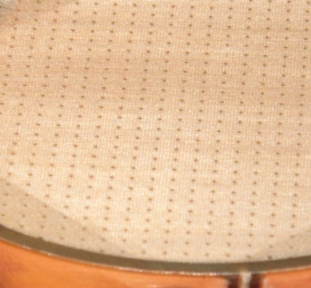
Bulk Micromegas technology
pad
Bulk Micromegas: The pillars are attached to a woven mesh and to the readout plane
  Typical mesh thickness 30 μm, gap 128 μm
  Uniformity, robustness, lower capacity, easy fabrication, no support frame, small surrounding dead region ➔
  Large area detectors feasible and robust!
  Curved surfaces
  Mass production!
  Mesh thickness & bigger gap: some disadvantages in special applications:
  Good but limited energy resolution (~18% @ 6keV)
  Restrictions on materials
pillar

Slide 11
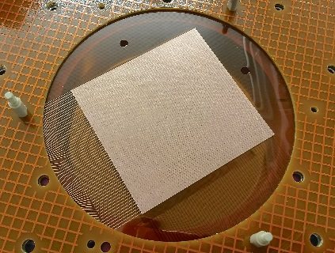
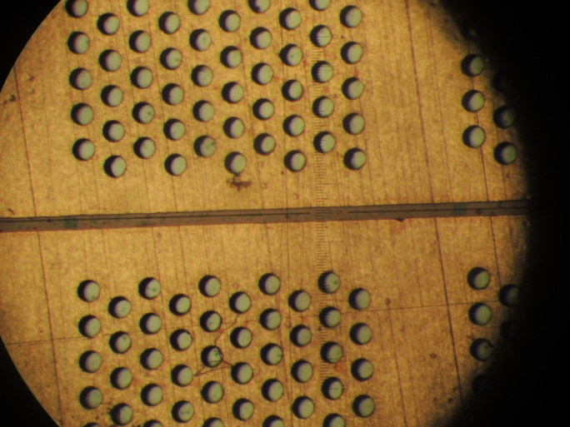
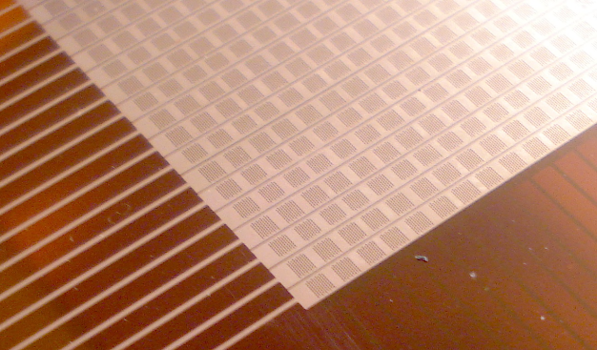
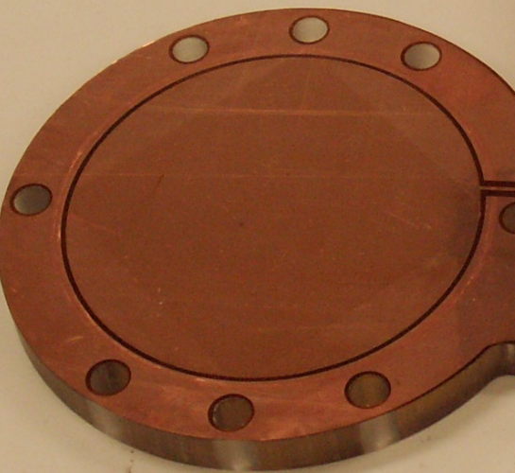
Microbulk Micromegas technology
Micromesh
5µm copper
Readout plane + mesh all in one
Kapton 50 µm
Readout pads
By I. Giomataris and R. De Oliveira
Microbulk Technology
  The pillars are constructed by chemical processing of a kapton foil, on which the mesh and the readout plane are attached. Mesh is a mask for the pillars!
  Typical mesh thickness 5 μm, gap 50/25 μm
  Energy resolution (down to 10% FWHM @ 6 keV)
  Low intrinsic background & better particle recognition
  Low mass detector
  Very flexible structure
  Long termstability
  Higher capacity
  Fabrication process complicated
  Fragility / mesh can not be replaced
Lower capacitance
Under development

Slide 12
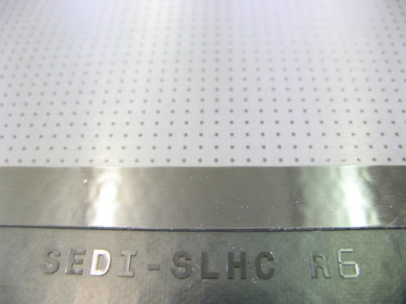
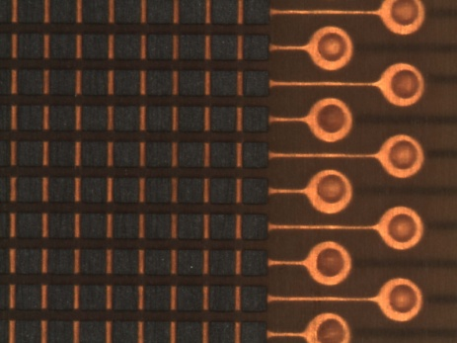
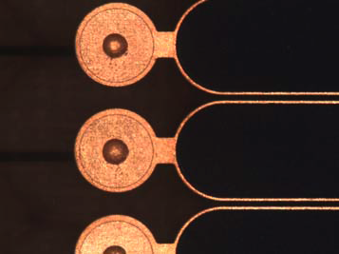
Micromegas with resistive strips
Electrode de dérive
5 mm
Protection against sparks
and/or
spread of the charge
M. Dixit et al., NIM A518 (2004), 721
Micro-grille
128 µm
Film résistif (kapton) ou pâte
(1k-500MΩ/☐)
Isolant (prepreg – 75 µm)
Anodes
Different technologies of resistive films developed @ CERN (R. de Oliveira)
Characteristics:
Resistive strips connected to the ground
Thin insulating layer between of the resistive and readout strips
AC coupling of signals
Sparks are neutralized through the resistive strips to the ground
Resistive kapton (2 MΩ/☐)
Resistive paste (250 MΩ/ ☐)
Resistive Pads
(a few tens of kΩ/☐)
Resistive strips (400 kΩ/ ☐)

Slide 13
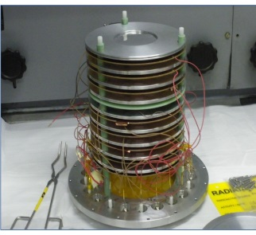
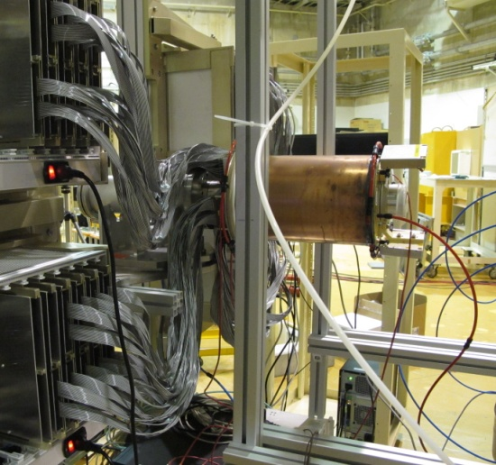
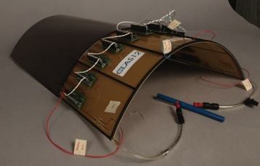
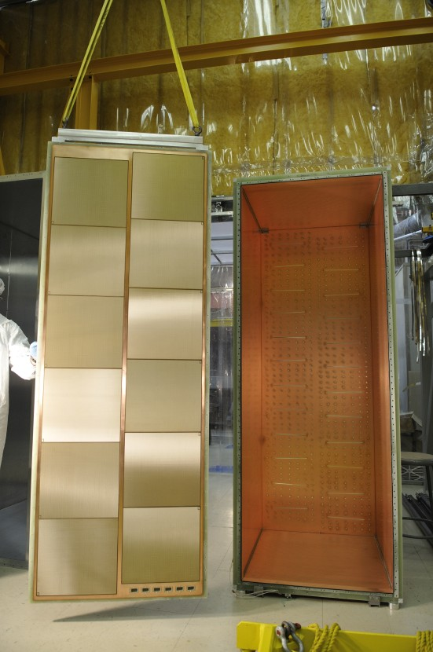
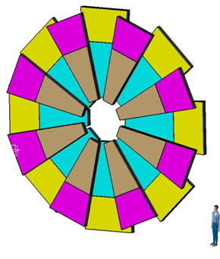
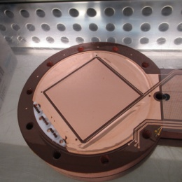
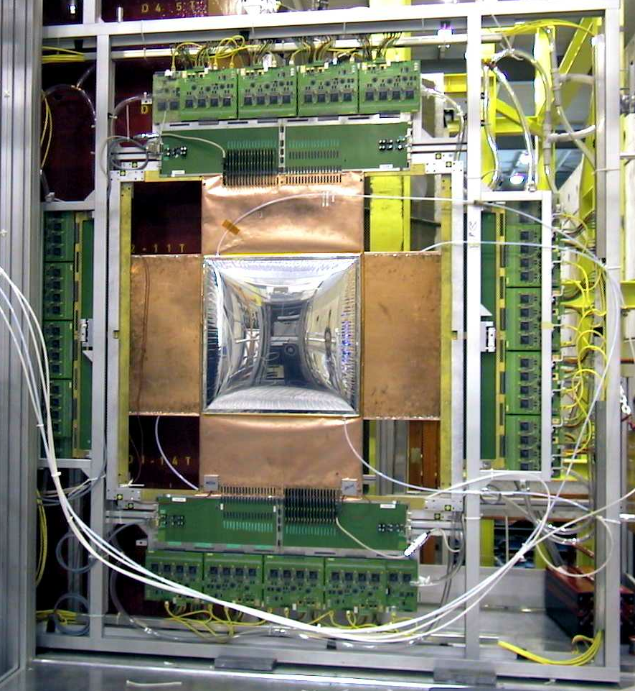
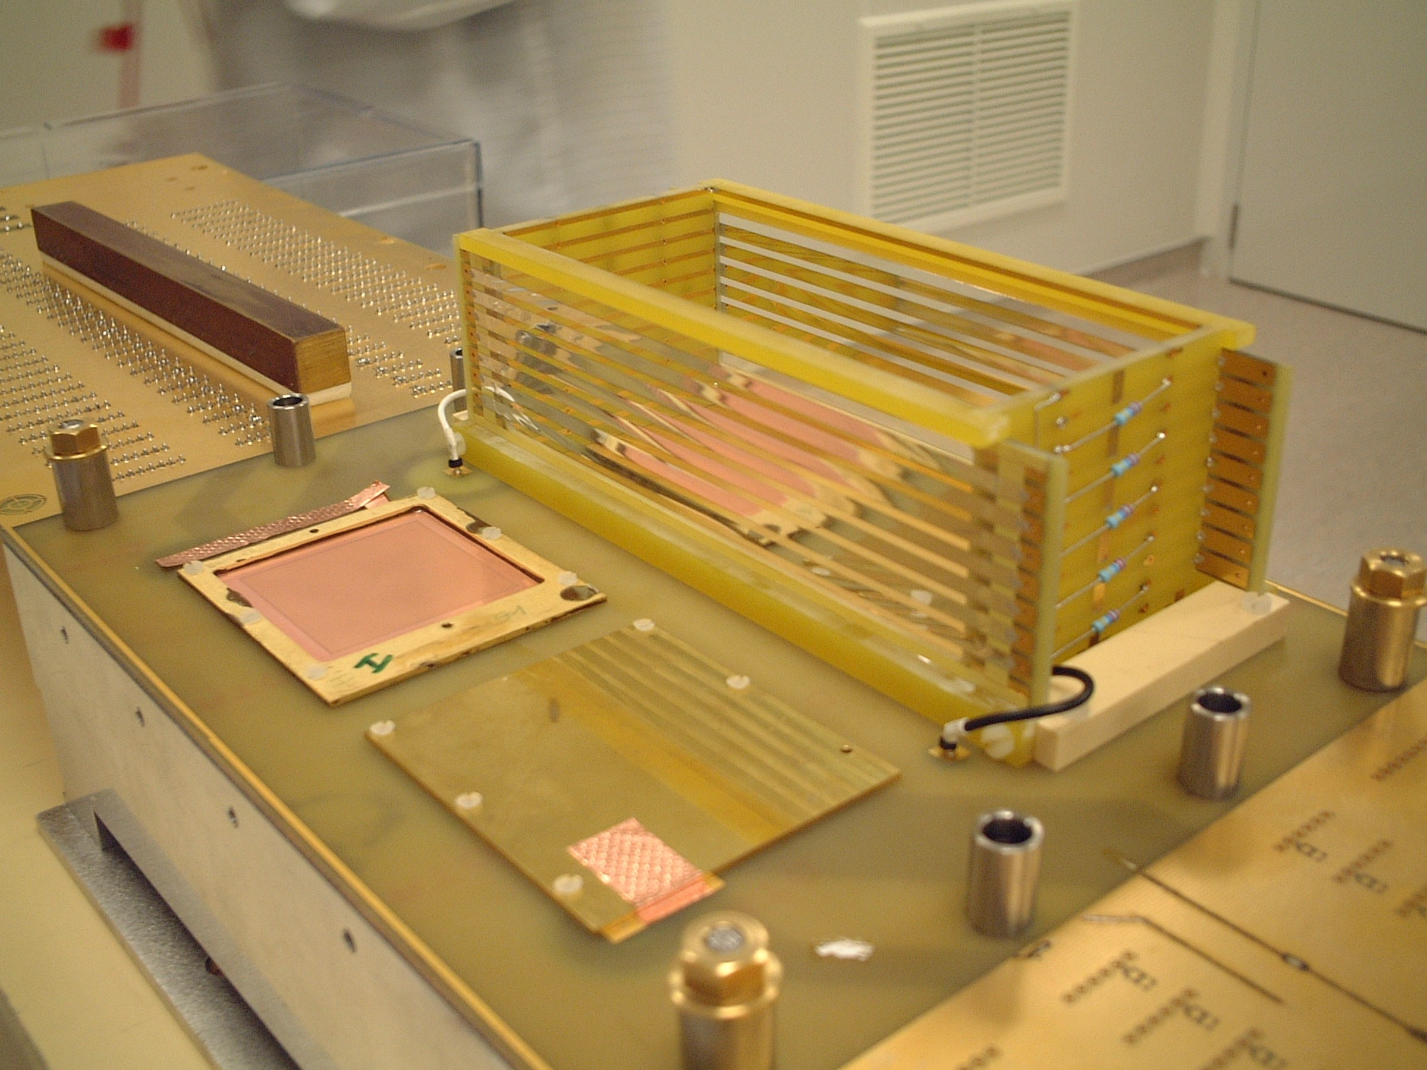
Micromegas applications
COMPASS
MINOS
CLAS12
NTOF
KABES/NA48
1996
2000
2001
2003
2009
2014
2015
2018
Micromegas
Invention
ATLAS-NSW
CAST
10_7
T2K

Slide 14
Micromegas as Beam Loss Monitor

Slide 15
Desired performance
Challenges:
RF cavities emit γ-rays. Those γ’s may pose a problem to ionization chambers used as BLMs
In the case of high intensity but low energy regions of an accelerator charged particles and γ’s do not even exit the accelerator vessel
At some cases, continuous monitoring of small losses is needed
Signature of beam loss: fast neutrons
  Thermal neutrons can come from moderation inside the walls, so must to be rejected
  Gamma’s and X-rays present during normal operation, so the detector must be insensitive to them
The nBLM should be:
sensitive enough to monitor small losses
sensitive & fast enough to react on
“catastrophic event”
appropriate for high rates
radiation hard
The “nBLM for ESS” project:
Micromegas equipped with combination of appropriate neutron convertors & moderators

Slide 16
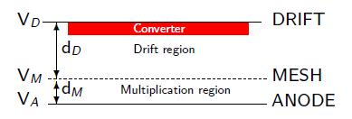
Neutron detection with Micromegas
Neutron detection ➔ neutron-to-charge converter
Solid converter: thin layers deposited on the drift or mesh electrode (¹⁰B, ¹⁰B₄C, ⁶Li, ⁶LiF, U, actinides…)
  Sample availability & handling
  Efficiency estimation
  Limitation on sample thickness from fragment range
  ⇒ limited efficiency
  Not easy to record all fragments
Detector gas (³He, BF₃…)
  Record all fragments
  No energy loss for fragments ⇒ reaction kinematics
  No limitation on the size ⇒ high efficiency
  Gas availability
  Handling (highly toxic or radioactive gasses)
Neutron elastic scattering
  gas (H, He)
  solid (paraffin etc.)
    Availability
    High energies
    Efficiency estimation & reaction kinematics

Slide 17
The proposed BLM for ESS
Assembly of the 2 modules:
1st module (MM + B₄C) capable of monitoring fast neutron fluxes ~ few n · cm⁻² s⁻¹
  minimum E_{n} defined by the absorber
  4π
  adjustable neutron sensitivity
  low gamma sensitivity
2nd module (MM + polyethylene) appropriate for high flux high energy neutrons, coming from the front
  directional
  insensitive to gammas
  high particle fluxes
Extra option as 2nd module:
MM + thin ²³⁸U layer
  E_{n} threshold ~1 MeV
  Fission fragments ➔ very low gain ➔ completely insensitive to gammas
  Very high radiation environment
Cd or other absorber
Polyethylene
MM +
Polyethylene + Al
MM
+
B₄C
~20 cm
~10 cm

Slide 18
The proposed BLM
Gas: Helium + quencher (CO₂ or CF₄)
  High max gain ➔ better stability
  Low sensitivity to gamma & electrons
  - Leek tightness more difficult
Sealed or semi-sealed operation
Front-end electronics integrated
Applied voltages ~ 500 V
Possibility of segmentation ➔ multi channel output
  higher rates
Detector parameters to be optimized according to the input for expected particle fluxes etc.
Prototype will be characterized at the facilities:
LICORNE (fast neutrons)
COCASE (high activity Cobalt source
ORPHEE (high thermal neutron flux / aging)
SEDI laboratory (long term stability)
Project started on June 1st 201. Estimated time for optimization, design, construction, characterization, installation & commissioning: 2.5 years (Commissioning: January 2019)
Cd or other absorber
Polyethylene
MM +
Polyethylene + Al
MM
+
B₄C
~20 cm
~10 cm

Slide 19
The nBLM for ESS project
The ESS BLM system can be divided in 3 sub-systems:
  Ionisation Chamber based BLM
  Neutron sensitive BLM (nBLM)
  Advanced BLM
nBLM: Micromegas detectors, specially designed to be
  sensitive to fast neutrons
  insensitive to low energy photons (X- and -rays).
  insensitive to thermal neutrons
Budget: 1.15 M€

Slide 20
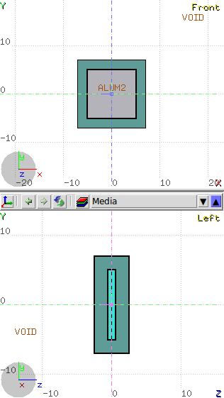
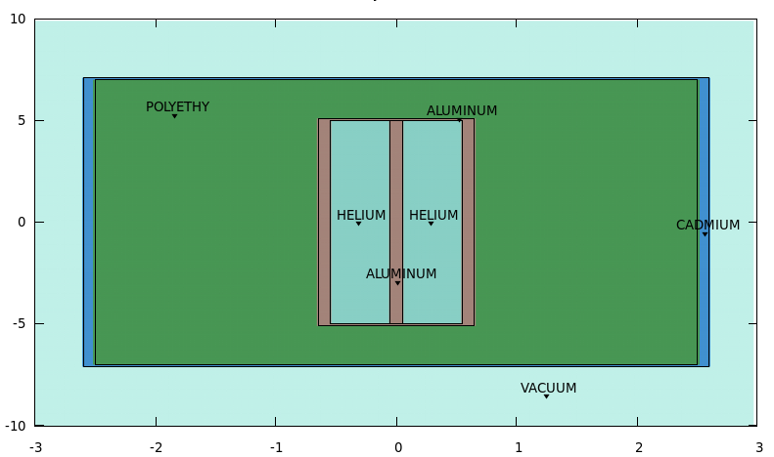
Fast neutron flux monitoring with high sensitivity
[cm]
A double micromegas detector ( ~ 1.5 cm thick)
MM
neutrons
B₄C
B₄C
Simulations by G. Tsiledakis
[cm]
A double Micromegas detector filled with Helium + quencher (CO₂, CF₄)
2 layers of a B₄C converter (~2 μm ) to capture thermalized neutrons
Polyethylene (2, 4, 6 cm) to thermalize beam neutrons
Cadmium (~1 mm) to eliminate incoming thermal neutrons
Detector size (4 cm thick Poly.) ~ 20 x 20 x 10 cm³

Slide 21
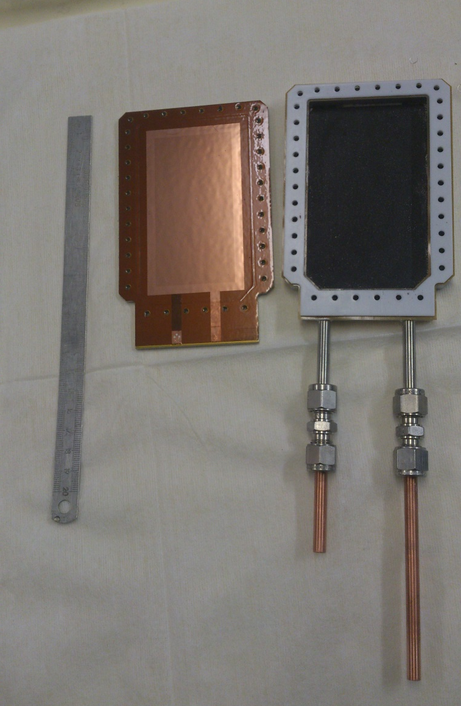
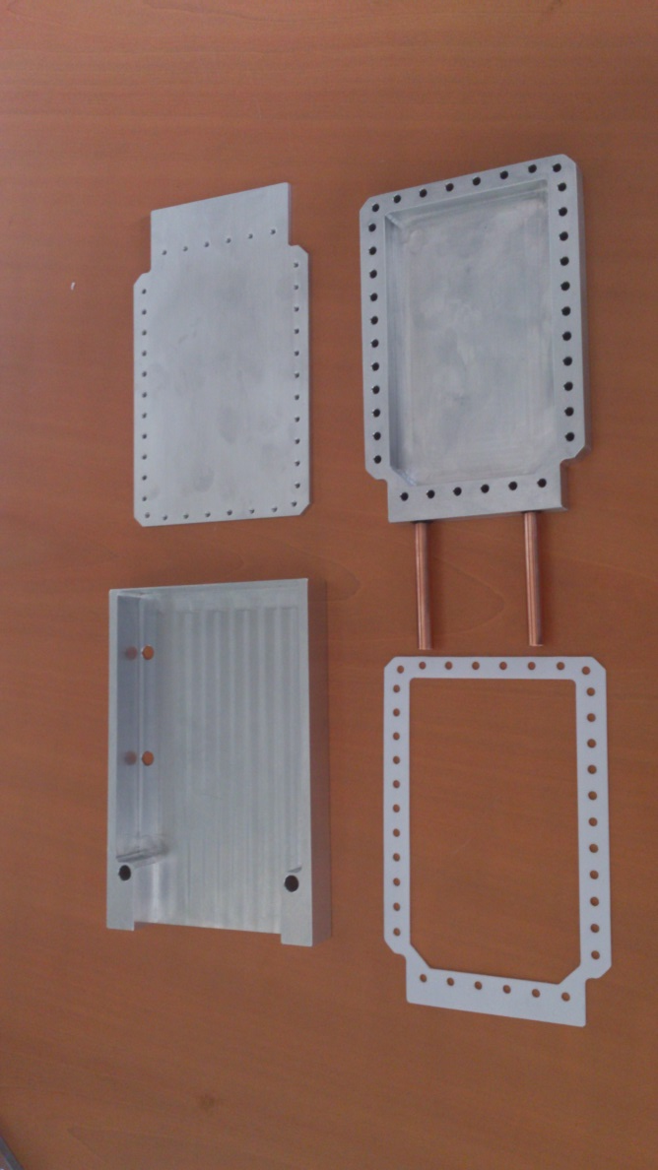
Ingredients to build a simple counter
¹⁰B layer (thick!) deposited on the inner part of the chamber
The ¹⁰B layer is the less trivial part to build
Material availability
Deposition methode
  Sputtering
  Evaporation
  Electrodeposition
  …
Teflon / kapton joint
Microbulk glued
on a metallic plate
Gas tubes

Slide 22
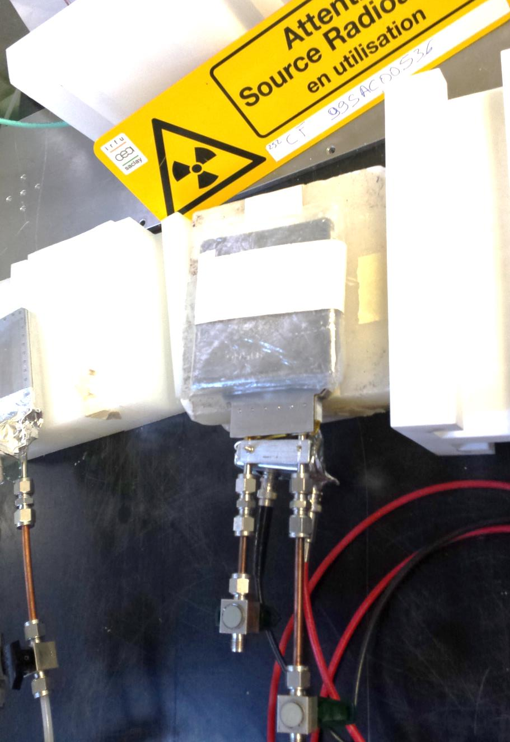
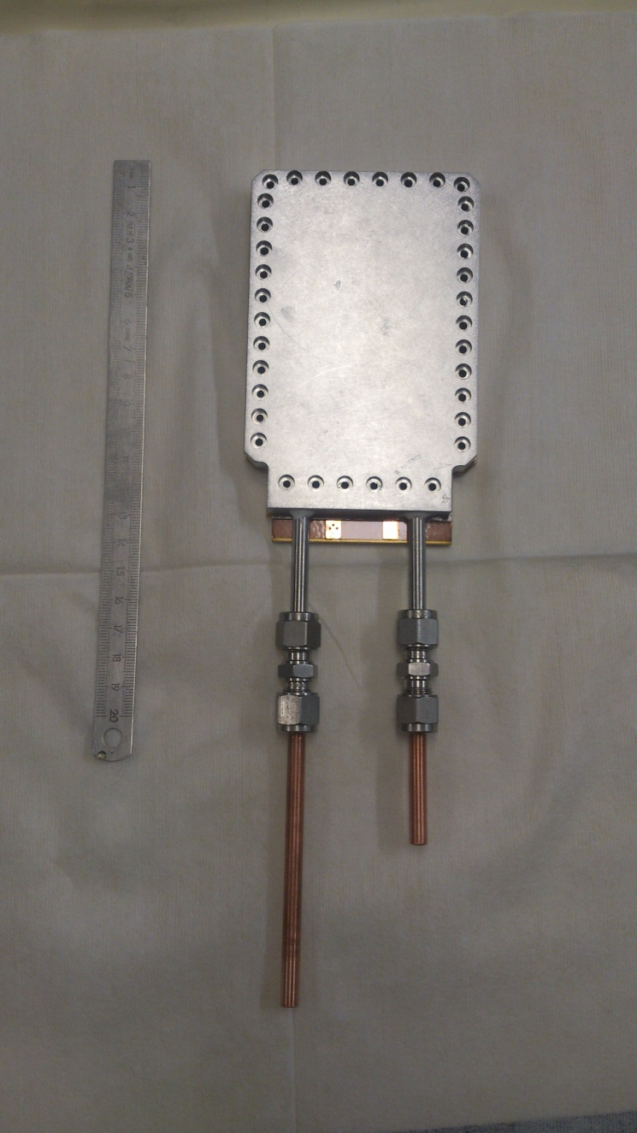
The simple neutron counter

Slide 23
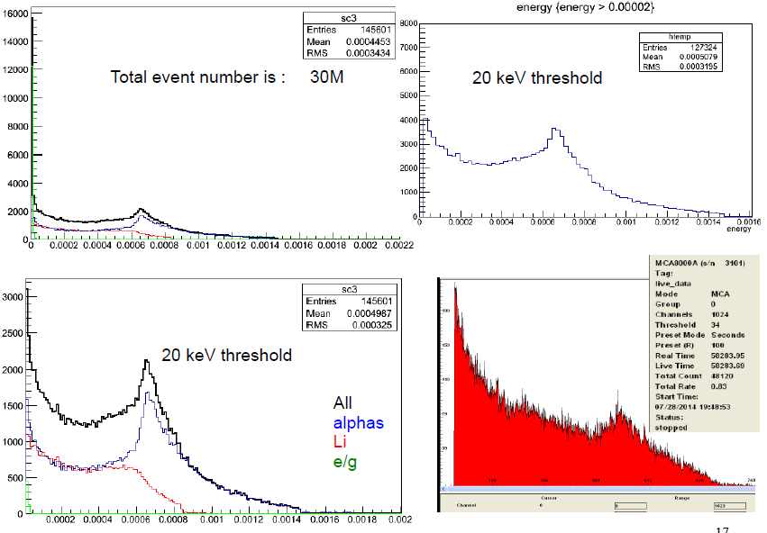
Performance
2 High voltages (+300V & +500V) for the mesh and the anode
Single readout channel
Operation in sealed mode (since July) – no gain loss
Measured efficiency: 4.3 – 5 %
(reference ³He tube)

Slide 24
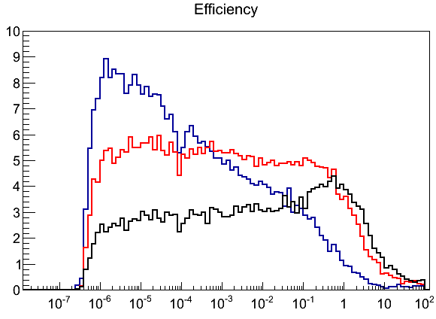
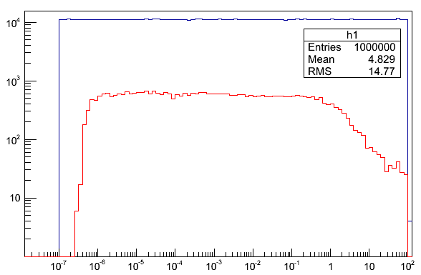


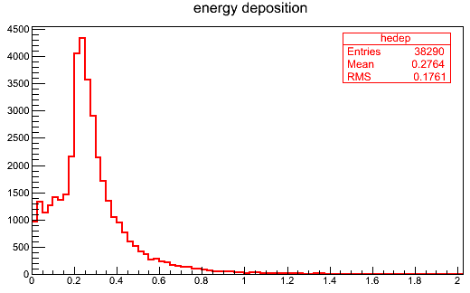
Simulated response to neutrons
Polyethylene
thickness
2 cm
4 cm
6 cm
Beam energy
Efficiency [ % ]
Recorded events in gas (4cm of Poly.)
Neutron Energy [MeV]
Neutron Energy [MeV]
For neutrons with energy 1 eV – 1 MeV, the recorded efficiency for a double-sided Micromegas detector with 2xB₄C layers is > 5% (4cm of Poly.).
Overall Eff. = 3.8% (4cm of Poly.)
For neutrons (10⁻¹ – 10⁷) eV
Threshold > 10 keV
[MeV]

Slide 25



Simulated response to thermal neutrons
Beam energy
Energy Deposition [MeV]
Recorded events in gas (4cm of Poly.)
Efficiency %
Neutron Energy [MeV]
Neutron Energy [MeV]
Neutrons that pass Cd and detected
¹¹³Cd (n,γ) Cd¹¹⁴ capture γ ‘s
Energy Deposition [MeV]
[MeV]
[MeV]

Slide 26
Response to gamma’s
Use of Helium mixtures ➔ low sensitivity to γ / electrons
A threshold ~10 keV, photons from 10 keV to 100 MeV could create a very small background with a detection efficiency of ~ 0.006%
(attenuation ~1000)
A threshold of ~ 30 keV cuts almost all the photons
10 keV – 100 MeV

Slide 27



Increasing the efficiency: 4 x B₄C layers + 4cm Polyeth.
Beam energy
Efficiency %
Recorded events in gas (4cm of Poly.)
Neutron Energy [MeV]
Neutron Energy [MeV]
For neutrons with energy 1 eV – 1 MeV, the recorded efficiency for 4xB₄C layer
is 7-8% (4cm of Polyethylene).
[MeV]

Slide 28

A module for very high E_{n} & very high flux
1 aluminum plate (1 mm) for the detector body
2 mm of polypropylene for “neutron conversion” to proton recoils
50 nm aluminum foil or deposition on the Polyethylene, Adjusting the thickness ➔ set the neutron energy threshold
0.1 - 10 mm gas (neon/helium) to produce electrons by ionization processes induced by the recoil proton.
Directional detection of fast neutrons (E_{n} > ~0.5 MeV)
Strong gamma rejection
High rate capability

Slide 29


Micromegas Concept for Laser MégaJoule & ICF Facilities
M. Houry et al., NIM,557(2006)648
The γ insensitivity of Micromégas applied to neutron spectroscopy
on Inertial Confinement Fusion experiments
2mm CH₂ converter
Time response < 500 ps
65 strips (1.6 mm pitch)
Gas In
HV1
HV2
Microstrips
Microstrips
Very good γ-rejection
< 15 cm >
Gas Out
Ref: CEA/DIF/DCRE/SDE M. Houry
DEMIN group (CEA/DIF/DCRE and DAPNIA)

Slide 30




Simulated response
neutrons of 10 MeV
Photons
2 MeV
1 MeV
500 keV
100 keV
50 keV
25 keV
5 mm
~ 0.3% efficiency, 1keV thr
Neutrons – 10 MeV
neutrons of 1 MeV
GeV
Simulations by G. Tsiledakis
5 mm
~ 0.025% efficiency, 1keV thr
Neutrons – 10 MeV
2 MeV
1 MeV
500 keV
100 keV
50 keV
25 keV
Efficiency × 10⁻⁵
Photons
E_{neutron} (MeV) | Threshold (keV)
 | 1 | 10 | 20 | 50
0.1 | 5 | 4 | 3 | 1
0.3 | 9 | 9 | 8 | 6
0.5 | 13 | 13 | 12 | 11
1.0 | 25 | 24 | 24 | 23
10.0 | 300 | 287 | 287 | 192
40 keV
GeV

Slide 31
Summary - Conclusions
Micromegas is a high performing MPGD, suitable for neutron measurements
  Mature technology
  Radiation hardness, aging properties
  Very good gain, energy & time resolution, granularity…
  Simplicity / low cost
Micromegas can be coupled with appropriate neutron converters in order to detect high energy neutrons with adjustable sensitivity
The operation parameters can be adjusted to:
  Increase neutron to gamma discrimination
  Coop with very high or low particle fluxes
  Extend the energy dynamic range
An assembly of 2 Micromegas modules with B₄C, Polyethylene or ²³⁸U converters and polyethylene moderator will be developed to be used as BLM at ESS based on the selective detection of fast neutrons
Expected time for optimization, design, construction, characterization, installation & commissioning of 42 modules: 2.5 years
A similar system is proposed for SARAF

Slide 32
Micromegas for high timing precision tracking

Slide 33


Micromegas time scales
The electron multiplication takes place in high E field (> 20 kV/cm)
between the anode (strips, pads) and the mesh in one stage
small amplification gap (50-150 μm)
fast signals (~ 1 ns)
short recovery time (~50 ns)
high rate capabilities (> MHz/cm²)
high gain (up to 10⁵ or more)
A GARFIELD simulation of a Micromegas avalanche (Lanzhou university)
micromesh signal
strip 1
strip 2
strip 3
Time response is limited from the continuous ionization on the drift gap

Slide 34
Localizing the e⁻ creation point
Limit the direct gas ionization
use a radiator / photocathode electron emitter:
Cherenkov light produced by charged particles crossing a MgF₂ crystal
Photoelectrons extracted from a photocathode (CsI)
  Simultaneous & well localized ionization of the gas (time jitter for the Cherenkov light ~10 ps)
  Well defined, small drift gap with strong electric field (~10kV/cm), or no drift
Reflective mode
Semitransparent mode
Charged particle
Charged particle
~80 photons/cm
~80 photons/cm
crystal
crystal
photon
photon
photocathode
electron
preamplification
electron
photocathode
micromesh
micromesh
avalanche
avalanche
anode
anode
insulator
insulator

Slide 35

Limiting the e⁻ diffusion in the gap
Small drift gap + strong electric field
  Limited diffusion
Simulations:
Few hundred μm drift field can provide time jitter per electron ~ 100 ps (Ed ~ 5kV/cm)
Several gas mixtures possible
Good performance for high amplification fields (>50 kV/cm)
➔ preamplification improves
time resolution!
5%
10%
15%
20%
Longitudinal time jitter as function of the drift field for several Ne mixtures. (R. Veenhof)

Slide 36
RD51 common fund project
Awarded 3/2015
Title of project: Fast Timing for High-Rate Environments: A Micromegas Solution
Contact persons: Sebastian White (co-PI), Princeton/CERN Sebastian.White@cern.ch
Ioannis Giomataris (co-PI), Saclay ioa@hep.saclay.cea.fr
RD51 Institutes:
1. IRFU-Saclay, contact person Ioannis Giomataris ioa@hep.saclay.cea.fr
E. Delagnes, T. Papaevangelou, M. Kebbiri, E. Ferrer Ribas, A. Peyaud, C. Godinot
2. NCSR Demokritos, contact person George Fanourakis gfan@inp.demokritos.gr
3. CERN, contact person, Leszek Ropelewsky Leszek.Ropelewski@cern.ch
E. Olivieri, H. Muller, F. Resnati
+ RD51&Uludag University, Rob Veenhof veenhof@mail.cern.ch
4. Universidad de Zaragoza, Diego González Díaz* diegogon@unizar.es
Ext. Collaborator:
Princeton University, contact person K.T. McDonald, kirkmcd@princeton.edu
Sebastian White, Changguo Lu
* Present Institute: Uludag/CERN

Slide 37
The RD51 project
R&D on charged particle timing towards ~10 ps
  ➔ high rates / high radiation environment (HL-LHC)
Project goal: demonstrate this level of performance based on a Micromegas photomultiplier with Cerenkov-radiator front window
  Single photoelectron time jitter ~100 ps
  produce sufficient photoelectrons to reach timing response → 10 ps.
Build a Micromegas prototype equipped with crystal / photocathode
Demonstrate the ~100 ps time jitter for single e- using high precision UV laser
  Semitransparent / Reflection mode
  Gas optimization
Measure time resolution @ MIP beam

Slide 38


UV photon detection
crystal
Reflective photocathode:
Photosensitive material is deposited on the top surface of the micromesh.
Photoelectrons extracted by photons will follow the field lines to the amplification region
  The photocathode does not see the avalanche ➔ no ion feedback effect ➔ higher gain in single stage (~ 10⁵)
  Better aging properties
  High electron extraction & collection efficiency
  Reflection on the crystal ?
  e⁻ path variation
  Limitation to Microbulk / opaque meshes
Semi-transparent photocathode:
Photosensitive material is deposited on an aluminized MgF₂ window (drift electrode)
  Extra preamplification stage ➔ better long-term stability, higher total gain
  Various MM technologies & gas mixtures possible
  Lower photon extraction efficiency
  Photocathode resistance to sparks (?)
  Ion backflow ➔ aging (?)
photon
electron
photocathode
micromesh
avalanche
anode
insulator
crystal
photon
photocathode
electron
preamplification
micromesh
avalanche
anode
insulator

Slide 39



Single-anode prototype
First tests with UV lamp / laser ➔ quartz windows
Microbulk Micromegas ø 1cm
Possibility to deposit CsI on the mesh surface
Capacity ~ 35 pF
Bulk Micromegas ø 1cm
Capacity ~ 5 pF
Amplification gap 64 / 128 / 192 μm
Ensure homogeneous small drift gap & photocathode polarization
Photocathodes:
  10 nm Al,
  6-8 nm Al + 10 nm CsI
Stainless steel chamber compatible with sealed mode operation
Very thin detector active part (<5 mm)

Slide 40






Detector prototype

Slide 41


Laboratory tests
Single photoelectrons from
a candles flame.
Estimated ~20 photoelectrons per pulse by comparing with the amplitude of the signal from a candle
24 hour run in sealed mode.

Slide 42



Measuring single p.e.
IRAMIS facility @ CEA Saclay
(thanks to Thomas Gustavsson! )
UV laser with σ_{t} << 100 fs
λ = 275-285 nm after doubling
intensity ~ 3 mJoule / sec
Repetition 8 MHz (!!) - limitations on gain
  Reduced to 9 kHz for the tests
Light attenuators (fine micro-meshes 10-20% transparent)
Trigger from fast PD
Cividec 2 GHz, 40 db preamplifier

Slide 43




Measurements @ IRAMIS laser

Slide 44

Very simple data acquisition
Registration of Micromegas & photodiode waveforms with 2GHz oscilloscope @ 10 GS/s
Offline analysis
thanks to Xavier & w. R. Zuyeuski
for osciloscope & LabView software

Slide 45




Response to single p.e.
Strong attenuation, so that events with no pulse appear
UV light from continuous source (candle)
Microbulk
Bulk 128
Signal modeling by
D. Gonzalez Diaz
& F. Resnati

Slide 46

Signal Modeling (D. Gonzalez Diaz, F. Resnati, R. Veenhof)

Slide 47

Signal Modeling (D. Gonzalez Diaz, F. Resnati, R. Veenhof)

Slide 48
Calculation of σ_{T} (~1 p.e.)
Calculate attenuation from <ampl>
Calculate <N_{p.e.}> from zeros.
28.9% zeros ➔ <N_{p.e.}> = 1.26

Slide 49


2015 laser test results
Calibrated attenuators
Maximum attenuation
➔ 29% zeros
➔ <N> ~1.26 p.e.
Results given for the mean photoelectron number – impossible to discriminate 1e/2e events
Resolution scaling with 1/sqrt(N) law
Gas used:
Ne (90%) + C2H6 (10%)
  Not optimal!
Very promising result:
  ~180 ps for 1.26 p.e.

Slide 50


Comparison with the simulation
Simulations by Diego Gonzalez
Improvement compared to the physical jitter due to the preamplification
Excellent agreement between data & simulation

Slide 51

Laser tests 2016
Laser tests May 2016
A different gas was used: Ne + 10% CF₄ + 10% C₂H₆
Improvements on signal conditioning
Ongoing Analysis
  Preliminary results σ_{single p.e.} ~ 150 ps for moderate field (12kV/cm)
Problems with Ne availability/cost due to the war in Ukraine (!) seem to pass
More measurements are planned for July
  He mixtures, pure quenchers
Simulations by Rob Veenhoff

Slide 52




Beam test @ SPS
June 2016, 150 GeV Muons (Thanks to E. Oliveri!)
CsI photocathodes:
  3mm MgF₂ + 6 nm Al + 10.5 nm CsI
  3mm MgF₂ + 8 nm Al + 10.5 nm CsI
Tests successful!
  Efficiency for μ ~100%
Ongoing Analysis. First estimations
  Preliminary results σ_{t} ~ 100 ps
  <p.e.> ≥ 5
Al Photocathode:
  5 mm MgF₂ + 8 nm Al
Problems gas availability. Some indication for good efficiency.
More measurements are planned for August
  optimized gases,
  new photocathodes,
  photocathodes by Hamamatsu,
  metallic photocathodes (Cr,Ni)
  Diamond photocathodes (quartz crystal)
Analysis by Filippo Resnati

Slide 53

Optimum gas mixtures for timing
  Single photoelectron time jitter ~100 ps
  produce sufficient photoelectrons to reach timing response → 10 ps.
By Rob Veenhof & Diego Gonzales
Notes:
Working fields in the MM for pure quenchers need to be about x2 higher. May limit the gain in case of defects.
Drift fields for pure quenchers need to be about x3 higher.
Dissociative attachment for CO₂ and freons expected to be compensated by gain. Needs to be verified.
now
Margin for improvement!!
( e^{αG})

Slide 54
Expected number of p.e. per MIP
  Single photoelectron time jitter ~100 ps
  produce sufficient photoelectrons to reach timing response → 10 ps.
A MIP passing through a crystal will emit:
For a MgF2 crystal and a CsI photocathode with typical bibliography values for QE(E), T(E) and n(E) as seen, we expect:
370 × 0.89 = 330 p.e./cm
This QE concerns operation in reflective mode!!! In
the semitransparent mode it is expected to be significantly
lower (factor 2-3)
for a 3 mm MgF2 crystal we would expect 30-50 photoelectrons.
Margin for improvement!!

Slide 55
Next steps – detector improvement
Detector studies
  Existing chamber
    Bulk technology for semi-transparent mode
    Microbulk for reflective mode
    Thin-mesh bulk
    Improve electron transparency / minimize path variations.
    First fabrication tests OK
  Laboratory tests (picosecond laser @ IRAMIS)
    Gas optimization (He mixtures, quenchers…)
    Reflective mode
    Continue single photo-electron performance studies
    Drift gaps
    Effect of the pillars
  Particle beam tests
  Ressistive Micromegas
  Design of a pixelated prototype (~10×10 cm²).
    Scalable to ~1 m²

Slide 56
Next steps (photocathode, aging, robustness)
Radiator / photocathode
  Photocathode (CsI fabrication, handling, storage, protection…)
  Diamond as photocathode
    Possibility to increase thickness towards 1 μm!
  Aging tests
    Deterioration with time
    Particle flux => high rate tests @ IRAMIS
  Robustness
  Total reflection problem @ reflective mode ? Coating,...
Secondary Emitter (Collaboration with CEA/DRT)
  Replace the crystal + photocathode with secondary electron emitter
    Robustness / spark reduction
    Free choice of substrate material
  Investigate materials with high secondary electron yield.
  (Doped-) diamond deposition, DLC, graphene…
    Conductive
    Robust
  Multi layer detector
  Diamond / graphene layer for photocathode protection ?
Improvement with
reflective mode

Slide 57


Next steps (Electronics)
Electronics for pixelated detector
  SAMPIC (D. Breton / LAL Orsay, E. Delagnes IRFU/CEA)
  Radiation hard amplifiers ➔ Mitch Newcomer / PENN
  Onboard electronics ?
  Improve signal transfer lines, bandwidth
http://arxiv.org/abs/arXiv:1604.02385

Slide 58
Conclusions - outlook
A Micromegas photodetector has been constructed in order to study the potential for ~10 picosecond timing for charged particles
First tests with a laser are positive.
~ 150 ps time resolution for single p.e. has been measured
with a standard bulk Micromegas in semi-transparent & sealed mode + preamplification
  Big margin for improvement
    Gas optimization
    Thin mesh
  Alternative design with diamond as secondary emitter
R&D will continue towards the construction of a scalable pixelated prototype with its electronics.
Involvement of more groups / labs
  Involvement of the Saclay SPP group
  Collaboration with CEA/DRT
Request for ANR funding
Encouraging results + growing interest!

Slide 59
Thank you!

Slide 60






The “piggyback” concept
Micromegas on a ceramic
Resistive layer
Readout trough capacitance coupling
Detector completely decoupled from readout electronics!
Readout without fit-throughs
Spark protection
Appropriate for sealed operation
Readout with a chip (Caliste)
arXiv:1208.6525 [physics.ins-det]

Slide 61
Radiation hardness
No space charge effect in radiation > 30 mC/mm² > 25 LHC years
High rate capability with 8 keV x-rays
10⁶/mm²/s
G. Puill, et al., IEEE Trans. Nucl. Sci. NS-46 (6) (1999)1894.

Slide 62
Micromegas for neutron time-of-flight measurements

Slide 63



Neutron flux monitors @ n_tof
Online neutron flux monitor:
Minimal perturbation of neutron beam
Negligible induced background
Cover a wide energy range
n_TOF: thin microbulks placed in the beam, equipped with appropriate converter (¹⁰B, ²³⁵U) deposited on the drift electrode
Higher efficiency & accuracy than any system sample in the beam / detector off the beam
Low mass in the beam
Low cost
The converter is not exposed to the avalanche (shielded by the micromesh)
neutrons

Slide 64



Neutron flux monitors @ n_tof
Setup from 2010
2 microbulks:
  ∅ = 10 cm
  Cu(5μm)/Kap(25μm)/Cu(5μm)
  Cu(5μm)/Kap(25μm)/Cu(5μm)
Windows:
  ∅ = 15 cm
  Kapton 12.5 μm
Unsealed converters:
  ²³⁵U = 18.5 mg, ∅ = 7 cm
  ¹⁰B = 0.6 μm, ∅ = 15 cm
NEUTRON FLUX 2010
borated water + demineralized water as coolant & moderator
n_TOF Collaboration, Facility performance report

Slide 65






Beam profiler
First detector:
bulk on a CAST microbulk prototype!
 6x6 cm² (2x106 strips, 0.5 mm pitch)
 drift gap = 4 mm
converter: ¹⁰B₄C enriched in ¹⁰B, 2 μm
 Ar + (10%)CF4 + (2%) iC4H10
Y
X
96 Y strips
96 X strips
See Francesca’s report!

Slide 66





Beam profiler: results
F. Belloni, A Micromegas Detector for Neutron Beam Imaging at the n TOF Facility at CERN“, ND2013”

Slide 67





Fission x-section measurements
Setup for fission
10 Microbulk Micromegas:
  ∅ = 10 cm
  Cu(5μm)/Kap(50μm)/Cu(5μm)
Windows:
  ∅ = 15 cm
  kapton 25 μm
Gas:
  Ar + (10%)CF₄ + (2%) iC₄H₁₀
Samples:
  4 ²⁴⁰Pu:
    ∅ = 3 cm each
    3.5 mg each ( 27.3 MBq)
  4 ²⁴²Pu:
    ∅ = 3 cm each
    3.0 mg each ( 1.2 MBq)
  1 ²³⁵U:
    ∅ = 3 cm each
    5.0 mg each ( 0.4 MBq)

Slide 68
A new Micromegas 2D structure transparent to neutron beams

Slide 69


Segmenting the micromesh
Neutron beam applications:
Microbulk a good solution :
Mass minimisation
(5um Cu - 50um kapton - 5um Cu).
Large surface detectors.
High radiopurity.
Drift region
mesh
anode
« A low mass microbulk with real XY structure »,Th. Geralis, RD51 Common Fund Project,
« A real x-y Microbulk MicroMegas with segmented mesh, Th. Geralis, PoS (TIPP 2014) 055
Segmented mesh microbulk:
1) No extra layers
2) Production simplification
3) Real XY structure => No charge loss from X or y strips
mesh
strips
…..Use as neutron beam monitor+
profiler
anode strips

Slide 70







Prototype evolution
First batch:
  Problems during etching
  due to holes topology.
  Many strips in short circuit.
Third batch
  Holes ∅ 60/40 μm
  Gaps reduced to 35 μm
  Energy resolution OK!
Second batch
  Etching OK with the new
  topology
  All detectors working
  Bad energy resolution due to
  large gaps (~150 μm)
The first two detectors produced:
58 x 59 strips on a 6 x 6cm² area (1mm thickness)
Mesh hole:~ 60μm / Pitch: 100 μm / 35μm interstrip gap
Drift HV

Slide 71





A thin flux & profile monitor
Status:
2 detectors installed at n_TOF
Data taking thrugh 2015
Ongoing optimization for larger surface
detectors

Slide 72




XY Micromegas performance with neutron beam
  Successfully used as a neutron beam profiler at GELINA, n_TOF, Orphee reactor.
neutron beam
Δt
The longest electron
drift time: point of the
interaction of the neutron
with the target.
4
3
1
2
Criterias applied : 1) Δt <= (drift space)/(drift velocity), 2) Total amplitude ratio ~1,
3) consecutive strips
Fit of the track with a straight line=> better spatial resolution
alpha peak
1.5 months run at n_TOF

Slide 73
Imaging capabilities

Slide 74
The end

Slide 75
Micromegas concept
The multiplication takes place in high E field (> 20 kV/cm)
between the anode (strips, pads) and the mesh in one stage
small size (50-100 μm)
fast signals (< 1 ns)
short recovery time (~150 ns)
high rate capabilities (> MHz/mm²)
high gain (up to 10⁵ or more)
V= -V₁
d
E
Ions
Q₁
x
Q₂
Electrons
Q₃
V= 0
p
micromesh signal
strip 1
strip 2
strip 3
A GARFIELD simulation
of a Micromegas avalanche
(Lanzhou university)

Slide 76

The virtue of the small gap
Micromegas is a proportional counter!
Parallel plate detector gain:
Ref: Y. Giomataris, NIM A419, p239 (1998)
Townsend coefficient α:
Gain variation:
E₁
The gain variation is reaching
a minimum for :
d = V/Bp
E₁> E₂
E₂
Stable gain – non sensitive to flatness defects or temperature and pressure variation
➔ good energy resolution
V

Slide 77
Microbulk mesh types
A “standard” for 50 μm gap: 30 μm holes placed in 100 μm pitch
Alternative: hexagonal arrangement for better optical transparency
Pillars: Areas without holes & full etching underneath normal holes
  Less material / capacity

Slide 78


Manufacturing a bulk Micromegas @ Saclay
Oven
Vacuum press
laminator
Mesh stretching

Slide 79





Manufacturing a bulk Micromegas @ Saclay

Slide 80






Micromegas + micro-pixels
surface: 1.4 x 1.6 cm²
Matrix of 256 x 256
pixel size: 55 x 55 µm²
InGrid technology
Medipix2
M. Cambell et al, NIMA540(2005)295
M. Chefdeville et al., NIMA556(2006)490
P. Colas et al., NIMA535(2004)506
Great resolution
Single electron counting!!
Gas On Slimmed SIlicon Pixels (GOSSIP)
Under study for ATLAS SLHC tracker
I. Giomataris
H. Van der Graaf, J. Timermans et al.
Notes:
80

Slide 81
General performance

Slide 82
Gain curves for argon mixtures
David.Attie@cea.fr
iC₄H₁₀
CO₂, CH₄
C₂H₆
Micromegas Mesh : 50 μm gap of 10x10 cm² size

Slide 83


Gain stability
Conventional Micromegas (2006)
Micromegas in CAST
(2003-2011):
Excellent long term stability!
Microbulk (2011)
2% Isobutane
Bulk (2008)
Change Vmesh
From 320->324V

Slide 84



Energy resolution
Microbulk: ⁵⁵Fe Calibration with Ar – 5% isobutane
@ 1 bar FWHM @ 6 keV = 11.5 %
Bulk: ⁵⁵Fe Calibration with Ar – 5% isobutane
@ 1 bar FWHM @ 6 keV = 17.6 %

Slide 85





Spatial resolution
Resolution in the presence of a magnetic field
→ σ ~ 50 µm independent of the drift distance
Conventional Micromegas calibration @ Panter with X-Ray telescope
Bulk: Spatial resolution measurements for the MAMA project (sLHC)
σ_{μΜ} = (24±7) µm .25 mm pitch
Ar Iso (95:5)
B = 5T
Microbulk: Image taken using a collimator with the words “axion cast”
σ_{μΜ} = (36±5) µm, .5 mm pitch

Slide 86



Sparking probability
Spark probability ~ 5.10⁻⁹ (He+10% isobutane @ gain ~ 10000)
Limitations due to sparks:
Dead time (up to 1 ms for mesh recharging )
Electronics destruction→ protection by diodes and decoupling capacitances
Detector damages→ Sparks not destructive!
Delbart et al., NIM A478 (2002), 205-209
SPARK in a Standard Bulk
Possibilities:
Resistive anode
Segmented mesh
Double stage amplification
Sparks are reduced by the use of resistive anodes
Topology of the sparks is very different: smaller in amplitude and shorter in time
The effect in dead time in resistive detectors is probably much smaller
SPARK in a resistive detector

Slide 87
Micromegas Applications

Slide 88





Particle & nuclear physics
COMPASS
40x40 cm² Micromegas
T2K
Large area
NA48
High rate, high resolution
S. Anvar et al. NIM A602:415-420, 2009
J. Bouchez et al. NIM A574:425-432,2007
CLAS 12: flexible structure
CLAS12 (Jefferson Lab) : Micromegas central and forward tracker
P. Konczykowski et al. NIM A612:274-277,2009

Slide 89




Axion search
Micromegas detectors in CAST: very low background (few counts per day)
Signal: excess of x-rays while pointing at the Sun

Slide 90






Dark Matter search
Prototype directional dark mater TPC: MIMAC (Micro-TPC Matrix of Chambers)
CLAS 12
T2K
3D Track and discrimination in
350 mbar He + 5% iC4H10
6 keV electron
12 slices
Skelton track
8 keV proton
F. Mayet et al. J. Phys. Conf. Ser. 179:012011, 2009
C. Grigon et al. JINST 4:P11003,2009.
8 keV proton
6 slices

Slide 91






The ILC TPC project
ILC TPC with Micromegas,
L = 4.6 m, D = 3.4 m
Large International collaboration
Ion feed back supression
No ExB effect
~ 40 μm average!!
Pad size 2x6 mm
1st TPC prototype
ILC TPC prototype
with Micromegas
Event in DESY test beam
I. Giomataris

Slide 92




ATLAS New Small Wheel
large + reliable detectors
2 new wheels (NSW):
1200 m² of resistive Micromegas
More than 2M electronic channels
D=10 m
Resistive anode:
Spark amplitude reduced
No dead time
Robustness
Maximum surface ~ 2 m²
Production: 1024 plans (2015-16)
Industrial transfer:
  ELVIA group (France)
  ELTOS (Italy)
Collaboration RD51
ANR « SPLAM »
Non resistive
Resistive

Slide 93



ATLAS New Small Wheel
At present construction of a mechanical prototype
Clean room
construction in 2014
1780
2220
LM2- Dubna +
Thessaloniki
SM2 Germany
1410
MILESTONES
2014: Definition M0 module
2015-2016: Production
2017: Surface Integration
2018: Cavern integration
1350
2042
1300
SM1 –
Italy-INFN
LM1- Saclay
2210
2310
460
660

Slide 94


CLAS 12 : cylindrical Micromegas
Cylindrical Flexible Micromegas operating at high magnetic field
4 m² Tracker
From conception of detector to electronics
Development of new electronics (30 k channels)
Production in 2014 and installation in 2015
Spinoff: ASACUSA
Patent on curved gaseous detectors

Slide 95




1er tuile CR6Z de CLAS12.

Slide 96


Slide 97



Micromegas in radiography
Neutron imaging: Beam tests at the Orphee
Nuclear plant 3x10⁸ thermal neutrons/cm²/s
⁶Li converter : 50 µm
Conversion gap : 400 µm
Amplification gap : 50 µm
Self-supported 50 mm micromesh
Spatial resolution
Hole diameter (µm) | s +/- D s (µm)
400 | 58 +/- 5
300 | 57 +/- 19
200 | 63 +/- 8
160 | 43 +/- 4
γ-ray scanner
F. Jeanneau, Proc. SPIE 4785, 214 (2002)

Slide 98















Micromegas for forest fire detection
FORFIRE: Developement of a solar blind detector sensitive to UV (200 – 250 nm)
The project received a European subsidy of 1.1 million € within the framework of the FP7 program-Small and Medium Enterprises. The industalization of the prototype is on-the-way.
Micromegas detector + solid photocathode (CsI)
Single electrons seen
By FORFIRE Micromegas
Q.E & Sensitivity
Photodiode Q.E.(200nm)≈70%
FORFIRE Q.E.(200nm)≈1%
However
Photodiode minimum signal ≈ 5 pA ➔
Photodiode minimum sensitivity ≈
  5×10⁷ photons
FORFIRE minimum sensitivity ≈
  5×10² photons

Slide 99





ATLAS NSW: large + reliable detectors
1000 m² of detector: 2 wheels of 125 m² quadruplets

Slide 100





Neutron flux monitors @ n_tof
Setup up to 2009
2 microbulks:
  ∅ = 3.5 cm
  Cu(5μm)/Kap(25μm)/Cu(5μm)
Windows:
  ∅ = 7 cm
  polypropylene 4 μm
Unsealed converters:
  ²³⁵U = 1 mg, ∅ = 2 cm
  ¹⁰B = 0.6 μm, ∅ = 3.5 cm
(S. Andriamonje et al., ND2010 Proceedings ND 1504)

Slide 101
Beam profiler
Neutron cross section measurements need also an accurate knowledge of:
Shape of the beam profile
  Beam optics misalignments affect the neutron flux
Beam intersection factor (BIF)
  Correction factor when samples are smaller than the beam ∅
    BIF = fraction of the number of neutrons hitting the area covered by
    the sample compared to the total number of neutrons in beam
Neutron beam profile from thermal up to ~1 MeV
experimental (almost real-time) position of the neutron beam
Micromegas + solid sample placed on the drift electrode
A Micromegas with 1D strips has already been used in 2001 !!!

Slide 102


Beam profiler
Second detector (2012):
pixelized bulk
pixelized readout with 2.5 mm pitch
number of pixels = 77 x 4
mesh gap = 128 μm
drift gap = 4 mm
window = 12.5 m kapton
Ar + (10%)CF4 + (2%) iC4H10
Equipped with B converter (2 μm thick)

Slide 103




Beam profiler: signal acquisition
n_TOF: ACQIRIS 1 GHz FADCs with large memore (>1MB/channel)
  1 eV neutrons @ n_TOF ➔ 14 msec TOF
Total number of channels: 64
XYMM electronics: GASIPLEX coupled to ACQIRIS FADC
Spatial resolution limited
by charged particle range!
New ASIC based electronics (GET) will allow operation in TPC mode ➔ trajectory reconstruction

Slide 104





Fission x-section measurements
Results
~1 year operation with few μΑ current
➔ total gain drop ~factor 2

Slide 105



Fission tagging
The accuracy in the capture cross sections measurement of fissile isotopes is reduced due to the large background contribution from fission reactions
Α total absorption calorimeter can be used in order to discriminate capture events using the Q_{γ}
  fission γ’s can have total energy close to Q_{γ}
A heavy ion detector can be used to discriminate fission events. Specifications:
  Low mass
  Insensitive to γ’s
  High FFs detection efficiency
  Good a to FF discrimination
  ⇒ Microbulk Micromegas

Slide 106






Fission tagging
Setup for fission tagging
3 Microbulks :
  ∅ = 3.5 cm
  Cu(5μm)/Kap(25μm)/Cu(5μm)
Windows:
  ∅ = 7 cm
  kapton 25 μm
Gas:
  He + (2%) iC₄H₁₀
Samples:
  3 ²³⁵U:
    ∅ = 2 cm each
    1 mg each ( 27.3 MBq)
Background reduction × 7
C. Guerrero, “Analysis of the Fission Tagging experiment in 2010”

Slide 107
Increasing the efficiency: the multilayer concept

Slide 108






Building the prototype
Bulk Micromegas 5x5 cm²
Ni frames 7x7 cm²
Ni meshes 10% & 20% transparent
Voltages applied with the help of kapton+Cu frames
One (10% transparent) mesh with two 1.5 μm B4C layers has been delivered by Linköping University and tested.
More expected soon!

Slide 109

The multilayer concept
A boron layer thicker than 1-2 μm is not efficient due to the absorption of the reaction products
Maximum efficiency that can be achieved in this case is of the order of 2-3 %
One solution: a tower of
detector-converter layers
  Several detectors
  Field configuration simplicity
Alternative: a tower of converter layers for each detector: ¹⁰B deposited on thin metallic meshes
  Less electronics
  Less material
  Difficulty: drift the produced charges to the detector through the mesh holes (proper configuration of the electric field)
¹⁰B
Micromegas
¹⁰B
¹⁰B on a
Ni mesh
Micromegas

Slide 110



Efficiency
1 unit with 5 x ¹⁰B₄C layers
Neutron Detection Efficiency for various neutron beam energies
with detection threshold at 10 keV
Thermal Neutron Detection Efficiency for various
detection thresholds
Neutron beam Energy
Detection Energy
Threshold
Thermal Neutron Detection Efficiency for various neutron beam energies with detection threshold at 1 keV
and thickness of B4C at 2μm
Simulations by
G. Tsiledakis

Slide 111
Efficient neutron detection with Micromegas
Motivation
³He crisis
Increased demand for neutron detectors
  Science
  Homeland security
  Industry
Micromegas with solid converters:
same principle as any gaseous detector but:
High performance
(gain, energy & time resolution)
High granularity
Radiation hardness
Simplicity
Low cost / big surface
Robustness
Low mass budget
Transparent to neutrons
Main difference compared to neutron-TOF applications
➔
need for high efficiency

Slide 112
The multilayer concept
One module can be consisted of a double-face Micromegas facing 7+7 ¹⁰B layers
Such a module can be ~1 cm thick!
Material:
  0.2 – 0.3 μm PCB
  6 x 5 μm Ni
  2 x micromesh
  2 x 1 mm Aluminum case
A stuck of such detectors can be used to increase efficiency
Detector can be tilted by 45º in respect to the neutron direction.
Monte-Carlo study to optimize the electron transmission & sample thickness

Slide 113


Micromegas in extreme environments
Micromégas Concept for Laser MégaJoule
Piccolo in Casaccia reactor
Challenges
Very small Micromegas
Seal detector
High radiation resistance
High temperature
Large dynamic range
Neutron measurement
in high γ background
Time resolution ~350 ps

Slide 114



Response to different angles
30 deg.
60 deg.
No tilt
30 deg. tilt
60 deg tilt
Efficiency %
Neutron Energy [MeV]
For neutrons with energy 1 eV – 1 MeV, the recorded efficiency for a 4xB₄C layer double-sided Micromegas detector is 7-8% (4cm of Poly.) for a perpendicular n beam
6-7% for a neutron beam at 30 degrees
4-5% for a neutron beam at 60 degrees

Slide 115


Wavelet treatment (by Sebastian White)
CERN Detector Seminar 25/09/2015

Slide 116

Wavelet treatment (by Sebastian White)

Slide 117

Wavelet treatment (by Sebastian White)

