Slide 1

Heavy Ion’s Mini-Me
Strong radial flow in proton collisions at RHIC
Hi, I am
A+A
Hi, I am
p+p
Mike Lisa
Ohio State University

Slide 2
Outline
What is the importance of flow (what does it tell us)?
What are the signals of radial flow at RHIC?
2-particle correlations in p+p collisions at RHIC
  femtoscopic & phasespace-induced
Single-particle spectra at RHIC. Effects of phasespace constraints
All together now: consistent treatment of 1- and 2-particle distributions
  flow “revealed”?
  other similarities: yields, “proton anomoly,” <pT> vs Nch vs mass
Summary/comments/outlook

Slide 3
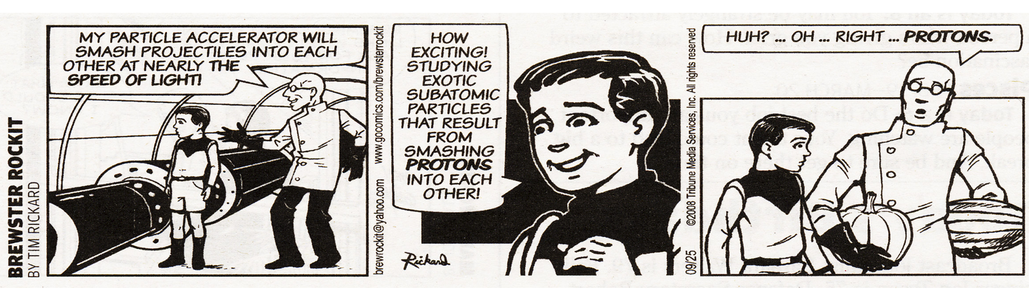
Life as a heavy ion physicist

Slide 4
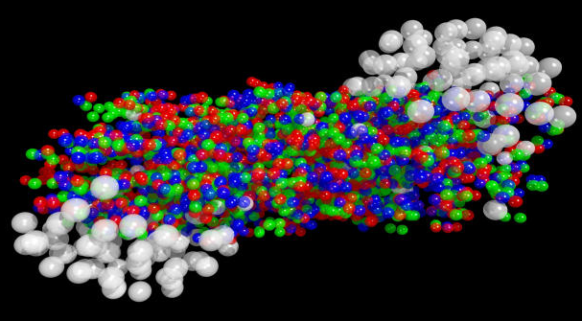
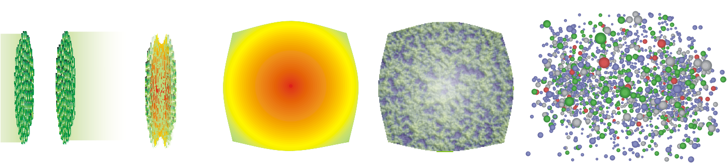
paradigms of seeds & watermelons
A+A → a system
“Clean” p+p– a crucial reference at high pT
(do we understand/care about low pT?)
p+p: a process

Slide 5
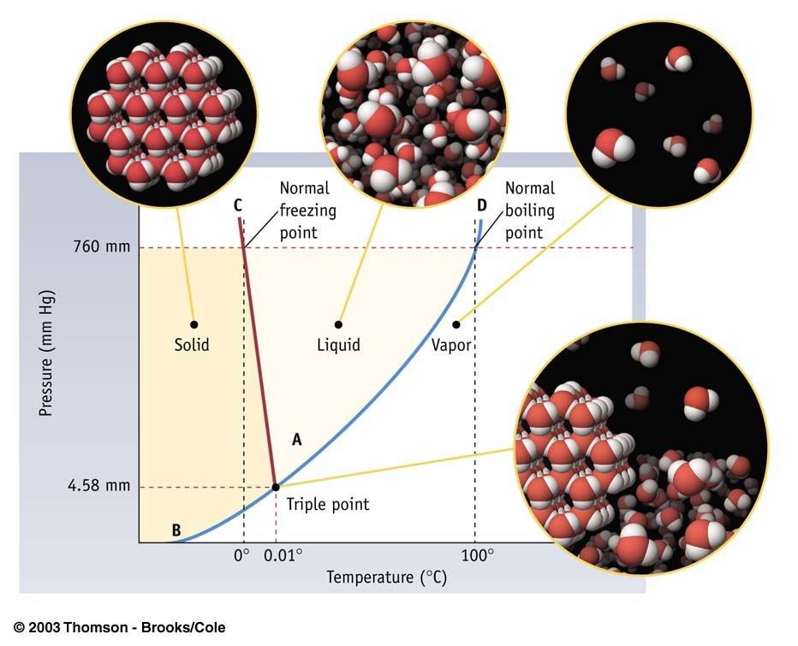
H.I.C. – a system
FLOW: most direct proof of existence of system
&
probe of its response
bulk physics
superfluids
superconductors
metal/insulator
…
Only for large system
- can’t melt one H₂0 molecule!

Slide 6
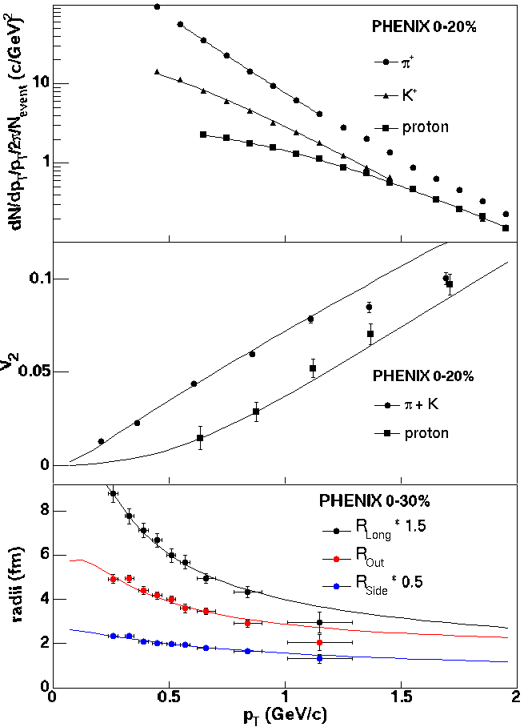
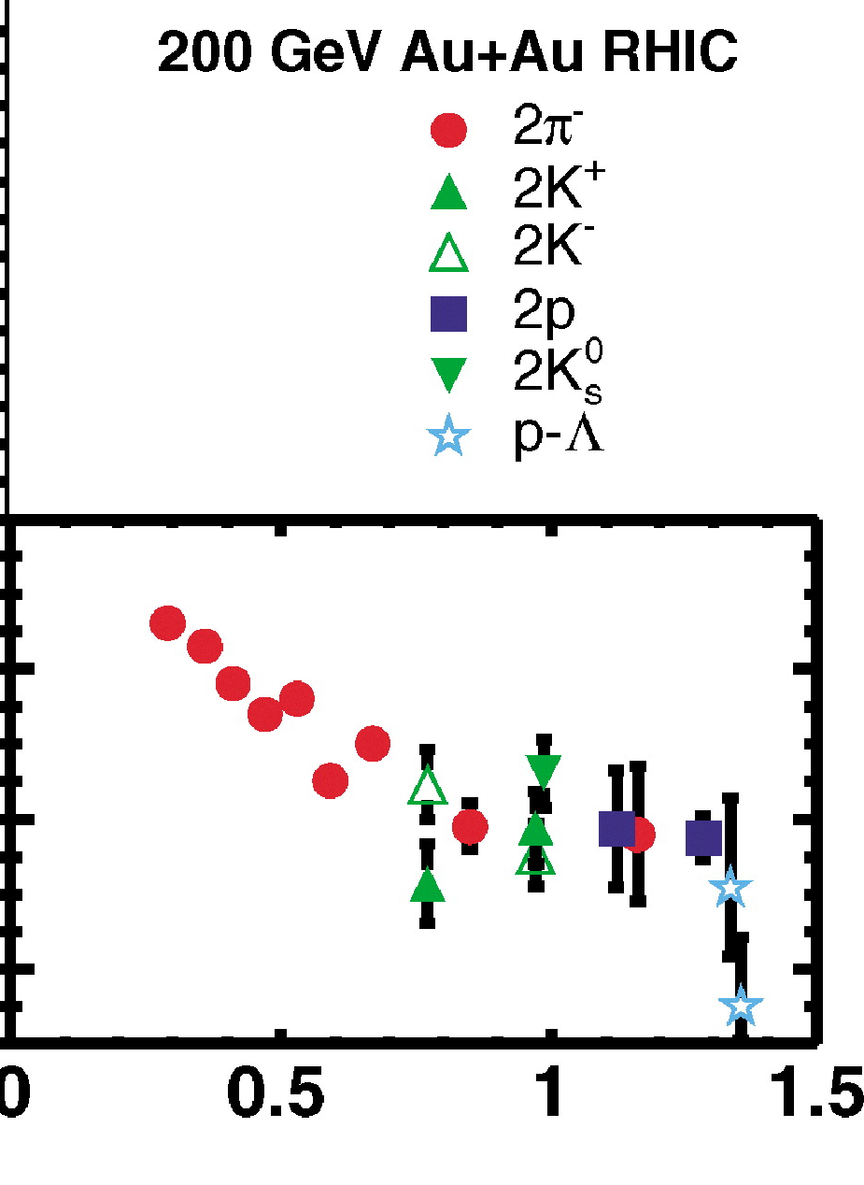
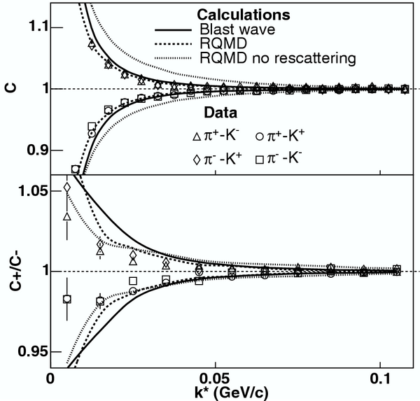
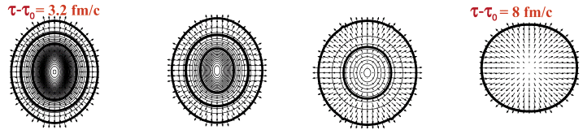
Explosive flow revealed through specific fingerprints on soft-sector observables
calculable in hydrodynamics or toy “blast wave” models
Spectra
R (fm)
v₂
π
HBT
slow π
STAR PRL 91 262301 (2003)
m_{T} (GeV/c)
K
space-momentum substructure mapped in detail
fast π
but the defining characteristic:
correlated position and boost direction
Notes:
OK OK clearly it is flow. We are QUANTITATIVE here!

Slide 7
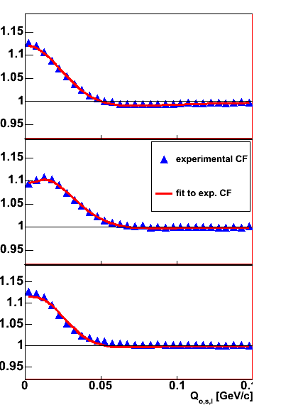
Obtaining 3D radii from 3D correlation functions
Au+Au: central collisions
C(Q_{out})
typical “Gaussian” fitting function
Au+Au: “Gaussian” radii capture bulk scales
  (resonance tails from imaging)
R(p_{T}) consistent with explosive flow
C(Q_{side})
“set of zero measure”
of full 3D correlation fctn
1/R_{SIDE}
C(Q_{long})

Slide 8
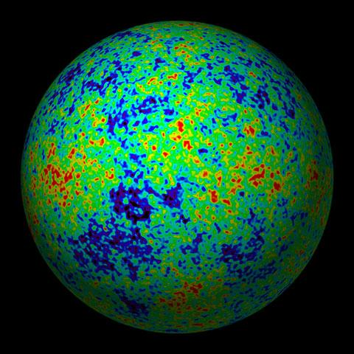
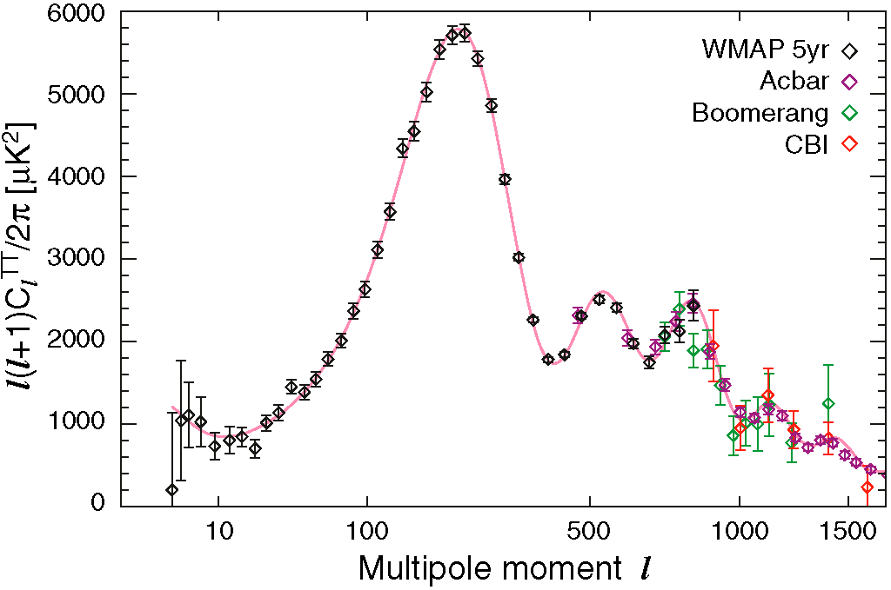
Spherical harmonic representation of 3D data
(average over m, no “special” direction)

Slide 9
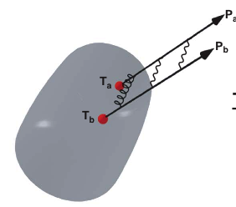
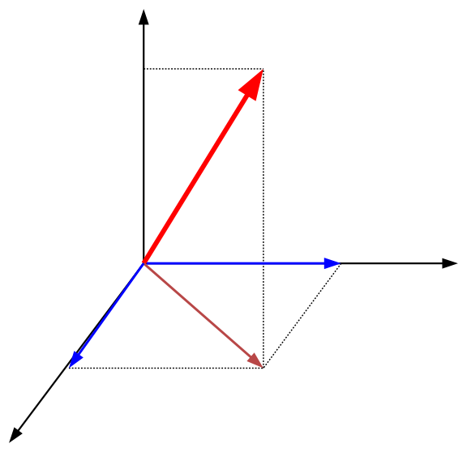
Spherical harmonic representation of 3D data
Q_{LONG}
Q
θ
Q_{OUT}
ϕ
Q_{SIDE}
Z. Chajecki & MAL, PRC 78 064903 (2008)
(average over m, no “special” direction)

Slide 10
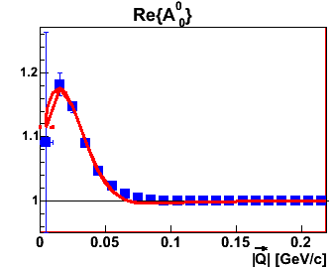
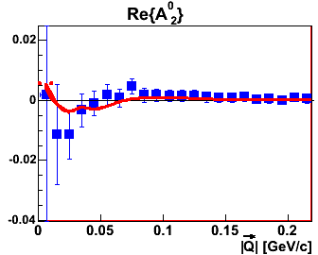
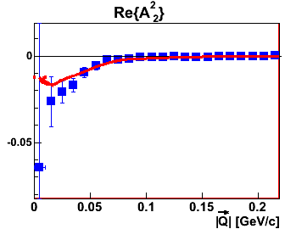
Spherical harmonic representation of 3D data
Au+Au: central collisions
C(Q_{out})
C(Q_{side})
C(Q_{long})
Z. Chajecki & MAL, PRC 78 064903 (2008)

Slide 11
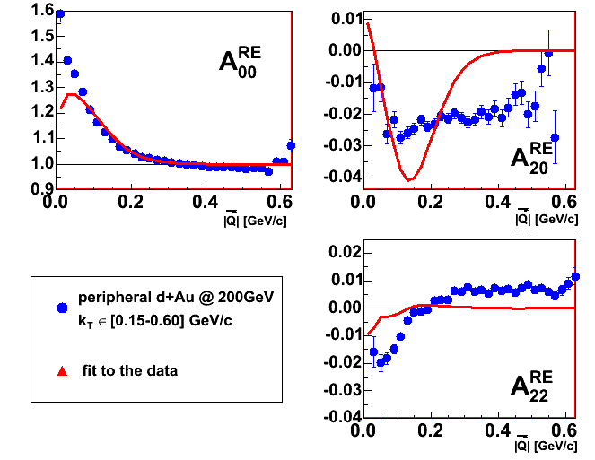
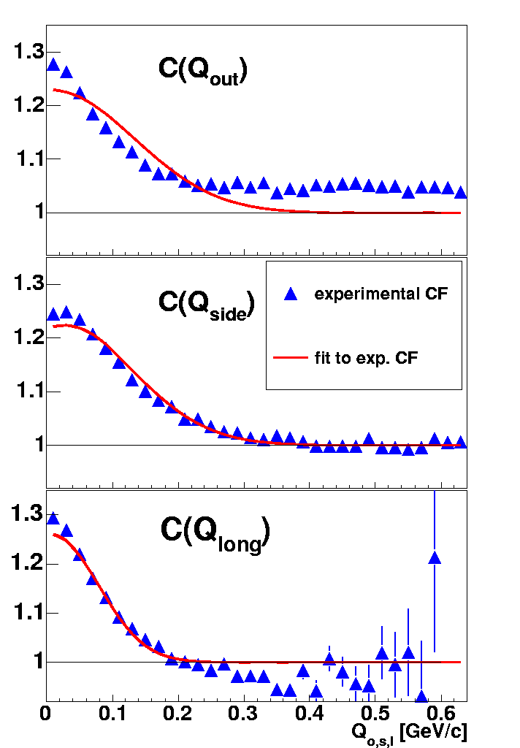
Spherical harmonic representation of 3D data
d+Au peripheral collisions
STAR prelim
Z. Chajecki & MAL, PRC 78 064903 (2008)

Slide 12
Spherical harmonic representation of 3D data
d+Au peripheral collisions
Not a “normalization problem”
Not a “non-Gaussian” issue
A real, non-femtoscopic correlation
STAR prelim (QM05)
Z. Chajecki & MAL, PRC 78 064903 (2008)

Slide 13
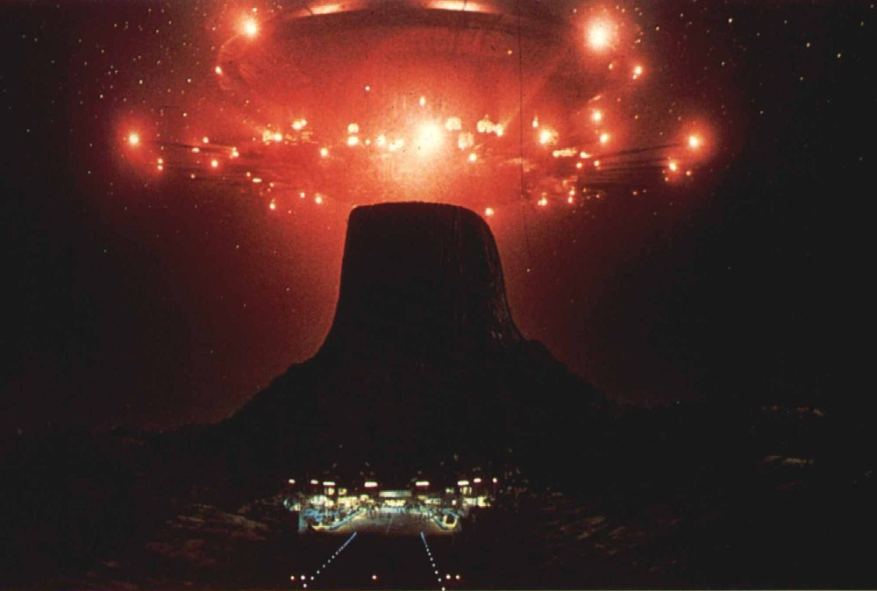
We are not alone...
Notes:
Roy’s talk: v2 vanishes and even goes negative below top AGS-- a really peripheral Au+Au collision at RHIC will not have v2<0 !

Slide 14
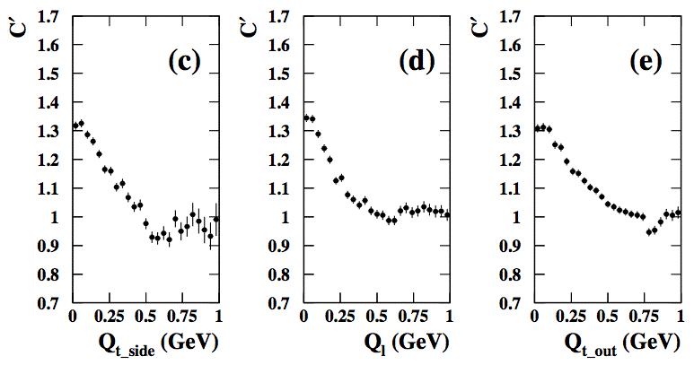
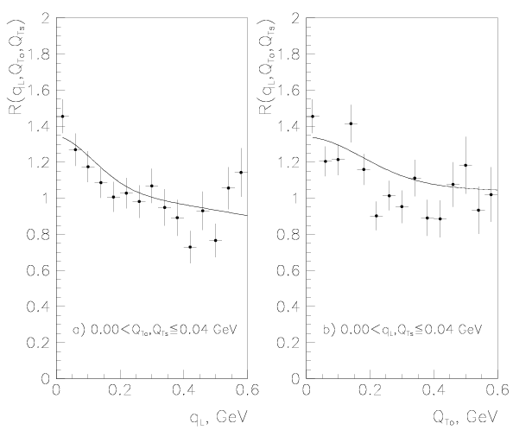
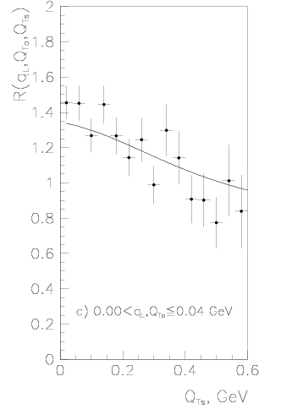
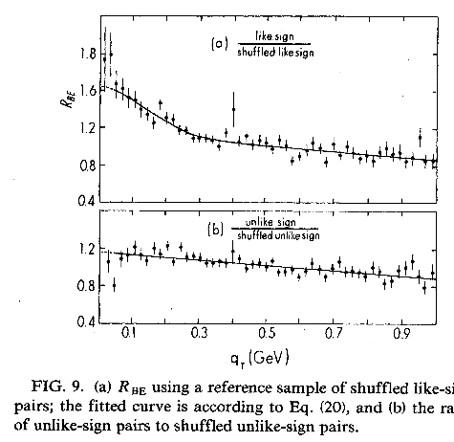
Non-femto correlations in B-E analysis through the years:
We are not alone...
Q_{x}<0.2 GeV/c
OPAL, CERN-PH-EP/2007-025
(submitted to Eur. Phys. J. C.)
Q_{x}<0.04 GeV/c
NA22, Z. Phys. C71 (1996) 405
CLEO PRD32 (1985) 2294
Review: Z. Ch., Acta Phys.Polon.B 40 1119 (2009)
Notes:
Roy’s talk: v2 vanishes and even goes negative below top AGS-- a really peripheral Au+Au collision at RHIC will not have v2<0 !

Slide 15
non-femto “large-Q” behaviour - various approaches
ignore it
various ad-hoc parameterizations
divide by π⁺π⁻ (only semi-successful, and only semi-justified)
divide by MonteCarlo PYTHIA, tuning until tail is matched (similar to ad-hoc)
Can we understand it in terms of simplest-possible effect–
Energy and Momentum Conservation Induced Correlations (EMCICs)?
  Z. Chajecki & MAL, PRC 78 064903 (2008)
see also
  pT conservation effects on v1 (v2) [Danielewicz, Ollitrault & Borghini]
  pT conservation on 3-particle “conical emission” observables [Borghini]
  p and E conservation effects on single particle spectra [Chajecki & MAL]

Slide 16
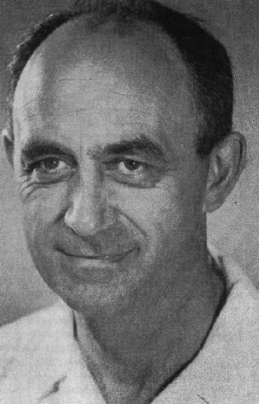
energy-momentum conservation in n-body states
spectrum of kinematic quantity α (angle, momentum) given by
n-body Phasespace factor R_{n}
statistics: “density of states”
larger particle momentum→ more available states
P conservation
Induces “trivial” correlations
(i.e. even for M=1)
Notes:
that first equation is essentially “Fermi’s Golden Rule”

Slide 17
Example of use of total phase space integral
In absence of “physics” in M : (i.e. phase-space dominated)
single-particle spectrum (e.g. p_{T}):
Hagedorn
“spectrum of events”:
F. James, CERN REPORT 68-15 (1968)
Notes:
nota: that first equation with pion decay channels actually is missing a numerical factor... See James.

Slide 18
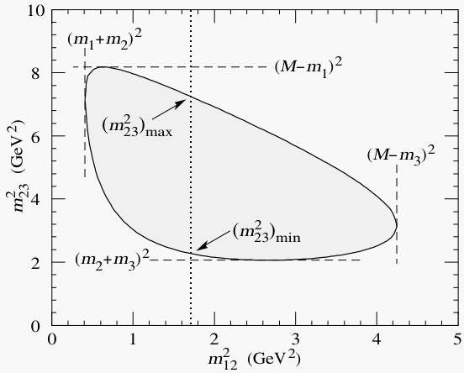
Phasespace constraints impt @ low multiplicity
Phase-space constraints
Extreme case, N=3,
easily visible with Dalitz plot (k=2)
What about the effect for higher number of particles?
Dalitz plot for a three-body final state.
PDG 2008

Slide 19
Fermi/Hagedorn factorization (“Golden rule”)
Probability for an n-particle final state:
dynamics
kinematics
Single-particle spectrum
R. Hagedorn, Relativistic Kinematics 1963

Slide 20
Consider correlations arising (only) from conservation laws
The k-particle distribution
single-particle “parent” distribution
w/o P.S. restriction
what we
measure
no other
correlations
click here
for details
Notes:
Note: k<N is just there because if k=N-1 then ALL particle momentum (all N) would be known already since P is conserved. So it just indicates that there is one less 4-vector degree of freedom in the distribution

Slide 21
Hidden Slides on applying Central Limit theorem

Slide 22
Applying CLT (1/3)
(Denominator of phasespace integral just a normalization)
Notes:
Note: k<N is just there because if k=N-1 then ALL particle momentum (all N) would be known already since P is conserved. So it just indicates that there is one less 4-vector degree of freedom in the distribution

Slide 23
Applying CLT (2/3)
Notes:
Note: k<N is just there because if k=N-1 then ALL particle momentum (all N) would be known already since P is conserved. So it just indicates that there is one less 4-vector degree of freedom in the distribution

Slide 24
Applying CLT (3/3) – diagonal covariance matrix!
✓
✓
✓
✓

Slide 25
k-particle distribution in N-particle system
detail
  Danielewicz et al, PRC38 120 (1988)
  Borghini, Dinh, & Ollitraut PRC62 034902 (2000)
  Borghini Eur. Phys. J. C30:381-385, (2003)
  Chajecki & MAL, PRC 78 064903 (2008)
PRC78 (2008); PRC79 (2009)
Notes:
(*) For simplicity, I from now on assume identical particles (e.g. pions). I.e. all particles have the same average energy and RMS’s of energy and momentum. Similar results (esp “experimentalist recipe) but more cumbersome notation otherwise

Slide 26
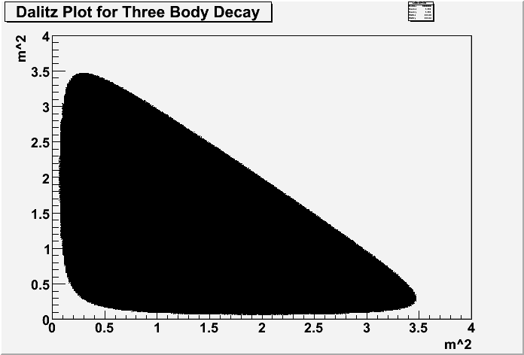
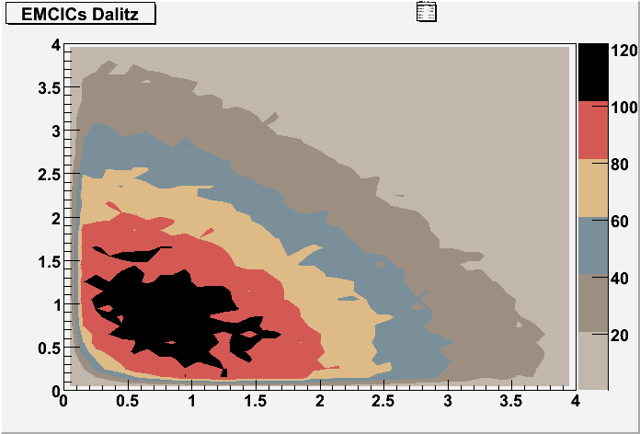
N-k=1 is not “large”
GENBOD calculation
Black area is uniformly filled in. Outside of that area has zero counts
Dalitz plot for 3-particle system:
N=3, k=2
calculated numerically by GENBOD* MC
* F. James, CERN 1964
Approx weight calculated uniformly in px,py,pz & projected onto M12-M23

Slide 27
Overlaid
I actually didn’t expect such good agreement in the N=3 case, especially on a
Dalitz plot which has the sharpest possible behaviour.

Slide 28
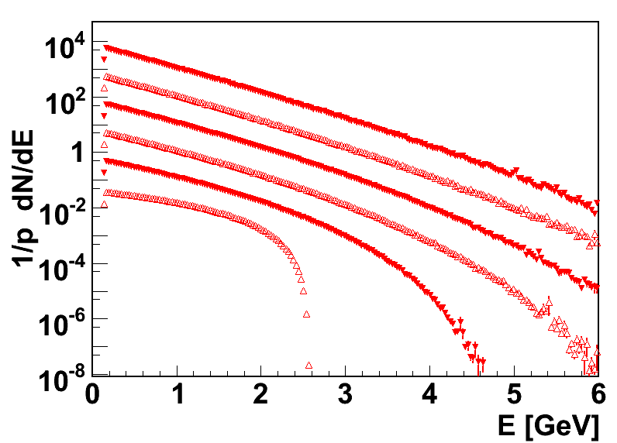
Effects on single-particle distribution
1-particle PS effect
We will return to this….
N=40
N=5
Z.Chajecki, MAL, PRC 79 034908 (2009)
Notes:
note that even single-particle distribution is modified.
I.e. it is not “just” a two-particle effect

Slide 29
k-particle correlation function
Dependence on “parent” distrib f vanishes,
except for energy/momentum means and RMS
2-particle correlation function (1st term in 1/N expansion)
for v2: Danielewicz (84), Ollitrault, Borghini (2000)

Slide 30
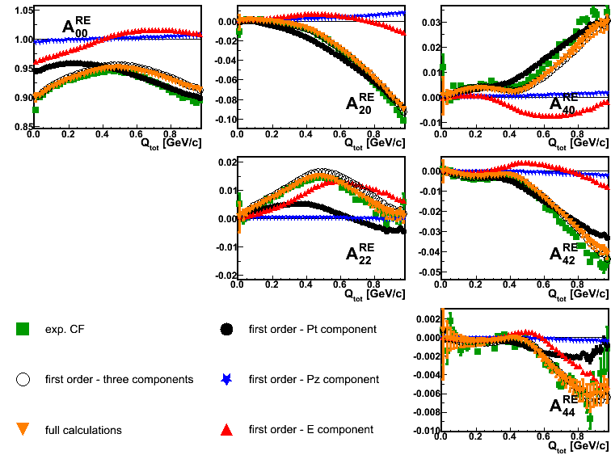
How do EMCICs look ? – nontrivial !
Genbod N=18 <K>=0.9 GeV; PRF - |η|<0.5
event generator (genbod)
with only EMCICs
O(1/N) term in
CLT approximation
CLT approximation
structure not confined to large Q
kinematic cuts have strong effect [not shown]

Slide 31
How do EMCICs look ? – nontrivial !

Slide 32
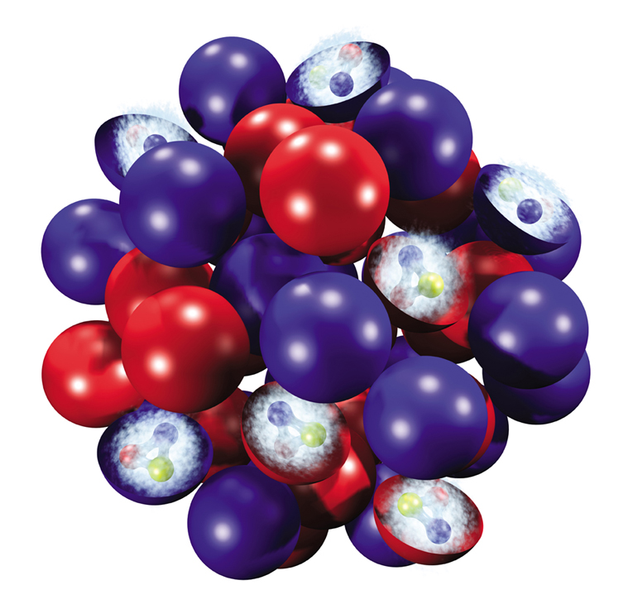
“the system”… a nontrivial concept
Characteristic scales of relevant system in which limited energy-momentum is shared
Not known a priori
should track measured quantities, but not be identical to them
N includes all primary particles (including unmeasured γ’s etc)
secondary decay (resonances, fragmentation) smears connection b/t <E²> and measured one
<E²> etc: averages of the parent distribution
“relevant system” almost certainly not the “whole” (4π) system
  e.g. beam fragmentation probably not relevant to system emitting at midrapidity
    characteristic physical processes (strings etc): Δy ~ 1÷2
  jets: “of the system” ??
    or just stealing energy from “the system?”
  if “relevant system” ≠ “whole system”, then total energy-momentum will fluctuate e-by-e

Slide 33
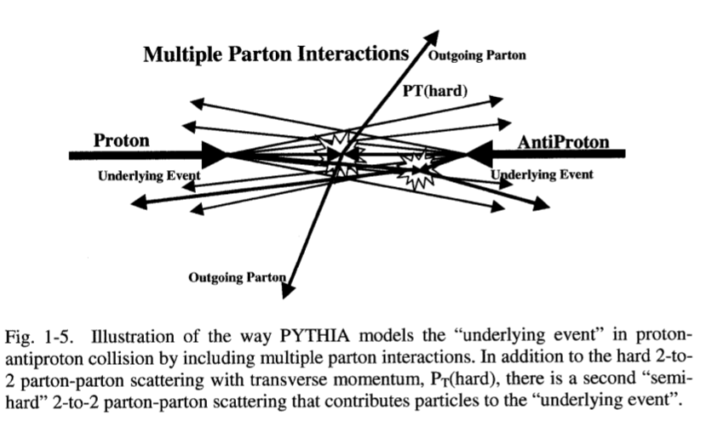
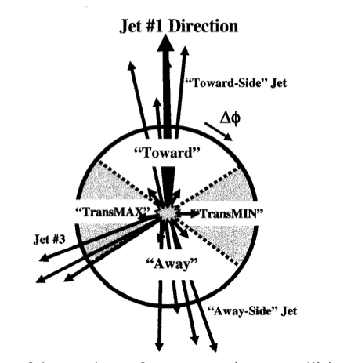
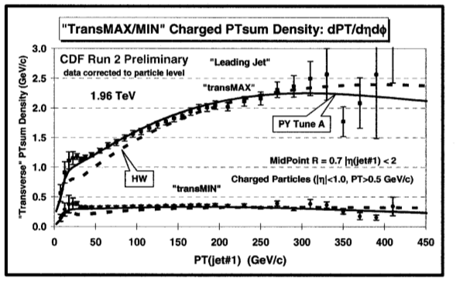
The underlying event appears indep of jet – CDF
L.A. Cruz, PhD Thesis, U. Florida
“Underlying event at Tevatron” (2005)

Slide 34
“the system”… a nontrivial concept
Characteristic scales of relevant system in which limited energy-momentum is shared
Not known a priori
should track measured quantities, but not be identical to them
Treat as parameters: what to expect?

Slide 35
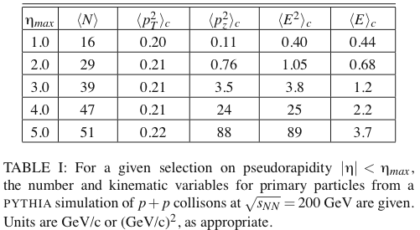
“the system”… a nontrivial concept
Characteristic scales of relevant system in which limited energy-momentum is shared
Not known a priori
should track measured quantities, but not be identical to them
Treat as parameters: what to expect?
35

Slide 36
Femtoscopic correlations and EMCICs
(experimentalists’ recipe)
Z. Chajęcki & MAL PRC 78 064903 (2008)

Slide 37
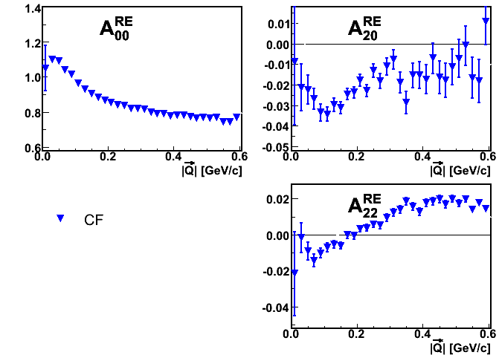
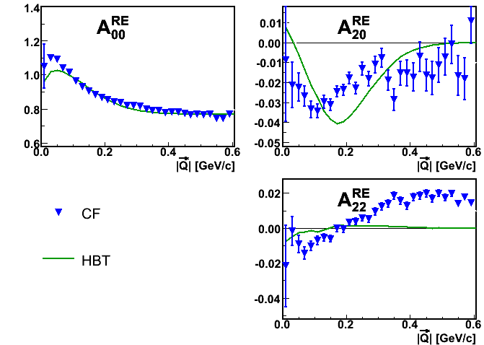
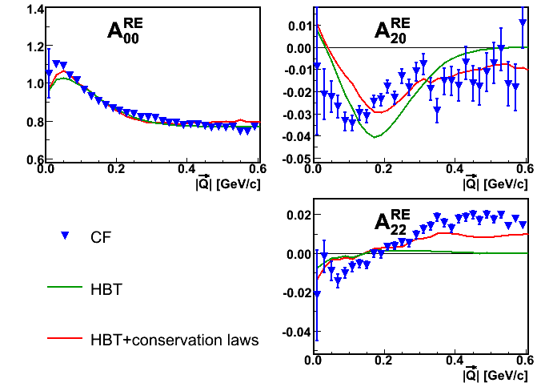
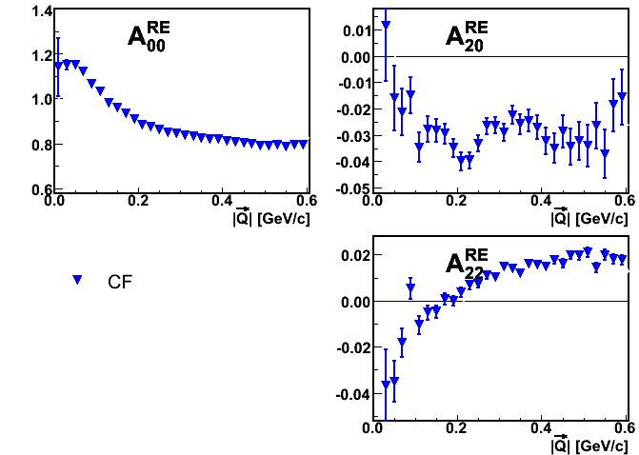
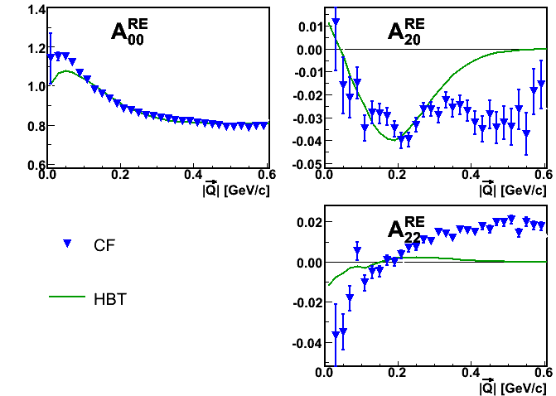
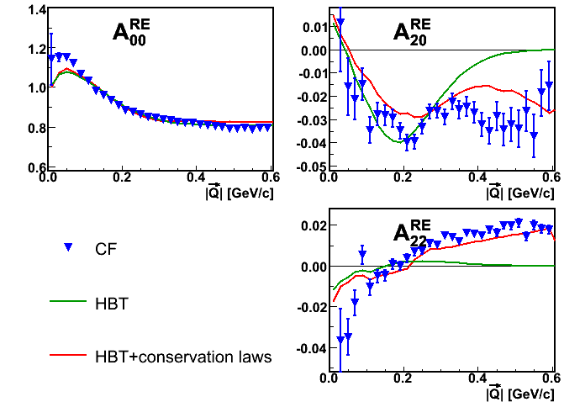
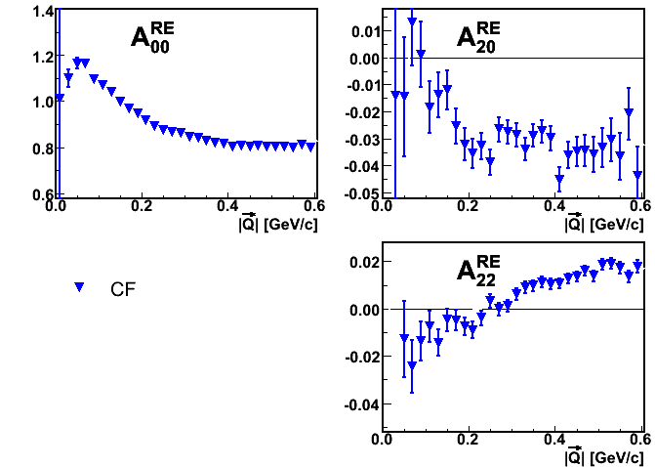
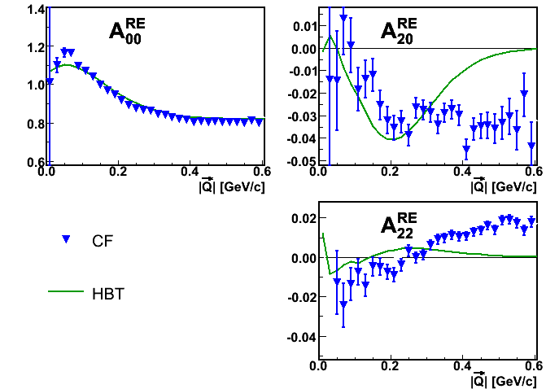
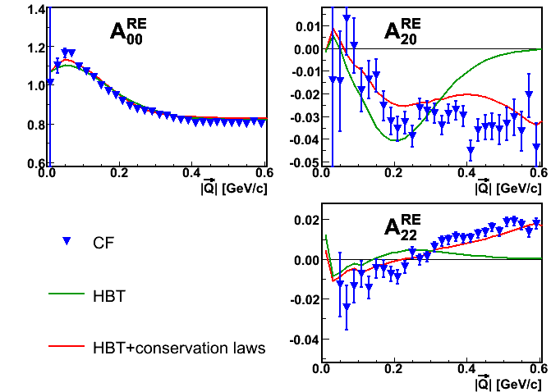
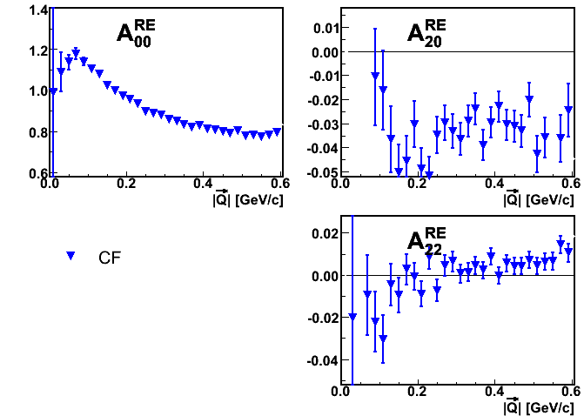
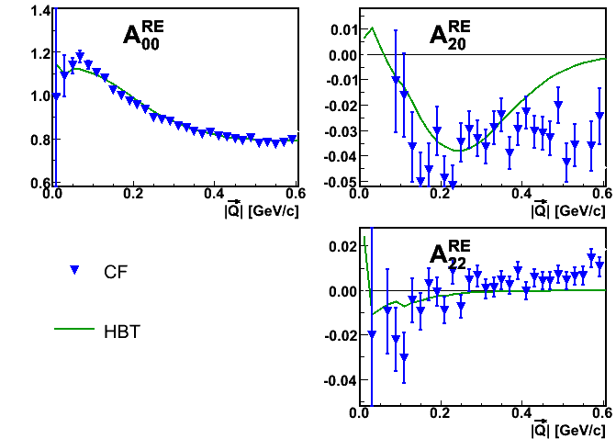
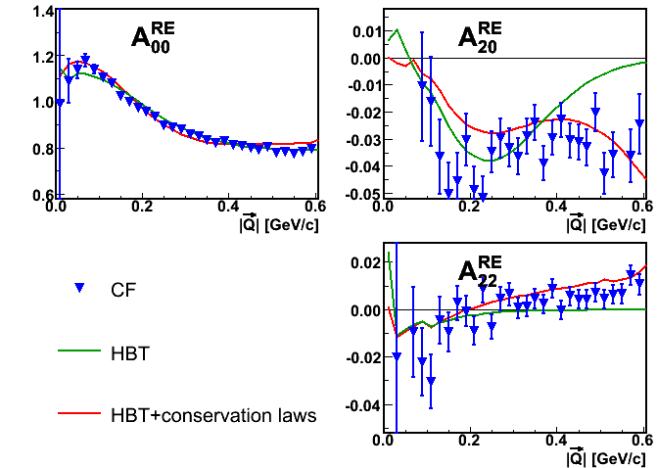
Fits to p+p data (STAR @ QM09)
STAR preliminary
k_{T} = [0.15,0.25] GeV/c
k_{T} = [0.25,0.35] GeV/c
k_{T} = [0.35,0.45] GeV/c
k_{T} = [0.45,0.60] GeV/c

Slide 38
Fits to p+p data (STAR @ QM09)
STAR preliminary
k_{T} = [0.15,0.25] GeV/c
k_{T} = [0.25,0.35] GeV/c
k_{T} = [0.35,0.45] GeV/c
k_{T} = [0.45,0.60] GeV/c

Slide 39
Fits to p+p data (STAR @ QM09)
STAR preliminary
k_{T} = [0.15,0.25] GeV/c
k_{T} = [0.25,0.35] GeV/c
k_{T} = [0.35,0.45] GeV/c
k_{T} = [0.45,0.60] GeV/c

Slide 40
Parameters from 2-particle correlations
Five physical variables - four fit parameters
Can we verify whether kinematic variables showing up in fit parameters have physical values?
STAR preliminary

Slide 41
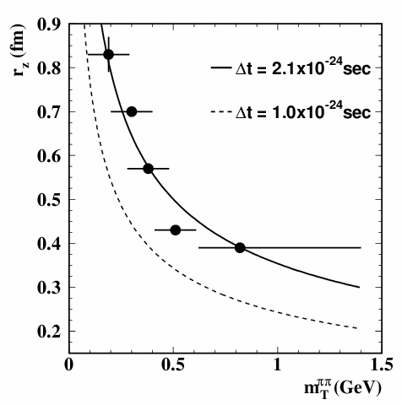
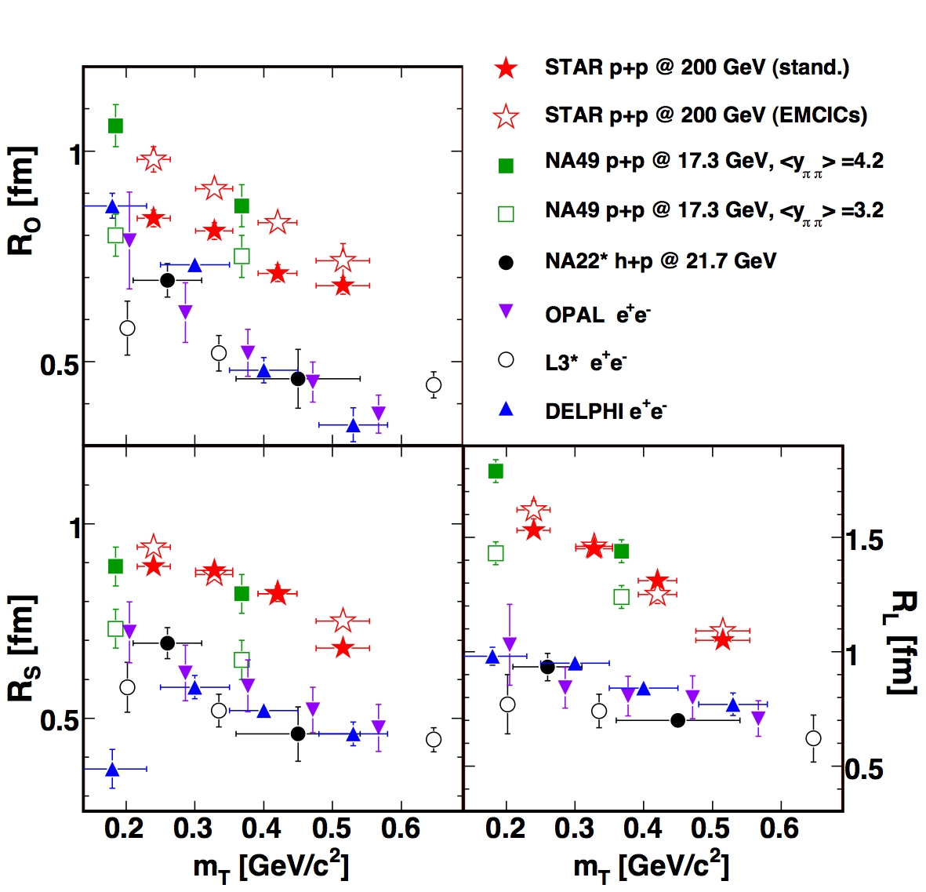
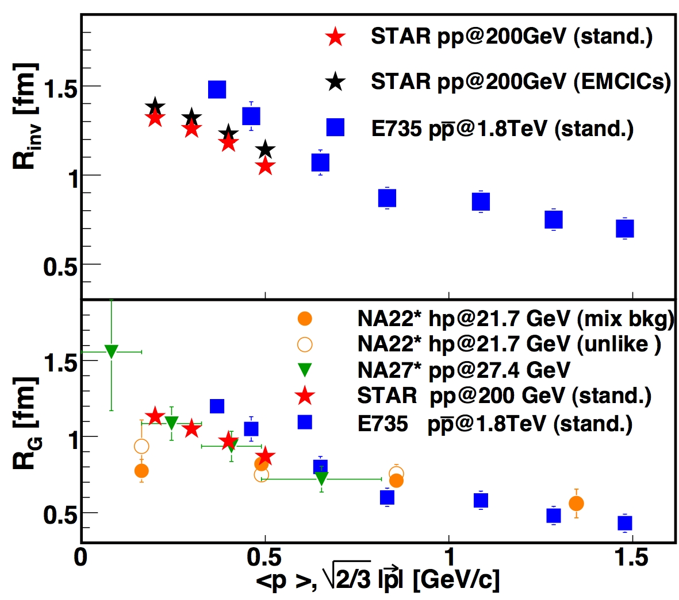
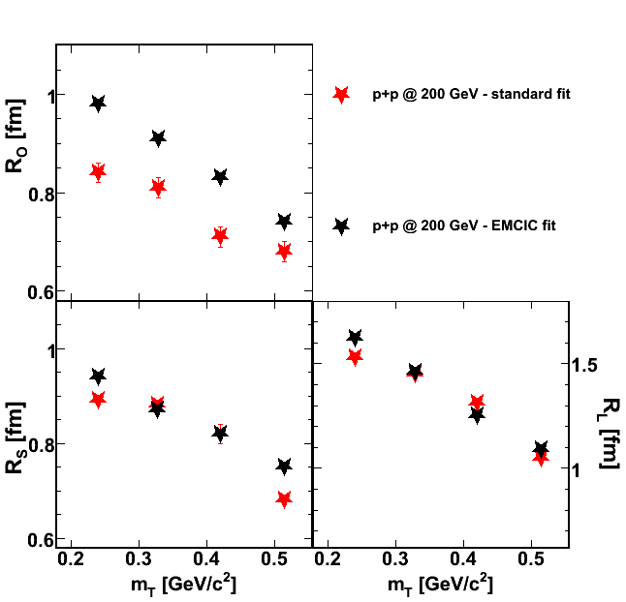

HBT radii (STAR @ QM09)
1. Heisenberg uncertainty?
Z⁰ decay @ LEP
2. String fragmentation? (Lund)
e.g. G. Alexander
“plausible” in z-direction
unlikely in transvrse
inconsistent with mult-dep
p+p and A+A measured in same experiment, same acceptance, same techniques
  unique opportunity to compare physics
  what causes p_{T}-dependence in p+p?
  same cause as in A+A?
m_{T} dep. of HBT radii - World Systematcs
R _{Z}(fm)
3. Resonance effects?
essentially no quantitative predictions
p_{T} dependence maybe (??)
mass dependence no
[Andersson, Moriond 2000]
4. Flow???
e.g. Wiedemann & Heinz ‘97
maybe, but will be significantly different effect than for Au+Au
DELPHI
Increasingly suggested in HEP experiments
π
π
HBT
R (fm)
K
HBT+ “conservation”
p
Λ
Z. Ch., Acta Phys.Polon.B 40 1119 (2009)
m, m_{T} (GeV)
hep-ph/0108194
Notes:
41
The Andersson reference is 2000 Recontres de Moriond meeting. It is reference [4] f the cited Alexander paper
Csorgo: fit to star proton-proton coll
Shuryak: check again
Heinz: dependence on the size
More on dAu
More on pp
Rlong

Slide 42
“HBT radii” in p+p (STAR@QM09)
1. Heisenberg uncertainty?
Z⁰ decay @ LEP
p+p and A+A measured in same expt,
same acceptance, same techniques
  unique opportunity to compare physics
2. String fragmentation? (Lund)
e.g. G. Alexander
“plausible” in z-direction
unlikely in transvrse
inconsistent with mult-dep
R _{Z}(fm)
3. Resonance effects?
essentially no quantitative predictions
p_{T} dependence maybe (??)
mass dependence no
[Andersson, Moriond 2000]
4. Flow???
e.g. Wiedemann & Heinz ‘97
maybe, but will be significantly different effect than for Au+Au
DELPHI
Increasingly suggested in HEP experiments
π
π
STAR prelim. QM09
R (fm)
K
c.f. Z. Chajecki arXiv:0901.4078 [nucl-ex]
p
Λ
m, m_{T} (GeV)
hep-ph/0108194
Notes:
The Andersson reference is 2000 Recontres de Moriond meeting. It is reference [4] f the cited Alexander paper
Csorgo: fit to star proton-proton coll
Shuryak: check again
Heinz: dependence on the size
More on dAu
More on pp
Rlong

Slide 43



femtoscopy in p+p @ STAR
Zbigniew Chajecki QM05
NA22 Collaboration Z. Phys. C 71, 405–414 (1996)
(hadron-hadron collisions)
OPAL Collaboration, Eur.Phys.J.C52:787-803,2007; arXiv:0708.1122 [hep-ex]
1. Heisenberg uncertainty?
Z⁰ decay @ LEP
[based on shape of C(q)…]
Our data do not confirm the expectation from the string type model… A good description of our data is, however, achieved in the framework of the hydrodynamical expanding source model.
e.g. G. Alexander
“plausible” in z-direction
unlikely in transvrse
2. String fragmentation? (Lund)
p+p and A+A measured in same experiment, same acceptance, same techniques
  unique opportunity to compare physics
  what causes p_{T}-dependence in p+p?
  same cause as in A+A?
R _{Z}(fm)
p_{T} dependence maybe (??)
mass dependence probably no
[Andersson, Moriond 2000]
3. Resonance effects?
4. Flow???
e.g. Wiedemann & Heinz ‘97
maybe, but will be significantly different effect than for Au+Au
DELPHI
Increasingly suggested in recent experiments
π
π
R2tside , R2tout and, less markedly, R2long decrease with increasing kt . The presence of correlations between the particle production points and their momenta is an indication that the pion source is not static, but rather expands during the particle emission process.
R (fm)
K
p
Λ
W. Kittel Acta Phys.Polon. B32 (2001) 3927 [Review article]
… and suggests the existence of an important “collective ﬂow”, even in the system of particles produced in e+e− annihilation!
A 1/√m T scaling ﬁrst observed in heavy-ion collisions is now also observed in Z fragmentation and may suggest a “transverse ﬂow” even there!
STAR preliminary
E735 Collaboration, PRD48 1931 (1993)
also PLB 2002
consistent with an expanding shell model.
m, m_{T} (GeV)
m_{T} (GeV)
m_{T} (GeV)
hep-ph/0108194
Notes:
The Andersson reference is 2000 Recontres de Moriond meeting. It is reference [4] f the cited Alexander paper
Csorgo: fit to star proton-proton coll
Shuryak: check again
Heinz: dependence on the size
More on dAu
More on pp
Rlong

Slide 44
femtoscopy in p+p @ STAR
Zbigniew Chajecki QM05
NA22 Collaboration Z. Phys. C 71, 405–414 (1996)
(hadron-hadron collisions)
RHIC: “comparison machine”
Vary size. All else fixed. [acceptance, technique…]
spectra
femtoscopy
compare with a system we “know” is flowing
OPAL Collaboration, Eur.Phys.J.C52:787-803,2007; arXiv:0708.1122 [hep-ex]
1. Heisenberg uncertainty?
Z⁰ decay @ LEP
[based on shape of C(q)…]
Our data do not confirm the expectation from the string type model… A good description of our data is, however, achieved in the framework of the hydrodynamical expanding source model.
e.g. G. Alexander
“plausible” in z-direction
unlikely in transvrse
2. String fragmentation? (Lund)
p+p and A+A measured in same experiment, same acceptance, same techniques
  unique opportunity to compare physics
  what causes p_{T}-dependence in p+p?
  same cause as in A+A?
R _{Z}(fm)
p_{T} dependence maybe (??)
mass dependence probably no
[Andersson, Moriond 2000]
3. Resonance effects?
4. Flow???
e.g. Wiedemann & Heinz ‘97
maybe, but will be significantly different effect than for Au+Au
DELPHI
Increasingly suggested in recent experiments
π
Spectra
π
R2tside , R2tout and, less markedly, R2long decrease with increasing kt . The presence of correlations between the particle production points and their momenta is an indication that the pion source is not static, but rather expands during the particle emission process.
R (fm)
K
v₂
p
Λ
W. Kittel Acta Phys.Polon. B32 (2001) 3927 [Review article]
… and suggests the existence of an important “collective ﬂow”, even in the system of particles produced in e+e− annihilation!
A 1/√m T scaling ﬁrst observed in heavy-ion collisions is now also observed in Z fragmentation and may suggest a “transverse ﬂow” even there!
HBT
STAR preliminary
E735 Collaboration, PRD48 1931 (1993)
also PLB 2002
consistent with an expanding shell model.
m, m_{T} (GeV)
m_{T} (GeV)
m_{T} (GeV)
hep-ph/0108194
Notes:
The Andersson reference is 2000 Recontres de Moriond meeting. It is reference [4] f the cited Alexander paper
Csorgo: fit to star proton-proton coll
Shuryak: check again
Heinz: dependence on the size
More on dAu
More on pp
Rlong

Slide 45

Apples:apples comparison…
Z. Chajecki, QM05
Ratio of (AuAu, CuCu, dAu) HBT
radii by pp
R(p_{T}) taken as strong space-time
evidence of flow in Au+Au
clear, quantitative consistency predictions of BlastWave
“Identical” signal seen in p+p
cannot be of “identical” origin?
(other than we “know it cannot”...)
pp, dAu, CuCu - STAR preliminary

Slide 46


Significant non-femto correlations, but little effect on “message”
STAR preliminary
Ratio of (AuAu, CuCu, dAu) HBT
radii by pp
“suggestion”
alternate non-femto
Femtoscopy is the most direct probe of explosive radial flow
Do p+p collisions flow as much as A+A collisions???
Fit w/o baseline parameterization
NEW fit w/ baseline parameterization

Slide 47

EMCIC effects for k =…
k=3 – conical flow?
  Borghini, PRC75:021904 (2007)
  EMCICs alone can mimic “conical emission”
k=2 – directed flow
  Danielewicz, PLBB157:146 (1985)
  Borghini et al, PRC66:014901,2002.
  Borghini et al PRC62:034902,2000.
  “[EMCICs] alone large enough to reverse the sign of the proton directed flow measured by NA49”
k=2 – femtoscopy
  Z. Chajęcki & MAL PRC 78 064903 (2008)
  EMCIC effects of similar magnitude as femto correlations

Slide 48


Of course not!
Au+Au 0-5%
Au+Au 60-70%
p+p minbias
STAR PRL 92 112301 (2004)
Blast-wave fit to spectra:
much less explosive flow in p+p collisions

Slide 49
Au+Au 0-5%
Au+Au 60-70%
p+p minbias
STAR PRL 92 112301 (2004)
Blast-wave fit to spectra:
much less explosive flow in p+p collisions

Slide 50
Don’t forget - EMCICs even for k=1
measured
“matrix element”
“distortion” of single-particle spectra
1-particle PS effect
N=40
Characteristic scales of relevant system in which limited energy-momentum is shared
N=5
Z.Chajecki, MAL, PRC 79 034908 (2009)

Slide 51
EMCICs even for k=1
measured
“matrix element”
“distortion” of single-particle spectra
What if the only difference between p+p and A+A collisions was N?
* we remove this absurd assumption soon!
Au+Au 0-5%
Au+Au 60-70%
p+p minbias
STAR PRL 92 112301 (2004)

Slide 52
EMCICs even for k=1
measured
“matrix element”
“distortion” of single-particle spectra
What if the only difference between p+p and A+A collisions was N?
Then we would measure:

Slide 53



Multiplicity evolution of spectra - p+p to A+A (soft sector)
N evolution of spectra dominated by PS “distortion”
p+p system samples same parent distribution, but under stronger PS constraints

Slide 54










IMPT: What changes with multiplicity…?

Slide 55
IMPT: What changes with multiplicity…?

Slide 56
IMPT: What changes with multiplicity…?

Slide 57
IMPT: What changes with multiplicity…?

Slide 58
IMPT: What changes with multiplicity…?

Slide 59
IMPT: What changes with multiplicity…?

Slide 60
IMPT: What changes with multiplicity…?

Slide 61
IMPT: What changes with multiplicity…?
multiplicity does !!
postulate of same parent consistent with all spectra
magnitude
pT dependence (shape)
mass dependence

Slide 62


Multiplicity evolution of spectra - p+p to A+A (soft sector)
N evolution of spectra dominated by PS “distortion”
p+p system samples same parent distribution, but under stronger PS constraints
K ~ unity. driven by conservation of discrete quantum #s (strangeness, etc)

Slide 63

By popular demand
(you’ve already seen the impressive result)
Almost universal “flow” & “temperature”
parameters in a BlastWave fit
Apparent changes in β, T with dN/dη caused by EMCICs*
Notes:
I say “you’ve seen the impressive result” because the COOL thing is that the SHAPES OF SPECTRA THEMSELVES evolve as if it were all due to EMCICs. Seeing that a two-parameter fit to those spectra evolve as due to EMCICs is really kind of a let-down after that. (Well, except that everybody focuses on the two-parameter fit...)

Slide 64

Blast-wave : simultaneous description of spectra, HBT
determined entirely
by spectra

Slide 65
Hey, that looks like flow!!
femtoscopic R(pT)
Hmm… Strong PS constraints on momentum distributions
2-particle correlations
EMCICs
<pT²> etc.
what about PS?
“correct” spectra for EMCICs
β, T
from BW fit
single-particle spectra
postulate identical parent
vary EMCIC <pT²> etc.
postulate works!

Slide 66
Can we do better…?
Hey, that looks like flow!!
femtoscopic R(pT)
Hmm… Strong PS constraints on momentum distributions
2-particle correlations
EMCICs
<pT²> etc.
what about PS?
“correct” spectra for EMCICs
β, T
from BW fit
single-particle spectra
postulate identical parent
vary EMCIC <pT²> etc.
postulate works!

Slide 67

Can we do better…?
Yes we can!
femtoscopic R(pT)
2-particle correlations
β, T
from BW fit to HBT and spectra
EMCICs
<pT²> etc.
“correct” spectra for EMCICs
“correct” spectra for EMCICs
β, T
from BW fit
single-particle spectra
postulate identical parent
vary EMCIC <pT²> etc.
postulate works!

Slide 68
Combined fit: consistent flow-based description
STAR Preliminary
Use parameters obtained from the fit to STAR femtoscopic correlation function and use them to “correct” spectra
k_{T} = [0.35,0.45] GeV/c
k_{T} = [0.35,0.45] GeV/c
STAR preliminary

Slide 69


Combined fit: consistent flow-based description
Blast-Wave Model:
F. Retiere, MAL, PRC70:044907,2004.

Slide 70

Combined fit: consistent flow-based description
“raw” (ignoring EMCICs)
EMCICs fixed by correlations
Joint spectra/HBT BW fit
EMCICs free adjusted
to spectra & fit to spectra
EMCICs fixed by correlations
Joint spectra/HBT BW fit
“raw” (ignoring EMCICs)

Slide 71
Combined fit: consistent flow-based description
“raw” (ignoring EMCICs)
p+p collisions show same flow signals as A+A collisions
EMCICs fixed by correlations
Joint spectra/HBT BW fit
EMCICs free adjusted
to spectra & fit to spectra
EMCICs fixed by correlations
Joint spectra/HBT BW fit
“raw” (ignoring EMCICs)

Slide 72
Implication: A+A is just a collection of flowing p+p?
No! Quite the opposite.
  femtoscopically
    A+A looks like a big BlastWave
    not superposition of small BlastWaves
    A+A has thermalized globally
  spectra
    superposition of spectra from p+p has same shape as a spectrum from p+p!
    relaxation of P.S. constraints indicates
    A+A has thermalized globally

Slide 73
Implication: A+A is just a collection of flowing p+p?
No! Quite the opposite.
  femtoscopically
    A+A looks like a big BlastWave
    not superposition of small BlastWaves
    A+A has thermalized globally
  spectra
    superposition of spectra from p+p has same shape as a spectrum from p+p!
    relaxation of P.S. constraints indicates
    A+A has thermalized globally
rather, p+p looks like a “little A+A”
Hi, I am
A+A
Hi, I am
p+p

Slide 74

Implication: A+A is just a collection of flowing p+p?
No! Quite the opposite.
  femtoscopically
    A+A looks like a big BlastWave
    not superposition of small BlastWaves
    A+A has thermalized globally
  spectra
    superposition of spectra from p+p has same shape as a spectrum from p+p!
    relaxation of P.S. constraints indicates
    A+A has thermalized globally
rather, p+p looks like a “little A+A”
  anisotropic flow
    A+A shows increased signal over superposition of p+p
    is the p+p signal “flow” ??

Slide 75



PID’d <pT> systematics
similar systematics AA vs pp
increasing flow
or
relaxed P.S
?
STAR
E735 PRD48 984 (1993)
E735 PRD48 984 (1993)

Slide 76

Two effects… or one?
p+pbar @ Tevatron
p+p, Au+Au @ RHIC
EMCICs
EMCICs
more flow
more minijets
STAR PRL 92 112301 (2004)
Wang & Gyulassy 1992
Geometric substructure argues against changing flow argument
…and for soft sector, a pure minijet mechanism (global x-p correlations)

Slide 77

flow in AA, minijets in pp?
flow
minijets [2]
[1] R. de Souza et al, Phys. Lett. B300, 29 (1993); I. G. Bearden et al, Phys. Rev. Lett. 78 (1997) 2080
[2] A. Dumitru and C. Spieles, Phys. Lett. B446, 326 (1999)

Slide 78


“Anomalously” new physics in AA?
“anomolous” p/pi

Slide 79


Summary 1
E&M conservation induces phasespace constraints w/ explicit N dependence
  should not be ignored in (crucial!) N-dependent comparisons
  significant effect on 2- (and 3-) particle correlations [c.f. Ollitrault, Borghini, Voloshin…]
  …and single-particle spectra (often neglected because no “red flags”)
kT=0.35-0.6

Slide 80
Summary 1
E&M conservation induces phasespace constraints w/ explicit N dependence
  should not be ignored in (crucial!) N-dependent comparisons
  significant effect on 2- (and 3-) particle correlations [c.f. Ollitrault, Borghini, Voloshin…]
  …and single-particle spectra (often neglected because no “red flags”)
Femtoscopy & Spectra
  in H.I.C., well understood, detailed fingerprint of flow
  RHIC – first opportunity for direct comparison with p+p
  accounting for EMCICs, identical flow signals in p+p
collective signals in A+A also seen in hadron-hadron collisions
Has AA become the reference system for pp in non-perturbative sector???
Thermalization, hadronization, very early color dynamics…
  Mrowczynski, Pratt, Broniowski, Strickland, Werner, Venugopalan,…

Slide 81
Summary 2 - LHC
At RHIC (200 GeV), unique apples:apples comparison → flow in p+p
At Tevatron (2 TeV), low statistics soft sector data hinted at flow in p+pbar
At LHC (14 TeV), most people now expect flow in p+p
  and it will be seen
  because “multiplicity in p+p @ LHC is similar to Cu+Cu at RHIC” ?? yes and no
    the high multiplicity will make flow easier to see (less EMCIC “distortion”)
    we will not have to be so careful as at RHIC
    but the flow will not be due to the high multiplicity (rescattering or so).
  when we observe it, use it as a tool to study general problem of collectivity in hadron collisions

