Slide 2
CEPH Days Switzerland
CERN
Geneva
Ontroduction
Frédéric Hemmer
IT Department Head
14 June 2016

Slide 3


Welcome
CEPH Day
Switzerland
to Accelerating Science and Innovation
Notes:
3

Slide 4
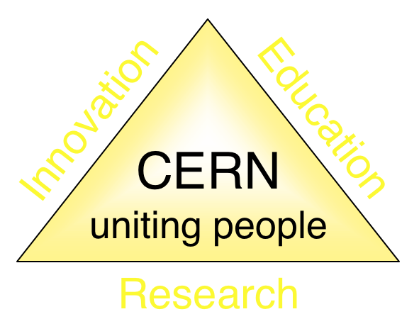
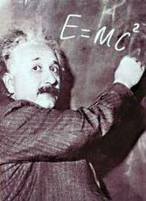
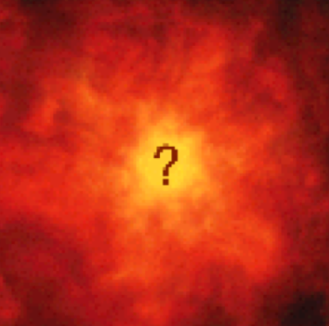


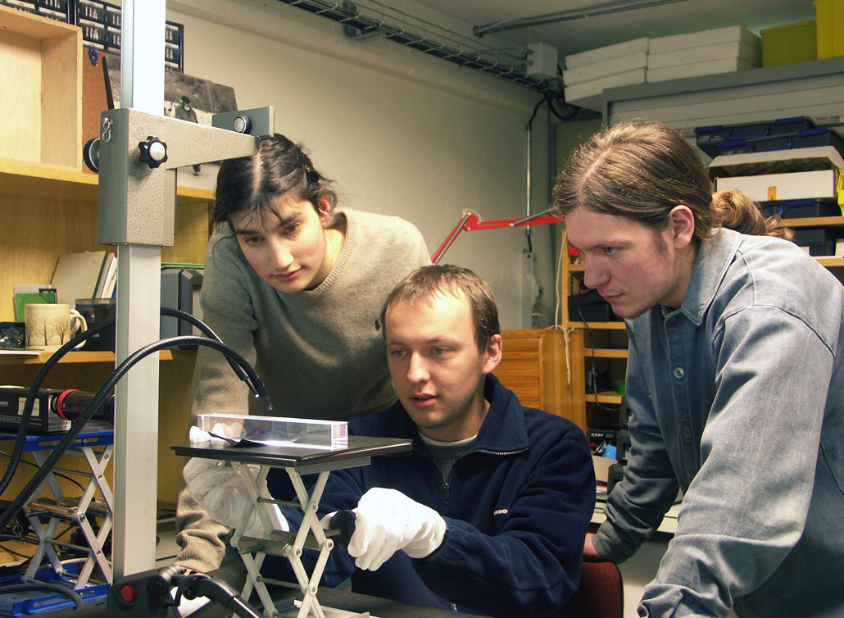
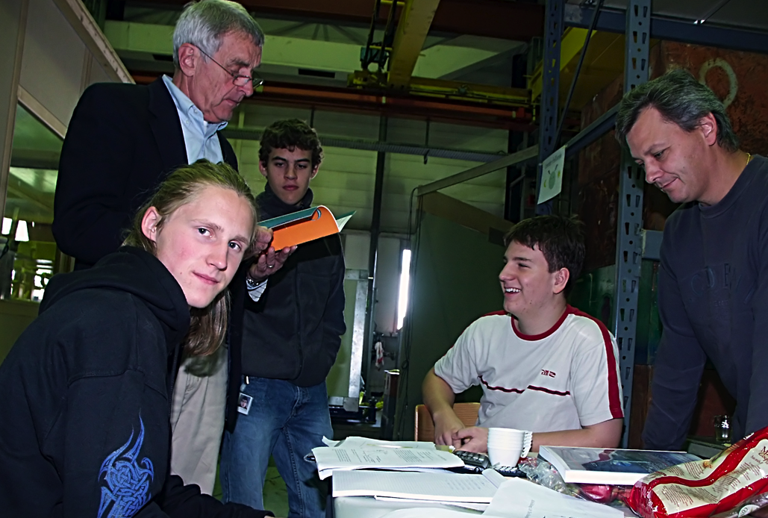
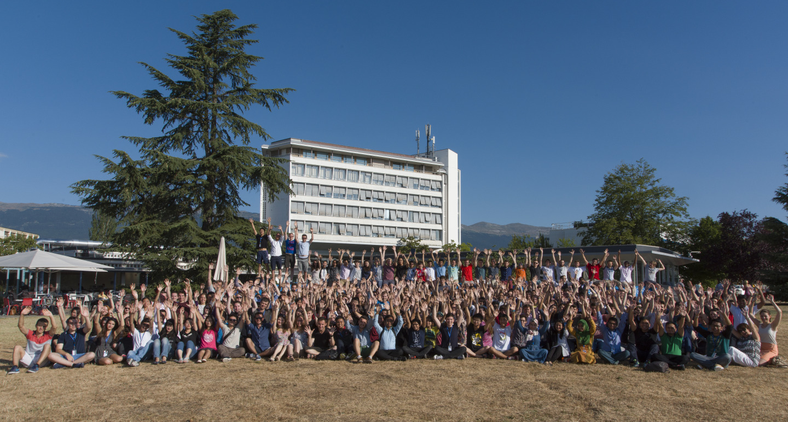
The Mission of CERN
Push back the frontiers of knowledge
E.g. the secrets of the Big Bang …what was the matter like within the first moments of the Universe’s existence?
Develop new technologies for accelerators and detectors
Information technology - the Web and the GRID
Medicine - diagnosis and therapy
Train scientists and engineers of tomorrow
Unite people from different countries and cultures
Notes:
4

Slide 5
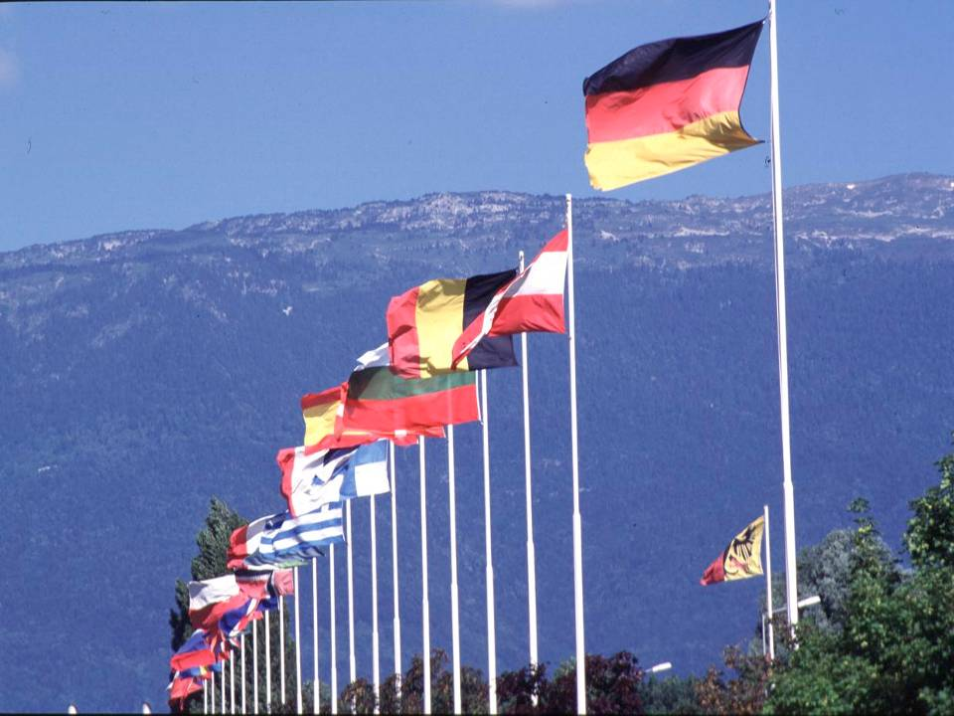

CERN: founded in 1954: 12 European States
“Science for Peace”
Today: 21 Member States
~ 2300 staff
~ 1400 other paid personnel
~ 12500 scientific users
Budget (2016) ~1000 MCHF
Member States: Austria, Belgium, Bulgaria, Czech Republic, Denmark, Finland, France, Germany, Greece, Hungary, Israel, Italy, Netherlands, Norway, Poland, Portugal, Slovak Republic, Spain, Sweden, Switzerland and
United Kingdom
Associate Member States: Pakistan, Turkey
States in accession to Membership: Cyprus, Romania, Serbia
Applications for Membership or Associate Membership:
Brazil, Croatia, India, Lithuania, Russia, Slovenia, Ukraine
Observers to Council: India, Japan, Russia, United States of America; European Union, JINR and UNESCO
5
Notes:
5
----- Meeting Notes (09/01/2013 14:16) -----
nnn

Slide 6
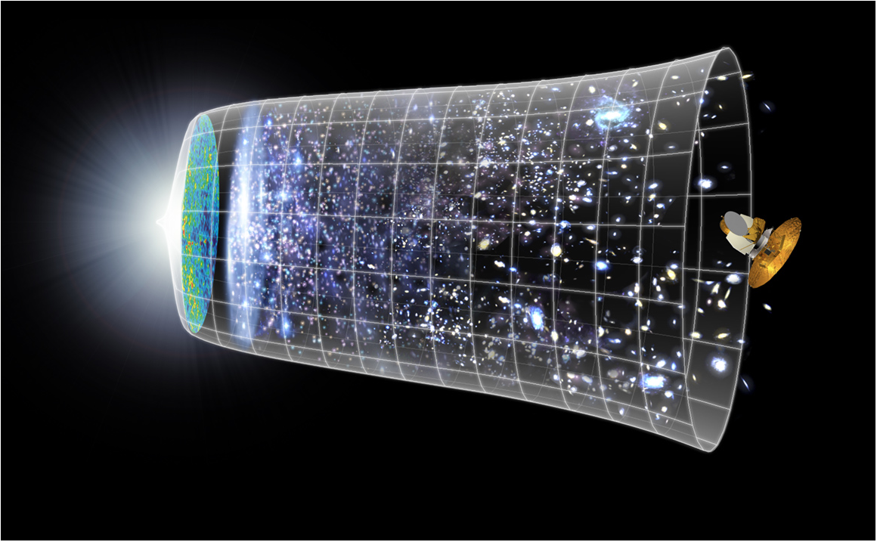
Next Scientific Challenge:
to understand the very first moments of our Universe after the Big Bang
Big Bang
WMAP
13.8 Billion Years
Today
10²⁸ cm

Slide 7
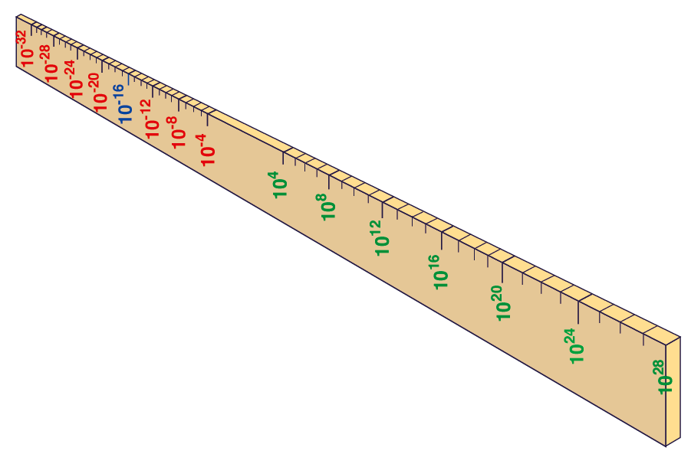
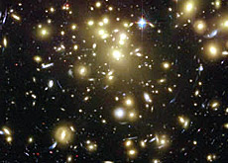
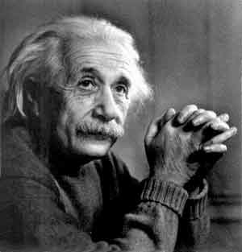
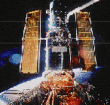
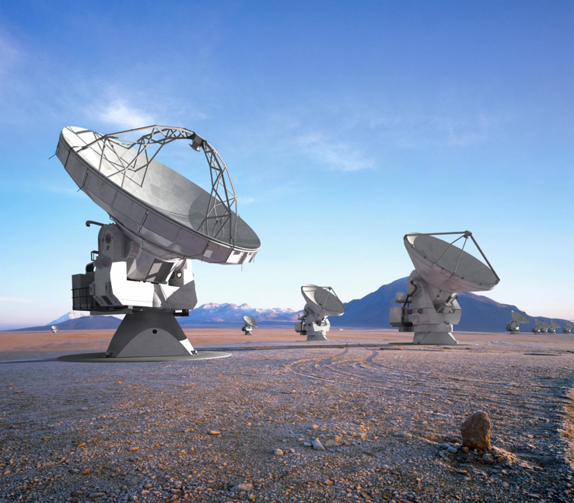
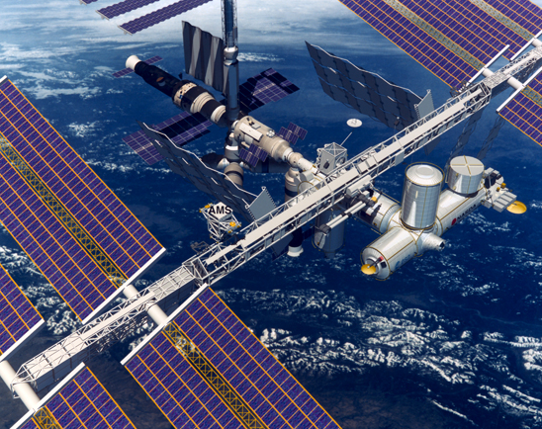
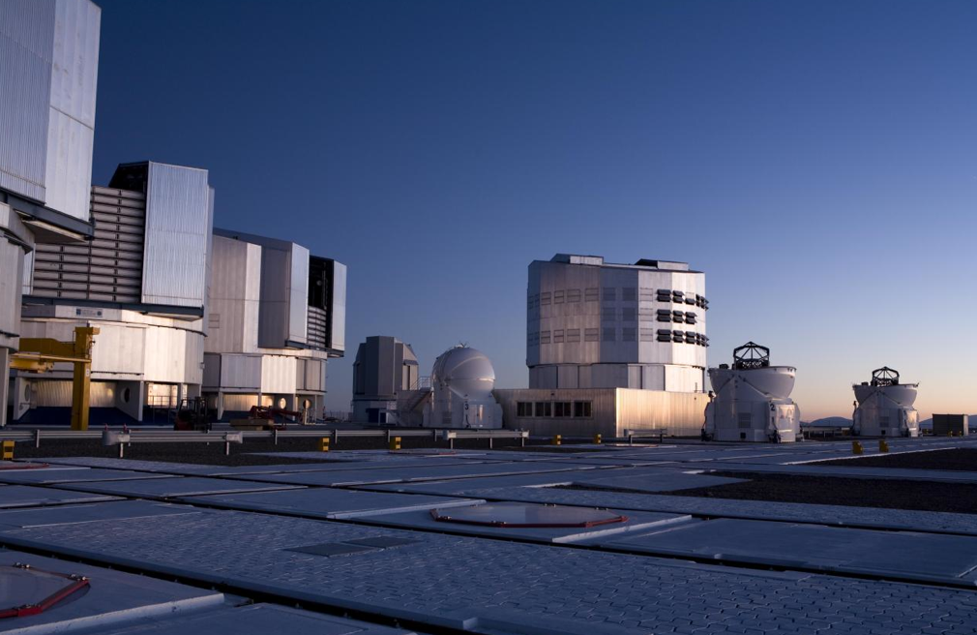
Big Bang
Proton
Atom
Radius of Earth
Earth to Sun
Radius of Galaxies
Universe
Hubble
ALMA
cm
AMS
VLT
Notes:
7
60 Grössenordnungen

Slide 8
Next Scientific Challenge:
to understand the very first moments of our Universe after the Big Bang
Big Bang
WMAP
380,000 years

Slide 9


Big Bang
Proton
Atom
Radius of Earth
Earth to Sun
Radius of Galaxies
Universe
LHC
Super-Microscope
Hubble
ALMA
cm
Reproducing conditions
Looking back
AMS
VLT
Notes:
9
60 Grössenordnungen

Slide 10
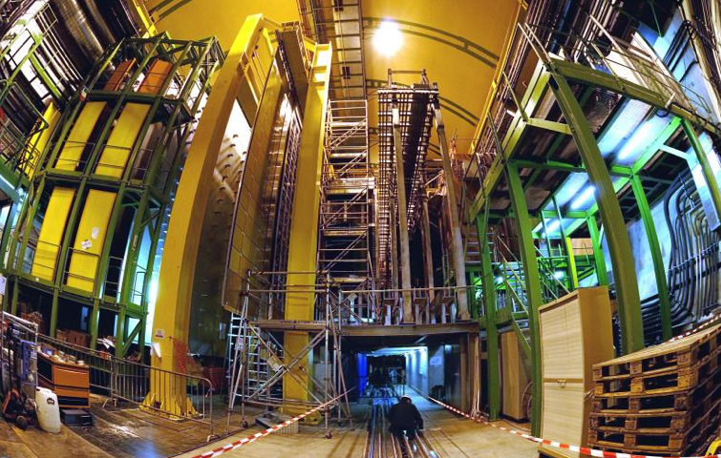


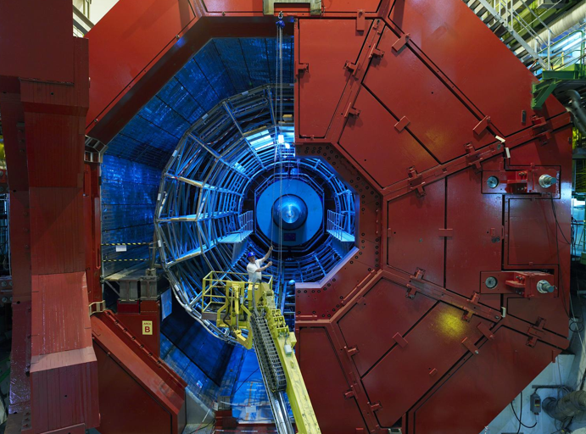

2010: a New Era in Fundamental Science
LHCb
CMS
ATLAS
Exploration of a new energy frontier
in p-p and Pb-Pb collisions
ALICE
LHC ring:
27 km circumference
Notes:
10

Slide 11
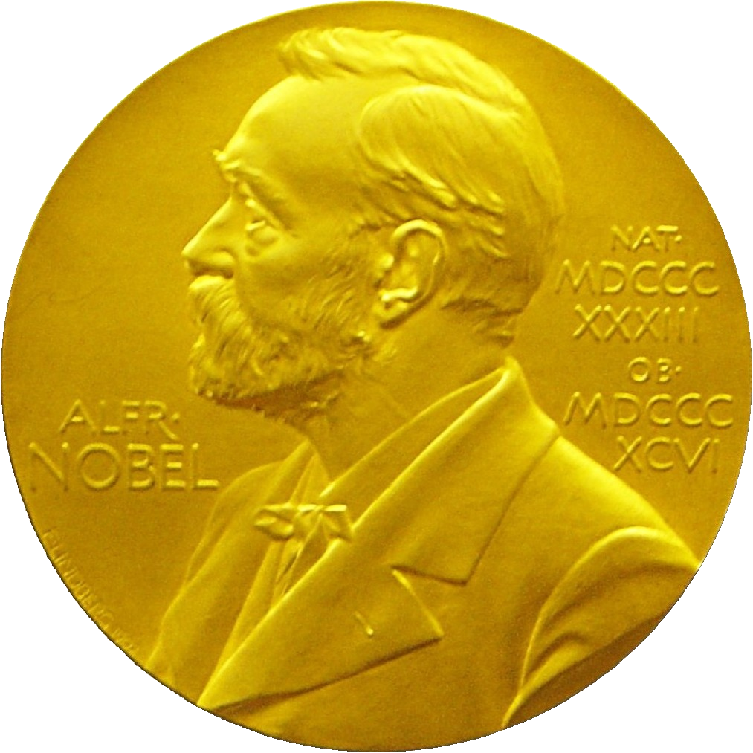
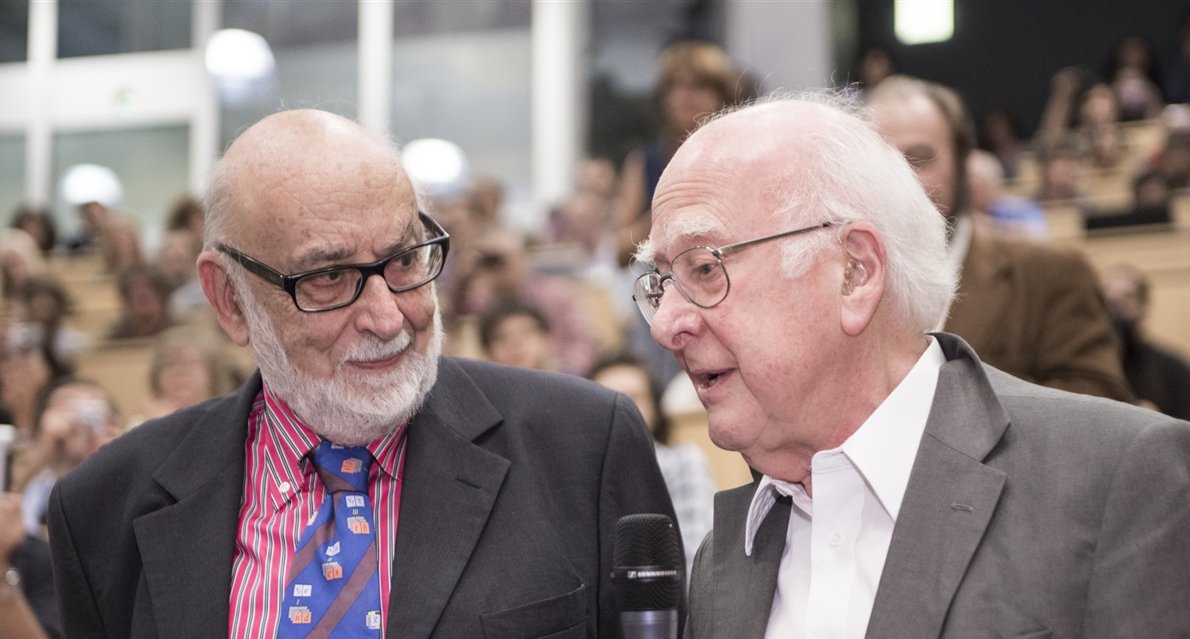
Discovery 2012, Nobel Prize in Physics 2013
The Nobel Prize in Physics 2013 was awarded jointly to François Englert and Peter W. Higgs "for the theoretical discovery of a mechanism that contributes to our understanding of the origin of mass of subatomic particles, and which recently was confirmed through the discovery of the predicted fundamental particle, by the ATLAS and CMS experiments at CERN's Large Hadron Collider”.

Slide 12
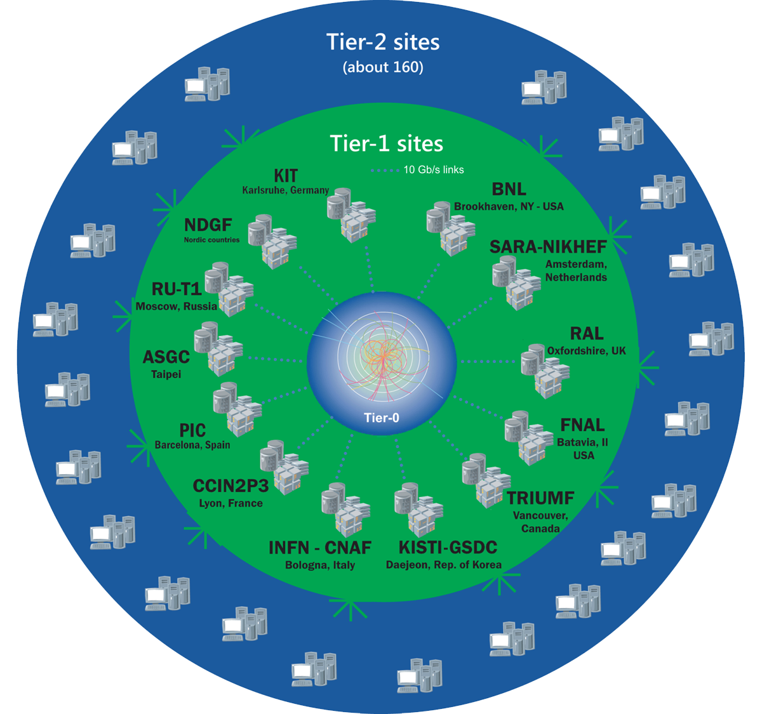
The Worldwide LHC Computing Grid
Tier-0
(CERN and Hungary):
data recording, reconstruction and distribution
~170 sites,
40 countries
~500k CPU cores
Tier-1: permanent storage, re-processing,
analysis
500 PB of storage
> 2 million jobs/day
Tier-2: Simulation,
end-user analysis
10-100 Gb links
WLCG:
An International collaboration to distribute and analyse LHC data
Integrates computer centres worldwide that provide computing and storage resource into a single infrastructure accessible by all LHC physicists

Slide 13
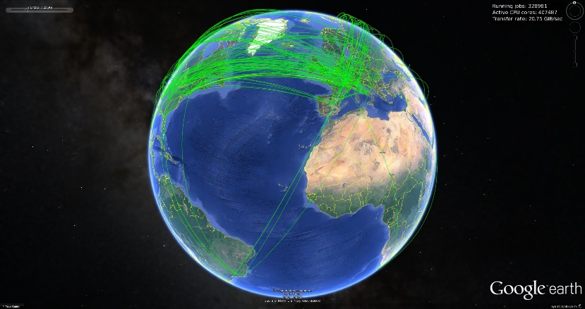
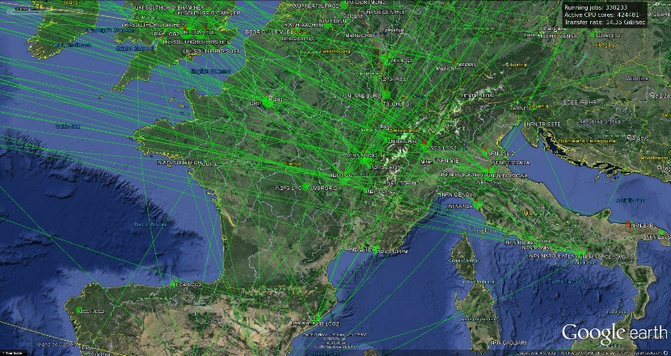
Ramp-up of WLCG CPU

Slide 14
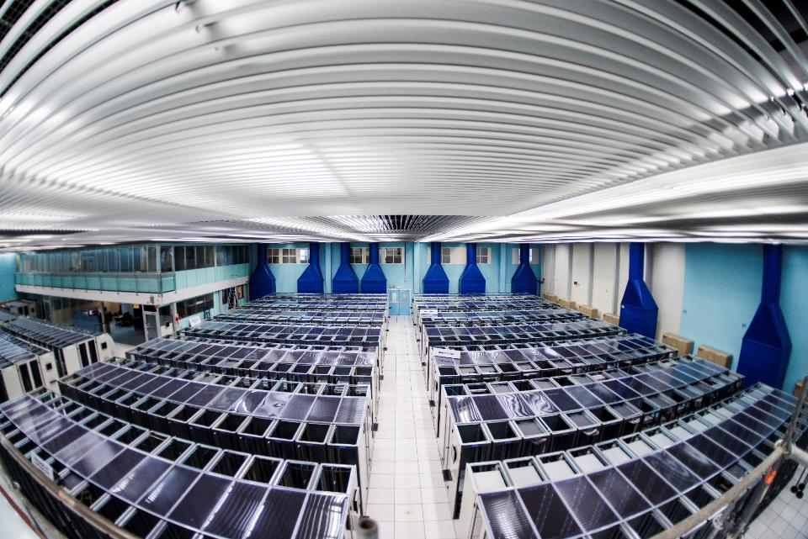
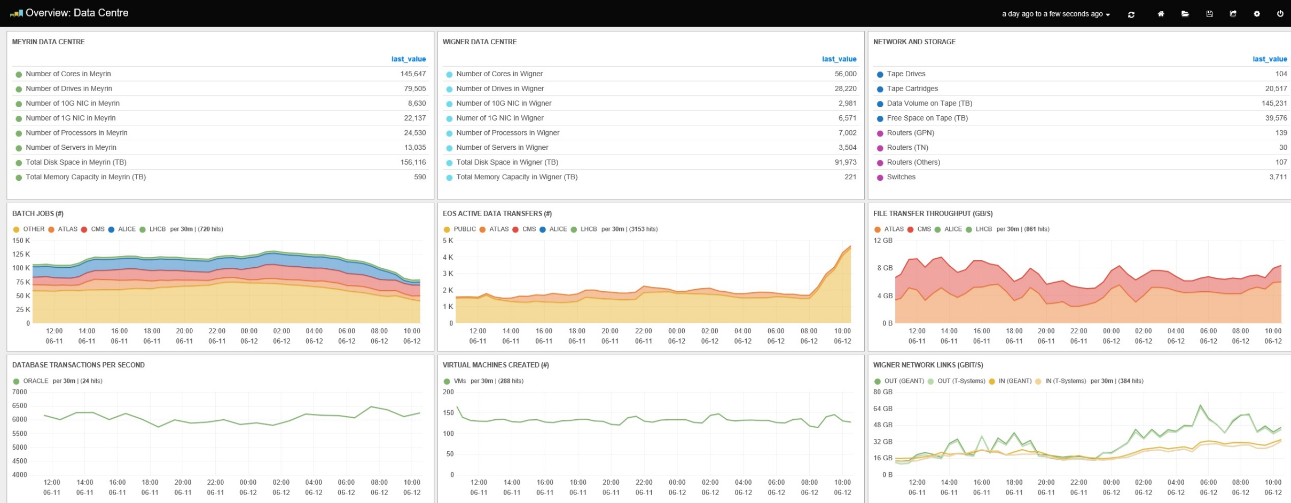
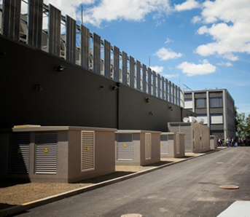
The CERN Data Centres

Slide 15
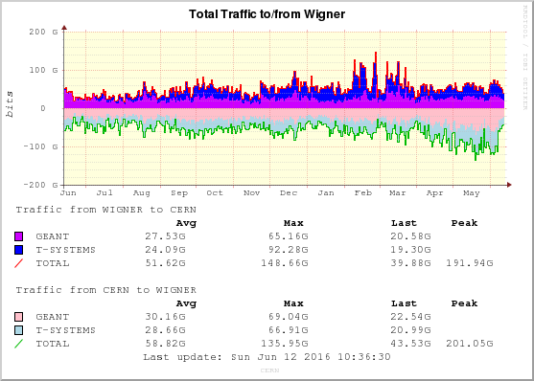
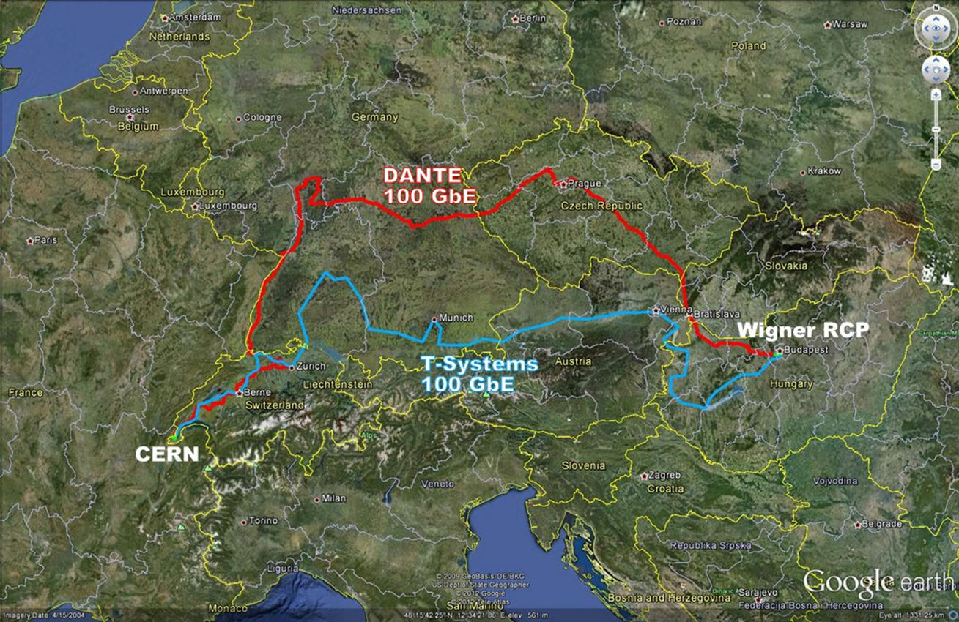
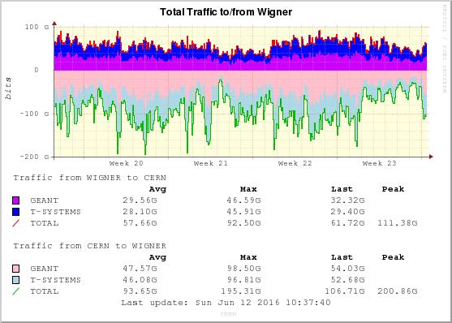
Linking the CERN Data Centres

Slide 16
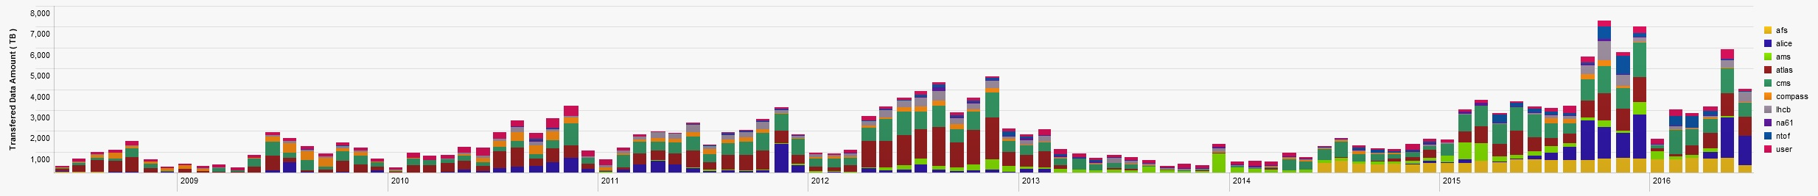
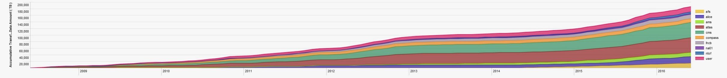
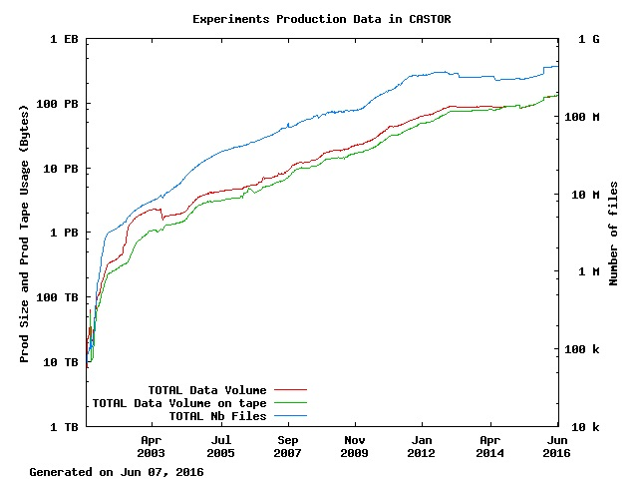
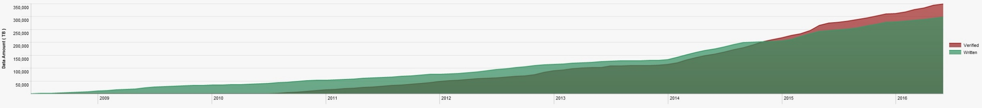
Data in the Tier-0
LHC: 26/36 PB
15 PB
23 PB
27 PB
2016
Tape Verification

Slide 17
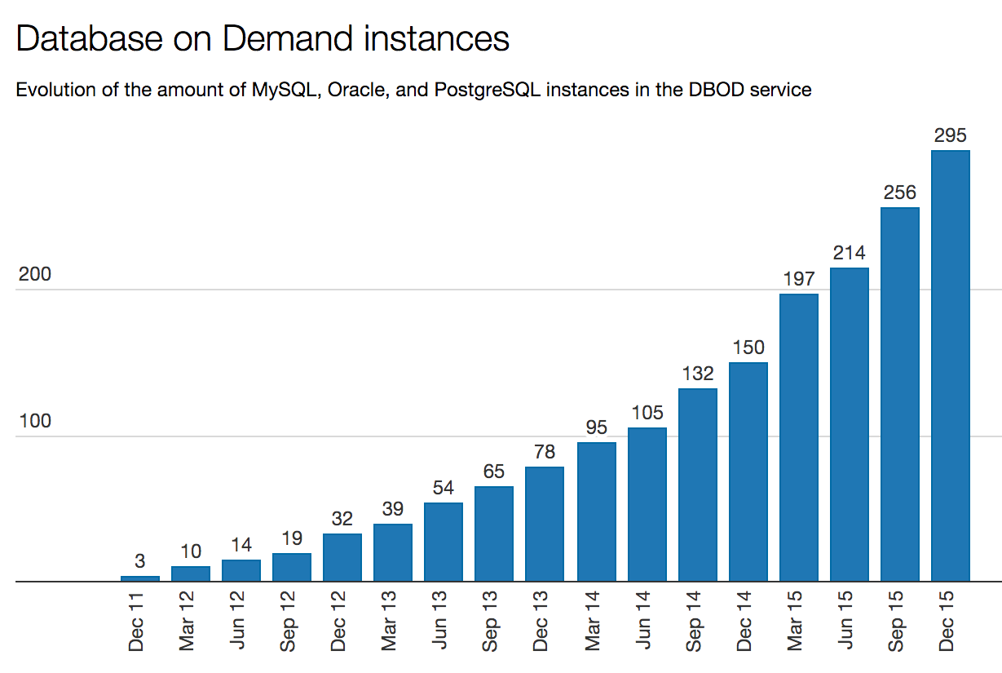
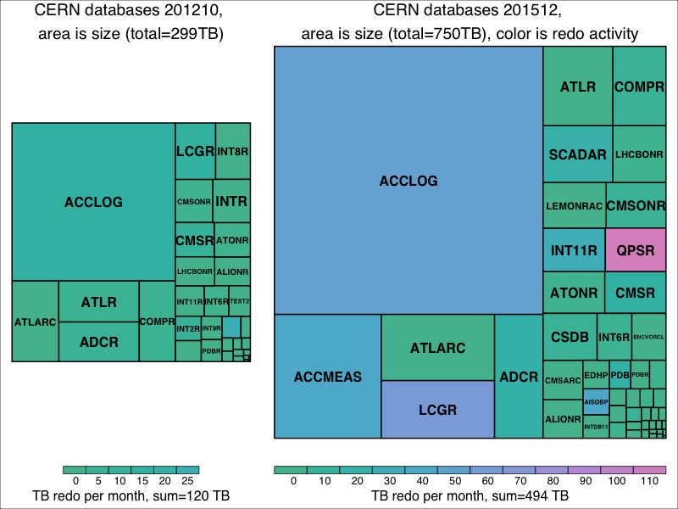
Databases for Run2
Based on three main solutions:
MySQL / PostgreSQL (DBoD managed)
  High growth, count of databases ~doubles every year.
  With critical databases: OpenStack, Zenodo, Drupal, Puppet (stored configuration and Foreman Data, and Puppet Cert Manager), VOMS, Dirac (LHCb Dirac and Dirac File Catalog), Jupyter, Indico, Gitlab (VCS), Alfresco (eFiles), etc.
OracleDB, HW/OS/SW stable combination
  Stable number, growing in size and activity:
  Significant size increase (500GB/day for ACCLOG since beginning of Run2).
  Very active, total changes size (redo) per month around 500TB.
Hadoop-based components/databases
  For larger scale data analysis and OracleDB offloading.
  Production for WDT dashboards, ATLAS DDM, IT monitoring, OpenStack Ceilometer, etc.
  Working on improving integration with OracleDB.
  Investigating next generation accelerator control and logging (ACCLOG being loaded: 250TB in OracleDB is compressed to 50TB on Hadoop/Parquet format).
 | October 2012 | December 2015
Max size | ACCLOG 136TB | ACCLOG 352TB
Max redo | ACCMEAS 27TB / month | QPSR 115TB / month

Slide 18
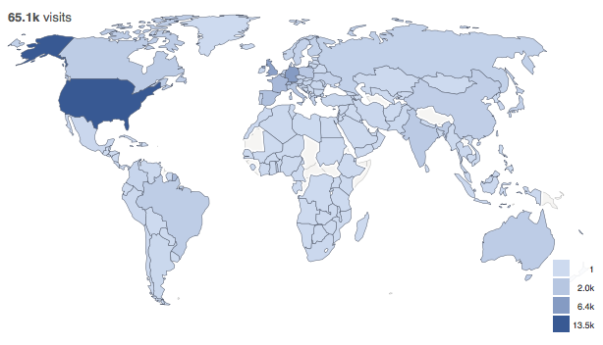
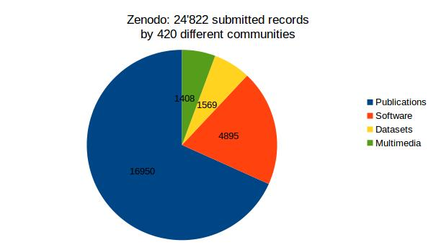
Open Access to Data
Zenodo launched in May 2013
CERN has continued to operate its underlying infrastructure
  Which benefits from the same storage services than the LHC Data
Interfacing with Github
  Making your code citable
  ~25000 records from 420 communities
  incl. 32 software packages not accessible on github ANYMORE

Slide 19
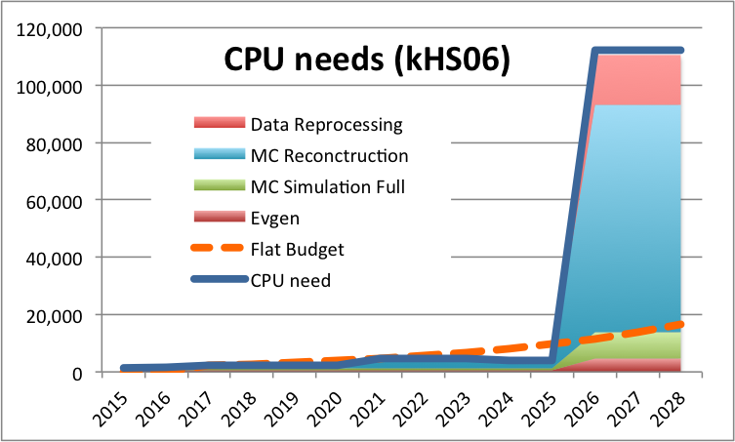
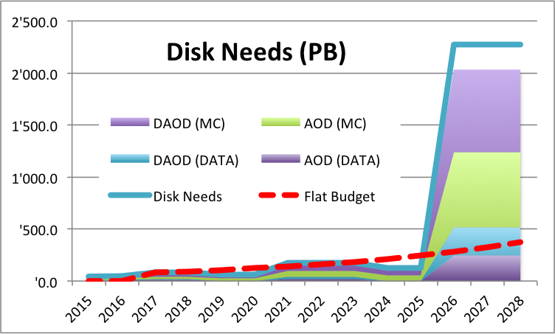
Evolution
LHC RUN 2
Initial studies on Computing for HL-LHC

Slide 20
Data Preservation for Re-Use
Re-use: by Collaboration, Theorists, Scientists, Public, Others for Science, Education, & more
  New analyses, reproducibility of results, linking papers to data, data sharing, etc (= Data Management Plan)
  LEP data: ~100TB/expt until ~2030 (and more)
  LHC data: many EB and more – until FCC??
Preserve data, documentation, code, meta-data, etc
  “Data” is the “easy” bit (no pun intended)
Collaboration: IT groups, other CERN depts, expts, other HEP labs, other DP projects worldwide…
OPERA: a new challenge for 2016
  ~70TB in Oracle, ~10TB in ROOT files
  Can we use our “template” on other HEP experiments?

Slide 21




CERN openlab in a nutshell
A science – industry partnership to drive R&D and innovation with over a decade of success
Evaluate state-of-the-art technologies in a challenging environment and improve them
Test in a research environment today what will be used in many business sectors tomorrow
Train next generation of engineers/employees
Disseminate results and outreach to new audiences

Slide 22
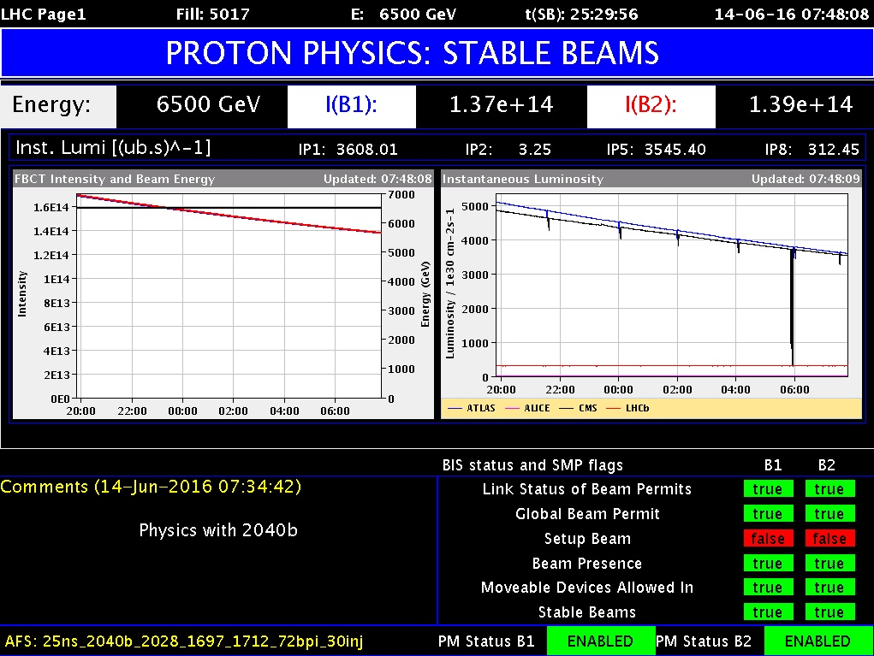
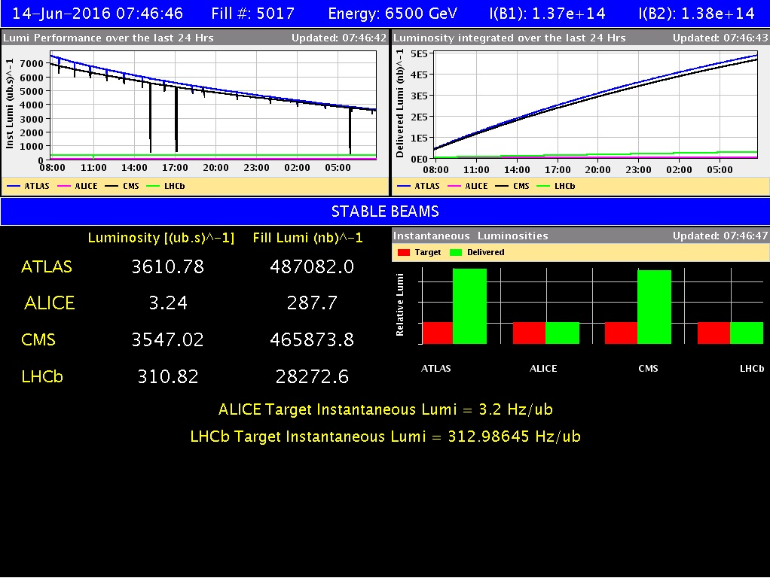
Thank you!

