Slide 1




SCARLET: A new High-Rate and High-Resolution X-ray Spectroscopy Detector for Synchrotron XRF and XAFS Applications
C. Fiorini^{(1,2)}, G. Bellotti^{(1,2)}, A.D. Butt^{(1,2)}, M. Carminati^{(1,2)},
A. Balerna⁽³⁾, C. Piemonte⁽⁴⁾, N. Zorzi⁽⁴⁾, Cedric Cohen⁽⁵⁾, M. M. Kocsis⁽⁵⁾
¹Politecnico di Milano, Milano, Italy
²INFN Sez. di Milano, Milano, Italy
³INFN, Laboratori Nazionali di Frascati, Frascati, Italy
⁴Fondazione Bruno Kessler, Trento, Italy
⁵European Synchrotron Radiation Facility - ESRF, Grenoble, France

Slide 2
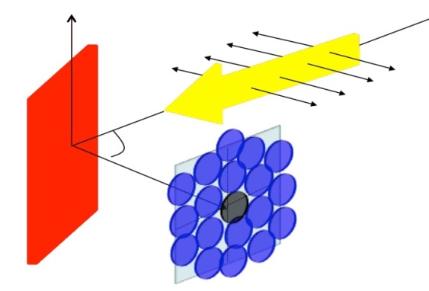
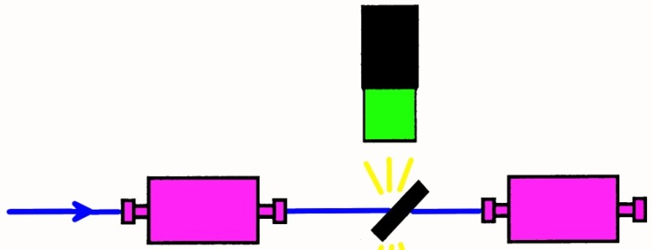
Introduction and motivations
Sample
X-ray spectroscopy
detector
X-ray Fluorescence
beam
Synchrotron X-ray beam
I₀
I_{T}
XRF and XAFS
Silicon Drift Detector is widely used in X-ray spectroscopy applications at synchrotron facilities (XRF, XAFS)
Commercially available SDDs-based systems are actually limited to single- or few-channel systems (4-7 units maximum).
High-rate performances of current SDD-based detection systems will be further challenged by synchrotron upgrades (x 10-100 beam-on-sample fluxes increase)
This motivates a new, sharp transition of this technology toward compact, multi-channels, high-density systems (hundreds of channels) to build high-resolution, high-rate and also versatile systems for synchrotron radiation applications.

Slide 3

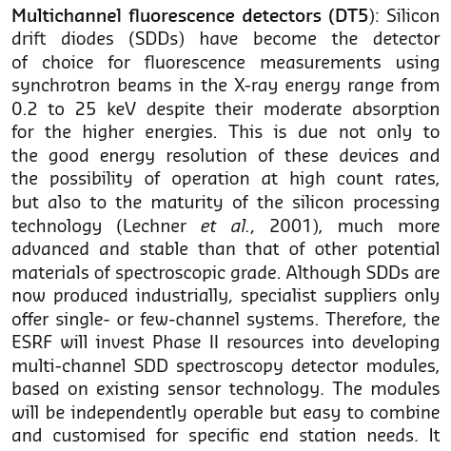
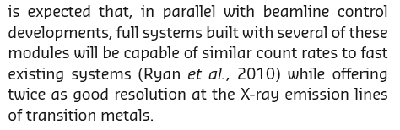

Slide 4
The proposed detector: SCARLET
(Sdd-asiC ARray for Large Events Throughput)
A new X-ray spectroscopy detector:
higher count rate capability
  larger number of channels (e.g. 64)
  increase of count-rate capability per channel (>1Mcounts/s/ch)
(still) good energy resolution
  close to optimum one (<150eV),
  but at high count rates, thanks to the CUBE preamplifier
  modularity (e.g. 2-4 tiled modules)
Detector design approach:
monolithic SDD array bump bonded to a readout ASIC
  high channels density
  ‘optimum’ electronics readout
  (5-10e- noise)
  direct digital output (on-chip ADC)
  close to room-T operation
Notes:
thin entrance window suitable for both soft X-ray detection (>200eV) and scintillator readout
Back entrance window optimized to achieve QE > 80 % at 380 nm (→ suitable also for soft X-rays).

Slide 5
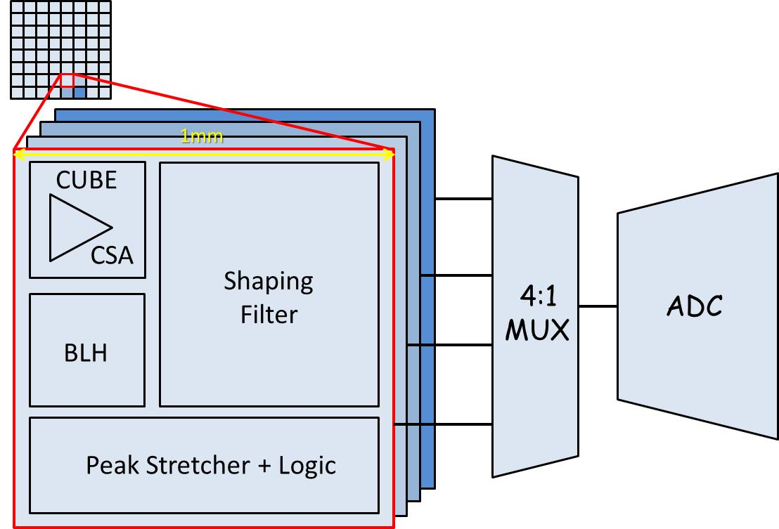
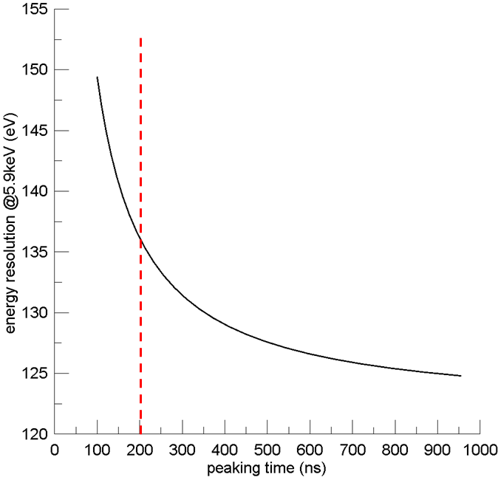
The readout ASIC
full analog processing (including CUBE) in the ASIC pixel
low noise at short processing time
12 bits ADC integrated in the ASIC (1 for 4 ch.)
expected
energy resolution
vs. peaking time
(7th order shaper)
1 Mcounts/s
output rate

Slide 6
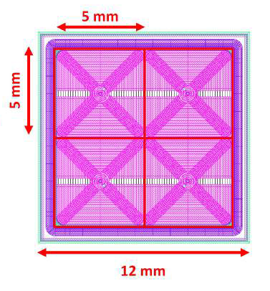
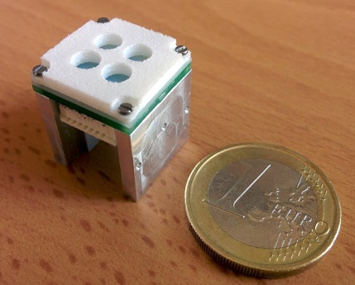
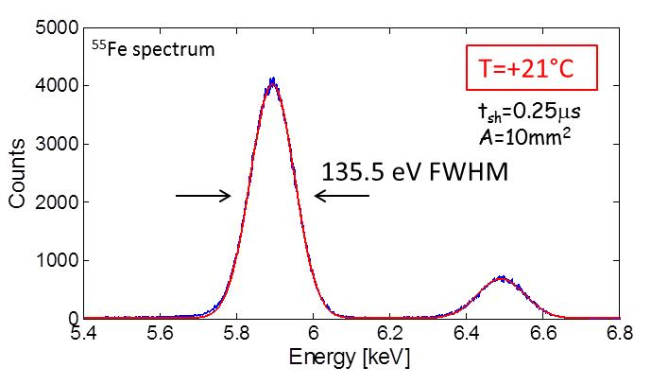
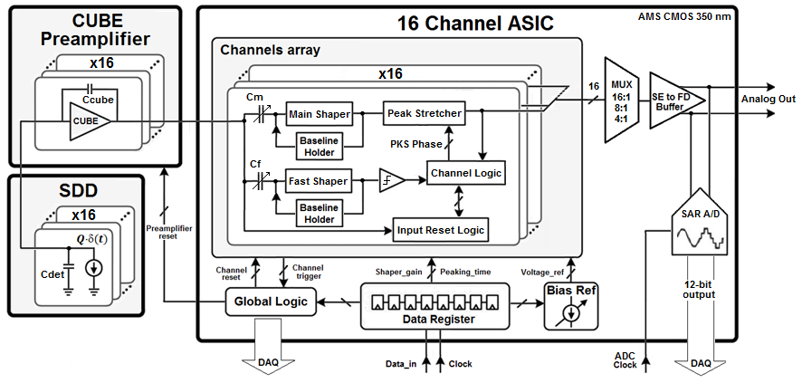
The starting point: the ARDESIA detector
X-ray beam
16mm
sample
4ch module
FBK low-leakage (200pA/cm²)
SDD processing technology
SFERA ASIC: F.Schembari et al., IEEE transactions on nuclear science, 2016, vol. 63, issue 3, pagg.1797-1807

Slide 7
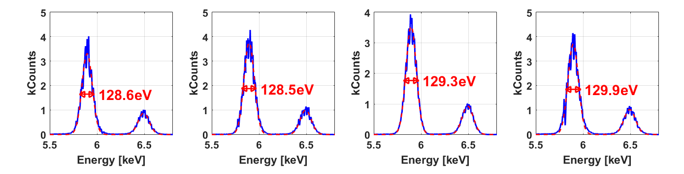
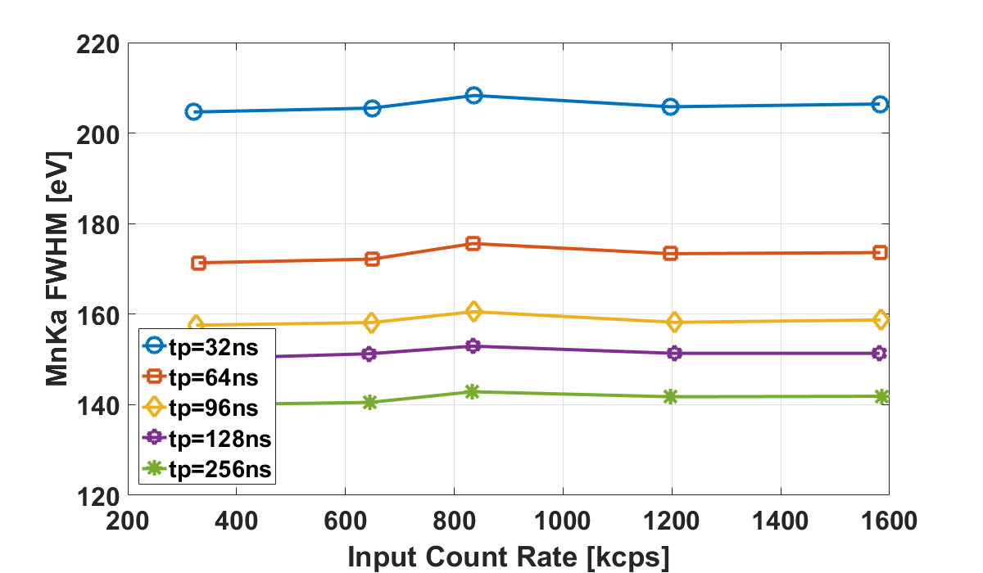
Preliminary measurements: ⁵⁵Fe spectra at 3 µs peaking time, measured with SFERA (internal ADC - 12 bits, 4Msps)
Ch1
Ch2
Ch3
Ch4
OCR: 1.1Mcps
OCR: 800kcps
Energy resolution @5.9keV at different count rates, measured with DANTE DPP

Slide 8
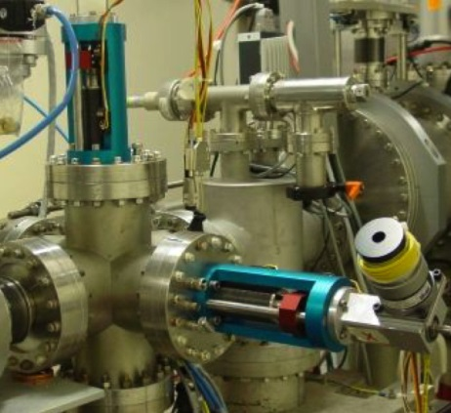
Impact
High-rate (>100Mcounts/s), good resolution (<150eV) X-ray spectroscopy detector
for wide range of synchrotron applications
A basic, versatile, X-ray detection module with potential impact also in industrial applications
(e.g. X-ray analytical instrumentation)

Slide 9
Development plan
Preliminary design phase
  feasibility study, preliminary design,
  assessment of detector and assembly technology
Design, production and test of a first small prototype
  design and production of a first 4x4 prototype
  experimental characterization in lab and at synchrotron
Design, production and test of the full prototype
  design and production of the full 8x8 prototype
  validation in experiments at synchrotron

Slide 10

thank you for your attention!

