Slide 1
WLCG Status Report
Computing in Run 2
Ian Bird
LHCC Referees Meeting
CERN, 20th September 2016

Slide 2
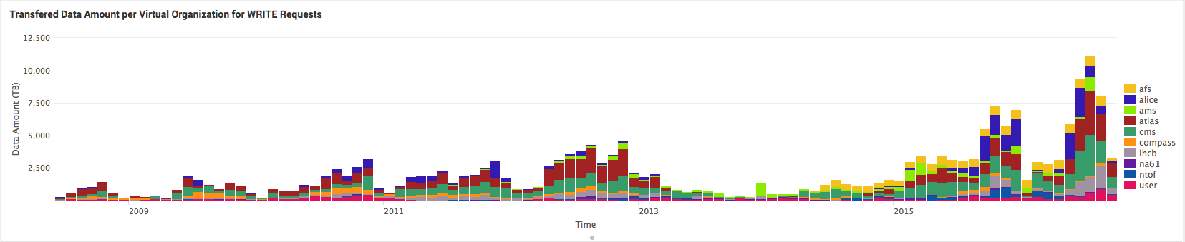
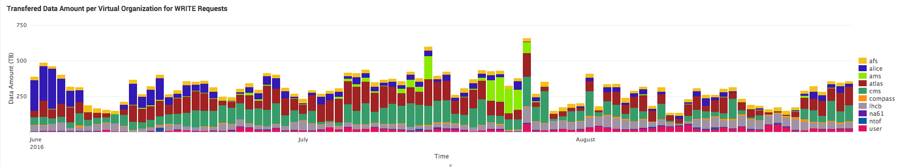
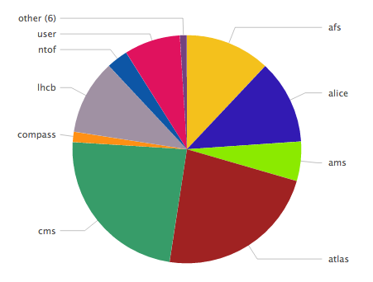
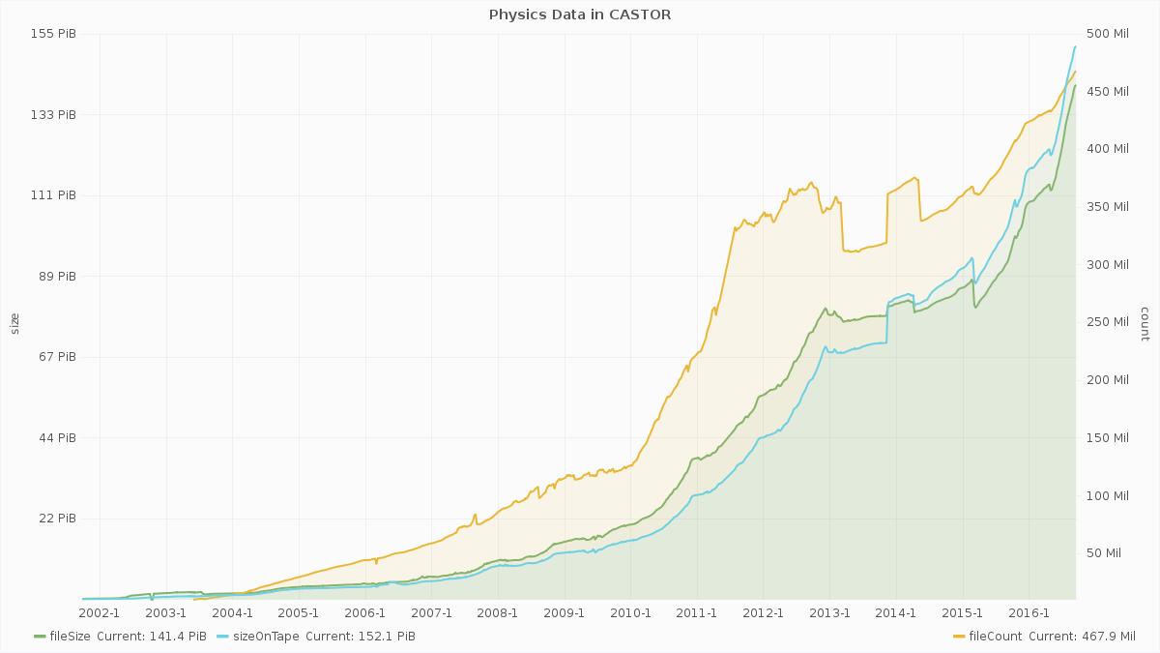
2016 data
LHC data – Continue to break records:
10.7 PB recorded in July
CERN archive ~160 PB
June-Aug 2016
>500 TB / day
(Run 1 peak for HI was 220 TB)
2016 to date: 35 PB LHC data:
ALICE 6, ATLAS 11.6, CMS 11.9, LHCb 5.4)
2016 Data acquired
~160 PB on tape at CERN
500 M files
Notes:
Top plot: data acquired in May and June 2016 – new daily records for pp data: >400TB/day (but mostly driven by ALICE not doing compression in HLT)
Middle: global data transfer rates – again new peaks at up to 35 GB/s – Run 1 was ~15GB/s. 2015 was 25 GB/s; right plot is CPU used
Bottom: internal CERN traffic to/from all storage systems (Tape and disk pools) – sums are close to 100 GB/s!

Slide 3
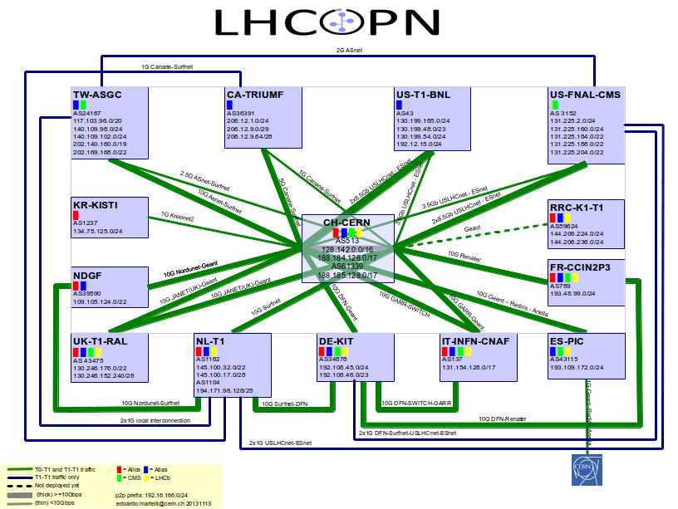
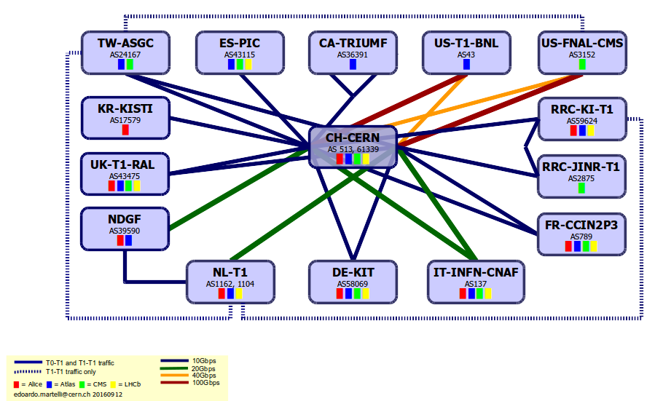

Optical Private Network
Support T0 – T1 transfers
Some T1 – T1 traffic
Managed by LHC Tier 0 and Tier 1 sites

Slide 4

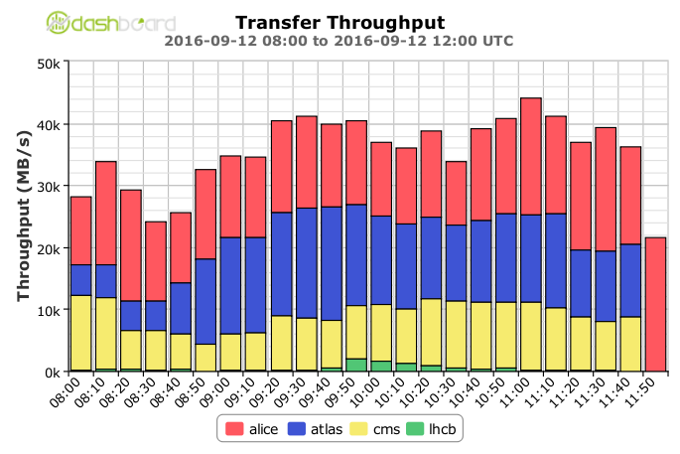
Data distribution
Global transfer rates increased to > 40 GB/s
(=2 x Run1)
Monthly traffic growth on LHCONE
Several Tier 1s have increased network bandwidth to CERN to manage new data rates;
GEANT has deployed additional capacity for LHC
Increased performance everywhere:
Data acquisition >10PB / month
Data transfer rates > 40 GB/s globally
Regular transfers of 80 PB/month with 100 PB/month during July-Aug
(many billions of files)
Notes:
Top plot: data acquired in May and June 2016 – new daily records for pp data: >400TB/day (but mostly driven by ALICE not doing compression in HLT)
Middle: global data transfer rates – again new peaks at up to 35 GB/s – Run 1 was ~15GB/s. 2015 was 25 GB/s; right plot is CPU used
Bottom: internal CERN traffic to/from all storage systems (Tape and disk pools) – sums are close to 100 GB/s!

Slide 5
CPU delivered
Experiments are able to use resources (significantly) exceeding those formally pledged

Slide 6
Resource requirement evolution

Slide 7
Evolution of requirements
The reliability of resource predictions is continually improving, the largest uncertainties being the LHC running conditions.
Funding guidance: flat budgets for computing
Slide from 2014
Estimated evolution of requirements 2015-2017
2008-2013: Actual deployed capacity

Slide 8
Run2: Increased computing needs
LHC performance is above expectations
Computing needs driven by (mainly):
  LHC live time (37% → > 60%)
  Luminosity (1.0x10³⁴ → 1.2x10³⁴ or better)
  Pile-up (CMS, ATLAS) (21 → 33 on average)
All have increased above anticipated levels
For 2016, the available resources will be sufficient
  More tapes at CERN have been bought
Re-analysis for 2017,18
  Just done in time for RRB
  Not yet scrutinized by RSG
  But: expectations are increased requirement above previous estimates of 15-30%

Slide 9
Re-assessment of needs
Estimated: Estimates made in 2014 for Run 2 up to 2017
20%: Growth of 20%/yr starting in 2016 (“flat budget”)

Slide 10
Strategy?
Have warned funding agencies about the increase for 2017
Expect discussion at the RRB (end Oct)
How should we manage a short fall in resources? Should be prepared for the RRB
  What are the strategies to be followed?
  Have already reduced replicas, re-processing, software performance, etc. Hard to find additional savings?
  Parking data? – Until when?
  Or?

