Slide 1

LHCC Referee Meeting
20/09/2016
ALICE Status Report
Predrag Buncic
CERN

Slide 2
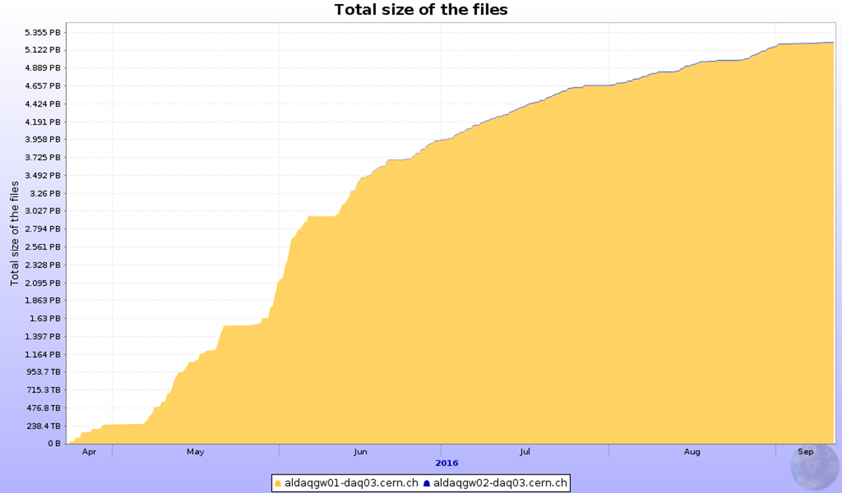
2016 data taking
HLT: TPC clusters compression tuning
Very stable operations: high operational efficiency >92%)
TS3
SCRUBBING
TS2
TS1
High Level Trigger:
With TPC cluster compression
High Level Trigger:
No TPC cluster compression
-> 2.6 PB collected
~ 5.7 PB stored

Slide 3
2016 data taking - optimization
IR = 300 –
550 kHz
IR = 200 kHz
IR = 100 kHz
  Period: Week 24 – Week 35
  IR = 100kHz
  Optimization of data taking with aim to
    Reduce data volume written to tape
    Collect data of better quality by reducing pileup and distortions in TPC
  Period: Week 35 – Week 36
  IR = 300 – 550 kHz
The total MUON luminosity collected during this period is ~2.3 pb⁻¹ (~25% of the total for 2016).
Collected CALO-only gamma triggers, for an integrated luminosity of ~2 pb⁻¹

Slide 4
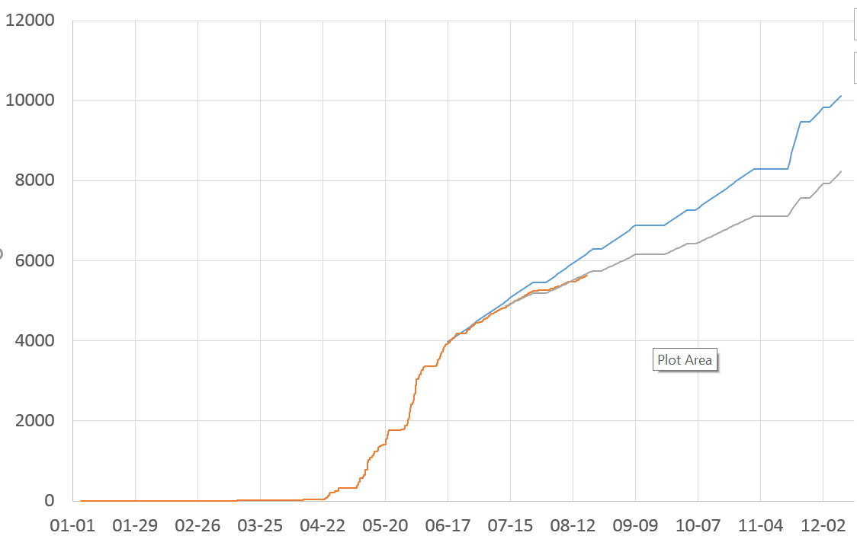
Recorded data volume
prediction: 8PB

Slide 5
TPC Space Point Distortions
TOF
TRD
Larger than expected Space Point distortions in the TPC seen in Run2 via tracking observables (Distance of Closest Approach to primary vertex)
Time dependent calibration procedure to correct the distortions as foreseen for Run3
  Use inner (ITS) and outer (TRD, TOF) detectors
  3D distortion vector for each TPC voxel
  Smooth parameterization used in reconstruction
ITS

Slide 6
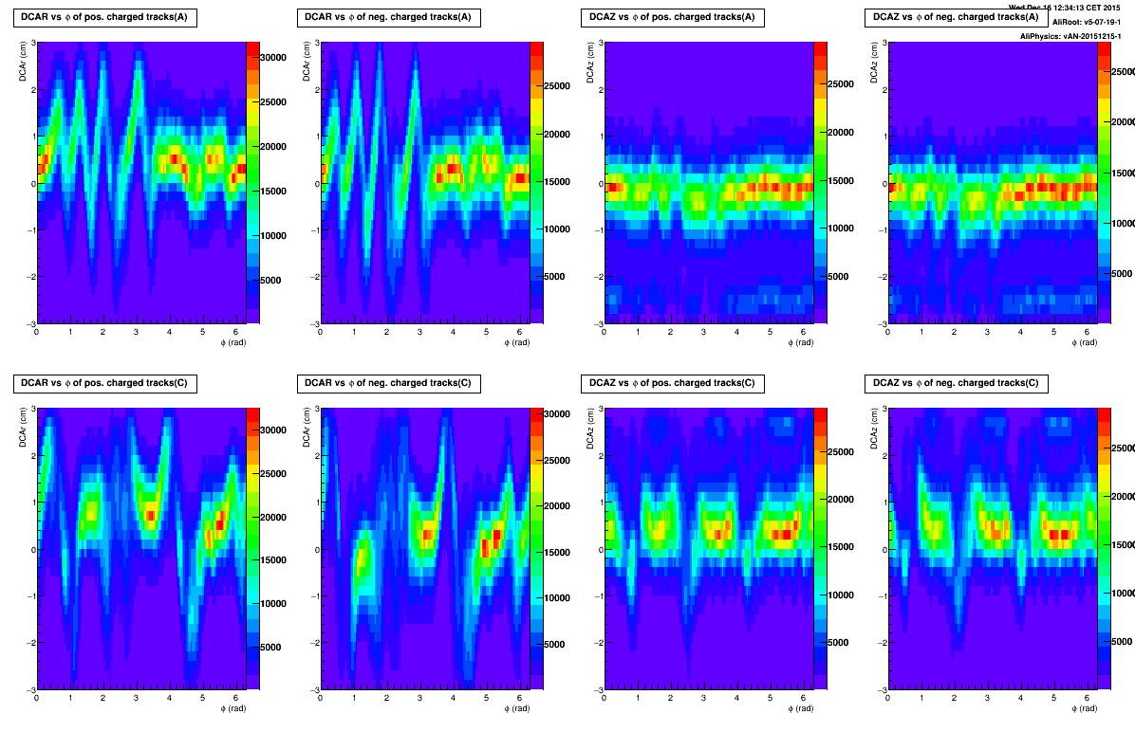
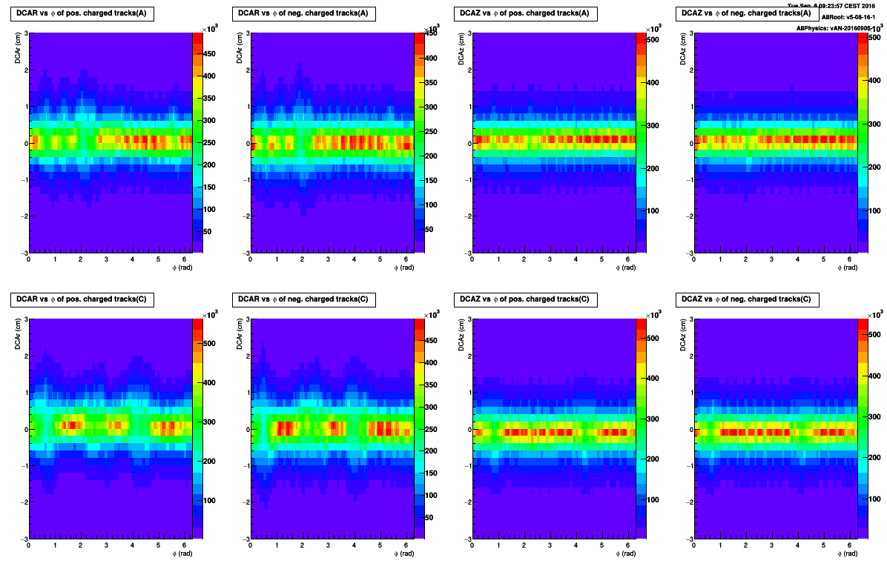
TPC Space Point Distortions
Before calibration
Pb-Pb @ 5.02 TeV, IR = 7.5 kHz
DCAR (cm)
DCAZ (cm)
Q+
Q-
Q+
Q-
3
A side
-3
3
C side
-3
φ (rad)
φ (rad)
φ (rad)
φ (rad)
After calibration

Slide 7
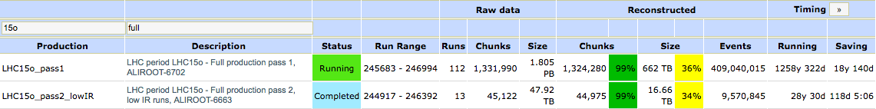
2015 data re-processing
Current status of data processing with the new TPC Space Point distortion calibration procedure:
pp @ 5.02 TeV: fully calibrated and reconstructed
PbPb @ 5.02 TeV: 100% calibrated, >75% reconstructed (25% ongoing)
pp @ 13 TeV (2016): ongoing
PbPb @ 5.02 TeV reconstruction

Slide 8
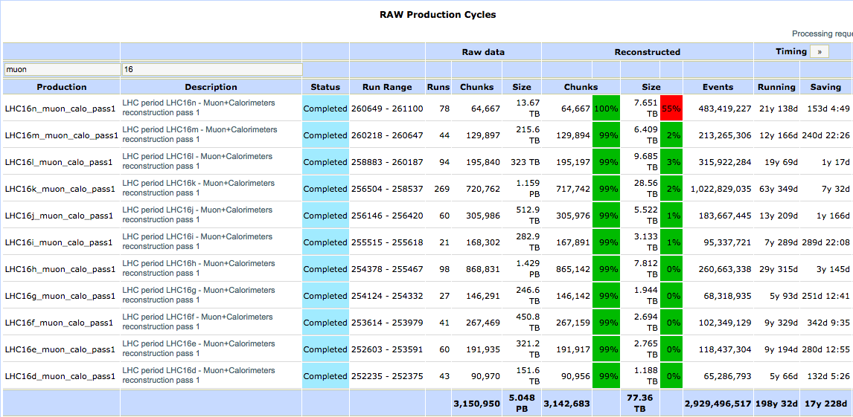
2016 data processing
“Fast-track” reconstruction
3e9 events

Slide 9
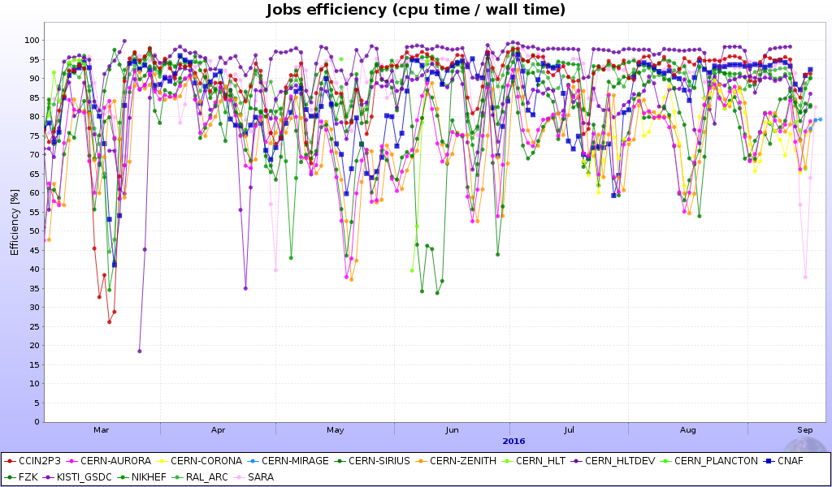
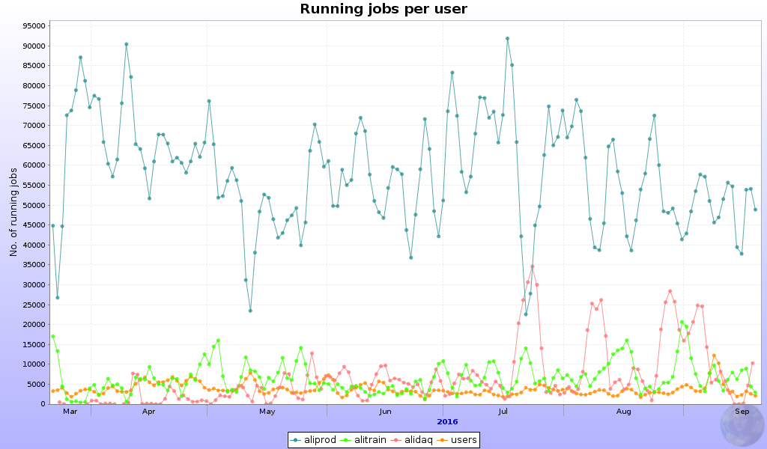
ALICE data taking summary
In spite of increased share of I/O intensive reconstruction jobs the average job efficiency remains high on most of T1 sites
Efficiency better than 83%

Slide 10

Next steps
IR = 100 kHz
Weeks 38 – 43: Continue pp Physics at 13 TeV at an IR = 100 kHz
Weeks 45 – 48: p-Pb Physics at 5 and 8 TeV
All Detectors are ready for the p-Pb run
From October, start running MC productions anchored to reconstructed data in preparation for QM’2017

Slide 11
Summary

Slide 12
ALICE Summary (1)
Run 2 data taking progressing very well
  Steps were taken to reduce data volume written to tape
    Running for most of time with lower the IR to reduce pileup in TPC
    Shorter high IR period dedicated for MUON & CALO
    HLT cluster compression improved from factor 4 to 6
This strategy allowed us to stay on track to meet the foreseen data taking goals without breaching the tape budget
Very stable operations: high operational efficiency >92%)
TS3
SCRUBBING
TS2
TS1
High Level Trigger:
No TPC cluster compression
-> 2.6 PB collected
High Level Trigger:
With TPC cluster compression
~ 5.7 PB stored
IR = 200 kHz
IR = 300 –
550 kHz
IR = 100 kHz
Tape budget for 2016 is 10PB will be respected

Slide 13
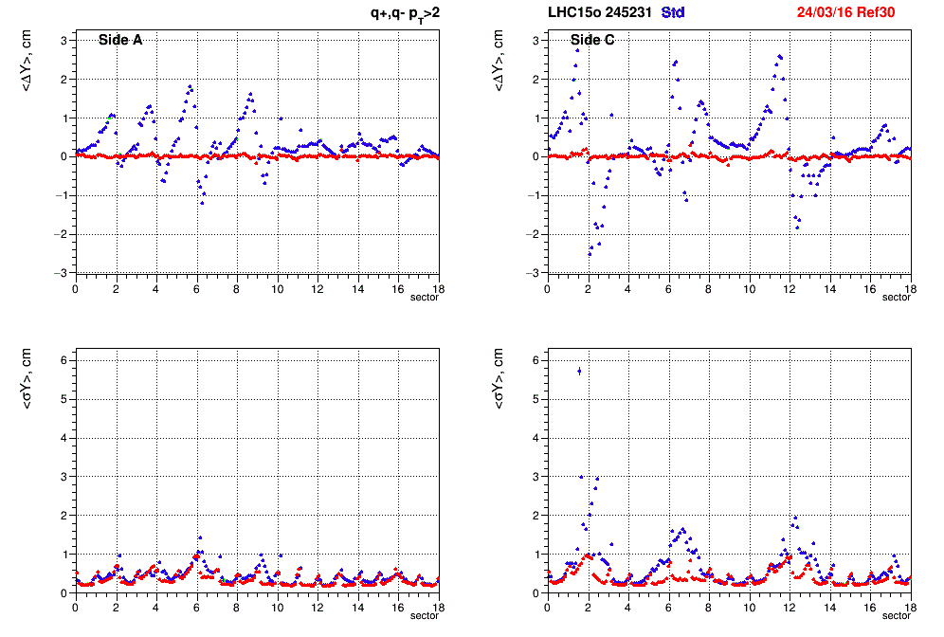
ALICE Summary (2)
TOF
Larger than expected Space Point distortions in the TPC seen in Run2 via tracking observables (Distance of Closest Approach to primary vertex)
Implemented time dependent calibration procedure to correct the distortions
  Similar to what was foreseen for Run3
  Use inner (ITS) and outer (TRD, TOF) detectors
  3D distortion vector for each TPC voxel
  Smooth parameterization used in reconstruction
Re-processing of 2015 data with new software is almost completed
  in parallel with reconstruction of data from the current run
TRD
ITS
DCArφ vs TPC sector
DCArϕ (cm)
Pb-Pb 2015, IR = 4.7kHz
before / after correction

Slide 14
ALICE Summary (3)
In spite of increased share of I/O intensive reconstruction jobs the average job efficiency remains high on most of T1 sites
Efficiency better than 83%

Slide 15
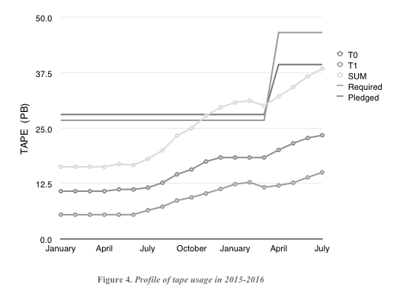

Slide 16
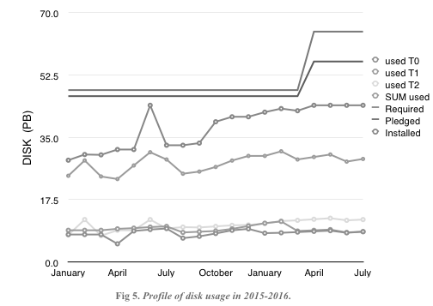

Slide 17
