Slide 1

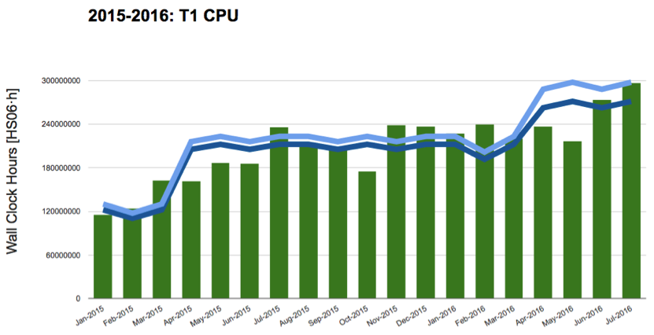
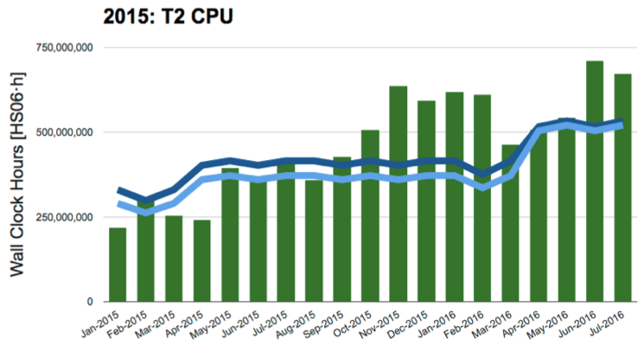
Resource utilisation
Resource utilisation continues to be very high
  production vs analysis share at 60%-40% over long periods
Average CPU usage at T1 level over last year was ~103%
  note that T1s are under-pledged in CPU/Disk/Tape, situation to be addressed with the help of the CRSG
Over last year, CMS used ~122% of the pledges at the T2 level

Slide 2
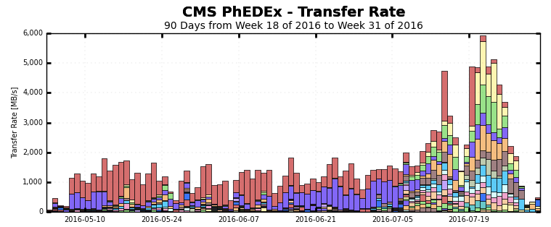
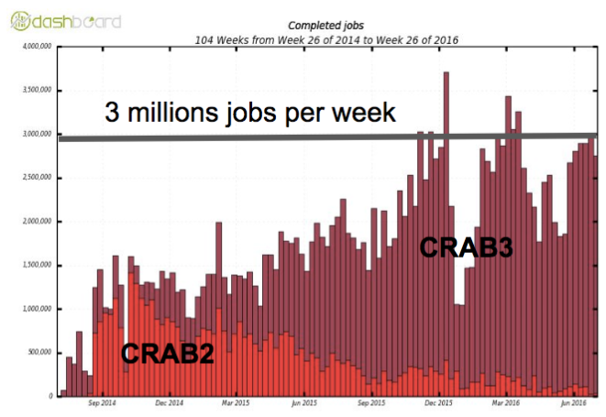
A couple of operations highlights
Unprecedented rates out of CERN
  close debugging of EOS, Network and other middleware components allowed to hugely increase export capabilities from CERN to all Tiers
6 GB/s
Transfers out of CERN - each color is a different destination
Consistent load from distributed analysis users
  Successfully completed migration to CRAB3, the latest version of the CMS Grid analysis toolkit
  Analysis is ramping up again at Run-1 levels

Slide 3
Computing resources in 2017/18
Higher LHC live time and performance pose challenges
  increase of requests with respect to the Spring’16 requests
  resource requests docs submitted to the CRSG - under scrutiny
Many actions to mitigate the increase in resource requests have been taken already
  we exploited the flexibility in the CMS Computing Model
    e.g. very aggressive tape deletion campaigns (with all the associated risks), reduction of AOD replicas on disk to <1, etc
  allowed already to achieve an increase in resource requests of +20% overall instead of +40% (as it would have been by just applying straight new LHC performance projections)
But CMS is short of resources in 2016 already
  data taking in 2016 much better than we could anticipate as from the LHC performance projections, so we are of course short now
  small contingency from 2015, and no contingency left for 2017
  NOTE: we are (since at least 3 years) underpledge at T1s
    REBUS: CPU -6%, Disk -7%, Tape -12%. And actually really installed (end of Jul) a few % less.

