Slide 1
LHCb Computing Report
Stefan Roiser
LHCC WLCG Referees Meeting
20 September 2016

Slide 2
Content
Computing Project Organisation
Situation with 2016 Data Processing & Simulation
Outlook to 2017, 2018 and 2019 resource requests
Run 3 Upgrade

Slide 3
Computing Project (Re)Organisation
Application Software
Distr. Comp. Software
Data Handling
Services & Operations
Core
Data Processing
Data Management
Workload Management
Real Data Production
Monte Carlo Production
LHCb
WLCG
Resources
External Relations
Computing & Software PL
Deputy PL
Simulation
User Analysis
Run 3 Upgrade
Framework
Computing Model
Collaborative Working
CERN
Storage Management
Data Preservation

Slide 4
Computing Project (Re)Organisation
Application Software
Distr. Comp. Software
Data Handling
Services & Operations
Core
Data Processing
Data Management
Workload Management
Real Data Production
Monte Carlo Production
LHCb
WLCG
Resources
External Relations
Computing & Software PL
Deputy PL
Simulation
User Analysis
Run 3 Upgrade
Framework
Computing Model
Collaborative Working
CERN
Storage Management
Data Preservation
SR
Andrew
McNab
Core Management Team
Concezio
Bozzi
Pete
Clarke
Marco
Cattaneo
Federico
Stagni
Concezio
Bozzi
Philippe
Charpentier
Ben
Couturier

Slide 5
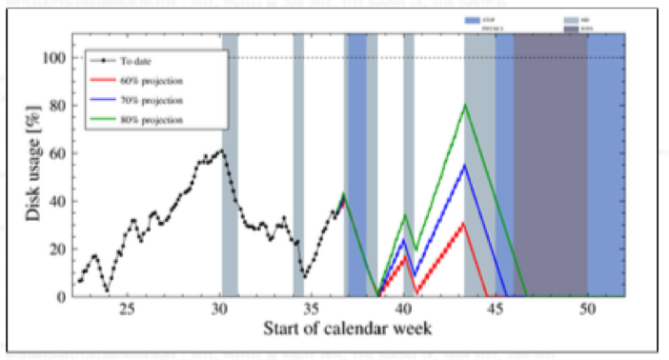
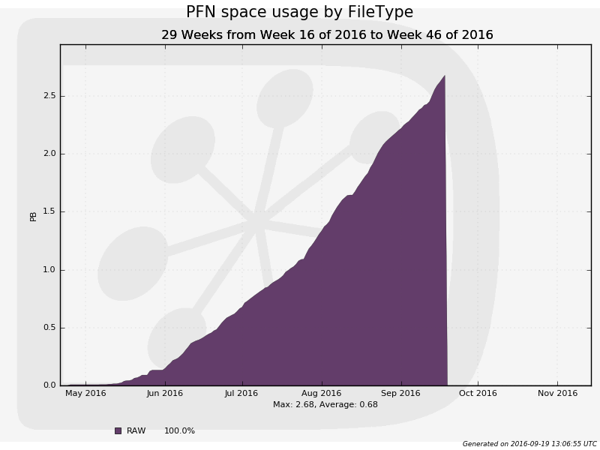
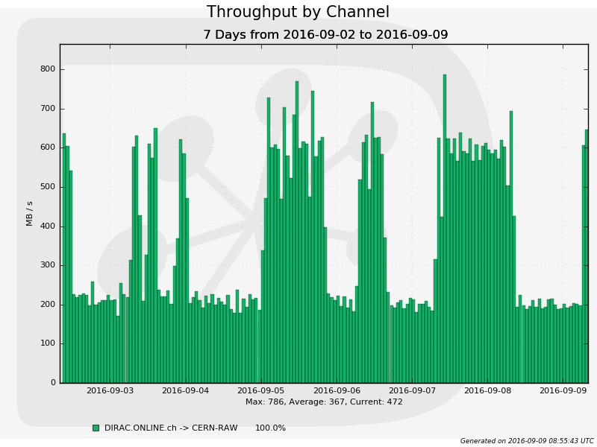
Data Export from LHCb Pit
HLT Disk Buffer Occupancy
RAW data volume
2016 expected
Expected further evolution
Pit Export Throughput
End of HLT processing
Today
Continuous data export from the pit to CERN/Castor
  Increased LHC efficiency with repercussions on data export volume
    Currently reaching exported RAW volume that was expected for all of 2016
    Mitigation via reducing the size of the reconstruction output format
  Output rate In-fill ~ 200 MB/s, Inter-fill ~ 600 MB/s with split HLT 1 & 2
  Will continue until mid November until HLT pit disk buffer is emptied

Slide 6
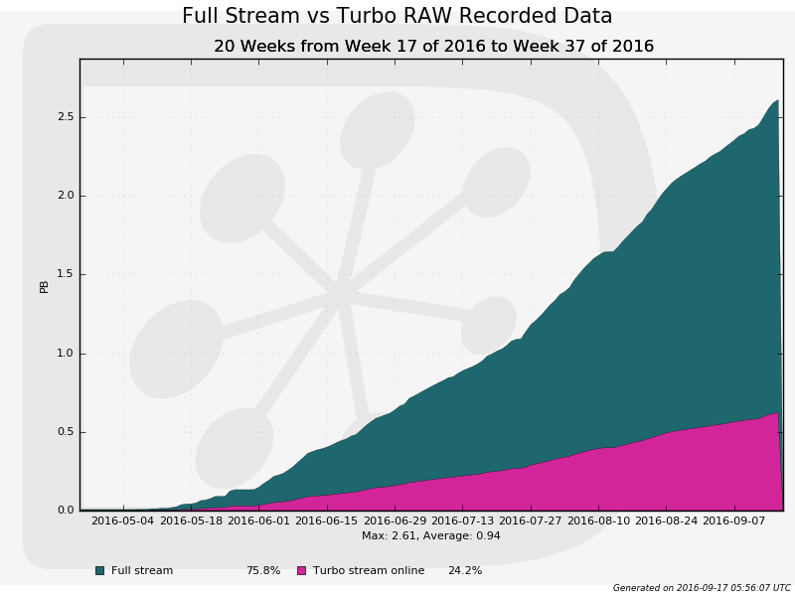
Full / Turbo Stream Partitioning
F
u
l
l
Turbo
F
u
l
l
T
u
r
b
o
Full Stream
10
2.5
7.5
4
kHz Pit Data Export Rate
Turbo Stream
Planned
2016 Data
Decided beginning of the year to also allow reconstruction information in Turbo stream data in addition to signal info (Turbo++)
  Moved data from Full to Turbo/Turbo++ → reduce offline CPU needs
  Event size increased from initially 10 kB to 50 kB, needed tape resources ~ the same but → strain on disk

Slide 7
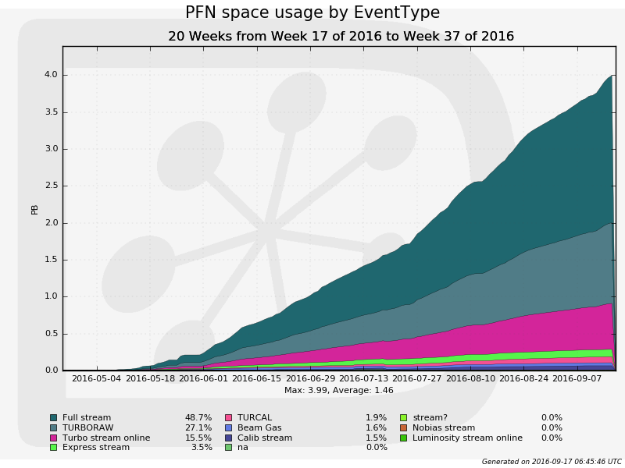
TURBORAW Stream
(
)
Split HLT Turbo RAW
data exported to
CERN/CASTOR
  Safety net for eventual
  need of re-running the
  trigger on Turbo data
  No additional strain on
  final tape resources,
  planned to be removed
  by the end of the year
FULL
TURBORAW
TURBO

Slide 8
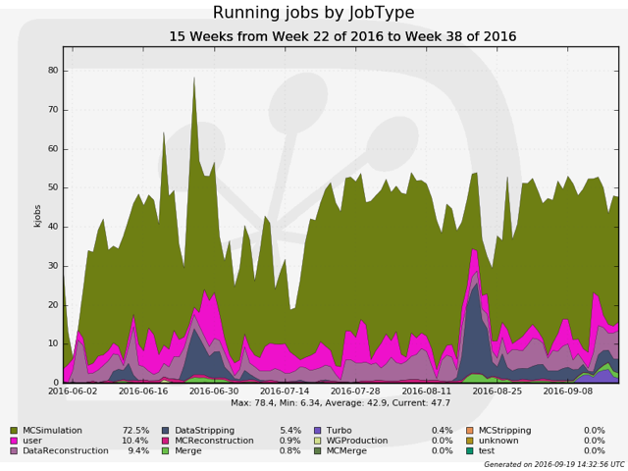
Offline Data Processing
Overall usage well
above pledged
resources
Usage dominated
by Simulation
Workflows (~ 70 %)
All Data Processing
Workflows setup
and running, i.e.
  Full Stream
  Reconstruction &
  Stripping
  Turbo Stream Processing
Pledge

Slide 9
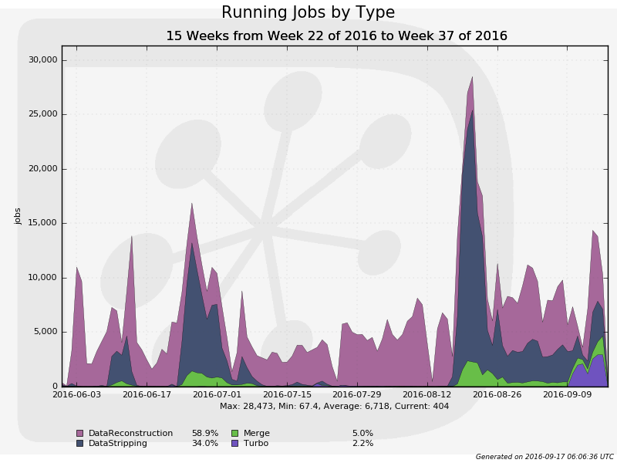
Data Processing Workflows
DataReconstruction
running continuously
since beginning of
data taking
DataStripping re-started
mid-August with lower
bandwidth to cope with
disk resources
  Processing in June/July is part of the same data sample
Development of streaming of Turbo data needed b/c of increased LHC efficiency & data format
  New development allows to park 1/3 of data on tape → reduce disk strain
  Development finished, production started 9 Sep and already caught up
Stripping
Reco
Turbo

Slide 10
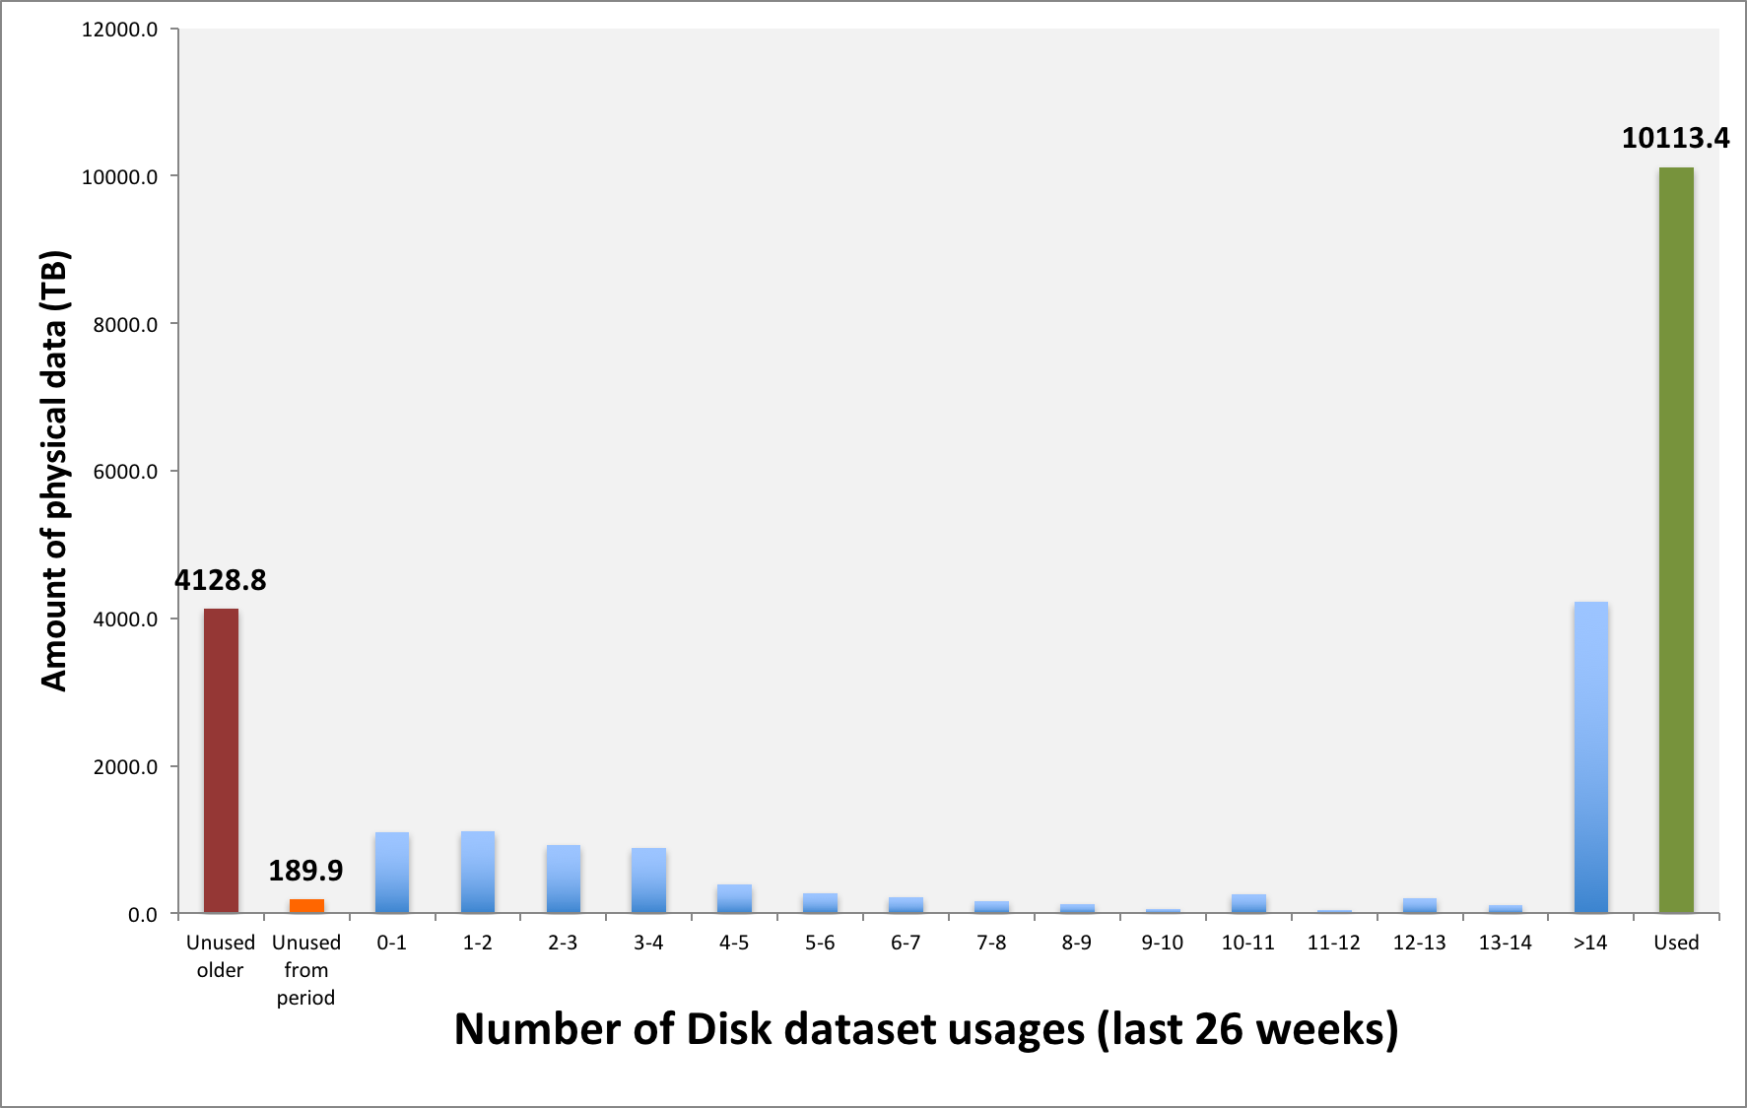
Disk Resident Data
2016 Mitigation Policies
  Reduce number of disk replicas
  Turbo streaming and parking 1/3 of data volume on tape
  Currently ongoing discussion about physics need for full end of year restripping of Run2 data
    NB: Trying to avoid any
    possible hit on the
    experiments physics
    performance and output
  Use data popularity to
  remove ~ 1 PB of
  currently not needed
  Simulation datasets
Aug ‘16 CRSG Resource
Usage Data Popularity Plot
was 5183 in Jan ‘16

Slide 11
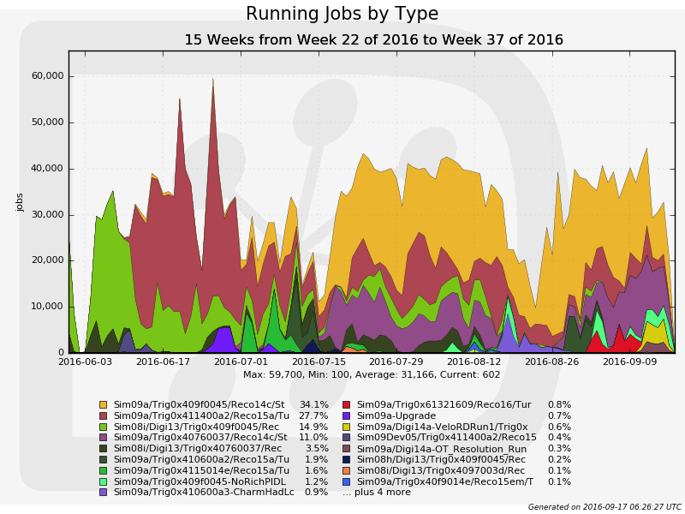
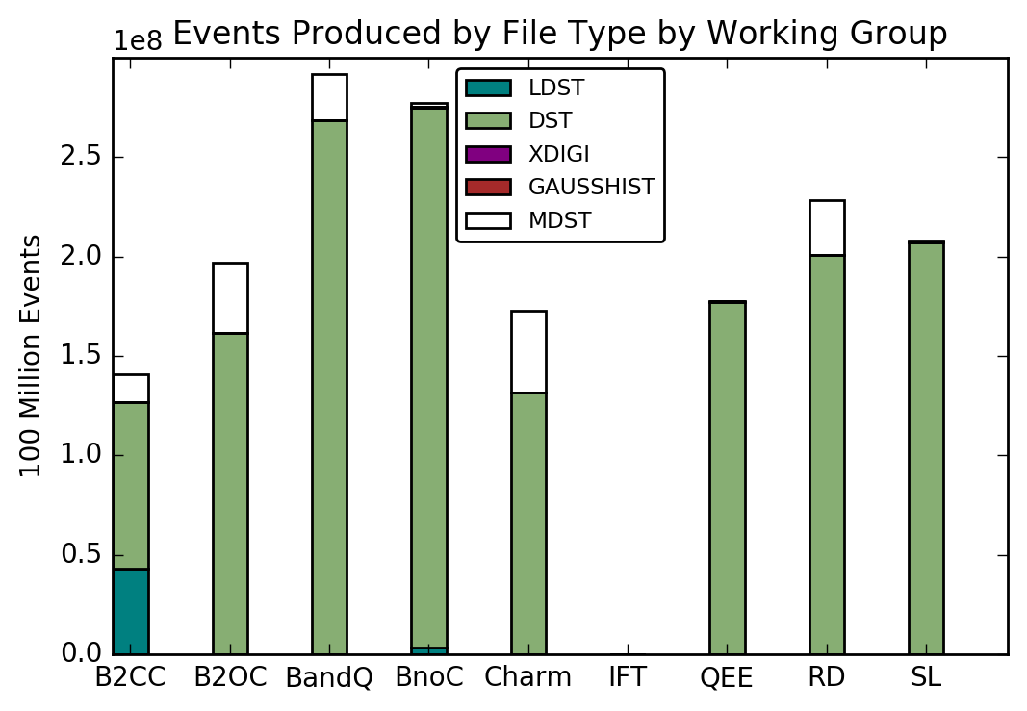

Simulation
Sim09
Sim08
Move from “Sim08”
to new simulation
framework “Sim09”
clearly visible
  Speed improvements in
  RICH simulation
  New microDST format
  starts being adopted
  by physics working
  groups
“Sim10” developments
targeting end of 2016:
  Move to Geant4.10
  Introduction of more
  generators (mostly for Pb)
  Re-use of underlying event

Slide 12
2016 Resource Usage Recap
Increased LHC efficiency and change in Turbo data processing with several repercussions on resources
  Increased usage of tape for RAW data, mitigated by change in the reconstruction output format
  Increase of offline CPU needs for data processing mitigated by introducing moving more data from Full stream (offline CPU intensive) to Turbo stream (little offline CPU needs)
  Increase of disk needs because of new Turbo++ format mitigated by usage of data popularity, reduction of replicas and parking of data
    NB: From 2017 onwards also planned to reduce the Turbo++ format by further slimming of reconstruction information

Slide 13
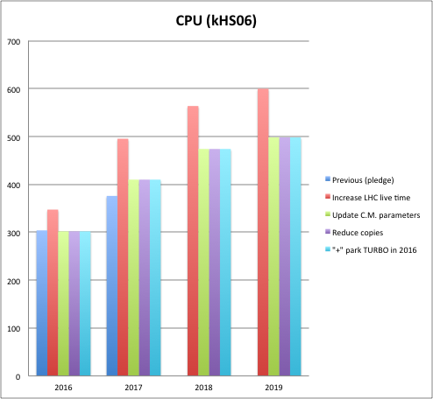
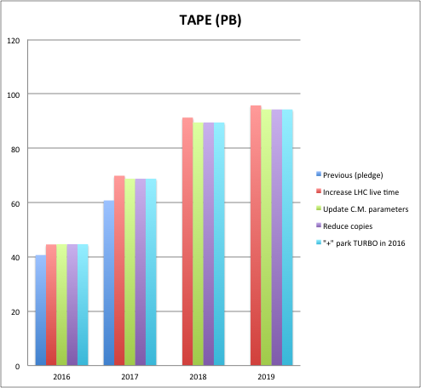
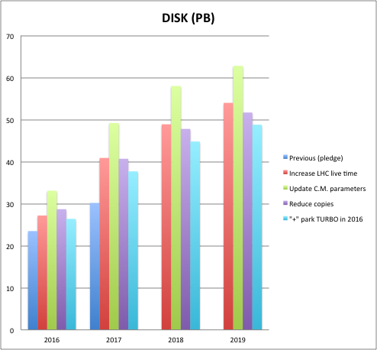
Resources ‘16-’19
Most strain on disk resources despite mitigation actions, ie.
  replicas, parking, data popularity
2016 resources under control applying actions above
2017 resources re-submitted to CRSG with 20 % increase mainly for disk
2018/19 resources inline with constant budget increase of resource requests for cpu/disk/tape on top of 2017

Slide 14
Computing Upgrade: Work Areas
Revolution → task force established
  Move Gaudi from single-threaded, sequential processing to task-concurrent framework by using Gaudi-Hive ideas
    algorithms as re-entrant entities to be executed in parallel
    Input/output data to become immutable
  Re-develop Event Model to exploit SIMD / vectorization
    Tightly coupled on usage of math libraries
  Re-implement conditions database and detector description
  Exploit alternative architectures (for trigger)
Evolution → use Run2 as testbed
  Simulation: fast / hybrid / parameterized / concurrent
  Distributed computing
    TURBO stream as default in Run3, centralized ntuple production, event indexing, incremental changes in DIRAC
  Collaborative tools and analysis preservation
14

Slide 15
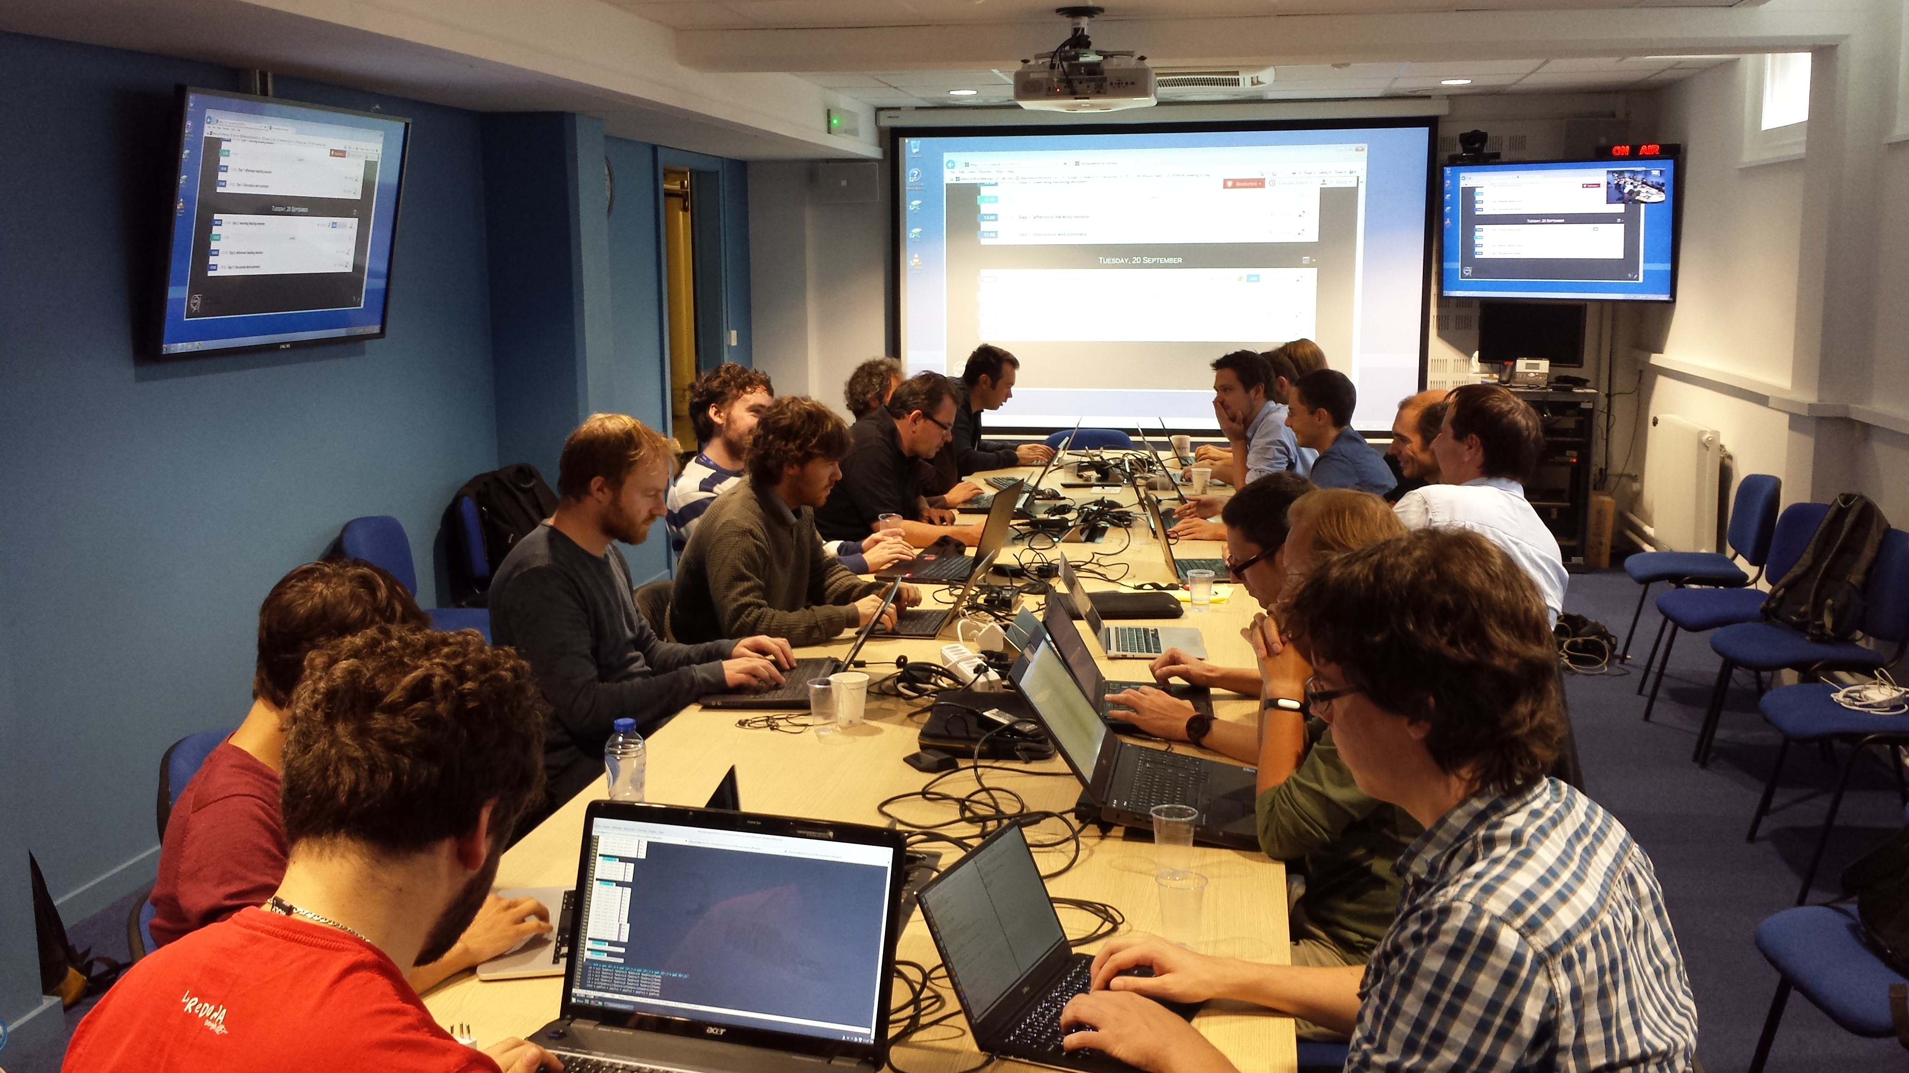
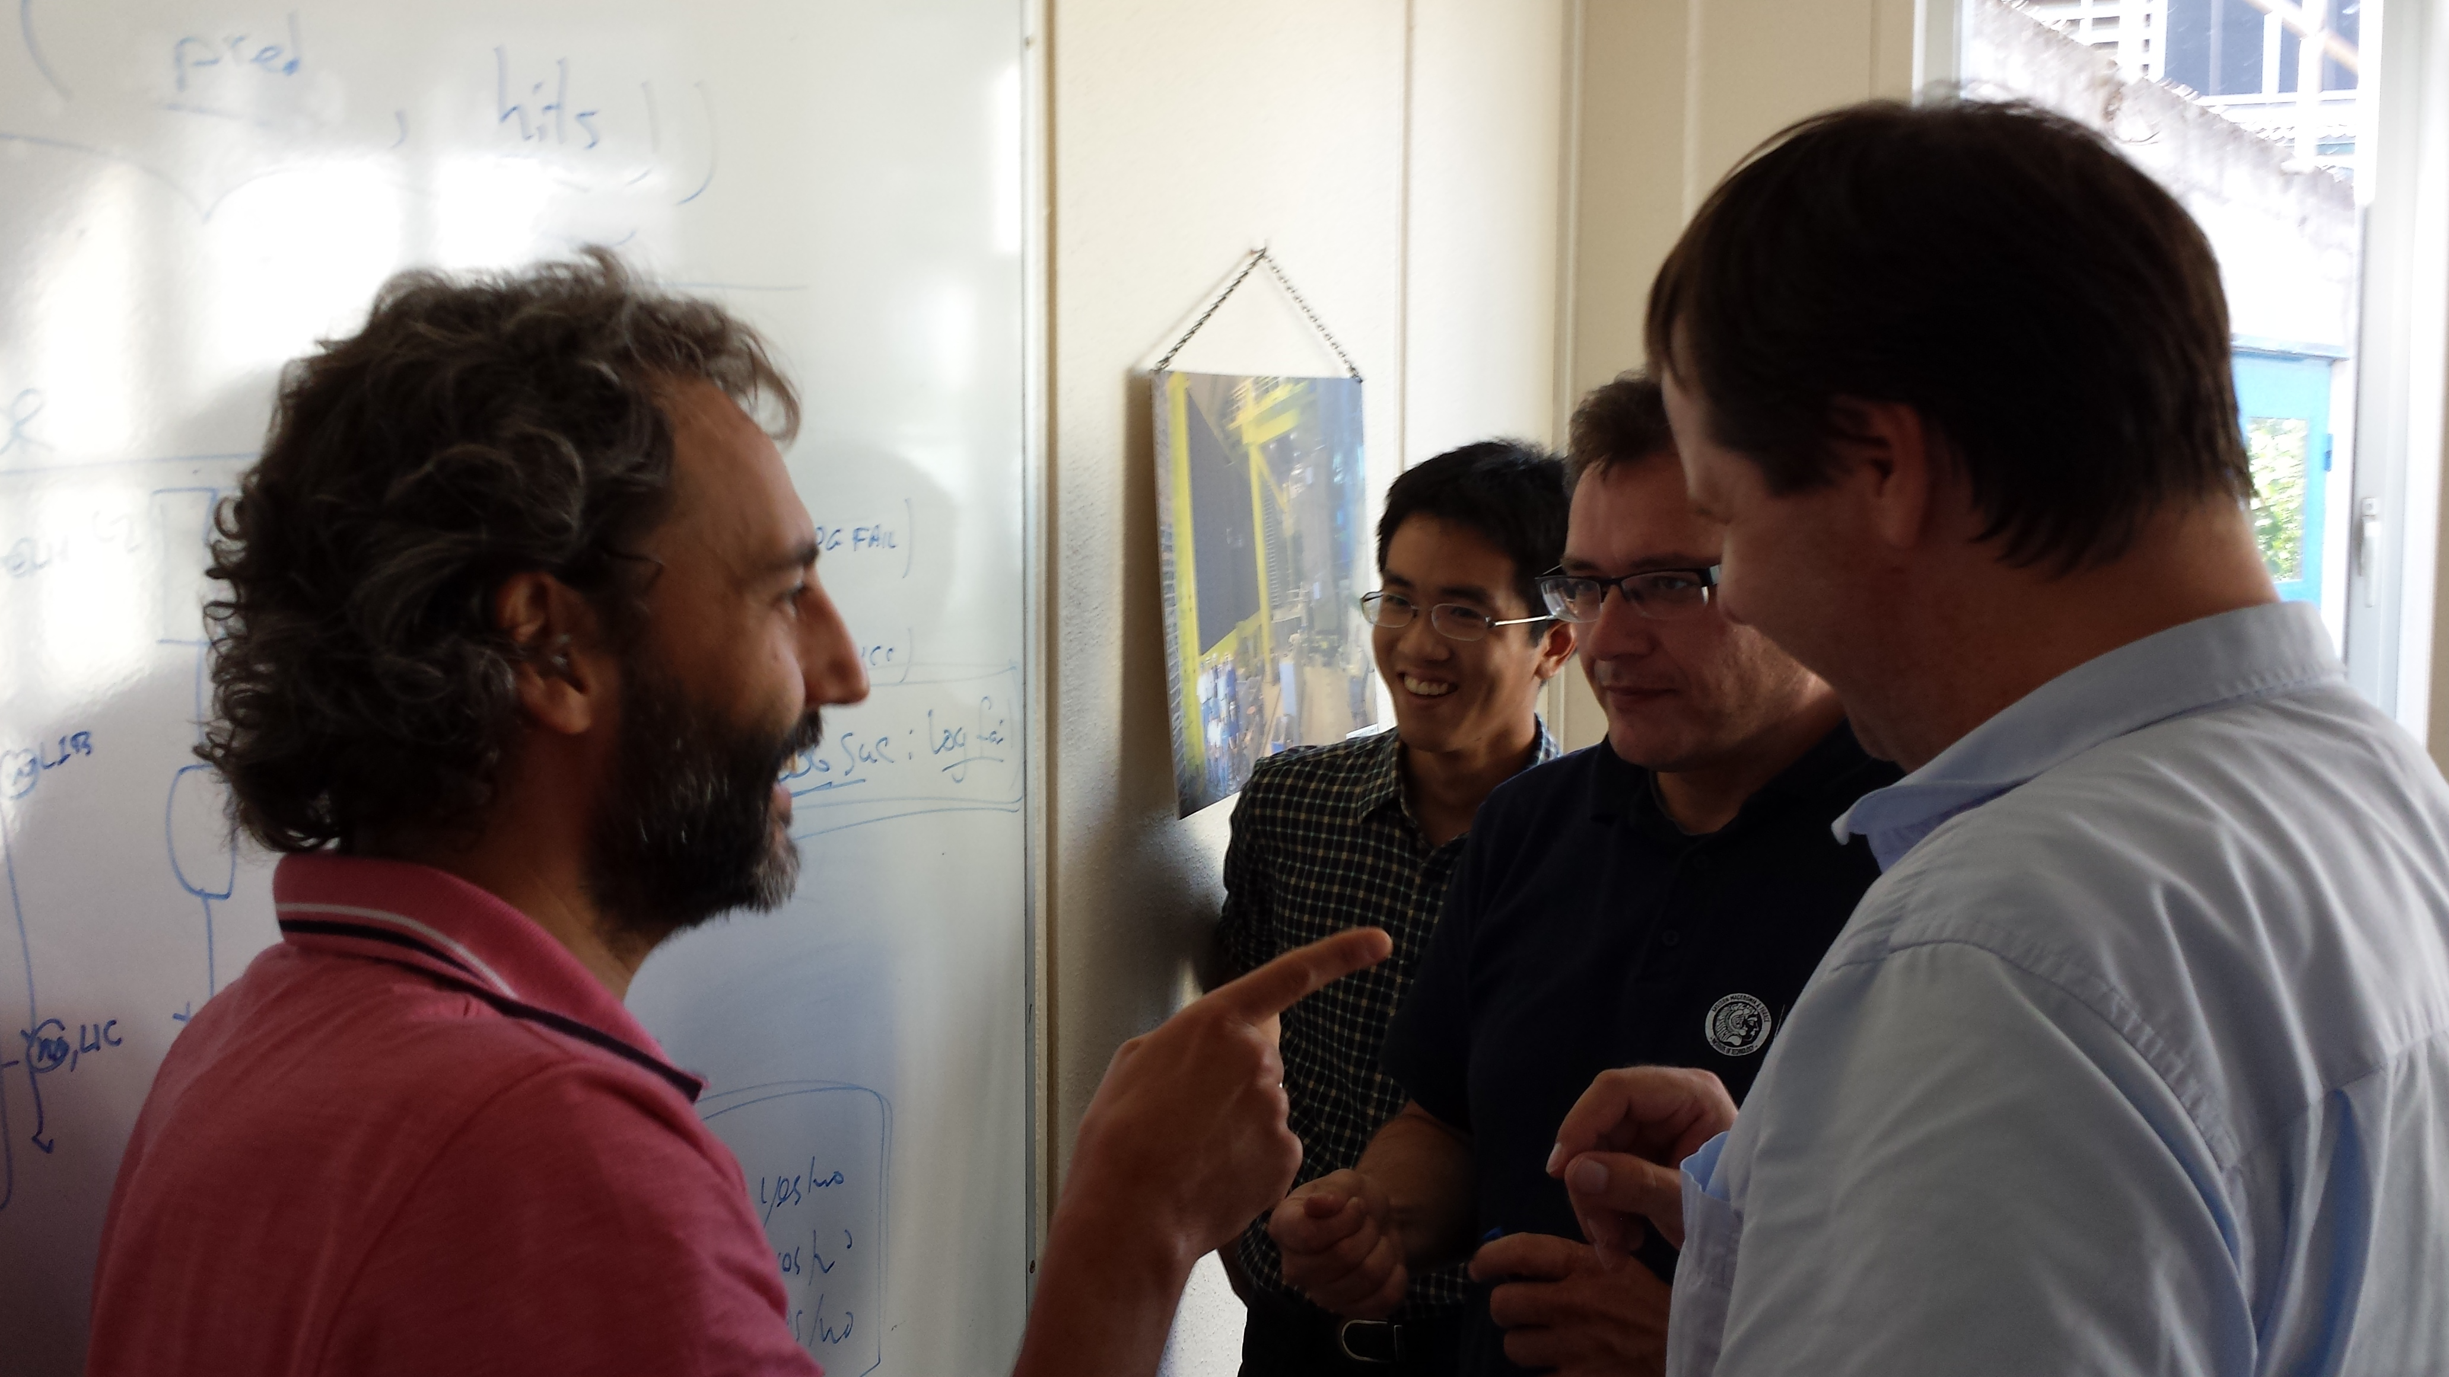
Organization of task force
“Revolutionary” program attacked with task-force approach
1st Taskforce hackathon – 26-27 May @ CERN
  Infrastructure ready, start of real work
2nd hackathon – 7-8 July @ CERN.
  Implementing further changes,
  start involving subsystems
3rd hackathon: September 19-20 @ CERN
  https://indico.cern.ch/event/562730/
  Progress towards implementing APIs
  GAUDI workshop September 21-23
4th hackathon: Nov 14-18 during
8th Computing Workshop
  APIs ready, subsystems more involved
  Currently planning a two-day hackathon in parallel with training sessions to enable newcomers to quickly contribute
Currently Ongoing
15

Slide 16
Summary
Overall high to very high usage of resources
  New Simulation framework in full swing with 80 % of CPU usage
  Increased LHC efficiency & new Turbo processing with strain on disk
2016 data processing situation
  Repercussions of increased LHC efficiency but situation under control with several mitigation policies applied
2017 resource needs increased and resubmitted to CRSG
  Together with evolution of resource requests for ‘18 + ’19 assuming constant budget increase
Computing Upgrade ongoing
  Improved situation for the upgrade of Gaudi framework but stays on critical path

Slide 17
Executive Summary Slides

Slide 18
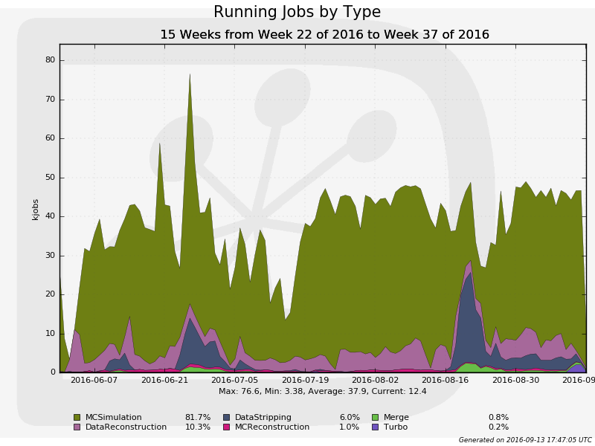
LHCb 2016 Distributed Data Processing
Continuous pp RAW data
export from pit expected
until mid November
  Result of HLT buffered data
  and its deferred processing
Overall very high usage of
distributed computing CPU
resources
  Adaptation of data processing
  workflows needed due to high LHC efficiency
  All workflows now running in production
  Release of new Simulation framework immediately adopted
    80 % of CPU on distributed compute resources needed for MC
Pledge

Slide 19
Data Storage
2016 RAW data collected
2016 pledge
Expected further evolution
Increased disk resource needs in 2016 b/c of higher LHC efficiency and change in Turbo
Mitigation actions taken:
  Reduction of disk replicas
  Parking of 1/3 of Turbo data on tape
  Use of data popularity to reduce not needed Simulation samples
2017 resource requests re-evaluated and re-submitted to CRSG with 20 % increase mainly for disk in respect to initial request
  2018/19 requests follow evolution of a constant budget increase
End of HLT processing
Today
Decided to allow Turbo data format to contain reconstruction information in addition to signal
  Moved from Full to Turbo stream
  → less CPU offline resources
  Turbo event size increased
  → additional strain on disk

